Slide 1

Data-driven quark and gluon jet substructure
Jasmine Brewer
with Jesse Thaler and Andrew Patrick Turner [2008.08596]
Kylie Ying, Yi Chen, and Yen-Jie Lee [2204.00641]

Slide 2
  Quark and gluon jets look different in terms of (sub)structure
  “quark jet”
  “gluon jet”
  q
  g
  Goal: disentangle (sub)structure modification of quark and gluon jets
Notes:
There have been a multitude of nice measurements quantifying the differences between the properties of p-p and A-A jets through jet modification observables, for example the dijet asymmetry and jet shape modifications. The aim in this program is to use jet modification observables to make direct inferences about how the quark–gluon plasma interacts with partons traversing through it.

Slide 3
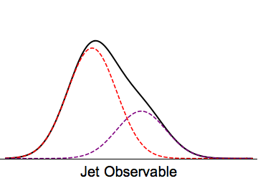
  Outline
  A data-driven method for extracting quark/gluon fractions (in cartoons)
  Monte Carlo studies in pp and AA
  Applications for studying the modification of quark and gluon jet substructure
  q
  g
  Multiplicity
Brewer, Thaler, Turner [2008.08596]
Ying, Brewer, Chen, Lee [2204.00641]
Notes:
There have been a multitude of nice measurements quantifying the differences between the properties of p-p and A-A jets through jet modification observables, for example the dijet asymmetry and jet shape modifications. The aim in this program is to use jet modification observables to make direct inferences about how the quark–gluon plasma interacts with partons traversing through it.

Slide 4
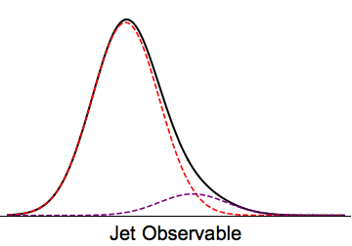






  Disentangling mixture distributions into “quark” and “gluon”
$$p_{1}=f_{1}b_{1}+\left(1−f_{1}\right)b_{2}$$
$$b_{1}$$
$$b_{2}$$
$$p_{2}=\left(1−f_{2}\right)b_{1}+f_{2}b_{2}$$
$$b_{1}$$
$$b_{2}$$
  p–p: Metodiev and Thaler [1802.00008] Komiske, Metodiev, Thaler [1809.01140]
Notes:
There have been a multitude of nice measurements quantifying the differences between the properties of p-p and A-A jets through jet modification observables, for example the dijet asymmetry and jet shape modifications. The aim in this program is to use jet modification observables to make direct inferences about how the quark–gluon plasma interacts with partons traversing through it.

Slide 5
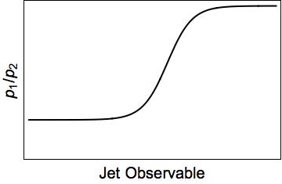
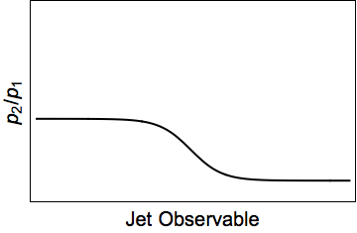

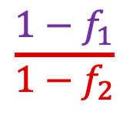
  Disentangling mixture distributions into “quark” and “gluon”
$$p_{1}=f_{1}b_{1}+\left(1−f_{1}\right)b_{2}$$
$$b_{1}$$
$$b_{2}$$
$$\frac{1−f_{1}}{1−f_{2}}$$
$$p_{2}=\left(1−f_{2}\right)b_{1}+f_{2}b_{2}$$
$$b_{1}$$
$$b_{2}$$
$$\frac{f_{2}}{f_{1}}$$
  p–p: Metodiev and Thaler [1802.00008] Komiske, Metodiev, Thaler [1809.01140]
Notes:
There have been a multitude of nice measurements quantifying the differences between the properties of p-p and A-A jets through jet modification observables, for example the dijet asymmetry and jet shape modifications. The aim in this program is to use jet modification observables to make direct inferences about how the quark–gluon plasma interacts with partons traversing through it.

Slide 6
  Disentangling mixture distributions into “quark” and “gluon”
$$p_{1}=f_{1}b_{1}+\left(1−f_{1}\right)b_{2}$$
$$b_{1}$$
$$b_{2}$$
$$\frac{1−f_{1}}{1−f_{2}}$$
$$p_{2}=\left(1−f_{2}\right)b_{1}+f_{2}b_{2}$$
$$b_{1}$$
$$b_{2}$$
$$\frac{f_{2}}{f_{1}}$$
  Solve for base distributions $b_{1}$,$b_{2}$ in terms of mixture distributions and fractions
  p–p: Metodiev and Thaler [1802.00008] Komiske, Metodiev, Thaler [1809.01140]
Notes:
There have been a multitude of nice measurements quantifying the differences between the properties of p-p and A-A jets through jet modification observables, for example the dijet asymmetry and jet shape modifications. The aim in this program is to use jet modification observables to make direct inferences about how the quark–gluon plasma interacts with partons traversing through it.

Slide 7




  Disentangling mixture distributions into “quark” and “gluon”
  example
  Requires…
  dijets
  $γ$+jet
  Independent mixtures of same base distributions
$$b_{1}$$
$$b_{1}$$
$$b_{2}$$
$$b_{2}$$
Notes:
There have been a multitude of nice measurements quantifying the differences between the properties of p-p and A-A jets through jet modification observables, for example the dijet asymmetry and jet shape modifications. The aim in this program is to use jet modification observables to make direct inferences about how the quark–gluon plasma interacts with partons traversing through it.

Slide 8
  Disentangling mixture distributions into “quark” and “gluon”
  example
  Requires…
  dijets
  $γ$+jet
  Independent mixtures of same base distributions
$$b_{1}$$
$$b_{1}$$
$$b_{2}$$
$$b_{2}$$
  samples are pure quark and pure gluon in some limits (“mutual irreducibility”)
  Above: base distributions are completely separated at $±∞$
  Quantified by
Notes:
There have been a multitude of nice measurements quantifying the differences between the properties of p-p and A-A jets through jet modification observables, for example the dijet asymmetry and jet shape modifications. The aim in this program is to use jet modification observables to make direct inferences about how the quark–gluon plasma interacts with partons traversing through it.

Slide 9
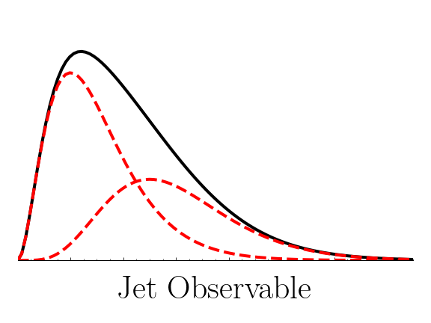


  Mutual irreducibility of counting observables
  Poisson distributions are mutually irreducible for large $Δλ$
$$b_{1}=Pois\left(λ_{1}\right)$$
$$b_{2}=Pois\left(λ_{2}\right)$$
  Quark and gluon constituent multiplicity distributions are mutually irreducible in the high-energy limit
Frye et al [1704.06266]
Notes:
There have been a multitude of nice measurements quantifying the differences between the properties of p-p and A-A jets through jet modification observables, for example the dijet asymmetry and jet shape modifications. The aim in this program is to use jet modification observables to make direct inferences about how the quark-gluon plasma interacts with partons traversing through it.

Slide 10
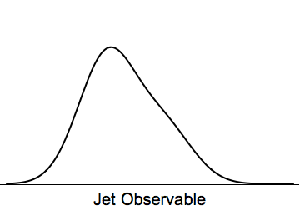
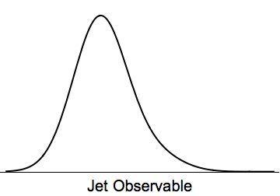
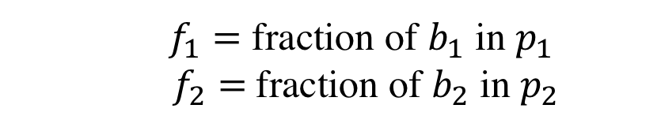




  Disentangling mixture distributions into “quark” and “gluon”
$$p_{1}$$
$$p_{2}$$
$$κ_{12}$$
$$κ_{21}$$
  $f_{1}=$ fraction of $b_{1}$ in $p_{1}$
  $f_{2}=$fraction of $b_{2}$ in $p_{2}$
  gives fractions
Notes:
There have been a multitude of nice measurements quantifying the differences between the properties of p-p and A-A jets through jet modification observables, for example the dijet asymmetry and jet shape modifications. The aim in this program is to use jet modification observables to make direct inferences about how the quark–gluon plasma interacts with partons traversing through it.

Slide 11
  Disentangling mixture distributions into “quark” and “gluon”
$$p_{1}$$
$$p_{2}$$
$$κ_{12}$$
$$κ_{21}$$
  $f_{1}=$ fraction of $b_{1}$ in $p_{1}$
  $f_{2}=$fraction of $b_{2}$ in $p_{2}$
  gives fractions
  “Topics”
Notes:
There have been a multitude of nice measurements quantifying the differences between the properties of p-p and A-A jets through jet modification observables, for example the dijet asymmetry and jet shape modifications. The aim in this program is to use jet modification observables to make direct inferences about how the quark–gluon plasma interacts with partons traversing through it.

Slide 12
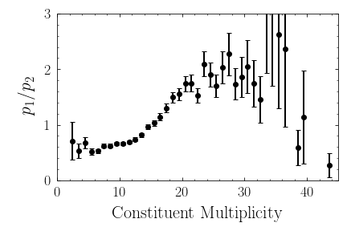
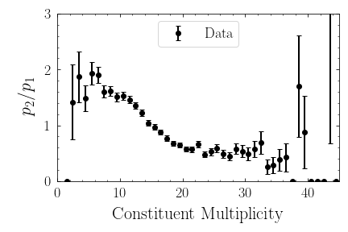




  Disentangling mixture distributions into “quark” and “gluon”
$$p_{2}$$
$$p_{1}$$
$$κ_{12}$$
$$κ_{21}$$
  $f_{1}=$ fraction of $b_{1}$ in $p_{1}$
  $f_{2}=$fraction of $b_{2}$ in $p_{2}$
  gives fractions
  “Topics”
Notes:
There have been a multitude of nice measurements quantifying the differences between the properties of p-p and A-A jets through jet modification observables, for example the dijet asymmetry and jet shape modifications. The aim in this program is to use jet modification observables to make direct inferences about how the quark–gluon plasma interacts with partons traversing through it.

Slide 13
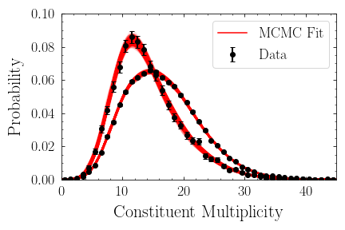
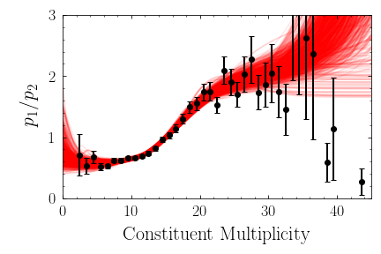
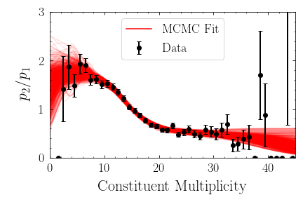
  Disentangling mixture distributions into “quark” and “gluon”
$$p_{2}$$
$$p_{1}$$
$$κ_{12}$$
$$κ_{21}$$
  $f_{1}=$ fraction of $b_{1}$ in $p_{1}$
  $f_{2}=$fraction of $b_{2}$ in $p_{2}$
  gives fractions
  “Topics”
Notes:
There have been a multitude of nice measurements quantifying the differences between the properties of p-p and A-A jets through jet modification observables, for example the dijet asymmetry and jet shape modifications. The aim in this program is to use jet modification observables to make direct inferences about how the quark–gluon plasma interacts with partons traversing through it.

Slide 14
  Extracting quark/gluon contributions to constituent multiplicity
  proton–proton
Notes:
There have been a multitude of nice measurements quantifying the differences between the properties of p-p and A-A jets through jet modification observables, for example the dijet asymmetry and jet shape modifications. The aim in this program is to use jet modification observables to make direct inferences about how the quark–gluon plasma interacts with partons traversing through it.

Slide 15
  Extracting quark/gluon contributions to constituent multiplicity
  heavy-ion
  Similar results in PYQUEN generator
Ying, Brewer, Chen, Lee [2204.00641]
Notes:
There have been a multitude of nice measurements quantifying the differences between the properties of p-p and A-A jets through jet modification observables, for example the dijet asymmetry and jet shape modifications. The aim in this program is to use jet modification observables to make direct inferences about how the quark–gluon plasma interacts with partons traversing through it.

Slide 16




  Application to modification of quark and gluon jet substructure
  Quark and gluon fractions are delicate…
$$b_{1}=Pois\left(λ_{1}\right)$$
  Used multiplicity to extract q/g fractions, due to approximate mutual irreducibility
$$b_{2}=Pois\left(λ_{2}\right)$$
  But with fractions, can separate q/g contributions to any observable
$$p_{1}=f_{1}b_{1}+\left(1−f_{1}\right)b_{2}$$
$$p_{2}=\left(1−f_{2}\right)b_{1}+f_{2}b_{2}$$
Ying, Brewer, Chen, Lee [2204.00641]
Notes:
There have been a multitude of nice measurements quantifying the differences between the properties of p-p and A-A jets through jet modification observables, for example the dijet asymmetry and jet shape modifications. The aim in this program is to use jet modification observables to make direct inferences about how the quark–gluon plasma interacts with partons traversing through it.

Slide 17
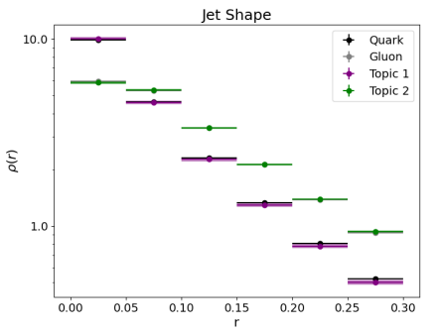
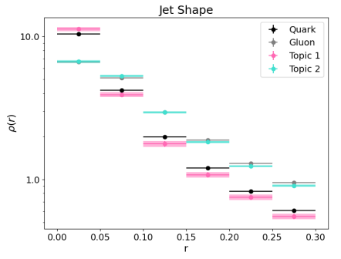
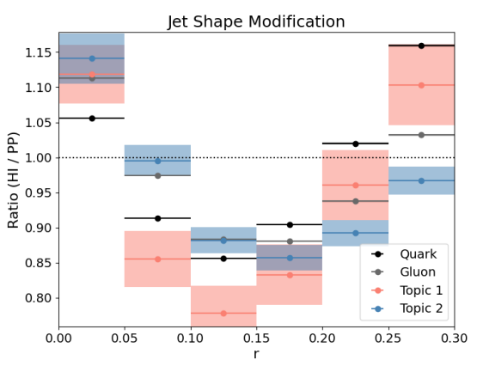
  Jet shape modification of quark and gluon jets
  proton-proton
  heavy-ion
  ratio
  Modified at smaller angles for quarks than gluons
Notes:
There have been a multitude of nice measurements quantifying the differences between the properties of p-p and A-A jets through jet modification observables, for example the dijet asymmetry and jet shape modifications. The aim in this program is to use jet modification observables to make direct inferences about how the quark–gluon plasma interacts with partons traversing through it.

Slide 18
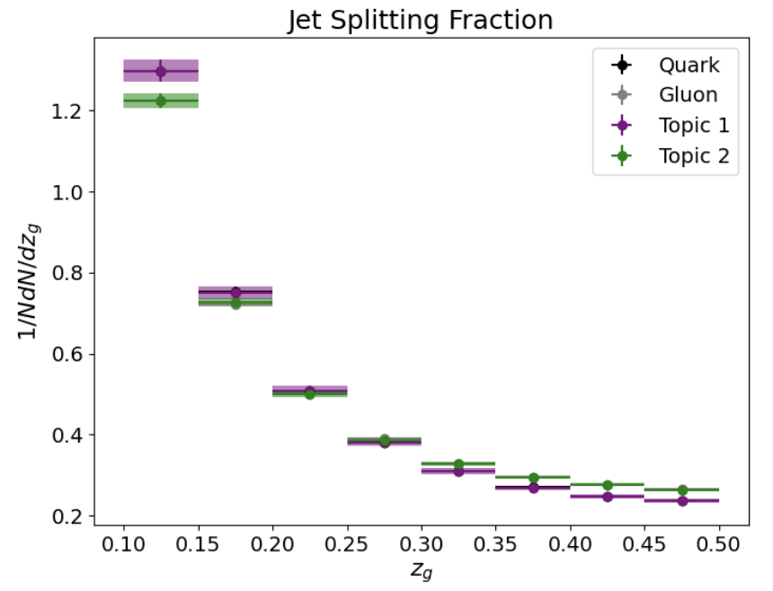
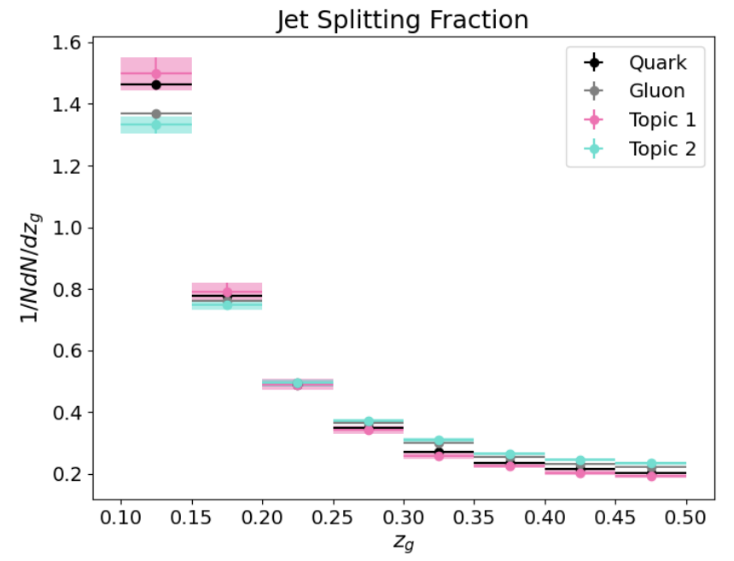
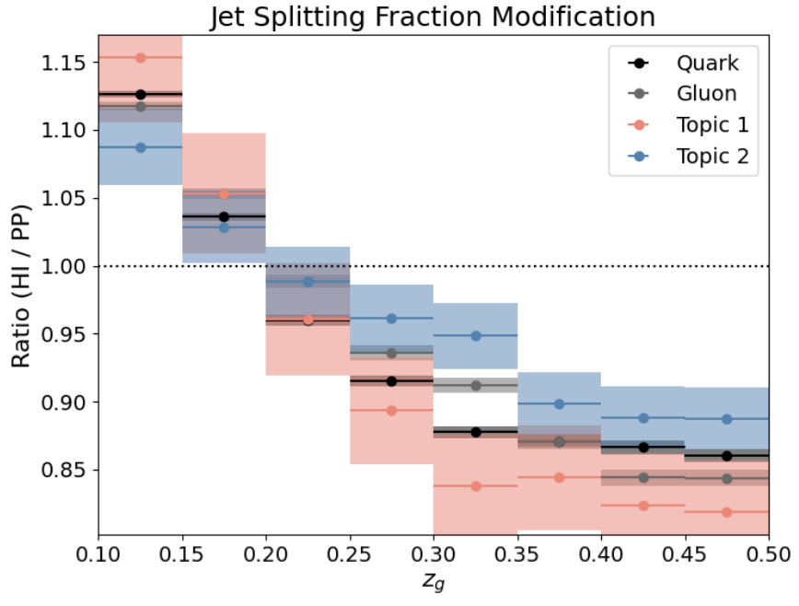
  Groomed momentum sharing of quark and gluon jets
  proton-proton
  heavy-ion
  ratio
  Larger modification for quarks than gluons
Notes:
There have been a multitude of nice measurements quantifying the differences between the properties of p-p and A-A jets through jet modification observables, for example the dijet asymmetry and jet shape modifications. The aim in this program is to use jet modification observables to make direct inferences about how the quark–gluon plasma interacts with partons traversing through it.

Slide 19
  Outlook
  Toward measuring quark- and gluon-like jet modification and energy loss
  This type of method has been used in p—p by ATLAS [1906.09254]
  Method of posterior estimation substantially improves robustness of the method to statistical uncertainties
    How to deal with systematic uncertainties?
  What observables are robust to background subtraction?
    charged particle multiplicity? constituent multiplicity of soft-dropped jets?
  Applications to other category problems in heavy-ions?
Notes:
There have been a multitude of nice measurements quantifying the differences between the properties of p-p and A-A jets through jet modification observables, for example the dijet asymmetry and jet shape modifications. The aim in this program is to use jet modification observables to make direct inferences about how the quark–gluon plasma interacts with partons traversing through it.

Slide 20
  Backup
Notes:
There have been a multitude of nice measurements quantifying the differences between the properties of p-p and A-A jets through jet modification observables, for example the dijet asymmetry and jet shape modifications. The aim in this program is to use jet modification observables to make direct inferences about how the quark–gluon plasma interacts with partons traversing through it.

Slide 21
  What do differences between topic and MC fractions mean?
  ?
Notes:
There have been a multitude of nice measurements quantifying the differences between the properties of p-p and A-A jets through jet modification observables, for example the dijet asymmetry and jet shape modifications. The aim in this program is to use jet modification observables to make direct inferences about how the quark–gluon plasma interacts with partons traversing through it.

Slide 22
  What do differences between topic and MC fractions mean?
  Limited statistics effects on topic fractions
Notes:
There have been a multitude of nice measurements quantifying the differences between the properties of p-p and A-A jets through jet modification observables, for example the dijet asymmetry and jet shape modifications. The aim in this program is to use jet modification observables to make direct inferences about how the quark–gluon plasma interacts with partons traversing through it.

Slide 23
  What do differences between topic and MC fractions mean?
  Limited statistics effects on topic fractions
  Insignificant change in fractions due to factor 2.8 increase in statistics
Notes:
There have been a multitude of nice measurements quantifying the differences between the properties of p-p and A-A jets through jet modification observables, for example the dijet asymmetry and jet shape modifications. The aim in this program is to use jet modification observables to make direct inferences about how the quark–gluon plasma interacts with partons traversing through it.

Slide 24
  What do differences between topic and MC fractions mean?
  Limited statistics effects on topic fractions
  Insignificant change in fractions due to factor 2.8 increase in statistics
  Ambiguity in MC quark and gluon labelling
Notes:
There have been a multitude of nice measurements quantifying the differences between the properties of p-p and A-A jets through jet modification observables, for example the dijet asymmetry and jet shape modifications. The aim in this program is to use jet modification observables to make direct inferences about how the quark–gluon plasma interacts with partons traversing through it.

Slide 25
  What do differences between topic and MC fractions mean?
  Limited statistics effects on topic fractions
  Insignificant change in fractions due to factor 2.8 increase in statistics
  Ambiguity in MC quark and gluon labelling
  Slight decrease in extracted gluon fraction for jets with an initiating parton within the jet radius
Notes:
There have been a multitude of nice measurements quantifying the differences between the properties of p-p and A-A jets through jet modification observables, for example the dijet asymmetry and jet shape modifications. The aim in this program is to use jet modification observables to make direct inferences about how the quark–gluon plasma interacts with partons traversing through it.

Slide 26
  What do differences between topic and MC fractions mean?
  Limited statistics effects on topic fractions
  Insignificant change in fractions due to factor 2.8 increase in statistics
  Ambiguity in MC quark and gluon labelling
  Slight decrease in extracted gluon fraction for jets with an initiating parton within the jet radius
  Deviations from quark/ gluon mutual irreducibility in constituent multiplicity
Notes:
There have been a multitude of nice measurements quantifying the differences between the properties of p-p and A-A jets through jet modification observables, for example the dijet asymmetry and jet shape modifications. The aim in this program is to use jet modification observables to make direct inferences about how the quark–gluon plasma interacts with partons traversing through it.

Slide 27
  What do differences between topic and MC fractions mean?
  Limited statistics effects on topic fractions
  Insignificant change in fractions due to factor 2.8 increase in statistics
  Ambiguity in MC quark and gluon labelling
  Slight decrease in extracted gluon fraction for jets with an initiating parton within the jet radius
  Deviations from quark/ gluon mutual irreducibility in constituent multiplicity
  “Quark-initiated” jets become more gluon-like
Notes:
There have been a multitude of nice measurements quantifying the differences between the properties of p-p and A-A jets through jet modification observables, for example the dijet asymmetry and jet shape modifications. The aim in this program is to use jet modification observables to make direct inferences about how the quark–gluon plasma interacts with partons traversing through it.

