Slide 1
Are Jets Narrowed or Broadened in e+A SIDIS?
W. A. Horowitz
University of Cape Town
July 1, 2022
Based on
Hannah Clayton, Matthew D. Sievert, and WAH, Eur.Phys.J.C 82 (2022) 5, 437; arXiv:2110.14737

Slide 2
Many-Body QCD Motivation
Quantify non-trivial, emergent many-body phenomena of non-Abelian QFT

Slide 3
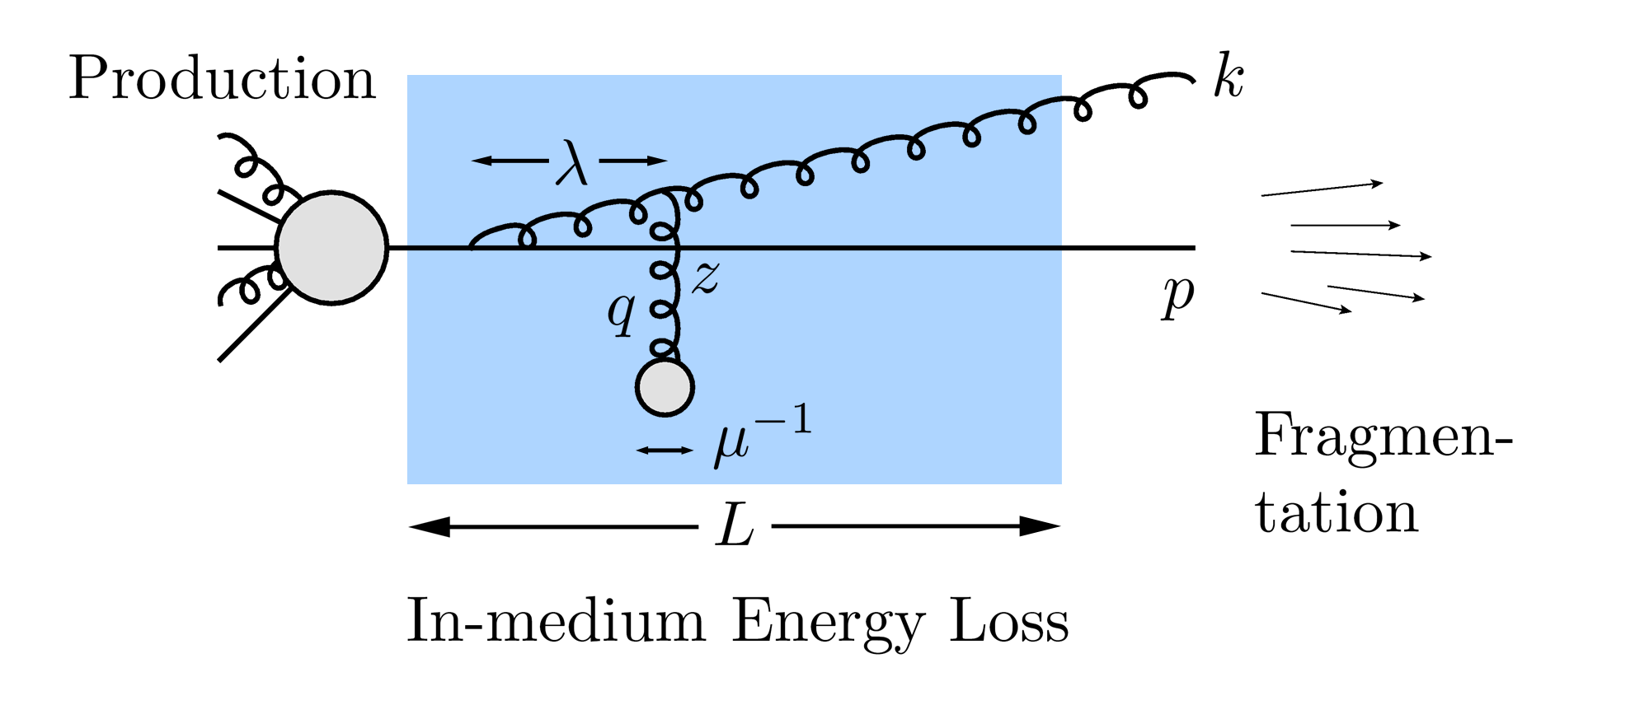
Jet Tomography
Most direct probe of DOF of QGP
pQCD Picture
Notes:
One could study Jet Tomo from AdS/CFT. However, hard to pinpoint physics; for E large, likely that perturbative dynamics dominate. Assumes: factorization + theoretical control over production, in-medium Eloss, and fragmentation. As a foreshadow: how important are these assumptions?

Slide 4
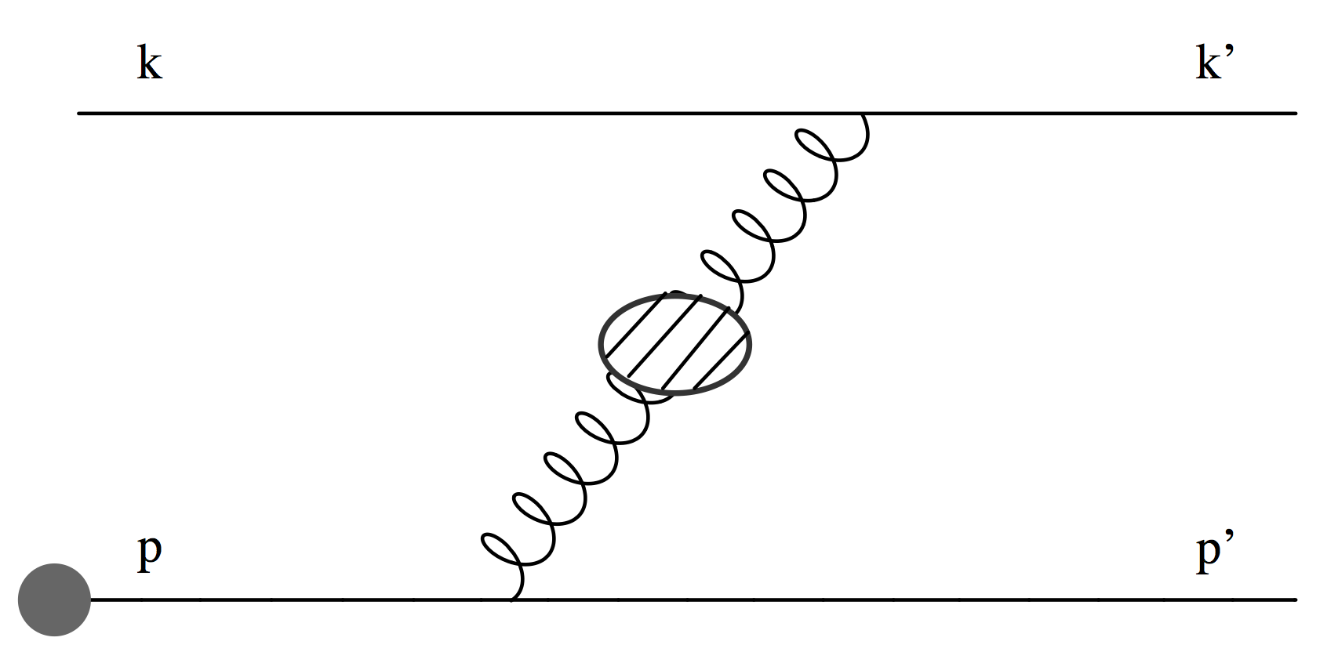
Types of Energy Loss
Two types of E-loss
Collisional (elastic) 2➞2
Radiative (inelastic) 2➞3
Scales => ~few scatterings, mult. coh. em. => LPM
Must include interference with production radiation
Bjorken, FERMILAB-PUB-82-059-THY
Braaten and Thoma, PRD44:2625–2630, 1991
Djordjevic, Phys.Rev. C74 (2006) 064907
Adil et al., Phys.Rev. C75 (2007) 044906
Djordjevic, PRC74 (2006)
Majumder and van Leeuwen, PPNPA66 (2011), and refs therein

Slide 5
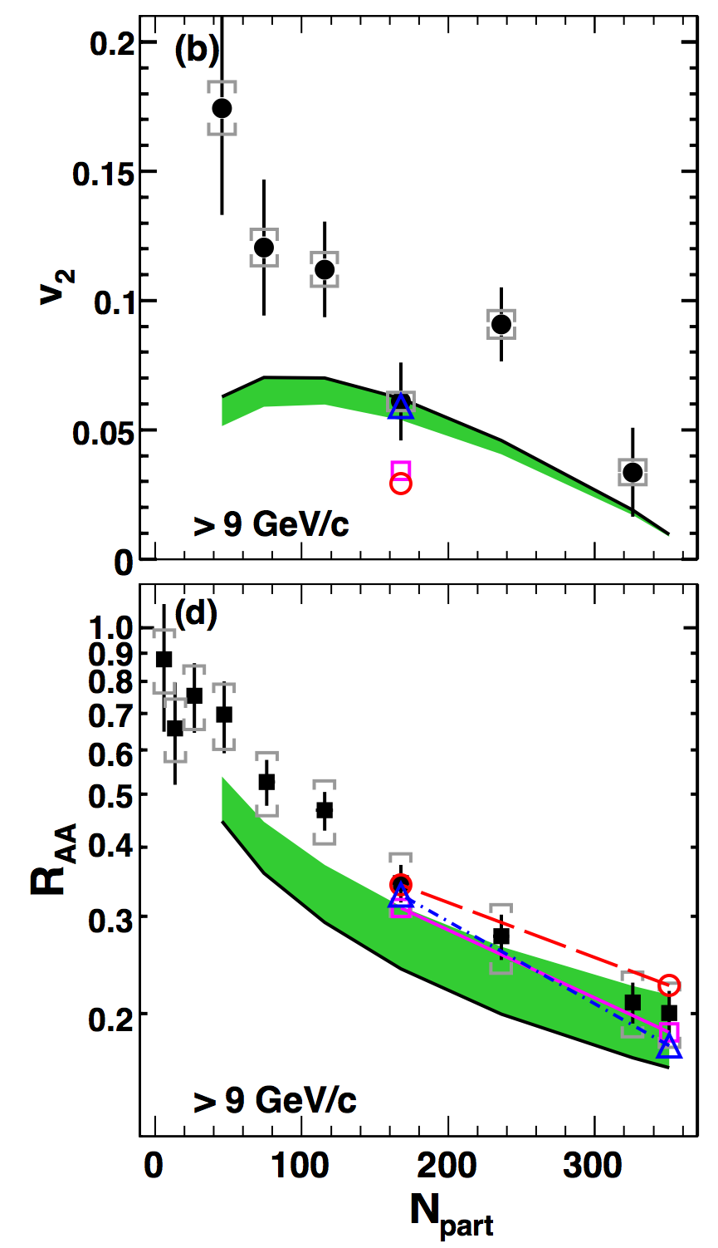
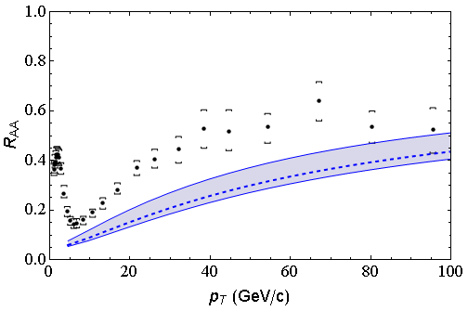
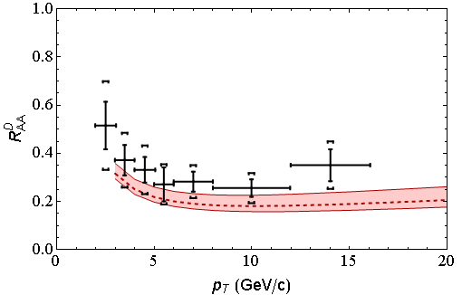
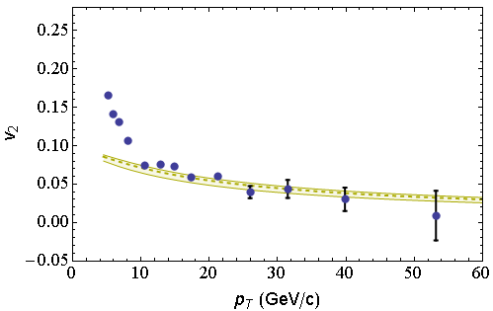
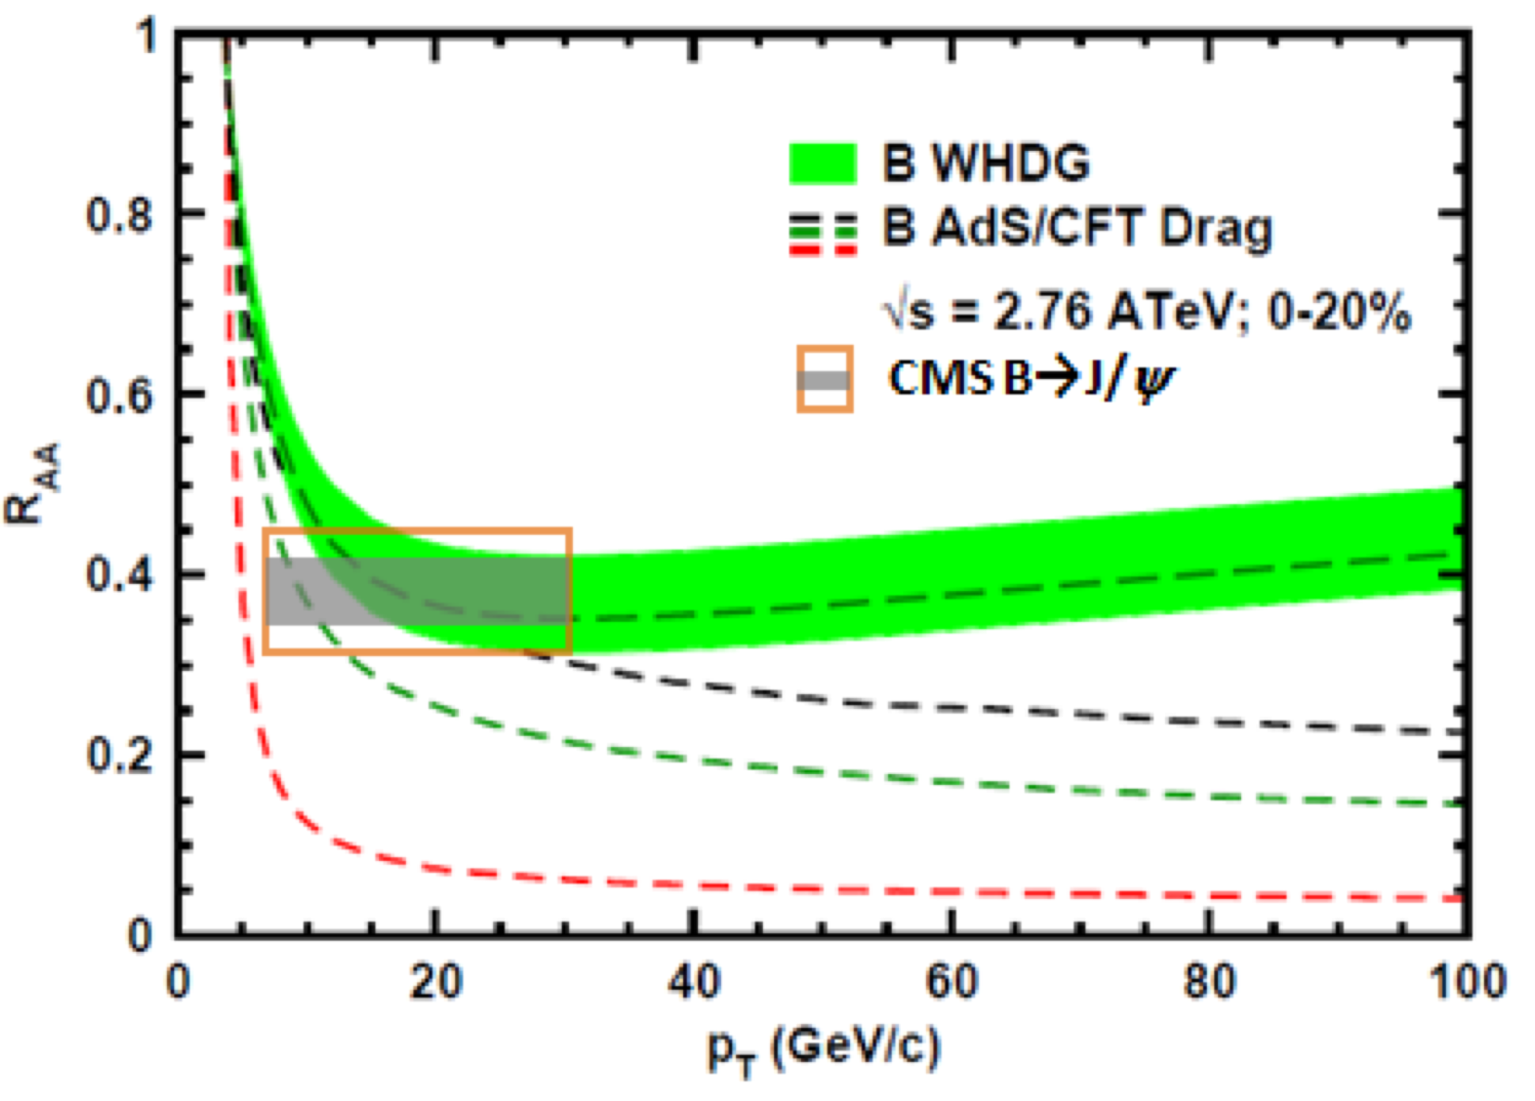
Qual. Success of “LO” Jet Tomo
Rad + El, realistic geom AA correct to factor ~2
LHC
CMS h± 0-5%
WHDG π⁰
LHC
ALICE D
WHDG D
RHIC
RHIC
LHC
CMS h± 40-50%
WHDG π⁰
LHC
CMS, Eur.Phys.J. C72 (2012)
CMS, PRL109 (2012)
ALICE, JHEP1209 (2012) 112
CMS, JHEP 1205 (2012) 063
PHENIX PRL105 (2010)
Notes:
Number of qualitative successes of pQCD suggests worth investigating further

Slide 6
Next Steps (?)
Improve E-loss calculations in various ways:
Higher orders in α_{s}
Vitev and Zhang, PRL (2010); arXiv:0910.1090
Consider small system corrections
Kolbé and WAH, PRC (2019); arXiv:1511.09313
Extract transport coefficients
Brick, TECHQM, JET, JETSCAPE
…
Place E-loss on more rigorous footing
Notes:
Going to focus on placing E-loss on a more rigorous footing for the rest of my talk

Slide 7
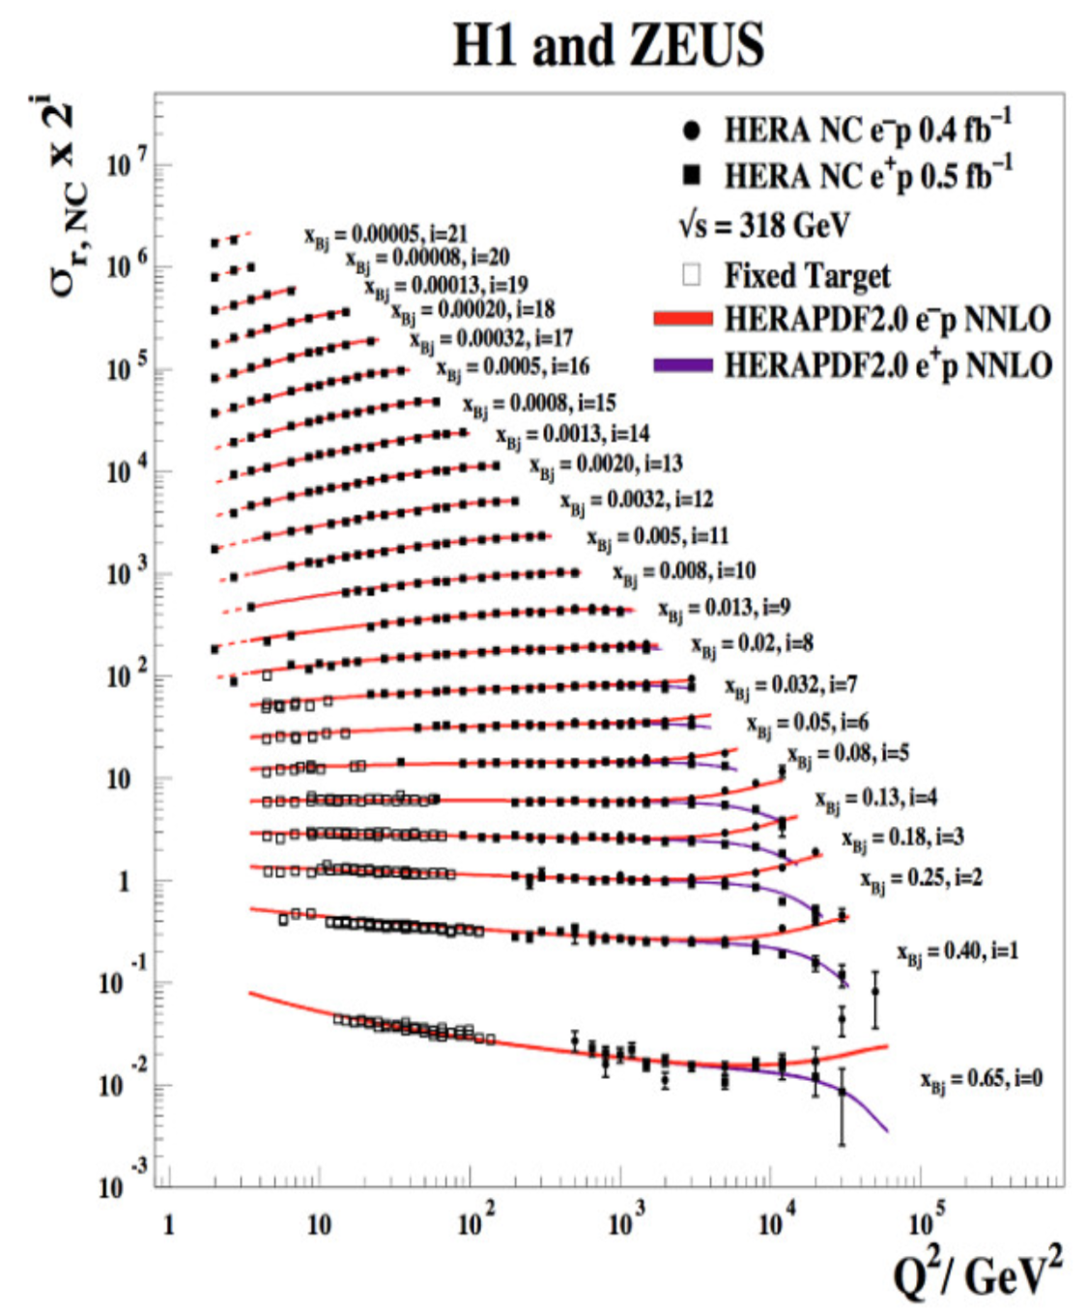
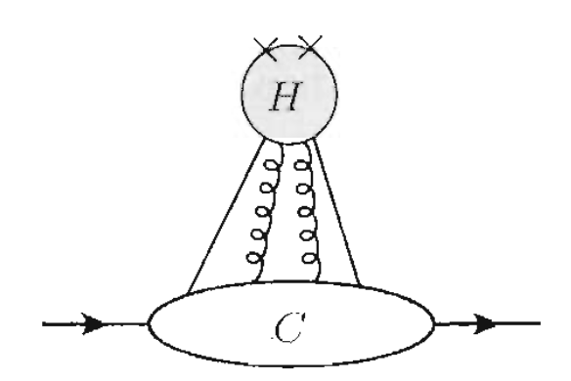
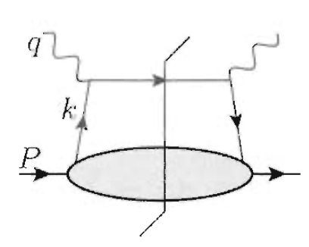
Factorization ⬄ Rigorous QCD
Controlled order-by-order expansion in perp/Q
Further controlled o-b-o expansion in α_{s}
Clean: rigorous theorems, expansion parameters clear, error estimates from higher order effects
Ex: e+p DIS, SIDIS, DY, …
Notes:
Goal: understand the Twist-4 calculation better; what are quantitative difference(s) from including production process and energy loss process on equal footing?

Slide 8
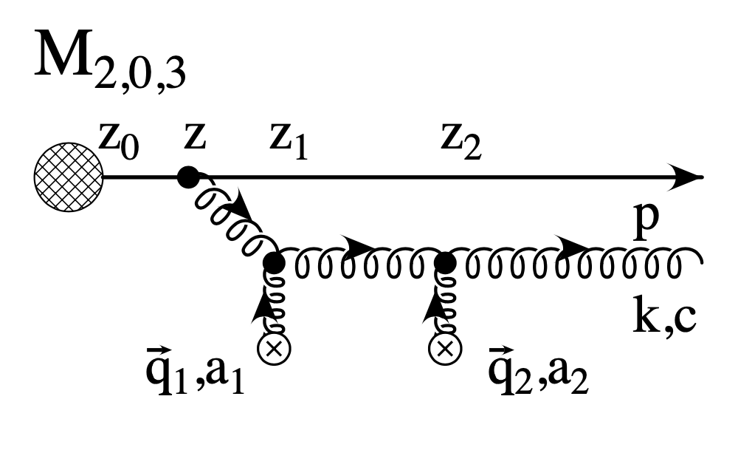
Factorization in E-Loss
Most E-loss models assume factorization of production and in-medium E-loss
DGLV, BDMPS-Z, AMY, …
Medium modification of DGLAP for FF (Guo, Wang, Majumder, Vitev, et al.)
eA SIDIS <p_{T}²> at Twist 4 (Kang, Wang, Wang, Xing)
Production and subsequent interaction on equal footing
Self-consistent to NLO; no factorization theorem yet
Make apples-to-apples comparison with DGLV? Quantify importance of ignoring production + E-loss interference in DGLV?

Slide 9
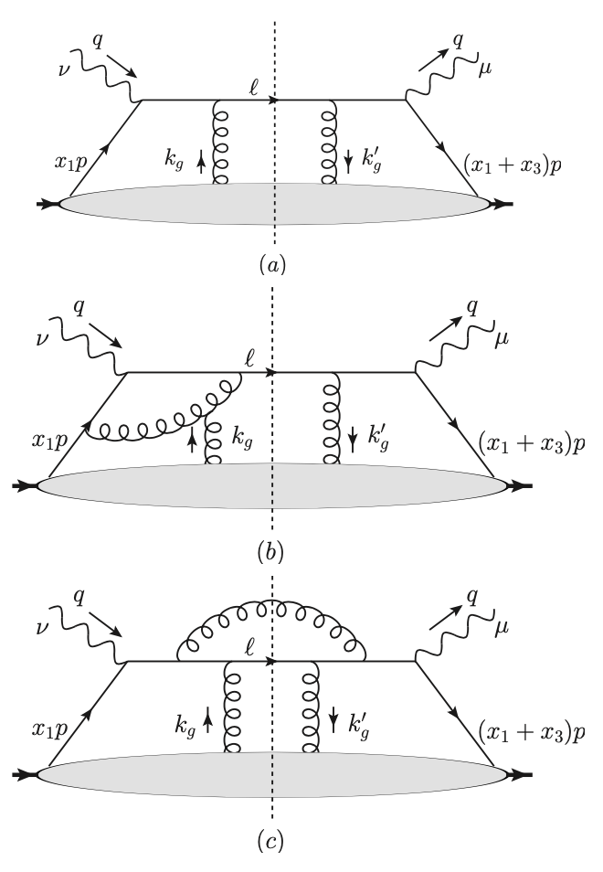
Twist 4 <p_{T}²> in SIDIS
Twist 4 PDFs
Cross talk with IS
Vac FF evolve with vac splitting functions
KWWX, PRL (2014)
KWWX, PRL (2014); arXiv:1310.6759
XKWW, NPA (2014); arXiv:1407.8506
KWWX, PRD (2016); arXiv:1409.1315
Notes:
LO is elastic scattering
At NLO, one has radiation + IS interference
How important is this radiation + IS interference? How should we think about organizing the various contributing diagrams?

Slide 10
Comparison to Opacity Expansion
Twist 4:
Order-by-order expansion in perp/Q
Order-by-order expansion in α_{s}
Collinear factorization framework
Opacity:
Order-by-order expansion in opacity
number of times there’s a scattering off a medium quasi-particle
Captures destructive interference of LPM fully
Assumed factorization of initial hard scattering process with no subsequent interference
Often assumes
soft (x << 1)
collinear approx. (k_{T} << x E)
Incorporates finite kinematics
How do the two compare at asymptotic E_{jet}?
Notes:
Opacity expansion assumptions fairly generic across energy loss derivations:
--assumed factorization: how important is this??
--LPM effect
--soft and collinear approx

Slide 11
0th Order in Opacity, LO α_{s} <p_{T}²>
Production is assumed factorized into blob
No medium scattering (0th Order in Opacity)
No emissions (LO α_{s})
We seek medium modification, so Δ<p_{T}²> = 0

Slide 12
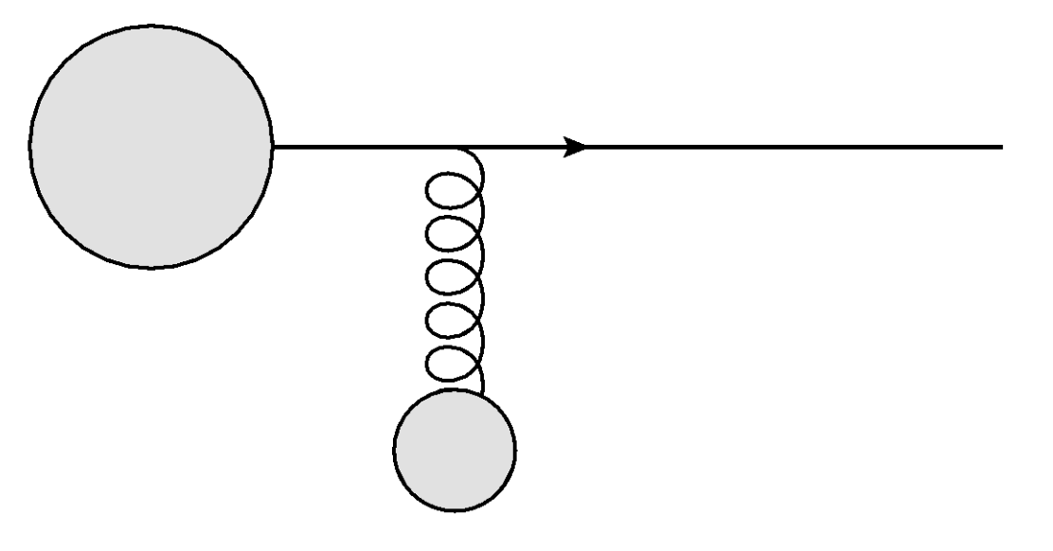
1st Order in Opacity, LO α_{s} <p_{T}²>
⬄ Elastic energy loss
Calculation:
In medium Debye-screened scattering center
Yields, assuming finite q_{max}² ~ E * μ:

Slide 13
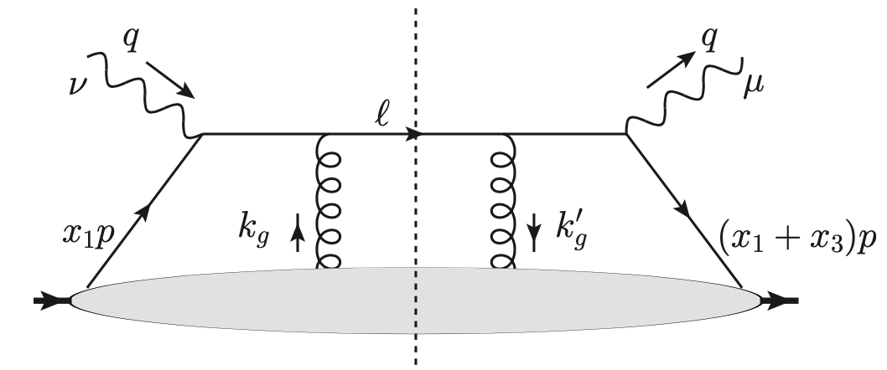
Twist 4 LO α_{s} <p_{T}²>
⬄ Elastic energy loss
Assume loosely bound nucleus
Make FF trivial for comparison:
Result, after dividing by 2=>2 x-scn
Same as opacity expansion!

Slide 14
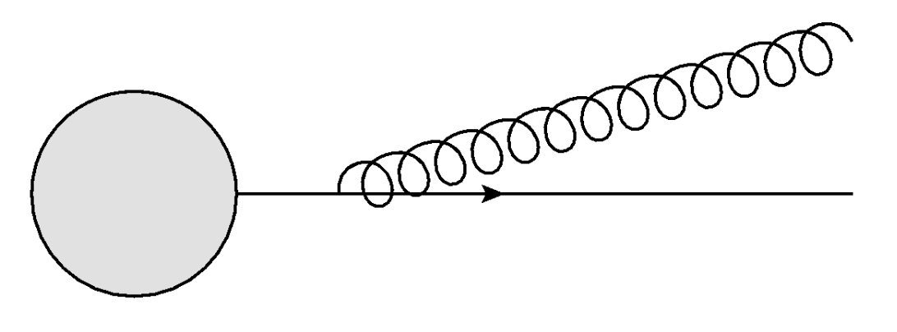
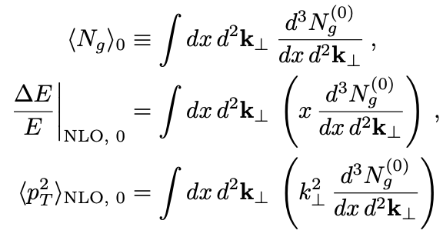
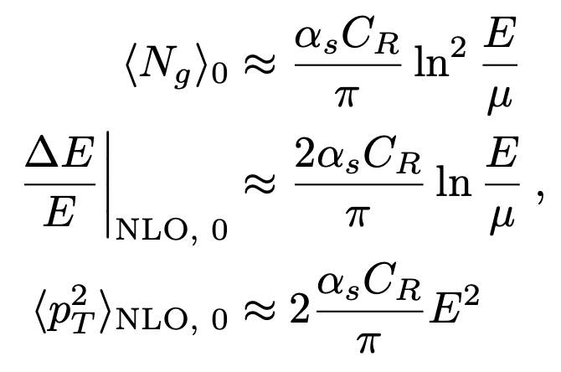
0th Order in Opacity, NLO α_{s} <p_{T}²>
⬄ Vacuum radiation
Compute single inclusive rad. glu. dist.:
Finite kinematics k_{T} < x E:
=>

Slide 15
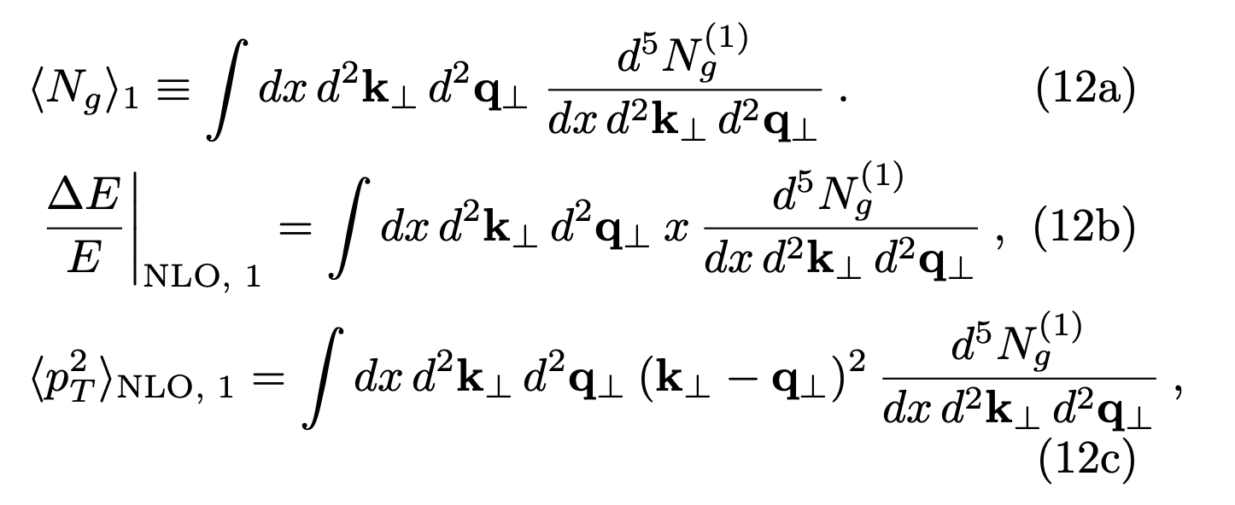
1st Order in Opacity, NLO α_{s} <p_{T}²>
Calculation:
Derivation of single inclusive kernel dN/dxd²kd²q:
Djordjevic et al, NPA733 (2004)

Slide 16
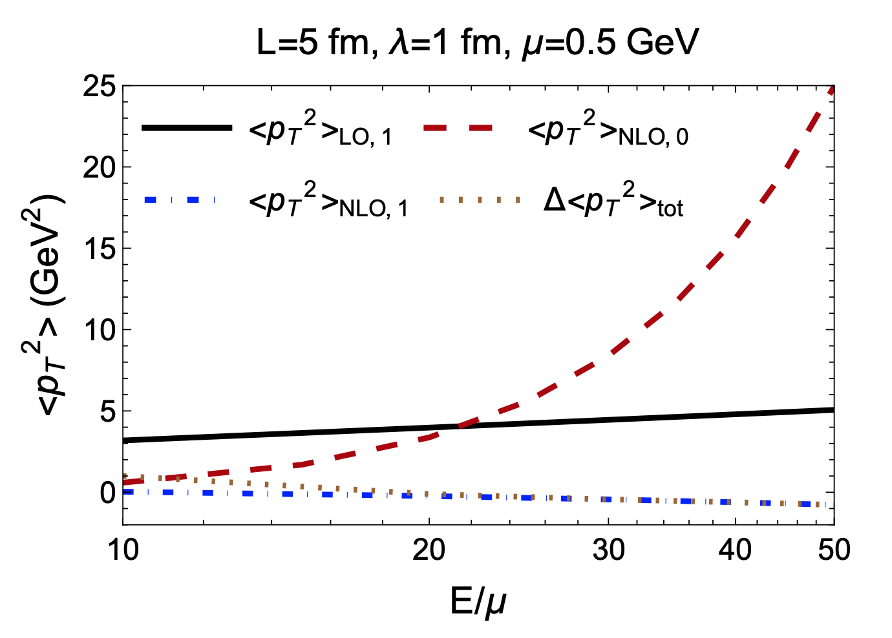
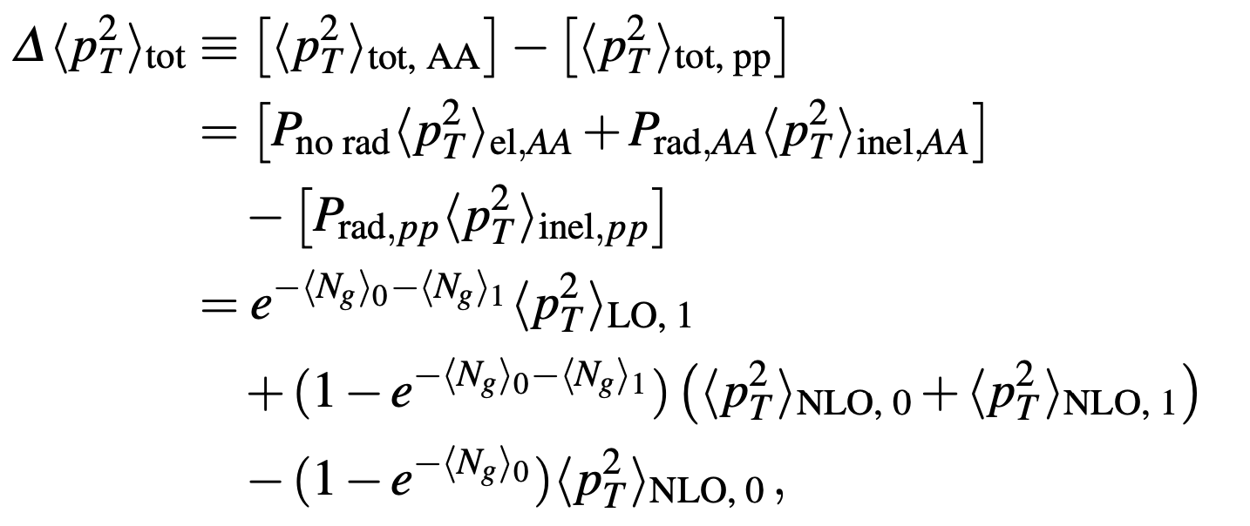
1st Order in Opacity, NLO α_{s} <p_{T}²>, cont’d
Full numerics for <p_{T}²>
1st LO ~ log(E/μ)
0th NLO ~ E²
1st NLO ~ −log²(E/μ)
Weighted average:
!!!
Clayton, Sievert, WAH,
EPJC; arXiv:2110.14737
Notes:
Weighted average shows how difficult it is to dig out the difference in <p_T^2>

Slide 17
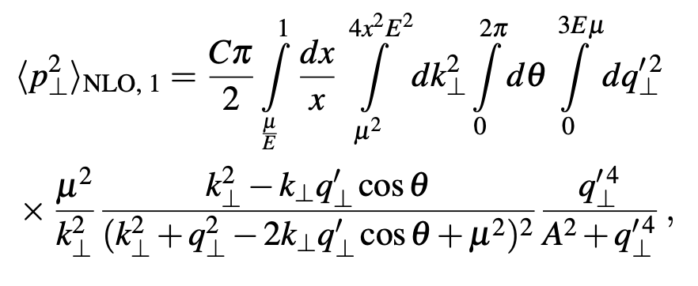
Jet Narrowing: Bad Numerics?
Seek analytic insight for
Attempt with naïve infinite kinematics
Examine E loss first
Integrate over all k_{T}
Shift integration over q_{T} and k_{T}
Agrees with numerics
Examine <p_{T}²>
Log squared growth
Jet broadening
Notes:
Jet broadening obviously disagrees with the numerics. Note the overall coefficient of the ratio

Slide 18
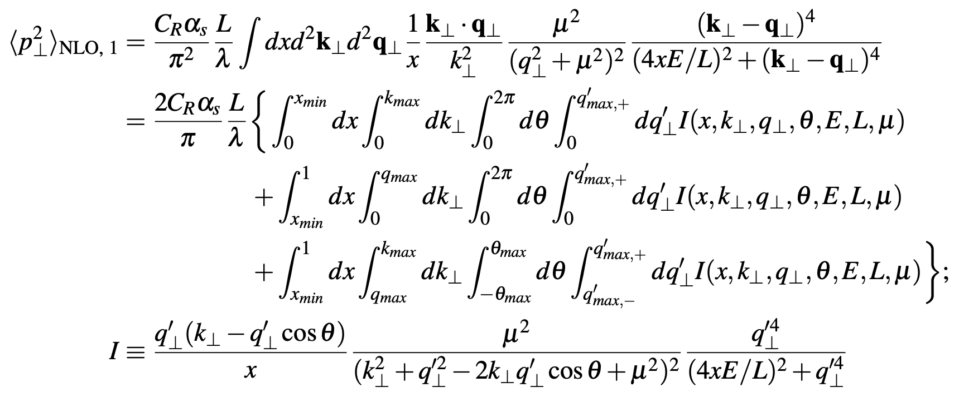
More Precise Kinematics
Attempt brute force integration, then expand for large E

Slide 19
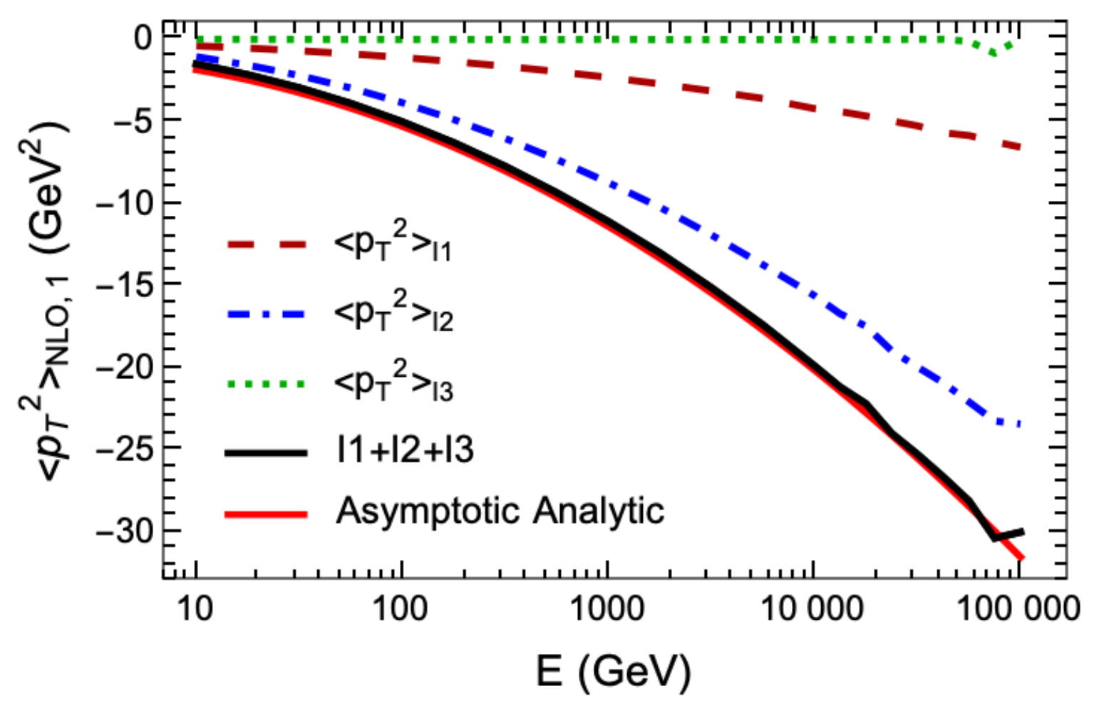
Careful Kinematics => Jet Narrowing
Determine individual contributions; compare with numerics
When dust settles:
Clayton, Sievert, WAH,
EPJC; arXiv:2110.14737

Slide 20
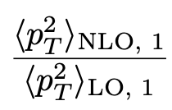
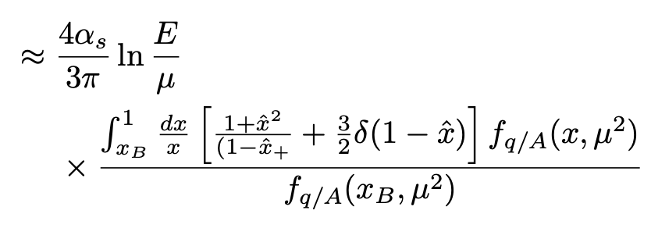
Twist 4 NLO α_{s} <p_{T}²>
More difficult to extract cf T-4 LO
Assume color triviality breaking terms are small, trivialize FF, loosely bound nucleus
NB: 4α_{s}/3π identical to naïve inf. kin. opacity
> 0

Slide 21
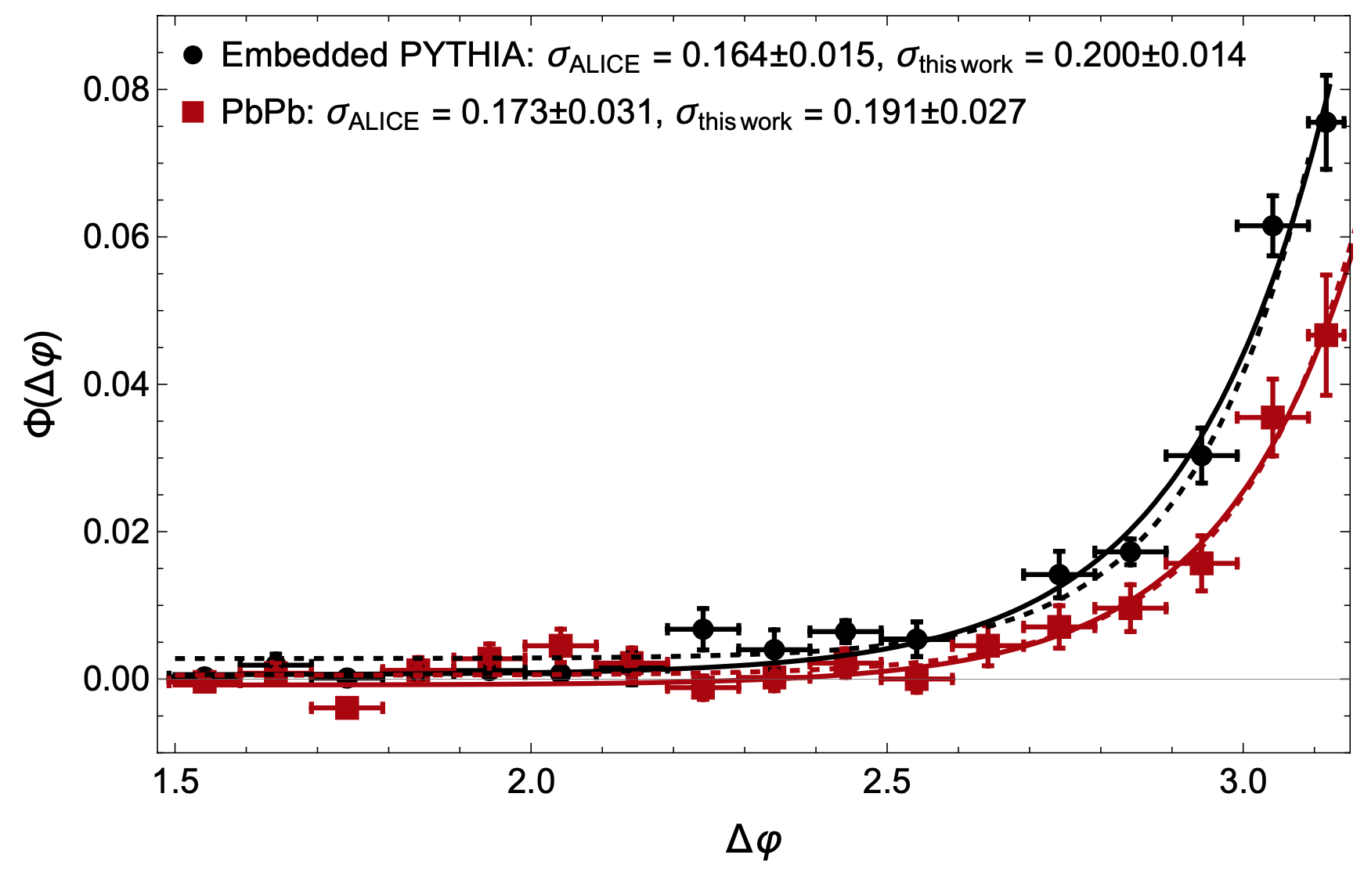
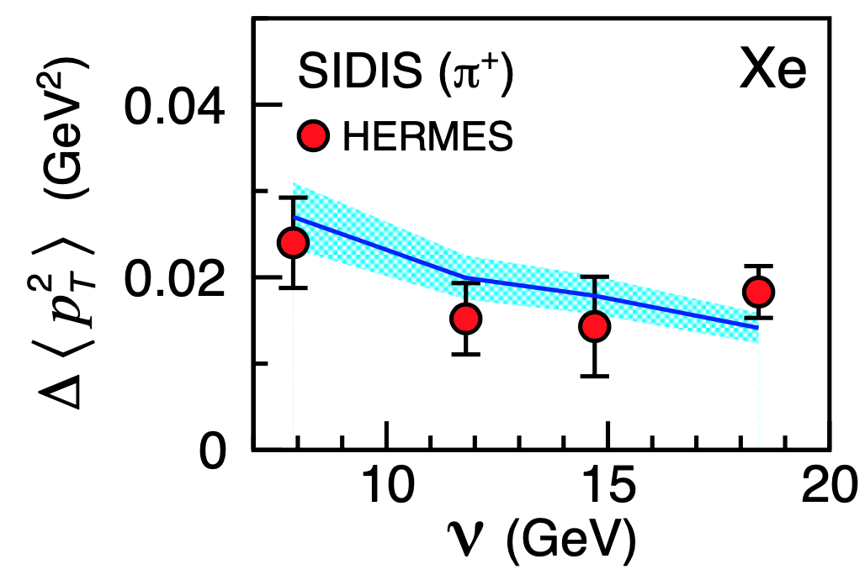
Comparison to Data
So do jets broaden (cf Twist 4) or narrow (cf Opacity)?
LHC data inconclusive; SIDIS suggests narrowing as E => infinity!
Figure:
Ru, Kang, Wang, Xing, Zhang, PRD 103 (2021) 3
Data: HERMES, PLB684, 114 (2010)
ALICE, JHEP 09, 170 (2015)
Clayton, Sievert, WAH, arXiv:2110.14737
See also Derek Anderson’s QM talk

Slide 22
Conclusions (1/3)
Seek precision jet tomography in HIC
=> Quantitative insight into many body QCD
Asymptotic analysis of Twist 4 and Opacity
Twist 4: jet broadening for large E
Opacity: jet narrowing for large E
Due to v delicate destructive (LPM) interference
Data: ambiguous, hints of narrowing
Difficult measurement, look forward to greater precision, range of systems, etc.

Slide 23
Discussion (2/3)
Why qualitative difference? (Educated guesses)
LPM:
Opacity captures LPM fully
Twist 4 only captures leading perp/E destructive interference
Future work: resummation? Finite kinematics:
Twist 4 integrates all k_{T}; needs generalization to TMD-like?
Loss of factorization?
Initial State Interference
Generalization of Opacity/E-loss to include production??

Slide 24
Future Work (3/3)
We saw:
Deep conceptual issues with Opacity Expansion vs Twist 4
How to categorize different classes of diagrams?
What’s in the initial state vs final state vs …?
Medium modification cannot be in FF
How to incorporate LPM, finite kinematics?
Generalization of collinear factorization needed?
E loss less sensitive to finite kinematics
Try to compare Twist 4 and Opacity for another observable, closer to E loss?
Much interesting work to do!

Slide 25
Bonus Material

Slide 26
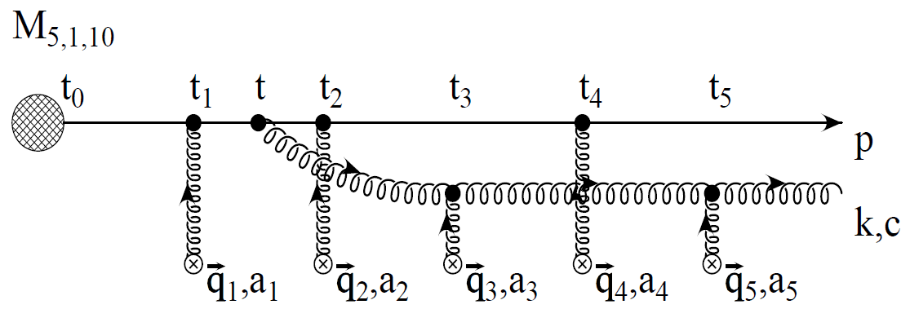
pQCD Rad Picture in Opacity Exp.
Bremsstrahlung Radiation
Weakly-coupled plasma
Medium organizes into Debye-screened centers
T ~ 250 MeV, g(2πT) ~ 2
μ ~ gT ~ 0.5 GeV
λ_{mfp} ~ 1/g²T ~ 1 fm
R_{Au} ~ 6 fm
1/μ << λ_{mfp} <<τ_{form}<< L
mult. coh. em.
Gyulassy, Levai, and Vitev, NPB571 (2000)
LPM
dp_{T}/dt ~ -LT³ log(p_{T}/M_{q})
Bethe-Heitler
dp_{T}/dt ~ -(T³/M_{q}²) p_{T}
Notes:
Assumed factorization of initial hard scattering process with no subsequent interference
Order-by-order expansion in opacity, which is the number of times there’s a scattering off a medium quasi-particle
Designed to “resum” all the destructive interference contributions that give LPM effect
Incorporates exact kinematics

