Slide 1
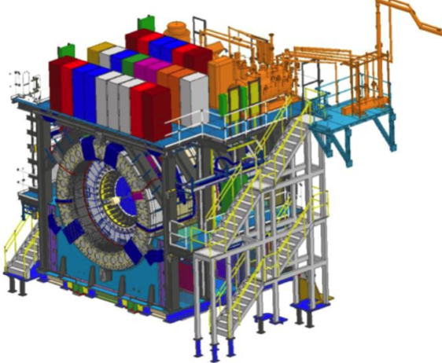
sPHENIX MIE Project Overview
TPC | Project Director | Last CD Achieved | % Complete | CPI | SPI
$27.0M | Edward O’Brien | PD-2/3 | 93.1% BCWP/BAC @ 12/31/2021 | 1.03 | 0.93
Scope
Detector systems produced, tested and ready for installation: Time Projection Chamber w/ electronics, Electromagnetic Calorimeter w/ electronics, Hadronic Calorimeter w/ electronics, DAQ/Trigger, Minimum Bias Detector, Project Management
Not in scope
SC-Magnet, Bldg/Det Infrastructure, Installation and System Commissioning
Schedule
CD-0 received Sept 2016
CD-1/3A received Aug 2018
PD-2/3 received Sept 2019
Early completion mid-Feb 2022 based on P6
Early completion based on November status end of April 2022
PD-4 Dec 2022
Cost
$27.0M AY TPC 80.1% contingency on an ETC of $2.68M
Commitments = $2.86 M
The early completion date did not move in December

Slide 2
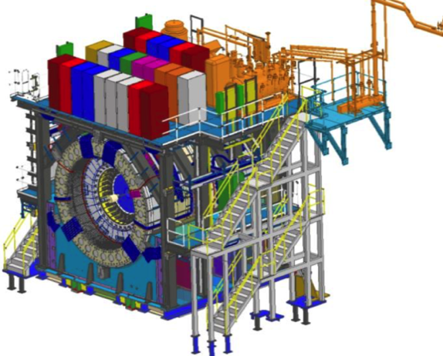
BNL 1008 Infrastructure & Facility Upgrade
TPC | Project Director | % Complete | CPI | SPI
$33.4 M AY | Edward O’Brien | 72.6% BCWP/BAC @ 12/31/2021 | 0.99 | 0.85
Scope
SC-Magnet support including the Flux Return, Cryogenics into Bldg 1008, Detector Carriage/Cradle, other Bldg 1008 Infrastructure improvements
sPHENIX Installation, Integration and Commissioning of each Subsystem is part of the scope
Not in Scope
PreOps prior to RHIC collisions
Schedule
sPHENIX Ready for Operations (Early Completion) 1/19/23
First RHIC run of sPHENIX Feb 1, 2023
0.5 months float in schedule between sPHENIX ORR and
nominal start of RHIC 2023 run.
Cost
$33.4 M AY Total Project Cost with 18.1% contingency on ETC of $9.1M
85.4% Costed and Committed
Commitments = $3.59M

Slide 3
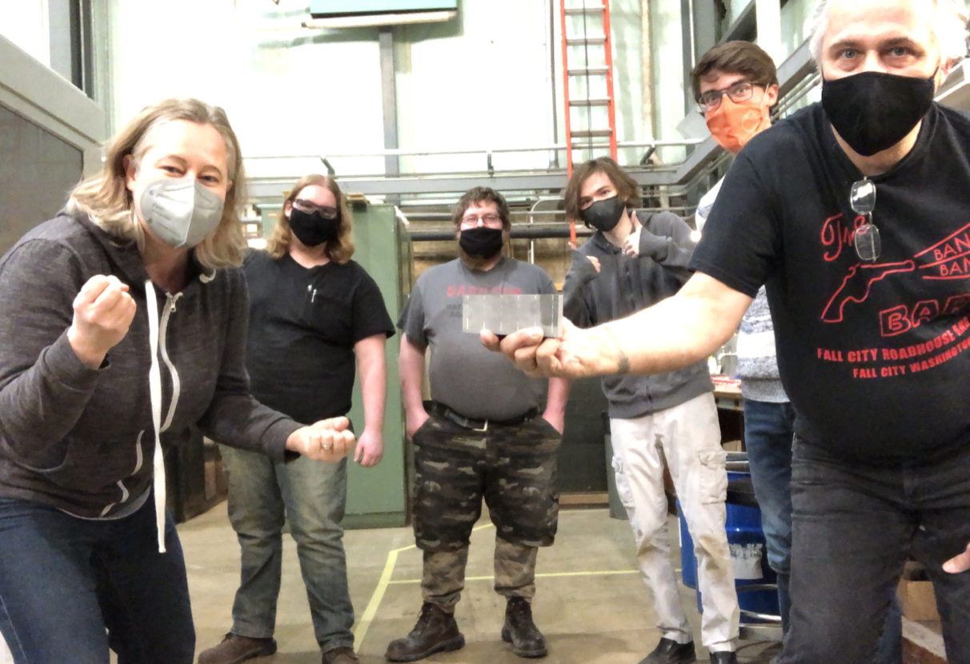
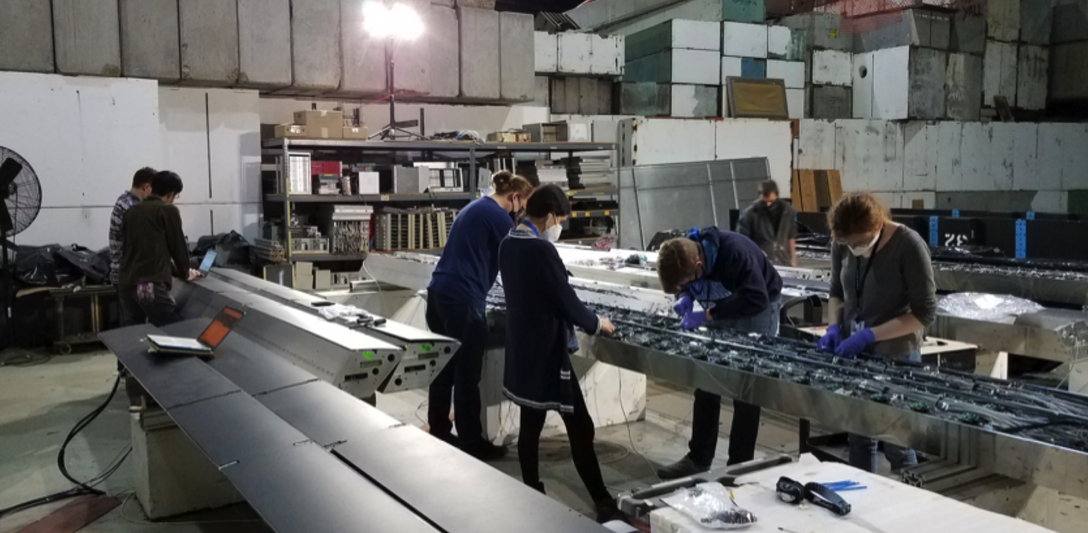
sPHENIX MIE Status
OHCal Sectors 1-20 installed in 1008. Sector 21 to be installed tomorrow. All remaining OHCal sectors complete, tested and ready to install.
All Inner HCal sectors instrumented. Electronic burn in of final 8 sectors underway.
All EMCal blocks complete at UIUC/Fudan/PKU/CIAE
EMCal Sectors 83% (53/64) complete at BNL. We’ve assembled all sectors needed for installation prior to the magnet mapping.
All TPC ASICs complete, tested and at BNL. TPC Fee boards/DAM boards 100% assembled. Testing and firmware development underway.
All EMCal and OHCal on-detector electronics received at BNL. Calorimeter digitizer components continue to arrive at Columbia University (99% received to date)
All GEM framing for TPC at WSU, WIS, Vanderbilt, Temple. Quad-GEM module assembly 100% complete at SBU
Major DAQ/Trigger orders: Large switch, DAQ computers and Buffer Boxes are delivered to BNL.
EMCal Fighting Illini
Final EMCal block
IHCal factory at BNL

Slide 4
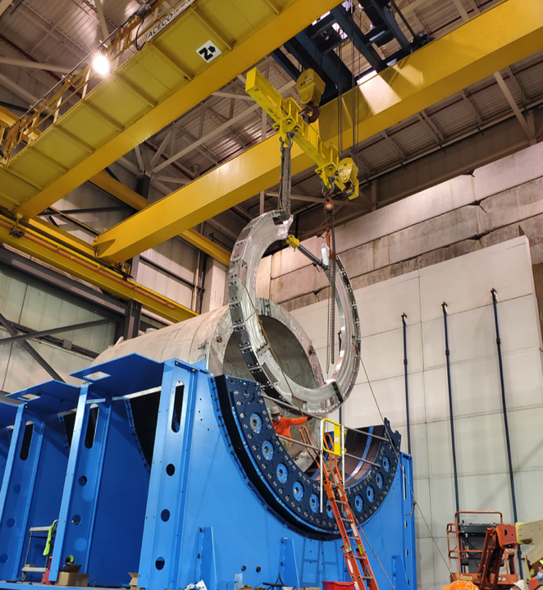
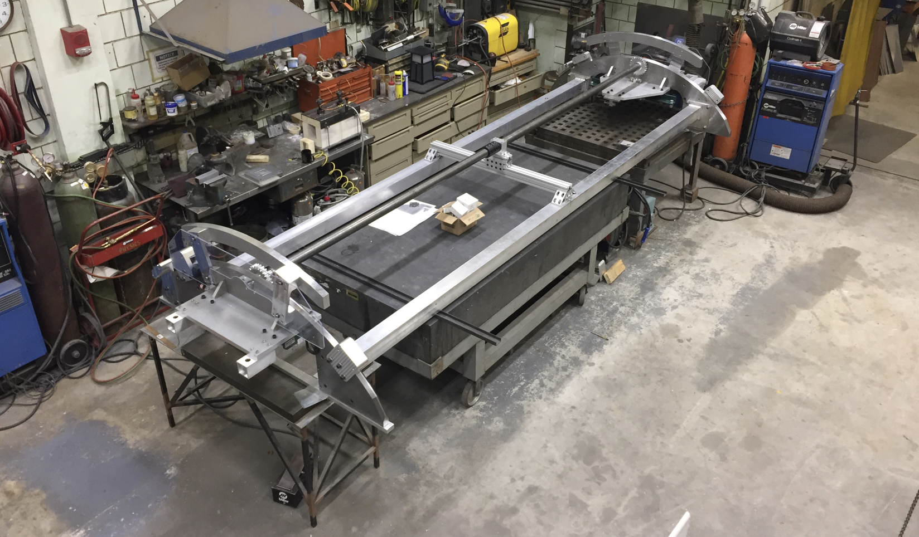
1008 Infrastructure and Facility Upgrade Status
Carriage/Cradle assembled in 1008
XY Carriage tables, Carriage Hydraulics installed
SC- Magnet installed in 1008
EMCal Installation fixture completed at SBU
IR track reinforcement complete.
Large Support Rings installed
LHe cryo components part delivered installation begun
LN2 & warm piping part delivered installation begun
IHCal assembly fixture complete
IHCal installation fixtures in production (Delivery in Mar)
Magnet flux return Pole tip/end cap in production (Delivery in Feb)
sPHENIX Beam Pipe at vendor for modification. (Delivery in Apr)
Rack Platform in production at vendor (delivery in Feb)

Slide 5
High Priority Issues
Installation in 1008.
The OHCal installation continuing. Projected end date for OHCal installation is 1st week of March
Keep the EMCal Sectors and IHCal on schedule.
Preparation of IHCal barrel build is underway.
Maintain the sPHENIX technical work force.
Order the TPC installation and support components
Keep remaining electronics on schedule (Cal Digitizers, LL1, GL1/GTM, MBD D/S, DCMIIs, JACK board)
Complete remaining engineering design tasks and order components
Place Remaining procurements

Slide 6
Key Remaining Orders MIE/I&F
MIE
DAQ/Trigger: GL1/GTM boards (parts order started)
TPC: JACK board ( Parts ordered. PCB being laid–out. Not yet ordered)
TPC: Laser servomotors and mechanics (line laser) (vendor quotes being obtained)
TPC: optical fibers (commercial order to be placed)
TPC: Fiber sort-out box (Not yet ordered)
I&F
TPC installation fixtures and bracketry (drawings complete)
INTT brackets and installation fixtures (drawings complete)
Beam pipe, MBD, sEPD supports, N&S platforms
Magnet Mapping (draft SOW w/ CERN )
Fiber Optics trunk cables (commercial order)
HVAC Improvements (order w/ outside contractor)
Seismic restraints (drawings far advanced)

Slide 7
EMCal Block Production-DONE
Blocks built at UIUC
Block in molds at UIUC
Blocks built at Chinese institutions
Block count
All EMCal blocks completed both at UIUC (MIE) and Fudan/PKU/CIAE (high eta) collaborating institutions
All delivered to BNL
This was the culmination of a great organizational and technical effort by Caroline Riedl, Anne Sickles, Eric Thorsland and the whole UIUC team plus the scientists, students and techs at Fudan/PKU/CIAE

Slide 8
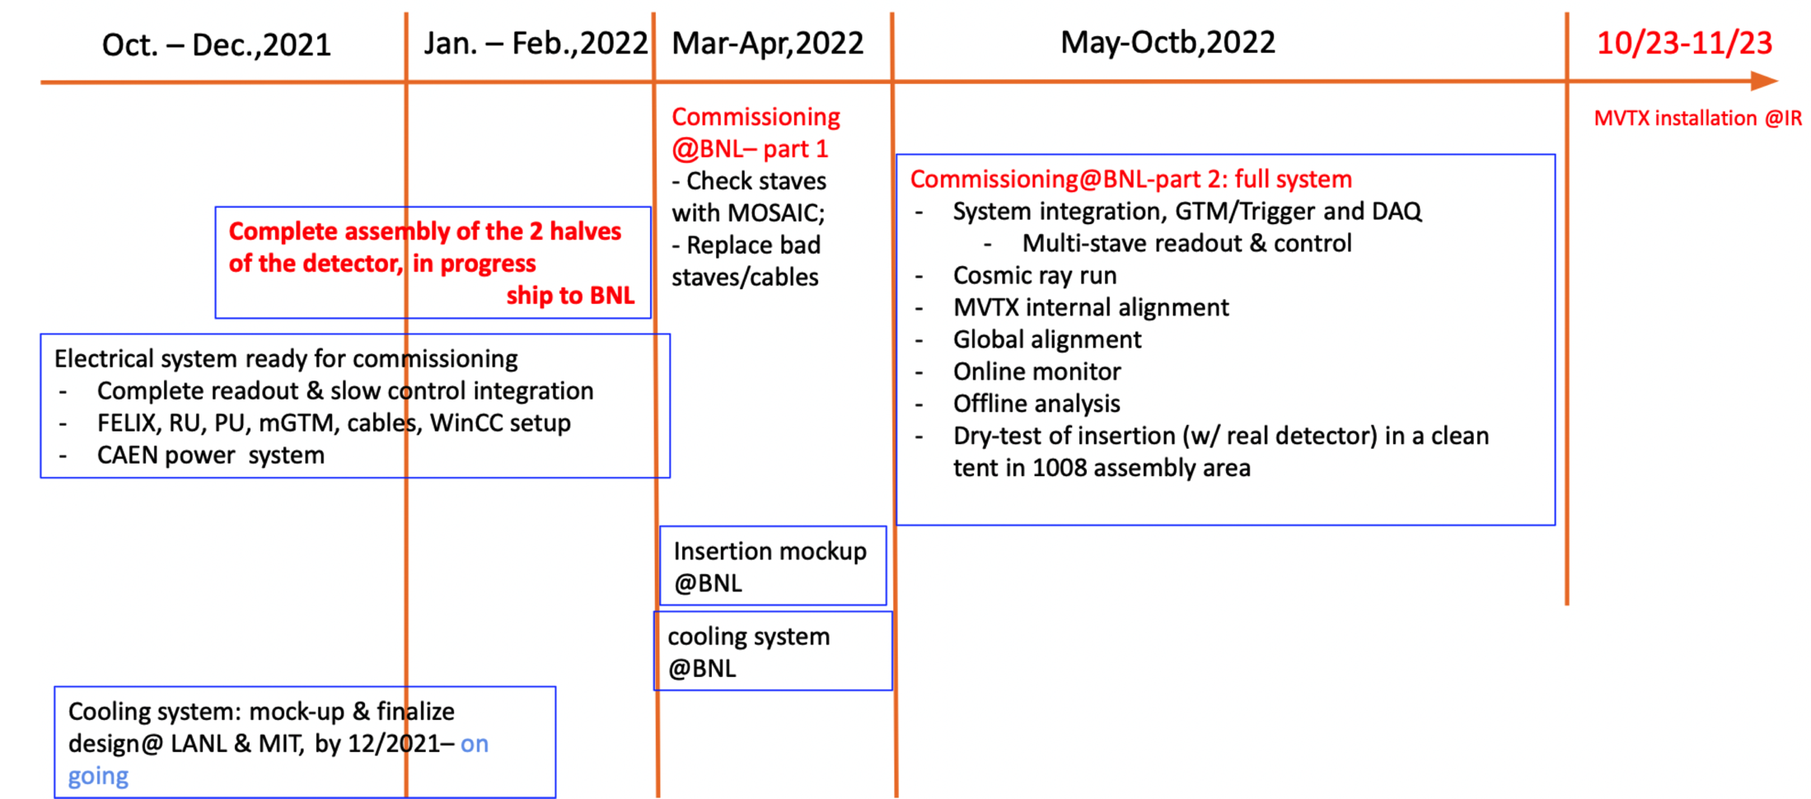
MVTX Status and Timeline

Slide 9
Summary
sPHENIX installation is proceeding well.
The 20/32 OHCal sectors installed on the detector carriage is proceeding well.
Completion of OHCal installation is projected for first week in March. Preparation for IHCal barrel build has started.
Most detector components complete.(OHCAL, IHCal, EMCal blocks, TPC electronics, Calorimeter on-detector electronics, DAQ/Trigger network/servers
Many major 1008 I&F parts are complete or on order.
We have a small but important subset of I&F orders to place including: Magnet mapping contract w/CERN, TPC installation fixtures, MBD/sEPD/beampipe/INTT bracketry, maintenance/access/chiller platforms, HVAC upgrade, fiber optic trunk lines.
Remaining engineering design continues at a fast pace with a large team of engineers and designers.
We have been successful in borrowing technicians and engineers from other parts of BNL: CAD, IO, SMD, NSLSII
Need to maintain this level of technical support until the start of RHIC run 2023.
sPHENIX Collaborators continue to make critical contributions in the factories and home institutions.

Slide 10
Back Up

Slide 11
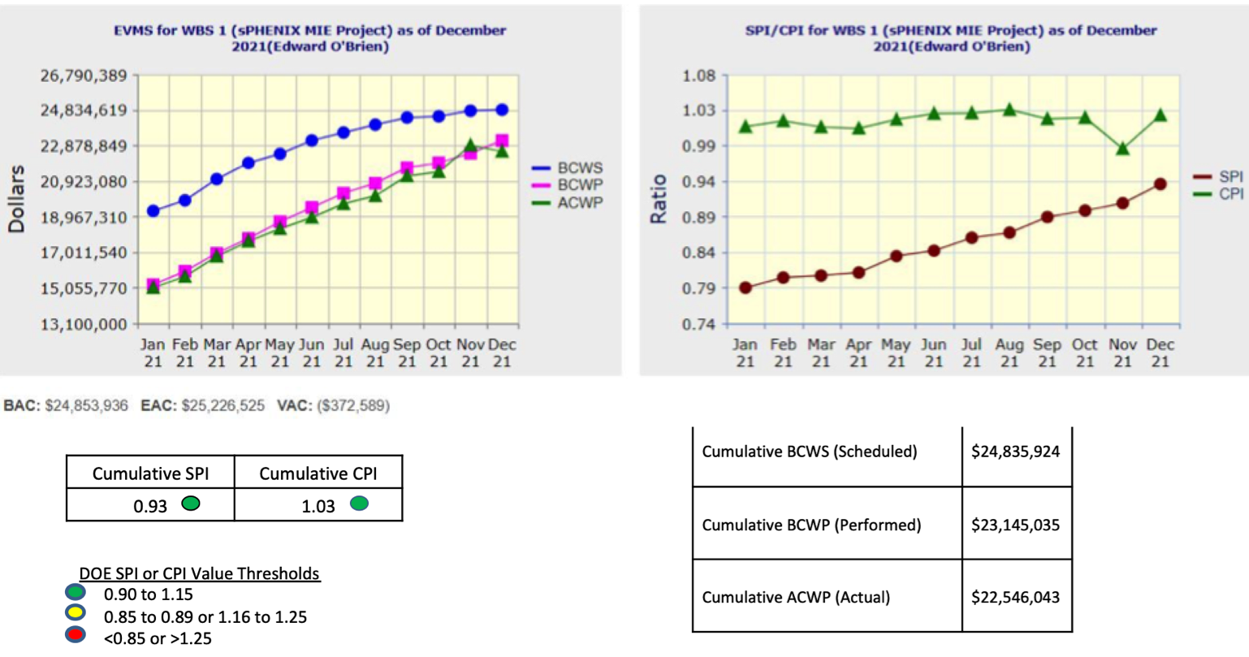
Performance Indices – sPHENIX MIE

Slide 12
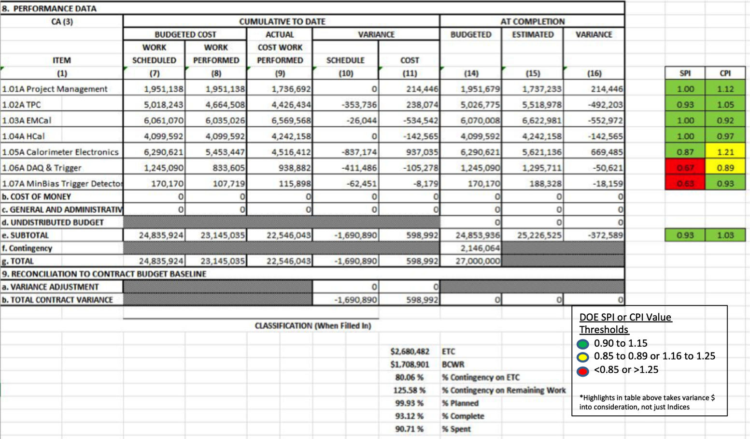
Cost Performance Report December 2021

Slide 13
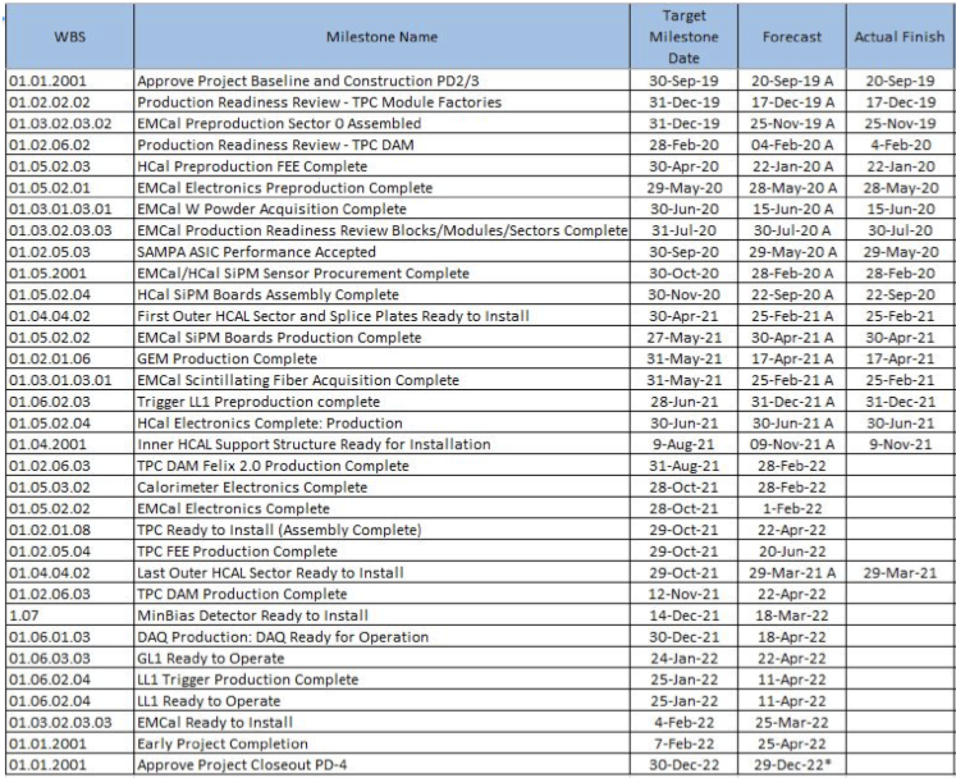
Milestones Status – sPHENIX MIE

Slide 14
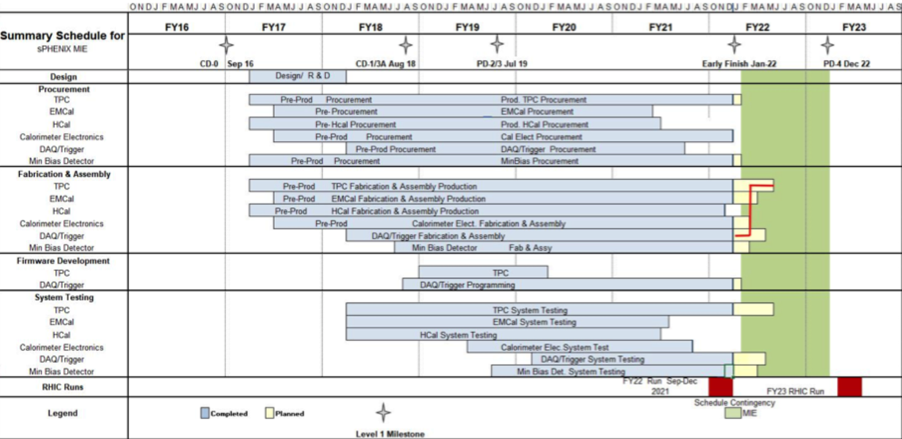
Summary Schedule – sPHENIX MIE
Apr-22

Slide 15
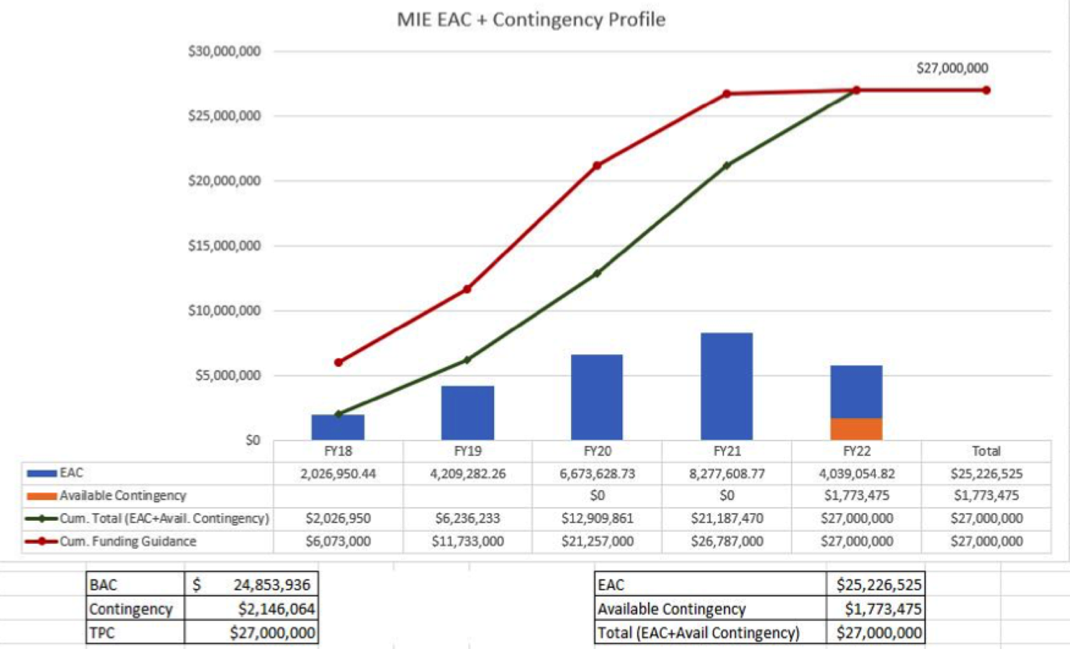
EAC and Contingency Profile – sPHENIX MIE

Slide 16
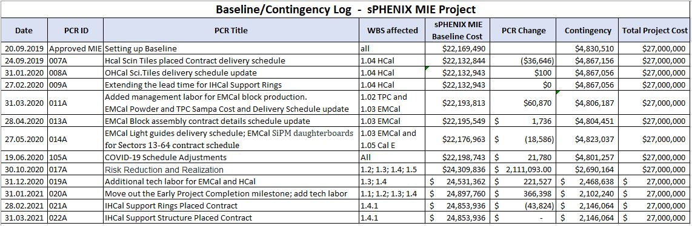
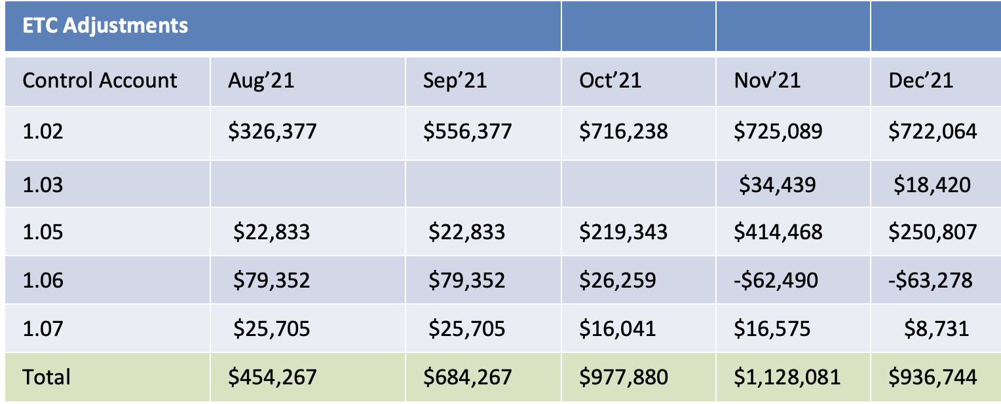
Baseline/Contingency Log and ETC adjustment Log - MIE

Slide 17
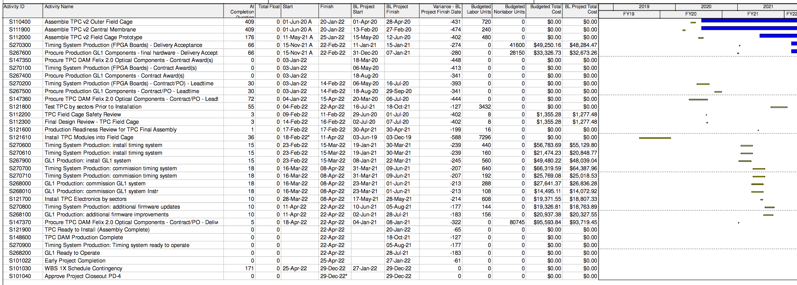
Critical Path – December 2021

Slide 18
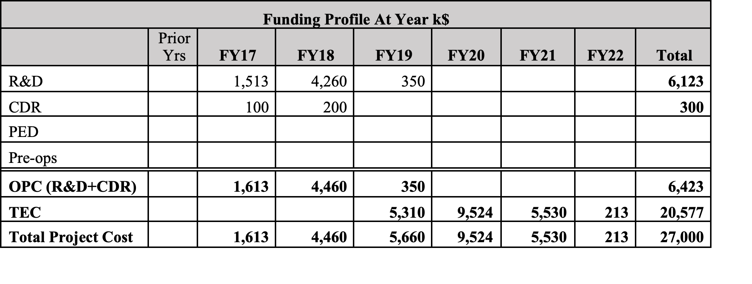
Budget Profile
All MIE funds now received

Slide 19
MIE Variance Report
sPHENIX MIE Project (Edward O'Brien [18368]) Report prepared by Irina Sourikova
Reporting Period: 12/1/2021 - 12/31/2021
December 2021
Cumulative BCWS $24,835,924
Cumulative BCWP $23,145,035
Cumulative ACWP $22,546,042
SV = -$1,690,890
CV = +$598,992 SPI = 0.9319
CPI = 1.0266
The following report discusses the major sources of schedule variance, including all items comprising 1% of the total schedule variance, plus a few select other items, and discusses the impact as well as the corrective actions taken. The analysis is done at level 3 of the Work Breakdown Structure.

Slide 20
MIE Variance Report - TPC
WBS 1.2.1 TPC Mechanics
Description – None. The activity, S120100 Production of GEM foils, which has had prior SV, is now complete.
Impact – None.
Corrective – None. The order is complete.
WBS 1.2.2 TPC GEM Modules R1
Description – Two activities were delayed by late arrival of TPC R1 padplanes. These are S125500 TPC R1 modules build, with SV = -$18,320 and S125600 TPC R1 Modules test, with SV = -$18,320. The total SV resulting is -$36,641. The R1 padplane, the smallest of the three types, were all delivered last month.
Impact – None as yet. The rest of R1 module construction is proceeding. Pad planes are to be attached to the modules as a late step in the module assembly sequence. Positive float remains. Corrective – The R1 pad planes have been delivered. The two above activities are now proceeding and will not impede overall TPC construction.
WBS 1.2.5 TPC Front End Electronics. Description – There are six activities with significant SV. They are:
activity S136500 TPC FEE Cooling System, SV = -$57,393,
activity S141500 TPC FEE Production components (optical transceivers), SV =-$22,999,
activity S141800 TPC FEE Production Components, SV = -$46,432
activity S142500 TPC FEE Low Voltage Power system, SV = -$123,533,
activity S143200 TPC FEE Production boards and assembly, SV = -$175,244,
and
activity S143250, TPC FEE components, SV = -$116,301.
The net SV is -$541,901.
Impact – None as yet.
Corrective – All the items covered by these activities are being ordered, with one exception, the optical transceivers. The manufacturer announced in February that it is replacing this part with a newer and less expensive version; the new variant will have to be the one purchased by sPHENIX and thus also will need to be tested in magnetic field, although no issues are expected based on technical input from the manufacturer. The required design and procurement reviews are complete. The cooling system requires a series of machined parts, for which the procurement is placed, and manufacturing is ongoing. The TPC FEE production components are on order and around 80% in hand. The TPC FEE Low Voltage power supplies are under contract and partially delivered, with the vendor scheduling all remaining deliveries over the next month. The TPC production board and assembly procurement is progressing, with a vendor identified. The TPC FEE components, mostly the quad transceivers, will be ordered later in the spring because they are added to the assembled boards by hand after the automatic board assembly is complete, thus their delivery schedule does not impede that for the boards.
WBS 1.2.1 TPC Mechanics
Description – None.
Impact – None.
Corrective – None.
WBS 1.2.2 TPC GEM Modules R1
WBS 1.2.3 TPC GEM Modules R2
WBS 1.2.4 TPC GEM Modules R3
Description – None.
Impact – None.
Corrective – None.

Slide 21
MIE Variance Report -TPC
WBS 1.2.1 TPC Mechanics
Description – None. The activity, S120100 Production of GEM foils, which has had prior SV, is now complete.
Impact – None.
Corrective – None. The order is complete.
WBS 1.2.2 TPC GEM Modules R1
Description – Two activities were delayed by late arrival of TPC R1 padplanes. These are S125500 TPC R1 modules build, with SV = -$18,320 and S125600 TPC R1 Modules test, with SV = -$18,320. The total SV resulting is -$36,641. The R1 padplane, the smallest of the three types, were all delivered last month.
Impact – None as yet. The rest of R1 module construction is proceeding. Pad planes are to be attached to the modules as a late step in the module assembly sequence. Positive float remains. Corrective – The R1 pad planes have been delivered. The two above activities are now proceeding and will not impede overall TPC construction.
WBS 1.2.5 TPC Front End Electronics. Description – There are six activities with significant SV. They are:
activity S136500 TPC FEE Cooling System, SV = -$57,393,
activity S141500 TPC FEE Production components (optical transceivers), SV =-$22,999,
activity S141800 TPC FEE Production Components, SV = -$46,432
activity S142500 TPC FEE Low Voltage Power system, SV = -$123,533,
activity S143200 TPC FEE Production boards and assembly, SV = -$175,244,
and
activity S143250, TPC FEE components, SV = -$116,301.
The net SV is -$541,901.
Impact – None as yet.
Corrective – All the items covered by these activities are being ordered, with one exception, the optical transceivers. The manufacturer announced in February that it is replacing this part with a newer and less expensive version; the new variant will have to be the one purchased by sPHENIX and thus also will need to be tested in magnetic field, although no issues are expected based on technical input from the manufacturer. The required design and procurement reviews are complete. The cooling system requires a series of machined parts, for which the procurement is placed, and manufacturing is ongoing. The TPC FEE production components are on order and around 80% in hand. The TPC FEE Low Voltage power supplies are under contract and partially delivered, with the vendor scheduling all remaining deliveries over the next month. The TPC production board and assembly procurement is progressing, with a vendor identified. The TPC FEE components, mostly the quad transceivers, will be ordered later in the spring because they are added to the assembled boards by hand after the automatic board assembly is complete, thus their delivery schedule does not impede that for the boards.
WBS 1.2.5 TPC Front End Electronics. Description – There are three activities with significant SV. They are:
activity S141800 TPC FEE Production Components, SV = -$9,286,
activity S142500 TPC FEE Low Voltage Power system, SV = -$30,883, and
activity S143200 TPC FEE Production boards and assembly, SV = -$12,267.
The net SV is -$52,436, which is a 74% improvement over last month.
Impact – None as yet.
Corrective – All the items covered by these activities are on order. The TPC FEE production components are on order and around 97% in hand; a specific timing crystal remains to be acquired but is on allocation and may require several months to obtain in bulk. Sample crystals each operating at a different frequency have been evaluated to see if the board can use a frequency for which an adequate supply of crystals can be obtained quickly. Fortunately, this is a simple 6-pad part that could be added later to otherwise assembled boards. The TPC FEE Low Voltage power supplies are delivered, with the remaining work being procurement of conductor wire and connectors and the fabrication of the cable assemblies for the LV system, all of which are on order. The series production for the TPC boards started in November at the vendor. A first major delivery occurred in early December. About 7% of the TPC boards remain to be delivered.

Slide 22
MIE Variance Report - TPC
WBS 1.2.1 TPC Mechanics
Description – None. The activity, S120100 Production of GEM foils, which has had prior SV, is now complete.
Impact – None.
Corrective – None. The order is complete.
WBS 1.2.2 TPC GEM Modules R1
Description – Two activities were delayed by late arrival of TPC R1 padplanes. These are S125500 TPC R1 modules build, with SV = -$18,320 and S125600 TPC R1 Modules test, with SV = -$18,320. The total SV resulting is -$36,641. The R1 padplane, the smallest of the three types, were all delivered last month.
Impact – None as yet. The rest of R1 module construction is proceeding. Pad planes are to be attached to the modules as a late step in the module assembly sequence. Positive float remains. Corrective – The R1 pad planes have been delivered. The two above activities are now proceeding and will not impede overall TPC construction.
WBS 1.2.5 TPC Front End Electronics. Description – There are six activities with significant SV. They are:
activity S136500 TPC FEE Cooling System, SV = -$57,393,
activity S141500 TPC FEE Production components (optical transceivers), SV =-$22,999,
activity S141800 TPC FEE Production Components, SV = -$46,432
activity S142500 TPC FEE Low Voltage Power system, SV = -$123,533,
activity S143200 TPC FEE Production boards and assembly, SV = -$175,244,
and
activity S143250, TPC FEE components, SV = -$116,301.
The net SV is -$541,901.
Impact – None as yet.
Corrective – All the items covered by these activities are being ordered, with one exception, the optical transceivers. The manufacturer announced in February that it is replacing this part with a newer and less expensive version; the new variant will have to be the one purchased by sPHENIX and thus also will need to be tested in magnetic field, although no issues are expected based on technical input from the manufacturer. The required design and procurement reviews are complete. The cooling system requires a series of machined parts, for which the procurement is placed, and manufacturing is ongoing. The TPC FEE production components are on order and around 80% in hand. The TPC FEE Low Voltage power supplies are under contract and partially delivered, with the vendor scheduling all remaining deliveries over the next month. The TPC production board and assembly procurement is progressing, with a vendor identified. The TPC FEE components, mostly the quad transceivers, will be ordered later in the spring because they are added to the assembled boards by hand after the automatic board assembly is complete, thus their delivery schedule does not impede that for the boards.
WBS 1.2.6 TPC Data Aggregator Modules
Description – One activity contributes to the SV:
activity S147370 FELIX 2.0 board optical components, SV =-$93,719.
Impact – None
Corrective – The FELIX optical components are fiber optics and specialized connectors to group and route signals from the TPC FEE cards (WBS 1.2.5) to the FELIX boards. The topology of these connectors must accommodate a board used to reprogram the FEE cards in case of radiation-induced single event upsets (SEUs); this board’s architecture was determined at the beginning of March and the board’s layout is now complete. The fiber topology was updated, the bill of materials for the fiber optic components was revised, and submissions started to Procurement in April. This production will require first articles be built and tested prior to releasing the full production. A first article arrived at the beginning of August and is being tested. This is a harness of multiple fiber optic cables of over 50m length because it must reach from the Interaction Region to the Rack Room. This length has been checked as part of the acceptance of this first article. Proper operation of a FEE card and a FELIX card connected by this first article cable harness is now being checked.

Slide 23
MIE Variance Report - TPC
WBS 1.2.1 TPC Mechanics
Description – None. The activity, S120100 Production of GEM foils, which has had prior SV, is now complete.
Impact – None.
Corrective – None. The order is complete.
WBS 1.2.2 TPC GEM Modules R1
Description – Two activities were delayed by late arrival of TPC R1 padplanes. These are S125500 TPC R1 modules build, with SV = -$18,320 and S125600 TPC R1 Modules test, with SV = -$18,320. The total SV resulting is -$36,641. The R1 padplane, the smallest of the three types, were all delivered last month.
Impact – None as yet. The rest of R1 module construction is proceeding. Pad planes are to be attached to the modules as a late step in the module assembly sequence. Positive float remains. Corrective – The R1 pad planes have been delivered. The two above activities are now proceeding and will not impede overall TPC construction.
WBS 1.2.5 TPC Front End Electronics. Description – There are six activities with significant SV. They are:
activity S136500 TPC FEE Cooling System, SV = -$57,393,
activity S141500 TPC FEE Production components (optical transceivers), SV =-$22,999,
activity S141800 TPC FEE Production Components, SV = -$46,432
activity S142500 TPC FEE Low Voltage Power system, SV = -$123,533,
activity S143200 TPC FEE Production boards and assembly, SV = -$175,244,
and
activity S143250, TPC FEE components, SV = -$116,301.
The net SV is -$541,901.
Impact – None as yet.
Corrective – All the items covered by these activities are being ordered, with one exception, the optical transceivers. The manufacturer announced in February that it is replacing this part with a newer and less expensive version; the new variant will have to be the one purchased by sPHENIX and thus also will need to be tested in magnetic field, although no issues are expected based on technical input from the manufacturer. The required design and procurement reviews are complete. The cooling system requires a series of machined parts, for which the procurement is placed, and manufacturing is ongoing. The TPC FEE production components are on order and around 80% in hand. The TPC FEE Low Voltage power supplies are under contract and partially delivered, with the vendor scheduling all remaining deliveries over the next month. The TPC production board and assembly procurement is progressing, with a vendor identified. The TPC FEE components, mostly the quad transceivers, will be ordered later in the spring because they are added to the assembled boards by hand after the automatic board assembly is complete, thus their delivery schedule does not impede that for the boards.
WBS 1.2.7 TPC Support Systems
Description – There are two areas of effort. The TPC Lasers delivery has started but only the line lasers have been delivered, with the diffuse lasers remaining on order, SV =-$158,058. The TPC Gas System has procured and received some 60% of the components but still needs to place requisitions for the balance, SV =-$36,406.
The total SV for these key items is -$194,464.
Impact – These are all items being procured ahead of their needed installation to allow for more time to test them on the bench and adjust settings.
Corrective – The Final Design Reviews are complete. The Procurement Readiness Reviews for the lasers and gas systems are complete. A contract for the six Diffuse Lasers was awarded in September. The delivery schedule for these six units will stretch into summer 2022, with one unit expected to be delivered every 2 months. Procurements for remaining items are being submitted.

Slide 24
MIE Variance Report - EMCal
WBS 1.2.1 TPC Mechanics
Description – None. The activity, S120100 Production of GEM foils, which has had prior SV, is now complete.
Impact – None.
Corrective – None. The order is complete.
WBS 1.2.2 TPC GEM Modules R1
Description – Two activities were delayed by late arrival of TPC R1 padplanes. These are S125500 TPC R1 modules build, with SV = -$18,320 and S125600 TPC R1 Modules test, with SV = -$18,320. The total SV resulting is -$36,641. The R1 padplane, the smallest of the three types, were all delivered last month.
Impact – None as yet. The rest of R1 module construction is proceeding. Pad planes are to be attached to the modules as a late step in the module assembly sequence. Positive float remains. Corrective – The R1 pad planes have been delivered. The two above activities are now proceeding and will not impede overall TPC construction.
WBS 1.2.5 TPC Front End Electronics. Description – There are six activities with significant SV. They are:
activity S136500 TPC FEE Cooling System, SV = -$57,393,
activity S141500 TPC FEE Production components (optical transceivers), SV =-$22,999,
activity S141800 TPC FEE Production Components, SV = -$46,432
activity S142500 TPC FEE Low Voltage Power system, SV = -$123,533,
activity S143200 TPC FEE Production boards and assembly, SV = -$175,244,
and
activity S143250, TPC FEE components, SV = -$116,301.
The net SV is -$541,901.
Impact – None as yet.
Corrective – All the items covered by these activities are being ordered, with one exception, the optical transceivers. The manufacturer announced in February that it is replacing this part with a newer and less expensive version; the new variant will have to be the one purchased by sPHENIX and thus also will need to be tested in magnetic field, although no issues are expected based on technical input from the manufacturer. The required design and procurement reviews are complete. The cooling system requires a series of machined parts, for which the procurement is placed, and manufacturing is ongoing. The TPC FEE production components are on order and around 80% in hand. The TPC FEE Low Voltage power supplies are under contract and partially delivered, with the vendor scheduling all remaining deliveries over the next month. The TPC production board and assembly procurement is progressing, with a vendor identified. The TPC FEE components, mostly the quad transceivers, will be ordered later in the spring because they are added to the assembled boards by hand after the automatic board assembly is complete, thus their delivery schedule does not impede that for the boards.
WBS 1.3.1 EMCal Blocks
Description – This work is now complete and thus removed from the critical path for the MIE.
Impact – None.
Corrective – None.
WBS 1.3.2 EMCal Modules and Sectors
Description – The S196910 Technical Support Labor for EMCal Assembly is not complete, SV = -$25,520.
Impact – None. The EMCal sector production remains near the critical path for the MIE.
Corrective – Labor to complete sectors remains a key aspect of holding the critical path schedule. Recent retirement of a technician has slowed the rate of sector production to the point that completion of the EMCal sectors only by late March 2022 appears now likely. A request to hire a replacement technician is being processed, and two technicians have been loaned to us by other groups at BNL These latter two technicians are at work and handling several mechanical tasks in sector assembly.

Slide 25
MIE Variance Report – Cal Electronics
WBS 1.5.2 Calorimeter Front End Electronics
Description – Three separate activities contribute substantially to this SV. All consist of cable orders. The electronics board orders are all complete. The activities are:
activity S233200 EMCal external cables are only 90% complete, SV = -$20,585,
activity S233250 EMCal trunk signal cables are only 20% complete, SV = -$622,275, and
activity S244400 HCal External cables are only 90% complete, SV = -$10,194. The total SV for these activities is -$653,054, a 26% improvement over last month driven by the start of delivery of the trunk signal cables.
Impact – None.
Correctives – The remaining cables are catalog items built to order to a custom length. The largest of the procurements for these were finally placed the first week of August. These remaining cables are all for installation external to the calorimeters and thus do not impact the progress in the rest of the MIE project. The vendor began delivery in December.

Slide 26
MIE Variance Report – Cal Electronics
WBS 1.2.1 TPC Mechanics
Description – None. The activity, S120100 Production of GEM foils, which has had prior SV, is now complete.
Impact – None.
Corrective – None. The order is complete.
WBS 1.2.2 TPC GEM Modules R1
Description – Two activities were delayed by late arrival of TPC R1 padplanes. These are S125500 TPC R1 modules build, with SV = -$18,320 and S125600 TPC R1 Modules test, with SV = -$18,320. The total SV resulting is -$36,641. The R1 padplane, the smallest of the three types, were all delivered last month.
Impact – None as yet. The rest of R1 module construction is proceeding. Pad planes are to be attached to the modules as a late step in the module assembly sequence. Positive float remains. Corrective – The R1 pad planes have been delivered. The two above activities are now proceeding and will not impede overall TPC construction.
WBS 1.2.5 TPC Front End Electronics. Description – There are six activities with significant SV. They are:
activity S136500 TPC FEE Cooling System, SV = -$57,393,
activity S141500 TPC FEE Production components (optical transceivers), SV =-$22,999,
activity S141800 TPC FEE Production Components, SV = -$46,432
activity S142500 TPC FEE Low Voltage Power system, SV = -$123,533,
activity S143200 TPC FEE Production boards and assembly, SV = -$175,244,
and
activity S143250, TPC FEE components, SV = -$116,301.
The net SV is -$541,901.
Impact – None as yet.
Corrective – All the items covered by these activities are being ordered, with one exception, the optical transceivers. The manufacturer announced in February that it is replacing this part with a newer and less expensive version; the new variant will have to be the one purchased by sPHENIX and thus also will need to be tested in magnetic field, although no issues are expected based on technical input from the manufacturer. The required design and procurement reviews are complete. The cooling system requires a series of machined parts, for which the procurement is placed, and manufacturing is ongoing. The TPC FEE production components are on order and around 80% in hand. The TPC FEE Low Voltage power supplies are under contract and partially delivered, with the vendor scheduling all remaining deliveries over the next month. The TPC production board and assembly procurement is progressing, with a vendor identified. The TPC FEE components, mostly the quad transceivers, will be ordered later in the spring because they are added to the assembled boards by hand after the automatic board assembly is complete, thus their delivery schedule does not impede that for the boards.
WBS 1.5.3 Calorimeter Digitizers
Description – There are two activities contributing to this SV. They are:
activity S252700 Digitizer Parts, now 95% complete, SV = -$33,927, and
activity S252900 Digitizer Assembly, now 35% complete, SV = -$150,193,
for a total SV = -$184,120, a 28% improvement from last month’s SV. Impact – None presently. The EMCal and OHCal sector production lines have an adequate number of digitizers to perform all needed QA during remaining detector construction. Therefore, the remaining digitizers are only needed by the completion of the MIE project.
Corrective – The contract for the production digitizers is placed. The vendor indicates they have placed orders for production quantities of all parts but that world-wide supply chains have led to more lead time than foreseen pre-COVID. Supply chains for electronics parts continue to experience 6-9 months delays in parts availability. Parts arrivals have now reached 95% of required deliveries. The parts vendors used by the digitizer vendor now have accepted all remaining parts orders. Board orders are complete. Full assembly kits have been delivered to electronics assembly houses for three of the seven required board types and some 35% of the board assemblies have been completed.

Slide 27
MIE Variance Report – DAQ/Trigger
WBS 1.2.1 TPC Mechanics
Description – None. The activity, S120100 Production of GEM foils, which has had prior SV, is now complete.
Impact – None.
Corrective – None. The order is complete.
WBS 1.2.2 TPC GEM Modules R1
Description – Two activities were delayed by late arrival of TPC R1 padplanes. These are S125500 TPC R1 modules build, with SV = -$18,320 and S125600 TPC R1 Modules test, with SV = -$18,320. The total SV resulting is -$36,641. The R1 padplane, the smallest of the three types, were all delivered last month.
Impact – None as yet. The rest of R1 module construction is proceeding. Pad planes are to be attached to the modules as a late step in the module assembly sequence. Positive float remains. Corrective – The R1 pad planes have been delivered. The two above activities are now proceeding and will not impede overall TPC construction.
WBS 1.2.5 TPC Front End Electronics. Description – There are six activities with significant SV. They are:
activity S136500 TPC FEE Cooling System, SV = -$57,393,
activity S141500 TPC FEE Production components (optical transceivers), SV =-$22,999,
activity S141800 TPC FEE Production Components, SV = -$46,432
activity S142500 TPC FEE Low Voltage Power system, SV = -$123,533,
activity S143200 TPC FEE Production boards and assembly, SV = -$175,244,
and
activity S143250, TPC FEE components, SV = -$116,301.
The net SV is -$541,901.
Impact – None as yet.
Corrective – All the items covered by these activities are being ordered, with one exception, the optical transceivers. The manufacturer announced in February that it is replacing this part with a newer and less expensive version; the new variant will have to be the one purchased by sPHENIX and thus also will need to be tested in magnetic field, although no issues are expected based on technical input from the manufacturer. The required design and procurement reviews are complete. The cooling system requires a series of machined parts, for which the procurement is placed, and manufacturing is ongoing. The TPC FEE production components are on order and around 80% in hand. The TPC FEE Low Voltage power supplies are under contract and partially delivered, with the vendor scheduling all remaining deliveries over the next month. The TPC production board and assembly procurement is progressing, with a vendor identified. The TPC FEE components, mostly the quad transceivers, will be ordered later in the spring because they are added to the assembled boards by hand after the automatic board assembly is complete, thus their delivery schedule does not impede that for the boards.
WBS 1.6.1 Data Acquisition
Description – Three activities contributed to this SV, including:
activity S255900 Production Boards not complete, SV = -$121,503,
activity S256700 Crates not complete, SV = -$74,284,
and
activity S258700 jSEB Slow Control Boards not complete, SV = -$19,181,
for a total SV = -$214,968.
Impact – None. These items do not affect the production schedule for any other MIE items.
Corrective – The contract has been placed with the vendor for the final items. The vendor is now ordering parts and PCBs for this effort. These activities construct more of existing designs from the PHENIX experiment thus need no development or preproduction cycle.
WBS 1.6.2 Local Level-1 Trigger
Description – Activity S264900 Production LL1 trigger is not complete, SV = -$135,800.
Impact – None
Corrective – The production manufacture is still expected to start in February 2022 based on the existing board assembly house and Bill of Materials. That production will complete this level-3 WBS. The contract with the vendor was finally placed in August. There is now some concern about electronics parts availability to complete this order by the Early Finish date. A review of the prototype is set for January.

Slide 28
MIE Variance Report – DAQ/Trigger
WBS 1.2.1 TPC Mechanics
Description – None. The activity, S120100 Production of GEM foils, which has had prior SV, is now complete.
Impact – None.
Corrective – None. The order is complete.
WBS 1.2.2 TPC GEM Modules R1
Description – Two activities were delayed by late arrival of TPC R1 padplanes. These are S125500 TPC R1 modules build, with SV = -$18,320 and S125600 TPC R1 Modules test, with SV = -$18,320. The total SV resulting is -$36,641. The R1 padplane, the smallest of the three types, were all delivered last month.
Impact – None as yet. The rest of R1 module construction is proceeding. Pad planes are to be attached to the modules as a late step in the module assembly sequence. Positive float remains. Corrective – The R1 pad planes have been delivered. The two above activities are now proceeding and will not impede overall TPC construction.
WBS 1.2.5 TPC Front End Electronics. Description – There are six activities with significant SV. They are:
activity S136500 TPC FEE Cooling System, SV = -$57,393,
activity S141500 TPC FEE Production components (optical transceivers), SV =-$22,999,
activity S141800 TPC FEE Production Components, SV = -$46,432
activity S142500 TPC FEE Low Voltage Power system, SV = -$123,533,
activity S143200 TPC FEE Production boards and assembly, SV = -$175,244,
and
activity S143250, TPC FEE components, SV = -$116,301.
The net SV is -$541,901.
Impact – None as yet.
Corrective – All the items covered by these activities are being ordered, with one exception, the optical transceivers. The manufacturer announced in February that it is replacing this part with a newer and less expensive version; the new variant will have to be the one purchased by sPHENIX and thus also will need to be tested in magnetic field, although no issues are expected based on technical input from the manufacturer. The required design and procurement reviews are complete. The cooling system requires a series of machined parts, for which the procurement is placed, and manufacturing is ongoing. The TPC FEE production components are on order and around 80% in hand. The TPC FEE Low Voltage power supplies are under contract and partially delivered, with the vendor scheduling all remaining deliveries over the next month. The TPC production board and assembly procurement is progressing, with a vendor identified. The TPC FEE components, mostly the quad transceivers, will be ordered later in the spring because they are added to the assembled boards by hand after the automatic board assembly is complete, thus their delivery schedule does not impede that for the boards.
WBS 1.6.3 Global Level-1 Trigger
Description – Activity S267600 Production of final GL1 is not complete, SV =-$24,505.
Impact – None
Corrective – The prototype Global Level-1 Trigger is being used as part of an extended test of electronics for sPHENIX. This test requires multiple front-end cards to operate, respond to triggers and timing signals, and send data to the production DAQ computers correctly over an extended period. These tests are done. The prototype board is in use with both calorimetry FEE and TPC FEE in the various test setups. The basic real-time board at the core of the Global Level-1 Trigger arrived in November. The design of the Global Level-1 Trigger and also the Timing System (WBS 1.6.4, below) has converged so that the same add-on fanout board can serve both functions. The circuit schematic for the fanout board needed was reviewed in December and approved to proceed to final layout and thence to manufacturing. Parts acquisition has started.
WBS 1.6.4 Timing System
Description – Activity S270300 Production of Timing System is not complete, SV =-$36,213.
Impact – None
Corrective – The prototype Timing System is being used as part of an extended test of electronics for sPHENIX. This test requires multiple front-end cards to operate, respond to triggers and timing signals, and send data to the production DAQ computers correctly over an extended period. These tests are done. The prototype board is in use with both calorimetry FEE and TPC FEE in the various test setups. The basic real-time board at the core of the Timing System arrived in November. The design of the Timing System and also the Global Level-1 Trigger (WBS 1.6.3, above) has converged so that the same add-on fanout board can serve both functions. The circuit schematic for the fanout board needed was reviewed in December and approved to proceed to final layout and thence to manufacturing. Parts acquisition has started.

Slide 29
MIE Variance Report – Min Bias Det
WBS 1.2.1 TPC Mechanics
Description – None. The activity, S120100 Production of GEM foils, which has had prior SV, is now complete.
Impact – None.
Corrective – None. The order is complete.
WBS 1.2.2 TPC GEM Modules R1
Description – Two activities were delayed by late arrival of TPC R1 padplanes. These are S125500 TPC R1 modules build, with SV = -$18,320 and S125600 TPC R1 Modules test, with SV = -$18,320. The total SV resulting is -$36,641. The R1 padplane, the smallest of the three types, were all delivered last month.
Impact – None as yet. The rest of R1 module construction is proceeding. Pad planes are to be attached to the modules as a late step in the module assembly sequence. Positive float remains. Corrective – The R1 pad planes have been delivered. The two above activities are now proceeding and will not impede overall TPC construction.
WBS 1.2.5 TPC Front End Electronics. Description – There are six activities with significant SV. They are:
activity S136500 TPC FEE Cooling System, SV = -$57,393,
activity S141500 TPC FEE Production components (optical transceivers), SV =-$22,999,
activity S141800 TPC FEE Production Components, SV = -$46,432
activity S142500 TPC FEE Low Voltage Power system, SV = -$123,533,
activity S143200 TPC FEE Production boards and assembly, SV = -$175,244,
and
activity S143250, TPC FEE components, SV = -$116,301.
The net SV is -$541,901.
Impact – None as yet.
Corrective – All the items covered by these activities are being ordered, with one exception, the optical transceivers. The manufacturer announced in February that it is replacing this part with a newer and less expensive version; the new variant will have to be the one purchased by sPHENIX and thus also will need to be tested in magnetic field, although no issues are expected based on technical input from the manufacturer. The required design and procurement reviews are complete. The cooling system requires a series of machined parts, for which the procurement is placed, and manufacturing is ongoing. The TPC FEE production components are on order and around 80% in hand. The TPC FEE Low Voltage power supplies are under contract and partially delivered, with the vendor scheduling all remaining deliveries over the next month. The TPC production board and assembly procurement is progressing, with a vendor identified. The TPC FEE components, mostly the quad transceivers, will be ordered later in the spring because they are added to the assembled boards by hand after the automatic board assembly is complete, thus their delivery schedule does not impede that for the boards.
WBS 1.7 Min Bias Trigger Detector
Description – Activity S273500 Min/Bias production digitizers is not complete, SV = -$8,572, and activity S273600 MBD Shaper/Disc Board is not complete, SV = -$53,879, for a total of -$62,451.
Impact – None
Corrective – The digitizers needed for the MBD are part of the larger digitizers order noted above for WBS 1.5.3 A final design review and production readiness review were held for the MBD shaper/discriminator board in February, no required changes were identified, and the board approved for production procurement. This procurement is placed with the vendor who prepared and tested the prototype versions. The all-too-common worldwide electronics procurements delays apply to the MBD also. Completion by December 2021 is still anticipated.

Slide 30
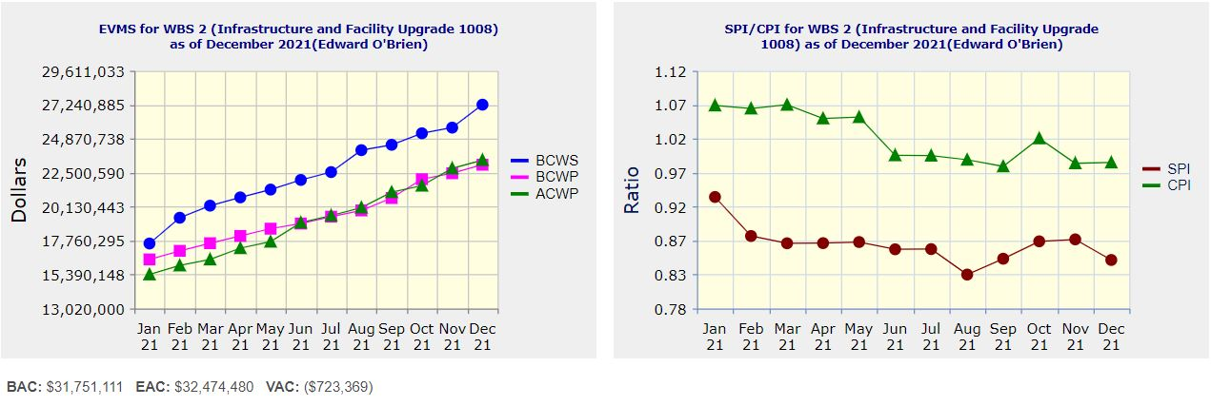
Performance Indices – 1008 Infra and Facility Upgrade
Cumulative SPI | Cumulative CPI
0.85 | 0.99
Cumulative BCWS (Scheduled) | $27,250,195
Cumulative BCWP (Performed) | $23,059,648
Cumulative ACWP (Actual) | $23,383,523
DOE SPI or CPI Value Thresholds
0.90 to 1.15
0.85 to 0.89 or 1.16 to 1.25
<0.85 or >1.25

Slide 31
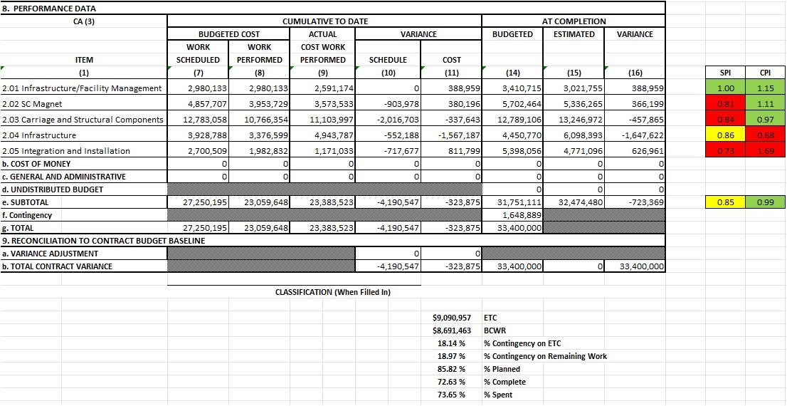
Cost Performance Report (CPR) – 1008 Infra and Facility Upgrade
DOE SPI or CPI Value Thresholds
0.90 to 1.15
0.85 to 0.89 or 1.16 to 1.25
<0.85 or >1.25
*Highlights in table above takes variance $ into consideration, not just Indices

Slide 32
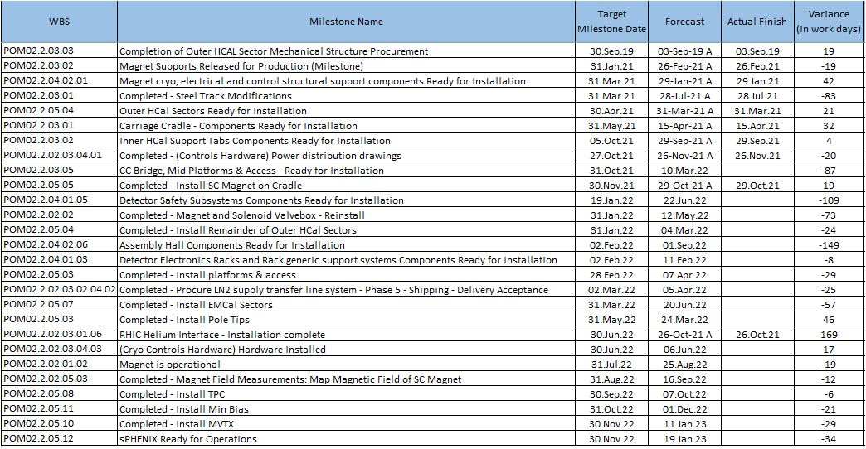
Milestones Status – 1008 Infra and Facility Upgrade

Slide 33
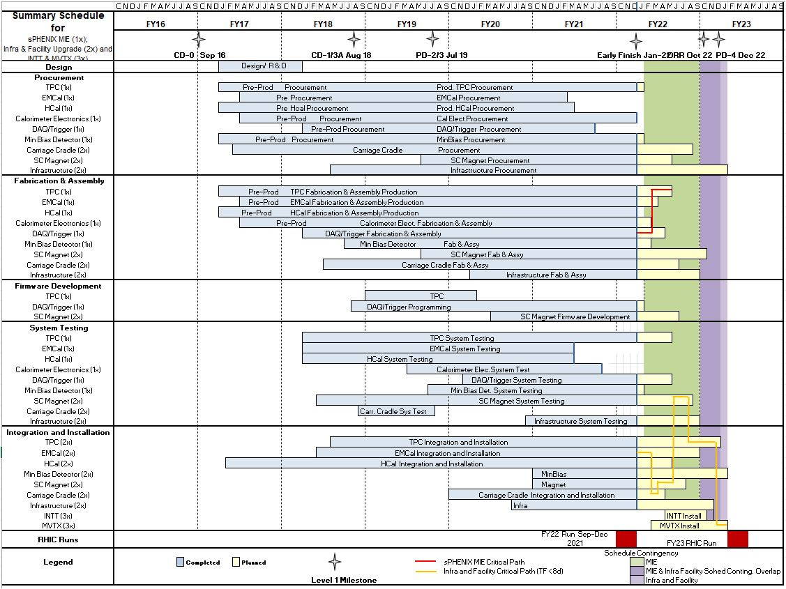
Summary Schedule – sPHENIX MIE and 1008 Infra and Facility Upgrade

Slide 34
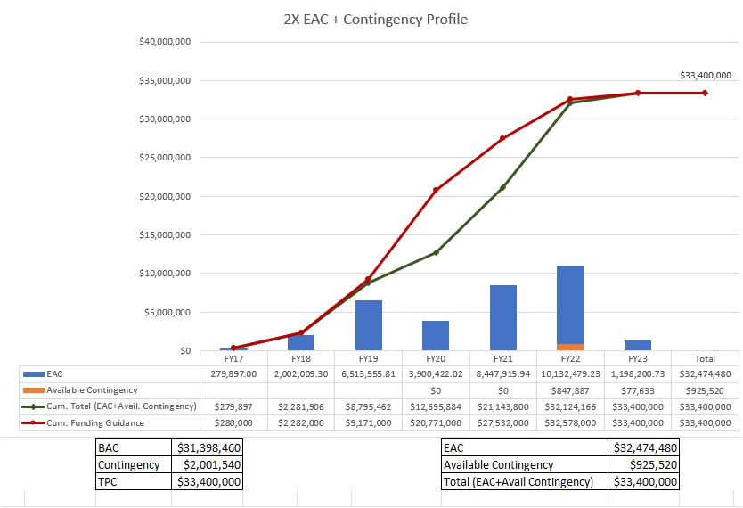
EAC and Contingency Profile – 1008 Infra and Facility Upgrade

Slide 35
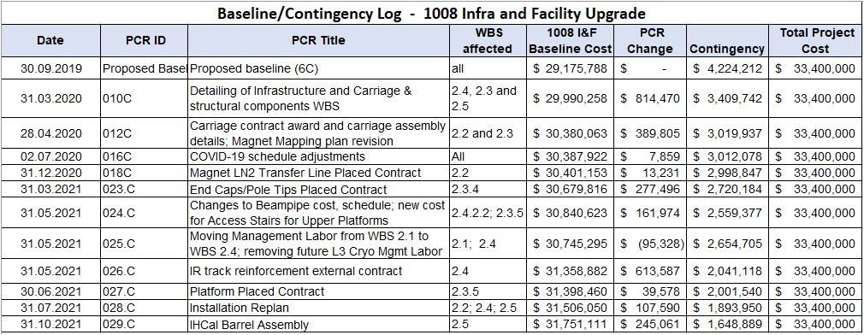
Baseline/Contingency Log and ETC adjustment Log – 2.X
ETC Adjustments
Control Account | Sep’21 | Oct’21 | Nov’21 | Dec’21
2.3 | $90,775 | $70,349 | $125,472 | $102,957
2.4 | $70,160 | $350,388 | $152,069 | $69,283
2.5 | - | $73,413 | $63,117 | $161,496
Total | $160,935 | $494,150 | $340,658 | $333,737

Slide 36
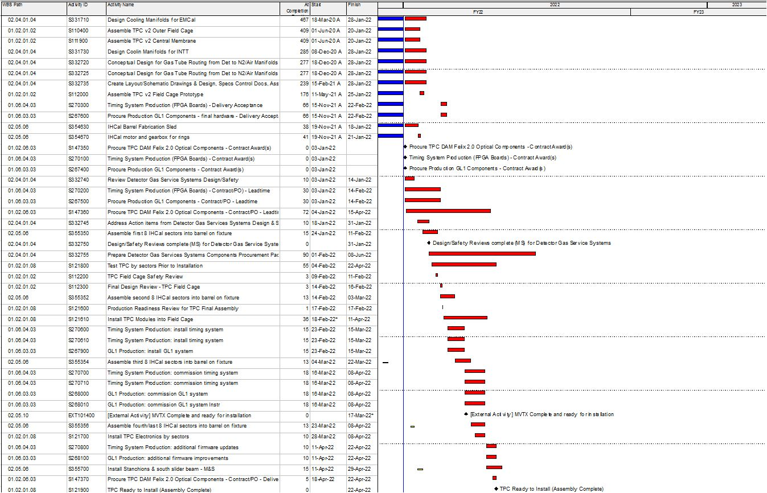
Critical Path (1x, 2x and 3x Combined)

Slide 37
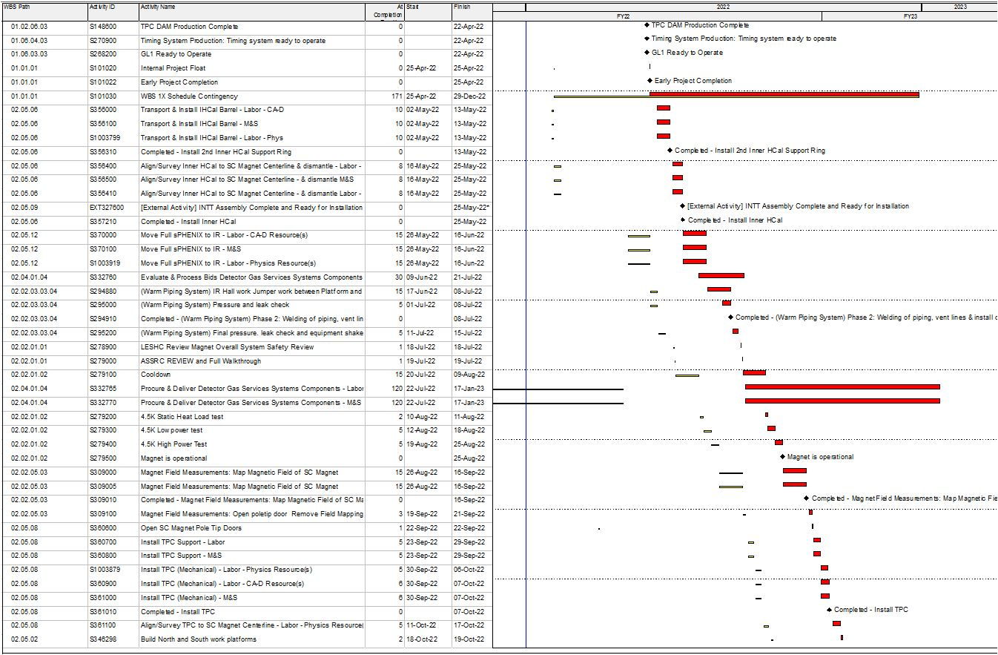
Critical Path (1x, 2x and 3x Combined)

Slide 38
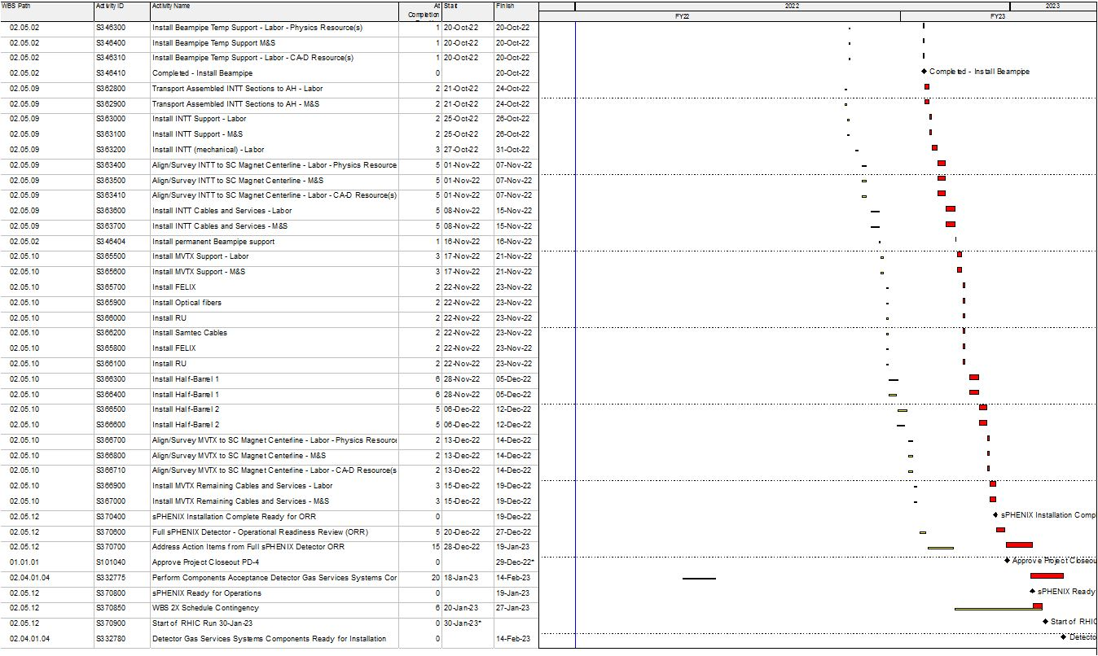
Critical Path (1x, 2x and 3x Combined)

Slide 39
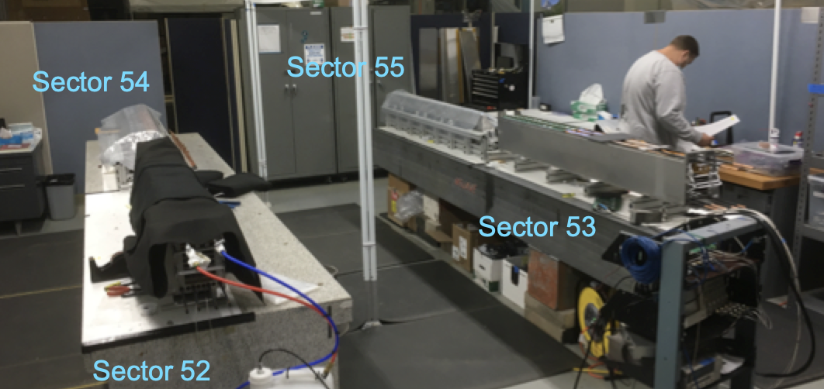
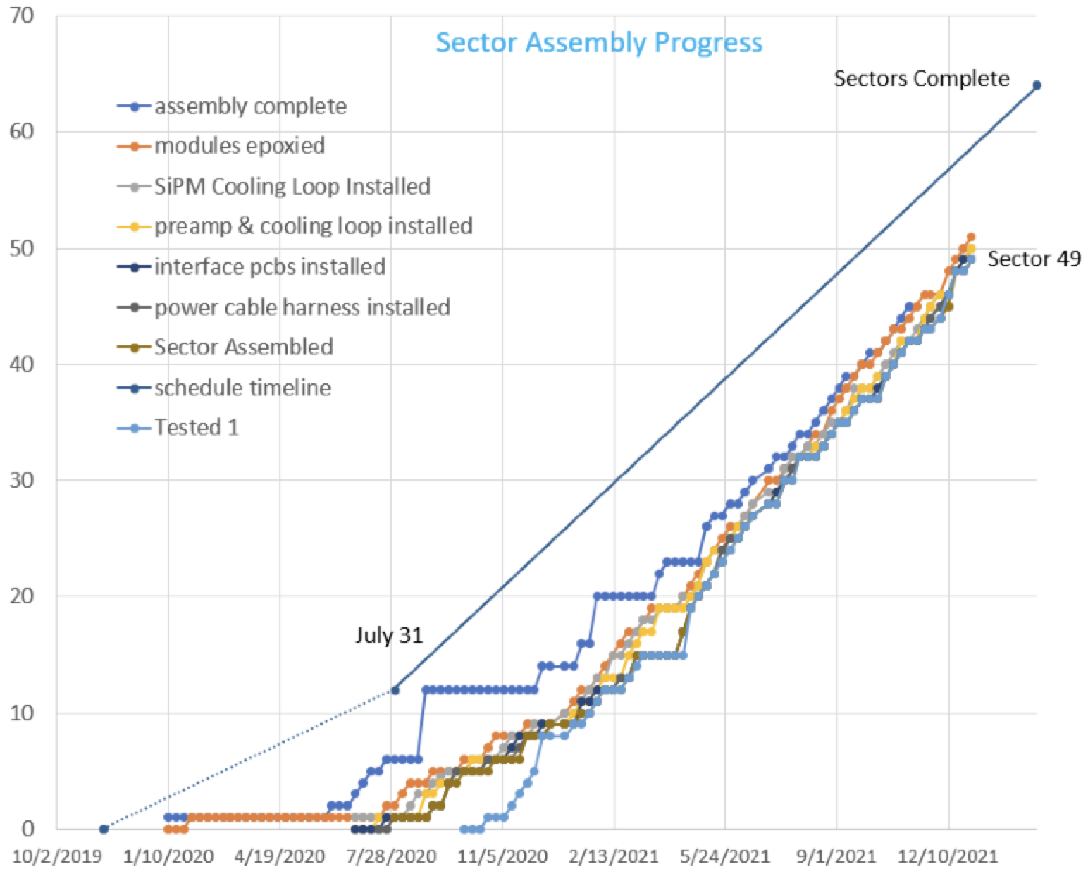
EMCal Sector Assembly 83% Complete as of 1/26/22
Maximum 52 sectors installed in sPHENIX prior to magnet mapping
Sector 32
Sectors 1-53 complete
Sectors 54, 55 being assembled
Modules for Sector 56, 57 being prepared
We have added 3 additional mech techs to the EMCal Sector factory since mid-fall 2021.

