Slide 1
Final Moments. I. Precursor Emission, Envelope Inflation, and Enhanced Mass Loss Preceding the Luminous Type II Supernova 2020tlf W. V. Jacobson-Galán et al
Host Galaxy
0.99-1.04 Zsolar
Star Formation Rate 0.29 Msolar/year
from Hydrogen emission

Slide 2
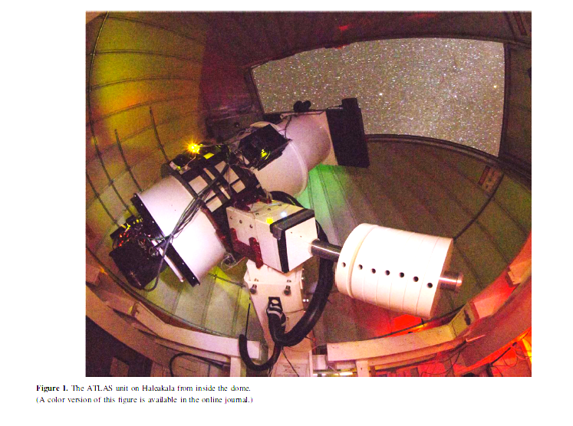
Discovery by ATLAS ATLAS: A High-cadence All-sky Survey System
“Asteroid Terrestrial-impact Last Alert System” (ATLAS)
Publications of the Astronomical Society of the Pacific, 130:064505 (19pp), 2018 June https://doi.org/10.1088/1538-3873/aabadf
All sky search for transients due to nearby objects
Two telescopes, Haleakula and Mauna Kea
0.5 m Schmidt Wright Design, equatorial mount, Ash dome
Normally uses c and o filters to find Asteroids
Covers the entire available sky (above -45 dec, more than 60 deg from Sun) with 4 observations (to detect motion of asteroid) every 2 days.
Can get to detection +19.5 m.
Processing for transients (not NEA’s) runs after NEA detection.
>1000 sn had been detected by the time of 2018 paper
Detection of SN 2020tlf SEPT 16, 2020

Slide 3
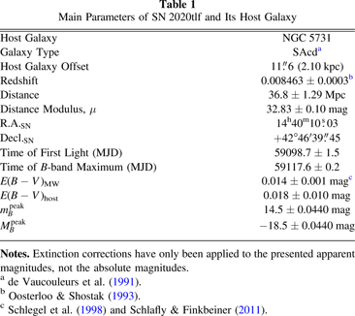
Position/Distance/Apparent Magnitude

Slide 4
Blue Supergiant
Is precursor a
Blue Supergiant or a
Red Supergiant?
Red Supergiant has
larger Radius,
similar Luminosity
Simulations and observations indicate mass loss over time, question is how much?
Red Supergiant

Slide 5
Status of Star pre- SN is being studied
Need rapid revisit (high cadence) and automatic processing to detect SN before eruption
Observations detect excess light, evidence of Circumstellar Medium etc before maximum light
Theoretical models predict modest mass loss, Observations up to 1M_{solar} pre explosion

Slide 6
g = 481 nm | r = 617 nm | i = 752 nm | z = 866 nm | y = 962 nm | from Pan-STARRS
Pre explosion
Stack of -169.7 to -3.7 day
s before “first Light”
Detection
(no detection in y, radio or x ray)
Detection
minus Pre explosion

Slide 7
from Wikipedia

Slide 8
Wavelengths of observations
Filters at ASTRO normally used for asteroids
c, cyan, 420-650 nm
o, orange,560-820 nm
Conversion between Atlas c-o and Pan-STARRS central wavelengths from Tonry et al 2018b
g = 481 nm | r = 617 nm | i = 752 nm | z = 866 nm | y = 962 nm | from Pan-STARRS

Slide 9
https://doi.org/10.3847/1538-4357/abd7f5

Slide 10
Initial observations in Sept, characterized it as SnIIn with flash ionization spectrum narrow emission lines.
Sun blocked observations until +95 days, hence the gap in observations. By that time the narrow lines had disappeared, replaced by normal SNII
After detection by ATLAS, YSE (Young Supernova Experiment) and ZTF (Zwicky Transient Faciity)
with 2-3 day cadence examined prior images of the region. Excess emission detected ~-120d, but not SN more than -1.4 days prior to ATLAS detection. Integrating the emission over the 120 d, give about 10⁴⁰ ergs. That is roughly the same as the binding energy of the wind.

Slide 11
Non Detections , although the area was observed, prior to first light and there is some excess emission
PS1, PS2 are Pan Starrs 1.8 m telescopes

Slide 12
⁵⁶Co |  |  | 55.9398393(23) | 77.233(27) d | β⁺ | ⁵⁶Fe | 4+
plateau
⁵⁶Co ->⁵⁶ Fe + positron + neutrino
⁵⁶ Co -> ⁵⁶ Fe + positron+ neutrino
Half Live 77.233 d

Slide 13
10⁴³
Bolometric Light Curve, Luminosity ergs/sec
10⁴²
10⁴¹
50,000K
20,000K
Black Body Temperature
10,000K
10,000K
Radius Associations

Slide 14
Pre Explosion Light Curve
L_{solar} ~ 3.892x10³³ erg/sec
10⁶L_{solar}
10,000K
Temperature from photometry to correct to bolometric
Luminosity in band observed,
Distance from redshift
10⁴R_{solar}
R_{solar} ~ 1.4x10¹¹cm

Slide 15
Concept:
Star has been losing mass for a while, producing CSM out to ~10¹⁵cm
Core collapse produces a shock which initially heats medium providing initial increase
As CSM expands the emission lines broaden, light decreases linearly until ⁵⁶Co decay powers it.

Slide 16
Narrow lines before peak light

Slide 17
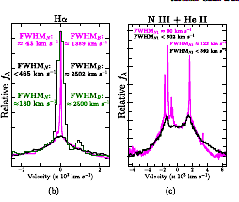
H line mostly consistent with wind at ~50 km/sec, NIII and HeII wind at 90-120 km/sec

Slide 19
Comparing IR spectrum to other SN
SN2020tlf has narrower lines
(lower velocity) than in other SN

Slide 20
Circles are 2020tlf

Slide 21
Matching the nebular spectrum with other models, 12 M_{solar} best matches at 250 d, 10 M_{solar} at 250d.
Modeled as a wind, not a thin shell.

