Slide 1
SNII Precursor: Section 6 - 9 Summary: https://phys.org/news/2022-01-astronomers-witness-dying-star-explosive.html?utm_source=nwletter&utm_medium=email&utm_campaign=daily-nwletter SNII Precursor paper :https://iopscience.iop.org/article/10.3847/1538-4357/ac3f3a Young Supernova Paper https://iopscience.iop.org/article/10.3847/1538-4357/abd7f5
BNL LSST Journal Club
19 January 2022
Mike Sivertz

Slide 2
TLAs
SBO = Shock Break Out (when the star goes supernova)
CSM = Circum Stellar Material (gas surrounding star)
ZAMS = zero-age main sequence (age of star)
LTE (usually non-LTE) local thermal equilibrium
RSG = Red Super Giant

Slide 3
Sizes of things
1 Solar Radius ~= 1 x 10¹¹ cm
1 AU = 1.5 x 10¹³ cm
Size of progenitor: 1100 R₀ = 1.6 x 10¹⁴ cm ~= 11 AU
CSM out to 1 x 10¹⁵ cm

Slide 4
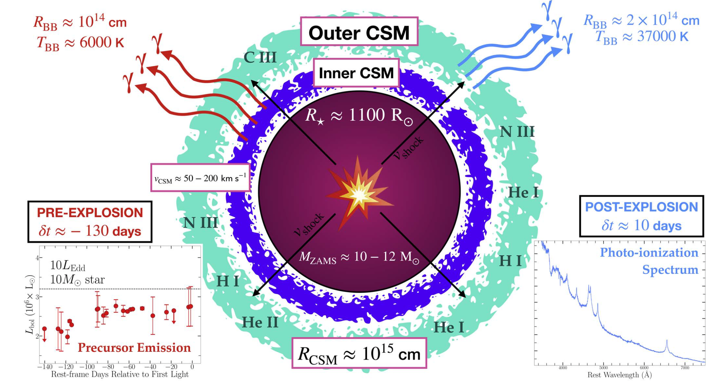

Slide 5
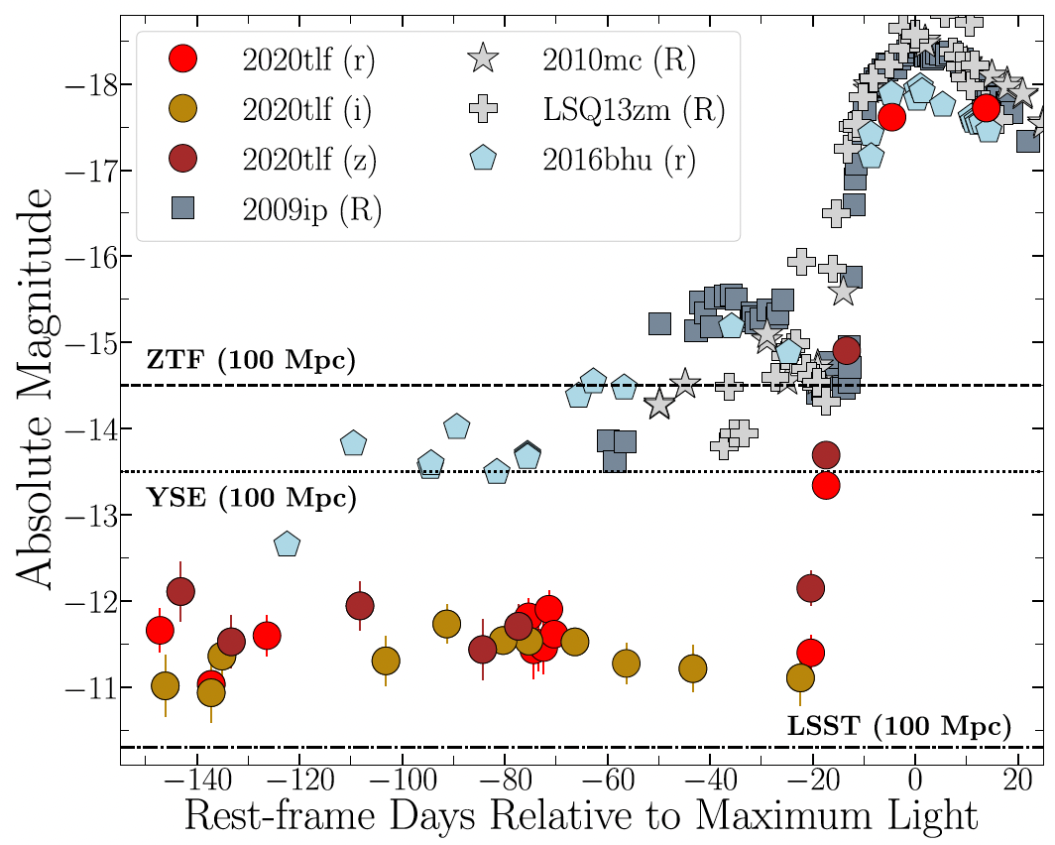
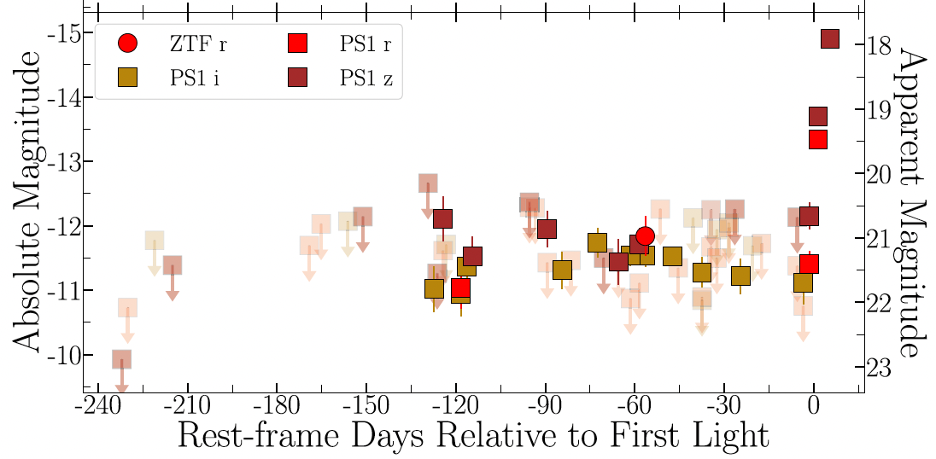
SN 2020tlf Light Curve

Slide 6
Section 6: Light-curve and Spectral Modeling
After all the observations made on the SN Type II it is modeled in an attempt to explain the properties.
Modelling programs:
HERACLES - radiation hydrodynamics code to calculate the interactions between photons and stellar material, ionization, stellar wind
Assume 1-D, spherical symmetry
Assume Ideal gas
Assume Adiabatic index γ = C_{p}/C_{v} = 5/3
CMFGEN - radiative transfer code,

Slide 7
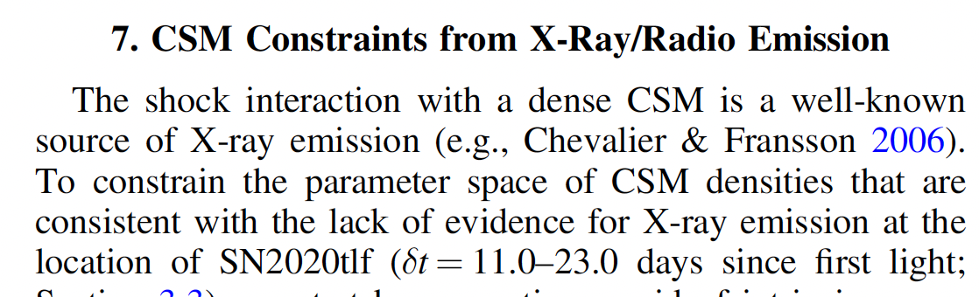
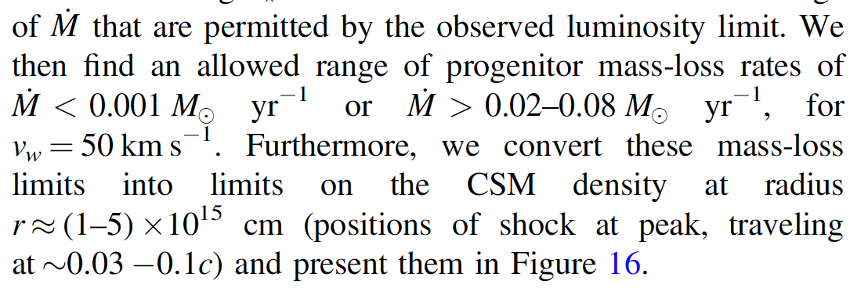
Section 7: X-ray emission
Absence of X-rays sets upper limit on CSM density.

Slide 8
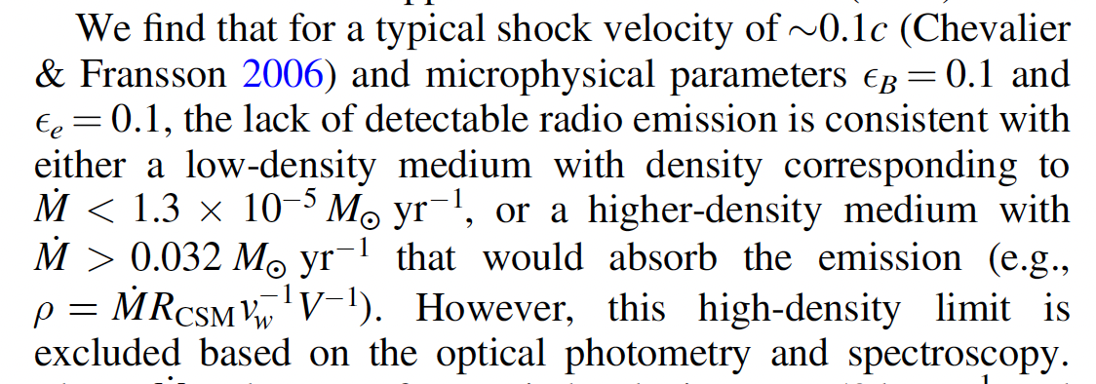
Section 7: Radio emission

Slide 9
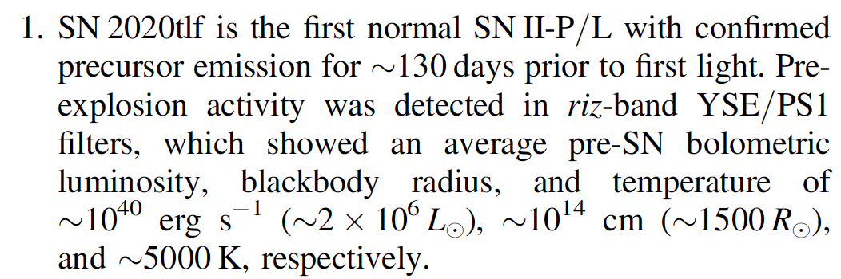

Slide 10
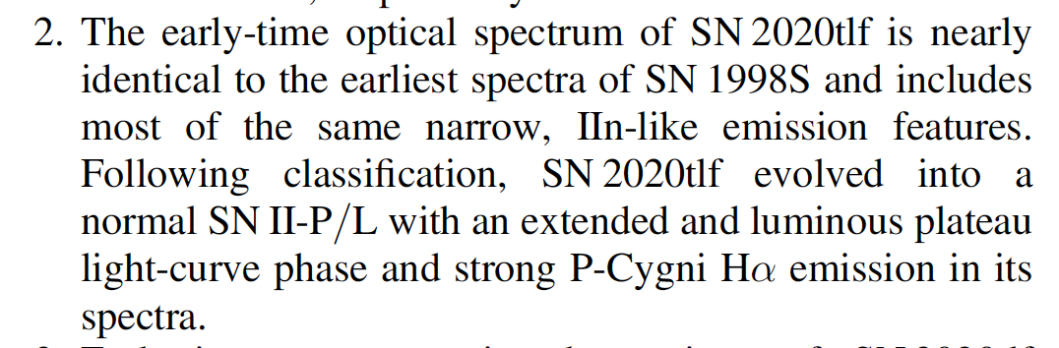

Slide 11
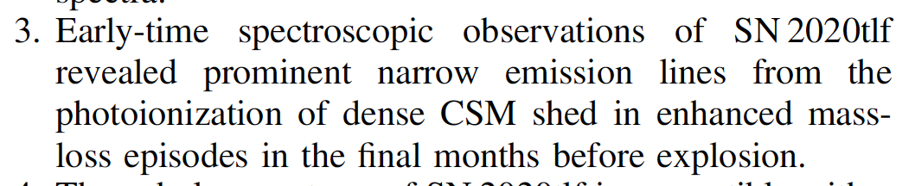

Slide 12
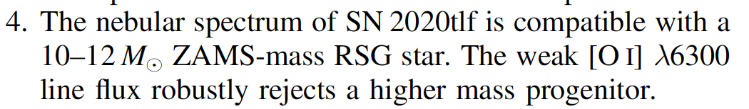

Slide 13
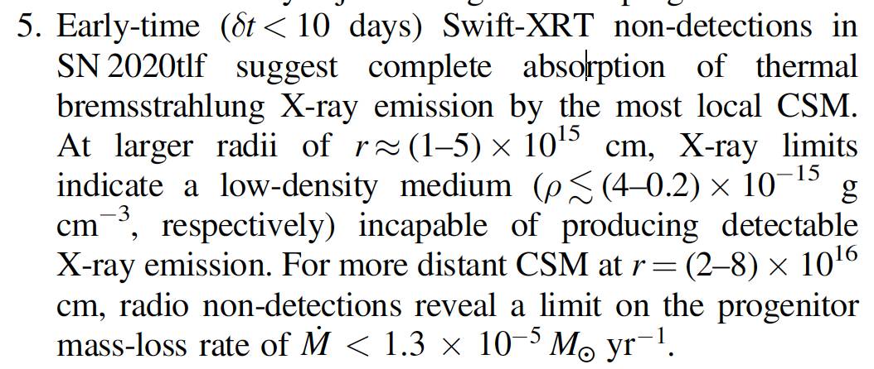

Slide 14
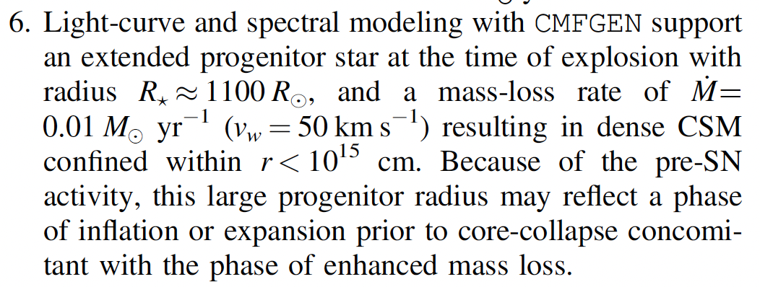

Slide 15
