Slide 1
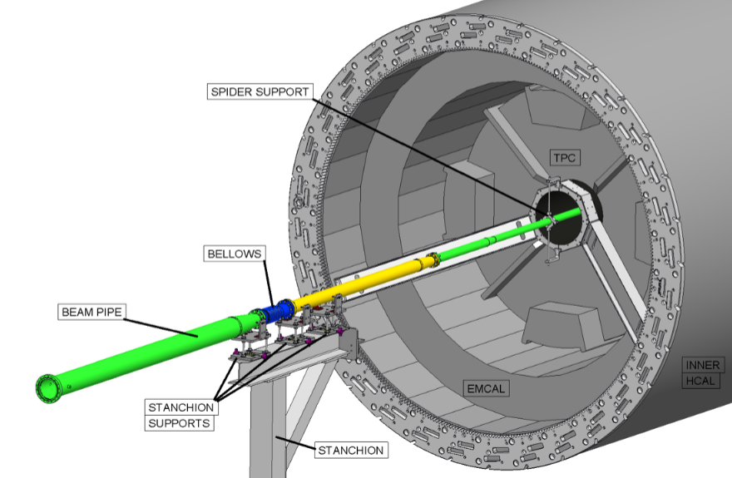
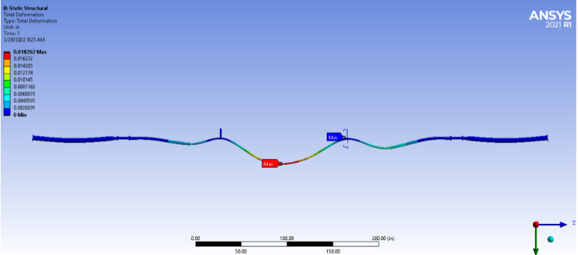
sPHENIX Beam Pipe FDR
March 30th, 2022

Slide 2
sPHENIX Beam Pipe FDR Scope
Beam pipe install and supports FDR (30 March 2022) · Indico (bnl.gov)
Covering four aspects of the sPHENIX beam pipe implementation
Design of tools and components for beam pipe installation
Design of tools and components for beam pipe support
Status of the beam pipe extension and rehab with Materion
Status of the beam pipe NEG coating facility set up at BNL
Start fabrication of simple support and handling components with drawing review and approval. PRR is not needed for these components.
Engineering Team | FDR Panel
Brian Brenton, Chris Runyan, and Rich Ruggiero (sPHENIX) Beam pipe install and supports design Beam Pipe analysis Beam pipe bake planning Dan Weiss and Sumanta Nayak (CA-D Vacuum) Beam pipe rehab at Materion BNL NEG coating facility Beam pipe bake planning | Russ Feder (Chair) – BNL sPHENIX construction manager Jim Mills – sPHENIX Project Engineer and mechanical engineering John Haggerty – sPHENIX physics and integration Rahul Sharma – STAR detector, Mechanical engineering and integration Jason Bessuille – MVTX detector, mechanical engineering and integration Walter Sondheim – MVTX detector, mechanical engineering and integration Cameron Dean – MVTX detector, physics Dan Cacace – INTT detector, mechanical engineering and integration Rich Ruggiero – sPHENIX design and integration Lori Stiegler – sPHENIX safety
Review charge letter questions at end of FDR

Slide 3
PDR Recommendations and Comments
sPHENIX Beam Pipe integration and support PDR: Beam Pipe Integration and Support PDR (7 September 2021) · Indico (bnl.gov)
There were no panel recommendations from the PDR that had to be addressed in final design
There were a few comments and suggestions that we considered and are highlighted below.
Selected PDR Comment
Create a more detailed model of the Al-Be interface to get a more accurate stress result. | Analysis of the beam pipe has been focused on predicting deflection during the installation steps and for the final support configuration. We have looked at general stress in the models. Unless the pipe is badly mishandled stress is low during bake and vacuum. We decided not to spend time trying to model and analyze the details of the welded joints at the Al-Be and Al-Al interfaces. This would be a largely academic exercise and we would spend a lot of time trying to model something that we don’t think is an issue. Strong-back supports will be used in the NEG coating facility and for sPHENIX installation. We also decided we did not need to evaluate buckling as a failure mode for the beam pipe. The only viable scenario for buckling is during the vacuum conditioning bake. During bake, the pipe and bellows supports are configured to allow the pipe to grow and contract. This will be shown in the FDR presentations today.
Buckling analysis. To be conservative, assume some axial loads due to bellows spring constant during bake. Use to evaluate eigenvalue buckling modes.
Beam pipe handling strong back design and deployment. When handling the beam pipe during NEG coating processing and during installation into sPHENIX the beam pipe should be mounted in some kind of strong-back structure. | This was implemented

