Slide 1
sPHENIX Beam Pipe Bake Jacket FDR
Chris Runyan 03/30/22

Slide 2
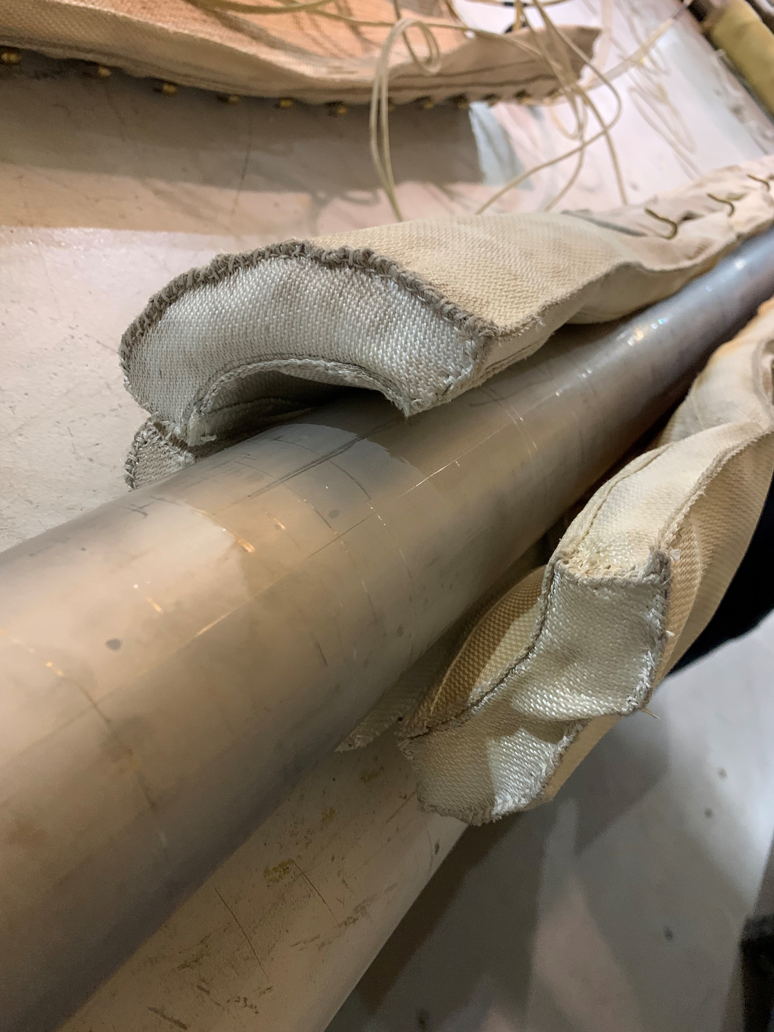
Beam Pipe Heating Jacket Thermal/Mechanical Design Requirements
Not to exceed 1” total jacket thickness
Must reach 200°C minimum operating temperature
Must be capable of reaching 250°C test temperature
Surrounding INTT Carbon Fiber not to exceed 60°C to protect epoxy used in surrounding components
Custom cloth heating jacket fabricated by BriskHeat, same jackets used in STAR/others
Insulating layers:
Inner layer – Silicone impregnated Beta cloth (Alpha composites)
Middle layer – Fiberglass insulation (Pardus E-Mat 1200)
Outer layer – Silicone impregnated facing (TCI Tufjac 1550)
Insulating cuffs protect the spider supports and flanges from heating appreciably to prevent differential CTE issues
Dan and Sumanta to cover installation/removal details
Assumed combined avg. density of .18 gm/cm^3

Slide 3
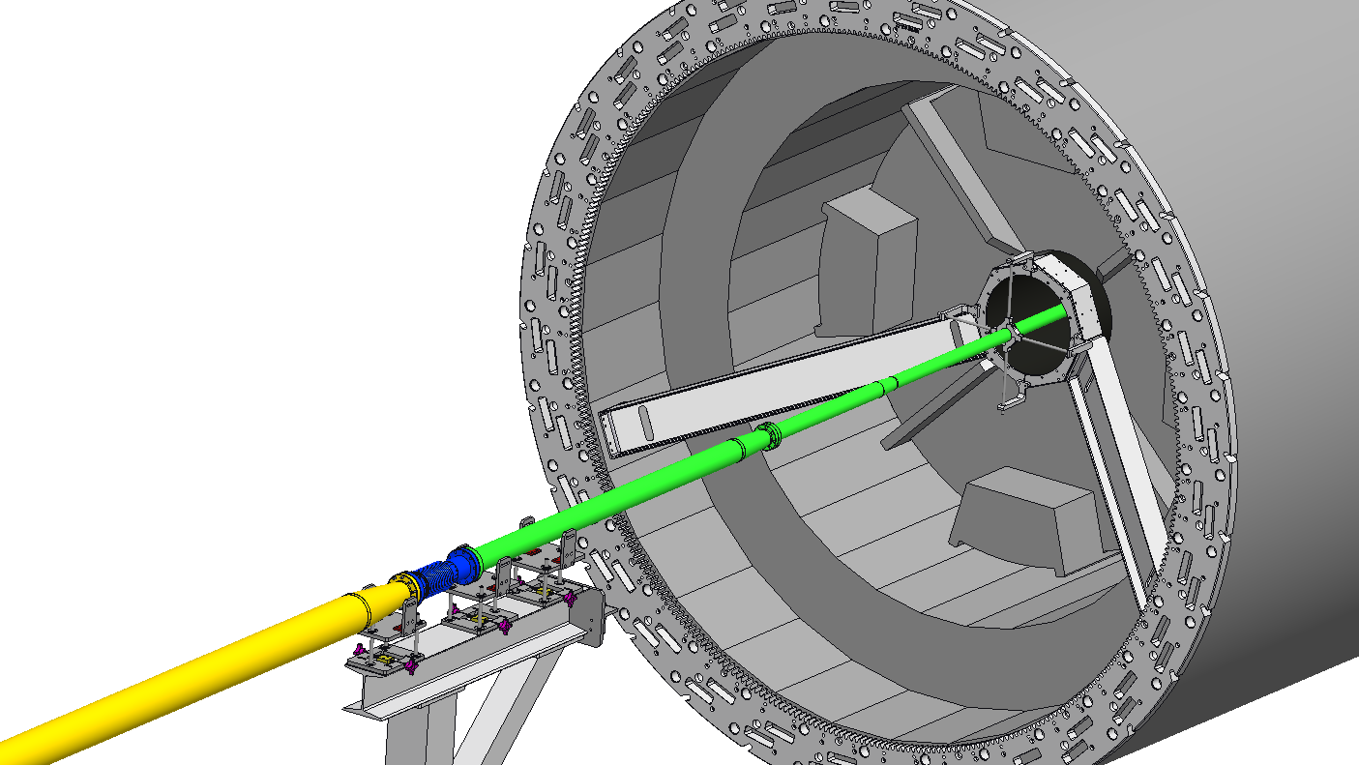
Heating Jacket Layout – No Jacket
North
Side

Slide 4
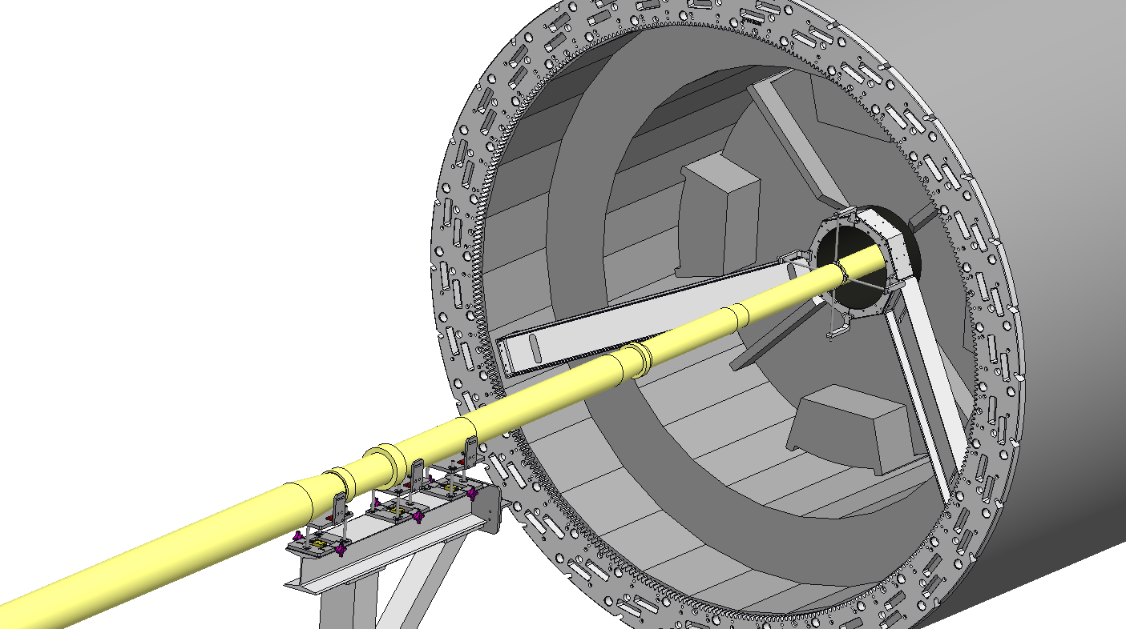
Heating Jacket Layout – With Jacket
North
Side

Slide 5
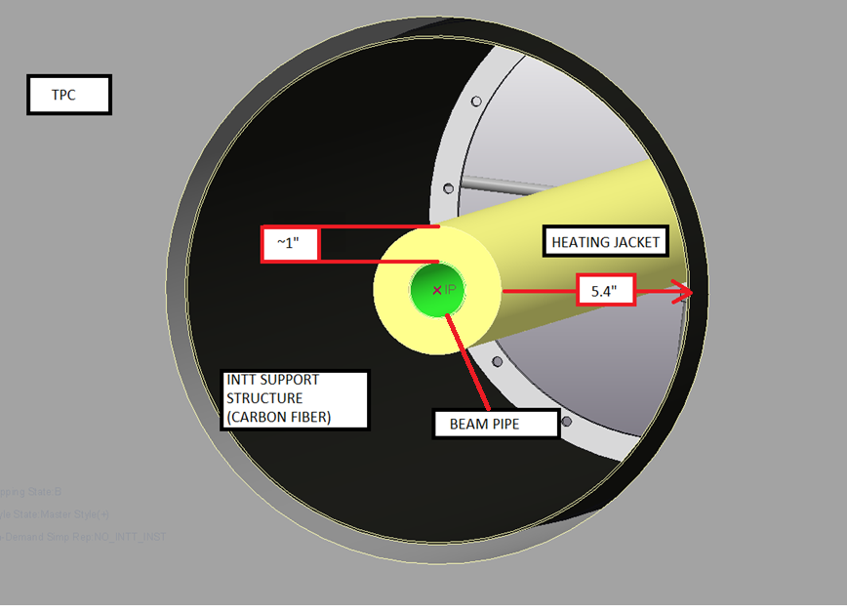
Heating Jacket Layout

Slide 6
ANSYS CFX CFD and Thermal Analysis

Slide 7
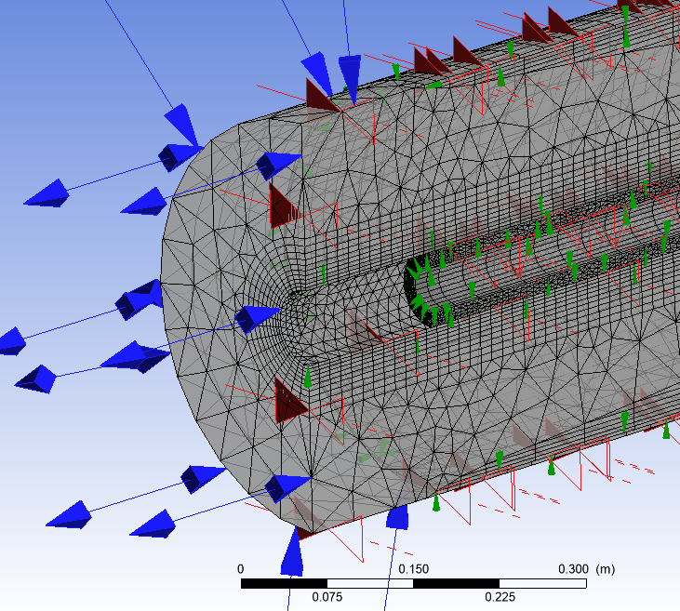
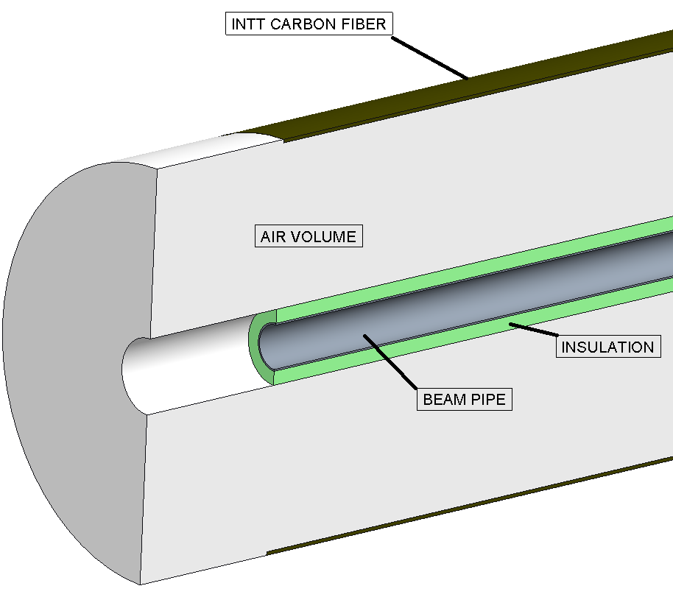
CFD Analysis with ANSYS CFX, components and mesh
*Analysis was done with a jacket thickness of .5” for a large FOS, since fabricator quotes a maximum jacket thickness of 1”

Slide 8
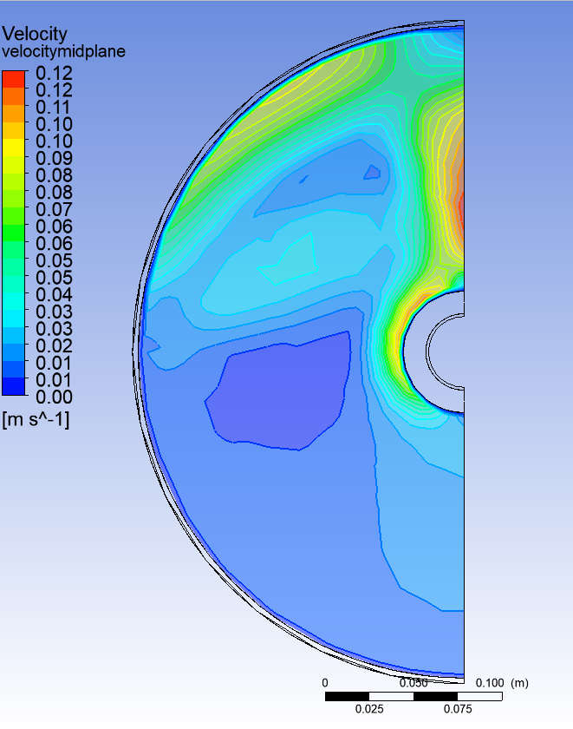
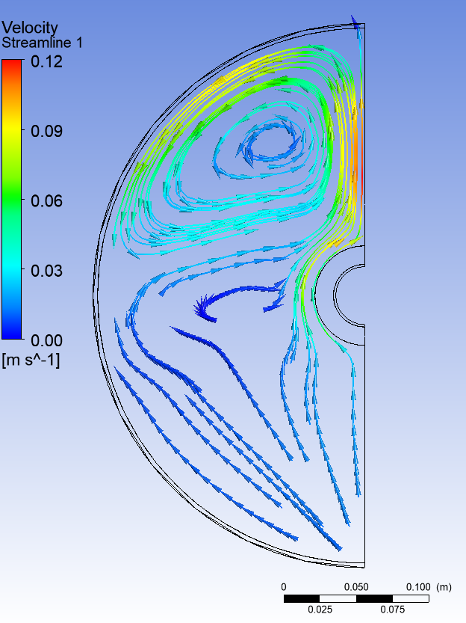
CFD Analysis, air velocity cross section/streamlines, midplane
Boundary Conditions
Steady state
Vertical symmetry
Ambient air, no forced convection
Results
Midplane velocity plot and streamline
Natural convection due to thermal gradient
Maximum velocity:
.12 m/s

Slide 9
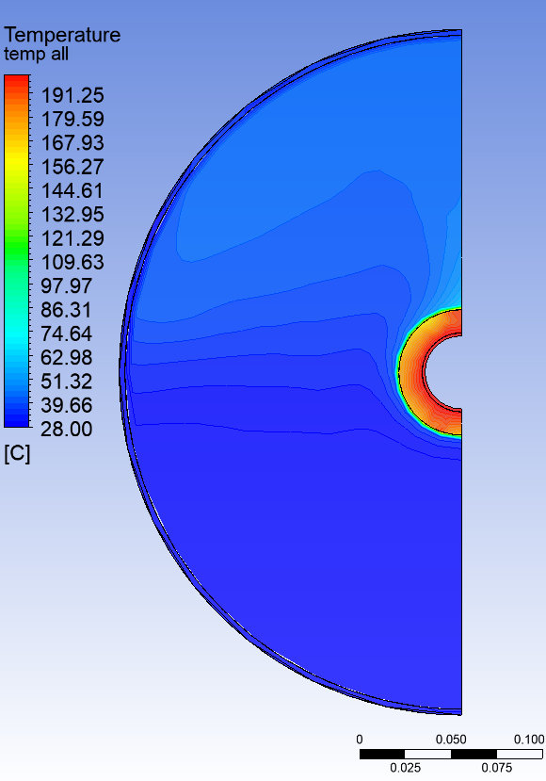
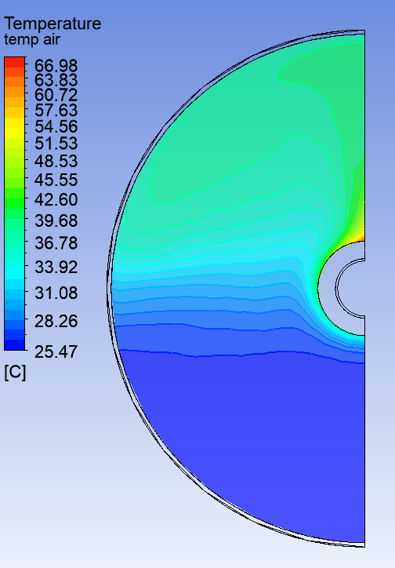
CFD Analysis, steady state temperature at midplane, inlet air temp 25° C
Boundary Conditions
Steady state
Vertical symmetry
200°C at beam pipe surface
Results
Midplane temperature plot
Thermal gradients indicate air temperature does not heat appreciably
Maximum air temperature:
68.57 °C
Maximum air temperature near carbon fiber tube:
43.71°C
The air mass is warmer on the top due to gravity-buoyancy force

Slide 10
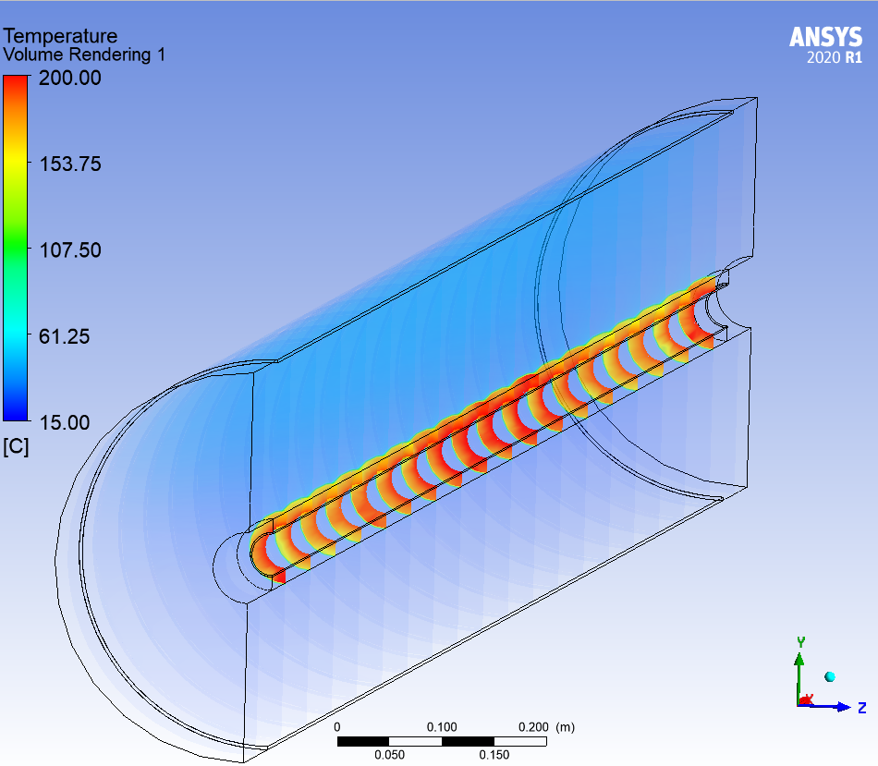
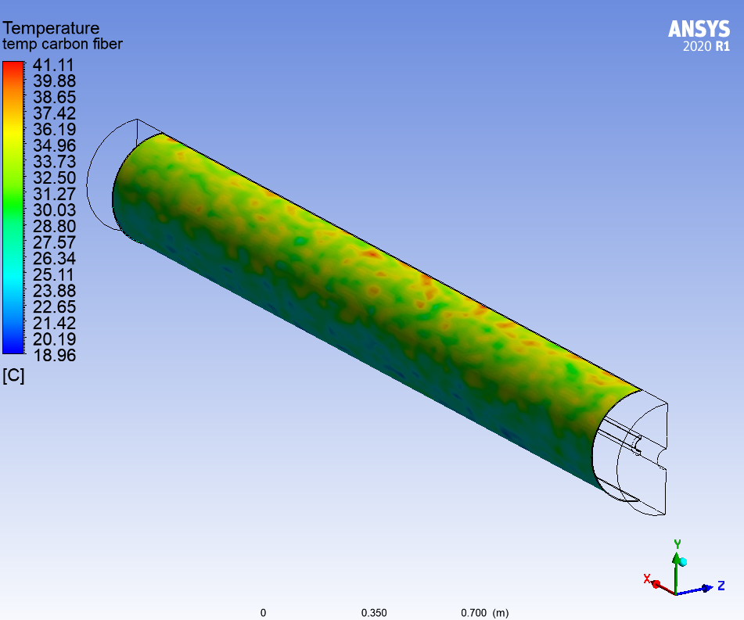
CFD Analysis, carbon fiber temperature, with radiation, air temp 25° C
Monte-Carlo ray scattering model employed to simulate radiation heat transfer
Very high emissivity (.8) used for both jacket and INTT carbon fiber support tube to assume worst-case scenario
As expected, maximum temperature occurs near the top of midsection where distance to ambient air inlets is maximized:
Maximum temperature in INTT carbon fiber is 41.11°C
Considering all conservative assumptions made for this analysis (.5” thk insulation, high emissivity), there is plenty of thermal margin

Slide 11
Beam Pipe Jacket Specifications Document

Slide 12
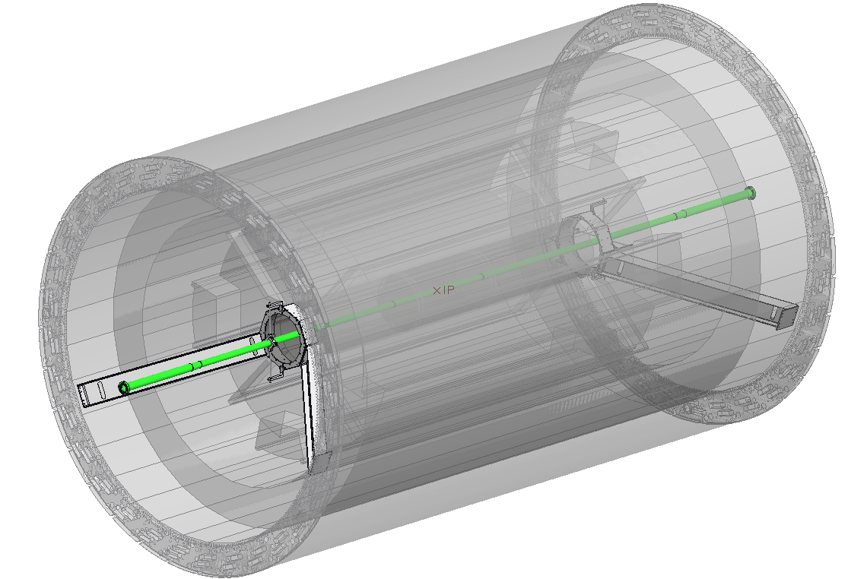
Al-Be Beam Pipe Jacket Sections
[Jacket 1 – Quantity =2 – Length = 58.25”]
2X Jackets for the mid section of beam pipe up to spider support on both sides and both jackets meet at the IP. Conforms to small diameter changes in beam pipe.
Spider Support
2” CF Flange 3.375” OD
NORTH END
Spider Support
1.7” to 2” Transition
2” CF Flange 3.375” OD
IP
[Jacket 2 – Quantity =2 – Length = 50.6163”] Jacket-covers from Spider Support over 1.7” to 2” transition to the first flange.
SOUTH END
1.7” to 2” Transition

Slide 13
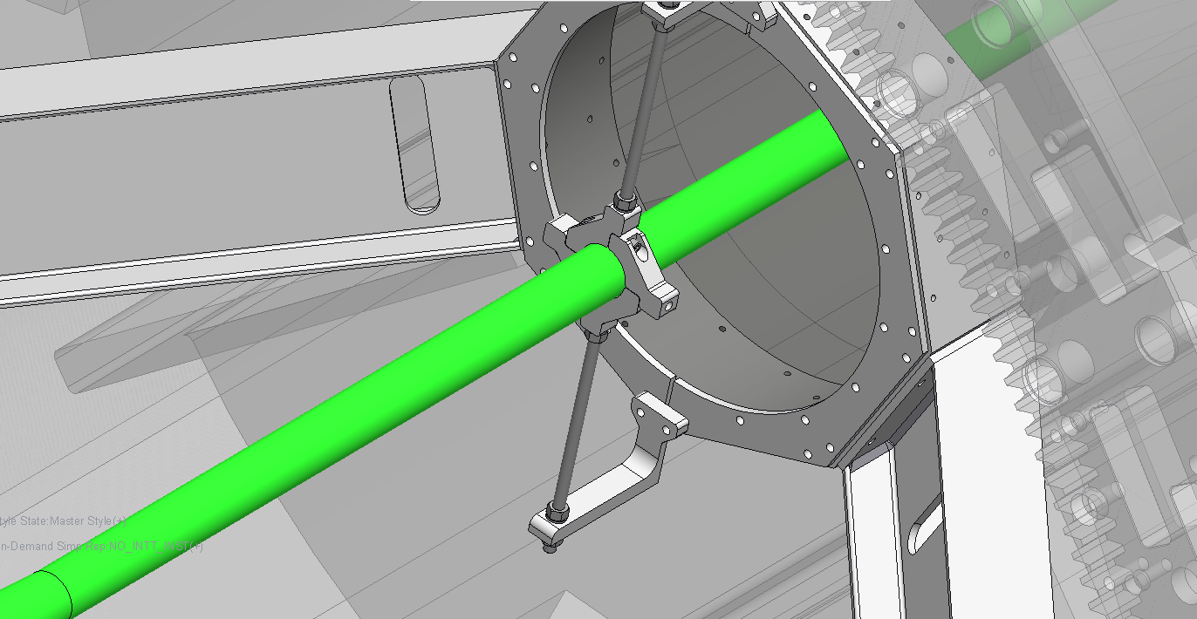
Al-Be Beam Pipe Jacket Sections
[Jacket 1 – Quantity =2 – Length = 58.25”]
2X Jackets for the mid section of beam pipe up to spider support on both sides and both jackets meet at the IP. Conforms to small diameter changes in beam pipe.
Spider Support,
Thickness = .75”
[Jacket 2 – Quantity =2 – Length = 50.6163”] Jacket-covers from Spider Support over 1.7” to 2” transition to the first flange.
BOTH NORTH AND SOUTH

Slide 14
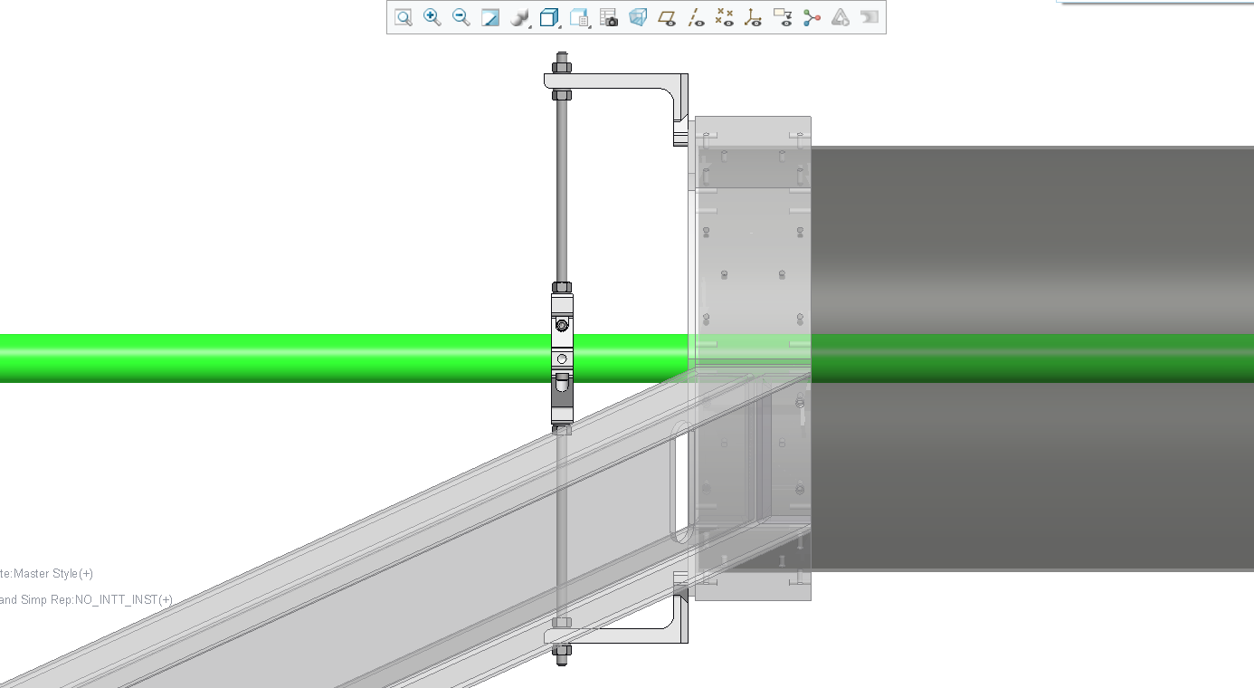
Al-Be Beam Pipe Jacket Sections
[Jacket 1 – Quantity =2 – Length = 58.25”]
2X Jackets for the mid section of beam pipe up to spider support on both sides and both jackets meet at the IP. Conforms to small diameter changes in beam pipe.
[Spider Support Cuff – Quantity = 2]
Cuff surrounds spider support to insulate support and beam pipe through support section. Openings in cuff allow for mounting rods. Insulation only, no heater circuits.
[Jacket 2 – Quantity =2 – Length = 50.6163”] Jacket-covers from Spider Support over 1.7” to 2” transition to the first flange.
BOTH NORTH AND SOUTH
Spider Support,
Thickness = .75”

Slide 15
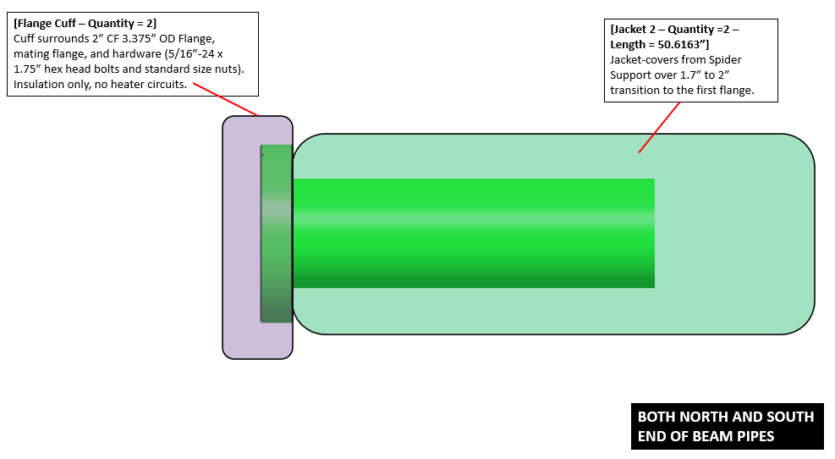
Al-Be Beam Pipe Jacket Sections

Slide 16
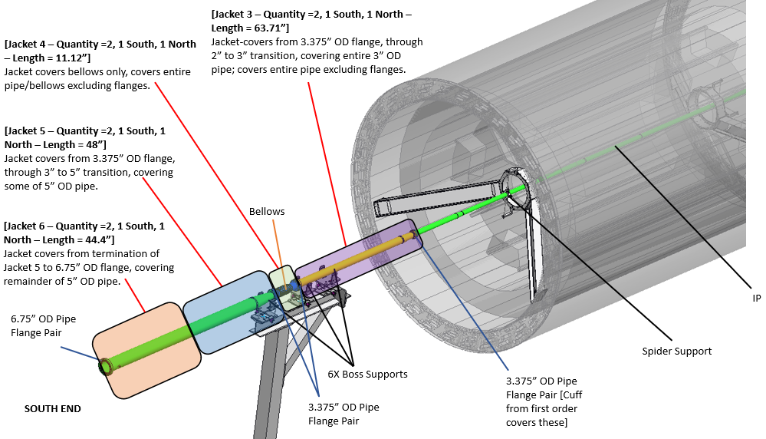
Remaining Beam Pipe Jacket Sections

Slide 17
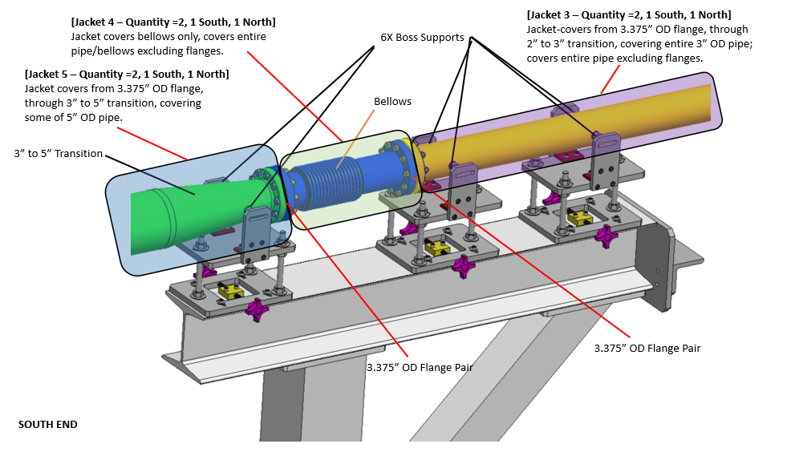
Remaining Beam Pipe Jacket Sections

Slide 18
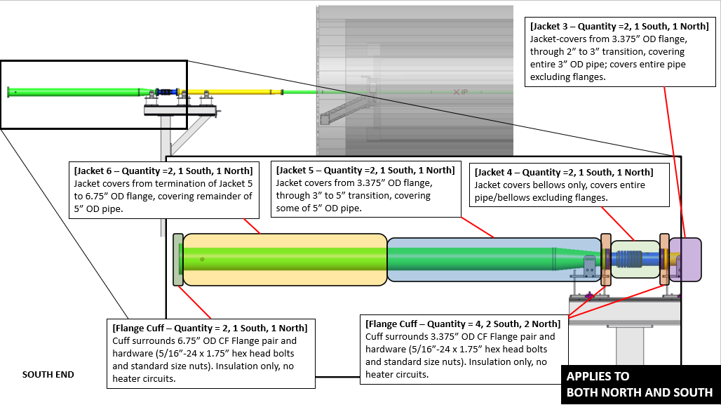
Remaining Beam Pipe Jacket Sections

Slide 19
Jacket Procurement

Slide 20
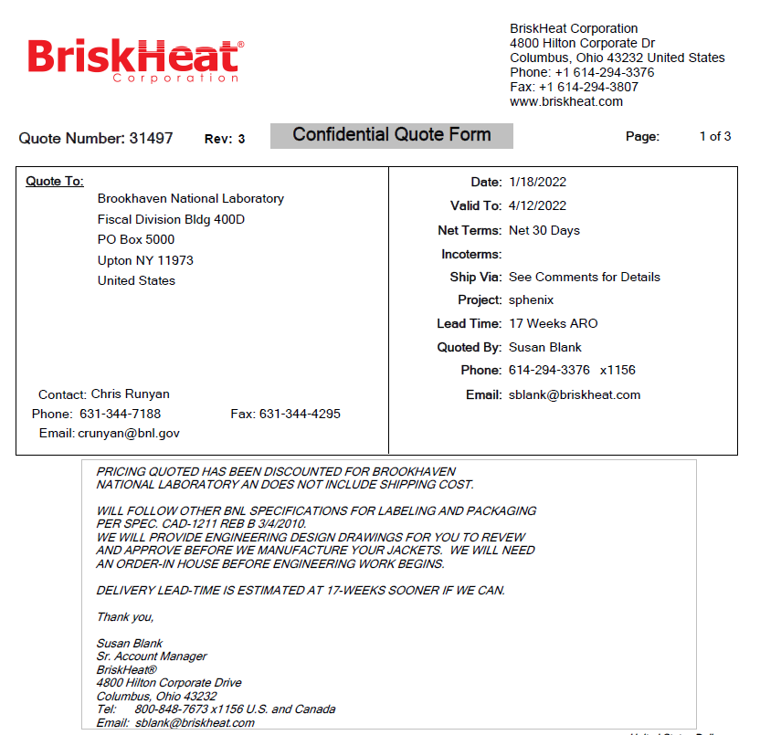

Beam Pipe Jacket Procurement
Original beam pipe installation timeline required immediate procurement of BP jackets
Vacuum group would like jackets before BP install, sometime in Summer ’22
Jackets were split into two separate requisitions to speed up procurement
PO has been issued for Al-Be portion of beam pipe jackets, working on Requisition for remaining jackets
Total cost of all sPHENIX jackets: $26,157.60
Lead time: 17 Weeks ARO
Al-Be Jacket PO was dispatched on 03.07.22
Should receive jackets 07.01.22
Remaining jackets should “piggyback” onto first order to circumvent lead time
+
Jacket Total = $26,157.60

Slide 21
BACKUP SLIDES

Slide 22
INSTALLATION SUPPORT STEPS SOUTH SIDE

Slide 23
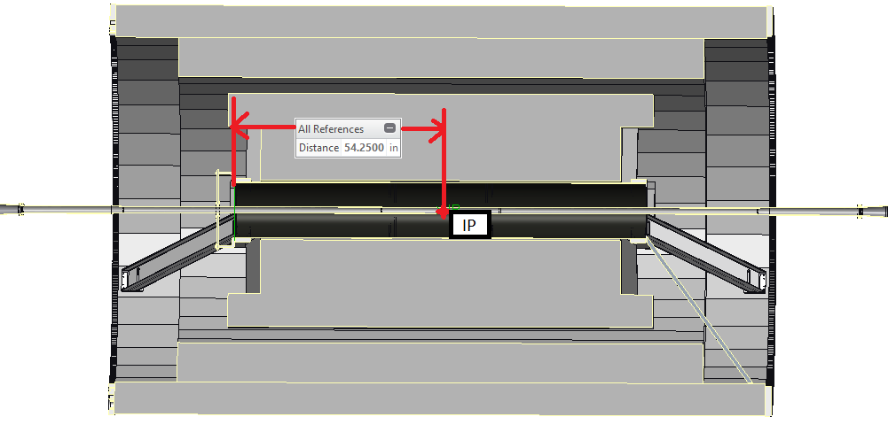
Reach Distance to IP
North
Side
South
Side

Slide 24
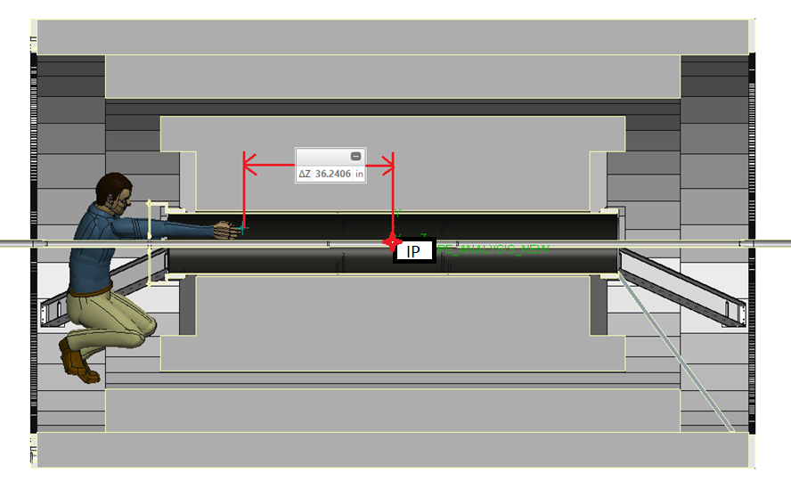
Reach Distance to IP
North
Side
South
Side

Slide 25
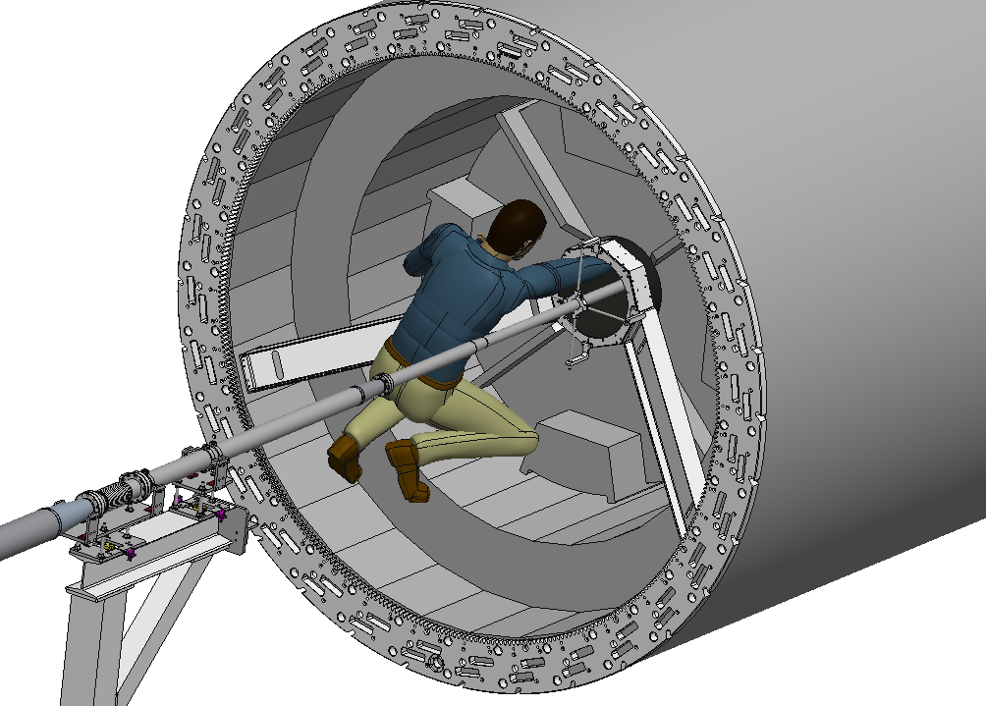
Reach Distance to IP
North
Side
*scaffolding and temporary
platform not pictured, old model

Slide 26
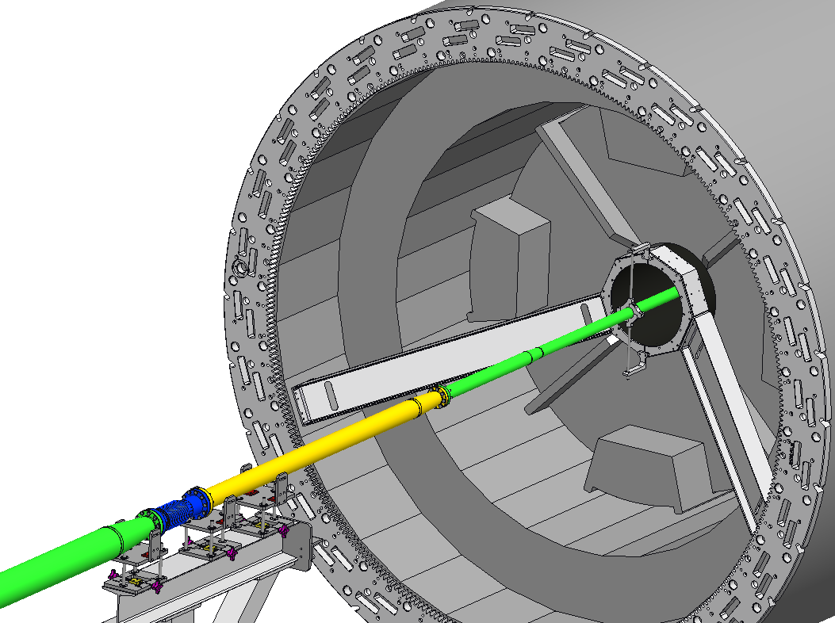
SOUTH SIDE STEP 1: DURING BAKE, TEMPORARY VERTICAL SUPPORT

Slide 27
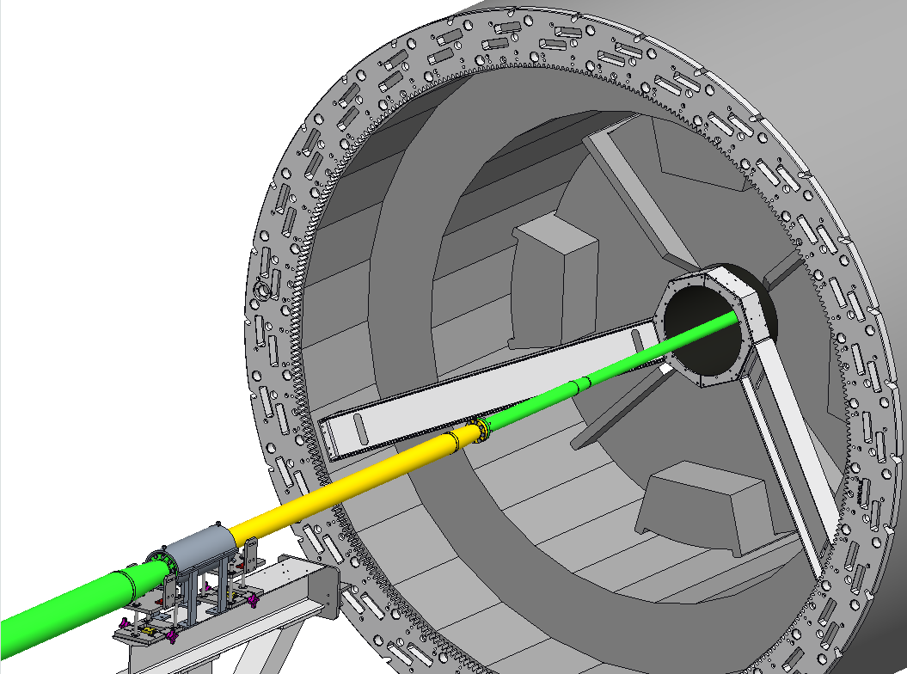
SOUTH SIDE STEP 2: ADD BELLOW CLAMP, THEN REMOVE TEMP. SUPPORT AND FIRST PERMANENT STANCHION SUPPORT

Slide 28
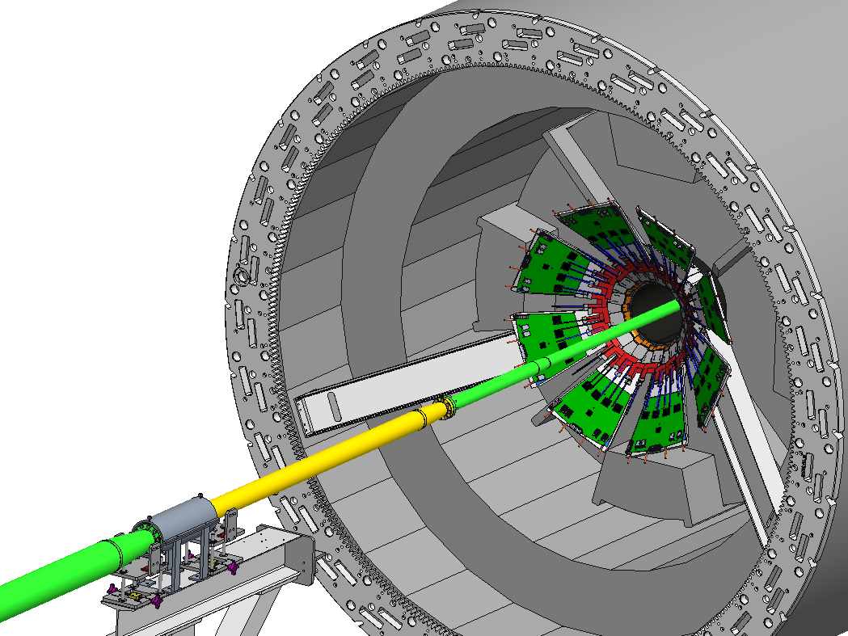
SOUTH SIDE STEP 3: INTT INSTALL FROM SOUTH

Slide 29

SOUTH SIDE STEP 4: REINSTALL TEMP. AND PERMANENT SUPPORTS, REMOVE BELLOW CLAMP

Slide 30
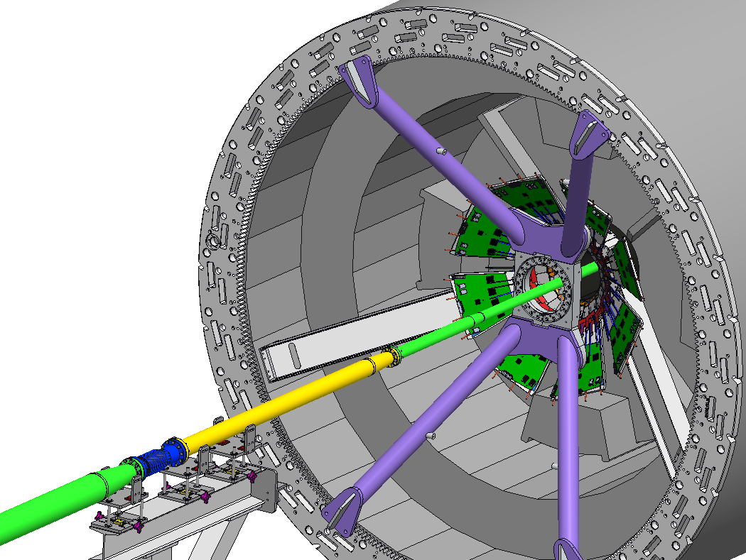
SOUTH SIDE STEP 5: X-WING INSTALL

Slide 31

SOUTH SIDE STEP 6: INSTALL STRAP SUPPORT/REMOVE TEMP. SUPPORT

Slide 32
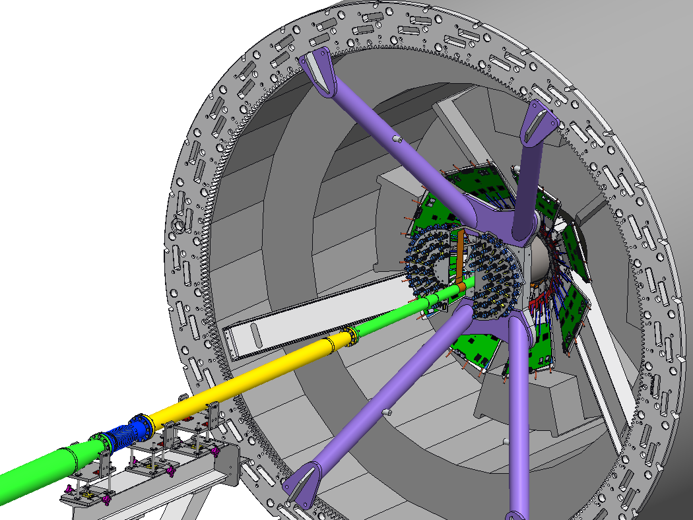
SOUTH SIDE STEP 7: MVTX INSTALL

Slide 33
INSTALLATION SUPPORT STEPS NORTH SIDE

Slide 34
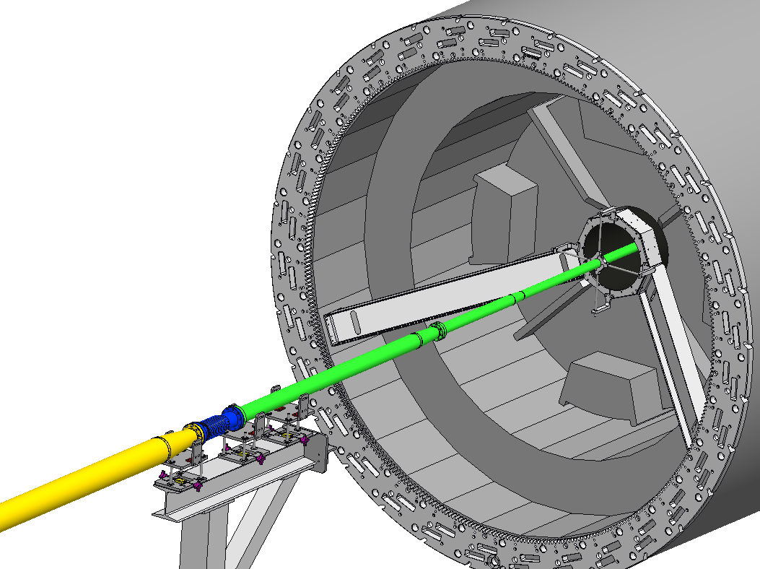
NORTH SIDE STEP 1: DURING BAKE, TEMPORARY SUPPORTS

Slide 35
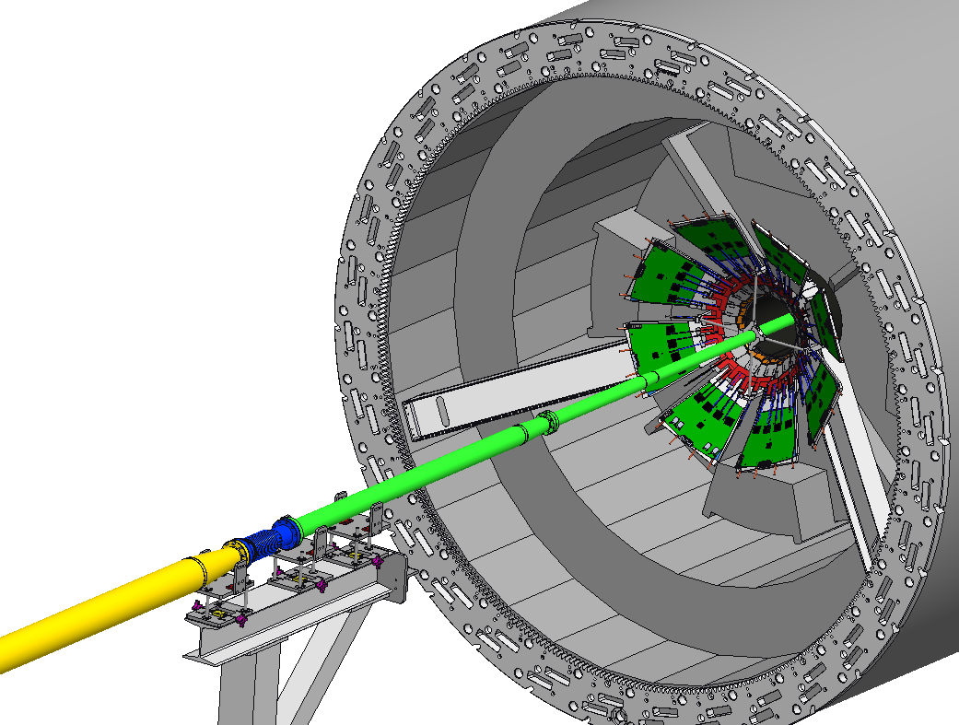
NORTH SIDE STEP 2: INTT INSTALL FROM SOUTH

