Slide 1
sPHENIX FDR C-AD Vacuum
Prepared By: D. Weiss, S. Nayak
30 MARCH 2022
Central Experimental Beamtube
- Procurement, Status & Schedule
- NEG Program, Status
Beamline Bakeout: DX-DX
Heater Jacket System Design, Procurement
In-Situ Bakeout Plan & Schedule

Slide 2
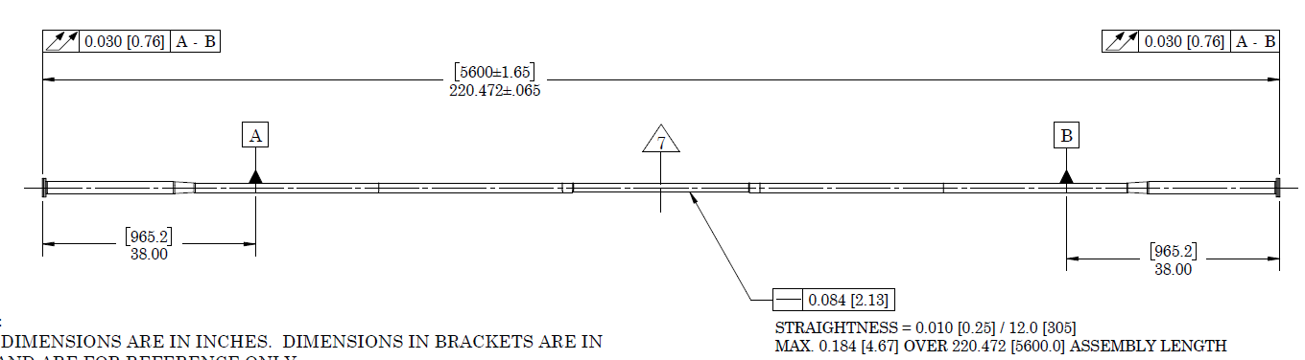
Beam pipe fabrication status (Al-Be)
Major updates:
Procurement of SS-Al bimetallic flanges – 11/18/21
Weld qualification - 01/07/22
NEG coating removal from Be tube ends – 01/14/22
Machining of Al tubes and cleaning/etching – 02/15/22
EBW - two out of 12 is complete – 02/17/22
EBW - 8 out of 12 were complete – 03/03/22.
But Al-Be weld joint leaks. Misalignment between welding torch and the weld joint are causes for failure. 4 out of 8 needs to be rewelded.
Be tube ends are to be refaced. Materion has spare Aluminum stubs.
Expected delivery of beam tube to BNL – 06/15/22
Inspection and testing – 06/29/22
NEG coating and vacuum performance check – 09/30/22

Slide 3
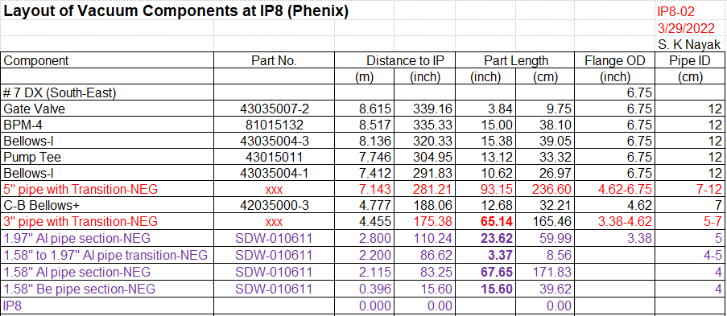
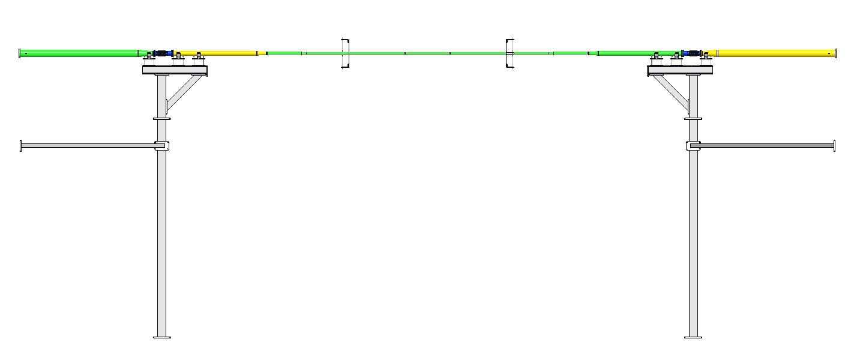
Beam pipe fabrication status (Adjacent Al and SS pipes)
Beam line is symmetric around IP.
5” pipe with transition: Existing pipes will be modified. One need to be cut and another need to be welded to make to desired length.
3” pipe with transition: Existing pipes will be modified. Both cone sections need modification. One need to be cut and another need to be welded (with new spool and NEG coated) to make to desired length.

Slide 4
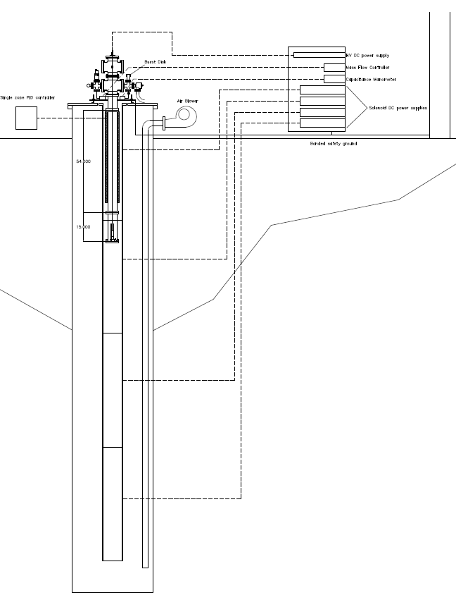
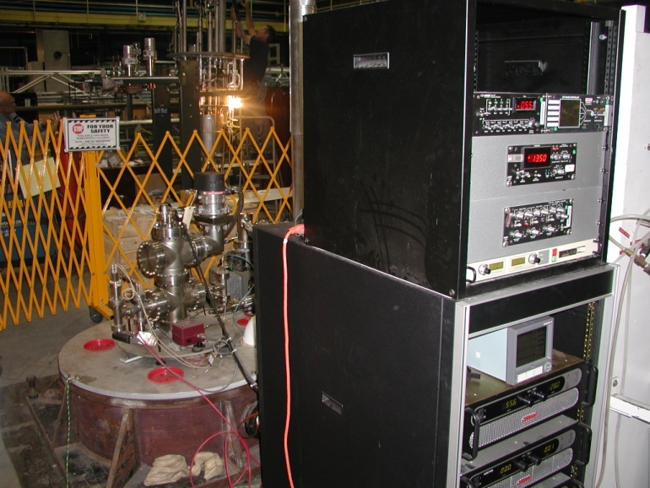
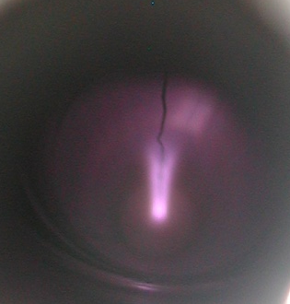
Cylindrical Magnetron Coating System, B902

Slide 5
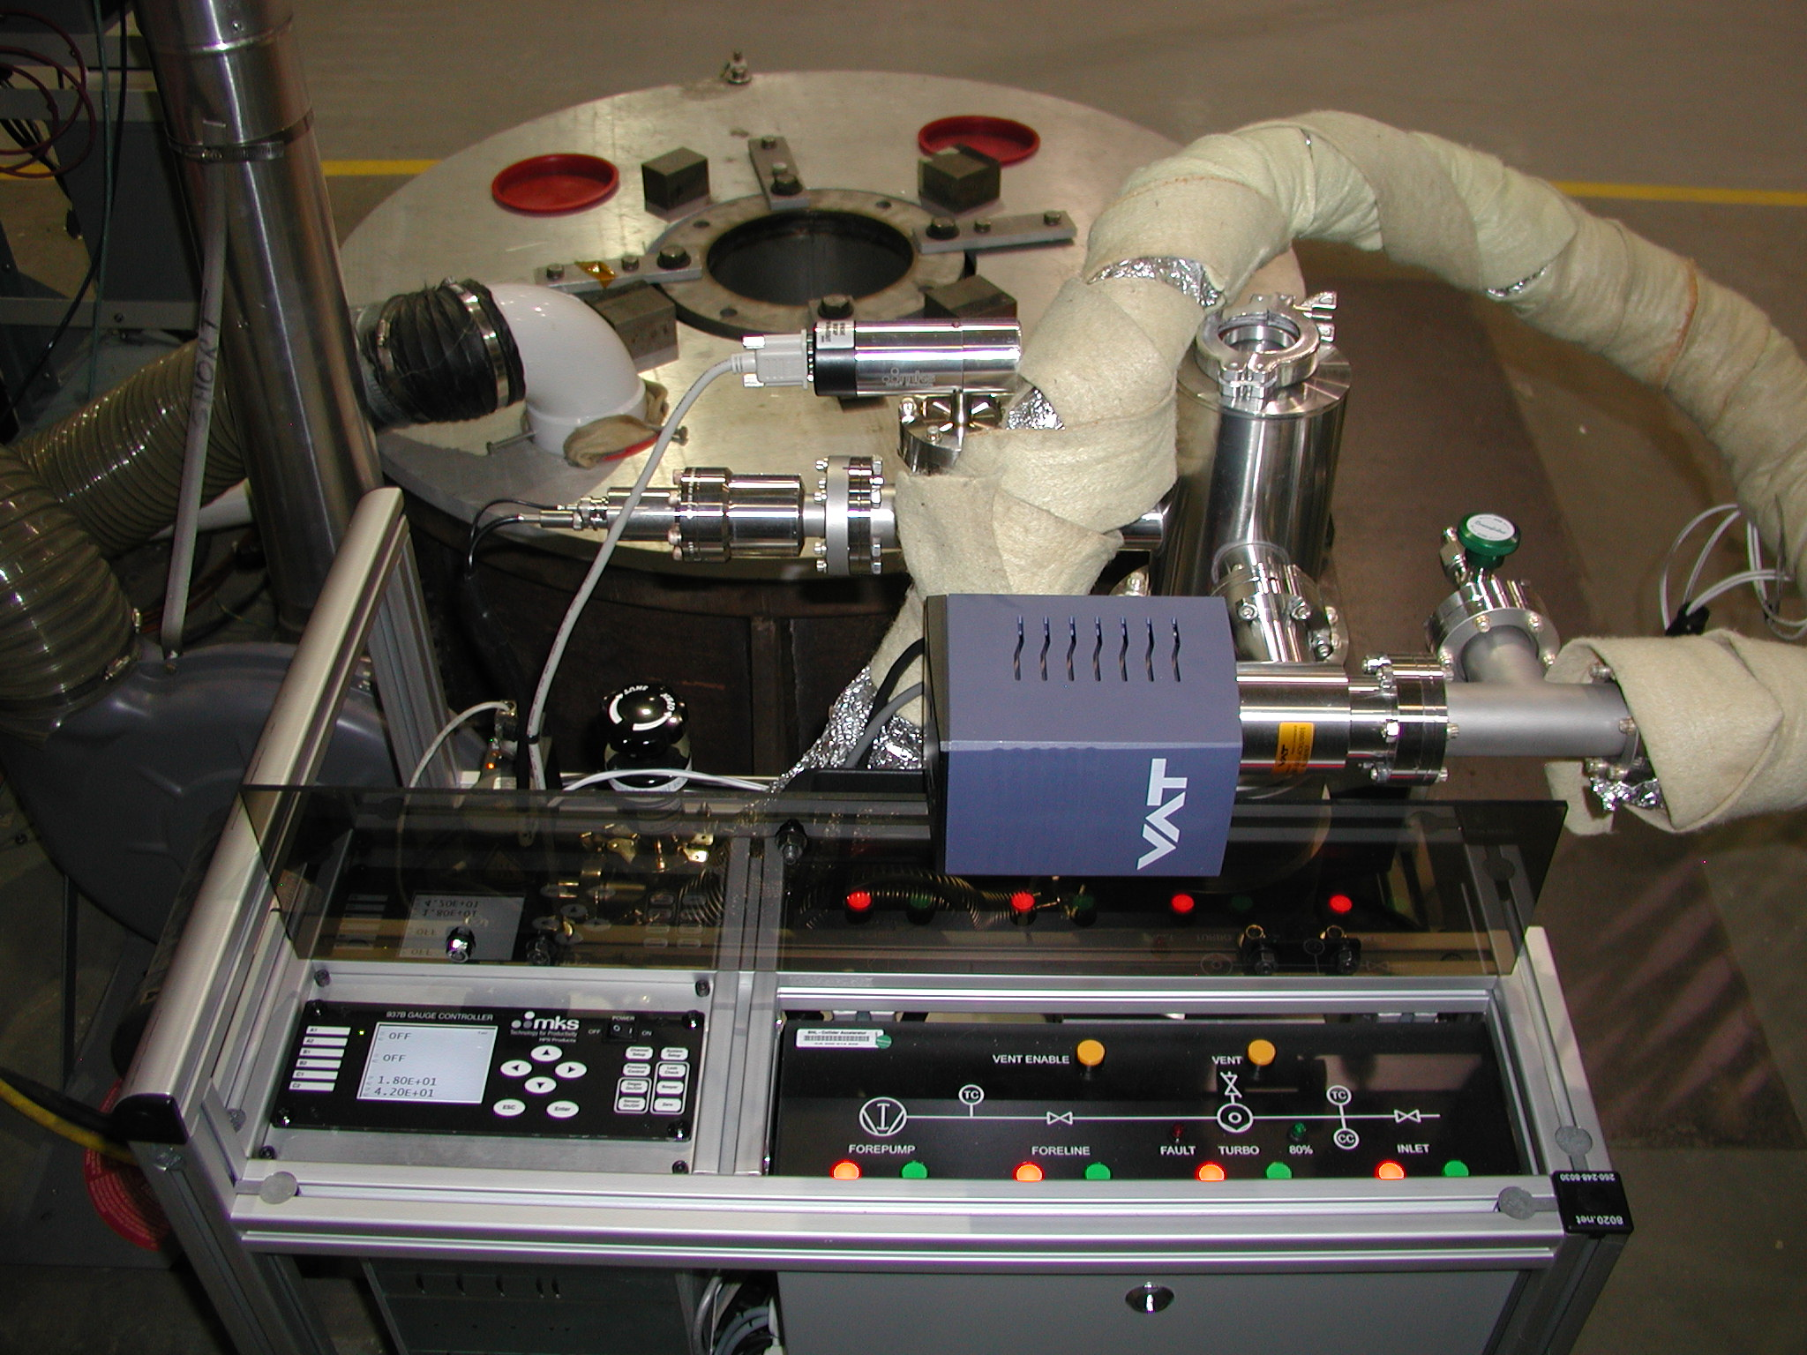
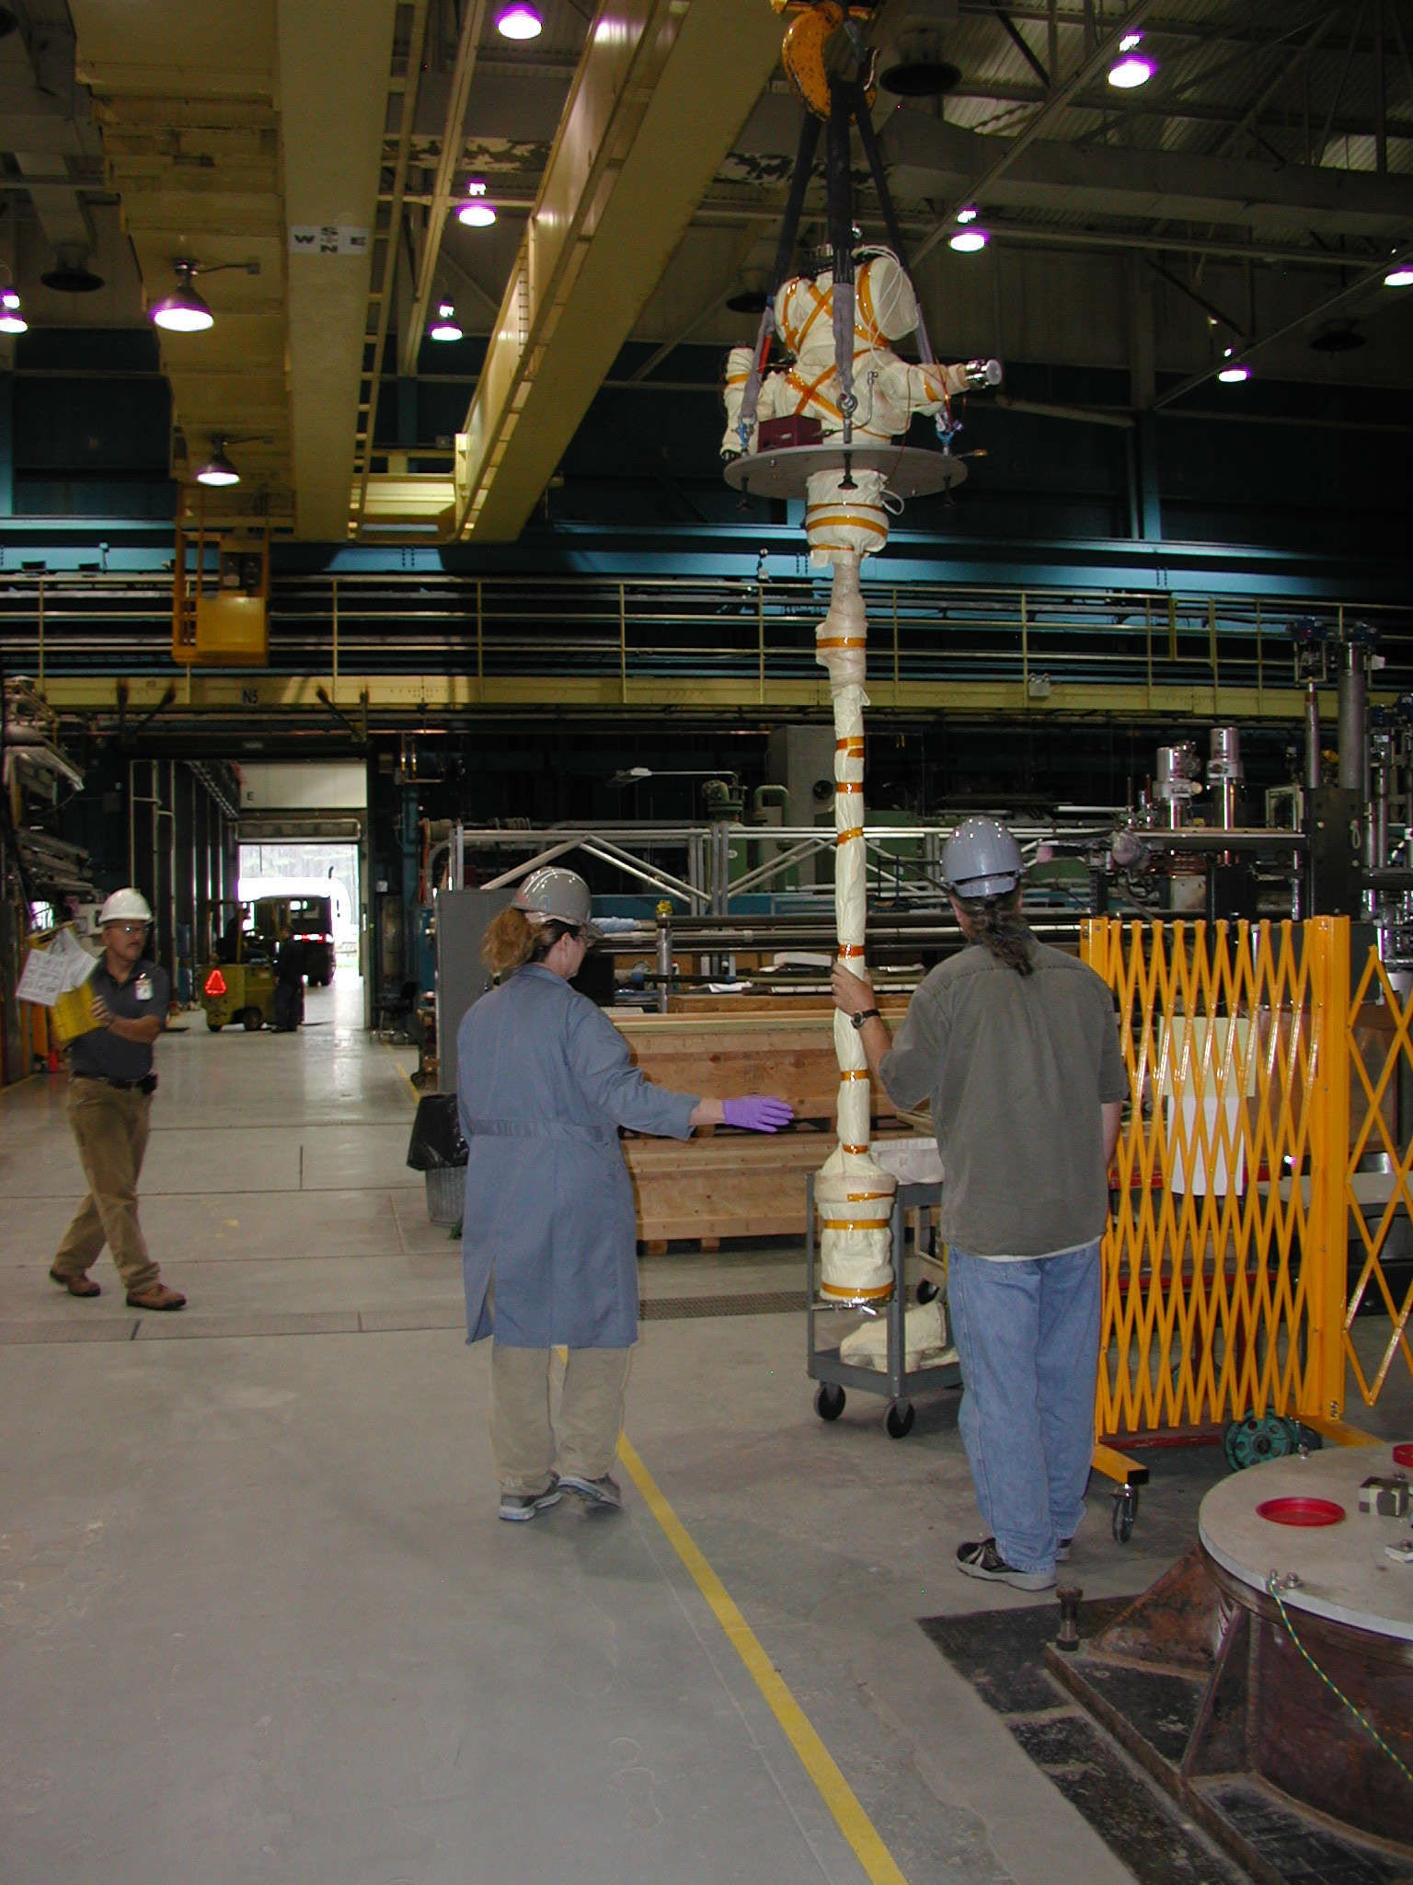
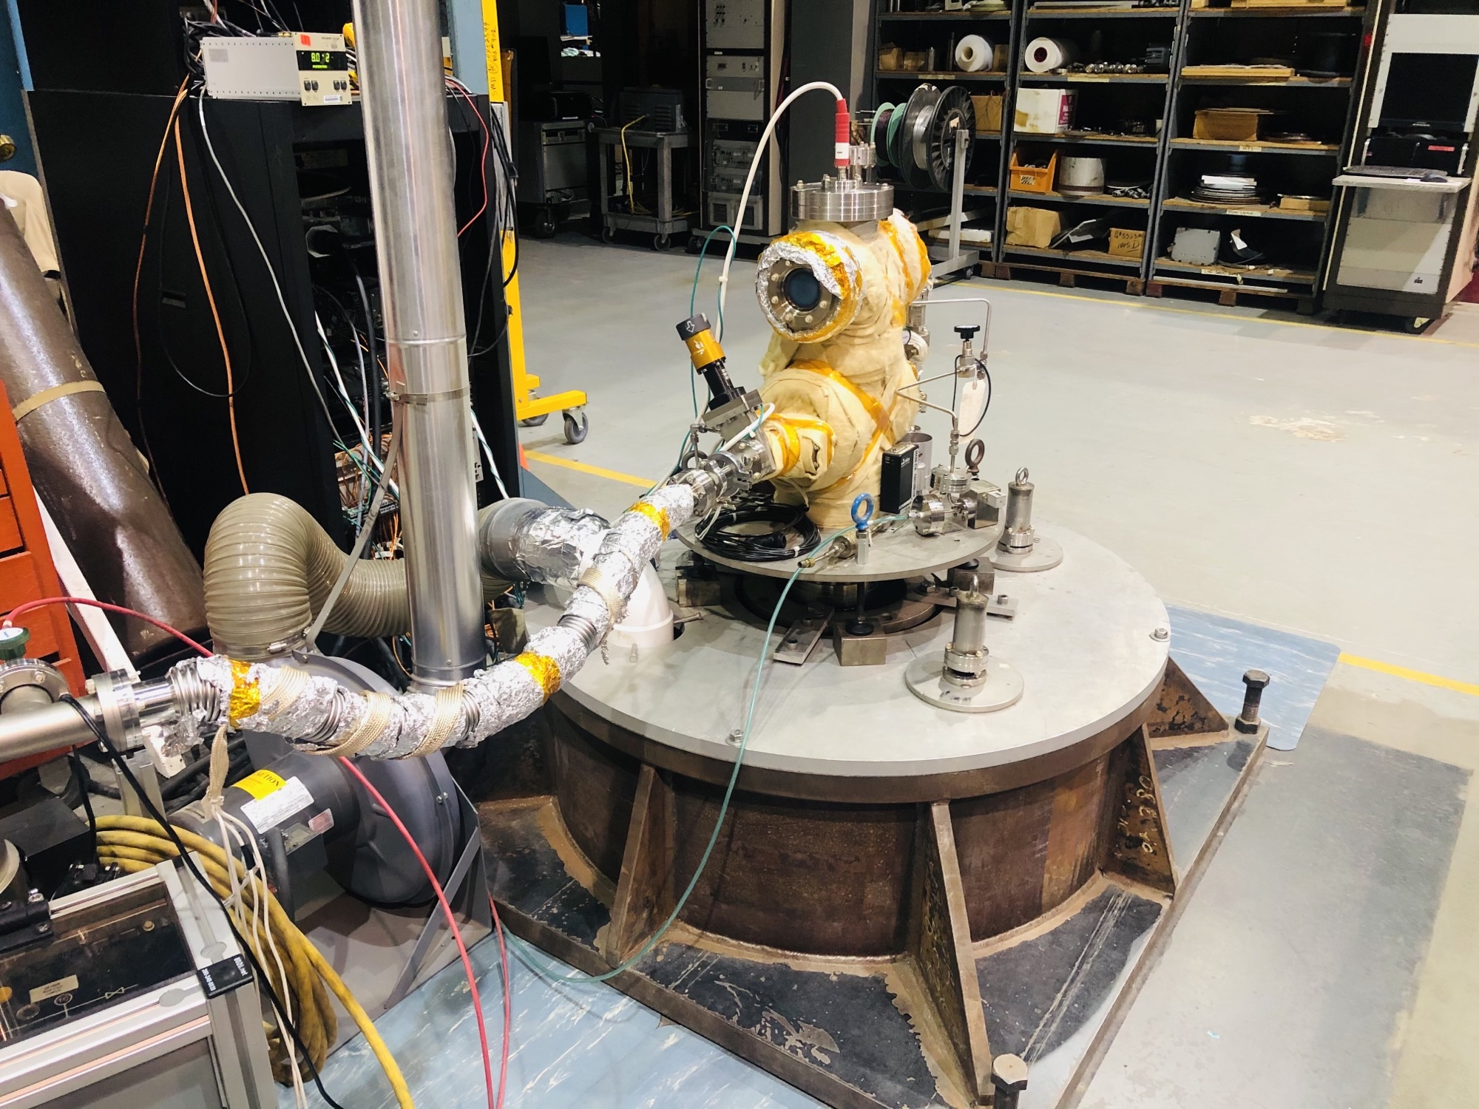
Building 902 Vertical Coating System
-Non-Evaporable Getter
-Titanium Nitride
-amorphous Carbon

Slide 6
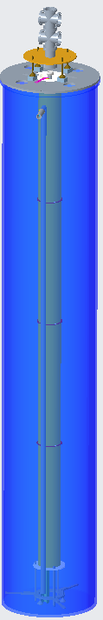
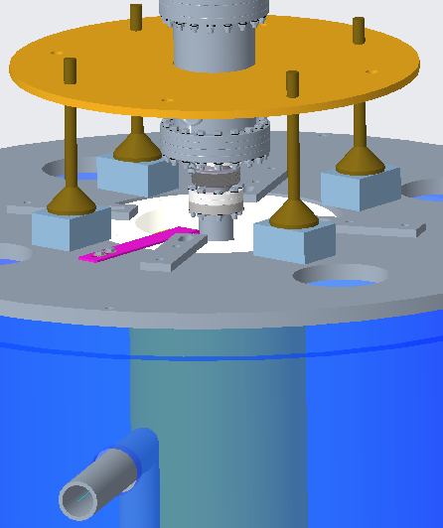
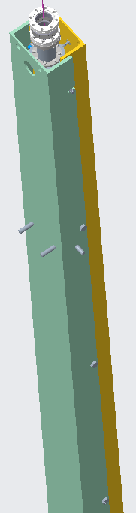
Set Up to NEG Coat the beam pipe
Pit
Solenoid magnet
Beam pipe with strong back assembly
NEG coating Pit

Slide 7
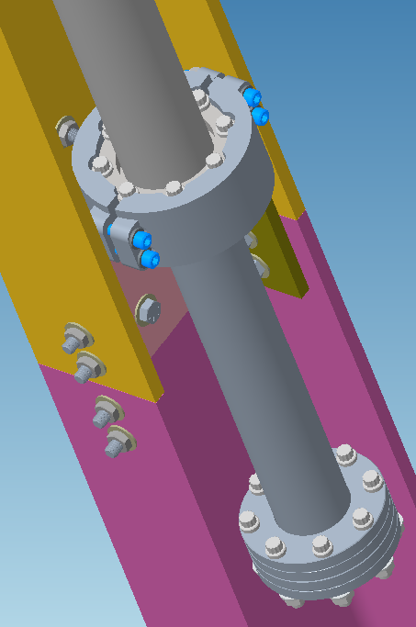
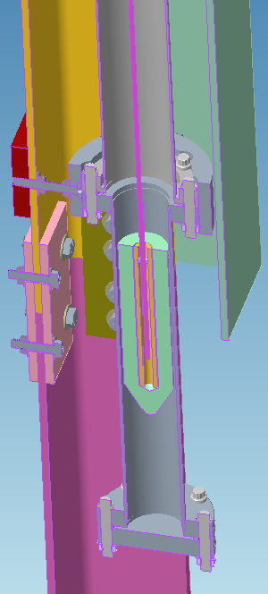
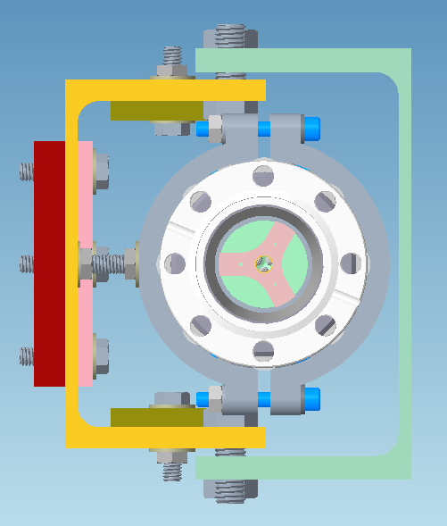
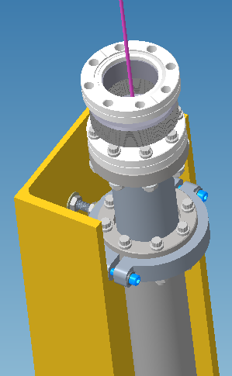
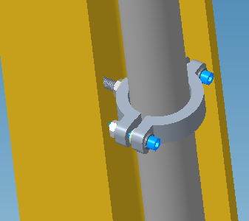
Set Up to NEG Coat the beam pipe
Two channel enclosure to provide stiffness & protect the beam tube during transportation.
Bottom clamp provides fixed support.
Top clamp support also provides fixed support during transportation, but will be loosened during coating to allow thermal expansion.
Three intermediate ring supports with clearance around beam tube, allow expansion and restricts beam tube deflection less than 2mm. (add rubber sleeves for transportation)
Ceramic sleeve and discs isolate and align the cathode.
Beam pipe weight = 8.2 lbs, jacket weight = 13 lbs, total assembly weight = 200 lbs
Ceramic Sleeve to isolate and align the cathode
Top clamp supports
Intermediate clamp supports
Bottom clamp supports
Four such Ceramic discs to center the cathode along the beam tube

Slide 8
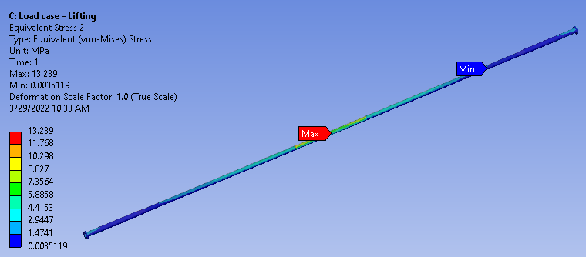
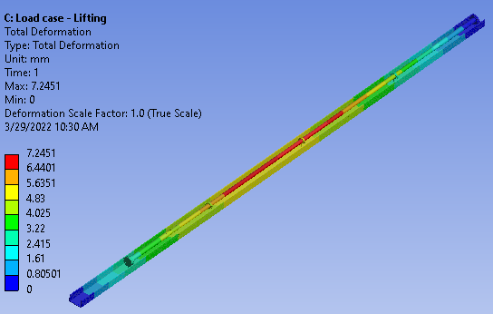
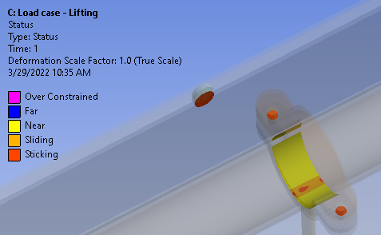
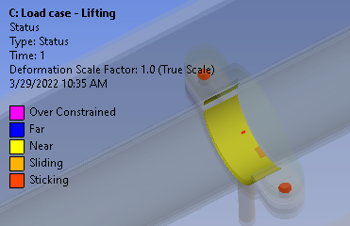
FEA of Strong Back with Beam pipe with Jacket Installed (worst case scenario while lifting)
Strongback design limits beampipe deflection
Peak stress at contact area
Stress in beam pipe
Deflection of strong back assembly
Contact between clamp and Beryllium tube
Load case while the beam pipe getting coated
is yet to be analyzed, part of upcoming Critical Lift Review
Contact between clamp and Aluminum

Slide 9
sPHENIX Beamtube Coating Plan
Plan includes multiple length and diameter configurations proceeding to a full length mockup beampipe prior to coating the actual sPHENIX beampipe. The process will take several months to complete. Goal is to be ready 1 month before the scheduled beam pipe delivery (ready in March for April delivery).
Coating parameter development is complete.
NEG film process in the B902 vertical pit system is generally well established, except for parameters for the small central pipe diameter and overall length.
Small diameter coating parameters established to produce 1-2 μ thick NEG film
solenoid B field, discharge gas pressure, cathode voltage, ion current, anode temperature
Full length cathode prepared. Aluminum & SST mock-up complete: NEG uniformity and adhesion verified.
SST mockup fabrication & NEG coating complete (NEG activation test successful)
A full-length cathode and beampipe support fixture designed. Plan is to use the sPHENIX in-situ bake out jackets for the coating bakeout.
Can prepare temporary system by hand for coating if jackets not available.
Prepare beam tube with procured heater jacket and t/c system prior to installation in sPHENIX
NEG Development sPHENIX specific:
1 meter NEG cathode
- Prepare 1 meter cathode
- Coat and measure samples on 3inch diameter 1m long tube (Recalibrate and validate standard parameters)
- Coat and measure samples on ~40mm diameter 1m long Al tube (Develop parameters for smallest diameter)
Parameters and thickness for activation level between 200 and 250C
Full length NEG cathode
Prepare Full length NEG Cathode
Design, Fabricate and Test Lifting Fixture (Critical lift review planned, AI from PDR)
Coat and measure samples on full length Al & SST mock-ups (verify parameters, uniformity for full length tube)
Coat and measure samples on mock-up sPHENIX beamtube (with fixture)
Coat and measure sPHENIX beampipe

Slide 10
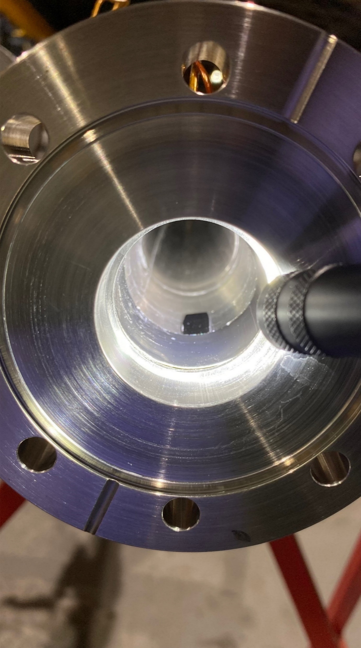
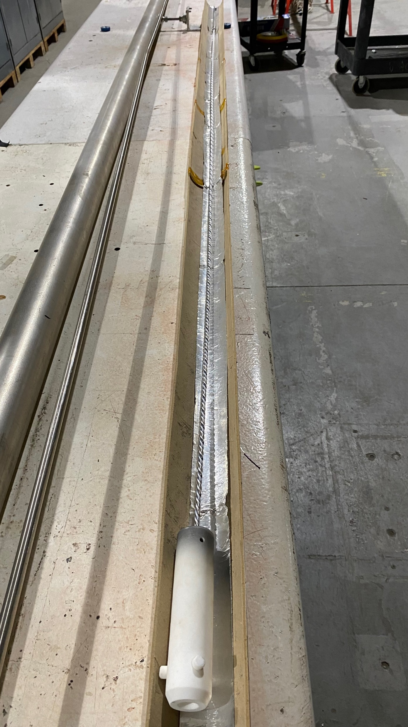
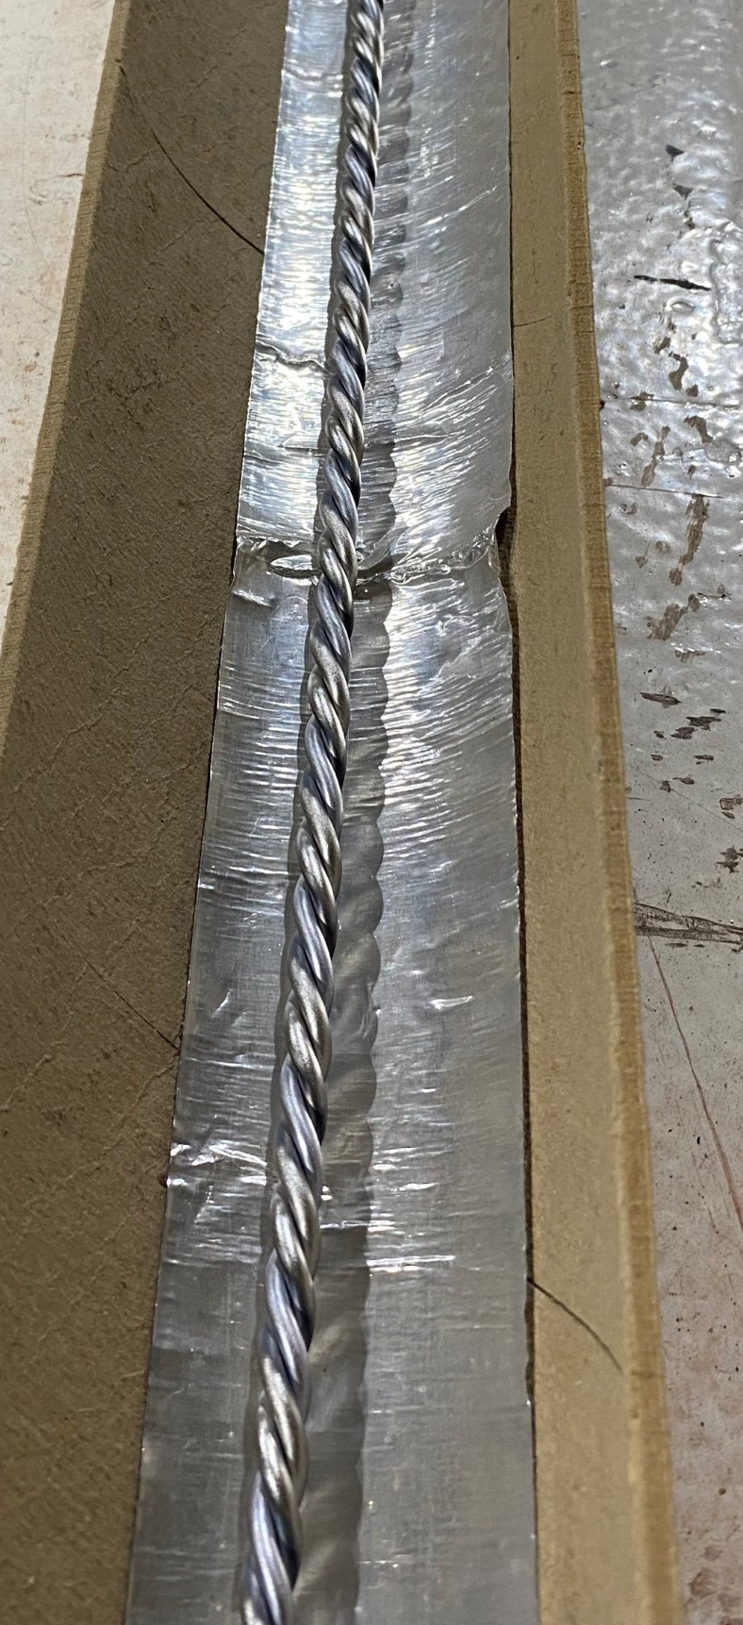
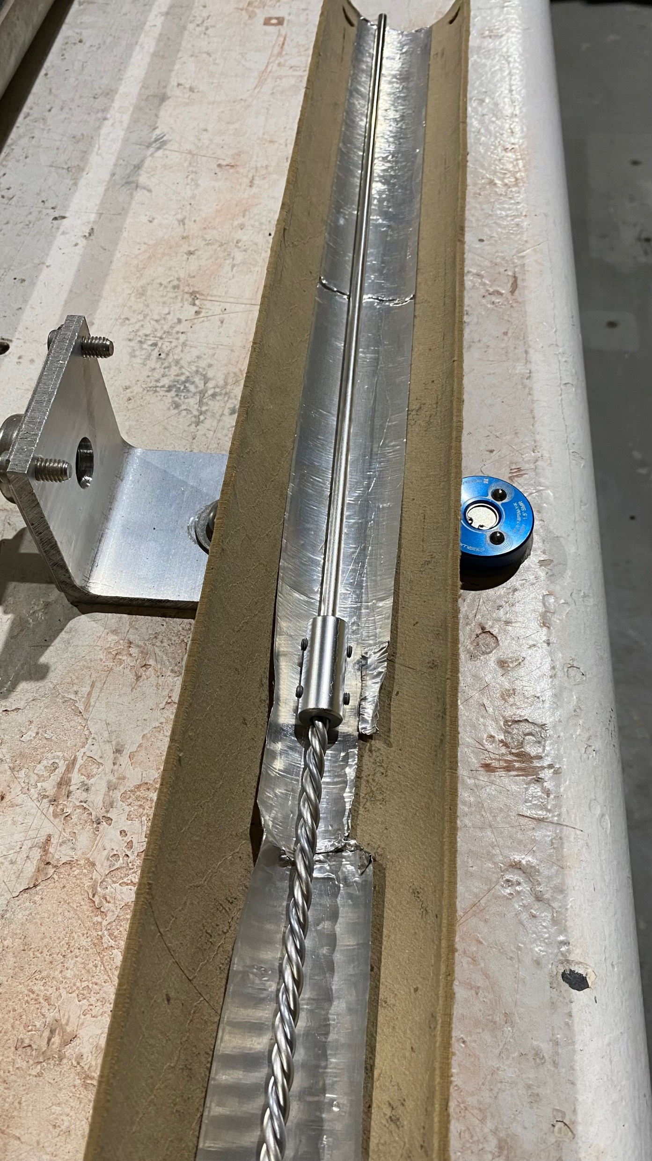
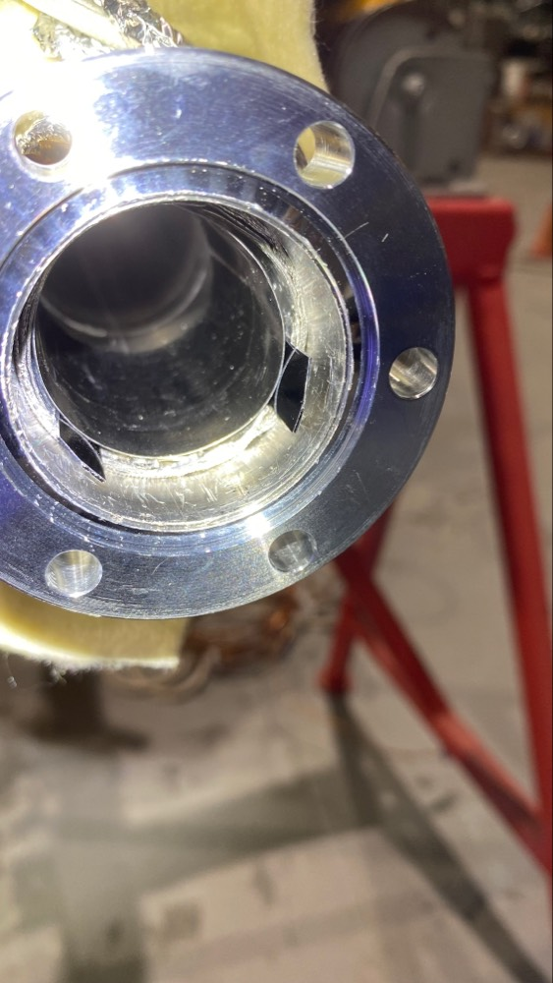
sPHENIX NEG Development
40mm anode with shielded silicon samples
Full length sPHENIX NEG cathode
Ceramic cathode aligner
Φ3mm Ti, V, Zr twisted wires
Feedthru lead-cathode support

Slide 11
sPHENIX Beamtube BNL Timeline
Upon receipt: (~3 weeks from receipt to delivery to sPHENIX)
Receipt
Unpack Visual inspect 1 day
Vacuum QA He leak rate and RGA 2 day
Coating bake and fixture prep 2 days
Coating pit install 1 day
Pump leak check start bake 1 day
Bake and ramp down leak test 3 days
NEG coat 2 days
Verify NEG performance 2 days
Vent remove blank and pump 1 day
Remove temporary bake out 1 day
Pack and ship to IR8 (include pump down and seal) 1 day
IR8 Vacuum Schedule:
Install central beam pipe,
Install remaining beamline & components (DX7 to DX8) and survey 5 days
Pump down and Leak check beam line 1 day
Test temporary INTT Bellows Support bridge set-up and operation (1-2 days)
Prep bakeout 5 days
Bakeout, hot leak tests and activate NEG, commission vacuum system 4 days
Extend to 5 days for greater NEG activation at lower temperature (Al2219)
Break down bakeout system and remove blankets 3 days
Final survey 1 day

Slide 12
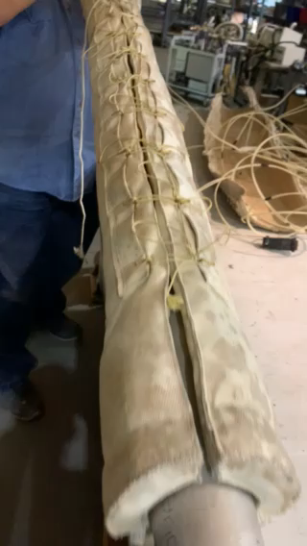
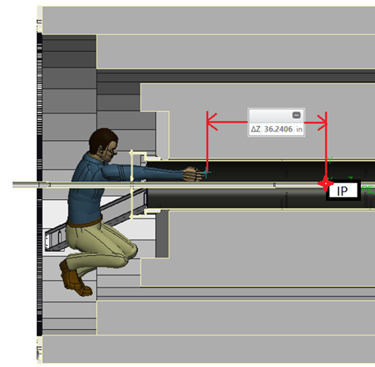
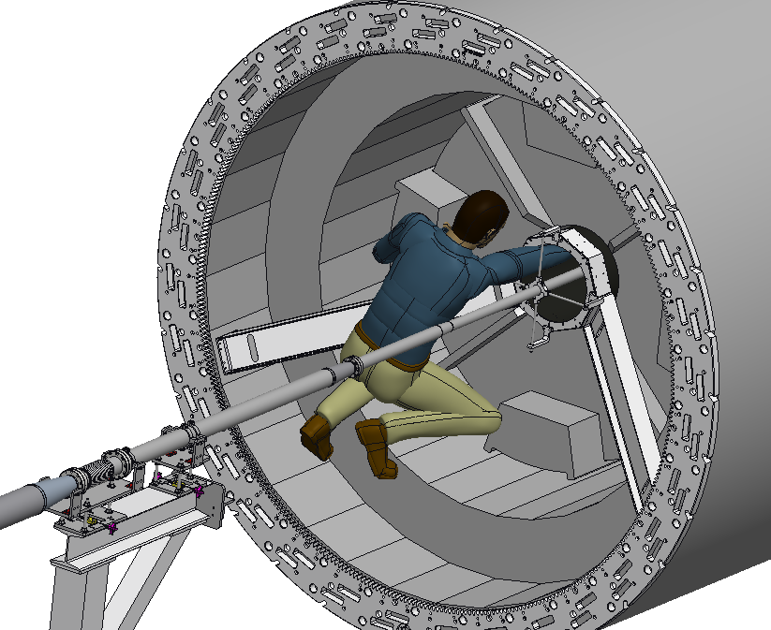
Jacket installation and removal
About 10ft long beam tube not directly accessible.
Grommets and lace with special tying technique to install and removal of jacket from inaccessible area.

Slide 13
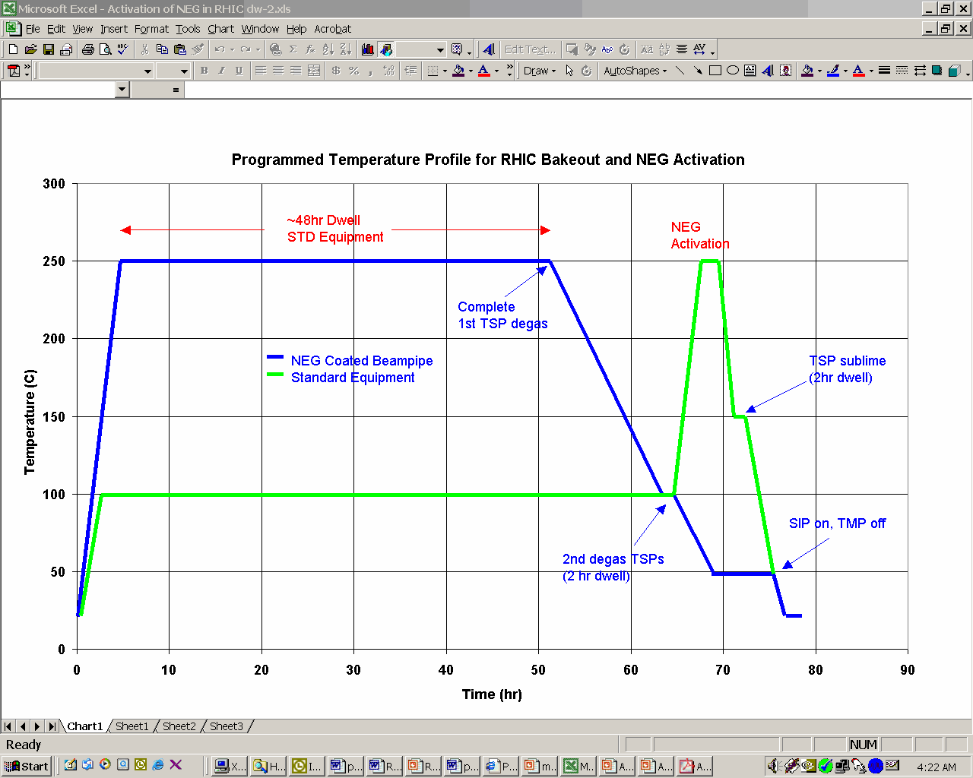
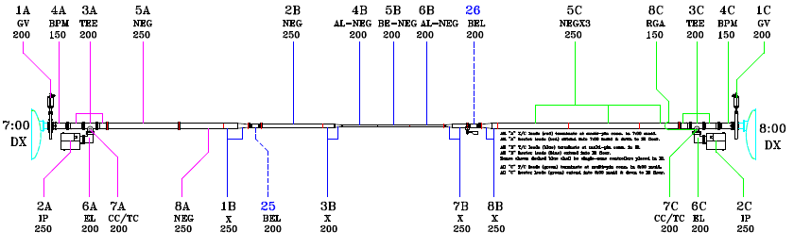
C-AD Vacuum Bakeout w/ NEG UPDATE graph with longer activation
Extend activation time by 10 hours, adds 1 day to process (Total ~5 days)
Bakeout jacket system designed to meet zone (PID/SCR) control limits.
Longer tube, baking procedure remain same.

Slide 14
Schedule
Schedule:
Fabrication of strong back and fixtures: 05/22/22
Delivery of beam pipe at BNL: 06/15/22
Inspection and testing: 06/29/22
Delivery of heating jackets: 07/01/22 (Order dispatched 03/07/2022)
Fabrication and NEG coating of adjacent Al and SS beam pipes: 09/30/22
Coating schedule: ~3 weeks in September ‘22 (includes inspections, prep, coating, testing, packing (sooner if EIC a-C coating development is completed earlier)
Beam pipe available for installation by early October the latest.
Install, survey, pump, leak test, test INTT interim supports, prep bakeout, bake out, commission vacuum, final survey, remove bake out

