Slide 1




EICROC0
F. Bouyjou, E. Delagnes, F. Dulucq, M. Firlej, T. Fiutowski, J. Gonzalez, F. Guilloux, M. Idzik, C. de La Taille, J. Moron, L. Raux, K. Swientek, D. Thienpont, D. Marchand, C. Munoz, M. Morenas, N. Seguin-Moreau, L. Serin
27 jan 2022

Slide 2

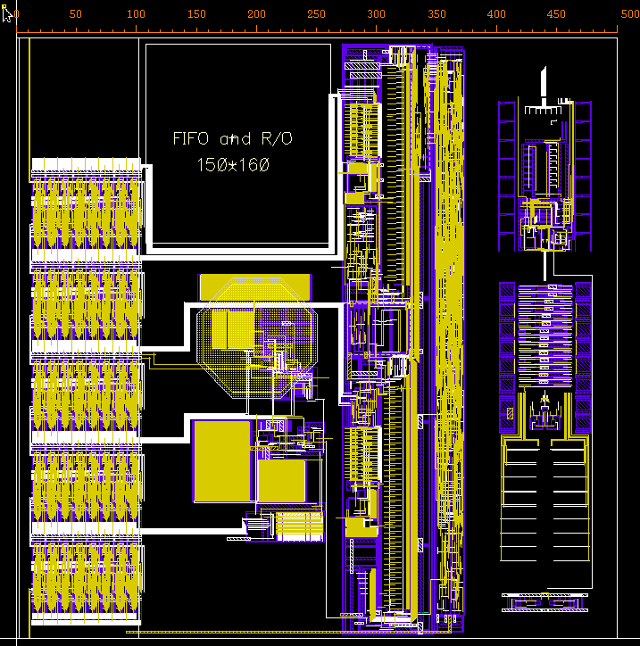
One pixel
Most blocks ready
  Preamp, discri taken from ATLAS ALTIROC
  I2C slow control taken from CMS HGCROC
  TOA TDC adapted by IRFU Saclay
  ADC adapted to 8bits by AGH Krakow
In progress
  Shaper/ADC driver
  Digital readout :
    FIFO depth 8 (200 ns)
Variant with TOT instead of ADC
  In preparation at IRFU
Slow control
PA +discri
TOA TDC
8b 40M
ADC

Slide 3
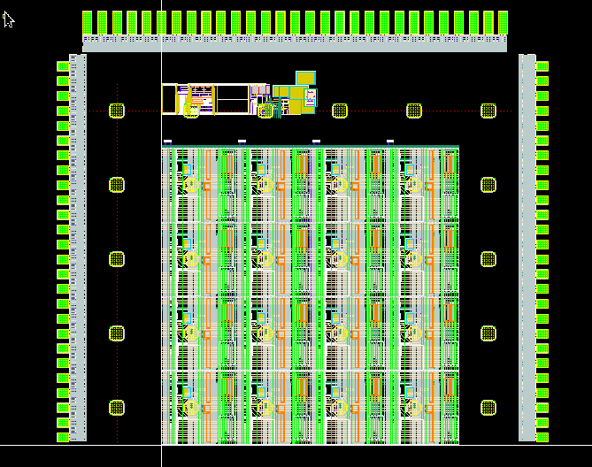
overview
2 chips foreseen 4x4 TOA/ADC and 4x4 TOA/TOT or 4x8 possible.

Slide 4
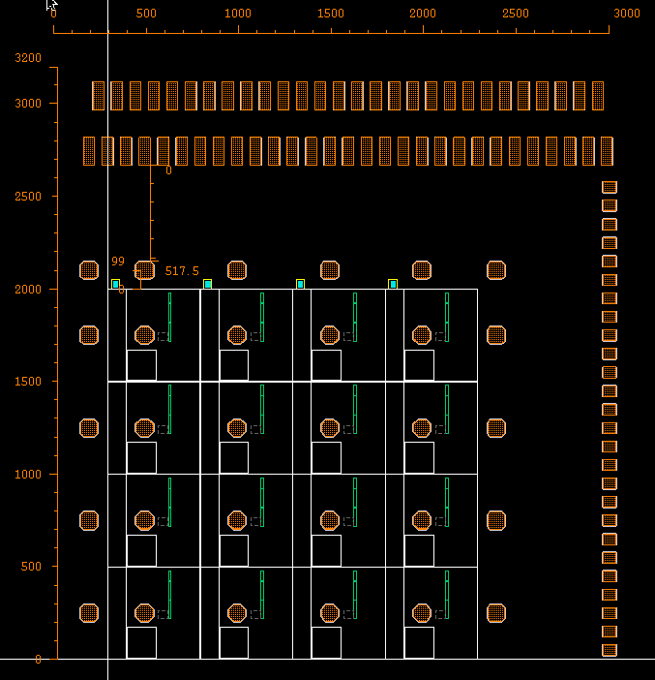
questions
Notice bump pad slightly off-centered by 50um (x=200,y=250)
Bump pad locations for guardring ?
Distance WB pads to bumps ?
WB pads spacing : 100 um
Extended WB pads needed ?
Can they be on 4 sides ?

