Slide 1
Status and Contribution to TowerSemi 65nm @BNL/LBNL
01/31/2022

Slide 2
Status of TowerSemi 65nm PDK
NDA signed and TowerSemi accounts established
PDK and DDK downloaded
Identifying tasks and assigning manpower
Aligning with CERN submission plans

Slide 3
Proposed contributions to ALICE ITS3 scope
SEE (SEU, SET, SEL) testing vehicle chip,
Slow control life function monitoring ADC,
Power Schemes, Serial powering etc.,
Help given to PLL, transmission encoding, serialization, and CML line driving.

Slide 4
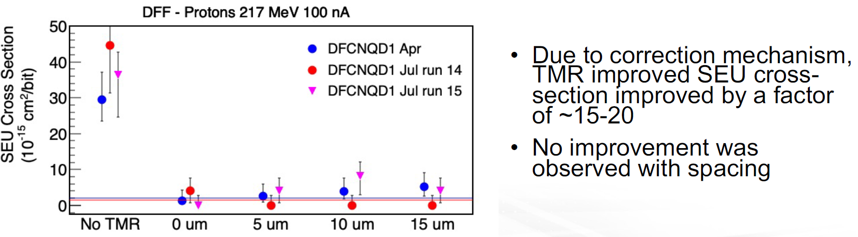
SEE (SEU, SET, SEL) test vehicle
Based on RD54SEE chip
Similar scope can be practiced in TowerSemi 65nm

Slide 5
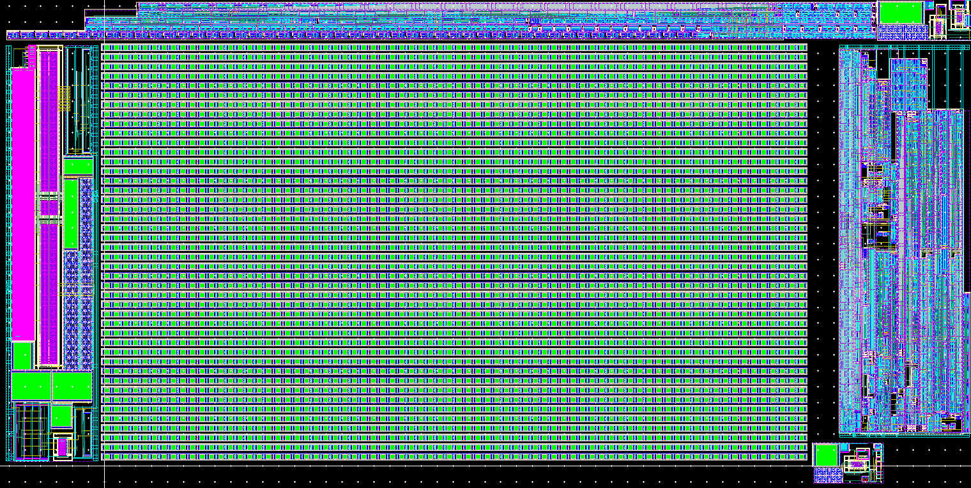
Slow control life-monitoring ADC
Given the relatively moderate resolution, a successive approximation (SAR) ADC based on a capacitive charge redistribution DAC should provide a compact and energy-efficient solution. Typical performance metrics for ADC designs of this type in comparable processes results in the following preliminary design specifications for this converter:
Parameter | Value | Notes
Sampling rate | 1 MS/s | Maximum design value
Unit capacitor size | 0.2-0.5 fF | To be optimized
Input type | Differential | A signal multiplexer and single-ended to differential converter can be added if required
Full scale voltage | >1.6 V | Assuming VDD = 1.2 V
Calibration requirements | None | DAC matching is expected to be sufficient
Effective number of bits (ENOB) | 8 | Worst case for near-Nyquist inputs
Power consumption | 10 µW | Including on-chip reference buffer
Layout area | 50 µm x 50 µm | Not including power supply decoupling
150 μm
300 μm
2. sprouted from digitized nEXODASIC (nEXO PD readout)
Parameter | Value
Sampling rate | Up to 50 MS/s
Output resolution | 12-bit
Full-scale voltage | 1.7 V_{pp}
Effective no. of bits (ENOB) | 11.0
Core power (at 50 MS/sec) | 820 μW
Reference buffer power | 1.15 mW
Walden FOM (incl. buffer) | 19.5 fJ/bit

Slide 6
Serial powering
New scope, needs to be understood if needed
Serial powering needs to be addressed as a complete scheme, including the system point of view while also descending onto individual components. Thus, the on-chip regulator and other circuit solutions should be designed in compliance with the entire powering system. LBL was involved initially in the serial power scheme for ATLAS, which could be a starting point for the current contribution. This is one area where the BNL/LBL teams could work with a more relaxed timeline (basically, until ER3), but it is also newer territory.

Slide 7
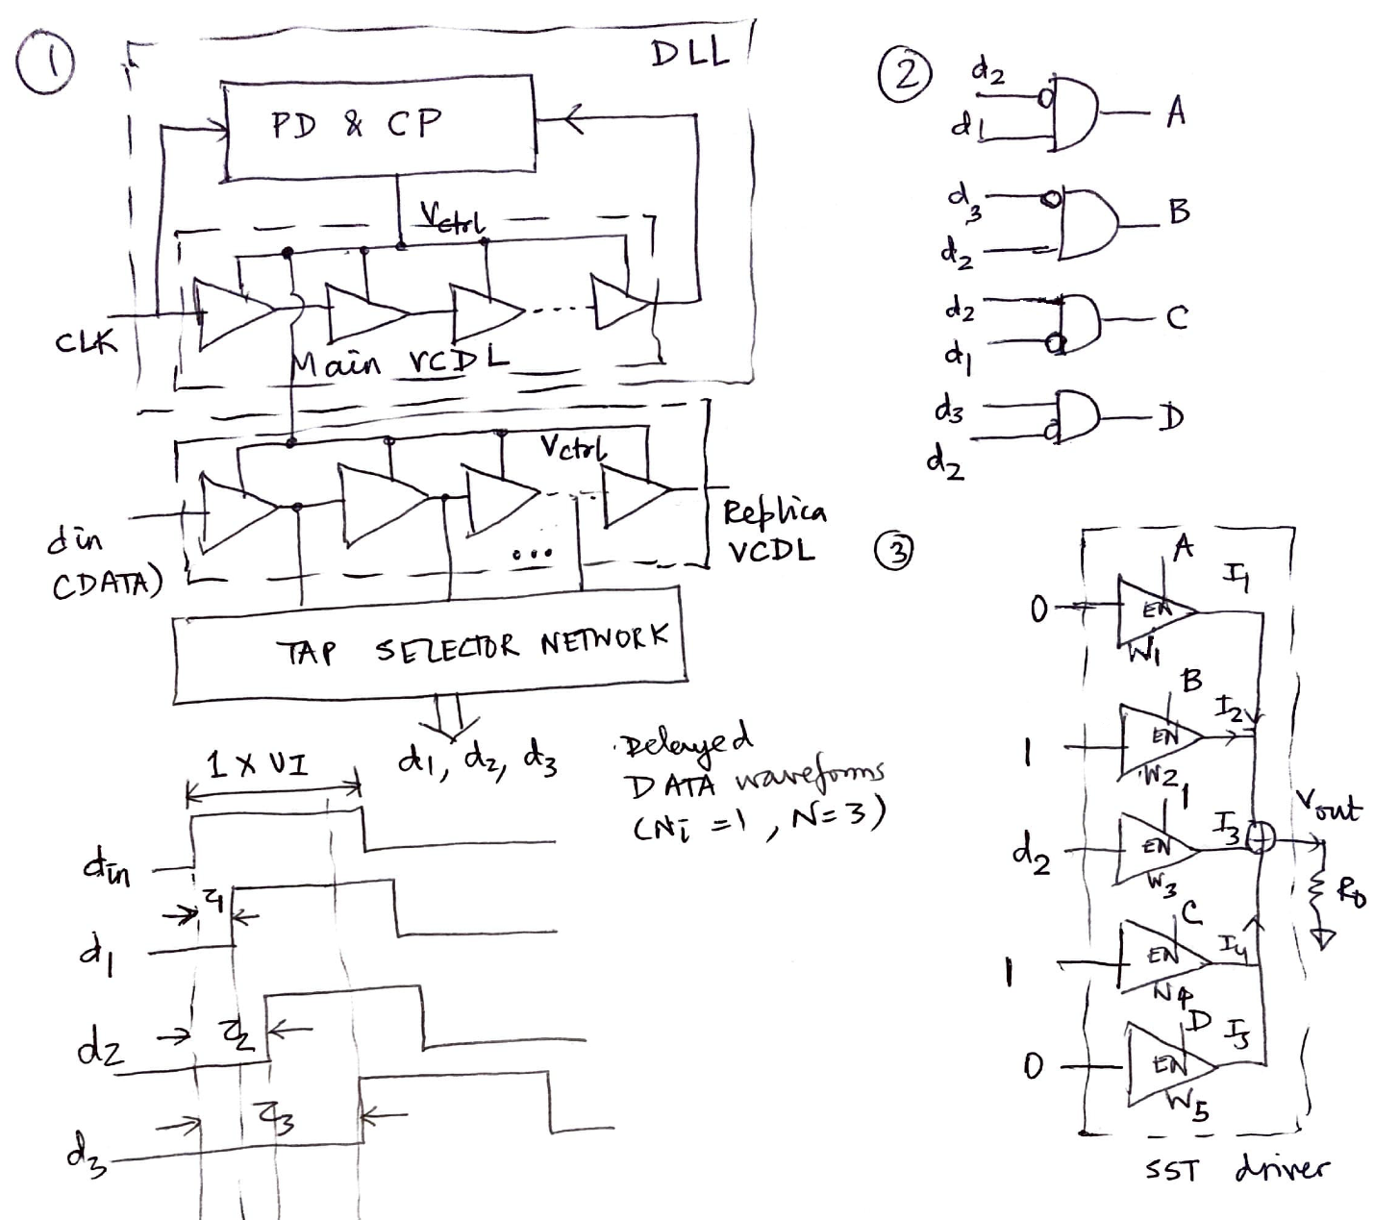
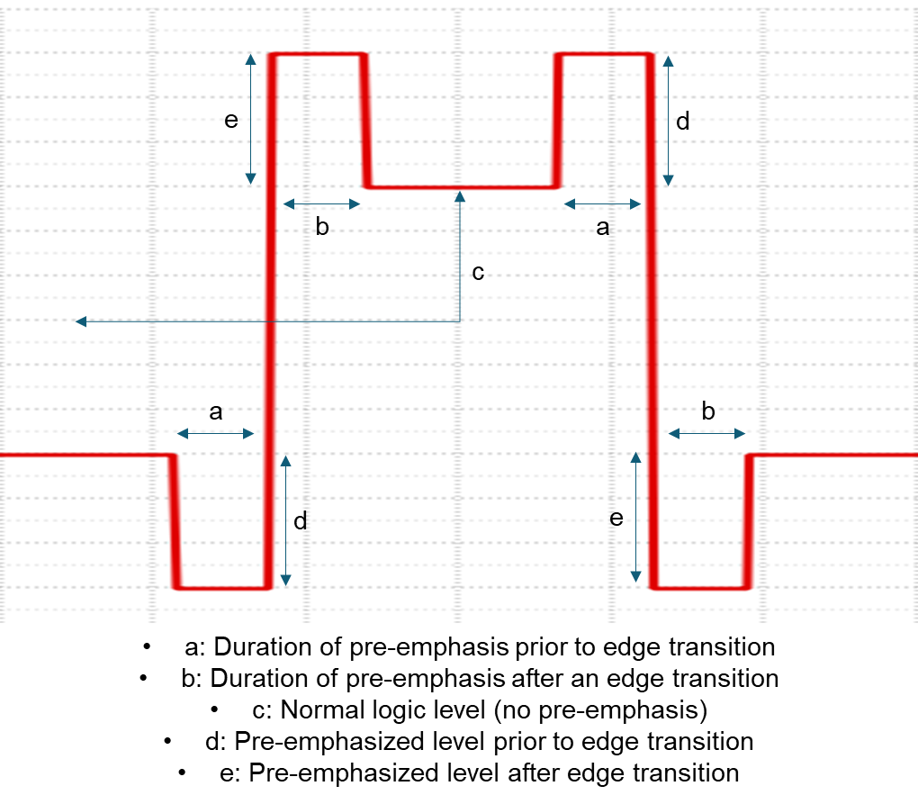
PLL, transmission encoding, serialization + line driving
Low-power line driving with premphasis for nEXODASIC.
Source-Series Terminated (SST) driver
no CML driving
Proposed solution: construction of pre-emphasis with DLLs and ganged SST drivers
~10% adj. of ‘a’, ‘b’, ‘c’, ‘d, ‘e’ w.r.t. UI is desired
for the nEXO Taiflex cable, the best settings were found: ‘a’ ð 10% of UI; ‘b’ ð 90% of UI; ‘c’, ‘d’, ‘e’ ð 0.5*VDD
canonical construction of line driver side pre-emphasis
core DLL ð 300uW
periphery DLL ð 1.5mW
cable driver ð 3mW
Total Driver ð 4.8mW

