Slide 1
IR layout and planned work at IR-6
E.C. Aschenauer (BNL)

Slide 2
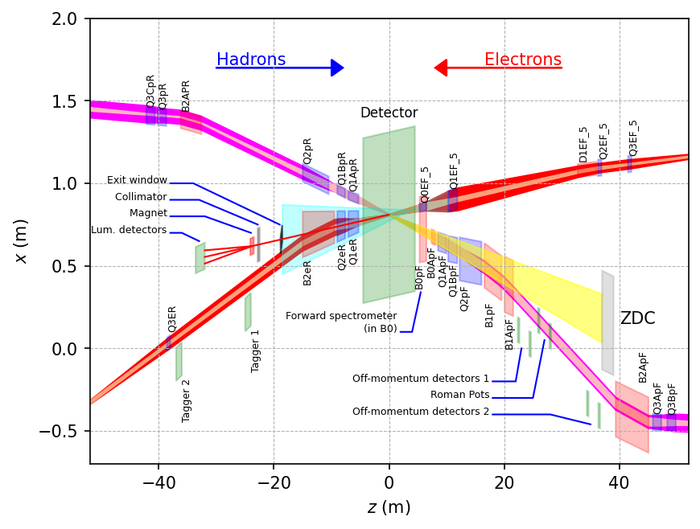
Perspective from Friends from Physics
Many interfaces and dependencies between EIC Experimental equipment and Interaction region at IP-6 → need to define them better and better

Slide 3
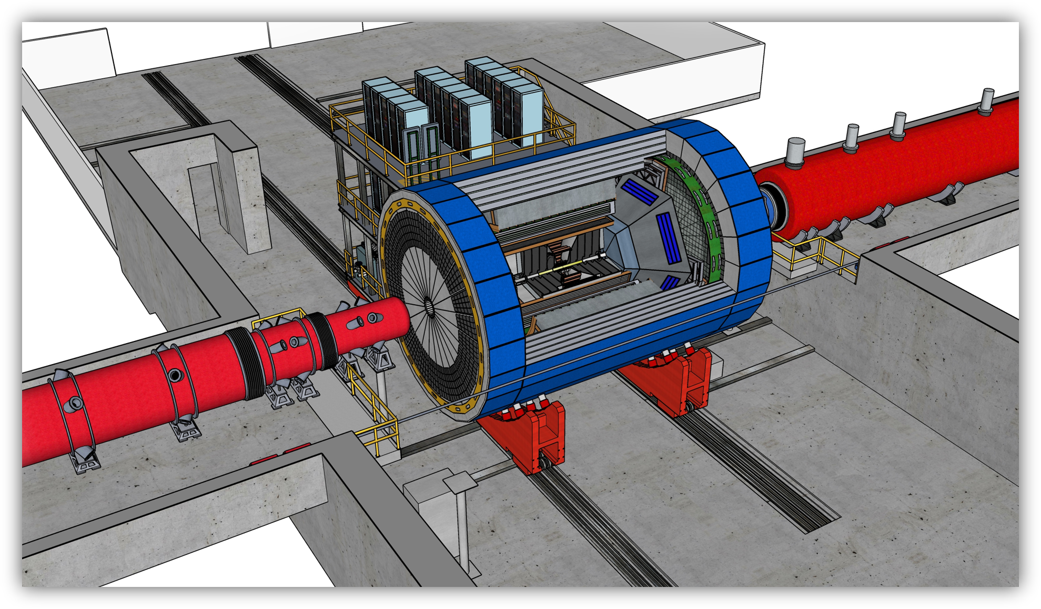
Progress: IR-Integration and Interfaces
Space Constrains:
-4.5 m – IP – +5m not negotiable
50 cm space to 1st IR-magnet occupied by vacuum pumps, valves, …..
IP moved 81 cm towards ring inside compared to RHIC; y: 432 cm above floor
no installation possible in collider hall
Hadrons
RCS
Electrons
9.5 long detector does not fit through the door
Door-Size: 823 cm x 823 cm
endcap hadron calorimeters need to stay in collider hall, if detector rolls in
assembly hall
RCS to IP: radial distance 335.2 cm at a height of 372 cm from floor
Maximum outer radius ~ 3.2 m
Fringe field requirements for solenoid
the fringe field at both endcaps impacting the IR magnets: < 5 gauss
and the fringe field radial along z to impact the RCS: < 0.007 Tm

Slide 4
Progress towards CD-2
General Points:
make progress on the installation sequence of the accelerator and experimental equipment
identify conflicts if any
this needs to include the STAR R&R schedule
defining any anticipated changes in IR layout and optics impacting the experimental equipment acceptance and overall performance early (beam pipe size in y, …..)
define the requirements for a fast beam abort system from the experimental point of view
what signals are needed from the detector to provide to the fast beam abort system
beam pipe bake-out and integration to keep vacuum in a as good shape as possible when breaking vacuum for detector maintenance.
can we further optimize the pressure bump at forward side by pump placement refinement?
Ancillary Detectors and IR Integration
improve beam pipe design in the experiment and in the far forward and backward direction
need a beam pipe design idea over the full +/- 40 m region
important for integration of RPs, off-momentum, ZDC, low-Q² tagger
refine far-forward and backward detector requirements and needs, i.e. pressurized gas, cooling, ……..
Polarimetry and Luminosity
luminosity detector exit window design and overall lumi-detector integration
are there any other measurements for the lumi-detector the collider needs → SR fan size and orientation?
next steps of lepton polarimeter integration → beam background SR and beam gas

Slide 5
Progress towards CD-2
Magnet:
improve maximum fringe field requirements of detector solenoid at nearest forward and backward IR magnet locations and for the RCS
improve detector solenoid compensation scheme
define requirements for maximum multipole components induced by the detector solenoid in the magnet-free IR region that can be mitigated
Not IP-6 but a big concern
Placement of hadron polarimeters for p,d and He-3 → H-jet + its taggers to veto He-3 breakup and pC, currently at IP-4 (RHIC location IP-12)
IP-4 not optimal location, backgrounds, flexibility in beam optics needed for polarimeters
Can we find space in IP-6 and IP-8 outside the hadron spin-rotators
challenge tunnel height to fit H-Jet, need dipole next to H-Jet and pC should be very close to H-jet
Requirements (space, optics, ..) well defined in official requirement-interface document

Slide 6
Accelerator Focus
Detector Solenoid Compensation
finalize ESR and HSR coupling corrections
Magnets
B0pF 2K Design
Spin rotator solenoids, 12T – Feasibility
Skew quads hadrons → Detector solenoid compensation
Dipole corrector B0ApF → Detector solenoid compensation
Integration (vac., beampipe, BPMs, assembly)
Vacuum
Central detector beampipe updates – Impact on physics simulations
Removal and installation gymnastics for central chamber
Cooling beampipe (Synrad)
Lattice
Look at solutions for closing crab bump
MDPS
Collimators & Absorbers – locations
ESR & HSR aborts
Location and Infrastructure
IR Instrumentation
Orbit Correction near the IP
eval. strategy for BPMs and corrector magnets design

