Slide 1
Accelerator planning for IR-8 this year
Walter Wittmer
2022 IR non collaboration specific topical meeting
January 31st 2022

Slide 2
Reminder
Project scope:
Feasibility of additional IR
What does this mean:
2nd IR pre conceptual design (pre CD-0)

Slide 3
Status
Linear lattice solution in place
Accommodates zero order space requirements from detector systems
Fits into RHIC experimental hall 8 between ARC 7 and 9 and is connected to both rings
Geometric layout determined as baseline for non colliding IR8 lattice (small changes possible) -> this will be soon “frozen”
Initial check for critical FF magnets complete
Detailed analysis ongoing to compare to IR6
Non linear lattice work started

Slide 4
Next Steps
Work to be done includes:
  Freeze geometric layout (crossing angle, …)
    Further study needed for the feasibility of the HSR forward IR magnets driven by complex integration
    Interface definition -> setup dedicated working group with POC
      First order detector systems requirements
      Infrastructure assumption still correct?
      Support systems assumptions?
  HW clearance check
    Spin rotator snake location
    Crab cavity space requirement for the high crossing angle
    RCS bypass
  Answer operability (simultaneously or …)
    Chromatic correction
    Integrated study of EIC dynamic aperture
  Upcoming technical review of 2nd IR design (part of IR6 review)
  Evaluate possible impact of detector selection
  Continuous evaluation of possibility of 2nd IR

Slide 5
IR Requirements & Parameters
 | 1st IR |  | 2nd IR
 | proton | electron | proton | electron
Detector occupied region | -4.5 m +5.0 m Beam elements < 1.5º in main detector |  | -4.5 m +5.0 m Beam elements < 1.5º in main detector
Polarimetry | Yes (IR4) | local | Yes (IR4) | local
2nd focus | No |  | yes
@ 275 GeV (h), 10 GeV (e) | = 80 cm = 7.2 cm | = 45 cm = 5.6 cm | = 80 cm = 7.2 cm | = 45 cm = 5.6 cm
ZDC | 0.6m x 0.6m x 2m @ s30m 4 mrad |  | 0.6m x 0.6m x 2m @ s30-40m 4 mrad
Roman Pots | 1-5 mrad, @s30m |  | 0-5 mrad, @s30-45m
Scattered particle acceptance | p: 0.18 GeV/c < p_{T} < 1.3 GeV/c |  | p: 0 GeV/c < p_{T} < 1.3 GeV/c
Q² tagger |  | Q² < 0.1 GeV |  | Q² < TBD
Crossing angle | 25 mrad |  | 35 mrad

Slide 6
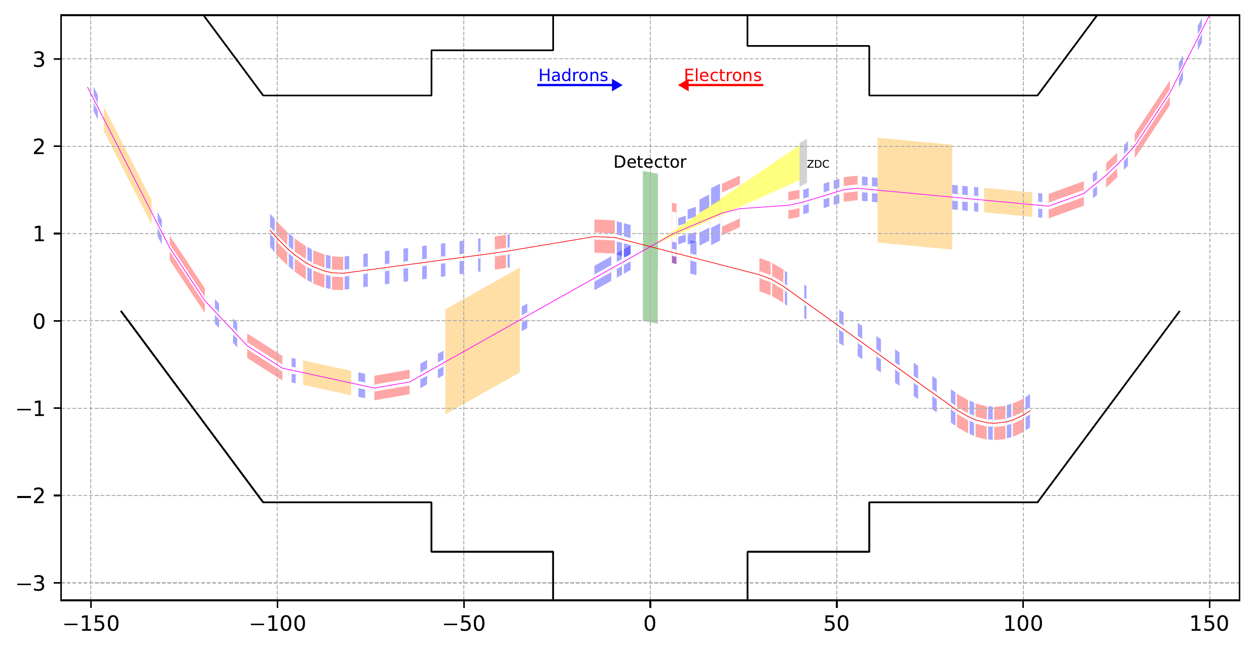
IR8 full layout
35 mrad crossing angle (driven by accelerator geometry).
Second focus point at ~47m.
Space for similar equipment as IR6.
Second focus

Slide 7
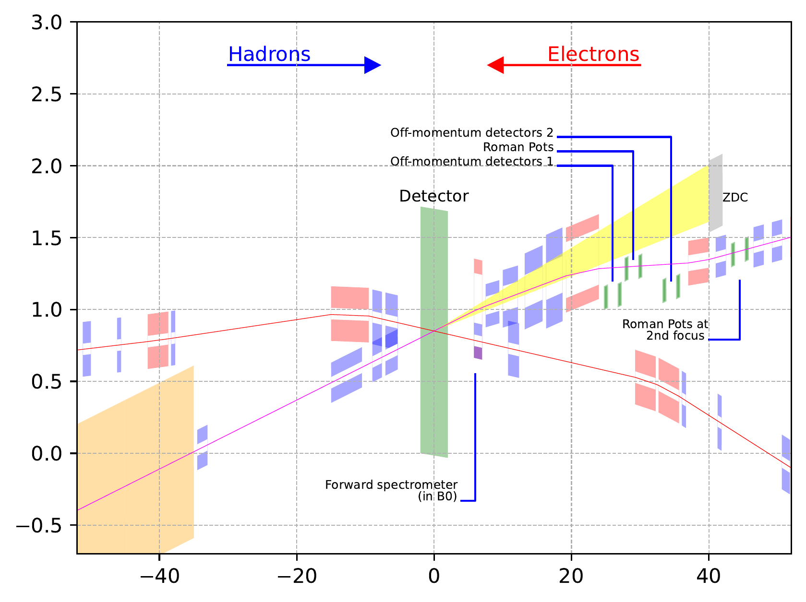
IR8 hall layout
Space available for luminosity monitor, low Q2 tagger and local hadron polarimeter
All ancillary detectors in outgoing hadron beam side (Forward) integrated

Slide 8
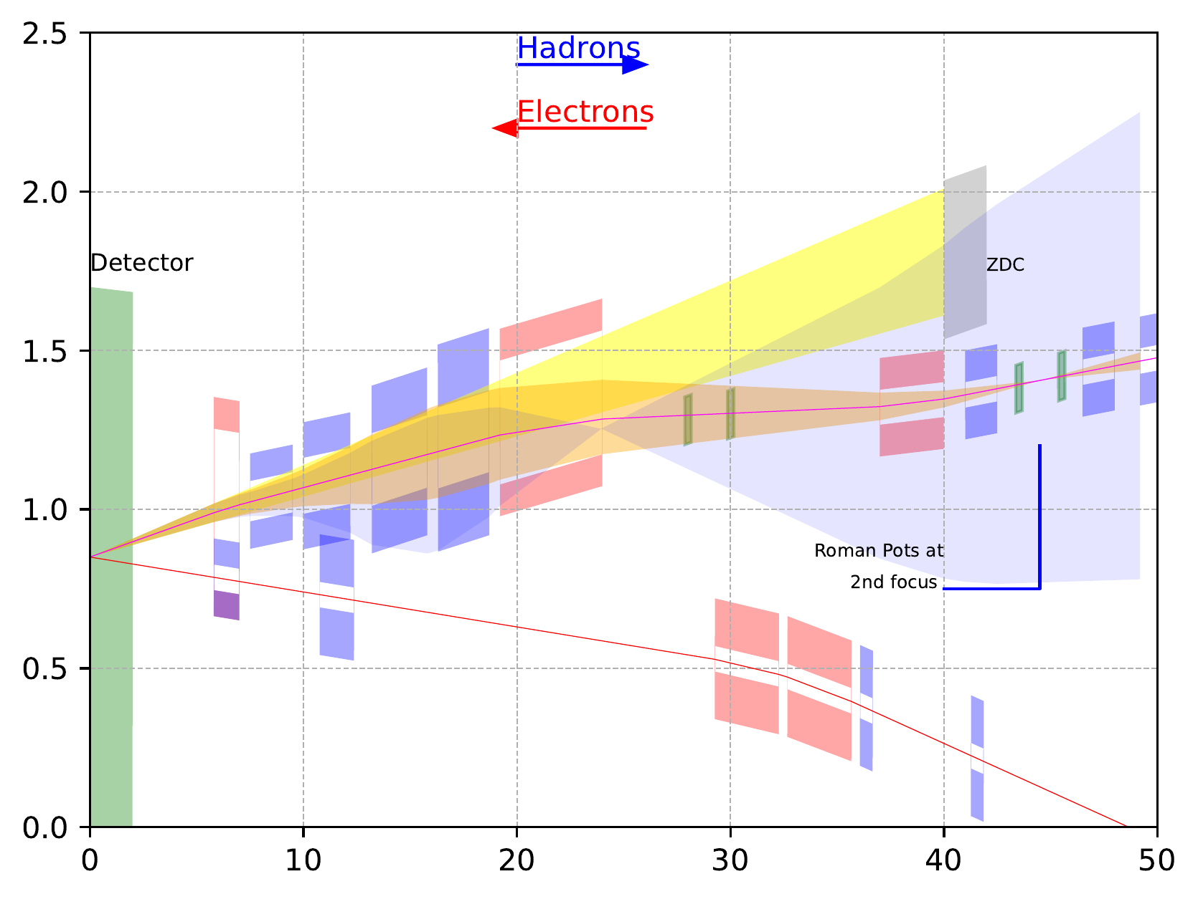
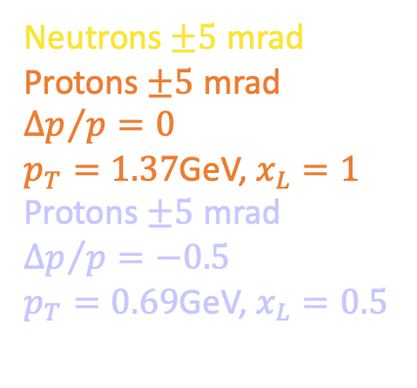
IR8 forward acceptance
This is the current design of the forward region with NbTi magnets
Final focusing quads and the dipole placements was optimized for forward scattering neutron and proton acceptance.
Neutrons $±5$ mrad
Protons $±5$ mrad
$${∆p}/{p=0}$$
$p_{T}=1.37$GeV, $x_{L}=1$
Protons $±5$ mrad
$${∆p}/{p=−0.5}$$
$p_{T}=0.69$GeV, $x_{L}=0.5$

Slide 9
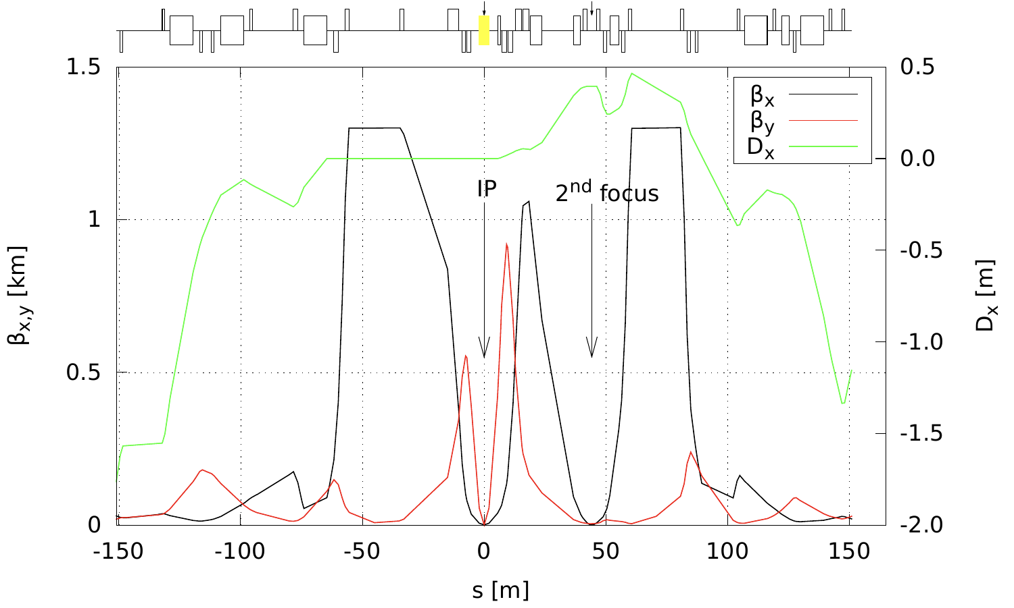
IR8 hadron optics
Rear :
  Non RHIC magnets → 3 final focusing and one wide aperture quad in the crabbing region.
  Space reserved for the same accelerator equipment as in IR6
Forward :
  Limited matching space requires few high gradient magnets (quadrupoles) than what is available from existing RHIC magnets.
Protons
Rear
Forward

Slide 10
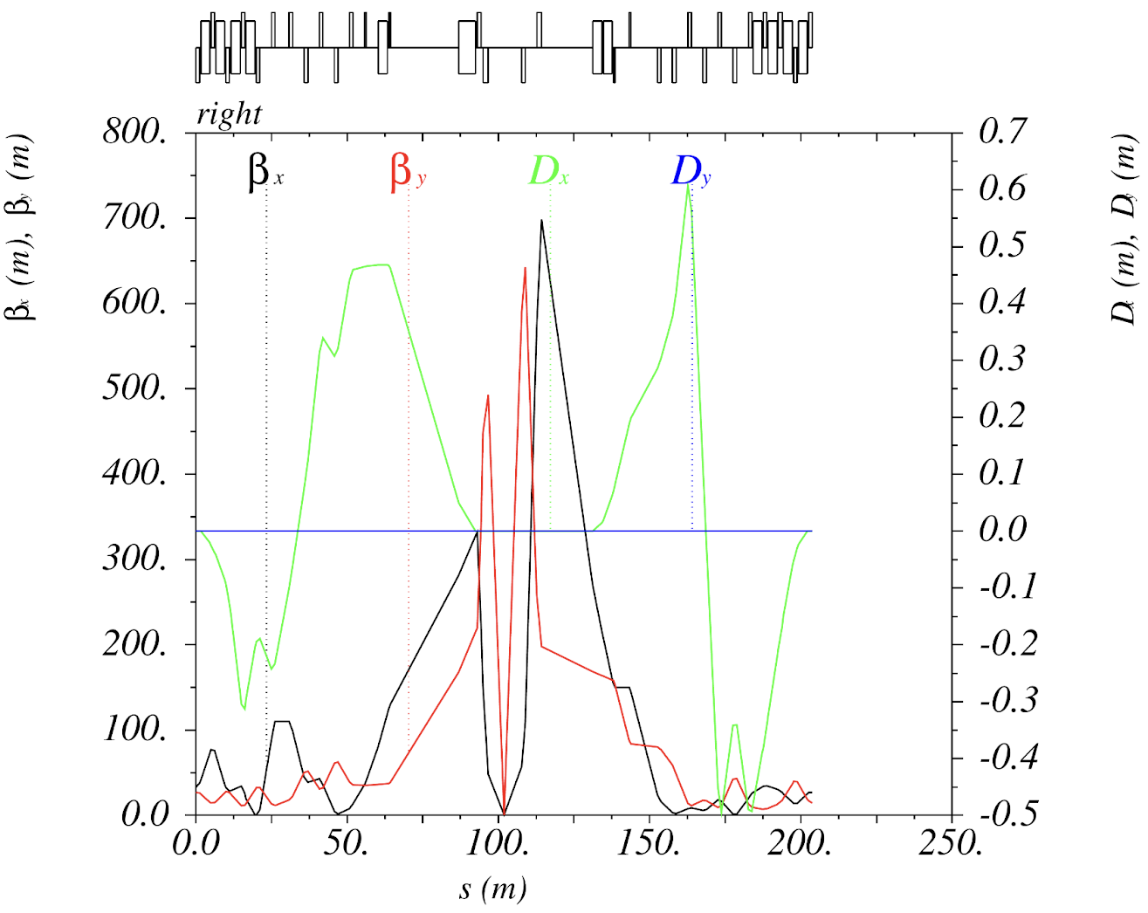
IR8 electron optics
Optics and design similar to IR6
electrons
Rear
Forward

Slide 11

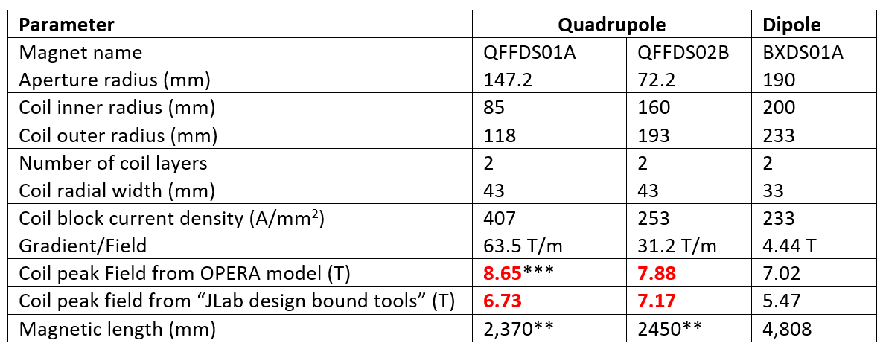
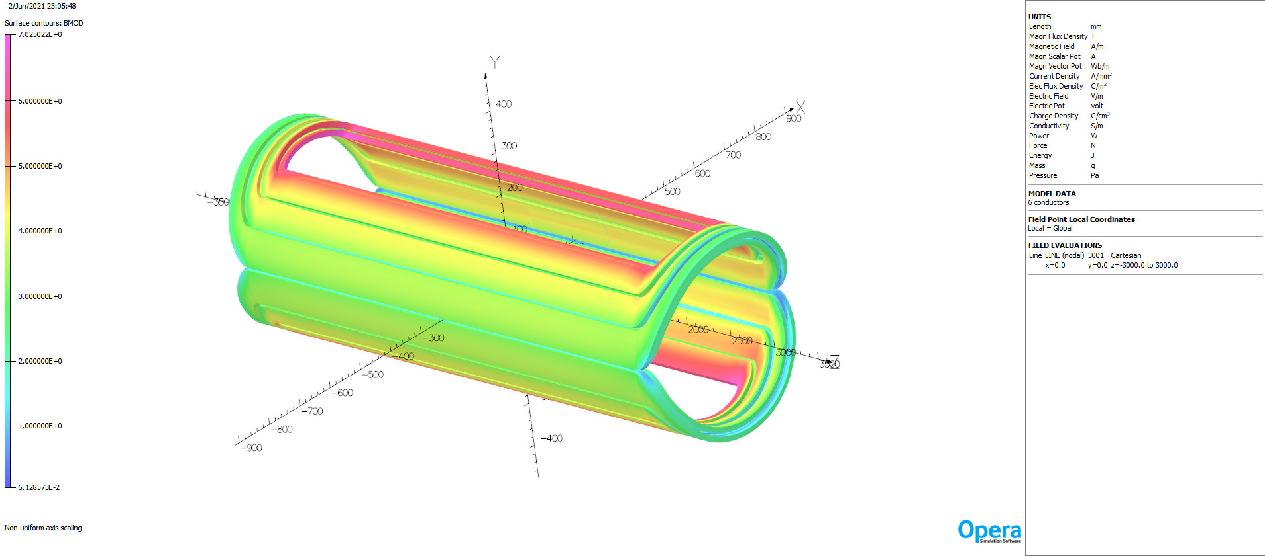
FF Magnet Analysis
One of the quadrupole in the rear side “QFFUS01” does not enough current density margin with the original bore size.
The dipole BXSP01 does not have sufficient temperature margin with the original bore size.
All the quadrupoles in the forward side do not have enough current density margin.
The dipole BXUS01, quadrupole QFFUS03, quadrupole QFFUS02, dipole BXDS01A, dipole BXDS01B and QDS01 have sufficient temperature and current density margin.
With the 15% reduction in the bore size, all the magnets have sufficient temperature and current density margin.
Analysis started to have apples to apples comparison with IR#1 magnet feasibility.

Slide 12
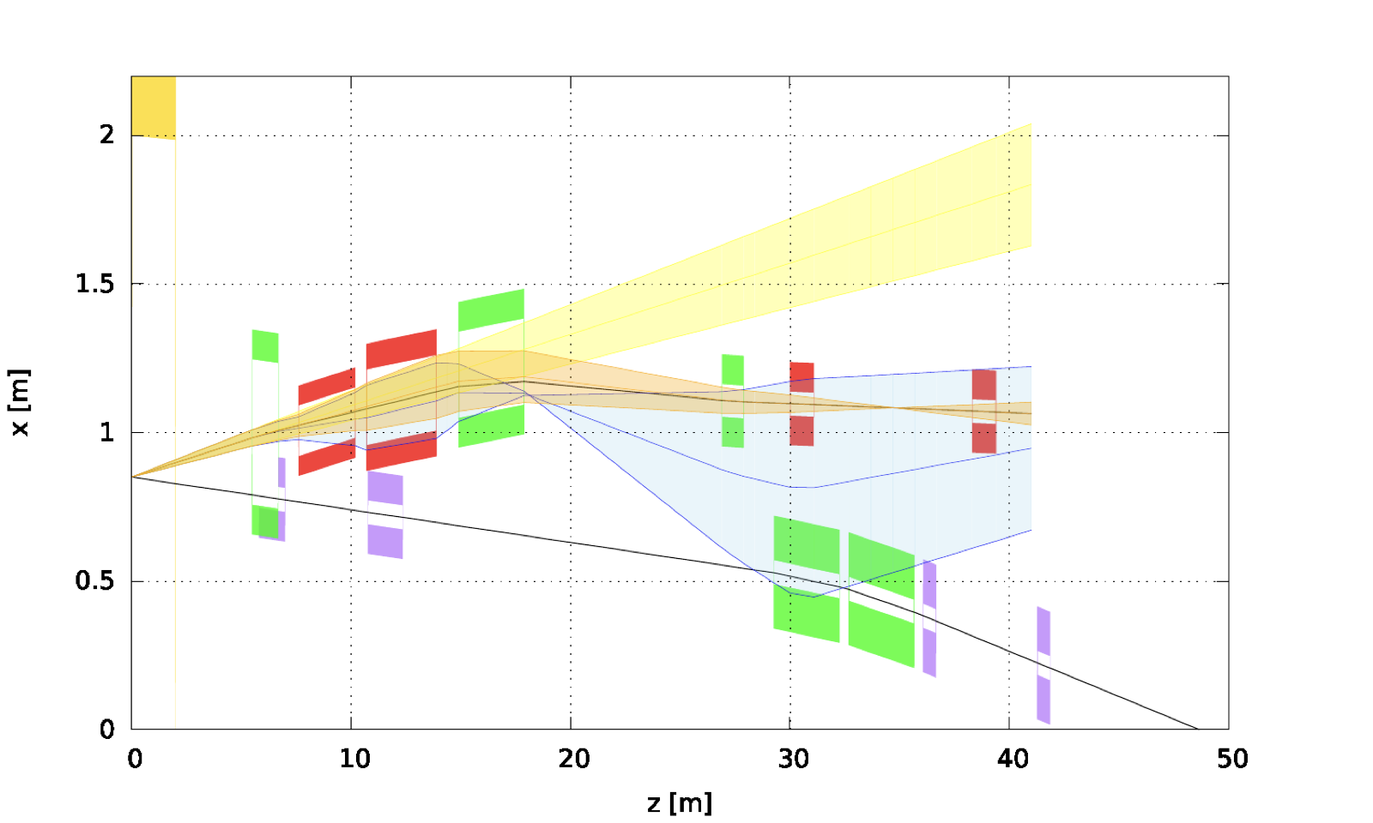
IR8 forward acceptance with Nb₃Sn (option 1)
Two Nb3Sn FFQs and two dipoles with correctors.
Neutrons $±5$ mrad
Protons $±5$ mrad
$${∆p}/{p=0}$$
$p_{T}=1.37$GeV, $x_{L}=1$
Protons $±5$ mrad
$${∆p}/{p=−0.5}$$
$p_{T}=0.69$GeV, $x_{L}=0.5$

Slide 13
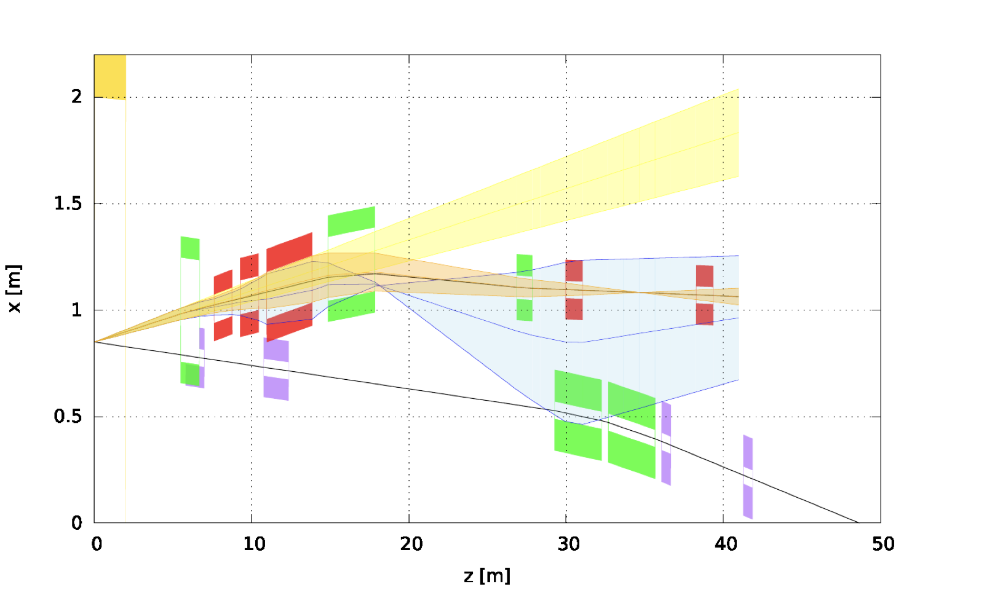
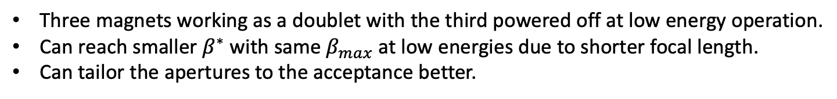
IR8 forward acceptance with Nb₃Sn (option 2)
Three magnets working as a doublet with the third powered off at low energy operation.
Can reach smaller $β^{∗}$ with same $β_{max}$ at low energies due to shorter focal length.
Can tailor the apertures to the acceptance better.
Neutrons $±5$ mrad
Protons $±5$ mrad
$${∆p}/{p=0}$$
$p_{T}=1.37$GeV, $x_{L}=1$
Protons $±5$ mrad
$${∆p}/{p=−0.5}$$
$p_{T}=0.69$GeV, $x_{L}=0.5$

