Slide 1
IR Meetings across Proto-Collaborations – Discussion on IR-8
E.C. Aschenauer (BNL)
R. Ent (JLab)
Co-Associate Directors for the Experimental Program
January 31st, 2022

Slide 2
From July 12th, 2021 Meeting: STATUS IP-8
All material to simulate physics at 18 GeV x 275 GeV has been posted at https://indico.bnl.gov/event/10974/contributions/51160/
Detailed Read-Me how to use all the provided information
Remember what is NOT yet done:
a full integration of the 2nd IR into the EIC accelerator
machine checks for operations
any background simulations, i.e. beam gas and SR
no design of the SR masks and simulations how effective the collimator system is with 2 IR → but as electron beam is not touched should be the same as IP-6
beam pipe design – this will need work as the larger crossing angle will make the transition into B0 more complicated
a design of the IR magnets – first checks that magnet parameters are reasonable (peak fields okay for conductor) have been done, but have not yet done designs such that we can guarantee cross-talks can be sufficiently limited.
→ Hence, this design still comes with some risk!

Slide 3
Present Status (High Level)
Position paper for 2nd IR to define commitment of layout and compatibility verification, and trigger point for further work. Scope agreed and being worked upon.
Initial trial layout with high-field Nb3Sn option (instead of default NbTi option) introduced at EIC 2021 Accelerator Partnership Workshop, 26-29 October.
EIC reference schedule now includes notional schedule 2nd detector/IR.
Multiple workshops in CY2021 on science with a 2nd detector/IR, advantage of 2nd focus started being included in EIC detector proposals.
Technical implementations of 1st and 2nd IR discussed in talk of Angelika Drees and Randy Gamage at Detector Proposal Advisory Panel Meeting of December 13-15, 2021.
Brochure aimed at international agencies on 2nd detector/IR “Maximizing the Scientific Output of the EIC” authored by EICUG Steering Committee being finalized by BNL & JLab media staff.
Further work ongoing within agreed-upon scope/budget of position paper for 2nd IR – see Walter Wittmer’s earlier talk.

Slide 4
Discussion on IR-8
Projecting further this calendar year, what will we have?
Further work on IR-8 lattice, beam dynamics, magnet feasibility (NbTi or Nb3Sn), technical risk assessment, etc.
Science further worked out benefitting from IR-8 with a secondary focus.
EICUG brochure on 2nd IR/detector sent to international agencies.
What we need is a pre-conceptual design report, including
a high-level science introduction
some notion of what a 2nd IR comprises
mention of a 2nd complementary detector.
Should this be the goal for this year?

Slide 6
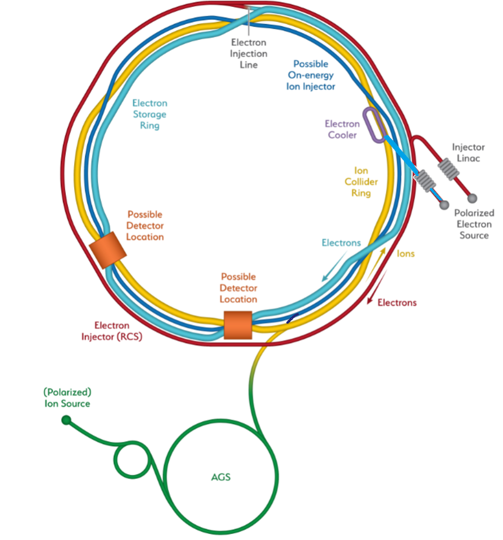
2nd IR Position Paper
https://indico.bnl.gov/event/10677/sessions/4108/attachments/33241/53351/IP-for-2ndIR.v3_post.pptx
IP6 - planned EIC project detector location
hadrons “going from inner to outer arc”
IP8 - viable location for complementary detector/IR
hadrons “going from outer to inner arc”
→ IR designs NOT interchangeable with each other
→ EIC Project position paper for 2nd IR to define commitment of layout and compatibility verification, and trigger point for further work. Scope agreed upon.
From Position paper: “It is important to realize that the IR designs are not interchangeable with each other, with the hadrons going from inner arc to outer arc in IR6 and in opposite direction in IR8. The physical layout of the IR halls (IR6 and IR8) and adjacent tunnel sections differ significantly such that the IR designs are not interchangeable. Two different dedicated designs are required that can directly lead to complementarity in science reach. The path length for the hadron and electrons in the IR varies between different IR designs. The overall path length difference in electron and hadron collider rings is a design constraint with little margin for modification once the lattice design, the placement of the hardware components in the tunnel, is frozen. From this it follows that the path length and therefore the conceptual lattice design of the second IR must be part of the integrated EIC design from the beginning. Otherwise, we risk excluding specific designs required for maximal science reach. Lastly, a 2nd IR will add a second beam collision per turn once operational, and viability of stable beams with a potential 2nd detector and IR deliverable must be ensured.”

Slide 7
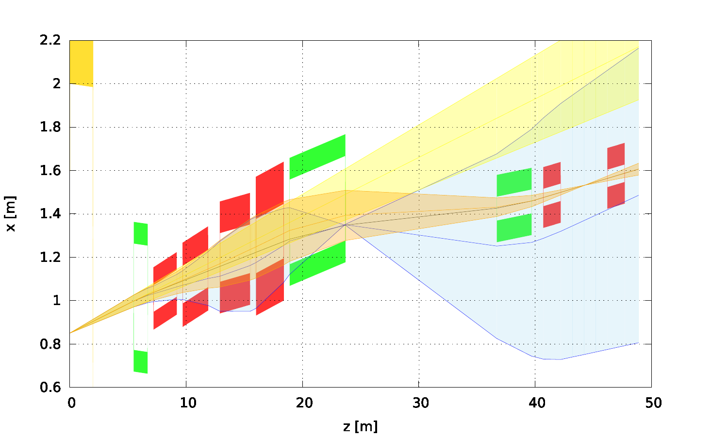
Current NbTi layout
Neutrons ±5mrad
Protons ±5mrad, Δp/p = 0, 𝑝_{T} = 1.37 GeV, 𝑥_{L}=1
Protons ±5mrad, Δp/p = -0.5, 𝑝_{T} = 0.69 GeV, 𝑥_{L}=0.5
(from talk of Randy Gamage at EIC 2021 Accelerator Partnership Workshop)
Dipole
Quad
second focus
ionBXDS01A
ionQFFDS02B
ionQFFDS02A
ionBXSP01
ionQFFDS01B
ionQFFDS01A
ionQDS02
ionQDS01
ionBXDS01B

Slide 8
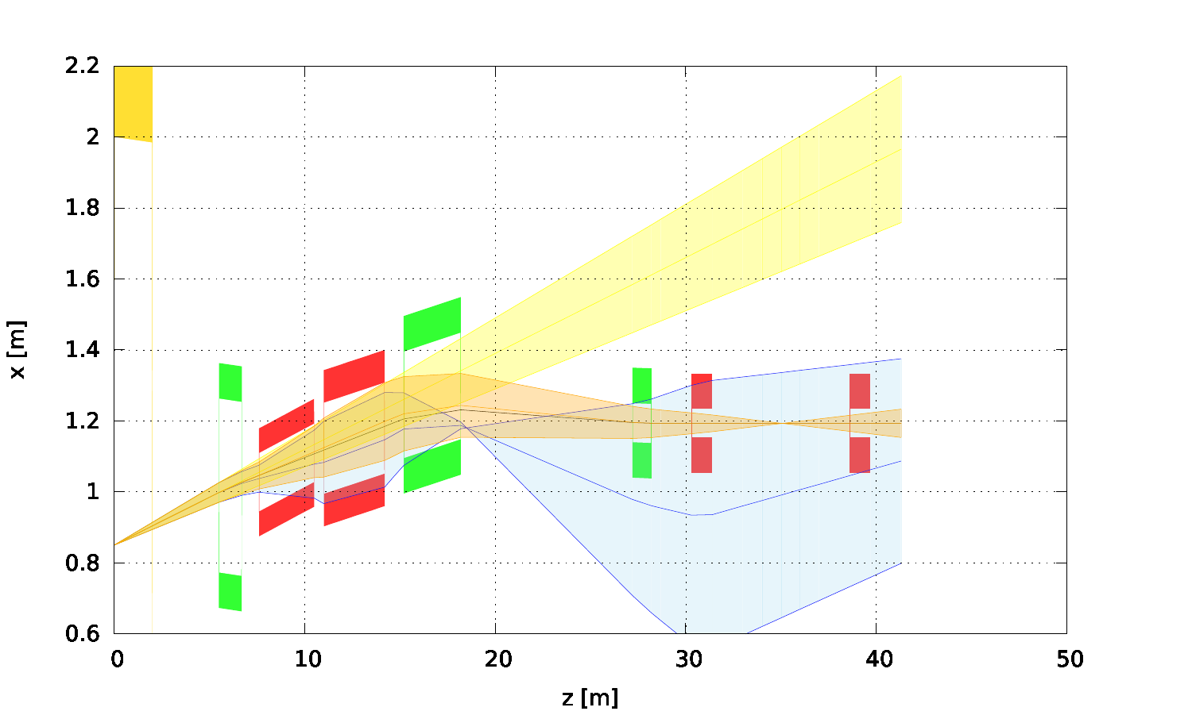
Nb3Sn
Neutrons ±5mrad
Protons ±5mrad, Δp/p = 0, 𝑝_{T} = 1.37 GeV, 𝑥_{L}=1
Protons ±5mrad, Δp/p = -0.5, 𝑝_{T} = 0.69 GeV, 𝑥_{L}=0.5
(from talk of Randy Gamage at EIC 2021 Accelerator Partnership Workshop)
Dipole
Quad
ionBXDS01A
ionBXSP01
ionQFFDS01B
second focus
ionQFFDS01A
ionQDS01
ionQDS02
ionBXDS01B

Slide 9
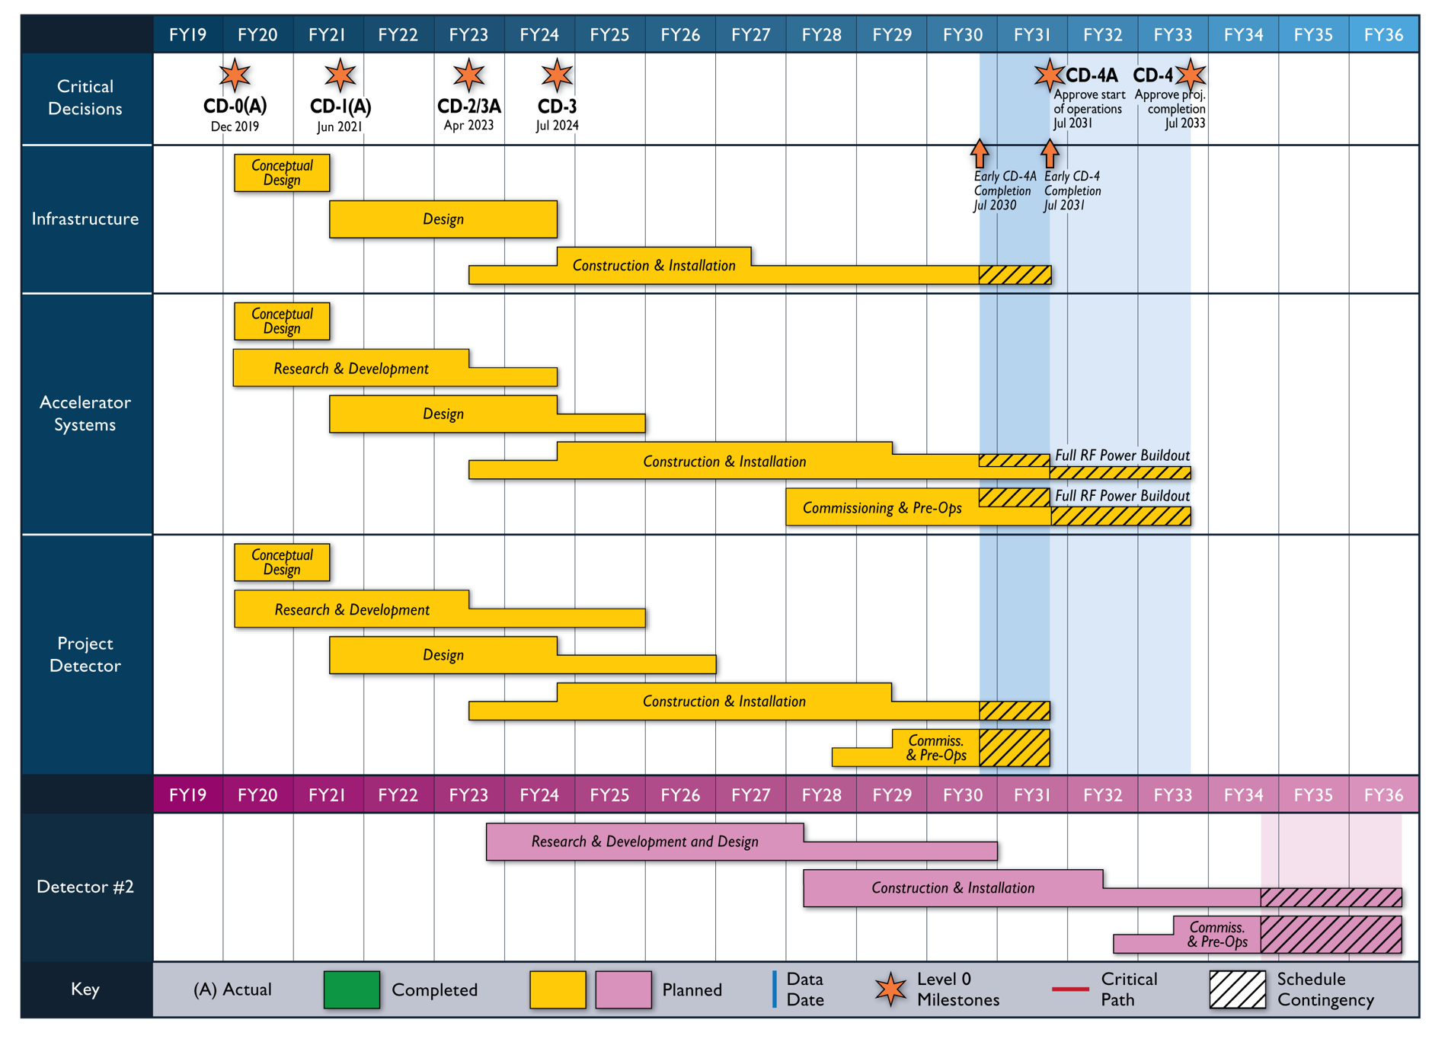
Reference Schedule with notional schedule 2nd Detector/IR
Notional Schedule
2nd IR and

Slide 10
IR Requirements and Parameters
(from talk of Angelika Drees and Randy Gamage at DPAP meeting December 13-15, 2021)
 | 1st IR |  | 2nd IR
 | proton | electron | proton | electron
Detector occupied region | -4.5 m +5.0 m Beam elements < 1.5º in main detector |  | -4.5 m +5.0 m Beam elements < 1.5º in main detector
Polarimetry | Yes (IR4) | local | Yes (IR4) | local
2nd focus | No |  | yes
$β$* @ 275 GeV (h), 10 GeV (e) | $β$*_{x} = 80 cm $β$*_{y} = 7.2 cm | $β$*_{x} = 45 cm $β$*_{y} = 5.6 cm | $β$*_{x} = 80 cm $β$*_{y} = 7.2 cm | $β$*_{x} = 45 cm $β$*_{y} = 5.6 cm
ZDC | 0.6m x 0.6m x 2m @ s$≅$30m $n: ±$ 4 mrad |  | 0.6m x 0.6m x 2m @ s$≅4$0m $n: ±$ 4 mrad
Roman Pots | 1-5 mrad, @s$≅$30m |  | 0-5 mrad, @s$≅$30-45m
Scattered particle acceptance | p: 0.18 GeV/c < p_{T} < 1.3 GeV/c |  | p: 0 GeV/c < p_{T} < 1.3 GeV/c
Q² tagger |  | Q²< 0.1 GeV
Crossing angle | 25 mrad |  | 35 mrad

Slide 11
EIC User Group 2nd Detector/IR Brochure
Maximizing the Scientific Output of the EIC
Electron-Ion Collider User Group Steering Committee
The Electron-Ion Collider – The Benefits of Two Detectors
The Electron-Ion Collider's Golden Opportunity for Two Detectors
Lessons from History
Detector Redundancy and Complementarity
Sidebar on Science Discovery Relies on Independent Experimental Confirmation
Taking Advantage of the RHIC/EIC Collider Layout
A Gateway to Innovation and International Collaboration
Two Detectors are More than 1+1
The Path to New Ideas
Sidebar on Radiation Therapy – Pushing the Envelope of Nuclear Physics Technology
A Long-Term Investment in Your Country’s Vitality
Brochure is eight pages, saw initial feedback from JLab science writer and folded in input from 10 external readers from around the globe, with some ties to international agencies.
Now in hands of JLab and BNL media people for final version.

Slide 12
Strategy for Detector 1 and 2nd IR/Detector 2
EIC with two interaction regions and detectors
Ensures a robust EIC physics program and enhances the science reach.
The DOE-NP supported EIC Project includes one detector and one IR
The included detector is ~70% scope as carried by the US-DOE EIC Project and ~30% international or in-kind scope.
The call for Expression of Interest was a crucial step to get guidance on the EIC detector scope.
IR2 and detector concepts needed now
Informs strategies for achieving IR2 and detector
Influences project decisions on IR1 and detector
EIC project schedule is an important planning constraint
We do have a little more time for a 2nd EIC detector and IR – to be ready by CD-4
Major effort needed to secure resources (~$500M)
Second detector may be opposite in scope, ~70% international or in-kind and ~30% possibly a DOE Major Item of Equipment (MIE) project
Significant international engagement is needed for 2nd detector and 2nd IR
Many bi-lateral meetings with potential partners underway to discuss opportunities in accelerator and experimental areas

