Slide 1
Perspective of R&D program
Elke-Caroline Aschenauer
BNL

Slide 2
EIC Detector R&D Program
Two tier Detector R&D program is critical for success of the EIC facility
Generic EIC Detector R&D program
In place since 2011 - FY21 projected as the last year of funding
Excellent experience (https://wiki.bnl.gov/conferences/index.php/EIC_R%25D)
Reduced the overall Risk level of EIC detector technology to Low/Moderate
Engaged 75 institutions (50% domestic, 50% international) from 10 countries
Triggered significant in-kind contributions (domestic and international) through available resources, LDRD, and national funding
Discussion between DOE/NP & labs to seek generic detector R&D continuation – relevant for alternate EIC detector technologies, upgrades, 2nd detector.
Project Detector R&D
EIC Project DAC joined last generic EIC Detector R&D meeting (March 2021).
DAC concurred with all Project and Generic tasks; advised to add few topics.
This was folded into the Project Detector R&D plan.
We have initiated FY22 follow-up with user groups pursuing project-specific detector R&D common to all proto-collaboration EIC detector proposals.
Again large international component: in-kind contributions from Italy/INFN, France/IRFU, France/IN2P3, UK/STFC, CERN synergy, etc. (this next to domestic component through universities, LDRD, SBIR/STTR synergy)

Slide 3
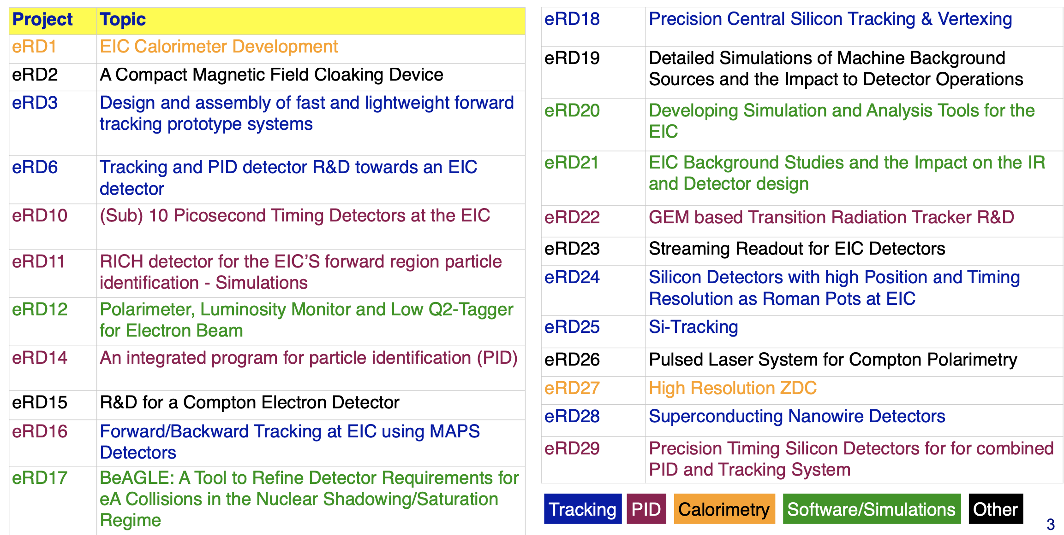
EIC Generic R&D Projects since 2014

Slide 4
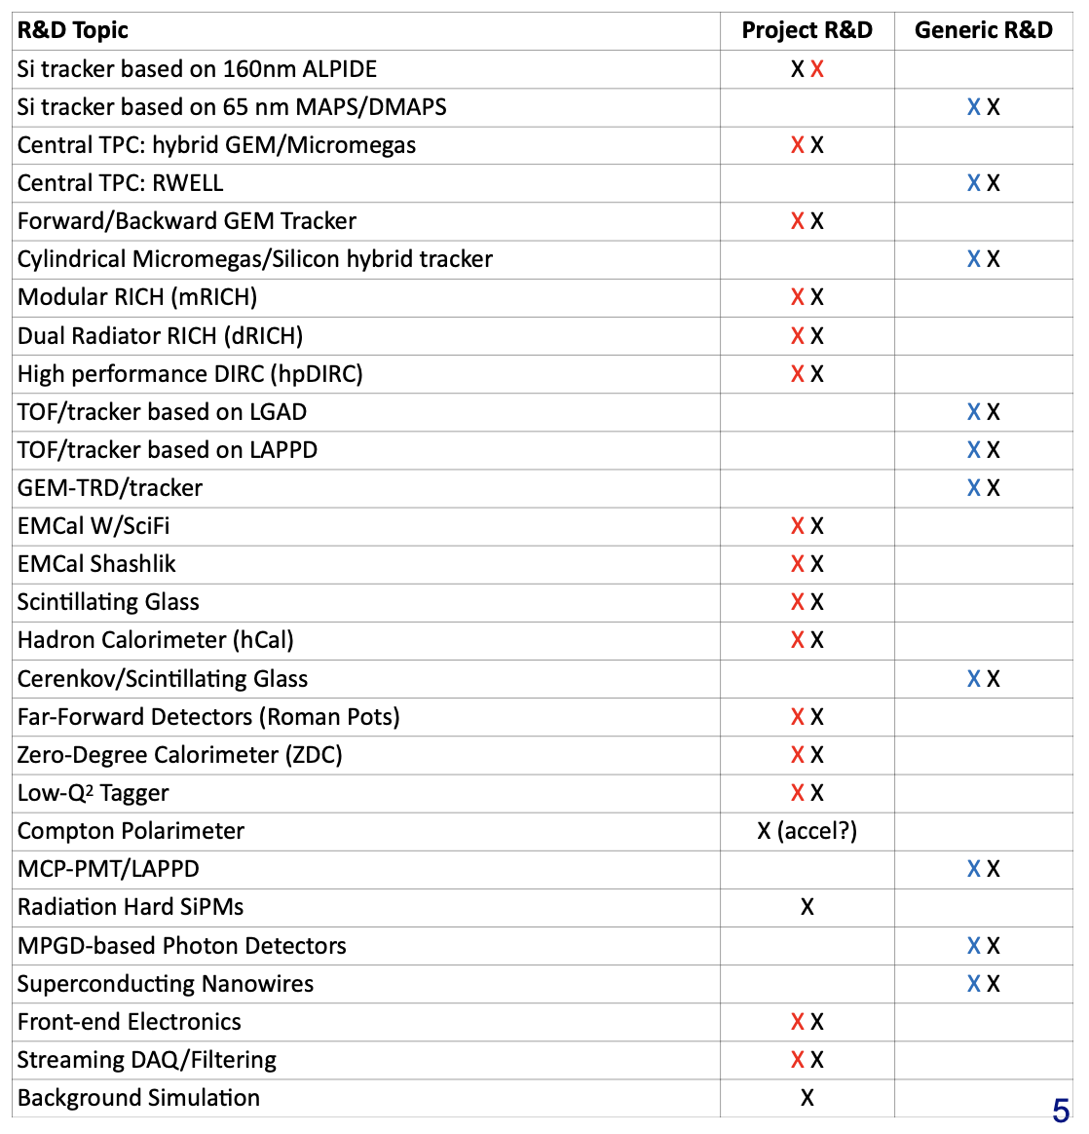
EIC Project R&D Plan
Report of DAC from March 2021 R&D Meetings on future EIC Detector R&D Program received in June 2021
Almost complete overlap of DAC recommendations and R&D plan
Differences
Compton Polarimeter (➟ work already ongoing, not true R&D)
Background simulations (➟ IR group
& proto-collaborations)
Radiation hard SiPM (now included
in R&D)
EIC Project R&D Plan:
https://wiki.bnl.gov/conferences/images/1/1a/Detector_RD_Plan_Aug10.2021.pdf
X = DAC
X = Project - Current R&D Plan (v3.6)
X = Generic - Current R&D Plan (v3.6)

Slide 5
EIC Project R&D
For details consult: https://wiki.bnl.gov/conferences/index.php/General_Info
Project R&D program is defined
R&D plan for reference detector in place, as well as plans for feasible alternative technologies and future opportunities
First selection of R&D projects for FY22 close to be finalized. Planning well underway. Timelines and milestones being defined. Groups formed.
Some changes will come with the ultimate choice of technologies by collaboration & project after 1st of March.
BUT
Currently the US is under a continuing resolution
→ US budget for FY22 is the same as for FY21
→ EIC Project funding can not yet ramp up as is needed for the next step CD2/3A
→ potentially look at a 6 month delay CD2/3A to fall 2023
→ Consequence EIC Project R&D could not be started yet
→ will start as soon as funding is flowing

Slide 6
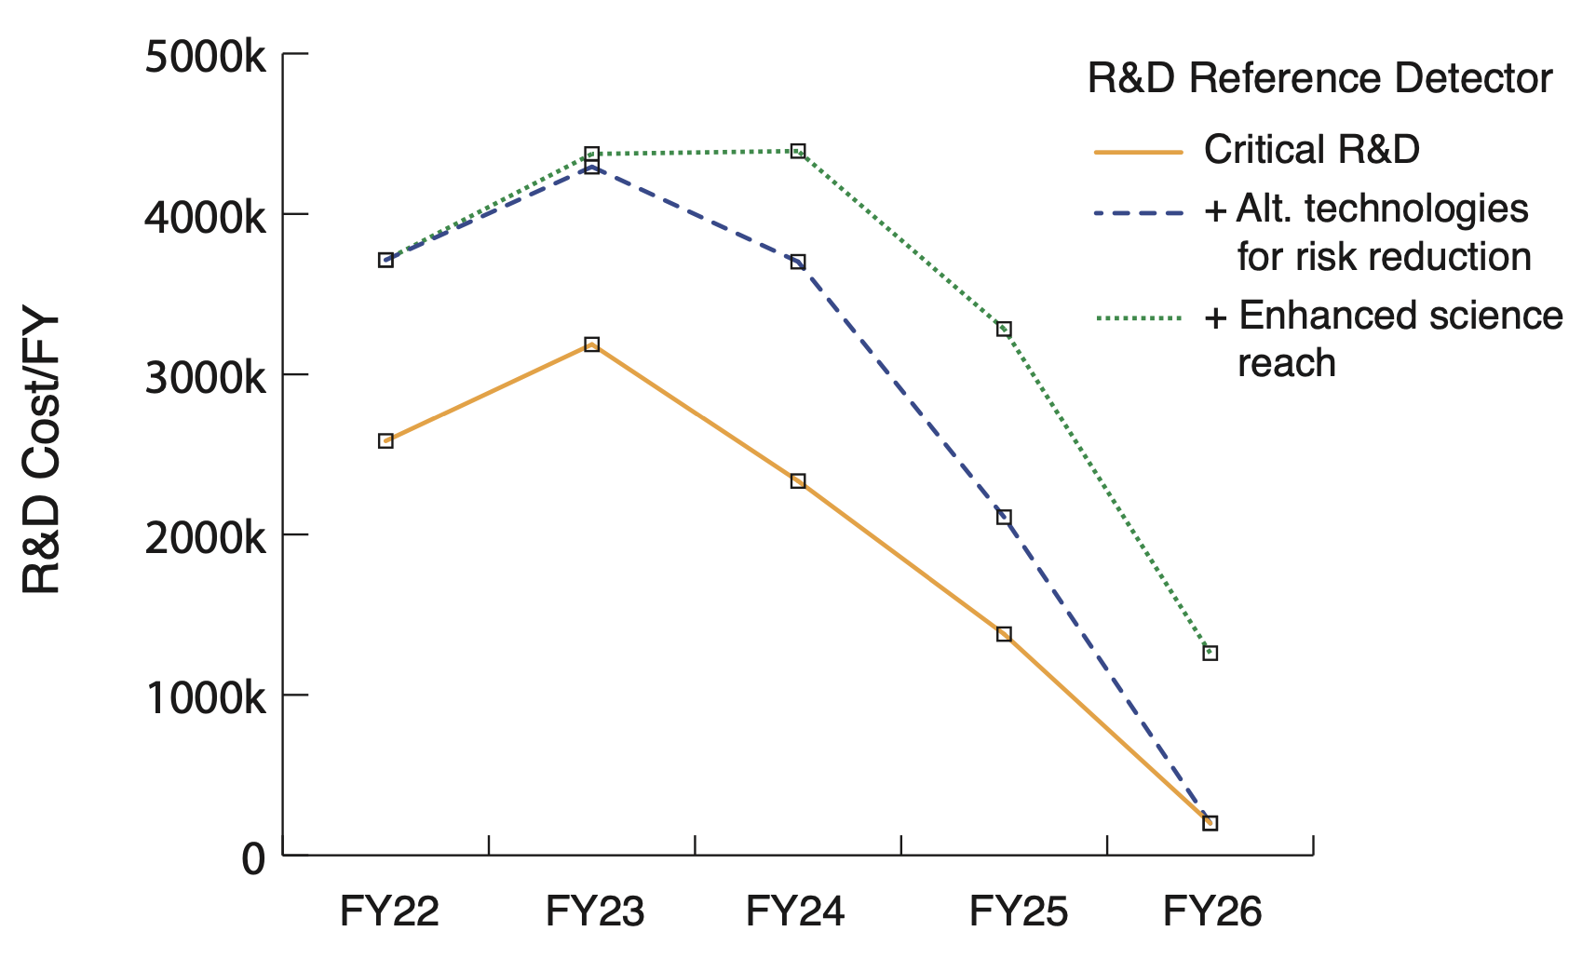
Summary
EIC Project R&D is well layout and can start as soon as funding is available
It is very important that the different PIs of the R&D are integrating everybody
→ the time to focus on your personal interest has ended
→ the R&D needs to focus on reducing risk on cost, schedule and performance
of the technology being part of the project detector
→ The R&D will be critical to baseline the detector and for the TDR needed for CD-3
Chart includes cost from R&D plan for all efforts (currently include large fraction but not all)
Current efforts in community investigate various alternative option that reduce risk and enhance performance

Slide 8
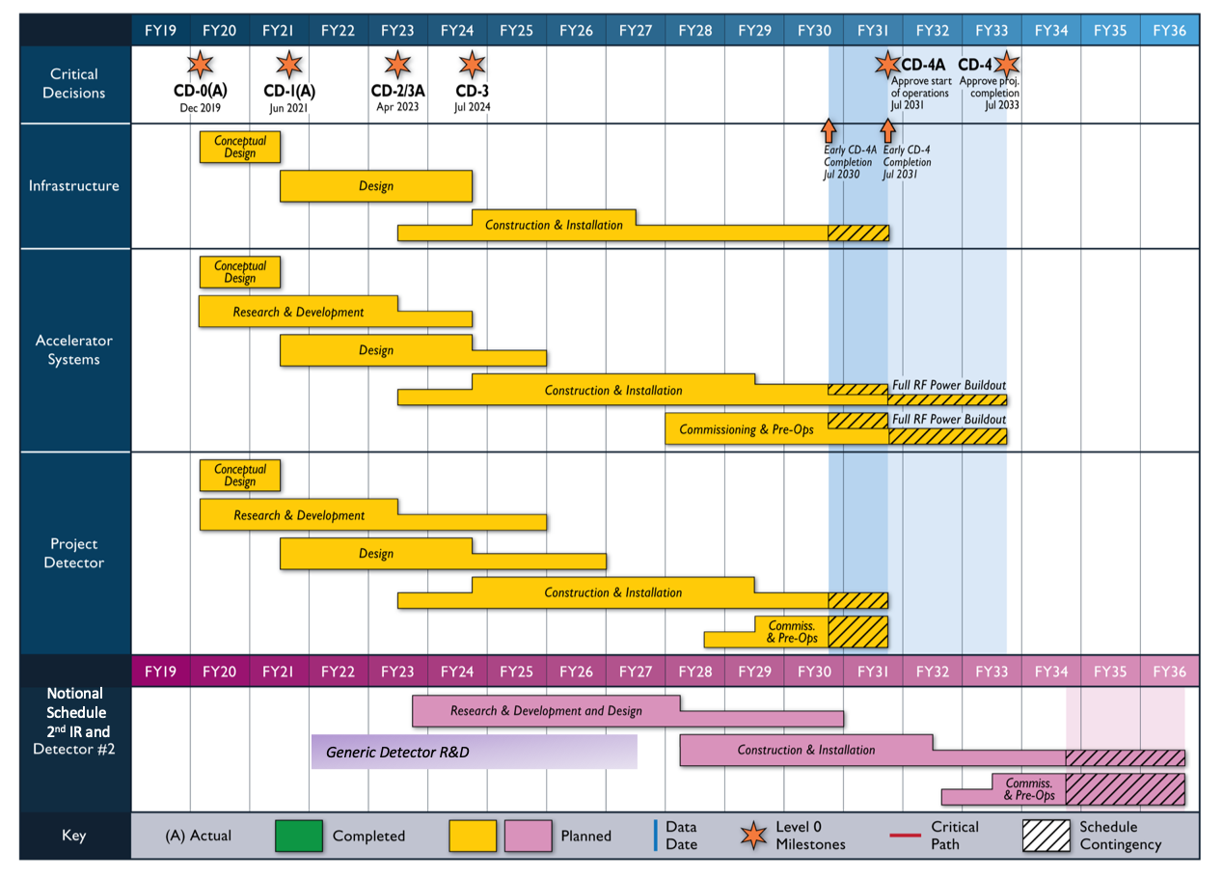
EIC Project Status
January 2020: CD-0 & site selection → BNL
June 28th 2021: EIC received CD-1
Accelerator Technical Reviews | Spring -- Autumn 2021
Start Preliminary Design | April 2021
Detector Proposals Submitted | 1st December 2021
Selection of Project Detector | 1st March 2022
Start Earned Value Tracking | Summer 2022
Clarify In-kind Deliverables - Agreements | Summer/Fall 2022
Goal for CD-2 Approval | April 2023 | Baselining the project
Goal for CD-3 Approval Goal for CD-4 Early Project Completion | July 2024 July 2031 | Start of Construction Early Start of Operation

