Slide 1
JWST HAS ORDERS OF MAGNITUDE GREATER SENSITIVITY THAN PRIOR MISSIONS
JWST SENSORS ARE AT
~40 K ( -387.67F)

Slide 2
JWST STATIONKEEPING
https://soundcloud.com/tzuctzuc/three-body-problem-3
Equipotentials in the rotating reference frame of two bodies
Circular orbit, Newtonian Gravity
L2, unstable Equilibrium
In Earth-Sun system,
~1.515 x 10⁶ km from Earth
Motion near L2 is exponentially
Unstable with a time constant 23 d
JWST planned stationkeeping each 21 d

Slide 4
JWST
SURROUNDING THE L2 POINT
The xy plane is the ecliptic, x toward Earth and Sun, z is toward the ecliptic pole
1.515x10⁶km
Operational Orbit Constraints RLP Y: ±832,000 km (130 Re) RLP Z: ±532,000 km (83 Re)
Variations of the James Webb Space Telescope Orbital Dynamics AAS 15-802 Jonathan Brown (a.i. solutions) Jeremy Petersen (a.i. solutions) Benjamin Villac (a.i. solutions) Wayne Yu (NASA GSFC)https://ntrs.nasa.gov/api/citations/20150017753/downloads/20150017753.pdf
Each tic mark
200,000 km

Slide 5
Period of the orbit relative to L2 ~ 6months
Reaction wheel unloading, up to 8 times per 21 day cycle using
Stationkeeping is affected by reaction wheel unloading and vehicle maneuvering,
so more frequent stationkeeping is expected than for other Lagrangian point
Current data gathering for stationkeeping `~19 days, Stationkeeping burn every 21 days
Stationkeeping algorithm drives along the stable monodromy eigenvector to zero out the
X component of the motion on the fourth successive crossing of the
XZ plane of the rotation libration point frame. https://ntrs.nasa.gov/citations/20190028877

Slide 6
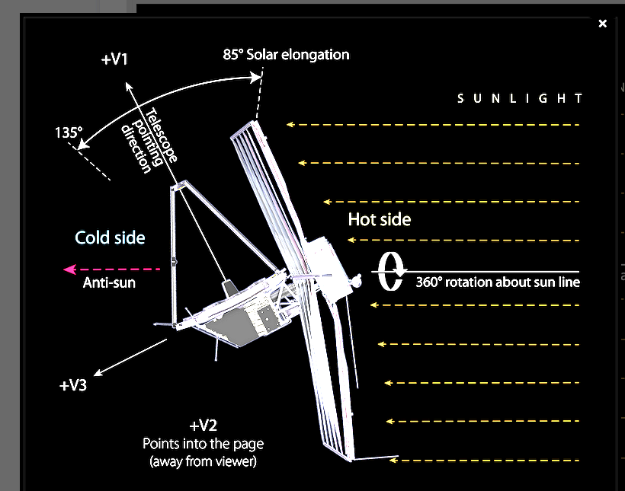
Coordinates for
Payload

Slide 7
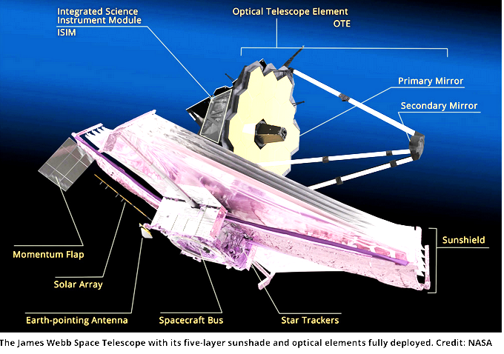

Slide 9
3.5m
Solar Array

Slide 10
Secondary Combustion Augmented Thrusters (SCAT) are used for orbit correction (Delta-V and station-keeping), SCAT 1 and 2 for midcourse, SCAT 3 and 4 for stationkeeping. Each rated for 5 lb thrust.
Only one SCAT used at a time. SCAT 1 and 2 are a redundant pair, 3 and 4 are a redundant pair.
They are bipropellant, using
hydrazine (N2H4) and dinitrogen tetroxide (N2O4) as fuel and oxidizer, I SP~343.8sec (v_{exit}=3379m/s)
He is the pressurizing agent.
Mono-propellant Rocket Engines (MRE-1) are used for attitude control and momentum unloading of the reaction wheels. Isp ~230sec (Vexit 2254 m/s)
Various thrusters used to achieve torque desired. Each rated for 1lb thrust.
Eight redundant pairs.
Up to 8 reaction wheel unloading and momentum dumps per 21 day stationkeeping cycle.
https://ntrs.nasa.gov/api/citations/20190028877/downloads/20190028877.pdf

Slide 11
Stationkeeping
3.5m
Mid Course Correction, angled to go through center of mass while partly folded

Slide 13
3.5m

Slide 15
JWST Can Be Tilted compared to the Sun direction

Slide 17
Changing the angle to the Sun traces out the instantaneous Field of Regard
Earth’s orbit carries the zone of avoidance around the ecliptic over the year

Slide 22
I Figure Mystem Image Motion Error Budget Allocates 3.7 mas to Fine Guidance Control System. POINTING CONTROL SYSTEM DESIGN APPROACH Design of the Pointing Control System (PCS) begins by modeling and analyzing the control loops using Matlab in the frequency domain to meet certain stability and disturbance rejection properties. The control loop topology is then modeled in the time domain using Simulink tc verify control performance in the presence of system nonlirrearities such as quantizations, sampling effects, and saturations. Figure 5 shows the integrated design cycle for the pointing control loop design. 7
Linear Analvsis 1) Control Loop Design 2) Generate Nichols, Bode Plots 3) Jitter Analvsis Revise 4controller -Parameters Nonlinear Time Domain Simulation 1) Verify Control Loop 3) Contains Nonlinear HxtrZlt:’xe?;Isde!s (i.e. Saturations, L i m i t s , Quantizations, etc) II f Nastran to Flexible Linear 1 1 MatlabImport Dynamics IRigid Body I - 7 = l Nastran Flexible Model Models Dynamics Group Figure 5: Integrated Modeling Architectureand Design Cycle for Attitude Control System POINTING CONTROL SYSTEM ARCHITECTURE The JWST Pointing Control System (PCS)is comprised of three integrated control systems: 1) a 3-axis, low bandwidth (0.02Hz) inertial referenced spacecraft attitude control system (ACS) for coarse attitude control; 2) a 2-axis, high-bandwidth (2Hz) telescope line-of-sight (LOS) stabilizationcontrol system using a Fast Steering Mirror (FSM); and 3) a 2-axis, very low bandwidth (0.004Hz) FSM Offloading control system. A concise but detailed interaction between ?hesethree main control systems, the required sampling times, :he handshaking between :he Spacecraft SBC and lSlM On-Board-Computer (OBC), and their connection to the real world is shown in Figure 6. 8
. * I Guide Star ID. Acquisition, I i =:"E= I I + FSM FSM Electronics 'I I I structural&Optical FSMWoad 4 I S/C Dynamics i i i SIC Pointing Control A Aitmtde Error --* t Tach Inertial Unit I Reference 4- Integration I I I ~-I I I Star 1 Trackers II 1- Figure 6: Integrated Pointing Control Architecture Showing the ACS topology (bottom loop: S/C Pointing Control, RW, IRU and STA), the FGCS (top loop: FSM control, FSM, FGS), and the connection of the FGCS and the ACS through the FSM Offloadingloop. AlllTUDE CONTROL SYSTEM The JWST ACS utilizes star trackers and IRU's for attitude determination, and RWAs for control. The ACS loop topology per axis consists of a ProportionaI+IntegraI+Derivate (PID) compensator, a second order bending filter to attenuate flexible modes, a momentum control loop for reaction wheel control, and an IRU (4Hz bandwidth) for body rate information. The on-board attitude information is maintained and propagated as quaternions, by performing the kinematic integration using IRU data at every SBC minor cycle (0.064sec). In addition, a Kalman filter, running a t - a slower rate (1.024 sec), is used to correct the IRU d r i i and the SBC attitude quaternion by using star tracker measurementsreferenced to a star catalog. The momentum exchange system consists of a 6 RWAs configured in a pyramid configuration to provide balanced momentum storage capability in each of the three spacecraft axes. The momentum control loop consists of a Proportional+lntegraI (PI) compensator, a first- order low-pass filter, a tachometer, and a tachometer-averaging filter for each wheel. The tachometer provides reaction wheel speed measurements at the quantization level of 19.5rpm, based on its 48 pulses-per-revolution(ppr) performance and 0.064 sec readout rate. The reaction wheels are speed biased to 2700rpm by using an additional bias control loop that regulates reaction wheel speed operation near a fixed speed in the null-space of the RWA cluster. This RW speed bias set point is needed to maintain RW speeds within an acceptable speed range of 15Hz to 75Hz in order to avoide structural excitations that may contribute to LOS jitter. The momentum and bias control loop bandwidths are set to 0.2Hz and 0.008Hz respectively 9
Fine Guidance Control System The Fine Guidance Control system (FGCS) bandwidth is approximately 2Hz in order to effectively remove ACS jitter, and utilizes guide star information processed and accessed by the ISlM to acquire and track desired targets in the ISlM FOV using the FSM. The ISlM contains an FGS that is used to report Guide Star locations in its focal plane to within 3.5 mas (NEA). The Fine Guidance Loop consists of a PID compensator, a second-order bending filter to improve sensor noise rejection, an FSM to provide corrections to the LOS, and a dedicated FGS. The FGS is usedto acquire and lock onto the desired guide star (GS) thereby stabilizingthe complete ISlM FOV where the science targets are being exposed. The FGS uses only one guide star for control. Therefore, the FGCS cannot control the roll axis, and controls only two the pitch and yaw LOS motion. - Gain Margin, dB I 1 5 I 1 5 - Phase Margin, deg 190 I 90 FSM OFFLOADING LOOP 15 90 The FSM Offloading Loop bandwidth is 0.004Hz and serves to maintain the FSM position about it's null setting in order to reduce FSM induced image smear. The FSM Offloading Loop consists of a PI controller that adds the FSM position (through the PI compensator) as a bias to the attitude error signal. Note that a coordinate transformation from optical to spacecraft coordinates is needed prior to biasing the ACS error signal. CONTROL LOOP DESIGN AND ANALYSIS The control loop design for the ACS, FGCS and the FSM Offloading is done using continuous linear hardware models and dynamics in the Matlab environment. The control loops are analyzed and designed in the frequency domain using Nichols and Bode plots. Refer to Table 1 for loop performance and margins. The ACS is analyzed as a PID controller, a second order bending filter, a momentum control system, linear rigid and flexible dynamics, and a second order IRU model. The momentum control loop is an embedded 0.2Hz bandwidth control system that is represented by a PI, a first order low pass filter, and linear reaction wheel dynamics. The IRU is modeled as a second order system with un-damped natural frequency of 4Hz and damping ratio of 0.87. The FGCS is analyzed and designed using a PID, a first order low pass filter, and linearized FSM dynamics. The FSM Offloading Loop connects the FSM position through a PI controller to the ACS attitude error.Table 2 lists the results of the linear stability analyses for the three loops. Figures 3 and 4 show the open loop Nichols plots for the ACS and FSM offloading loops. Table 2: Pointing Control -Loop Performance I ACS I 1 I I - Bandwidth, Hz 1 0.02 I 0.02 I 0.02 - Gain Marain. dB I 1 2 I 12 112 1 - Bandwidth, Hz I 0.004 I 0.004 1 0.004 1 10

