Slide 1
Rationale for LINAC Intensity Upgrade II
Cathy S. Cutler
September 14th, 2022

Slide 2
DOE Isotope Program Mission
Produce and/or distribute radioactive and stable isotopes that are in short supply; includes by-products, surplus materials and related isotope services
Maintain and upgrade the infrastructure required to produce and supply priority isotope products and related service
Conduct R&D on new and improved isotope production and processing techniques which can make available priority isotopes for research and application. Develop workforce.
Ensure robust domestic supply chains. Reduce U.S. dependency on foreign supply to ensure National Preparedness.
Isotopes are forms of the same element that contain equal numbers of protons but different numbers of neutrons in their nuclei, and hence differ in relative atomic mass but not in chemical properties; in particular, a radioactive form of an element.

Slide 3
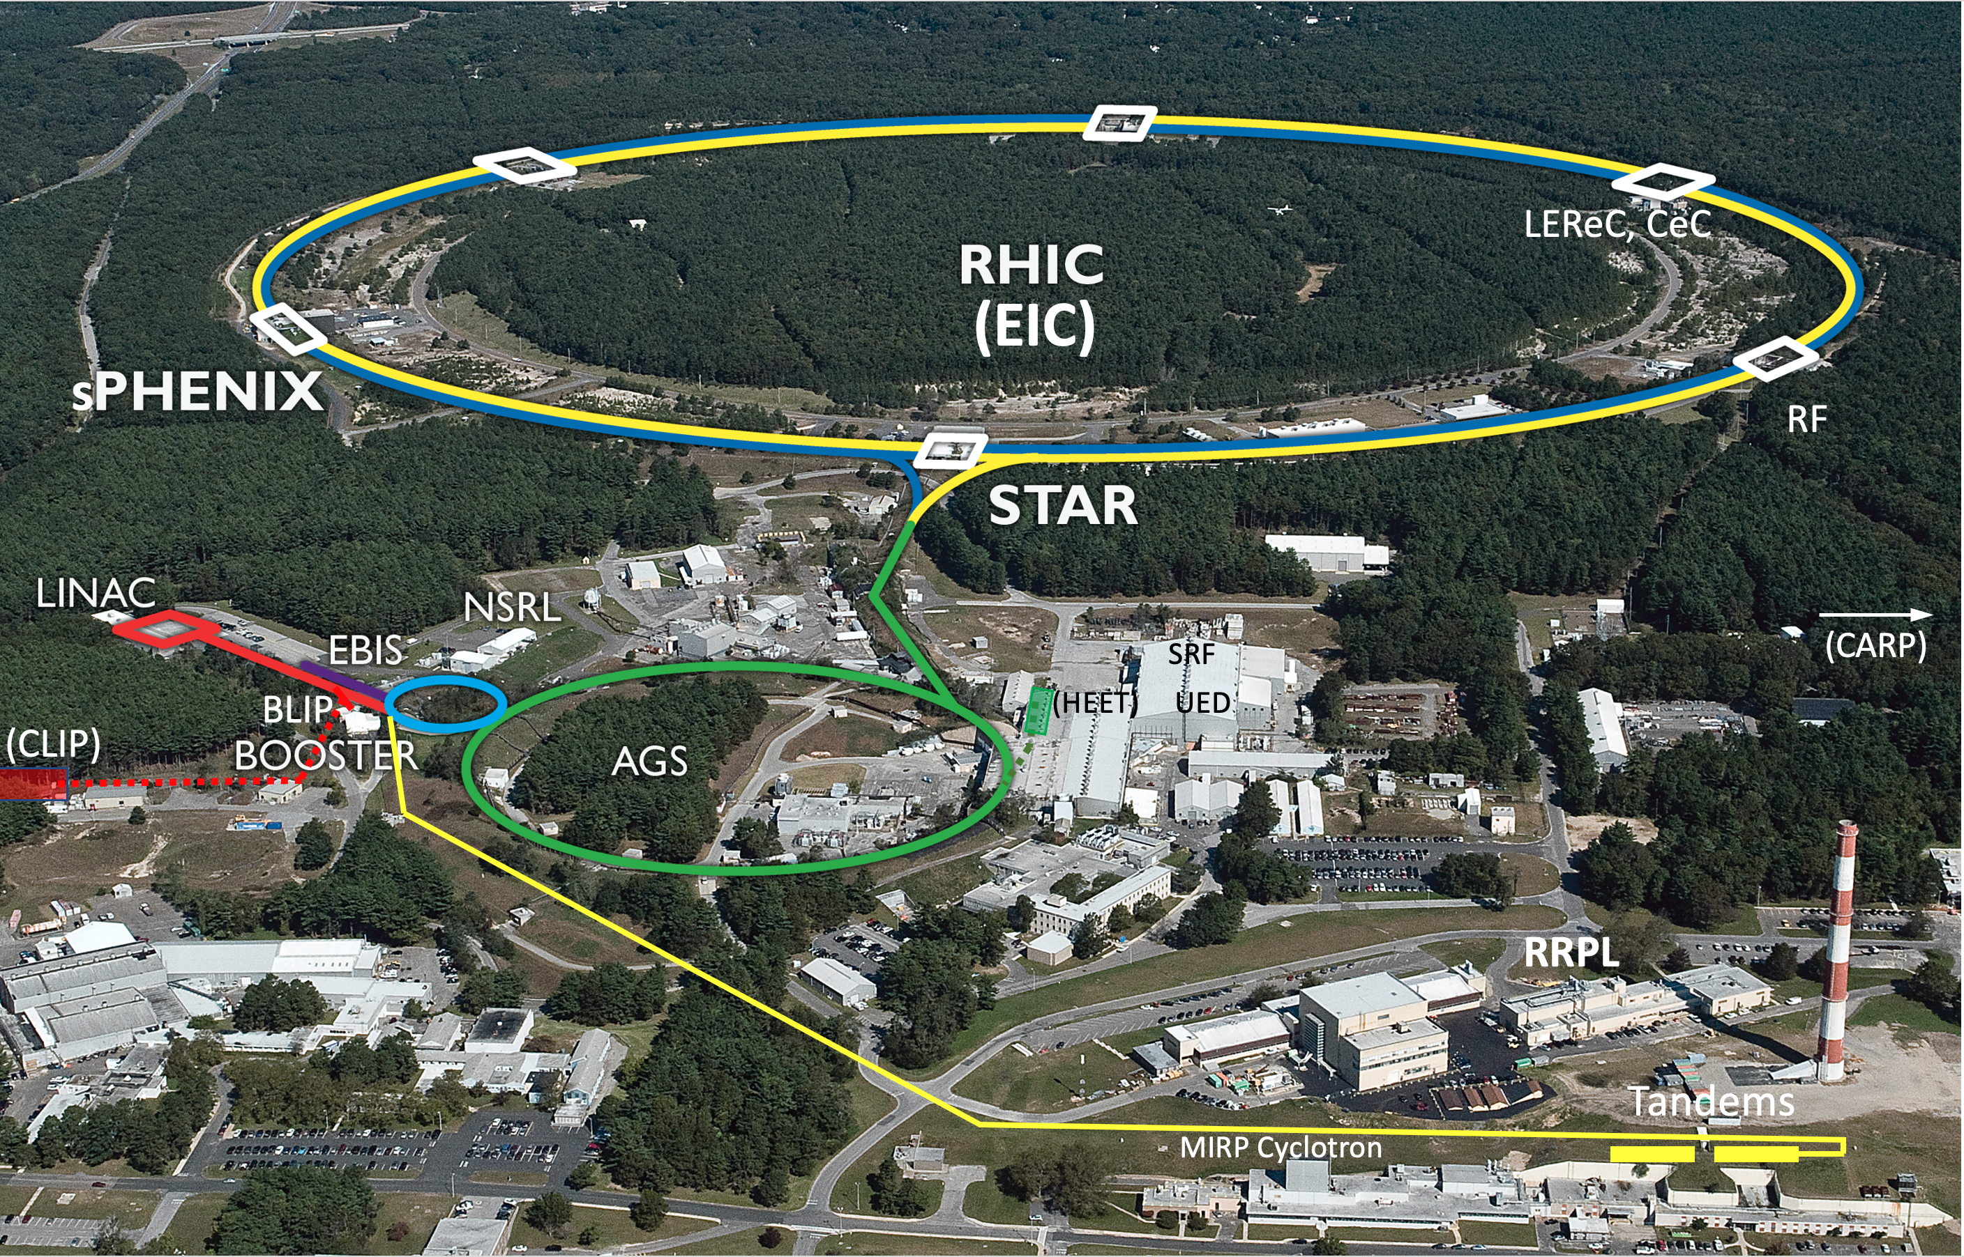
Collider-Accelerator Department facilities
Uniquely flexible and
only hadron collider in
US for exploration of
QCD phase diagram
and proton spin
Injectors also used for
application programs:
- Linac/BLIP for
isotope production
- Booster/NSRL for
space radiation studies
- Tandem for
industrial/academic users
R&D for future facilities
and application
sources, cooling, pol. beams, …

Slide 4
Opportunities for isotope production and R&D at BNL
^{nat}Ga(p,xn)⁶⁸Ge
⁸⁶Sr(p,n)⁸⁶Y
⁴⁵Sc(p,2n)⁴⁴Ti
^{nat}Ti(p,2pxn)⁴⁷Sc
^{nat}Rb(p,xn)⁸²Sr ⁷⁵As(p,4n)⁷²Se
^{nat}La(p,xn)¹³⁴Ce
²³²Th(p,2p6n)²²⁵Ac
^{nat}Ag(p, 2pxn)¹⁰³Pd

Slide 5
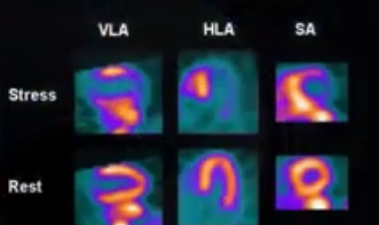
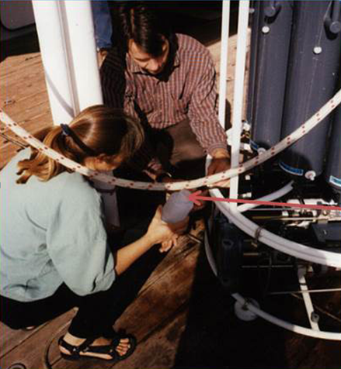
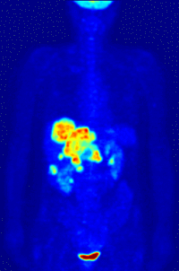
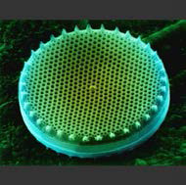
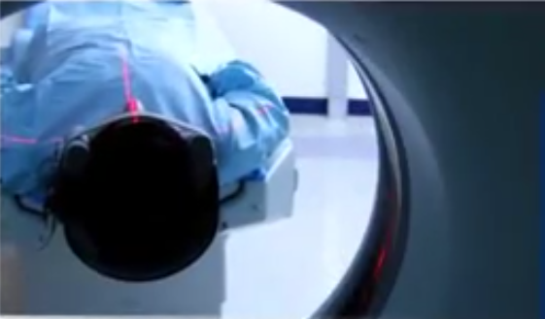
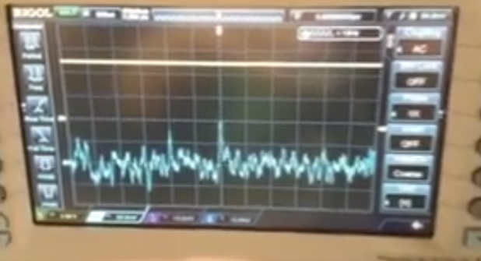
Applications – Accelerator Isotopes
Ge-68/Ga-68:
Generator-
cancer imaging
Sr-82/Rb-82:
Generator- cardiac imaging
Si-32: Environmental applications
Na-22: Source for PET imaging
Cd-109: X-ray fluorescence source
Notes:
Focusing initially on accelerator isotope products, LANL and BNL are engaged in the routine production of Ge-68 for Ga-68 generator applications (cancer imaging) and Sr-82 for cardiac imaging application. Both sites produce a variety of other products like Cd-109 (for X-ray….), Na-22 (a calibration source for PET imaging) and Si-32 (for environmental imaging) to name a few. The accelerator sites are also engaged in active R&D campaigns to make new isotopes available for applications development in the areas of fundamental R&D, medical research, and national security applications
Ge-68 (271 day)/Ga-68 (68 min)
Sr-82 (25 day)/Rb-82 (75 sec)
Si-32 (approx 170 years)
Cd-109 (461 days)
Na-22 (2.6 years)

Slide 6
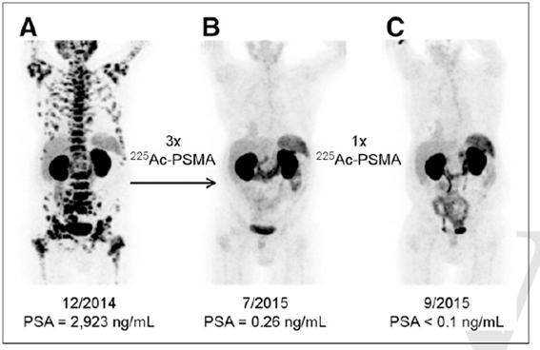
Prostate Cancer Therapy
J. Nucl. Med., 2016; 57 (12); 1941 DOI: 10.2967/jnumed.116.178673 C. Kratochwil

Slide 7
Upgrade Motivation
In order to increase isotope production capacity it is desirable to increase the beam current.
The beam is pulsed with high instantaneous beam current (~42mA prior to 2015). Combined with a sharply peaked Gaussian-shaped beam intensity profile (Full Width Half Maximum ~ 20mm) this creates very high-power density at the beam spot center and has caused target reliability and lifetime issues as well as erratic Sr-82 isotope yields due to partial melting and density variation of RbCl target material (2.80g/cc solid vs. 2.20g/cc liquid)
The short-term response was to limit Linac intensity to no more than 115 µA
By spreading out the power density, the raster scanning system proved beneficial for all targets by improving reliability and yield
By increasing the intensity from 115 uA to 165 uA we achieved an increase in yields of 35-50%.
We know the demand for Ac-225 is expected to grow higher than what we can meet with our current beam intensity.
There are other isotopes such as Ge-68 which is also growing and the demand outstrips what we can make with our current intensity.

Slide 8
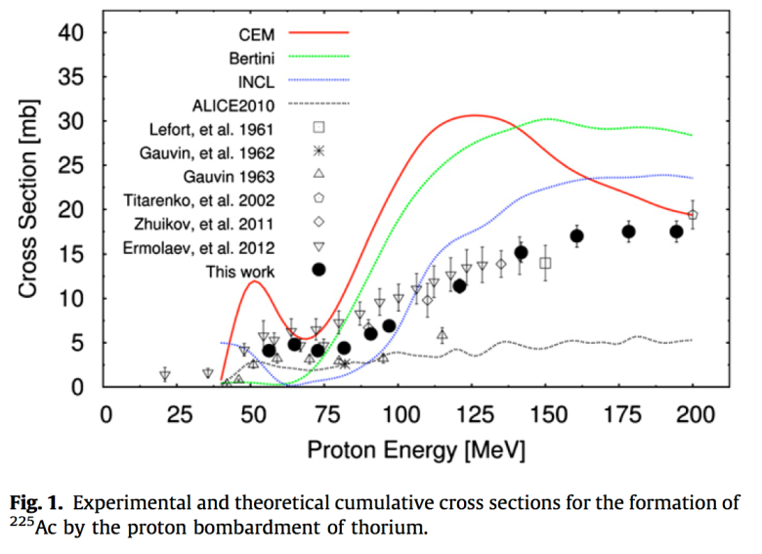
Accelerator Production via 232Th(p,x)225Ac:
Facility | Anticipated Single Target Ac-225 Yields (10 day irradiation)
LANL (100 MeV, 250 µA) | 1.3 Ci
BNL (200 MeV, 165 µA) | 2.2 Ci
Future Planned Facility and Targetry investments at IPF and BLIP will further increase our single target projected yields to:
J.W. Weidner et al. Appl. Radiat. Isot. 70 (2012) 2602
J.W. Engle et. al. Phys. Rev. C. 88 (2013) 014604
J.W. Engle et. al. Radiochim. Acta 102 (2014) 569
J.R. Griswold et. al. Appl. Radiat. Isot. 118 (2016) 366
LANL 450 μA 2.3 Ci
BNL 250 μA 3.3 Ci

Slide 9
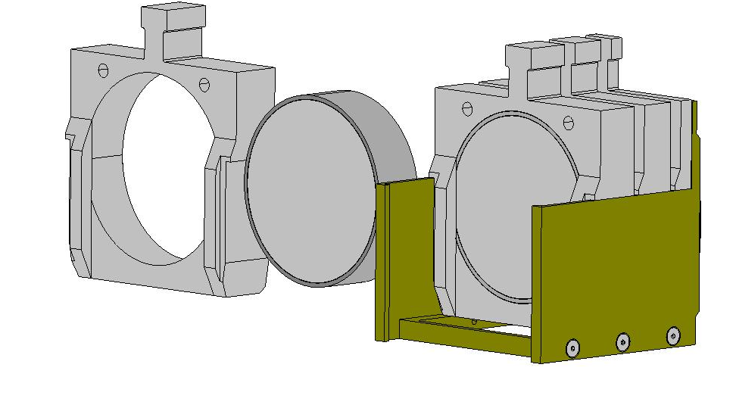
Scaling up Ac-225 production – a stack of 100 g targets
Welded Target d~70 mm
Target holder
1
Support basket
Five 100 g Th targets can fit in the basket
Test irradiation to test target survival under conservative thermal load (1) commenced

Slide 10
Projected activity per target at 165 µA based on latest data
Business Sensitive

Slide 11
Summary Slide
Current intensity of the LINAC does not meet the expected demand to support Ac-225 clinical trials of hundreds of Ci/yr
Currently could make up to 10 Ci per 5, 100g target irradiations.
Increasing intensity gets us to 15 Ci per batch and in the expected range of what will be needed to support clinical trials with Ac-225.
Two batches a month for 6 months gives 182 Ci
The increase in intensity will also aid with a boost in yield of other isotopes.
Business Sensitive

Slide 12
Questions?

Slide 13
200 MeV H- beams LINAC/BLIP
First beam: fall 1972
85-100% of all Linac pulses go to BLIP
Target irradiation with 66 – 200 MeV, 165 μA
Radioisotope production for diagnostic
(e.g. ⁸²Sr, ⁶⁸Ge) and therapeutic (²²⁵Ac) use
Contact: D. Raparia
Linac Intensity Upgrade Phase II (shovel-ready)
Why : 2x increase in beam current and significant increase
in isotope production capacity
Scope : Linac pulse length doubling to 900 ms for I_{avg} 250 mA
Schedule: ~3-4 years (with cost minimization)
Cost : ~$20 M (depending on scope and schedule)

