Slide 1
LIUP2 Overview – Project Goals
Deepak Raparia
LIUP2 Director Review
14-17 September 2022

Slide 2
Outline
Isotope Program
Beam Current Improvement Upgrade
LIUP2 scope
Technical parameters
Challenges
Project timeline
Summary

Slide 3
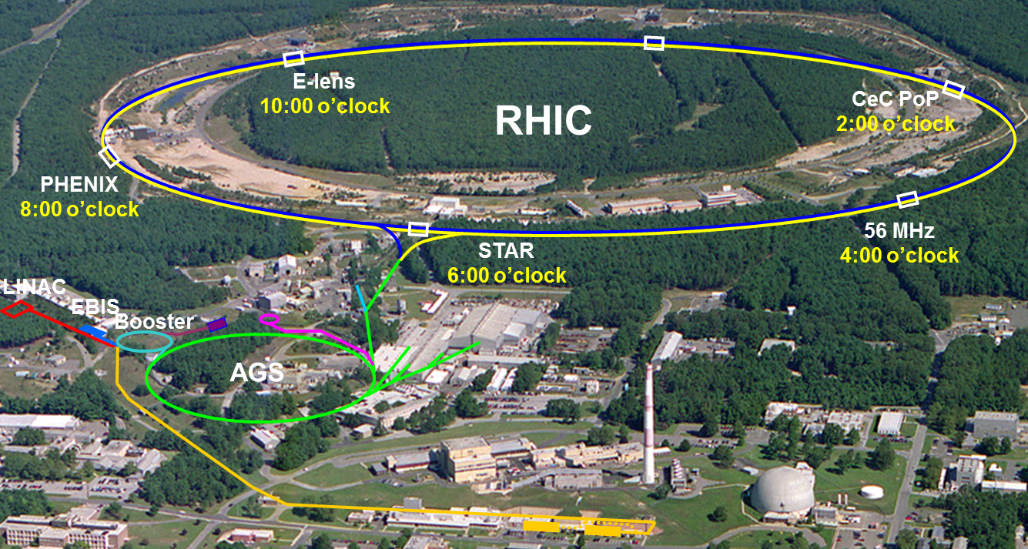
Overview of the BNL Hadron Complex
H- jet
12:00 o’clock
NSRL
BLIP
Tandem Van de Graaff
Hadron-based user and research facilities:
Linac Isotope Producer (BLIP) / Medical Isotope Research and Production Program (MIRP)
NASA Space Radiation Laboratory (NSRL)
Tandem van de Graaff accelerators
Relativistic Heavy Ion Collider (RHIC)

Slide 4
Opportunities for isotope production and R&D at BNL
^{nat}Ga(p,xn)⁶⁸Ge
⁸⁶Sr(p,n)⁸⁶Y
⁴⁵Sc(p,2n)⁴⁴Ti
^{nat}Ti(p,2pxn)⁴⁷Sc
^{nat}Rb(p,xn)⁸²Sr ⁷⁵As(p,4n)⁷²Se
^{nat}La(p,xn)¹³⁴Ce
²³²Th(p,2p6n)²²⁵Ac
^{nat}Ag(p, 2pxn)¹⁰³Pd

Slide 5
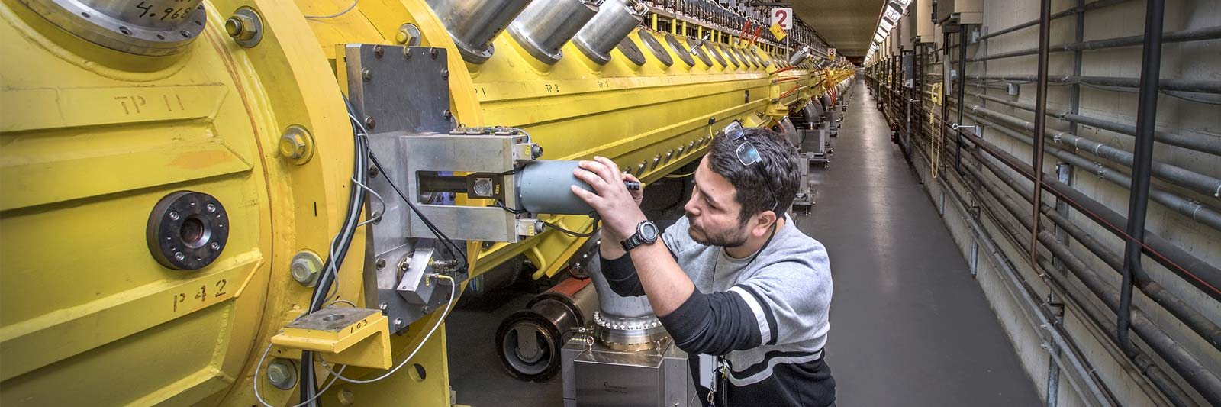
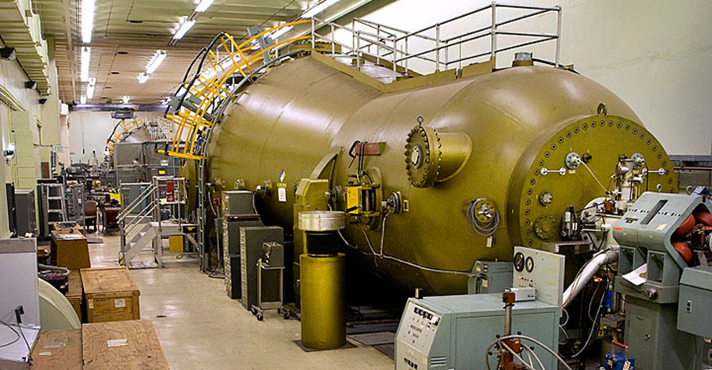
Hadron Preinjector at BNL
Linac (1970) EBIS injector (2010) Tandem (1970)
Ion: H-, H-^ He-U H-U
E: 10 -200 MeV 2 MeV/u 14 MV(1+q)
I_{ave} : 200uA, ~150 nA ~10 μA
RR: 10 Hz 5 Hz dc/pulsed
User: BLIP, NSRL, NSRL, RHIC SEU, NSRL
RHIC RHIC,
Can serve all users simultaneously

Slide 6
BNL 200 MeV LINAC Beam Parameters
Ion H⁻
Frequency 201.25 MHz
Injection Energy 0.750 MeV
Final Energy* 10-200 MeV*
Peak Current 60 mA/ ~ 1.5 mA P^ (~85%)
Pulse Length 575 μs
Repetition Rate 6.67-10 Hz
Number of Tanks 9
Length 144.8 m
Total Peak RF Power 22 MW
*Energy can be changed pulse to pulse
Built in 1970

Slide 7
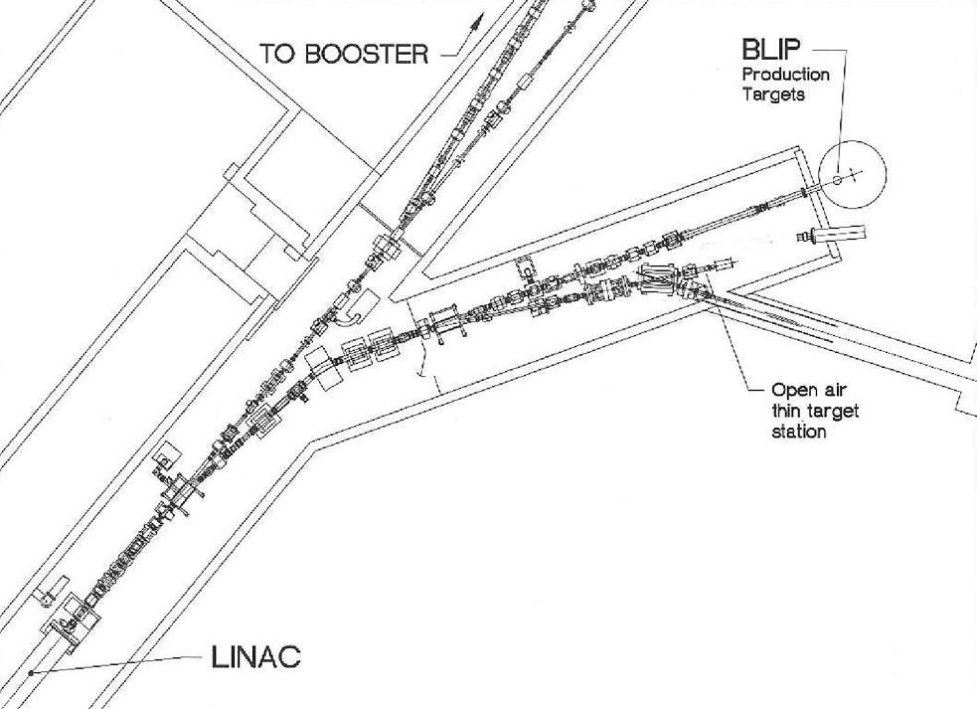
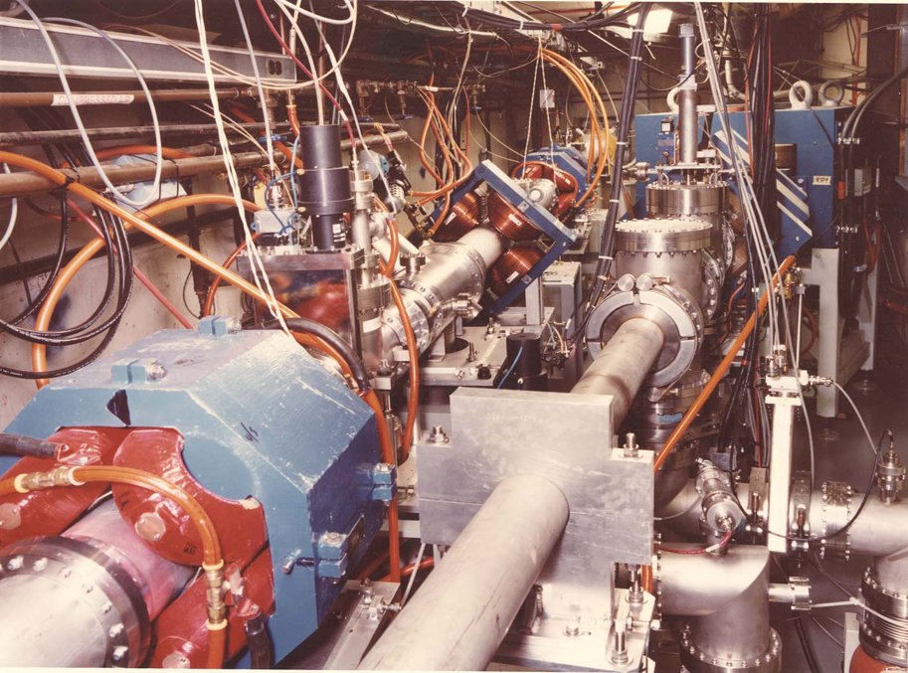
BLIP
REF

Slide 8
Mode of Operation
Mode | BLIP (%) | RHIC(%)
Dedicated | 100 | 0
RHIC with P^ +P^200 MeV polarimeter | 92.5 | 7.5
NSRL | 96.4 | 3.6
200 MeV P^ setup/study Day and Evening | 85 | 15

Slide 9
Recent Intensity upgrade (Not in Project scope)
Intensity Upgrade Phase I
Intensity 125 to 140 uA, system evaluation for 250 uA
Raster
Uniform beam
Ion source (Atoian’s Talk )
2nd Ion source, source extraction, etc.
Previous Upgrades. ( LoDestro’s Talk)

Slide 10
Intensity Upgrade –Phase I (2014-2016)
Increase beam current by 15%.
Evaluate the proposal to double the linac beam current
  Evaluate and prototype quadrupole pulse modulators flattops for 900 μs beam
  Evaluate conditions of water-cooling channels in drift tubes and accelerator cavities
  Prototype RF system for 1100 μs pulse length
  - Upgrading Modulator ; power supplies and low-level electronics
  - Increasing the 250-kW diver capacitor bank to 40 mF from 25 mF
  - increasing the 7835-amplifier capacitor back to 84mF from 50 mF
Completed FY-2016 : Recommend Phase 2 for 250 μA average beam current.

Slide 11
Intensity Upgrade Phase I and II
Linac Design Duty Cycle for the Linac RF 0.4% and for Beam 0.2% (1970)
Requirements
2013 2022 Phase I Phase II
Peak Beam current 42 mA 60 mA 45 mA 45 mA
Max Avg Beam current 120 μA 215 μA 140 μA 250 μA
Beam Pulse Length 450 μs 575 μs 480 μs 900 μs
RF Pulse Length 650 μs 715 μs 670 μs 1100 μs
RF Duty Cycle 0.43% 0.46% 0.44% 0.73%
Rep. Rate 6.67 Hz 6.67 Hz 6.67 Hz 6.67 Hz

Slide 12
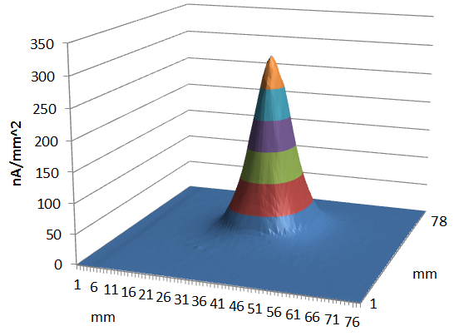
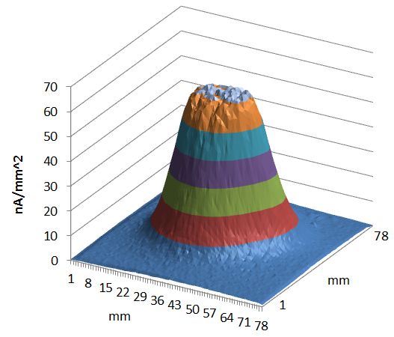
Raster System (2014-2016)
Beam FP without raster
FWHM: 13 mm, FWTM: 40 mm
Beam FP with raster
FWHM: 32 mm, FWTM: 60 mm

Slide 13
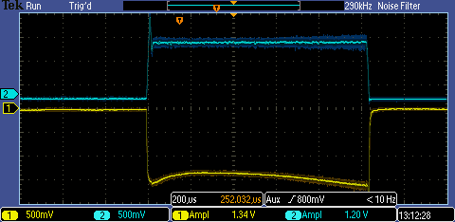
Two High Intensity Sources (2019)
Atoian
OPPIS
Peak current 1.5 mA
Pulse Length 500 𝜇s
Polarization. ~85%
Magnetron Source 1
Polarized source OPPIS
RFQ
Magnetron H- Source
Peak current 135 mA
Pulse Length 1.1 ms
Extraction 35 kV
Magnetron Source 2

Slide 14
Linac Intensity Upgrade Phase II
Project goal: increase average current to I_{avg} = 250 μA
(with potential for larger increase)
beam current
55 mA
6.67 Hz repetition rate
0
450 us
900 us
time

Slide 15
LIUP2: Scope
Average Beam current 250 uA with following systems upgrade
RF systems C. R. Lockward
Pulsed quadrupole power supplies. I. Marneris
Beam instrumentation R. Michnoff
Controls O. Gould
NOT In Scope
Ion source G. Atoian
MPS upgrade
Be window upgrade
Other Utility Upgrade

Slide 16
Technical Performance Parameters
System
Beam
 | Average beam current | 250 µA
 | Beam pulse width | 700-900 µs
 | Repetition rate | 6.67 Hz
RF
 | RF pulse width | 1100 µs
Quadrupole Power Supply
 | Max current | 275 A
 | Flat top width | 1200 µs
 | Current stability | 0.1%
Control System
 | Readback sampling frequency | 10 kHz
 | Analog to Digital Converter resolution | 16 bits
 | Voltage reference resolution | 12 bits
 | Voltage reference range | ±10 V

Slide 17
RF System
The following upgrades are required for the longer pulse based on the RF test system development:
Increase of the 250 kW driver capacitor banks for RF systems 3-9 from 25 to 40 µF.
Increase of the 7835-power amplifier anode power supply capacitor banks for RF systems 3-9 from 50 to 84 µF.
For all systems, replacement of the 4CW 25,000 Anode and Cathode power supplies and the A7 Low Level Electronics in the RF Modulator.
Replace stem collars in DTL tanks 4-9

Slide 18
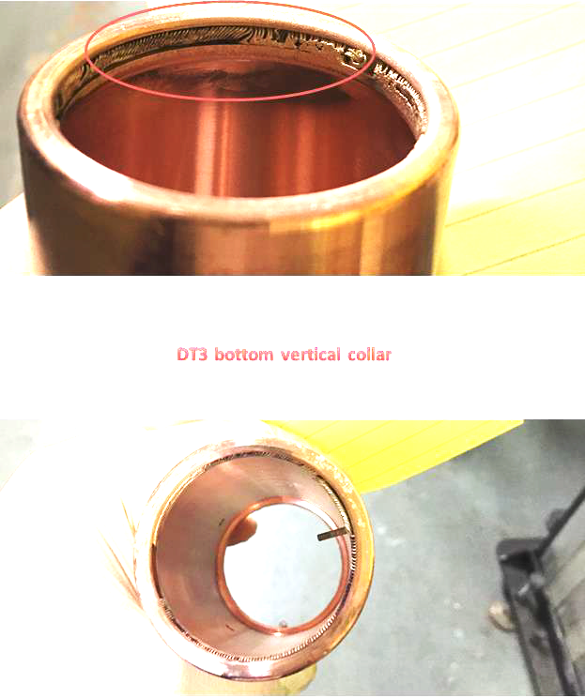
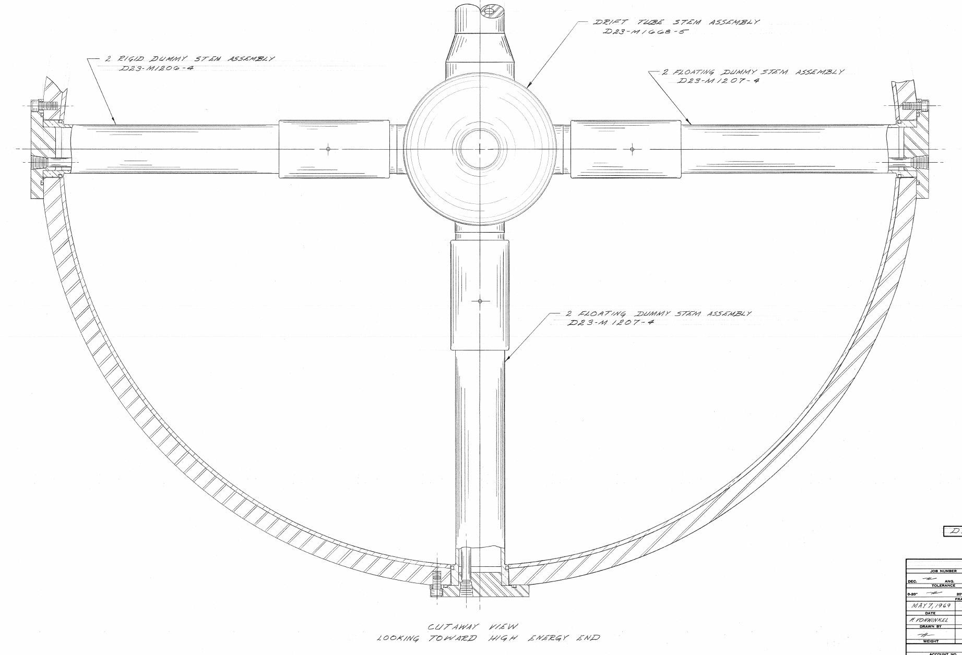
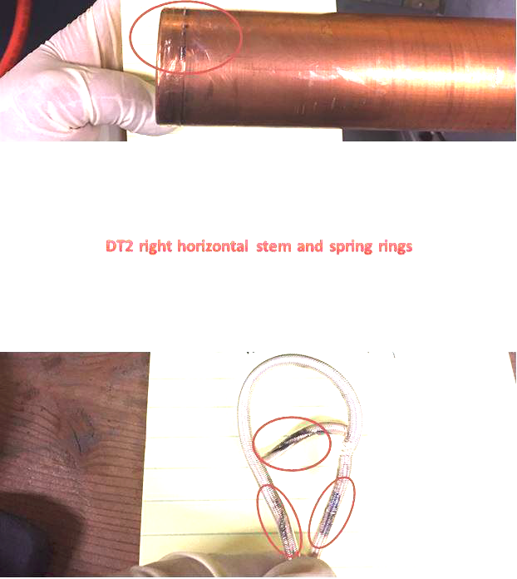
Drift Tubes Stems
RF System performed well in test dock to 1100µS
Modified RF mod 5 and 7 to drive 1.1 ms RF into tank 5 and 7
Vacuum activity at 0.95 ms
Drift Tube collars were overheating
Silver plated Beryllium copper RF spring ring damaged ( melting point 800-900 º C)
12 of 72 stems/collars suffered damage
RF Spring ring remnants

Slide 19
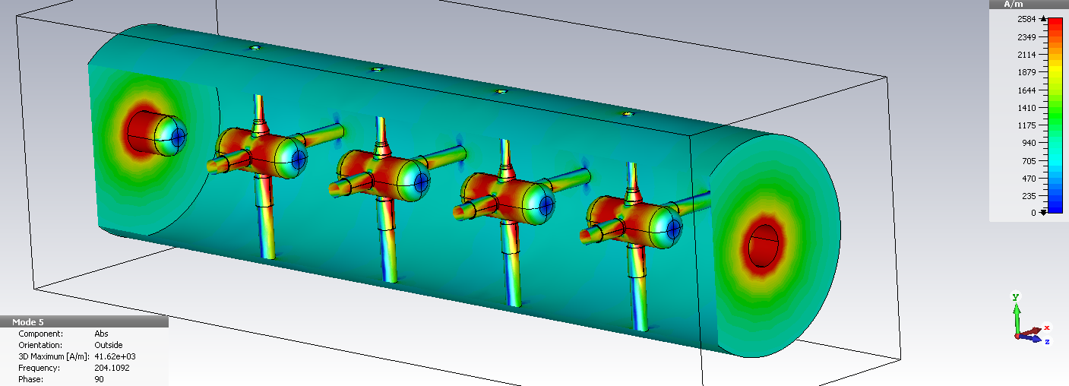
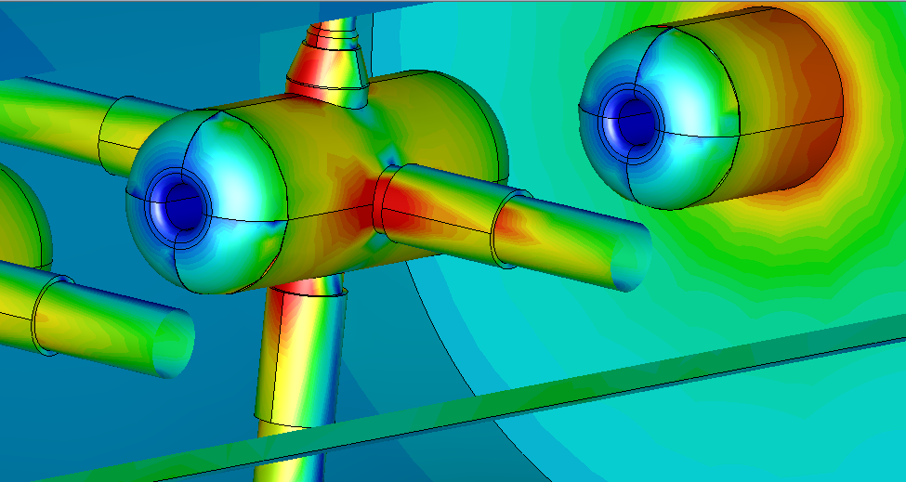
Drift Tubes Stems
CST simulations revealed that current at the spring ring are ~ 4000 A/m, about 50 W per collar.
5 Cell cavity

Slide 20
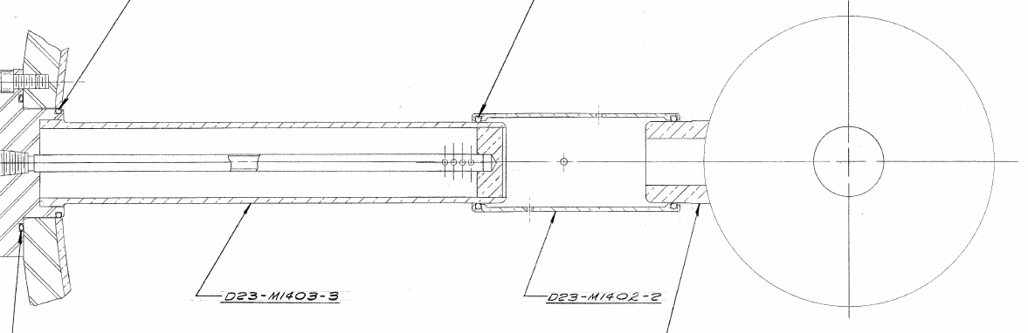
Drift Tubes Stems (Risk Retired)
Used shrink-fitted method to install spring ring ( Thermal resistance reduces to 0.51 ºC /W from 1.24 ºC/W)
Split collar was tried for several weeks in mod 7
Water cooling
Split collar
RF spring Ring
Water cooling
Collars with Shrink-fitted method in tank 5 and split collar in tank 7
Spilt collar and Shrink –fitted were successfully tested in tank 5 with 1.1 ms pulse length for several weeks

Slide 21
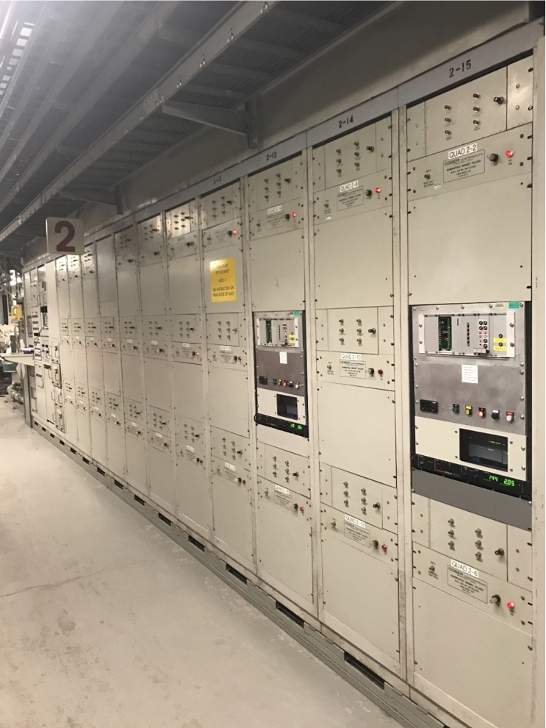
Quadrupole Power Supply
(Risk Retired)
52-year-old and contain obsolete components
Resonant Charge Power supply
No current feed back
Design for 200 us of beam pulse
Based on proven technology (CERN)
Two prototype PS were built and under operation since 2019

Slide 22
Beam Instrumentation System
The following instrumentation will be added or upgraded based on recent raster upgrades:
Beam position monitor (BPM) after DTL tank 9 and between the first (BM1) and second (BM2) bending magnets in the BLIP transport line
BPM electronics for the connection to existing BPMs after the DTL cavities 2 through 8 and the BPMs listed above
Single wire Secondary Emission Monitors (SEM) electronics (20 units)
Beam profile monitor (harp) between BM1 and BM2
New current transformers (11 units) for DTL tanks 2-9, and between BM1 and BM2
New slit and collector emittance monitors (X, Y) in front of DTL tank 1.

Slide 23
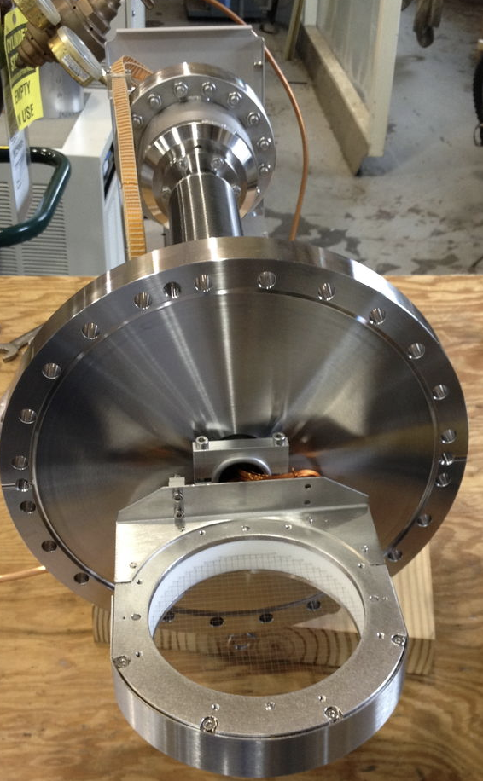
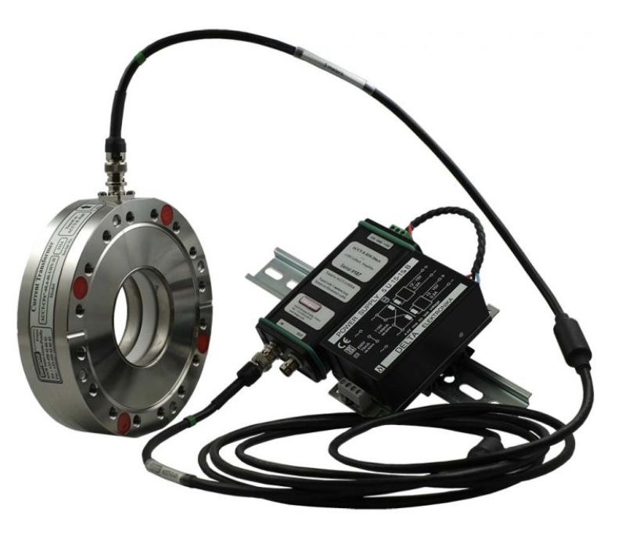
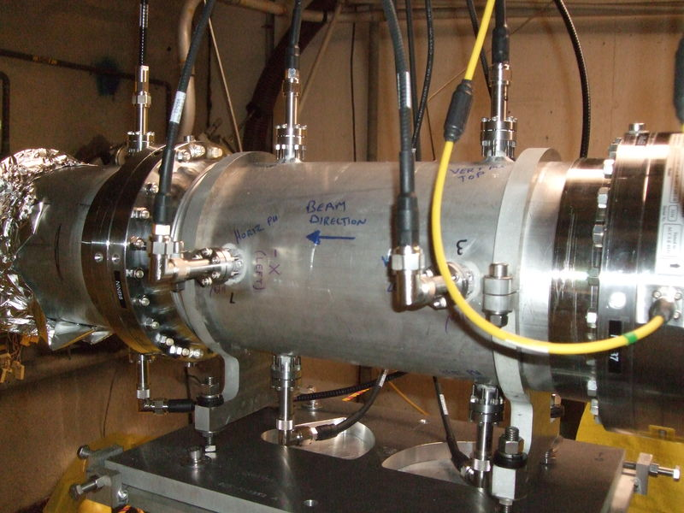
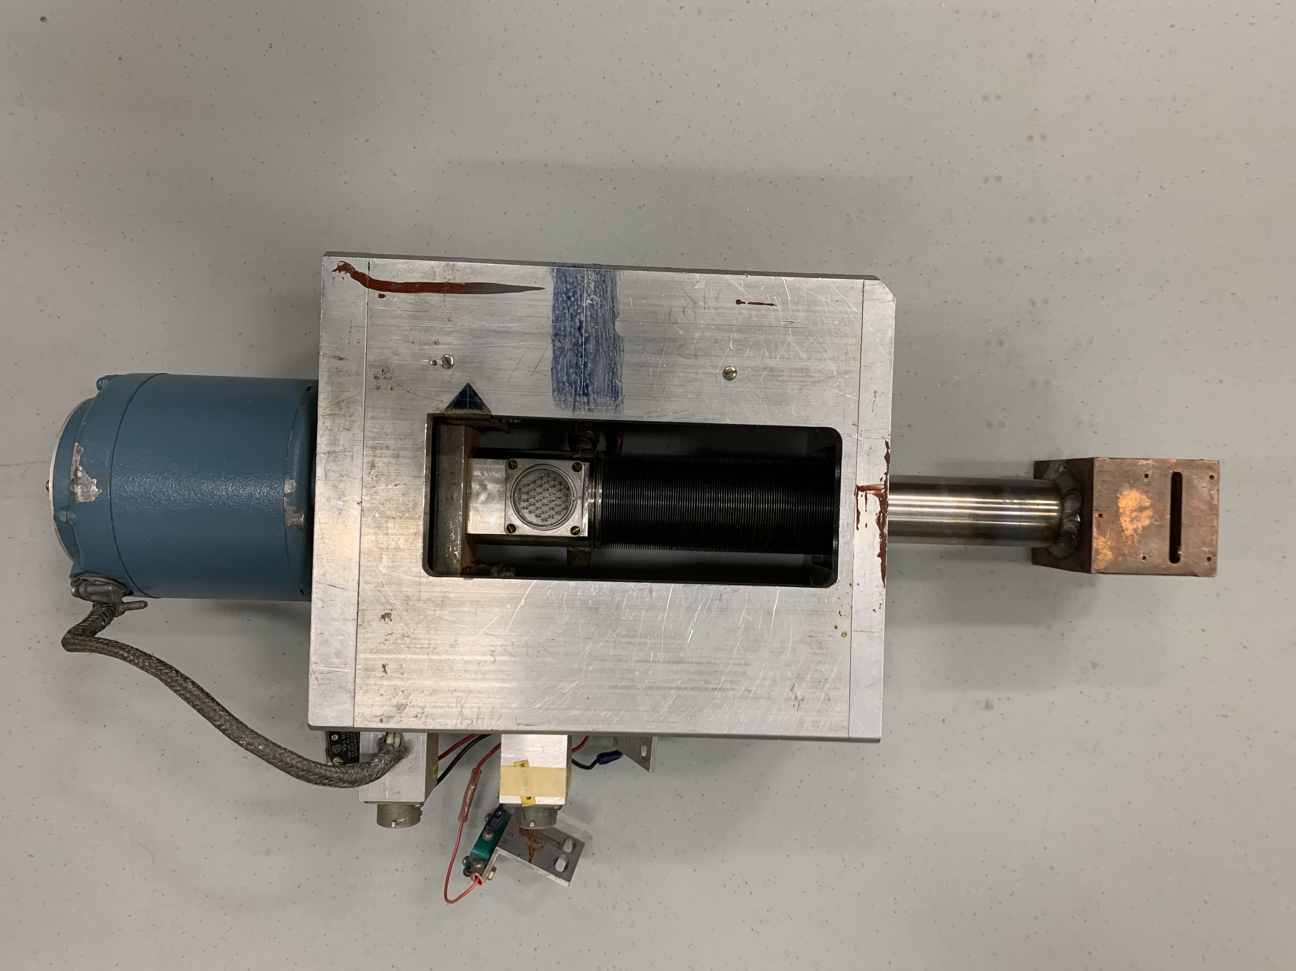
Beam instruments
BPM
Current Monitor
Multiwire
Emittance prob

Slide 24
Control System
The existing system is based on obsolete Datacon Systems.
There are two proven technologies that are being considered.
(1) Front-End Computer Remote I/O System (FRIO System), which is comprised of VME 4143 modules for analog reference outputs and VME PAS9737 modules for data acquisition, LINAC, Booster, AGS, RHIC
(2) The V233 Quadruple Function Generator (QFG) modules with the Power Supply Interface (PSI) modules (QFG System). LINAC, Booster, AGS, RHIC
Both systems are VME based.

Slide 25
Challenges
Scheduling upgrade activity constrained with operation of RHIC, NSRL, Polarized Proton in AGS and BLIP
BLIP schedule very uncertain due to demand of isotopes and partner lab schedule issues
- 2020-2021 run lasted 15 month
- 2022 run lasted 315 days
Yearly maintenance of utilities, cooling tower, HAV, Vacuum system, certification of access control system, etc.
Uncertainty of COVID
Supply chain issues

Slide 26
Schedule Constraints
 | 2023 | 2024 | 2025 | 2026 | 2027 | 2028 | 2029
Beam Operation
Outage
Start
Early Finish
Late Finish
Start date FY 2024
6 Months summer outage for early finish , 4.5 year
Late finish, 6 year
No dependency on other programs ,BLIP, NSRL, RHIC

Slide 27
Summary
LIUP1 evaluated all subsystems for beam current of 250 uA
All upgrades are based on proven technologies
Schedule: Early finish 4.5 years. Late finish 6 year
Cost: 21.8 M$, 32% contingency
Personal: 0.4 FTE/per year, per WBS
Project is “Shovel Ready”

Slide 28
Thank YOU
Questions

