Slide 1
Linac performance 1970 -2022
Deepak Raparia
LIUP2 Director Review
14-16 September 2022

Slide 2
Outlines
Introduction
Linac upgrade history
Replacement of Cockcroft-Walton to RFQ
Reconfiguration of LEBT and MEBT
LIUP1
Raster upgrade
Beam Loss monitor
Source and LEBT Upgrade
Conclusion

Slide 3
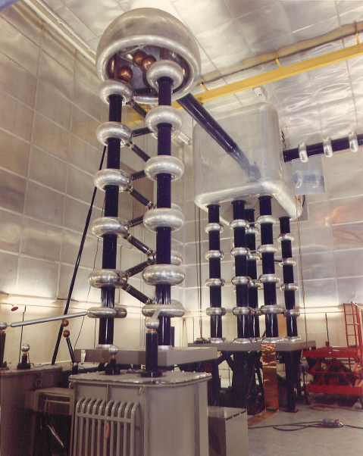
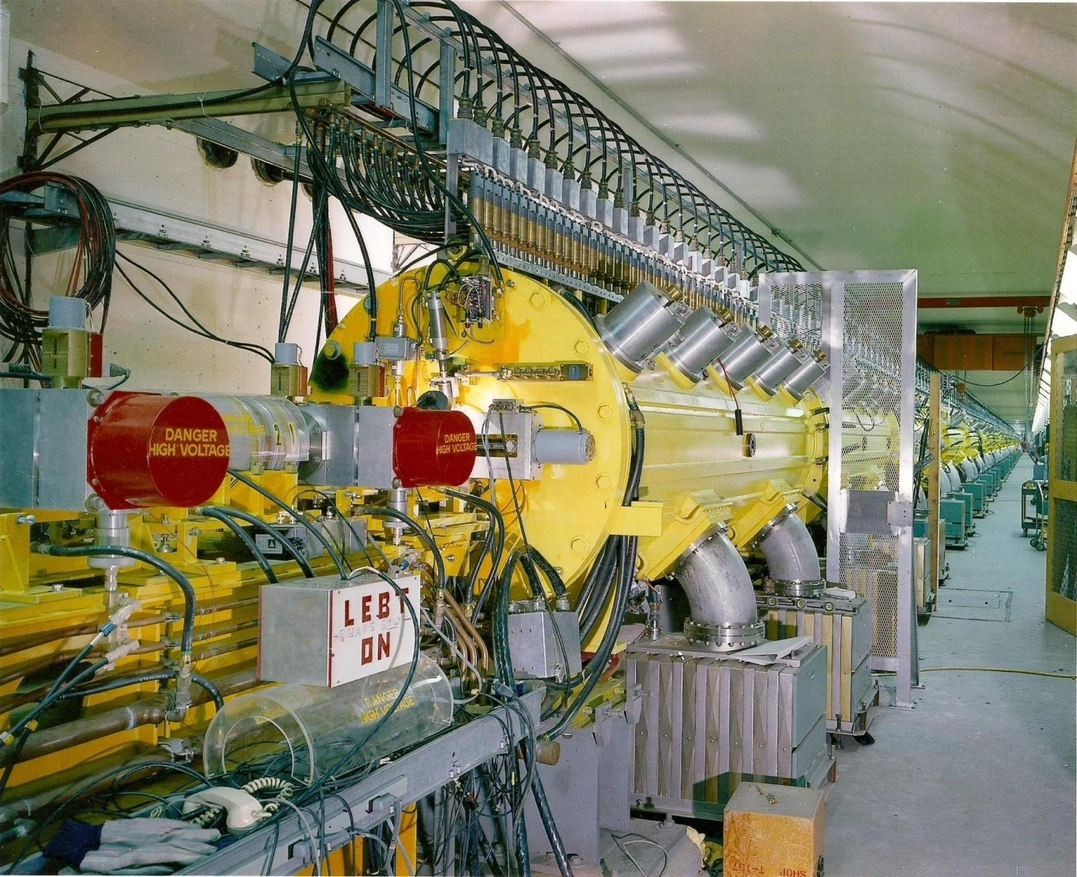
1970 BNL Linac 200 MeV
Cockcroft-Walton 750 KeV
Drift Tube Linac (Alvarez Linac) 200 MeV

Slide 4
BNL LINAC Beam Parameters
Frequency 201.25 MHz
Injection Energy 0.750 MeV
Final Energy 10-200 MeV
Peak Current ~60 mA/ ~ .5 mA P^
Pulse Length 575 μs
Repetition Rate 6.67 Hz
Number of cavities 9
Length 144.8 m
Total Peak RF Power 22 MW
G. W. Wheeler, K. Batchelor, R. Chasman, P. Grand, J. Sheehan, Part. Accel. 9, (1979)

Slide 5
BNL LINAC Design

Slide 6
First Beam

Slide 7
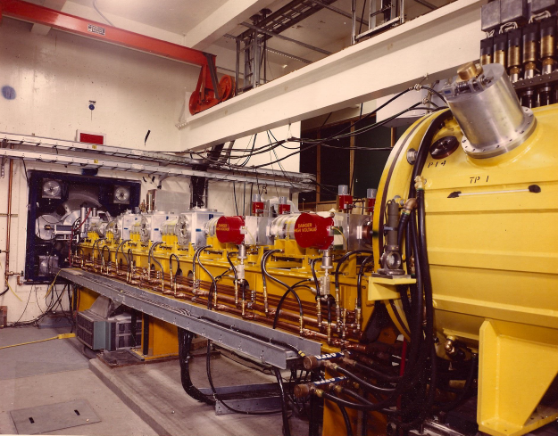
1970s BNL Low Energy Beam Transport (LEBT)
Buncher
DTL
Quadrupole

Slide 8
Linac Upgrades History
1970: Built for Proton beam pulse length 200 μs, RF pulse length 400 μs, 10 Hz
1977: 5 Hz operation
1984: Switch to H-
1986: Add Polarized H-
1990: Replacement of Cockcroft-Walton By RFQ
1996: Pressurized coax, RF system:50 kV power supply, new RF control system, new amplitude phase servo, and LEBT modification, 6.67 Hz
1999: New timing system
2000: addition of OPPIS

Slide 9
BNL Linac Upgrades ( Cont.)
2009: LEBT/MEBT reconfiguration short MEBT (7m to 0.7m)
2010: Short LEBT at 45 deg (4m to 2m)
2015: New beam loss monitor ,replacement of tetrode 7651 with 5 kW solid state amplifiers
2016: Intensity upgrade phase I, Beam raster system
2017: Upgrade to digital LLRF
2019: High intensity sources
2020: Vacuum upgrade replace all ion pumps
Most of the sub system has been upgraded to modern technology

Slide 10
BNL Linac History for High Intensity
Year | Rep. Rate Hz | Pulse length (us) | Peak current (mA) | Ave. Current (uA) | Comment
Desi. | 10 | 200 | 100 | 200
1972 | 10 | 80 | 55 | 44
1975 | 10 | 100 | 60 | 60
1979 | 5 | 220 | 70 | 77 | Switch to5 % Hz Operation (1976)
1984 | 5 | 200 | 25 | 25 | Switch to H- (1984)
1986 | 5 | 470 | 30 | 71 | Add Polarized H- (1986)
1990 | 5 | 500 | 25 | 63 | Switch to RFQ Pre-Injector
1996 | 6.7 | 400 | 38 | 90 | RF Upgrade,LEBT/MEBT, 6.67 HZ
2000 | 6.7 | 400 | 38 | 90 | Add OPPIS
2009 | 6.7 | 438 | 32 | 80 | LEBT/MEBT reconfiguration (short MEBT)
2010 | 6.7 | 430 | 39 | 110 | Short LEBT
2011 | 6.7 | 440 | 31 | 120 | New Buncher + Einzel lens –Solenoid
2016 | 6.7 | 500 | 45 | 160 | LIUP1
2019 | 6.7 | 550 | 55 | 200 | Source upgrade
2021 | 6.7 | 575 | 60 | 215 | RF pulse width

Slide 11
Average Current at BLIP
2nd Source _
New Buncher
PMQ in RFQ Flange
Increase beam width
Short LEBT
Short MEBT
RFQ
H-

Slide 12
First Change in Linac Block Diagram
Cockcroft-
Walton/
Buncher
System
750KeV
Drift-Tube Linac (DTL)
200 MeV
LEBT
1970s
1990s
Ion Source
35 KeV
Drift-Tube Linac (DTL)
200 MeV
RFQ
750 keV
LEBT
MEBT

Slide 13
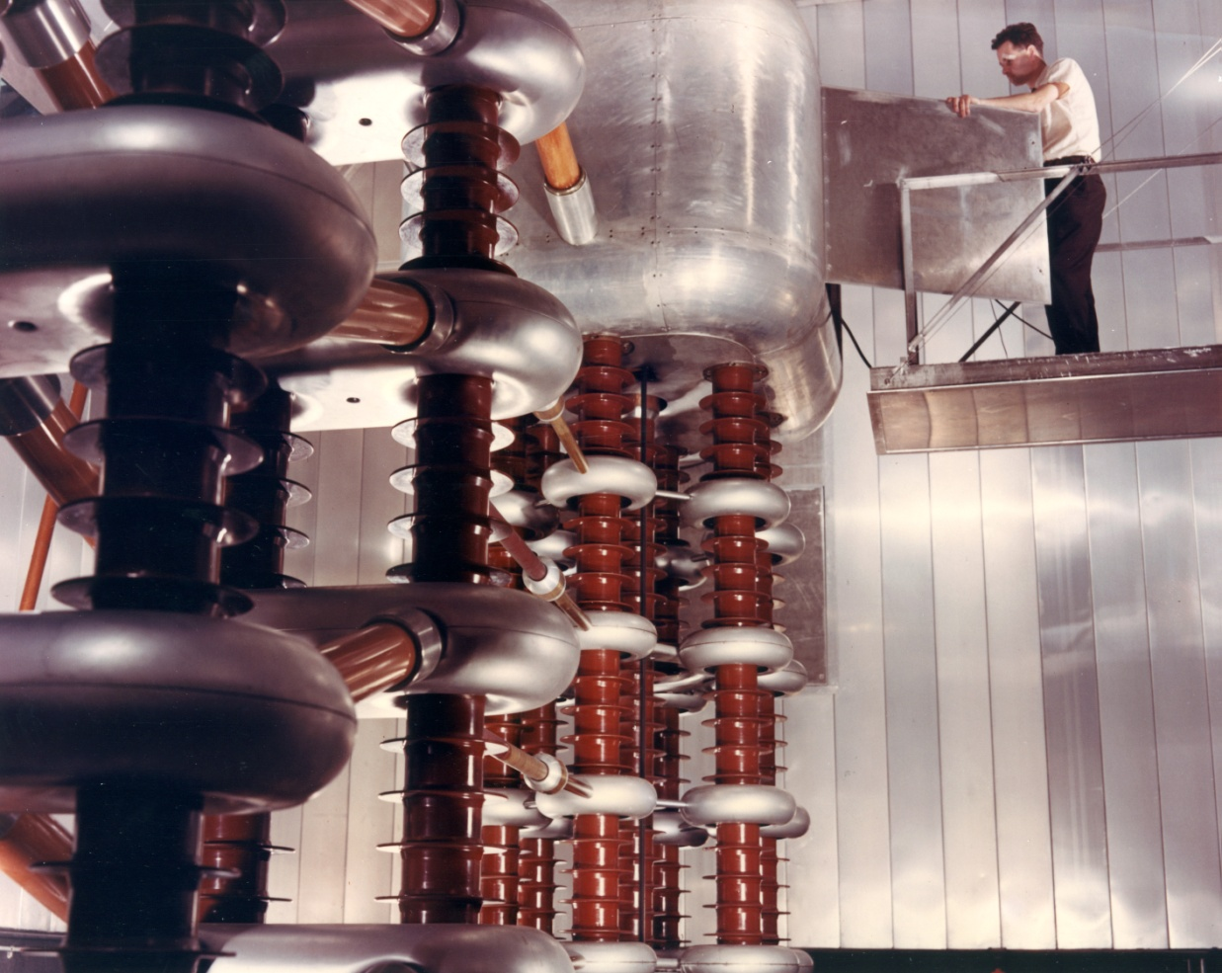
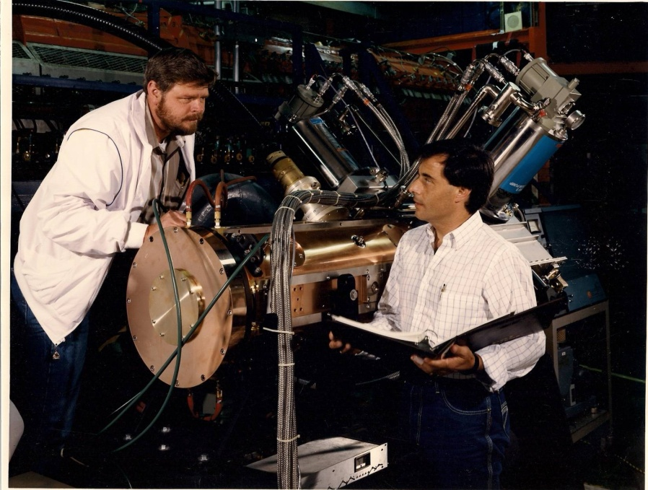
200 MeV Linac – converted from Cockcroft-Walton to RFQ in 1980s
RFQ
Cockcroft-Walton

Slide 14
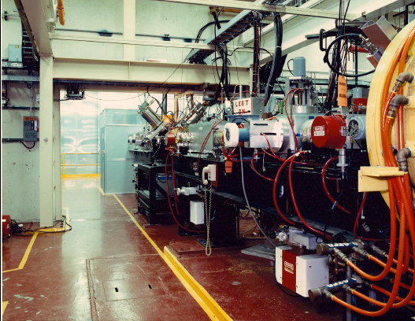
1989 New Configuration of LEBT

Slide 15
RFQ as Pre-Injector at BNL
Polarized H-
Tens nA of polarized current
65 % polarization, 20 keV
RFQ
Build at BNL
DTL
Medium Energy Beam Transport (MEBT)
RFQ
Build at LBNL
High Intensity H-
100 mA
35 keV

Slide 16
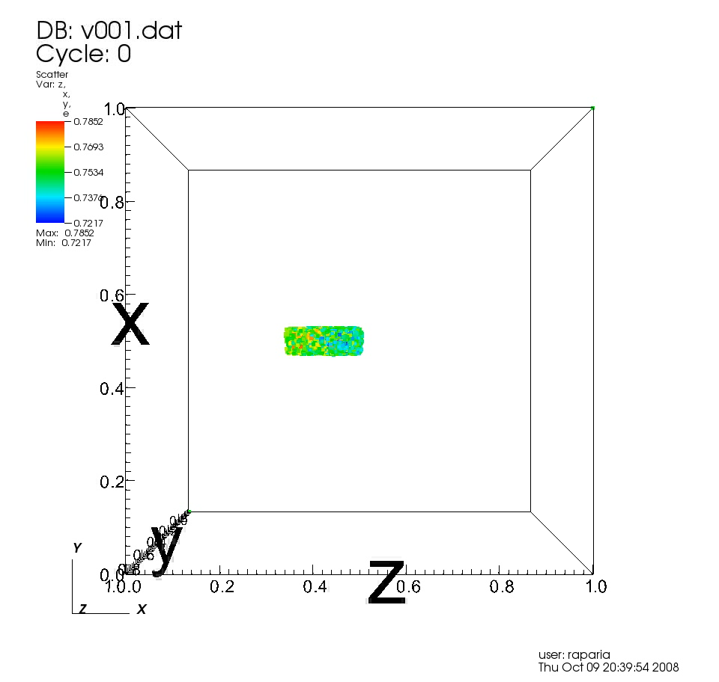
Bunch Through MEBT and LINAC
βλ

Slide 17
Linac Performance after RFQ
1989
Only BNL and CERN replaced Cockcroft-Walton with RFQ
RFQ was much more reliable and required less maintenance than Cockcroft-Walton
But capture efficiencies in the linac did not improve as advertise
Neither emittance nor intensity improved out of linac

Slide 18
2002 Addition of Optically Pumped Polarized Ion Source (OPPIS)
B
B
B
DTL
H
S
S
RFQ
Q
C
Q
S
D
Q
Q
B
B
B
H
Polarized
Polarized current increase to 200-300 uA from 100 nA

Slide 19
Modification In 2009 at BNL
35 keV
7 m
750 keV
DC
B
B
B
DTL
H
S
S
RFQ
Q
C
Q
S
D
Q
Q
H
Reduced MEBT length by 90% meters
750 keV
Polarized
35 keV
0.7 m
B
DTL
H
S
E
Q
S
C
S
S
RFQ
Q
Q
Q
E
H
B
Q
Quadrupole
Buncher
S
Solenoid
C
Chopper
S
Beam Stop
E
ES Lens

Slide 20
Changes in 2009 at BNL
MEBT was changed from 7 meters to 0.7 meters
LEBT was changed from 1 to 4 meters
-Emittance for polarized H- was reduced by factor of two
-Higher Transmission through LINAC
-Much lower radiation through out the linac
-Lower Transmission through RFQ
LEBT was too long and more Buncher needed more rf power

Slide 21
Changes in 2010 at BNL
B
DTL
E
Q
S
C
S
S
RFQ
Q
Q
Q
S
E
H
H
Reduced LEBT length from 4 meters to 2 meters
B
Q
Quadrupole
Buncher
S
Solenoid
C
Chopper
S
Beam Stop
E
ES Lens

Slide 22
Changes in2010 at BNL
Reduced LEBT length from 4 meters to 2 meters
-Increased peak current 32 to 39 mA
-In spite of higher current lower radiation
-Buncher still needed more power

Slide 23
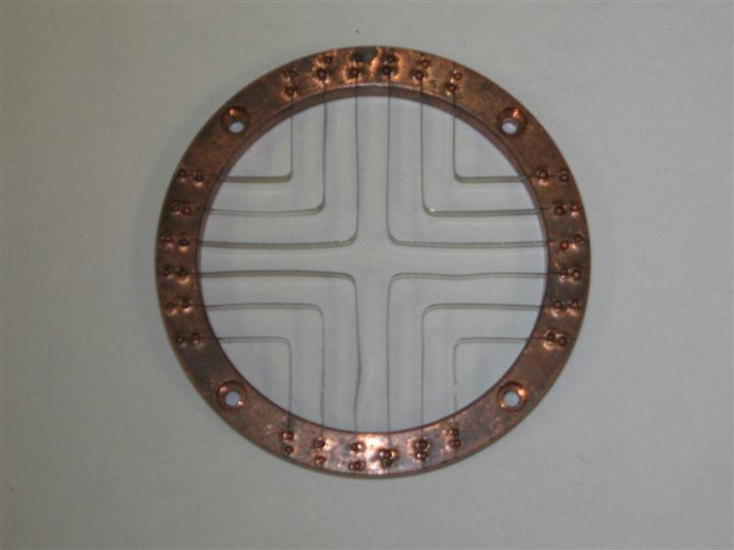
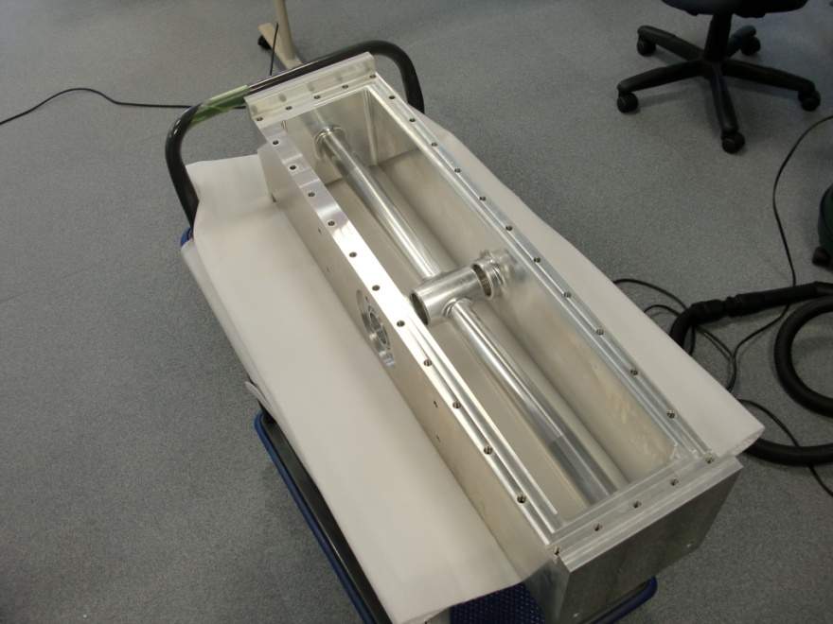
New Buncher 2011
Increased peak current 39 to 42 mA
-In spite of higher current lower radiation
-Buncher still needed more power
Grid
New (inside)

Slide 24
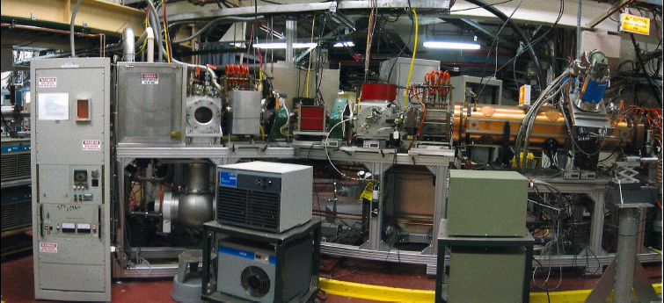
LEBT in 2010
High Intensity
H- ion source
Dipole
Solenoid
RFQ

Slide 25
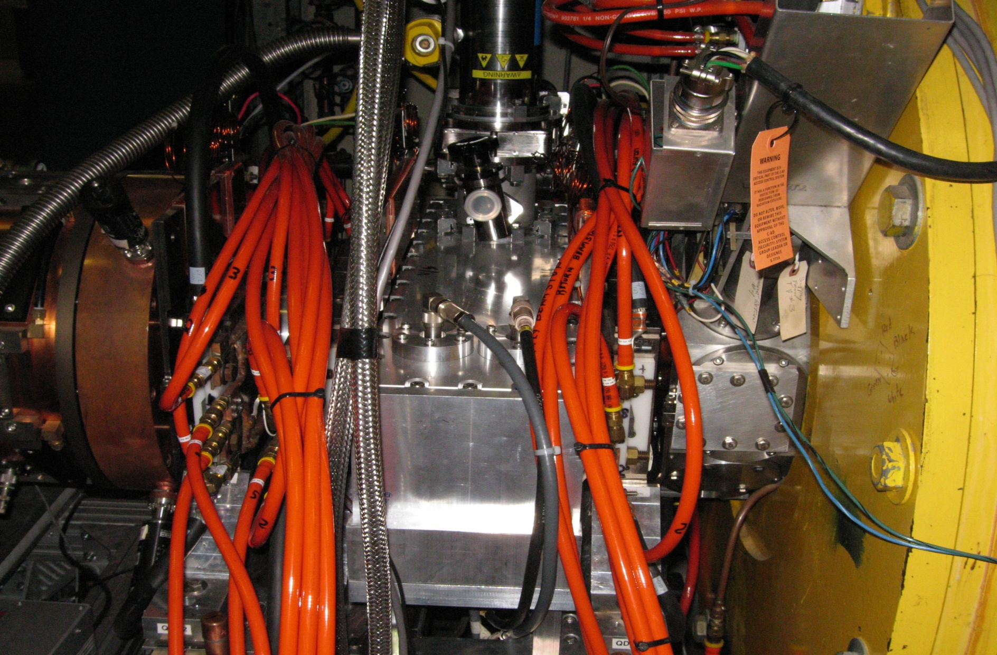
NEW MEBT 2011
DTL
RFQ
BUNCHER
QUADRUPOLE

Slide 26
Bunch Through OLD MEBT and LINAC
βλ

Slide 27

Bunch Through New MEBT and Linac
βλ

Slide 28
BNL Linac Performance for Polarized Protons after reconfiguration
Year | ε_{X} (N, 95%) πmm mr | ε_{Y}(N, 95%) πmm mr | Linac Transmission (%)
2008 | 10.7 | 15.9 | 60-65
2010 | 4.5 | 5.5 | 75-80
This emittance reduction was observed through out the
accelerator chain up to RHIC. At RHIC collision energy
emittance was reduced by 25 %

Slide 29
Benefits Reconfiguration of LEBT/MEBT for BLIP
Transmission of linac increase 55% to 85 %
Residual radiation decreased by order of magnitude.

Slide 30
Intensity Upgrade –Phase I (2014-2016)
Increase beam current by 15%.
Evaluate the proposal to double the linac beam current
  Evaluate and prototype quadrupole pulse modulators flattops for 900 μs beam
  Evaluate conditions of water-cooling channels in drift tubes and accelerator cavities
  Prototype RF system for 1100 μs pulse length
  - Upgrading Modulator ; power supplies and low-level electronics
  - Increasing the 250-kW diver capacitor bank to 40 mF from 25 mF
  - increasing the 7835-amplifier capacitor back to 84mF from 50 mF
Completed FY-2016 : Recommend Phase 2 for 250 μA average beam current.

Slide 31
Intensity Upgrade Phase I and II
Design Duty Cycle for the Linac RF 0.4% and for Beam 0.2%
Requirements
2013 2022 Phase I Phase II
Peak Beam current 42 mA 60 mA 45 mA 45 mA
Max Avg Beam current 120 μA 215 μA 140 μA 250 μA
Beam Pulse Length 450 μs 575 μs 480 μs 900 μs
RF Pulse Length 650 μs 710 μs 670 μs 1100 μs
RF Duty Cycle 0.43% 0.46% 0.44% 0.73%
Rep. Rate 6.67 Hz 6.67 Hz 6.67 Hz 6.67 Hz

Slide 32
Optimization of Source and LEBT

Slide 33
H- Space Charge Neutralization in LEBT
High Intensity
H- ion source
Dipole
Solenoid
RFQ

Slide 34
LEBT at 35 keV with 120 mA of H-
During Neutralization time phase space rotate
sol
sol
X’
τ_{N} ~ 100μs
H- beam
X
LEBT for 120 mA H-
Magnetic (solenoid) focusing
H⁻ ionizes residual gas and capture positive nucleus this is called space charge neutralization
H⁻ stripping
IS
SOL
SOL
RFQ

Slide 35
H- Stripping and Neutralization (cont..)
Left Triangular are represents
Losses due to Neutralization.
Top rectangular are represent
Losses due to the stripping
Total losses due to stripping
And neutralization as function
Of residual gas pressure for
200 cm long LEBT and 500 us
long beam pulse length.

Slide 36
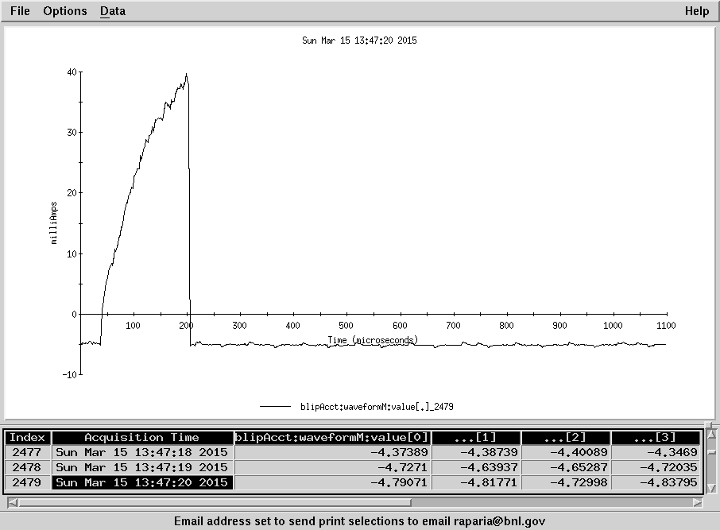
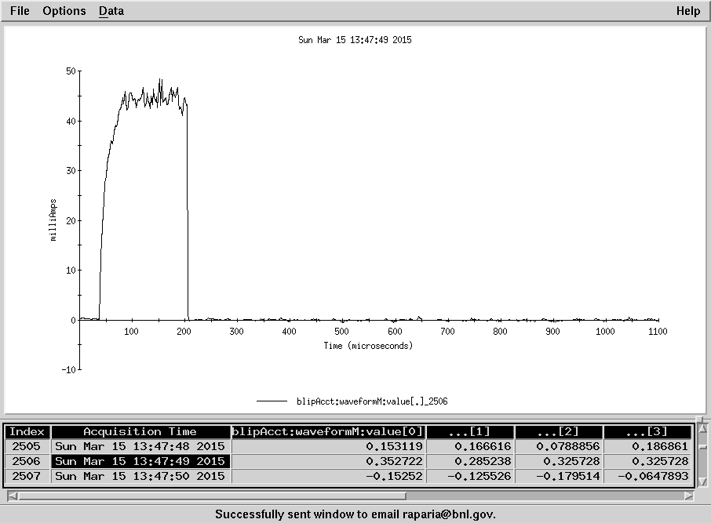
Xenon Gas Effect
Xenon
Av. Cur. 42.3 uA
No Xenon
Av. Cur. 20.7 uA

Slide 37
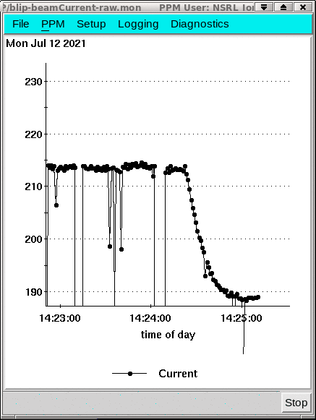
Beam Neutralization Source-1
Xe-on, 214, Xe-off 188 uA
Xe-on, Xe-off

Slide 38
Raster System (2014-2016)

Slide 39
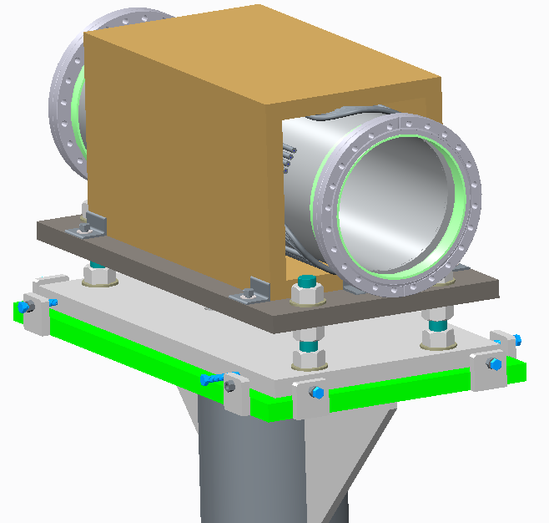
Raster Method
Paint the beam in a circular fashion to provide uniform beam distribution and minimize beam outside the target
Two orthogonal dipoles driven by high frequency (~ 5kHz) power supplies at phase difference of 90 degrees
Magnet
  2 coils, 8 turns each
  225 amp rms current
  Field 0.0142 Tesla
  3.3 mrad half angle

Slide 40
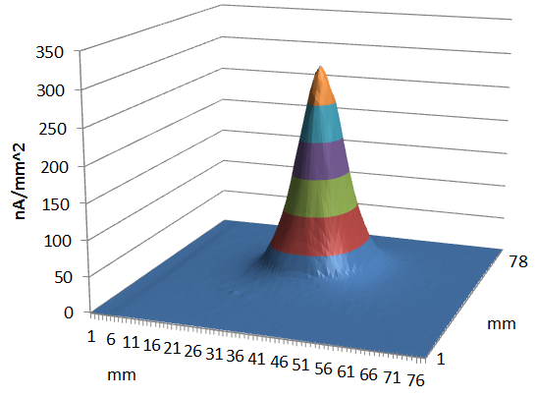
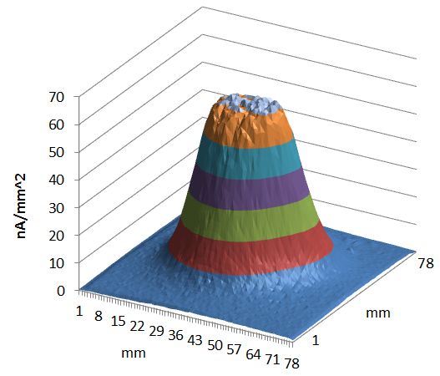
Beam Footprint
Beam profile on target without raster (left) and with repeating raster pattern of 4 Linac pulses at 11.5 mm radius and 1 Linac pulse at 4.5 mm radius (right), 117 MeV, 100 μA. The integral of the beam distribution is equivalent for both profiles. Note that the y-scale for the non-rastered profile is about 5 times the y-scale for the rastered profile.
Non-rastered beam FWHM: 13 mm, FWTM: 40 mm
Rastered beam FWHM: 32 mm, FWTM: 60 mm

Slide 41
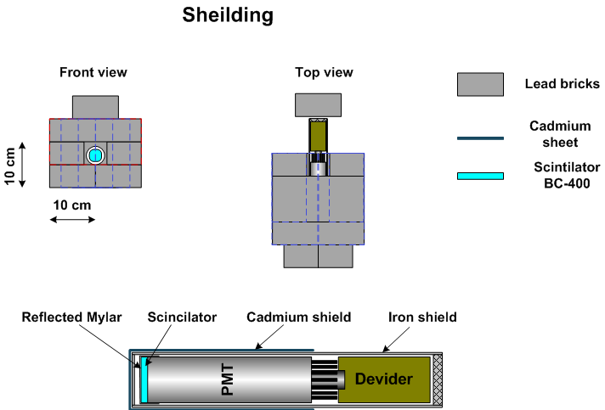
Beam Loss Monitor

Slide 42
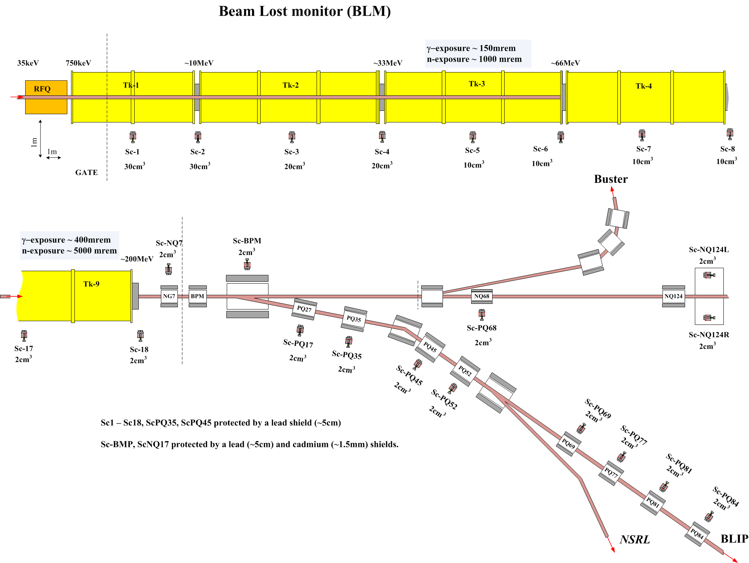

Slide 43
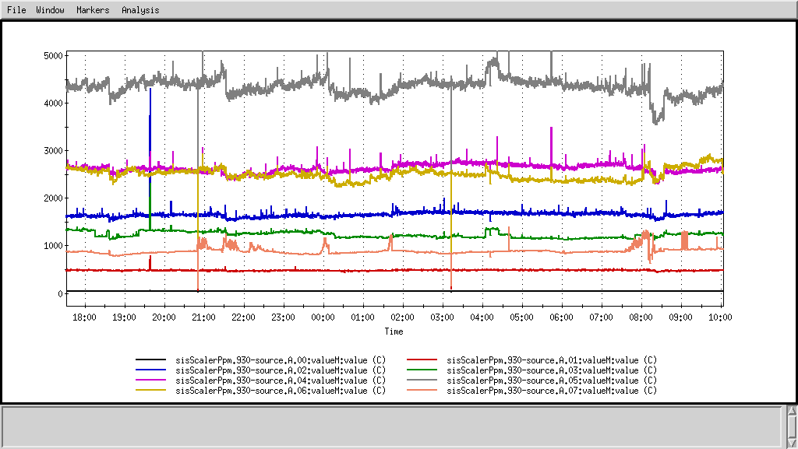
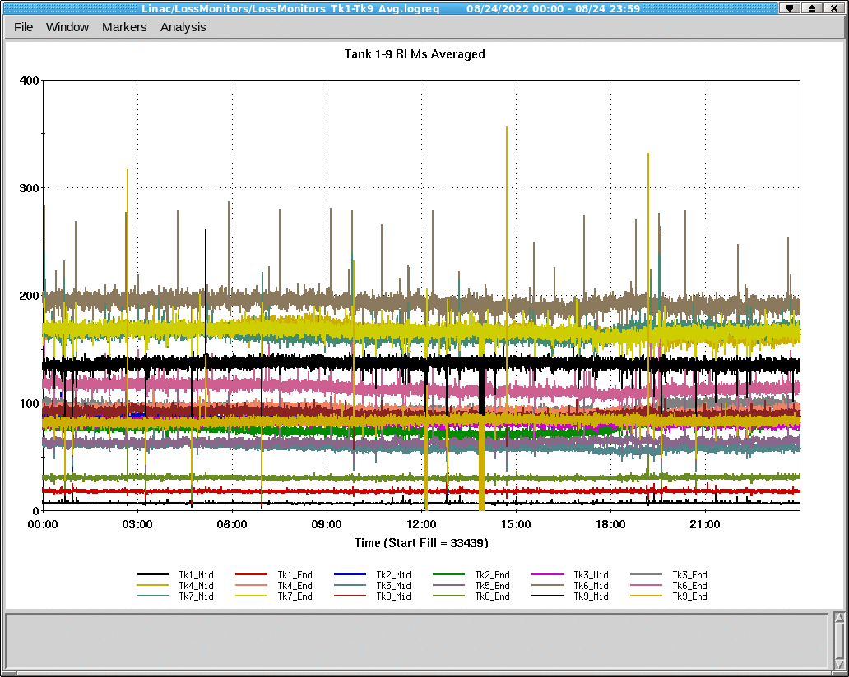
Beam Loss Monittor
2015 Beam Current 120 uA
2022 Beam Current 155 uA

Slide 44
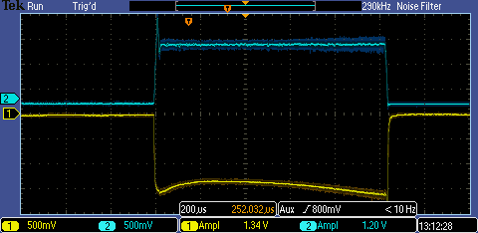
Two High Intensity Sources (2019)
OPPIS
Peak current 1.5 mA
Pulse Length 500 𝜇s
Polarization. ~85%
Magnetron Source 2
Polarized source OPPIS
RFQ
Magnetron H- Source
Peak current 135 mA
Pulse Length 1.1 ms
Extraction 35 kV
Magnetron Source 1

Slide 45
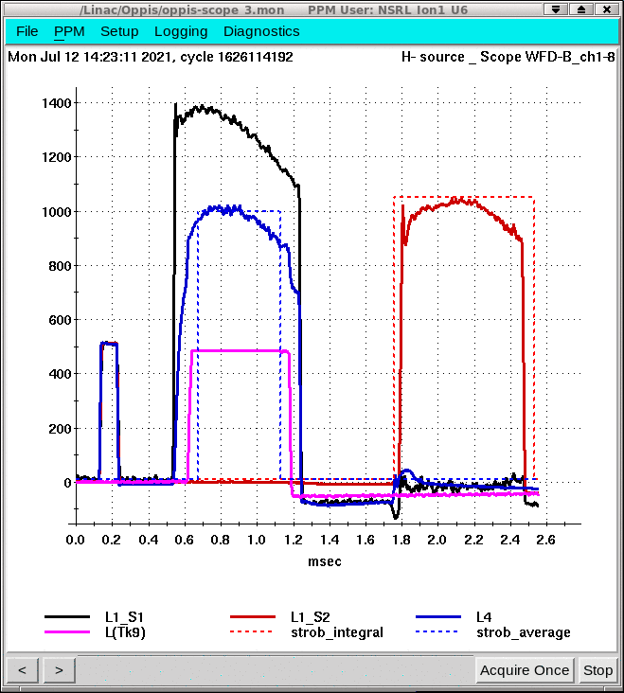
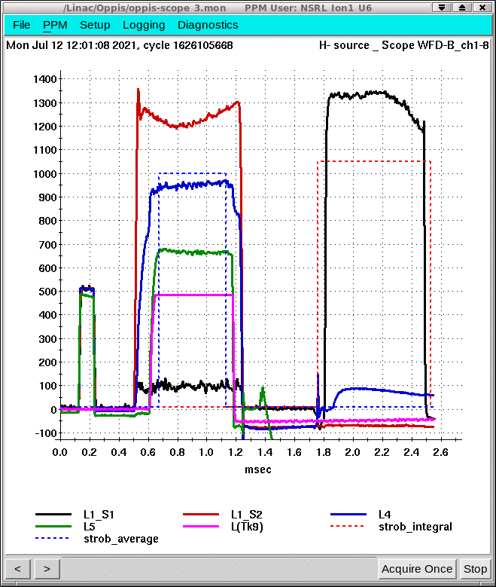
Source 1(black ) and 2 (red)

Slide 46
Average Beam Current

Slide 47
Peak Beam current
Source 2
Source -1
Changed to OPPIS ext PS
Changed over source 2-1

Slide 49
Reducing Beam Losses
Reducing length of MEBT to 0.7 meter from 7 meter
Reducing LEBT to 2 meter from 4 meter
Neutron beam loss monitor
Optimizing H- beam neutralization in LEBT
New buncher design
Now most of the beam losses in the linac is due to gas stripping of the H⁻

Slide 50
Yearly Ave. Current and Beam Power, Availability and Residual Radiation
Max Ave. Current 215 𝜇A in 2021
𝜇A

Slide 51
Summary
Fifty-two years of operations , performance still improving.
Severing multiple users , BLIP, RHIC, NSRL, 200 MeV Polarimeter.
Losses better understood, Three order of magnitude less losses with 10-fold increase in beam power.
H- neutralization better understood.
Reliability > 95%.

Slide 52
LIUP1 : system evaluation

Slide 53
Pulse Magnet system
Tests were done on a spare quadrupole magnet to evaluate the cooling water requirements for the increased duty factor, and it was found that increased water flow cooling is not required.
Modification of the existing quadrupole power supplies was evaluated and it was determined that it will be more cost effective to implement a complete redesign of the supplies with modern electronic components that do not use the “ resonant” charge approach. Two prototype pulse poser supply is now under development

Slide 54
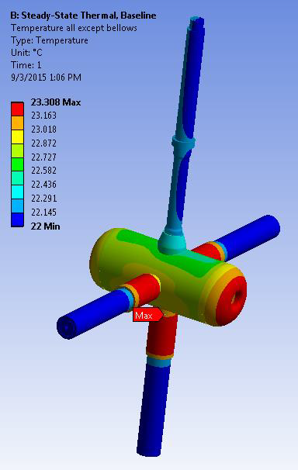
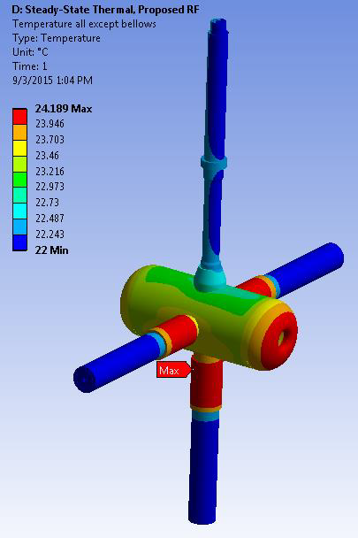
Cooling requirements
Calculations have been completed for a “high power” cavity and indicate that the existing cooling water flows and pressures are sufficient to maintain dimensional stability under the planned increase in duty factor.
Present
Upgrade

Slide 55
DT Thermal Analysis
Component | Present Max Δ T(°C) | Present Max Δ L (in) | Upgrade Max Δ T(°C) | Upgrade Max Δ L (in)
DT total | 1.30 | - | 2.18 | -
DT, X (axial) | - | 0.0003 | - | 0.0005
DT, Y&Z | - | 0.0002 | - | 0.0004
Stem 1& DT water | 0.27 | NA | 0.42 | NA
Stem 2 water | 0.004 |  | 0.007
Stem 3 water | 0.004 |  | 0.007
Stem 4 water | 0.004 |  | 0.007

Slide 56
Condition of DTL Cooling Channels
The conditions of water quality and flow channels were evaluated for three typical cavities and only minor anomalies were found. We have found couple of drift tube flow measure were completely block providing no water flow to drift tubes. We also found several side stamp water channel were clogged.

Slide 57
Thank You
Subtitle

