Slide 1
Project Managemnet
Deepak Raparia
LIUP2 Director Review
12-14 September 2022

Slide 2
Outline
Safety
LIUP2 Accelerator Improvement Project (AIP)
  Project Management Responsibilities
  Project organization chart
  Cost/Funding/Scope
  Contingency
  Risk
  Schedule and Milestones
  Key Performance Parameters (KPPs) and Ultimate Performance Parameters (UPPs)
Summary

Slide 3
Safety
The Lab makes safety a top priority; strong emphasis on working safely. Safety will not be compromised on this project.
Environmental, Safety, Security, Health and Quality (ESSHQ) Division of the Collider-Accelerator Department (C-AD) is very experienced and very helpful. They work along our side in the field in helping with work planning, process reviews, procedure writing, etc. We have all become sensitive to what is required to work safely, are accustomed to the processes and receive the appropriate training.
We have a high confidence that this project will be done safely.

Slide 4
Project Management Responsibilities
Within DOE’s Office of Science (SC), the Office of Isotope Program (IP) has overall responsibility for the LIUP2 Accelerator Improvement Project (AIP).
Arne Freyberger serves as the LIUP2 Point of Contact for IP, and reports to Jehanne Gillo (Director of Office of Isotope Program).
Funding for this project will be directed through BNL’s Collider-Accelerator Department (C-AD). Fiscal and management responsibility for the fabrication of LIUP2 will reside with the C-AD’s AIP Manager Michiko Minty.
The Chairman for the Collider-Accelerator Department, Wolfram Fischer, has appointed Deepak Raparia as the LIUp2 Contractor Project Manager(CPM).

Slide 5
LIUP2 Organization Chart

Slide 6
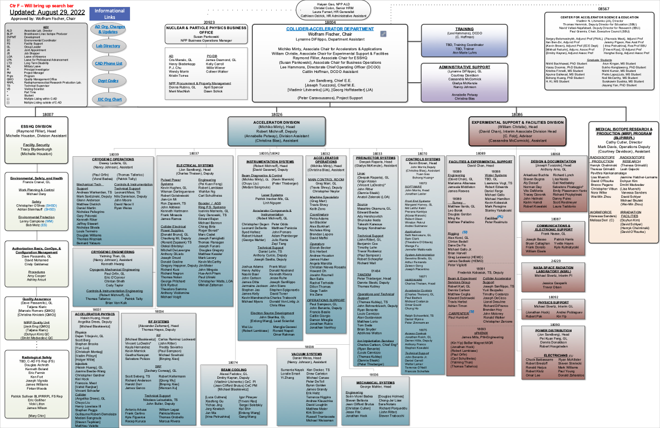
Subsystem responsibility in C-AD Org Chart.
Large resource pool.
Each task is supported by
an established group.
ESSH&Q
1.8
2.4
0.45
4.7
1.6

Slide 7
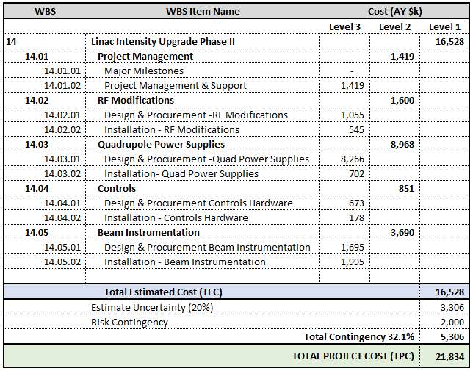
Work Breakdown Structure (WBS) and Cost Estimate

Slide 8
Schedule Constraints
 | 2023 | 2024 | 2025 | 2026 | 2027 | 2028 | 2029
Beam Operation
Outage
Start
Early Finish
Late Finish
Start date FY 2024
6 Months summer outage for early finish , 4.5 year
Late finish, 6 year
No dependency on other programs ,BLIP, NSRL, RHIC

Slide 9
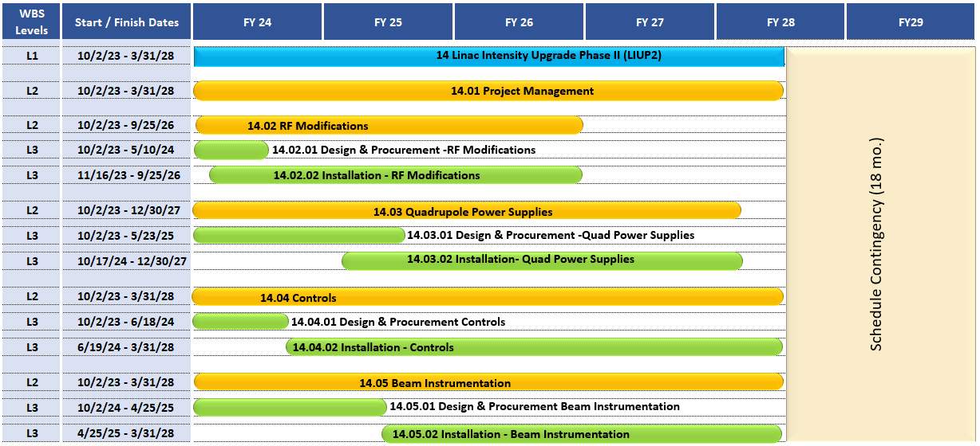
Schedule

Slide 10
Criteria for Risk Identification and Assessment
Likelihood of Occurrence
• Very likely (VL): risk is likely to occur with a probability greater than 90%
• Likely (L): risk is likely to occur with a probability greater than or equal to 50%
• Unlikely (U): There is a less than 50% chance that this event will occur

Slide 11
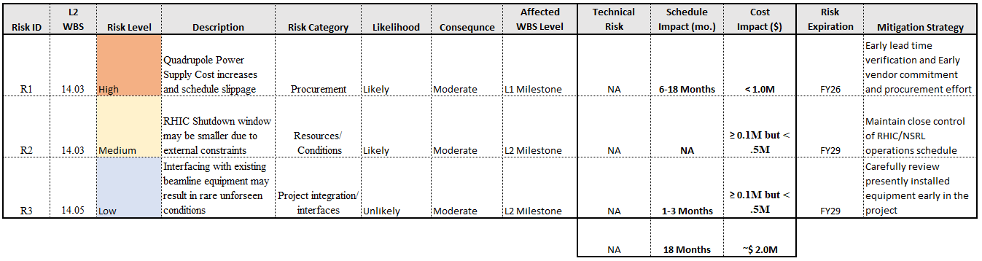
Risk and Mitigation
Individual risk items will be addressed in corresponding talks.

Slide 12
Risk and Mitigation
Individual risk items will be addressed in corresponding talks.
Cost & Schedule Impact Mitigation:
Although there are risk-based schedule impacts, due to the staged work during shutdowns, the forecasted final project completion date is not anticipated to be affected by any of the above risks.
There remains uncertainty about market supply chain issues that could result in cost and schedule impacts to the project.
Mitigating Strategies:
(a)The Contract Project Manager shall work closely with all CAM’s, and the BNL Procurement team, to identify early procurement dates to mitigate potential procurement delays. These schedule impact risks are difficult to quantify as they are driven by the unpredictable nature of market supply chain issues and other geopolitical factors within the market that may affect timely delivery of critical equipment/materials.
(b) We have added 18 months of project contingency to our project plan to offset these potential schedule impacts and have assigned project contingency in the amount of $5.3M to mitigate these and other cost related potential risks and uncertainties.

Slide 13
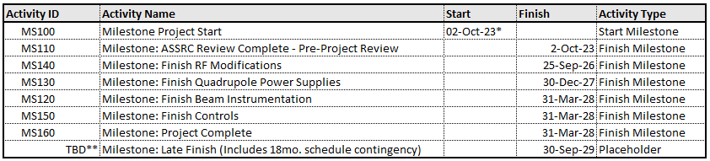
Reportable Milestones

Slide 14
Critical Path
The schedule has the following constraints putting them on the Critical Path:
Linac shutdowns – Installation in the tunnel is only possible when the Linac is not running.
Installation complete – Subsystem testing can only occur after all installation is complete.
Commissioning – Testing with beam can only begin after all subsystem tests and integrated installation is complete.
The early Finish date is planned for March 31, 2028, , approximately 4.5 years total project duration. There is an additional 18 months of schedule contingency added to the plan to accommodate potential delays, resulting in a Late Finish date of September 30, 2029, to the extent needed.

Slide 15
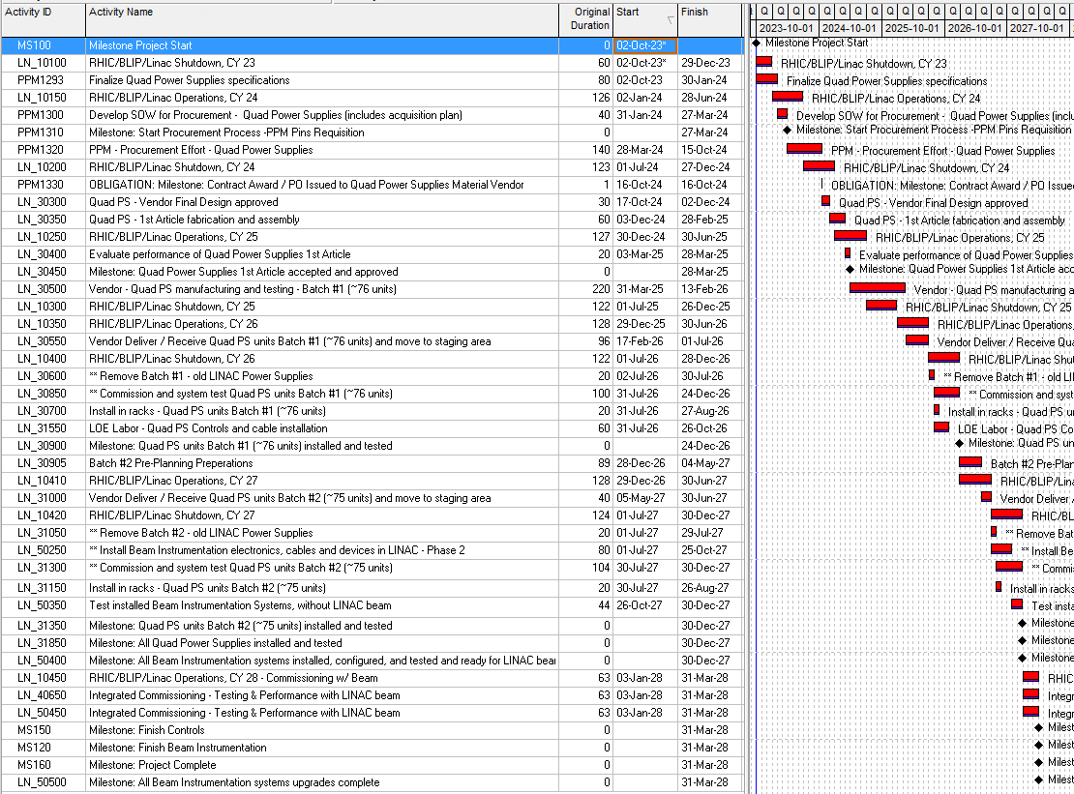
Critical Path (cont.)

Slide 16
Key Performance Parameters (KPP)
LIUP2 KPPs:
All the hardware installed
Demonstration of 950 µs RF pulse width.
Demonstration of 200 µA average beam current .

Slide 17
Ultimate Performance Parameters (UPP)
Demonstration of 1100 µs RF pulse width.
Demonstration of 250 µA average beam current

Slide 18
Summary
The LIUP2 design is technically sound
  Mod 5 has been tested at 1.1 ms for couple of weeks
  Two prototype Quad PS has been working since 2019 in Mod 2
  Harp, CM, BPM etc. will be like recent BLIP upgrade
  Control system, Booster, AGS, RHIC
Cost estimate and schedule exists, including cost and schedule contingency of 32 % and 18 months.
The project team is very experienced. They know how to build things (Booster, RHIC, NSRL, SNS, EBIS, eLens…)
Project is “Shovel Ready”

Slide 19
Slide Header
Body Text
  Bullet Tier 1
    Bullet Tier 2

Slide 21
Section Break
Subtitle

