Slide 1
Project Management Support
Peter Caravousanos
LIUP2 Director Review
12-16 September 2022

Slide 2
Project Management Support
Table of Contents:
Overview
Cost
Schedule
Resources
Project Control and Reporting
Q&A

Slide 3
Overview:
Project Management Support:
Providing support to the project team under the Director’s & Project Manager’s leadership
Support Areas: Cost, Schedule, Resources, Planning & Control
Project Organization:
Work Breakdown Structure – L2 Control Accounts: RF Systems, Quadrupole Power Supplies, Controls, & Beam Instrumentation
P6 Cost & Resource Loaded Time Phased Project Plan
Monthly P6 Status Updates & KPI reporting / Tailored EVM
Assumptions Summary:
Project Start, RHIC Shutdown and Operation cycles (6 mo. ea.) dictate the critical path, coupled with timely procurement, fabrication and delivery of the Quadrupole Power Supplies. Any delay in Critical Path activites can result in additional costs and schedule impacts.
Risk /Uncertainty: ( To be discussed in detail during respective L2 technical presentations)
L1 Risk - Procurement of the Quadrupole Power Supplies in 2 Batches (Cost & Schedule impacts)
Mitigating Strategy: Early procurement & early vendor engagement.
L2 Risk – External constraints and effect on Shutdown durations (Cost Impact)
Mitigating Strategies: Closely monitor / maintain control over RHIC/.NSRL Operation Schedules and manage, supply and supplement (as needed) appropriate resources to accommodate ~75 Units per batch / shutdown period.
L2 Risk – Unforeseen Conditions during installations (Cost & Schedule impacts)
Mitigation Strategy: Pre-Survey existing conditions and equipment to fullest extent possible.

Slide 4
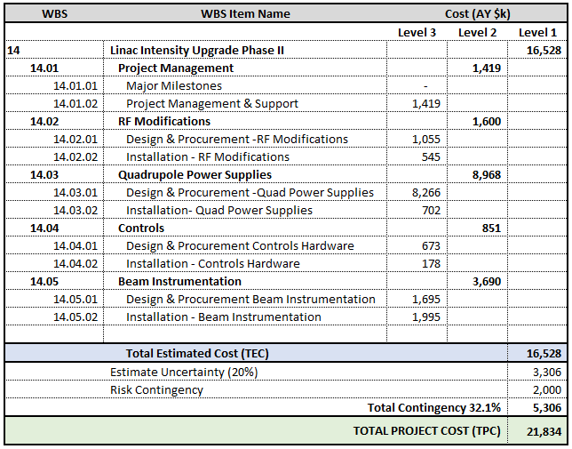
Cost:

Slide 5
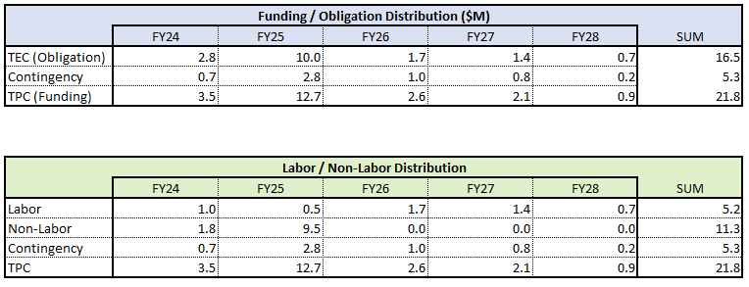
Cost: Distribution by FY

Slide 6
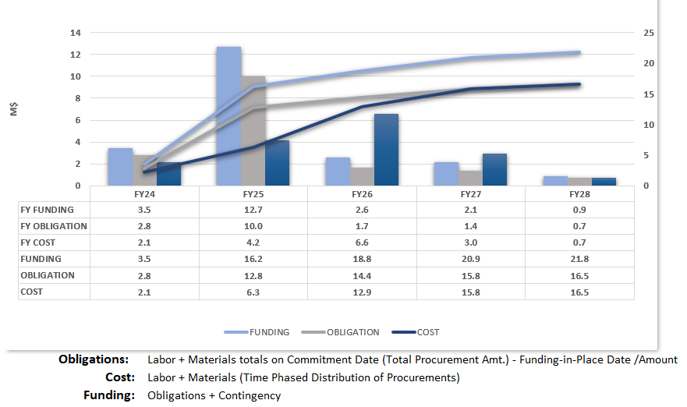
Cost: Funding, Obligation & Cost Profile

Slide 7
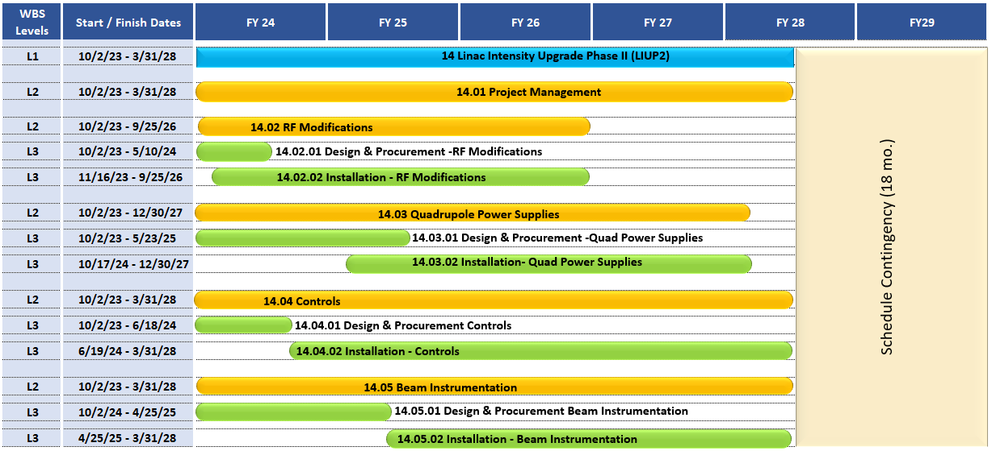
Schedule: Summary

Slide 8
Schedule: Milestones
Major Project Milestones have been embedded in order to track performance and progress at critical stages of value earned.
The additional activites and Milestones may be added in order to capture approved changes or to capture additional granularity to the plan as needed.

Slide 9
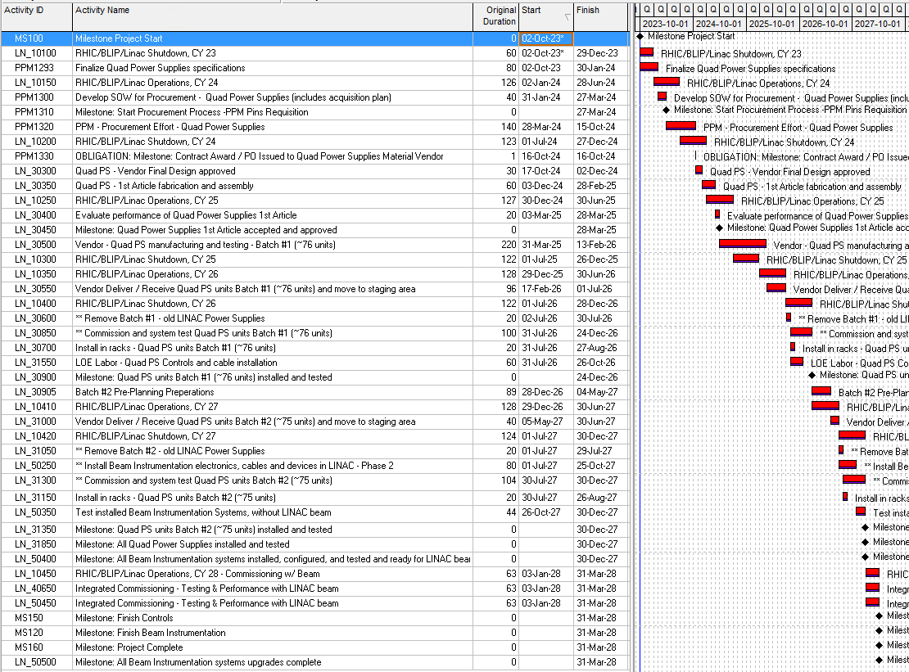
Schedule: Critical Path
RHIC Shutdown and Operation cycles coupled w/ the Quadrupole PS Procurement /Fabrication activities, predominantly.
Shutdown work activites are dependent on the Shutdown schedule duration of 6 months for on-site work activities, while maximizing the use of Operations time for non-field related project activities (e.g.: Survey, Design, Procurement, Pre-Fab, Preliminary Performance testing, etc.) to the fullest extent practical.

Slide 10
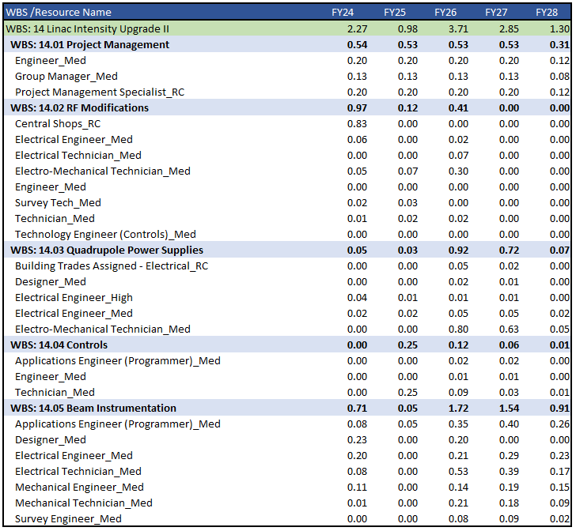
Resources: Labor FTE by WBS / FY

Slide 11
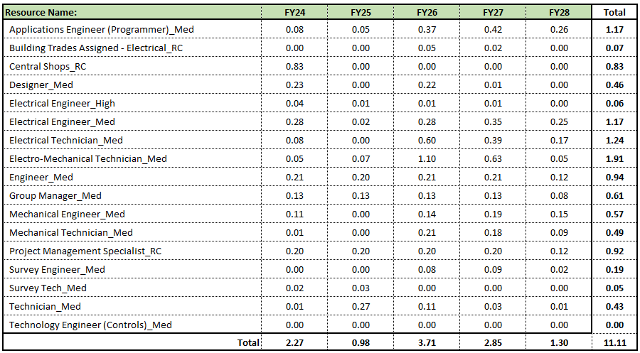
Resources: Labor FTE by Resource / FY

Slide 12
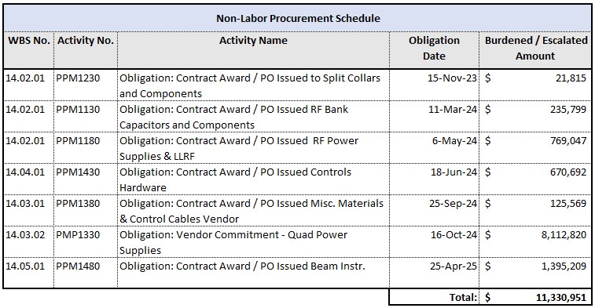
Resources: Non-Labor
This procurement schedule shall be monitored, updated and proactively coordinated PPM to ensure Non-Labor deliveries as planned.

Slide 13
Project Control and Reporting
The project may be monitored using any of the following Key Performance Indicators pursuant to a Tailored EVM approach:
Variance Analysis:
Cost Variance: CV=EV-AC. Actuals costs shall be supplied from Business Operations on a monthly basis, pursuant to Actual time charged and actual commitments made through respective reporting period.
CV represents the amount of budget deficit or surplus in a given time expressed as the difference between dollars earned and dollars spent.
Schedule Variance: SV=EV-PV. Planned value is the amount of work planned to be complete through the reporting period.
SV represents the amount the project is ahead or behind the planned delivery date expressed in dollars earned and dollars planned.

Slide 14
Project Control and Reporting
Performance Analysis KPI’s:
Cost Performance Index: CPI = EV/AC
CPI represents the cost efficiency of budgeted resources expressed as a ratio between Earned value to Actual costs.
Schedule Performance Index: SPI = EV/PV
SPI represents schedule efficiency expressed as a ratio between Earned value to Planned value.
Estimate at Completion: EAC = AC - BAC - EV assuming CPI and SPI = 1. If CPI and SPI will influence the planned work, EAC can be calculated as follows: EAC = AC+[(BAC-EV) / CPI x SPI)] . Budget at Completion is the total budget including approved changes to the cost baseline (excluding contingency).
Variance at Completion: VAC = BAC – EAC. To the extent this value = a negative value (-) this indicates the amount Contingency Allocation or budget overage in terms dollars planned through that period.

Slide 15
Project Management Support
Questions & Answers…

Slide 16
Section Break
Subtitle

