Slide 1
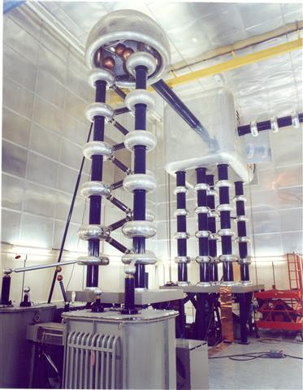
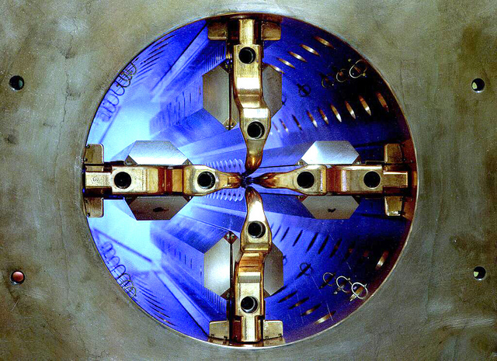
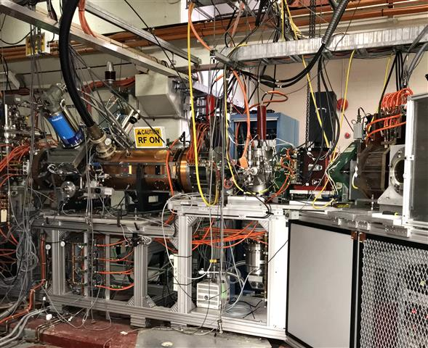
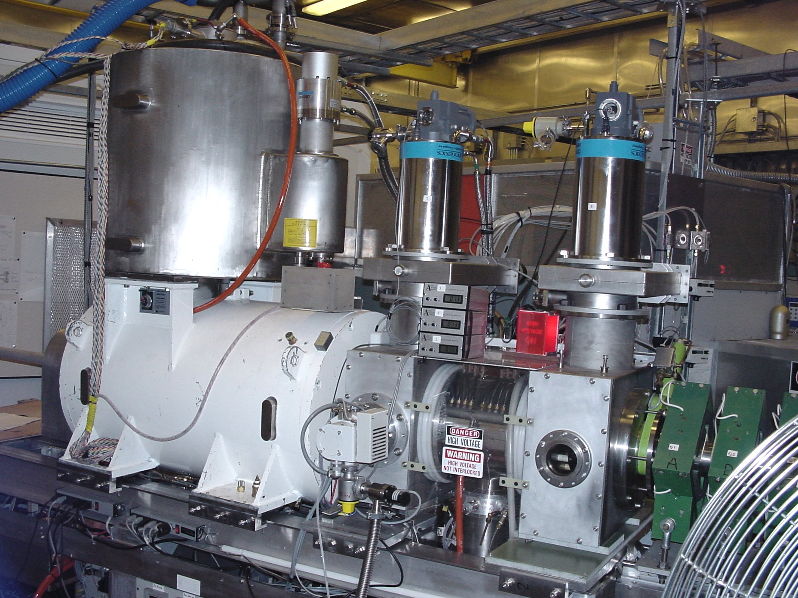
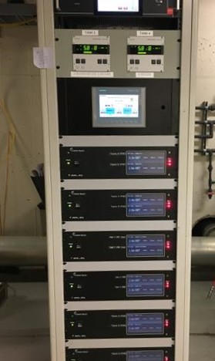
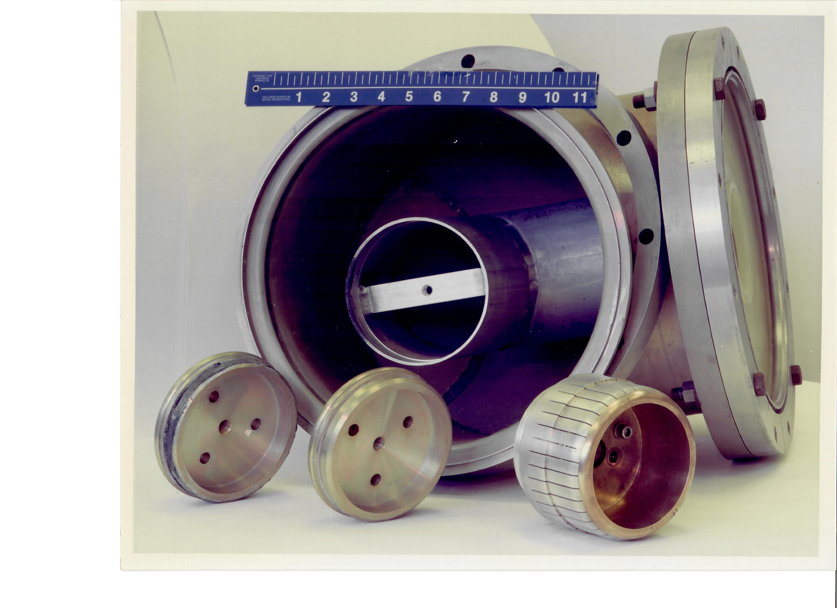
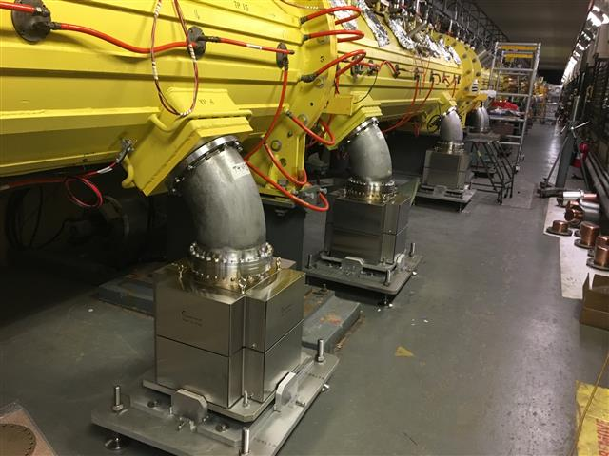
Performance & Previous Upgrads
Presenter Vincent LoDestro
LIUP2 Director Review
12-14 September 2022

Slide 2
OutLine
Introduction
System Upgrades Improve Reliability
New Beams & Capability Upgrades
RF Systems & Control Upgrades
Support System Upgrades, Facility
Summary

Slide 3
Systems Upgrades Improve Reliability

Slide 4
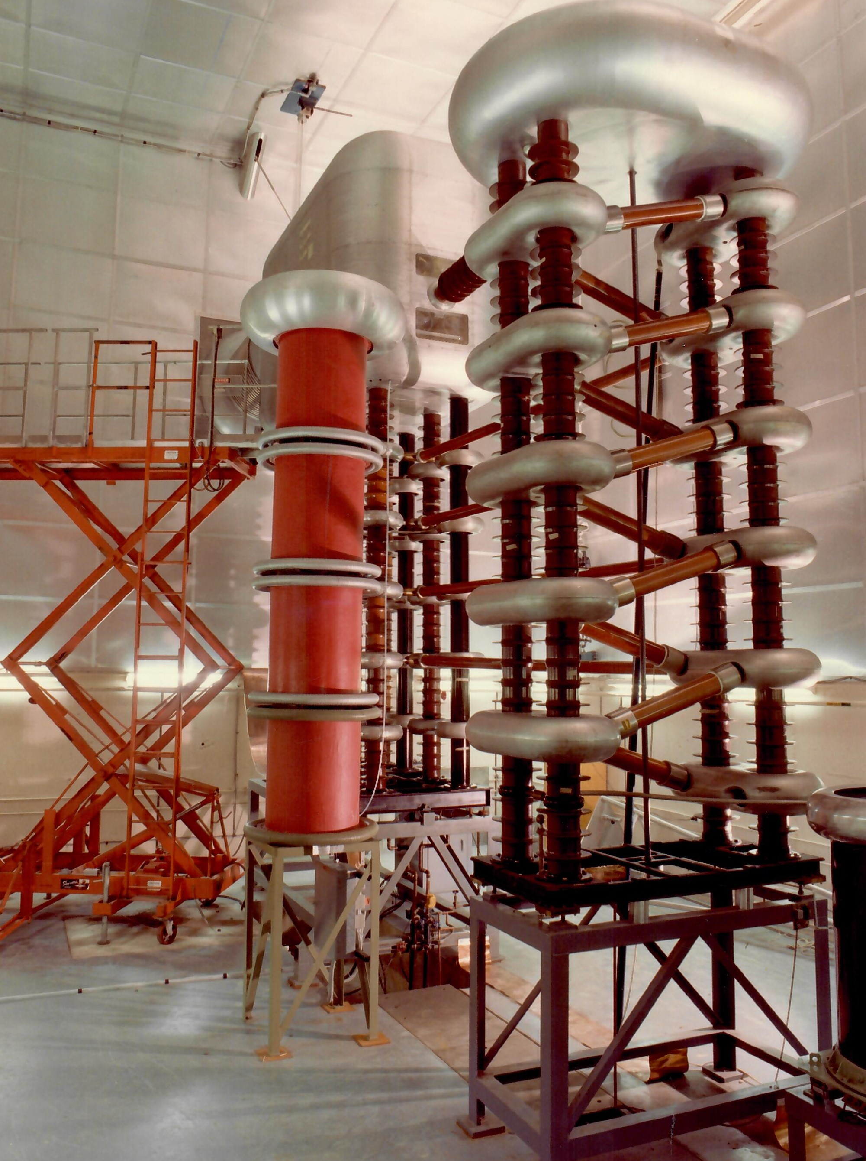
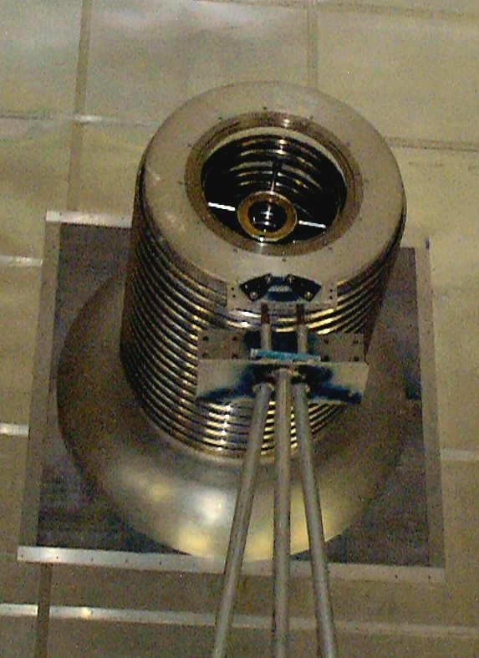
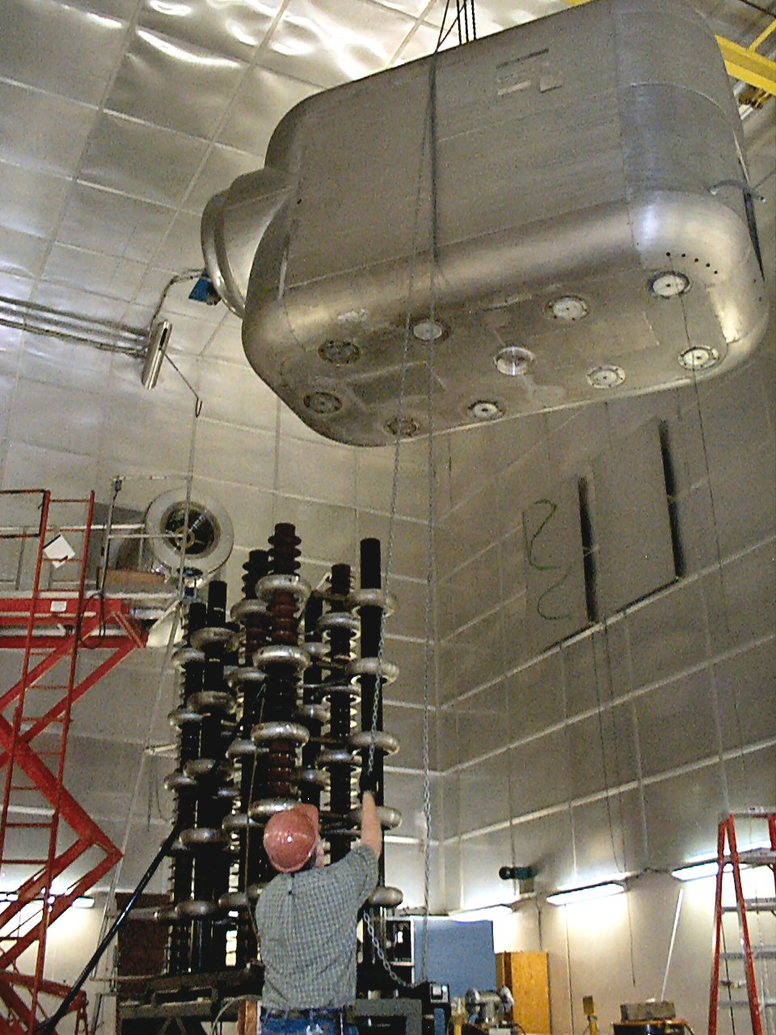
Install 750 Kv CW Preinjector
The original Cockcroft-Walton generator used in the AGS 50 MEV Linac was disassembled and moved to our Pit II area as a back up for our primary Haefely CW. After the installation of our RFQ preinjector this generator was used for several years in Cluster Ion Fusion Experiments by L. Friedman and G. Friedlander of our Chemistry Dept.

Slide 5
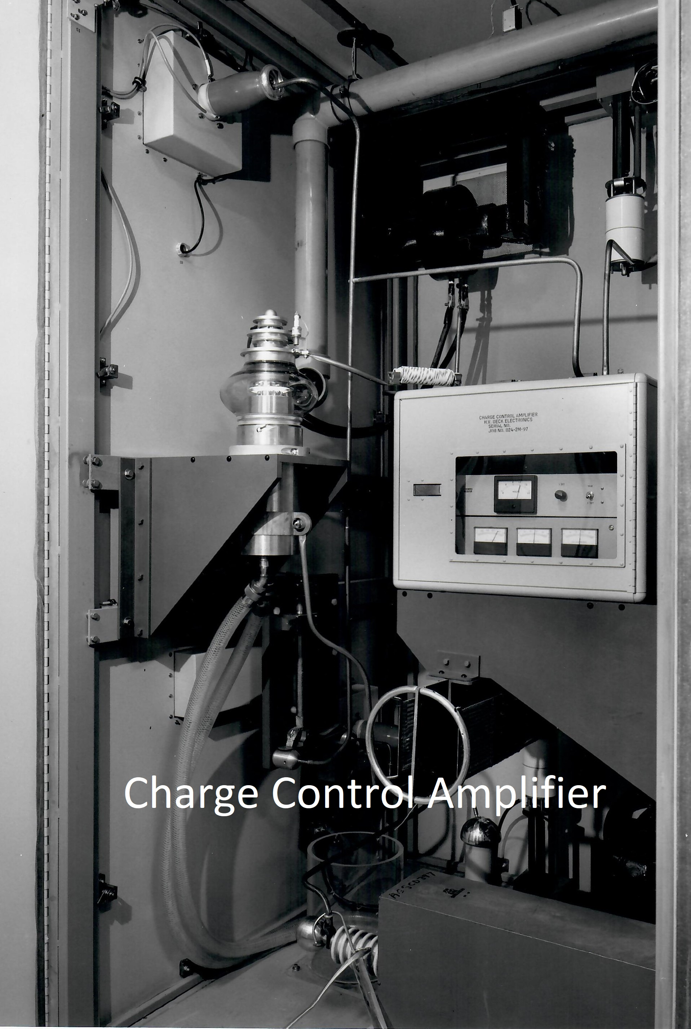
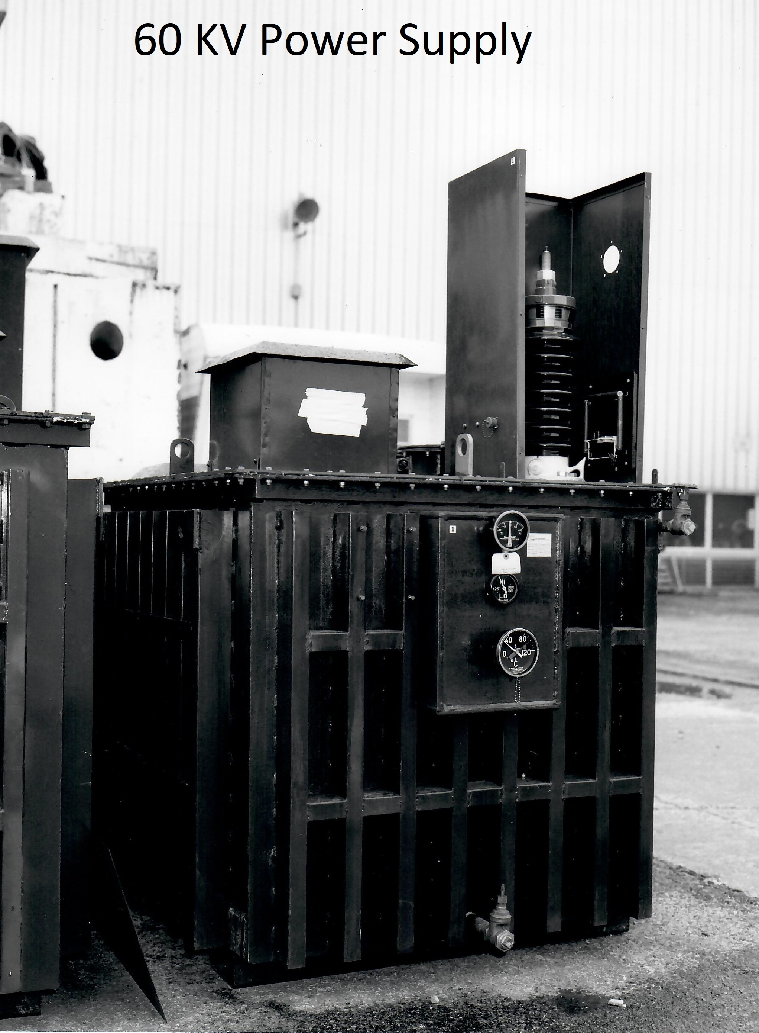
Power Amplifier Capacitor Bank Charging
This upgrade eliminated two major sources of Linac down time. The Charge Control Amplifier, CCA, and the 60 KV 120 KW PS residing outside the building, exposed to the environment. The 40 µf bank was charged through a hi-gain triode pass tube, acting as a controlled high voltage switch. This modification replaced the CCA’s by installing new HV PS’s on the RF gallery and incorporating primary SCR regulation to the power rectifier transformers.

Slide 6
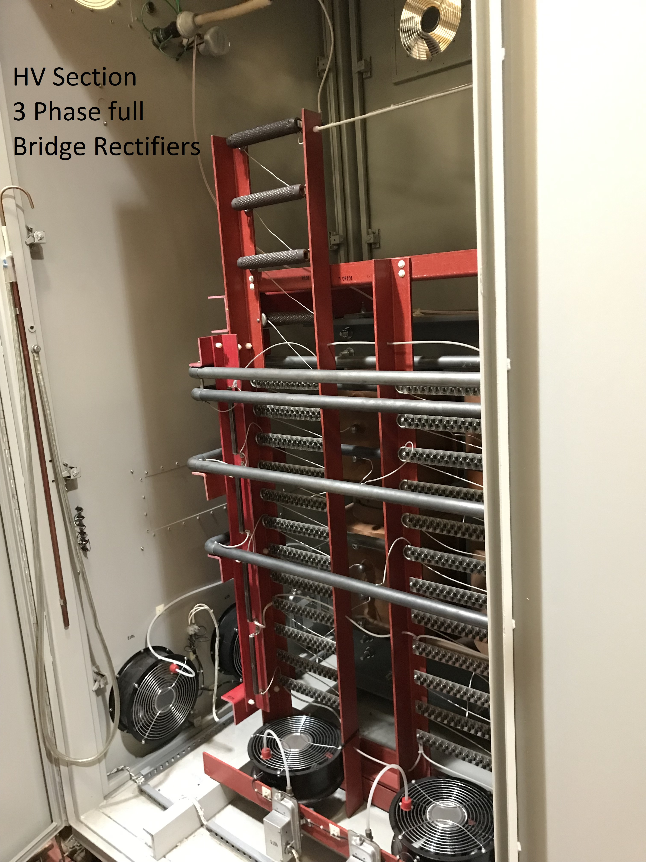
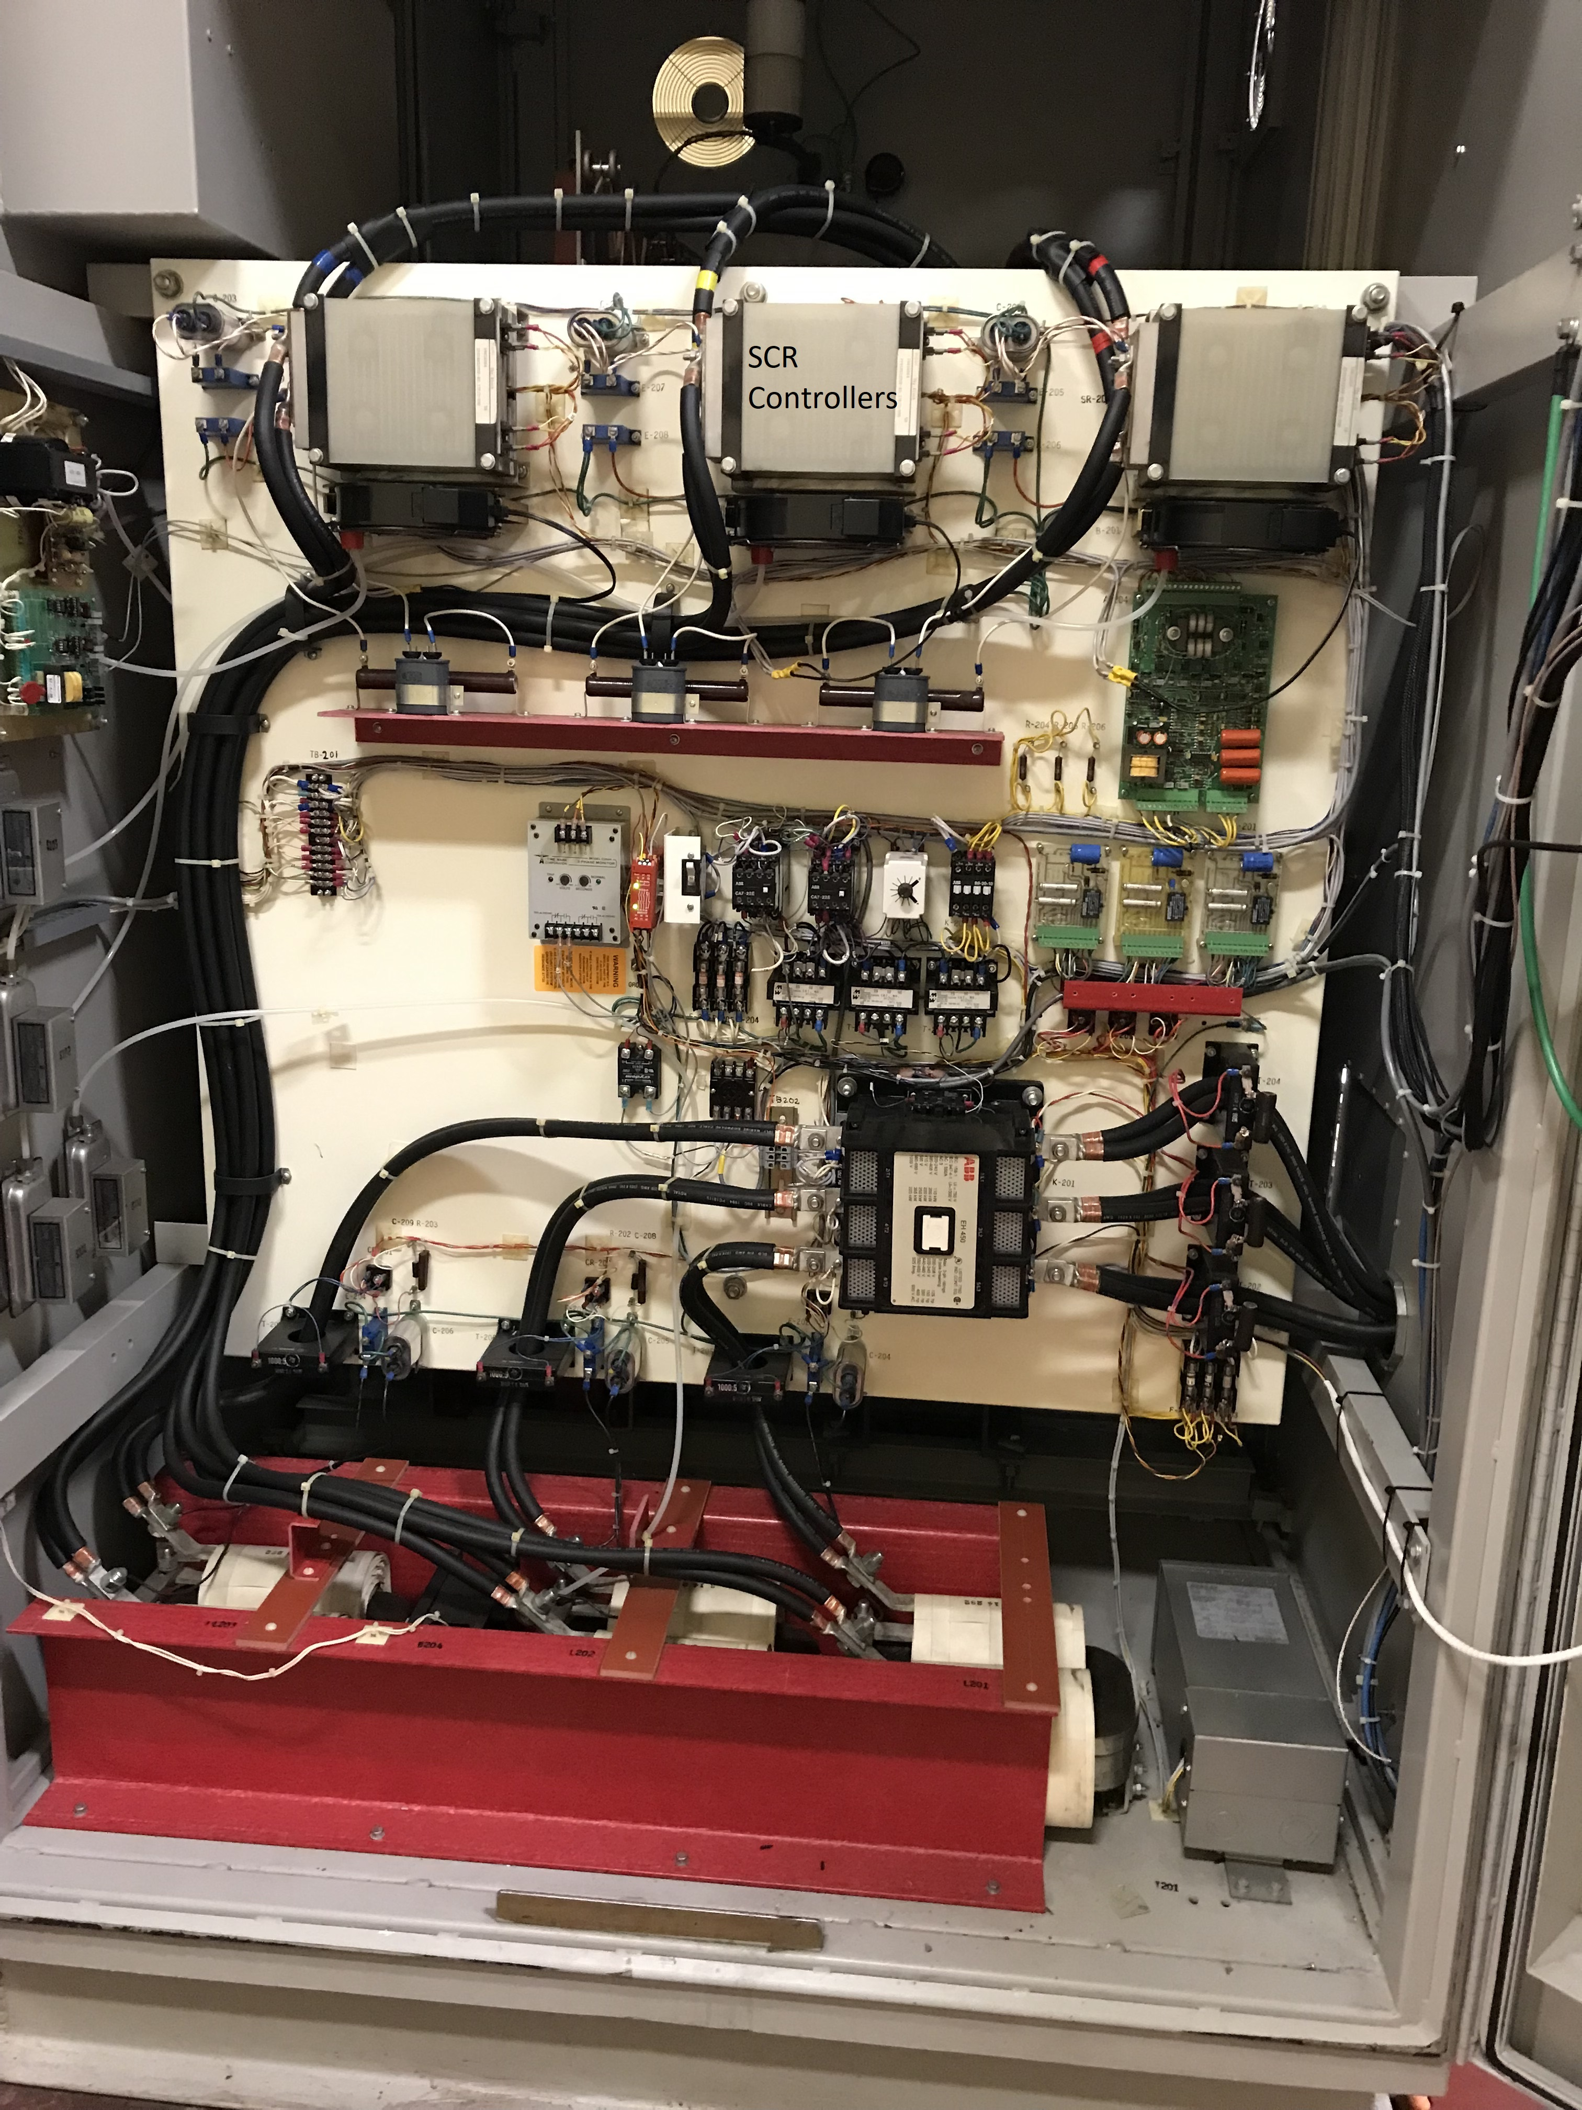
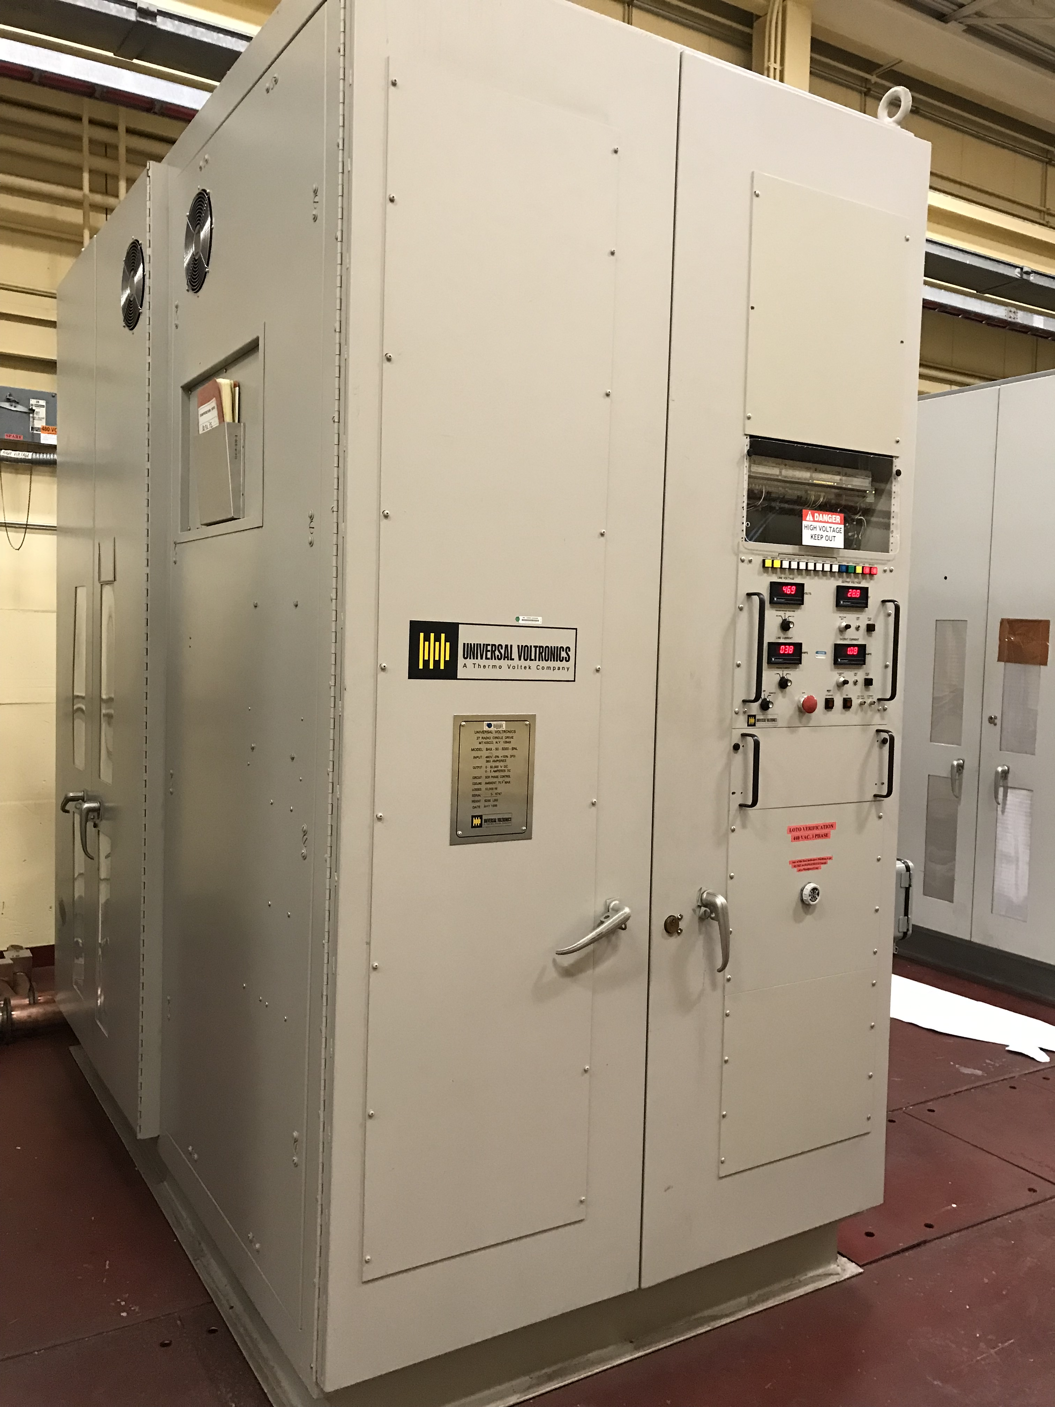
New 50 Kv 5 Amp PS Built into the old CCA Enclosure Located in the RF Gallery
PS View HV Section AC Controller

Slide 7
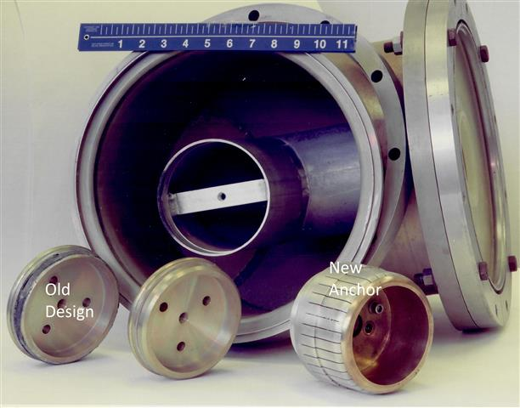
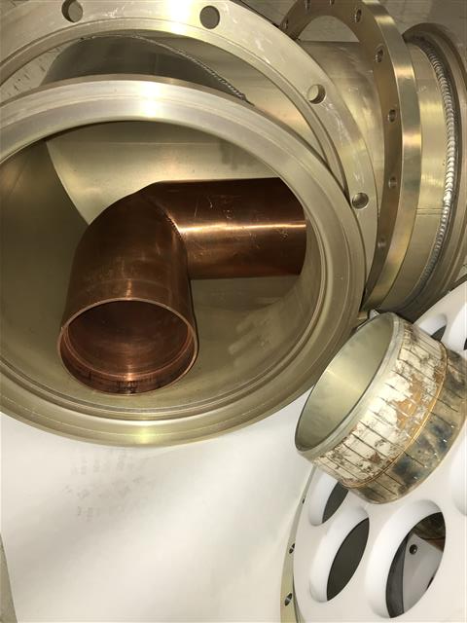
Replace the 12’ Coax RF Transmission Line
One of the largest sources of early Linac downtime was arcing in the coax lines. The original system was a BNL design. This proved problematic due to the short engagement of the inner bullets, spring ring contacts and aluminum inner conductor. In 1995 Dielectric Communications Inc. completely removed the old line and replaced it with coax built to EIA Standards with a copper inner conductor capable of pressurizing the line to suppress arcing. The system has proven to be virtually trouble free.

Slide 8
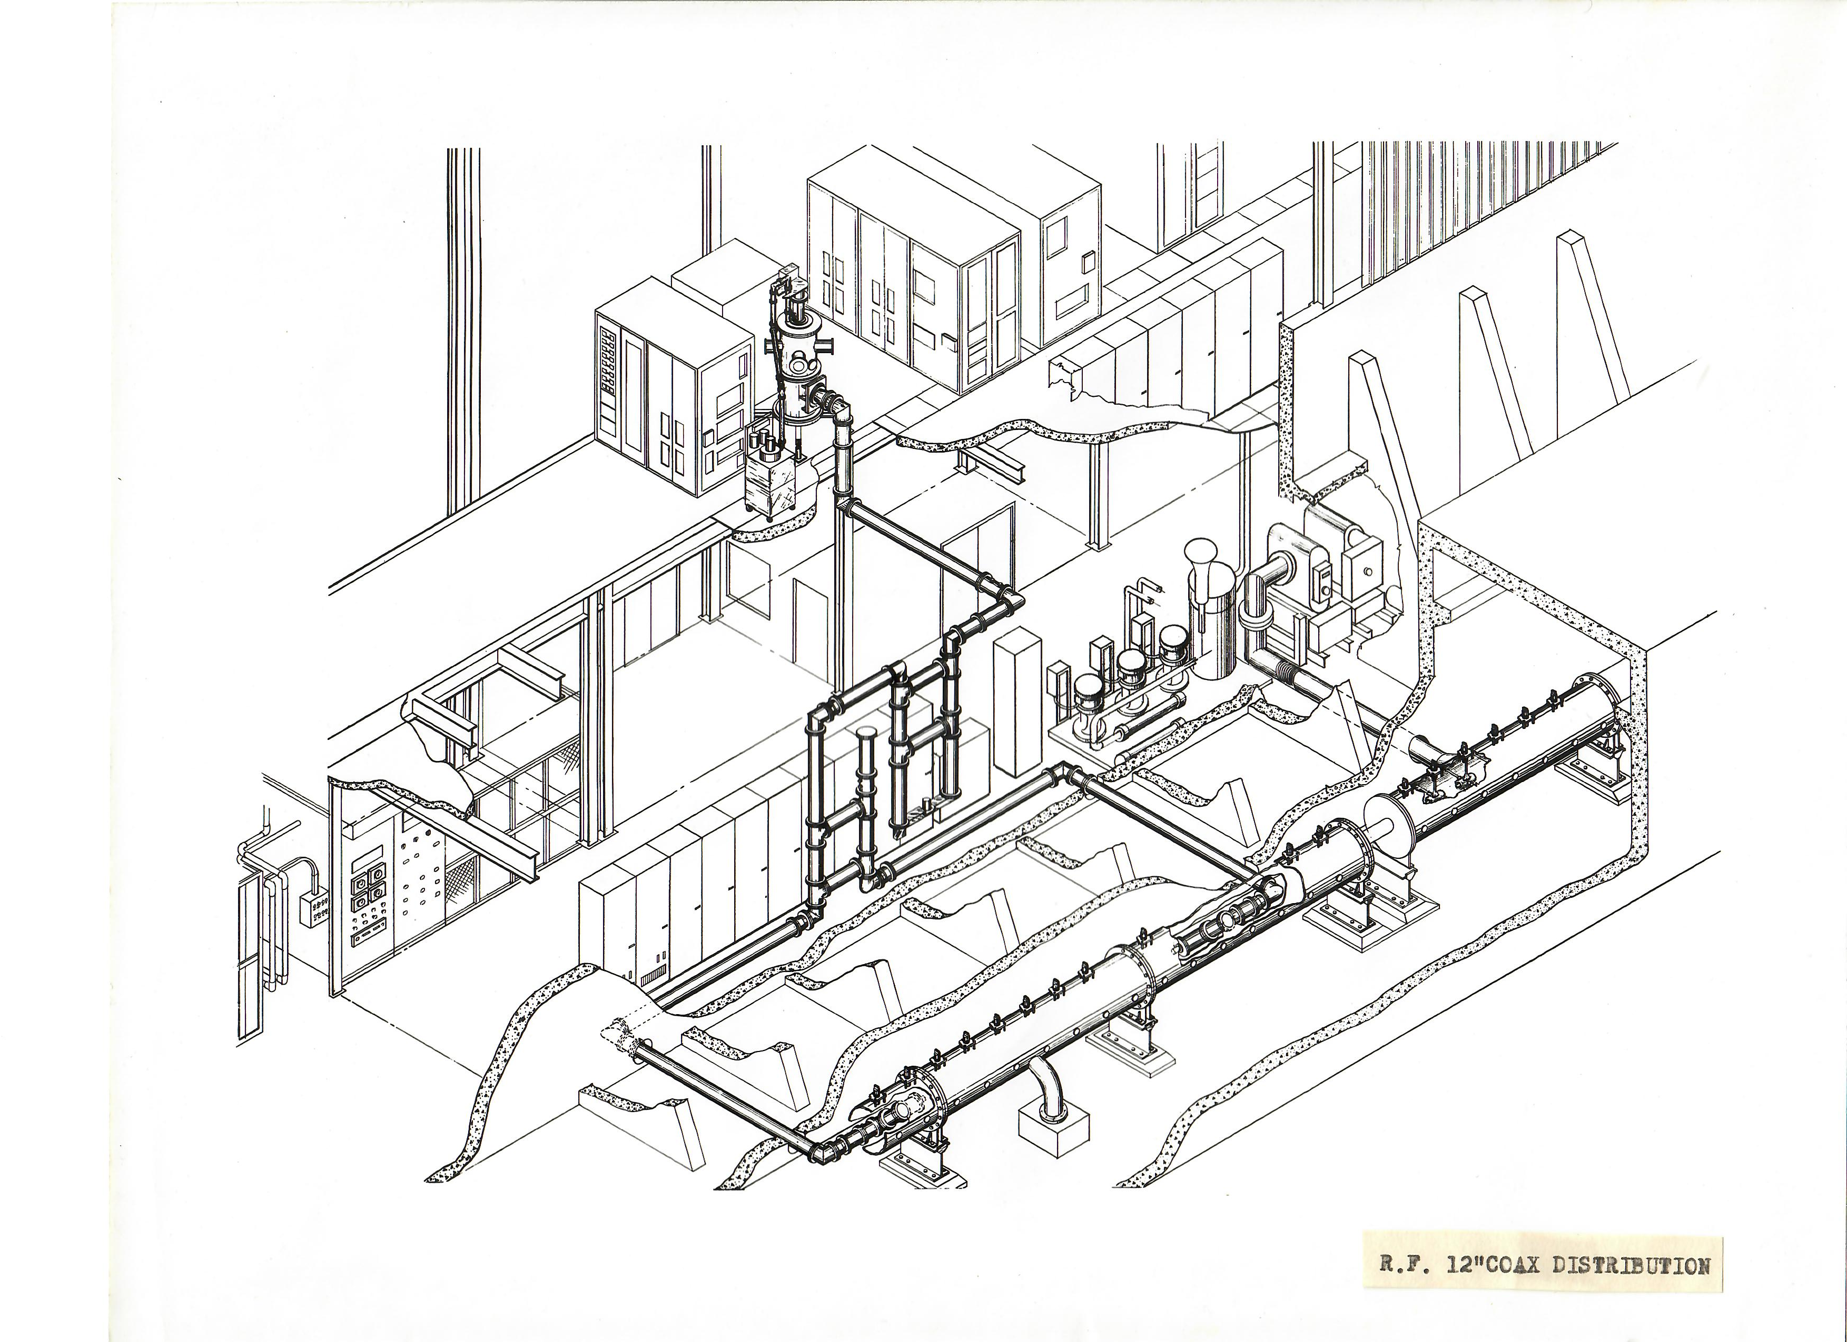
Coax Run From PA Thru Phase Shifter, 3DB Hybrid Power Divider and on to Feeding Two Loops in Each Tank. (This run is repeated 9 times)

Slide 9
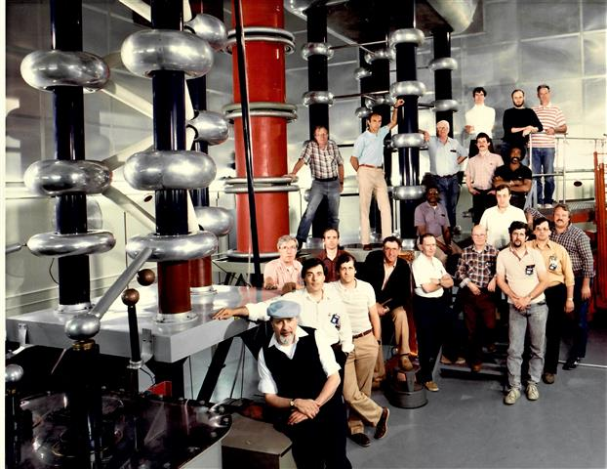
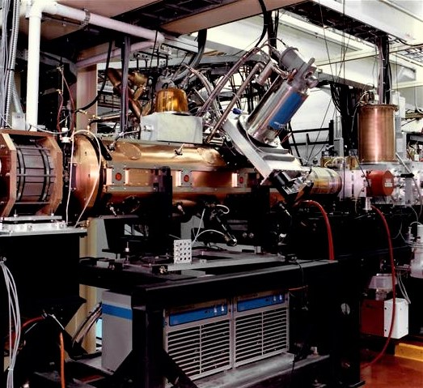
RFQ Replaces CW as Linac’s Prinjector, 1989
The CW, an operational and maintenance nightmare. This upgrade eliminated preinjector downtime! In 33 years of service <16 hours of down time have been logged to any RFQ cavity issue. All ion sources were moved to ground level for ease of service. Built at Lawrence Berkeley Lab the RFQ has a 35 KEV acceptance and 750 KEV output energy delivering a 100 ma peak H- beam current. It has a single feedloop design requiring 157 KW RF drive at 201 MHz with beam loading. A standard Linac RF 4616 tetrode driver is used for the power source

Slide 10
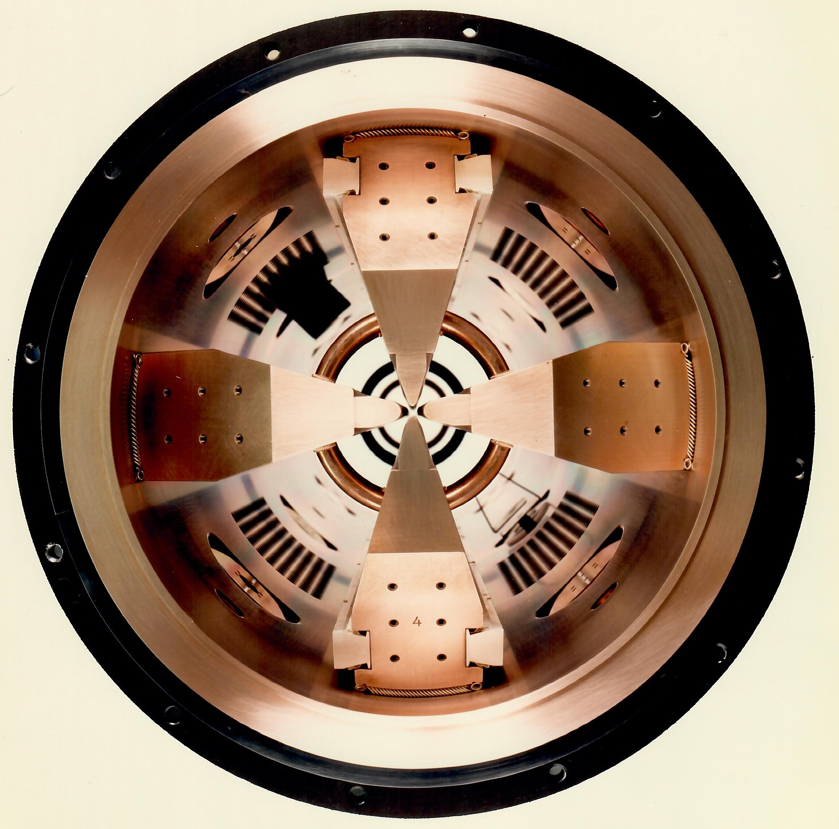
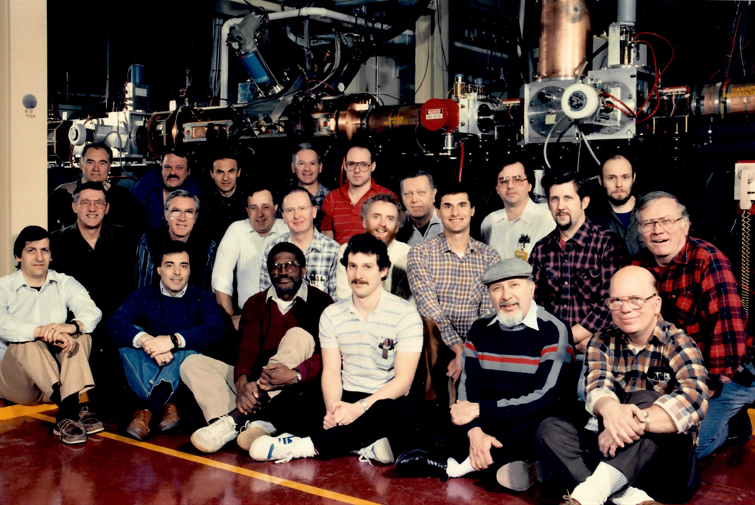
Installation Crew, RFQ Cross Section

Slide 11
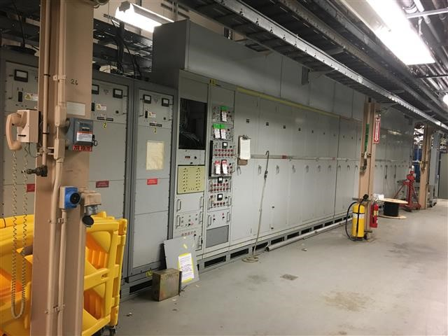
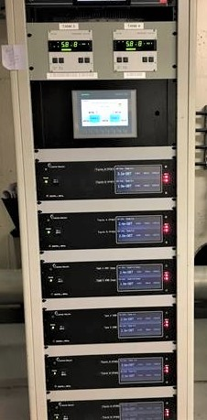
Linac Tank Vacuum System Upgrade
The original system design had 3 high voltage PS’s distributing power through racks of 45 resistor banks, one of each, to power a tank ion pump. The system included 28 racks of high voltage equipment. The system was completely removed and replaced with one computer ion pump controller per pump. Each Tank has 5 new DI style,1200 l/sec pumps with the controller racks distributed along the Lower Equipment Bay. A new inter-tank vacuum valve control PLC is also included.
Orig Vacuum Racks New controllers & PLC Valve Screen

Slide 12
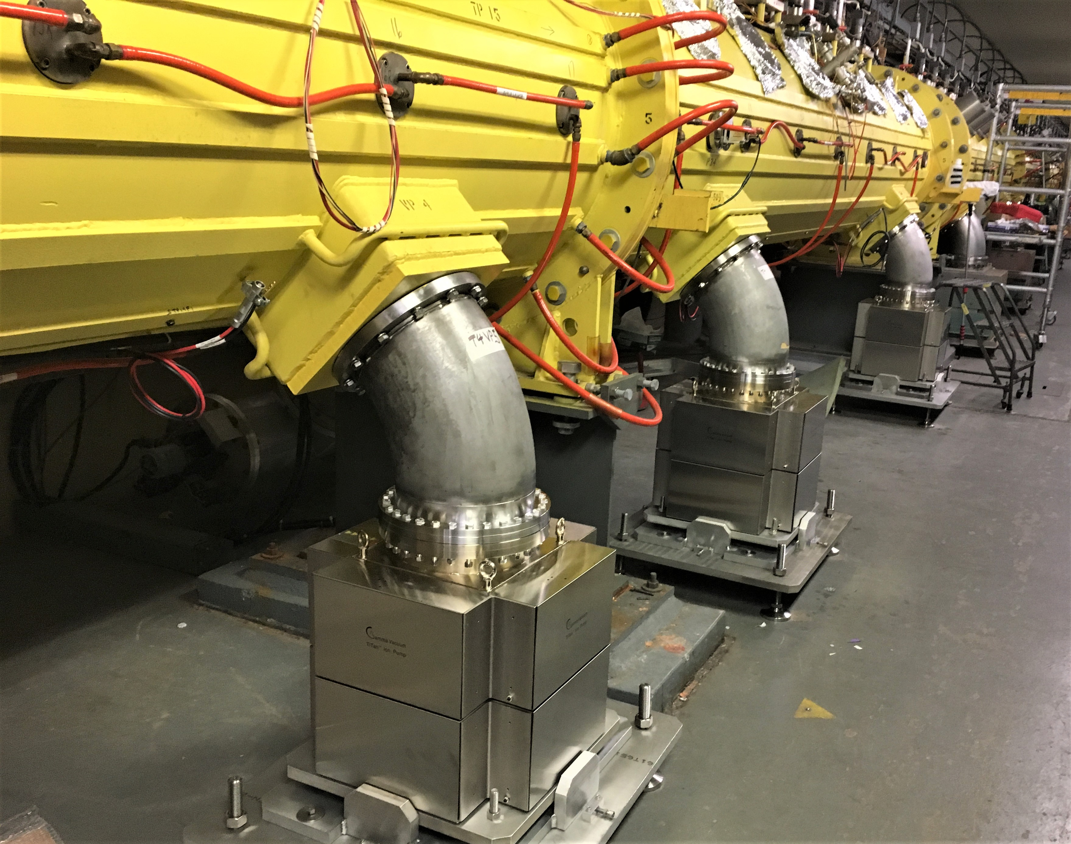
Linac Tank Ion Pumps Installed

Slide 13
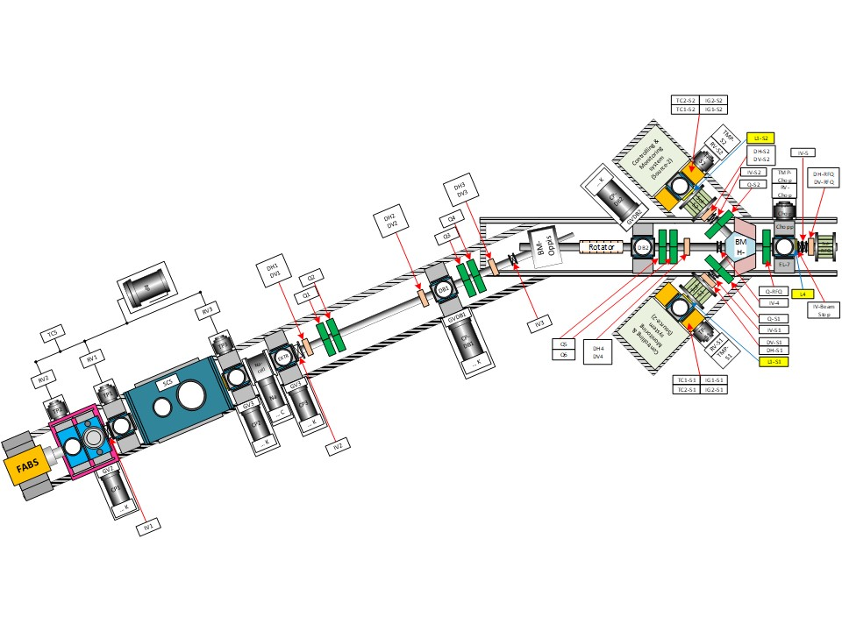
New Beams and Capability Upgrades
Body Text
Bullet Tier 1
Bullet Tier 2

Slide 14
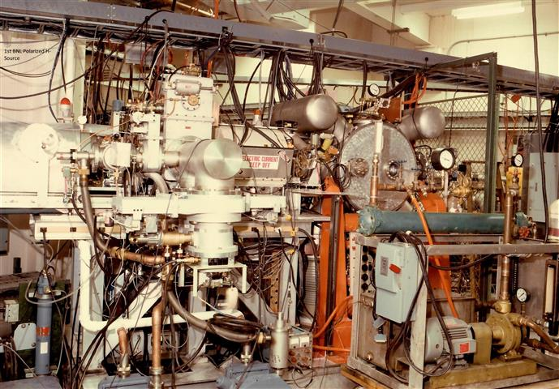
Linac Adds Polarized H- Proton Source, 1984
This first source was installed in the Lower Equipment Bay and utilized a Radio Frequency Quadrupole for acceleration to 750 KEV. Entering LEBT the beam was bent 120° into Linac. The input beam energy of the RFQ was 20 KEV, the Linac delivered an avg 10 µAmp beam to AGS. The PP RFQ was built at BNL and was one of the first such accelerators to be used for HEP Laboratories.

Slide 15
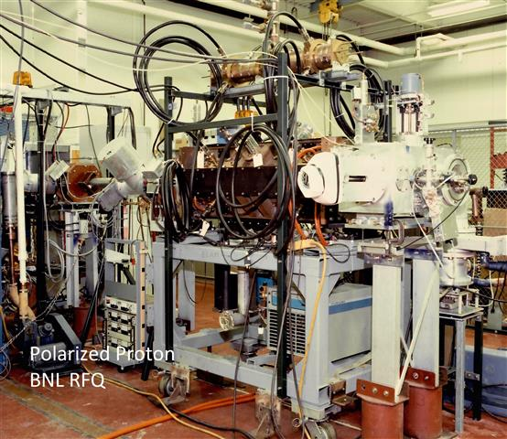
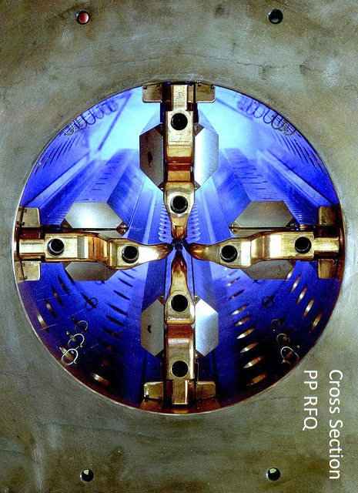
BNL PP RFQ Test Bay & Cross Section

Slide 16
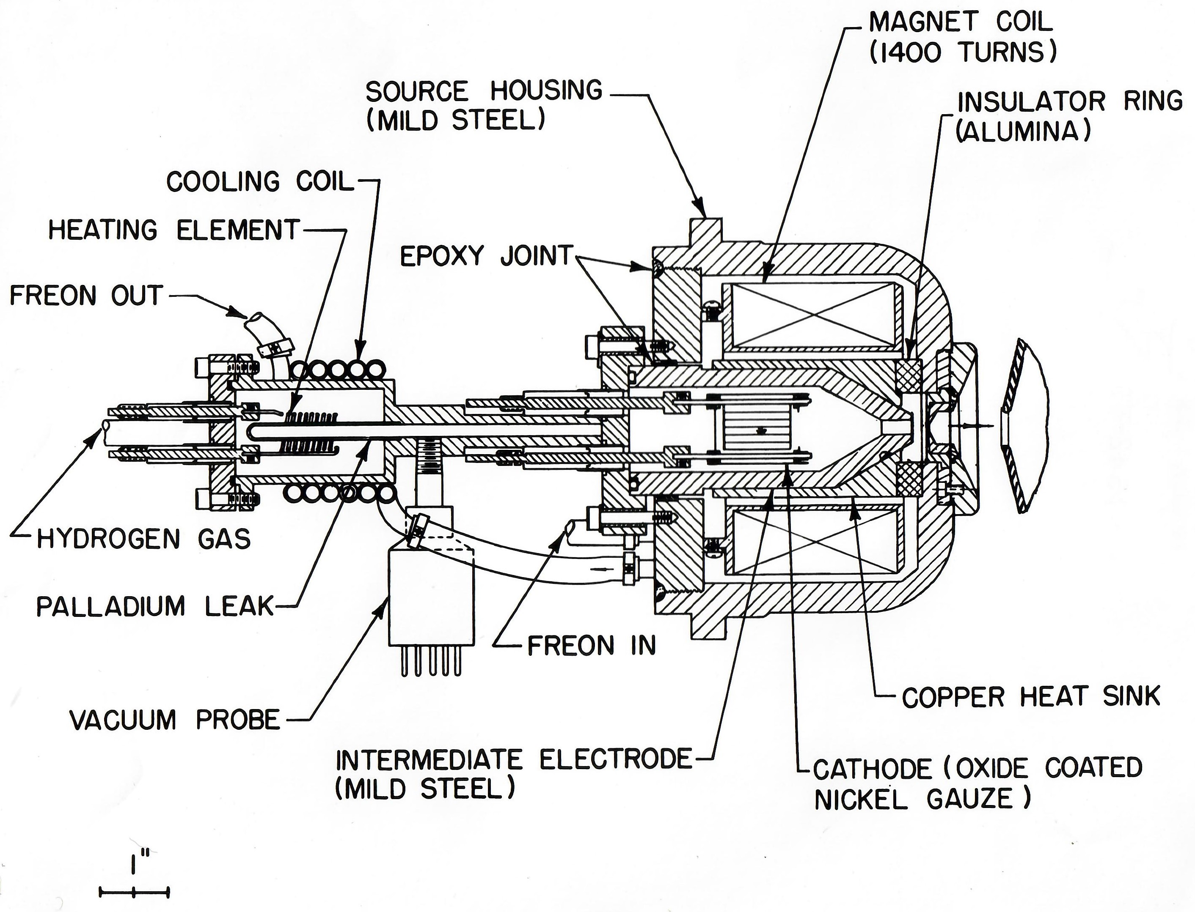
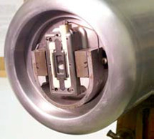
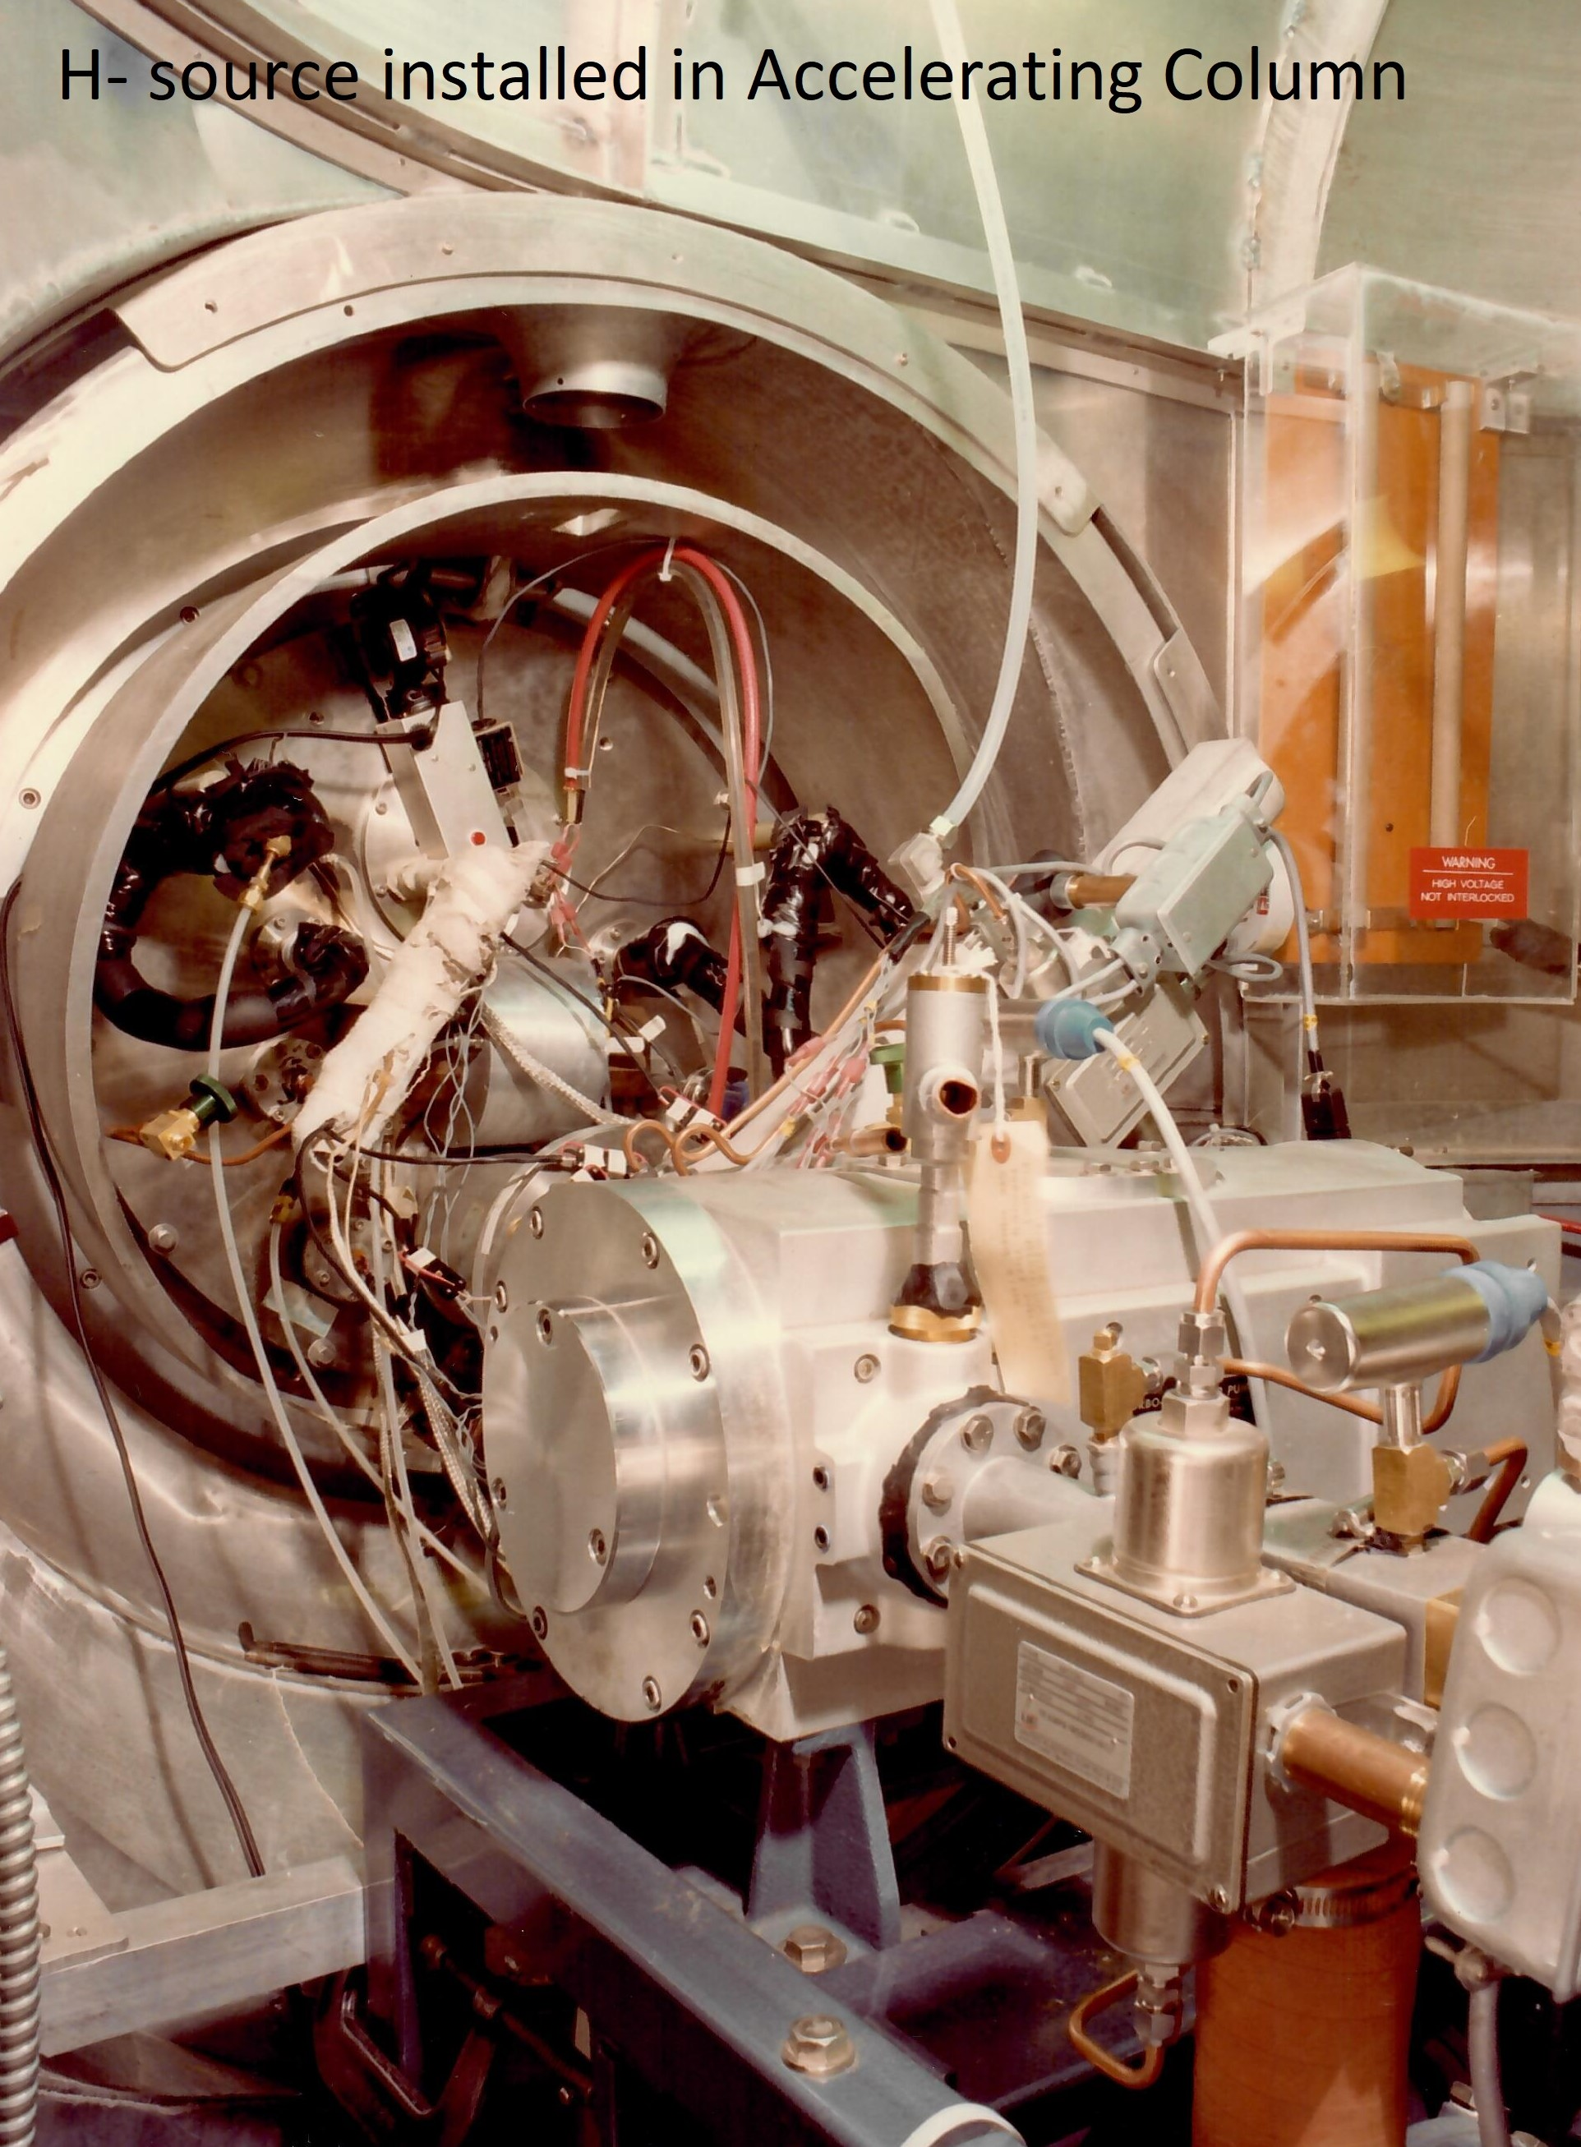
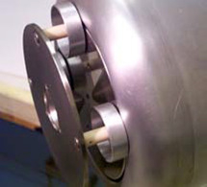
H- Source Installation
In 1982 this upgrade replaced the original relatively simple Duo Plasmatron proton ion source with a magnetron surface plasma H- source. The upgrade allowed for charge exchange injection into the AGS and later Booster. An additional innovation, for the time, allowed this source with many more control and monitor parameters to be operated by computer via an optical link to ground bridging the 750 KV potential. The source was later modified again for injection into the RFQ

Slide 17
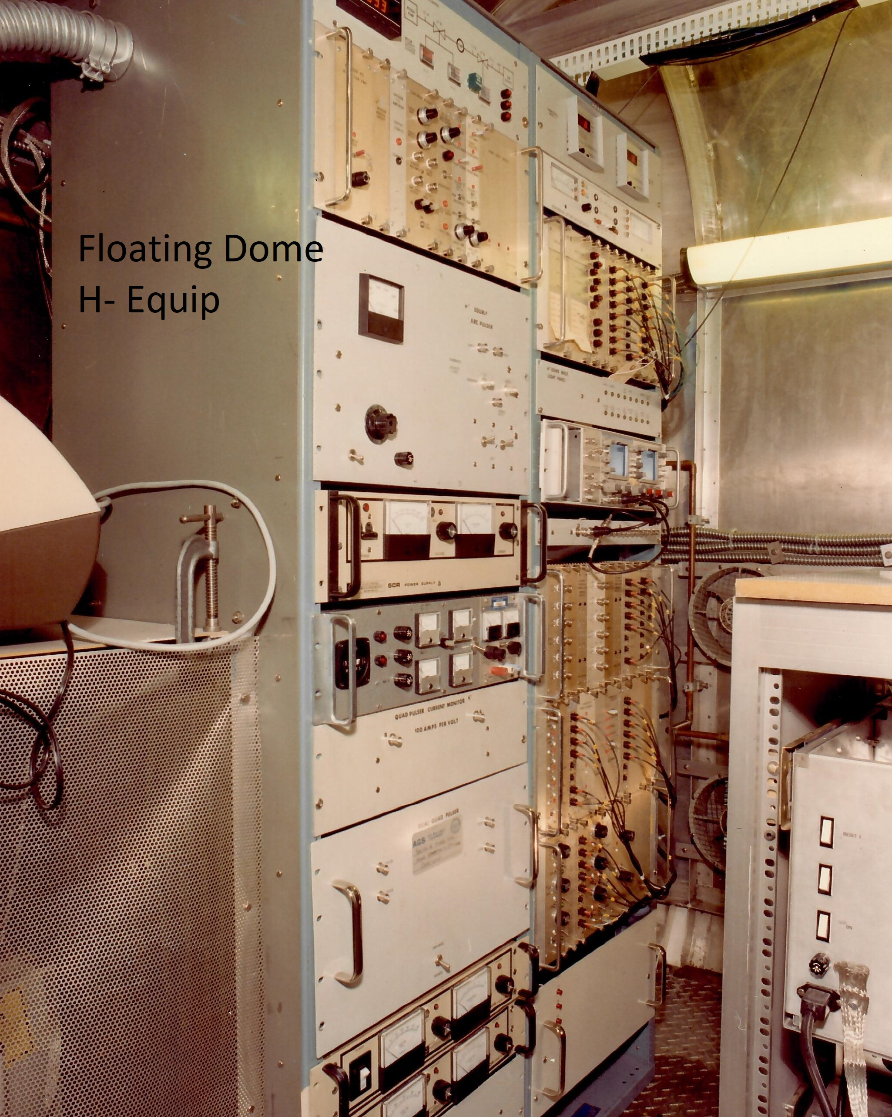
H- Install (Con’t)

Slide 18
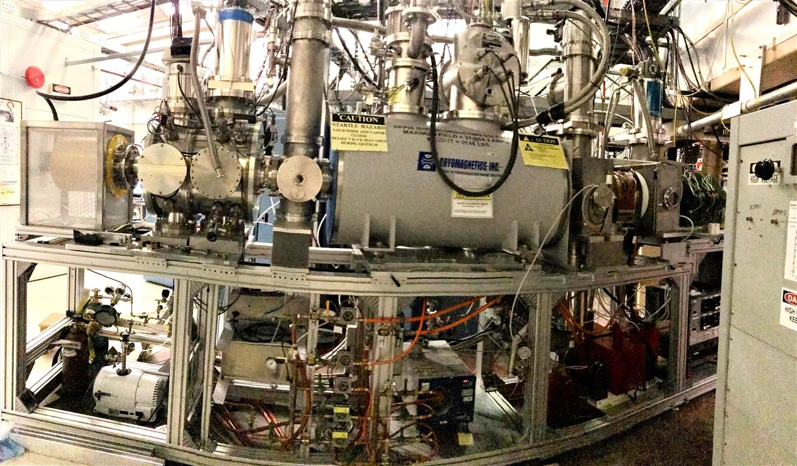
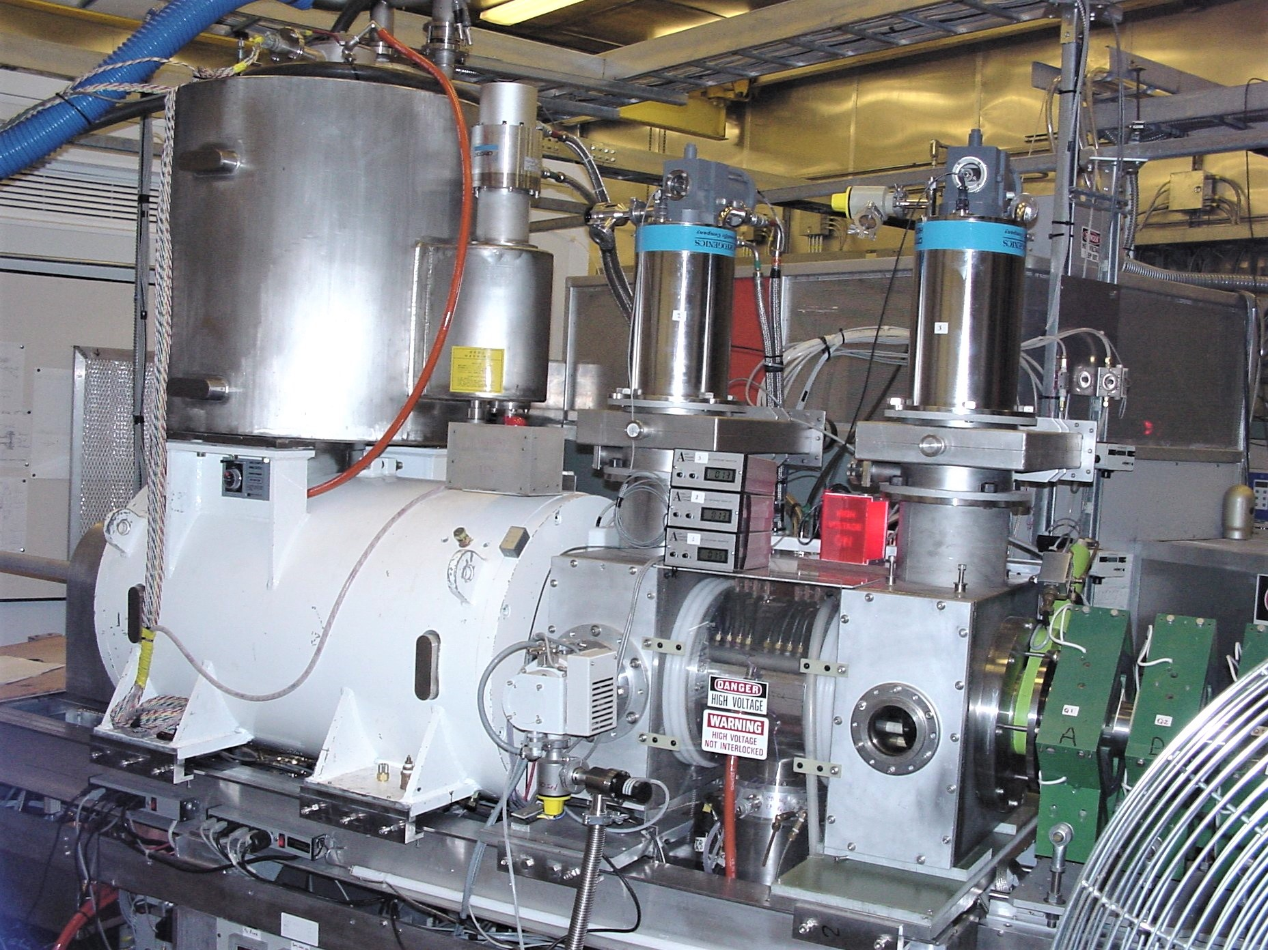
Ion Source Additions and Upgrades
The H- Polarized Proton sources at Linac were replaced with an OPPIS, Optically Pumped Polarized Ion Source. This source installed and first operated in the 2000-2003 RHIC runs. It has since been continuously upgraded and routinely produces a peak current sufficient to deliver a 200MEV Linac beam of 300+ µAmps with 80% polarization to the Booster.

Slide 19
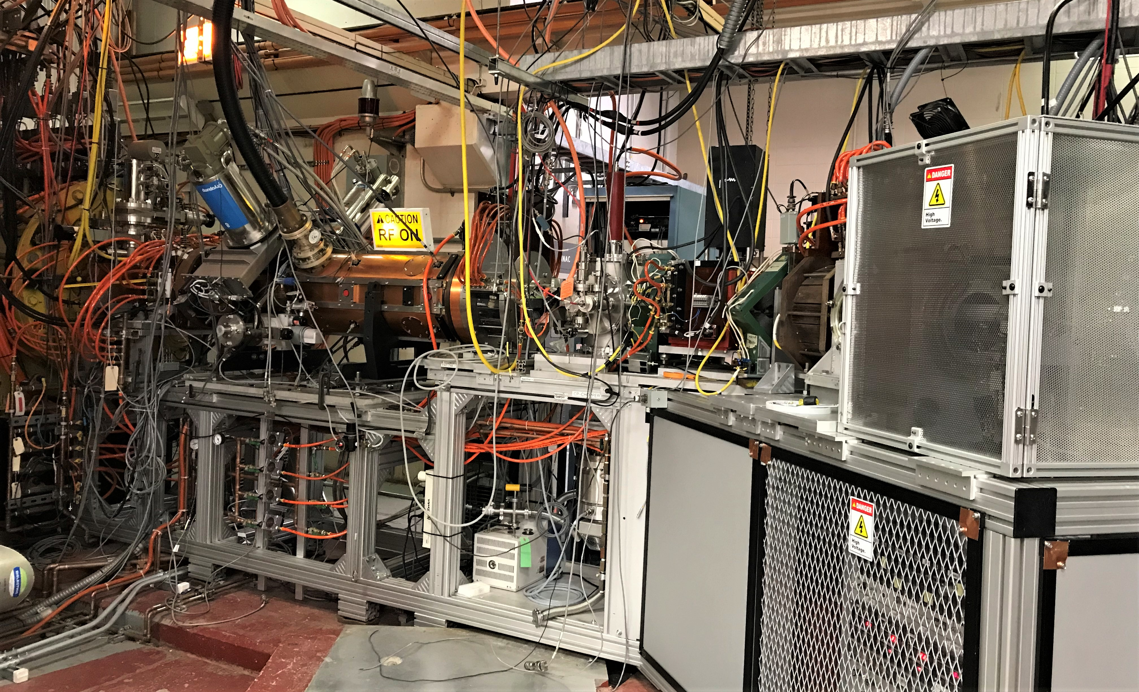
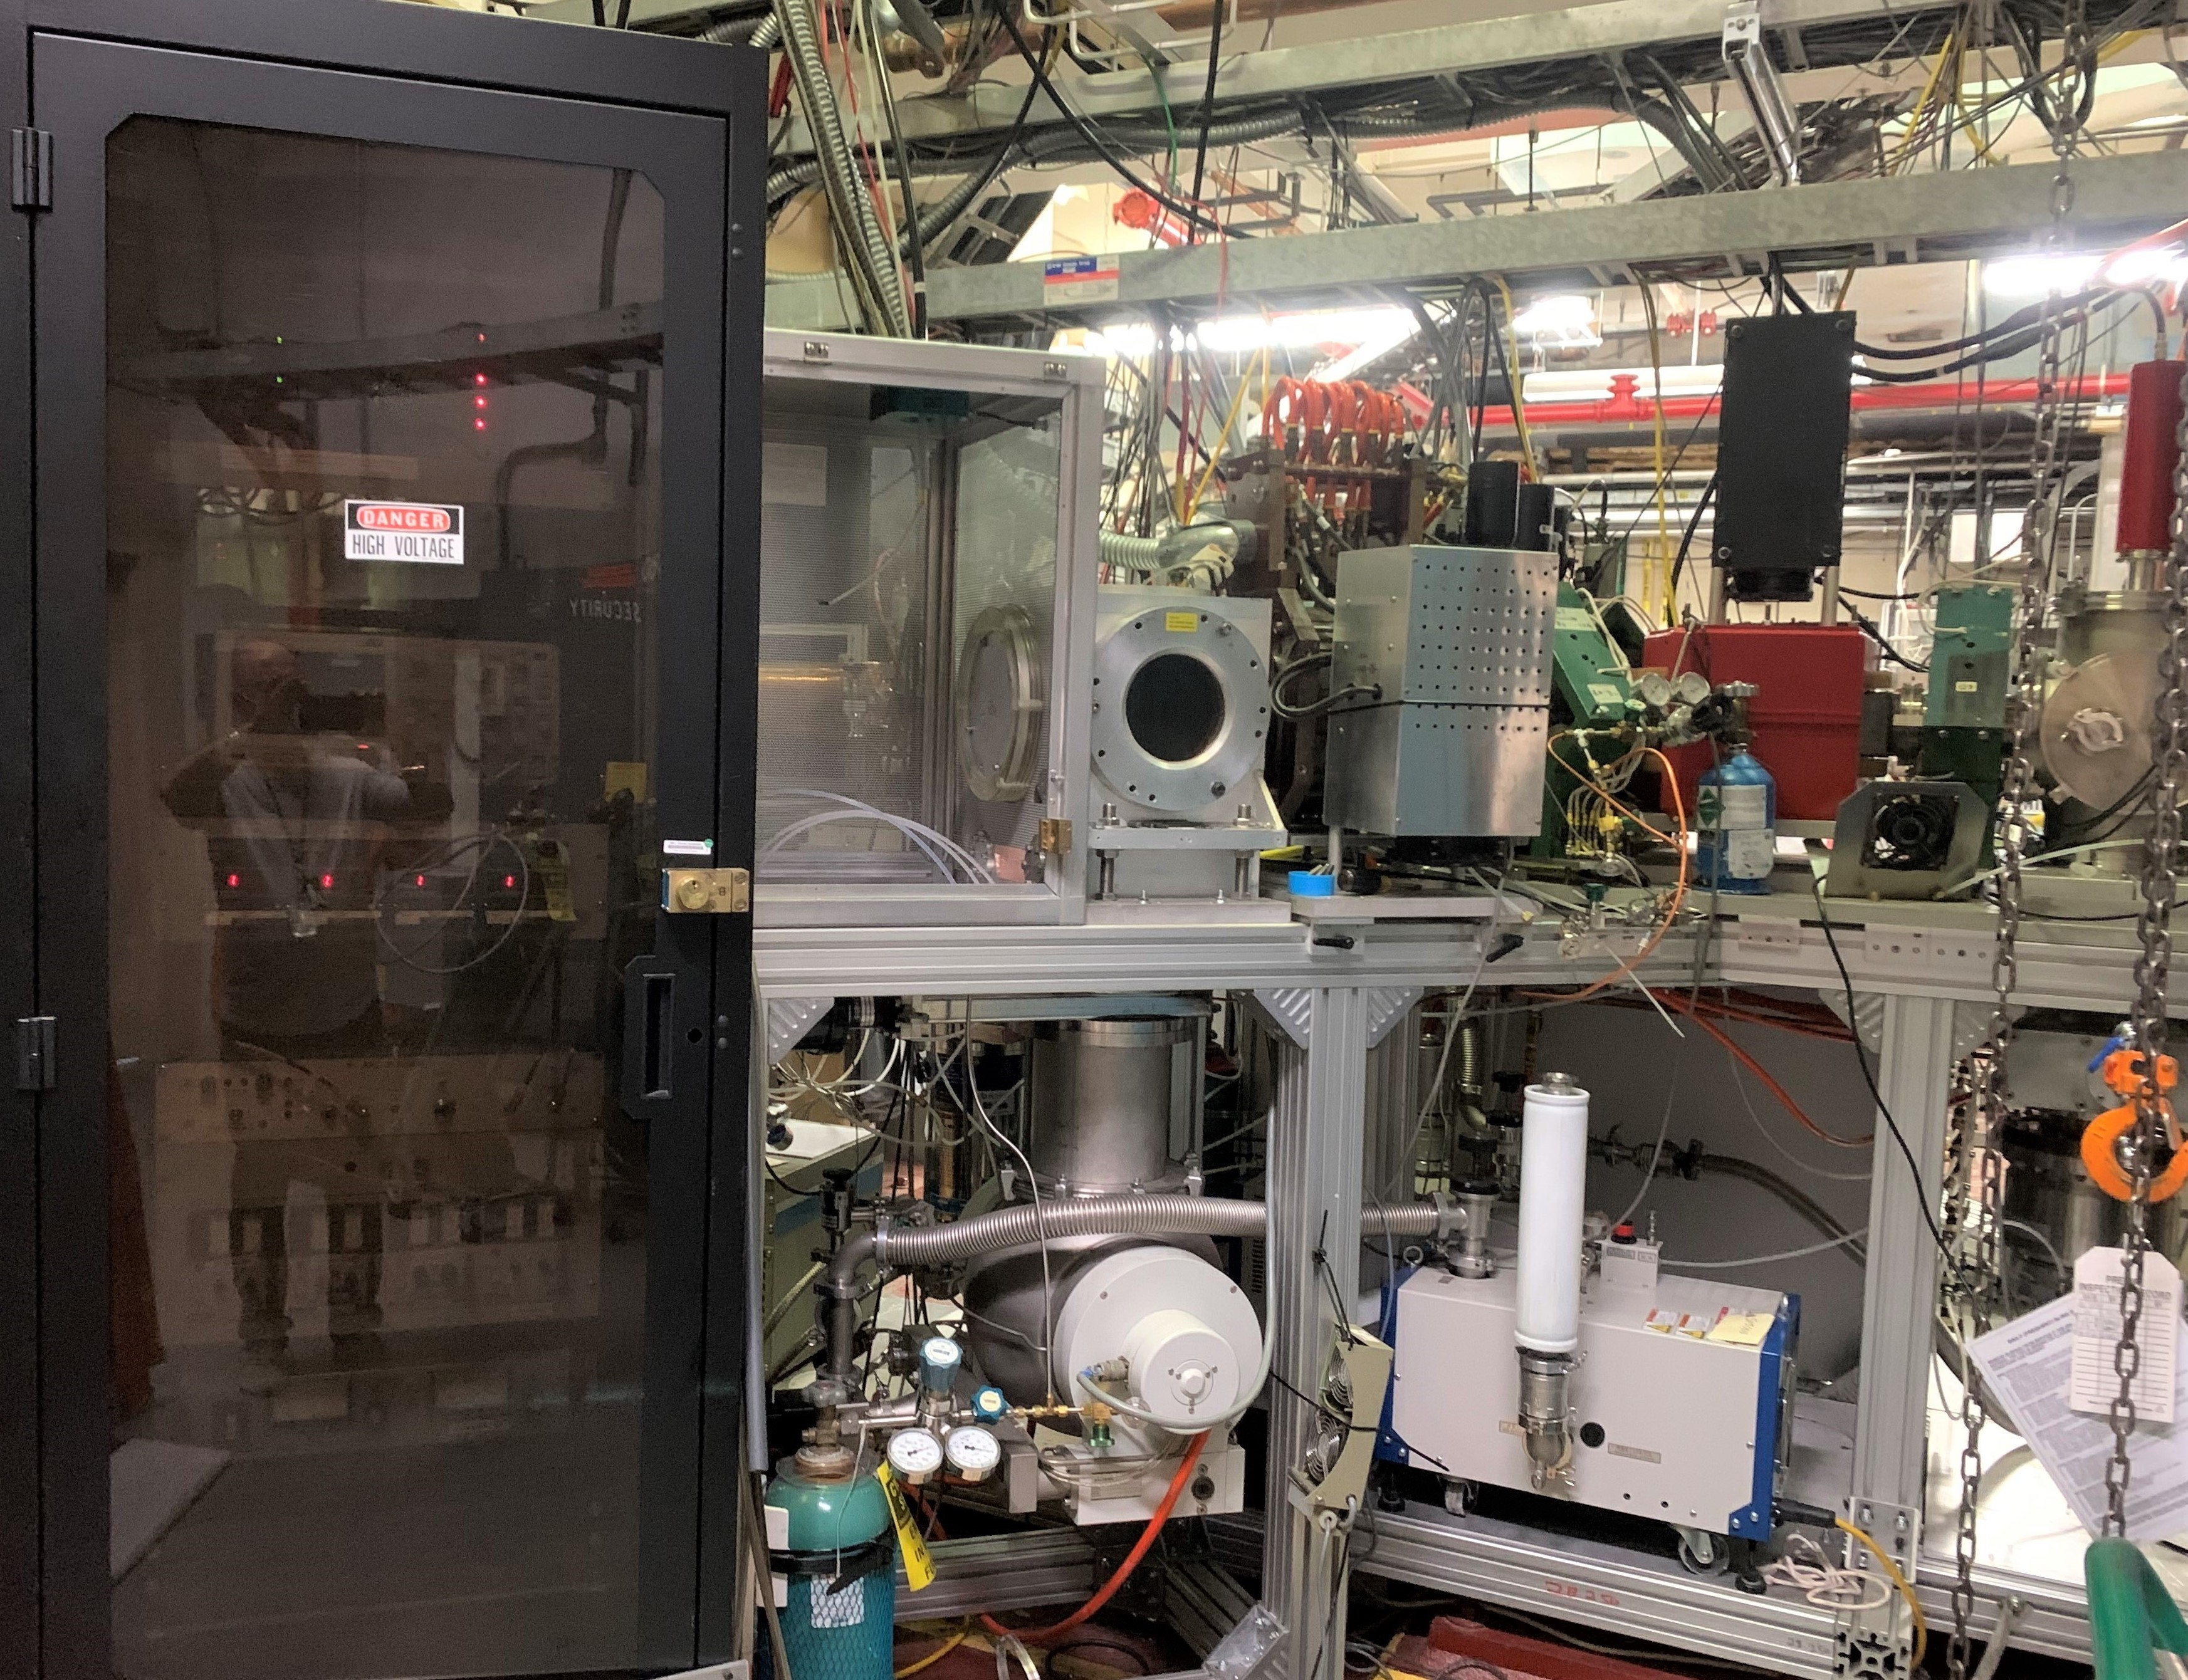
H- Magnetron Source 2
To improve reliability and allow for testing operational improvements a second H- Magnetron was added to the Low Energy Beam Line. A typical source replacement would require a 3 to 4 shift shutdown in BLIP operations, this is reduced to <1 shift for start up or 1 hour if the source is running. A sketch of LEBT showing the source locations follows:
Magnetron – S1 Magnetron - S2

Slide 20
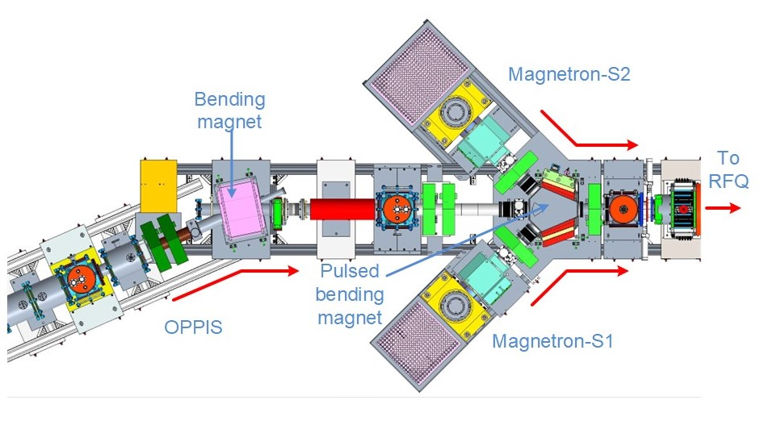
LEBT Showing Source Locations

Slide 21
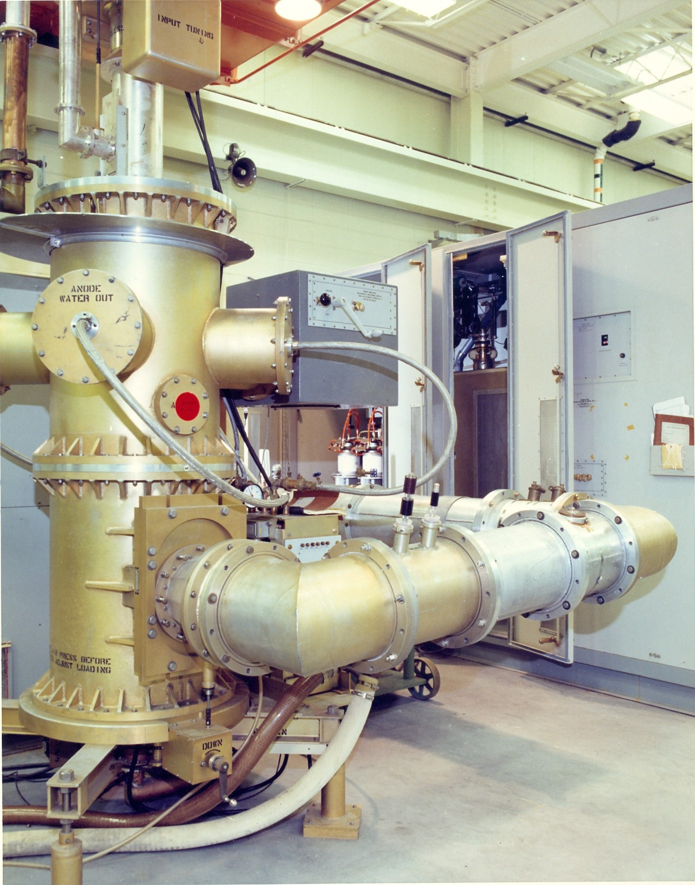
RF Systems and Control Upgrades
Body Text
Bullet Tier 1
Bullet Tier 2

Slide 22
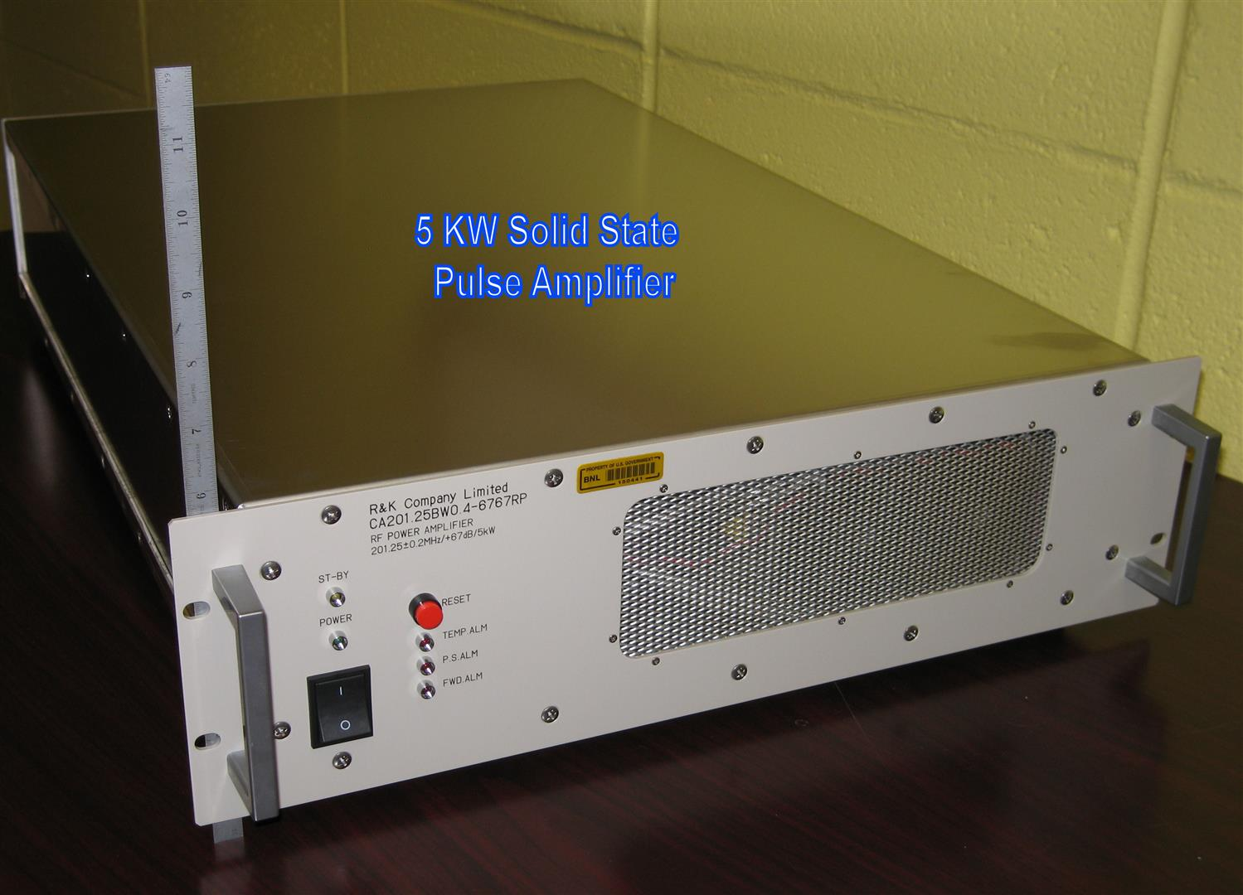
RF Systems 5 KW Solid State Amplifier Upgrade
The Linac RF system requires 13, 5 kw Peak Power Amplifiers in its many RF amplifier chains. To improve reliability a Solid State Amplifier has replaced all original 7651 tetrode amplifier racks.
7651 Amplifier Rack

Slide 23
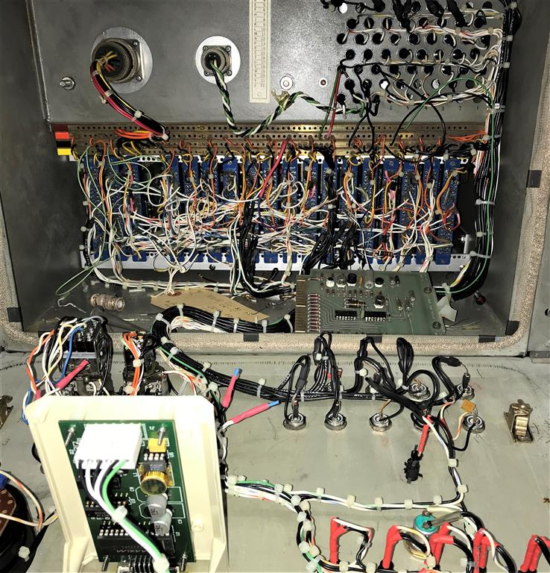
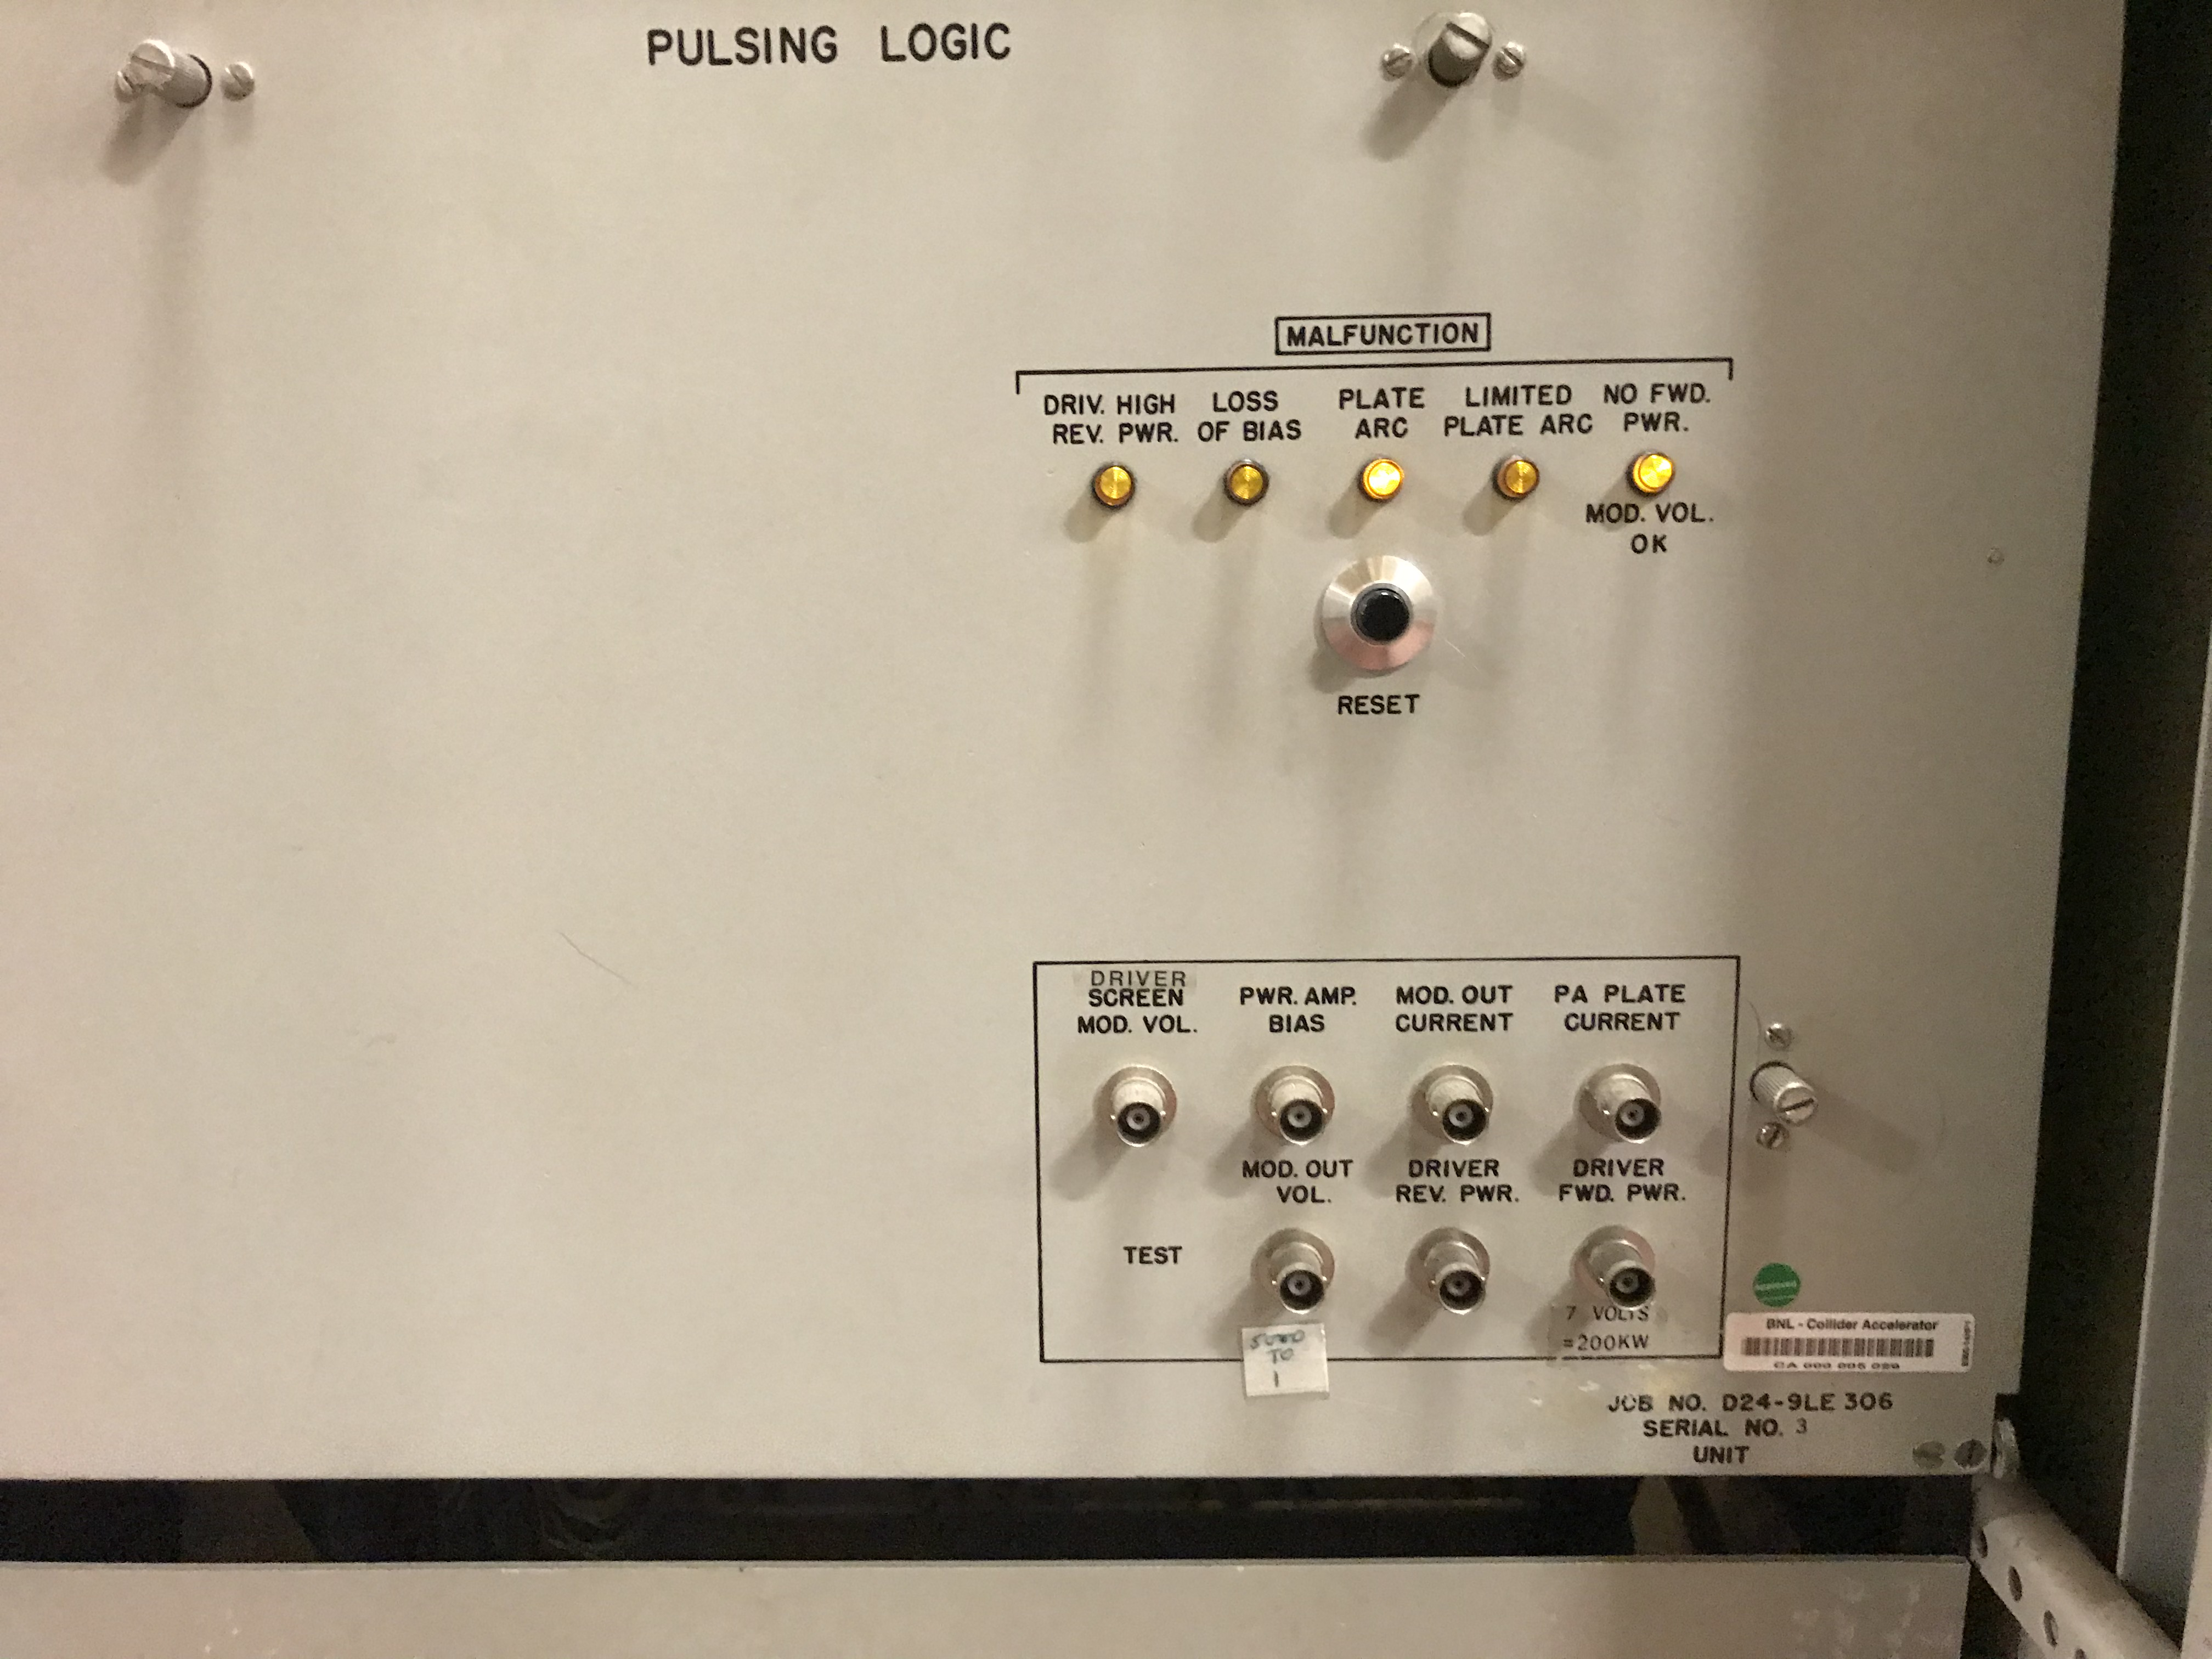
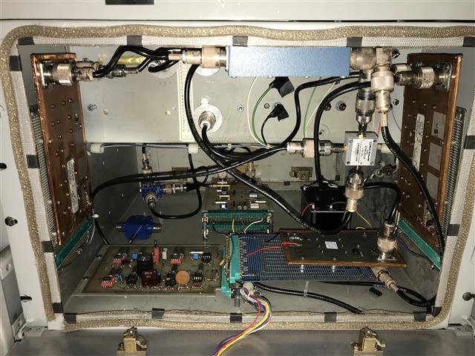
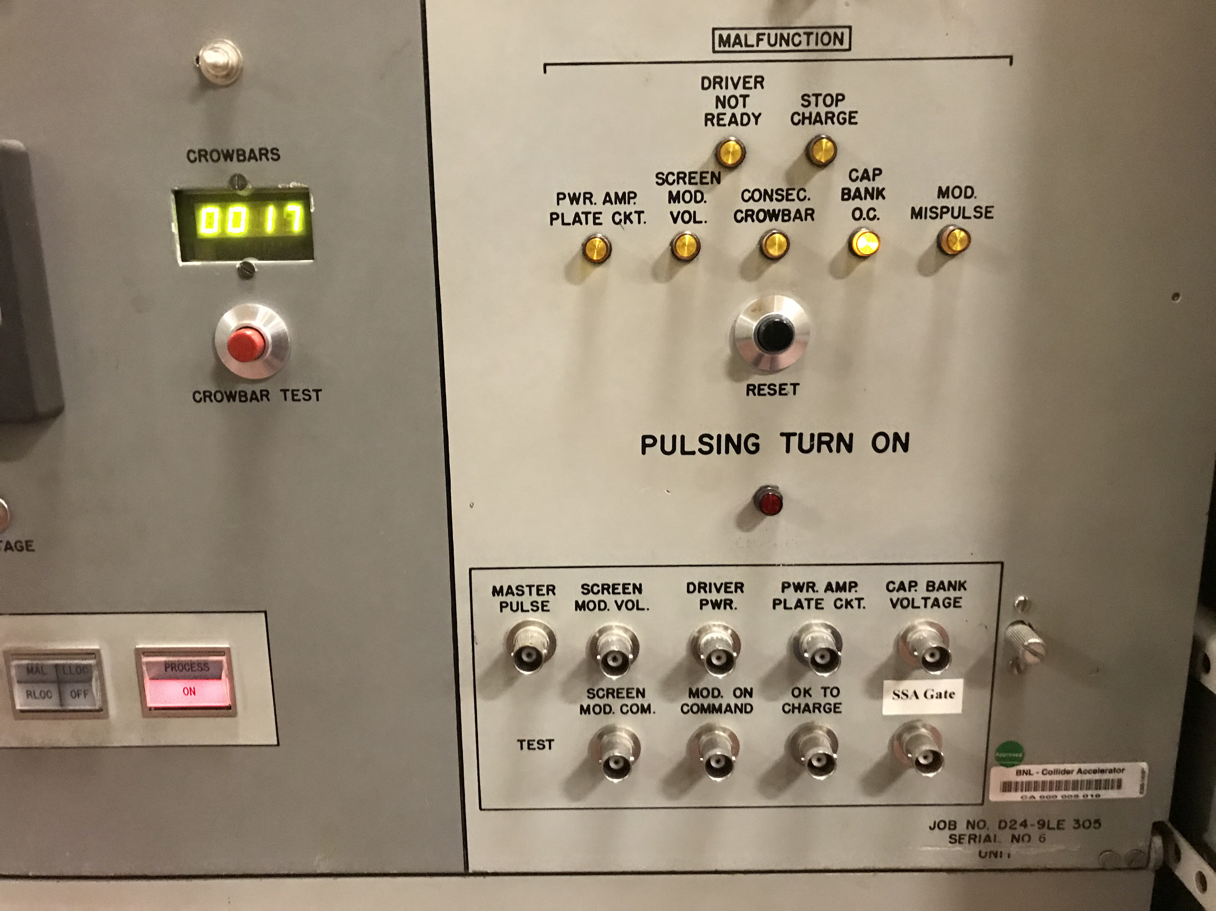
Digital Low-Level RF replaces Original TTL & Analog Controls
The original analog low-level RF system was replaced with a digital low-level cavity controller system. This cavity controller utilizes the same hardware and topology as all other RF systems within the Collider-Accelerator complex. This provides continuity throughout each of our accelerators. The cavity controller handles phase and amplitude regulation, malfunction status, independent timing parameters, high speed window comparator protection, cavity tuning control loops, and several RF ADC channels for Log View and data logging.
Recently all original TTL logic pulsing logic has been added with a second digital controller. What Was Changed:

Slide 24
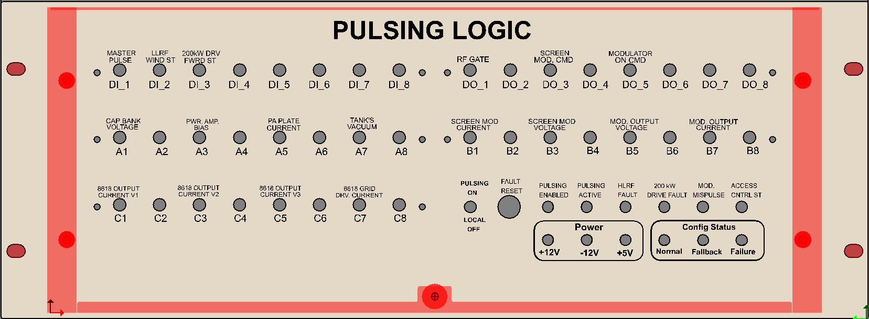
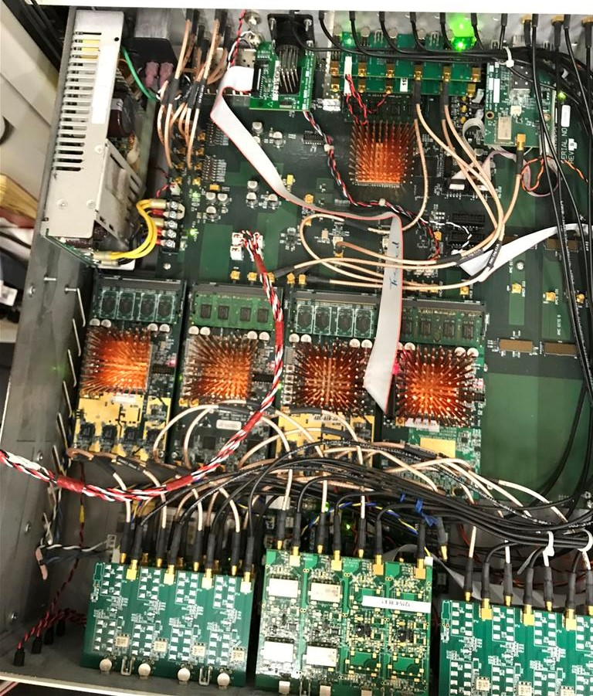
New Hardware
LEMO monitor points
Reset push button, also available on
Pulsing Logic pet page
Pulsing Status LEDs: First and last LED should be solid green, the second will be flickering, the next three are normally out, red means a fault
Toggle Switch: Pulsing ON/OFF

Slide 25
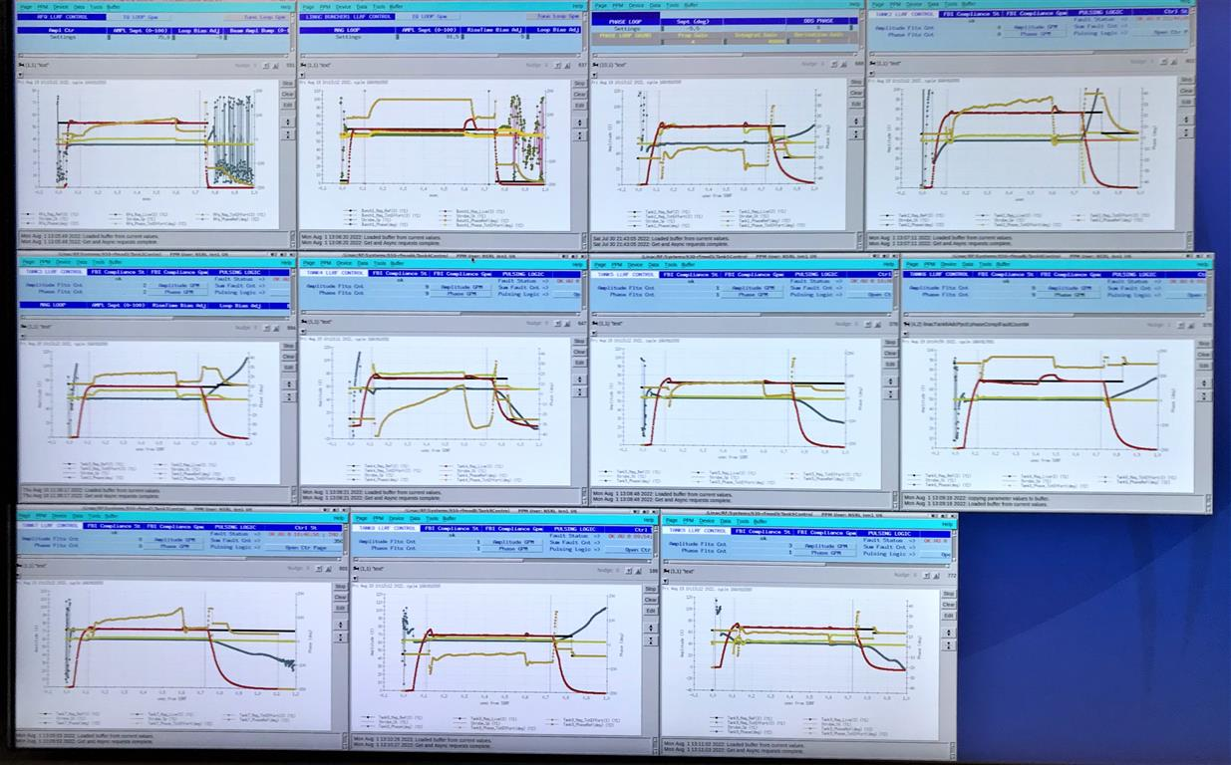
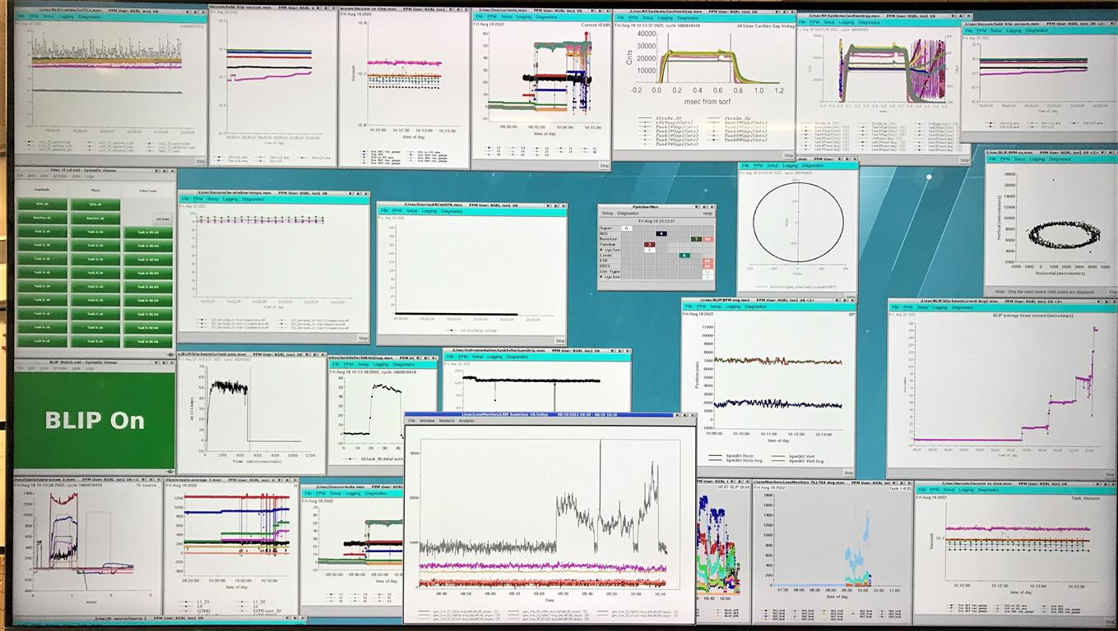
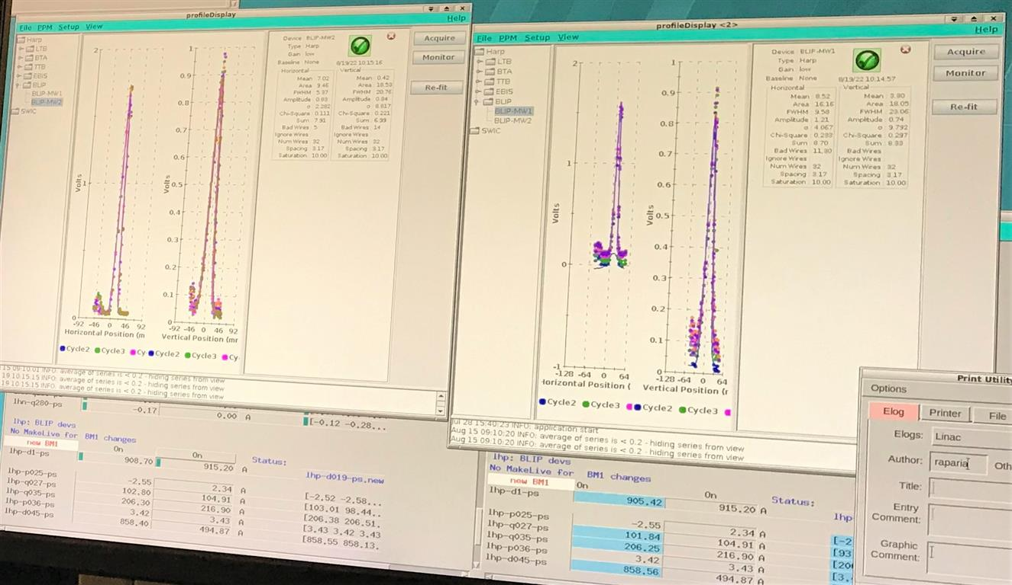
Upgrade of CAD Timing and Control Systems
This system has amazing capabilities in control, monitoring, applications programs and archiving of data. It has allowed the Linac through, pulse to pulse modulation to identify a user and download complete Linac beam tunes every 150 msec. Which includes beam energy, ion source, integrated currents, and beam line steering. In addition to control and troubleshooting remotely through the Web.
Some Examples of the RF and Beam control pages and monitors:

Slide 26
Pulsing Logic Control
Crowbar status and fault count since last reset
First Fault, and time stamp
Master Pulse, PLC and Compliance Statuses
Reset Faults, same as push button on FP

Slide 27
Tank Control
FBI Compliance: Can beam get through the tunnel
Show you the amplitude and phase FBI compliance windows
Pulsing Logic Fault Status
Two elements you need to be within FBI compliance: Amplitude & Phase

Slide 28
LinacRfMafunction
FBI Compliance: Can beam get through the tunnel
Pulsing Logic Fault Status

Slide 29
Facility Support Systems Upgrades.
Body Text
Bullet Tier 1
Bullet Tier 2

Slide 30
Replacement of Linac Cooling Tower
Body Text
Bullet Tier 1
Bullet Tier 2

Slide 31
Replacement of 1500 gallon Liquid Nitrogen Dewar
Supplying up to 20 SCFM at 45 PSI, for high voltage insulation, vacuum system bleed up2, cooling and glove box applications.

Slide 32
Replacement of Air Handlers 2 and 3 for Equipment Cooling and Building AC
This project is currently in process, replacing AH2 this year and AH3 next shutdown

Slide 33
Installation of Variable Frequency Drive for 400 KW RF Cooling Water Pump.
This will greatly improve system efficiency and reduce maintenance on all the high current RF PA Tube filament spring ring contacts. Drive is currently being installed.

Slide 34
Summary
The excellent beam uptime, availability >95%, and the many contributions to scientific knowledge throughout our 52 year history demonstrates our ability and dedication to success.
As we are presenting the many improvements to our Linac it important to realize that only the Accelerator Tanks themselves remain as originally installed. All operating systems, except for tubes and consumables, have been modernized to improve performance and efficiency.
We stand on the shoulders of many outstanding people who have built and worked on this Linac. There work and knowledge gained now allows us to be able to consider this present upgrade in intensity.
My final slide acknowledges some of the many who have contributed to our successful operation over the years and diverse field of scientific and applied applications.

Slide 35
Particle Physics & Applied Applications History
AGS and Booster Proton injector, Particle Physics, G. Wheeler, K. Batchelor, R. Chasman, J. Blewett, J. Keane, S. Giordano, N. Fewell, A. McNerney, J. Alessi, D. Raparia
Brookhaven Isotope Producer, BLIP Medical use isotopes, diagnostic and therapeutic, F. Horn, L. Mausner, C. Cutler
Chemistry Linac Irradiation Facility, CLIF, materials research, spallation neutrons, S. Katcoff, P. Haustein, Enia May Franz
Radiation Effects Facility, REF and Neutral Beam Test Facility, DOD Strategic Defense Initiative, P. Grand, R. Damn
Linac Medical Beam, 200 MEV Beam for cancer therapy G. Bennett
Cluster Ion Fusion Experiments, Pit II, 500 – 750 KEV, G. Friedlander, L. Friedman, R. Beuhler

Slide 36
Section Break
Next Presentation, Ion Source Upgrade and Performance

