Slide 1
Ion Source Upgrade and Performance
A. Zelenski, G.Atoian, T.Lehn, V.Lodestro, D. Raparia, J. Ritter
LIUP2 Director Review
14-16 September 2022

Slide 2
LINAC injector upgrade
The purpose of the source modification is:
to increase the average beam current for BLIP from ~150-170 mA to 250 mA and
reduce the downtime (<5%) of isotope production at BLIP.
The LINAC injector includes:
a high-intensity H- ion source (magnetron type)
750 keV RFQ;
200 MeV Linac.
In this report, we will talk about the modification of the magnetron source for a higher current and briefly about the upgrade of the OPPIS polarized proton source and
also upgrades the supporting elements (arc power supplier, pulse valve, extractor) to increase the stability of the magnetron and to improve duty factor and reliability .

Slide 3
BNL H- ion sources
There are two types of H- ion sources in use at BNL:
One polarized H- → based on charge-exchange Optically Pumped Polarized Ion Source (OPPIS) with atomic hydrogen injector (plasmatron) for RHIC.
And two high-intensity unpolarized H- Surface Plasma ion Sources (SPS) → are based on highly efficient H- ion production in collision of hydrogen plasma with Caesium coated molybdenum surface (1972, V. Dudnikov). A magnetron surface plasma H- source has been used at BNL since 1982 for isotopes production by BLIP. Similar source is in operation at Fermilab and was used for the long time at HERA injector.
BNL Linac Performance and Upgrade Goals:
 | 1996 upgrade |  | Achieved | New upgrade goals
 | before | after | 2018-2022 | goals
H- beam current, mA | 25 | 50 | 60 | 60
Repetition rate, Hz | 5 | 7 | 7 | 7
Average current, uA | 62 | 146 | 215 at 19A arc curr. | 250
Beam width, us | 500 | 530 | 580 (magnetron-1000) | 800 (1100)
Arc current, A |  | 10 to 15 | 10 to 20 | 10 to 20
Arc voltage, V |  | 160 | ~130 | ~130

Slide 4
35 keV LEBT upgrade with three sources
The Low Energy Beam Transport (LEBT) lines combine three beams. The first line is the polarized OPPIS beam-line and the second and third are the high-intensity un-polarized beam-line from the magnetron source, which transports beam to the RFQ after the passage of 45 degree bending magnet.
Magnetron S-2
To RFG
OPPIS
Magnetron S-1

Slide 5
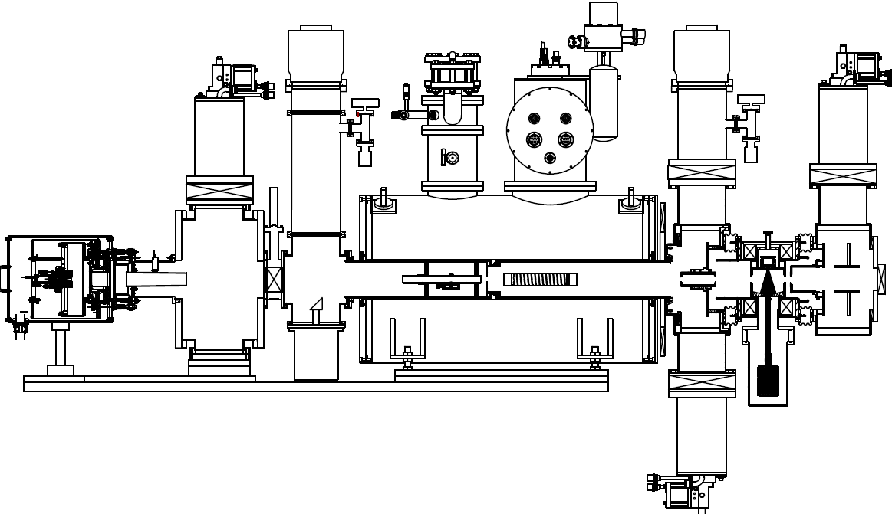
OPPIS source
  The OPPIS (Optically Pumped Polarized H- Ion Source) is constantly to improve polarization, intensity and emittance. Latest upgrades in 2020-22:
  He-cell, Rb-cell, Na-cell;
  Reducing the length LEBT by more than 4 feet (the distance between the Na-cell and the bended magnet);
  Upgrade power transformer system for 35kV extractor.
~1mA H-
He-ionizer
cell
Rb-cell
Sona
transition
Neutralizer
H₂-cell
Na-jet
cell
Atomic H
injector
H⁺
H⁰
H⁺
H⁰
H⁻
H₂
He
Rb
Na

Slide 6
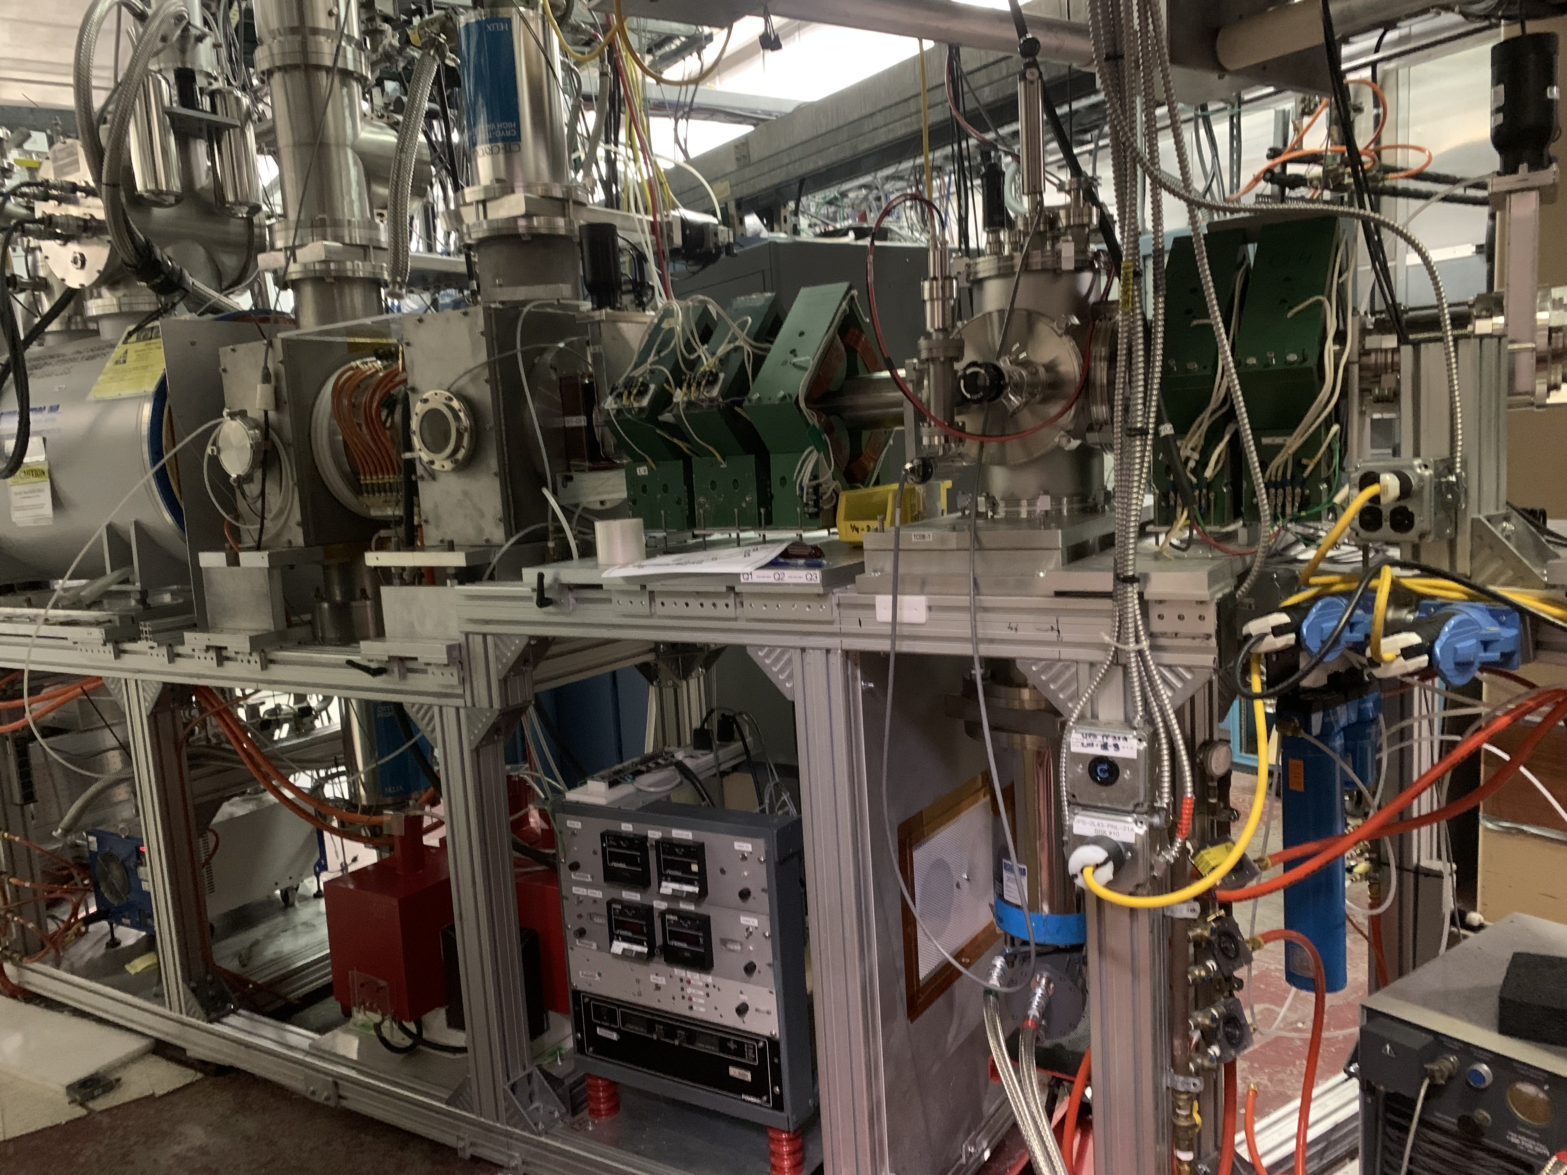
Upgraded OPPIS H- ion source

Slide 7
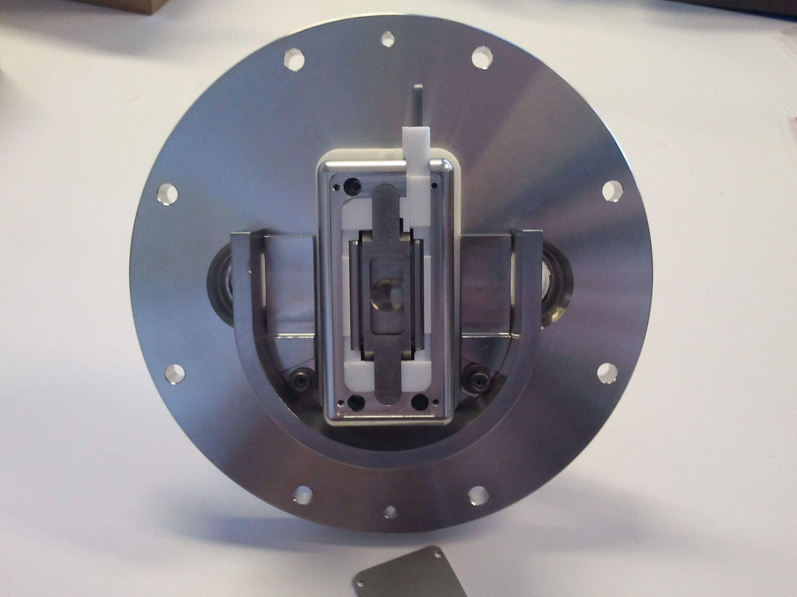
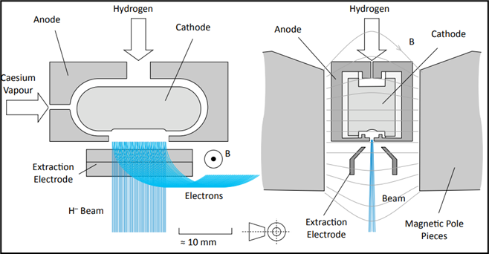
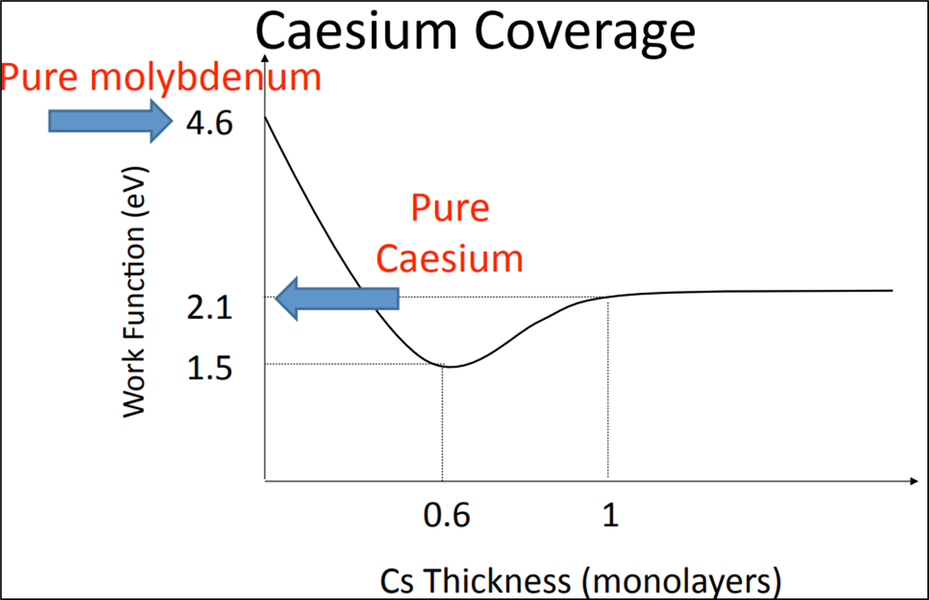
High Intensity Surface Plasma ion Sources (SPS) at BNL (H- source)
-35kV
~ -35.2kV
~1.0kG
Ground
120-140 mA
Parameters of magnetron:
H- Current 100-130 mA (1.5 A/cm2)
Extraction 35 kV
e/H 0.5 -1.0
Arc Voltage 120-160 V
Arc current 8-20 A
Rep Rate 7 Hz
Pulse width 700 -1100 𝜇s
Duty Factor 0.5- 1 %
Cs consumption < 0.5 mg/Hr (T_{Cs}~90-110C, 5 gm 6 months)
Gas flow. ~ 0.6 sccm
Emittance(rms, n) ~ 0.4 pi mm mrad, (RFQ acceptance 2 pi)
Magnetron temperature ~160 -180 deg C
Electron current is less than 50% of the ion current. It was measured as the difference between the total HV extractor power supply current and the H- ion beam current.

Slide 8
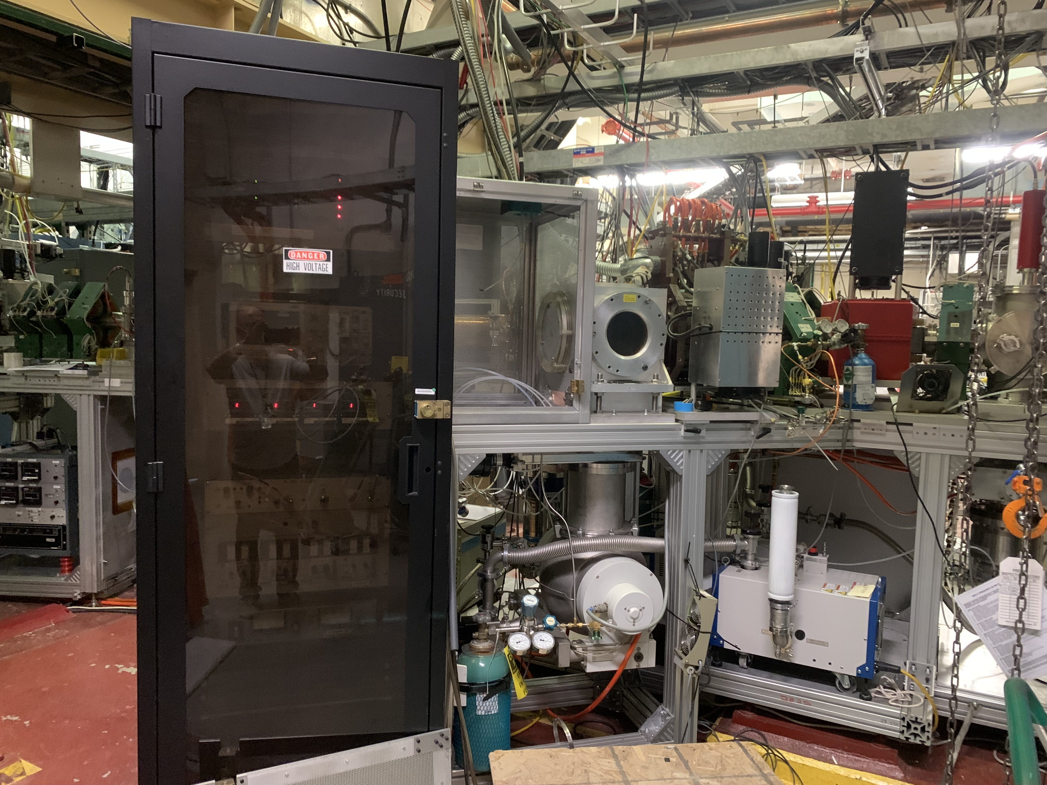
H- ion source S1
The S1 ion source has been rebuilt to reduce the length of LEBT.

Slide 9
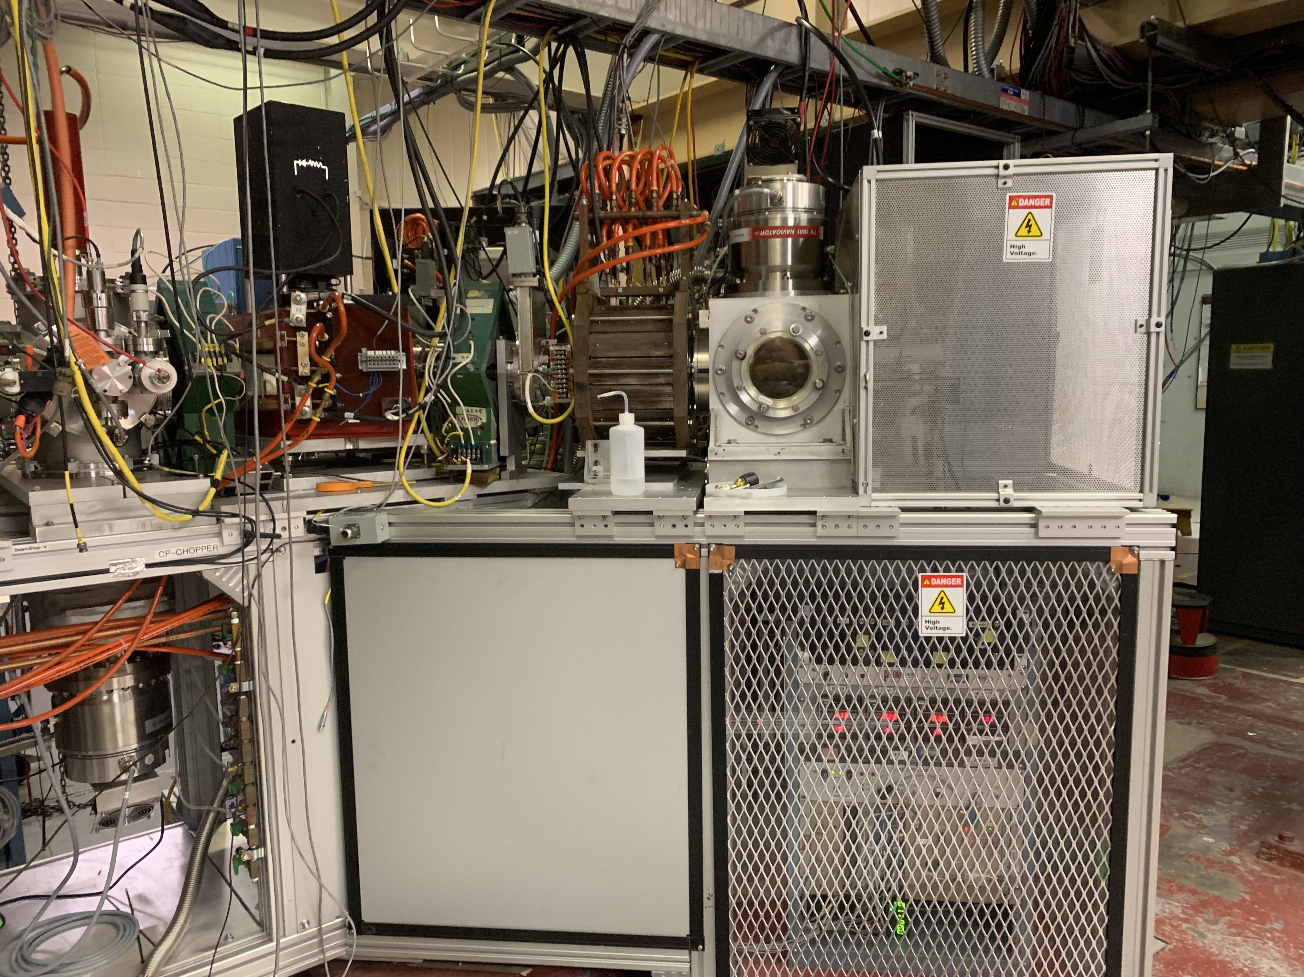
H- ion source S2
The second ion source (S2) was built in 2018-2020 for:
support for the main source S1 to improve the duty factor and reliability of BLIP operation;
and the possibility of exploring possible upgrades to increase the source current.

Slide 10
H- ion source upgrades (2018-2022)
Magnetron:
We modified the system of heaters for the Cs supply to magnetron discharge chamber to ensure steady flow with minimal Cs consumption.
The average power of the arc discharge is quite low ~10-15W, so we use an additional heater to maintain the magnetron case temperature of 160-180 ºC, which is optimal for the operation.
We modified the source ion optical system with the longer ceramic insulators and larger protection cups to reduce Cs and sputtered tungsten deposition to the insulators.The custom-made Macor insulators have been replaced with conventional (inexpensive) ceramic insulators. The new design has eliminated leakages along the ceramic insulators, which developed after long-term operation and increased the operating voltage selection range to at least 40 kV (maximum voltage of the PS).
Supporting elements:
Electromagnetic pulsed gas valve.
The new arc-discharge power supply improved current stability and reduced the current noise.
We built the complete new set of PS for the source. It is a very compact design just about 90 cm toll and placed in the bottom part of the source bench. At 7 Hz repetition rate we use just one turbo-molecular pump of the 1000 l/s pumping speed to operate the source.
New extractor based on 50 kV Behlke switch (under development).
Three new high current pulsed power supply for bending magnet and solenoid magnet for S1 and S2 (under development).
Control and monitoring.
Software.

Slide 11
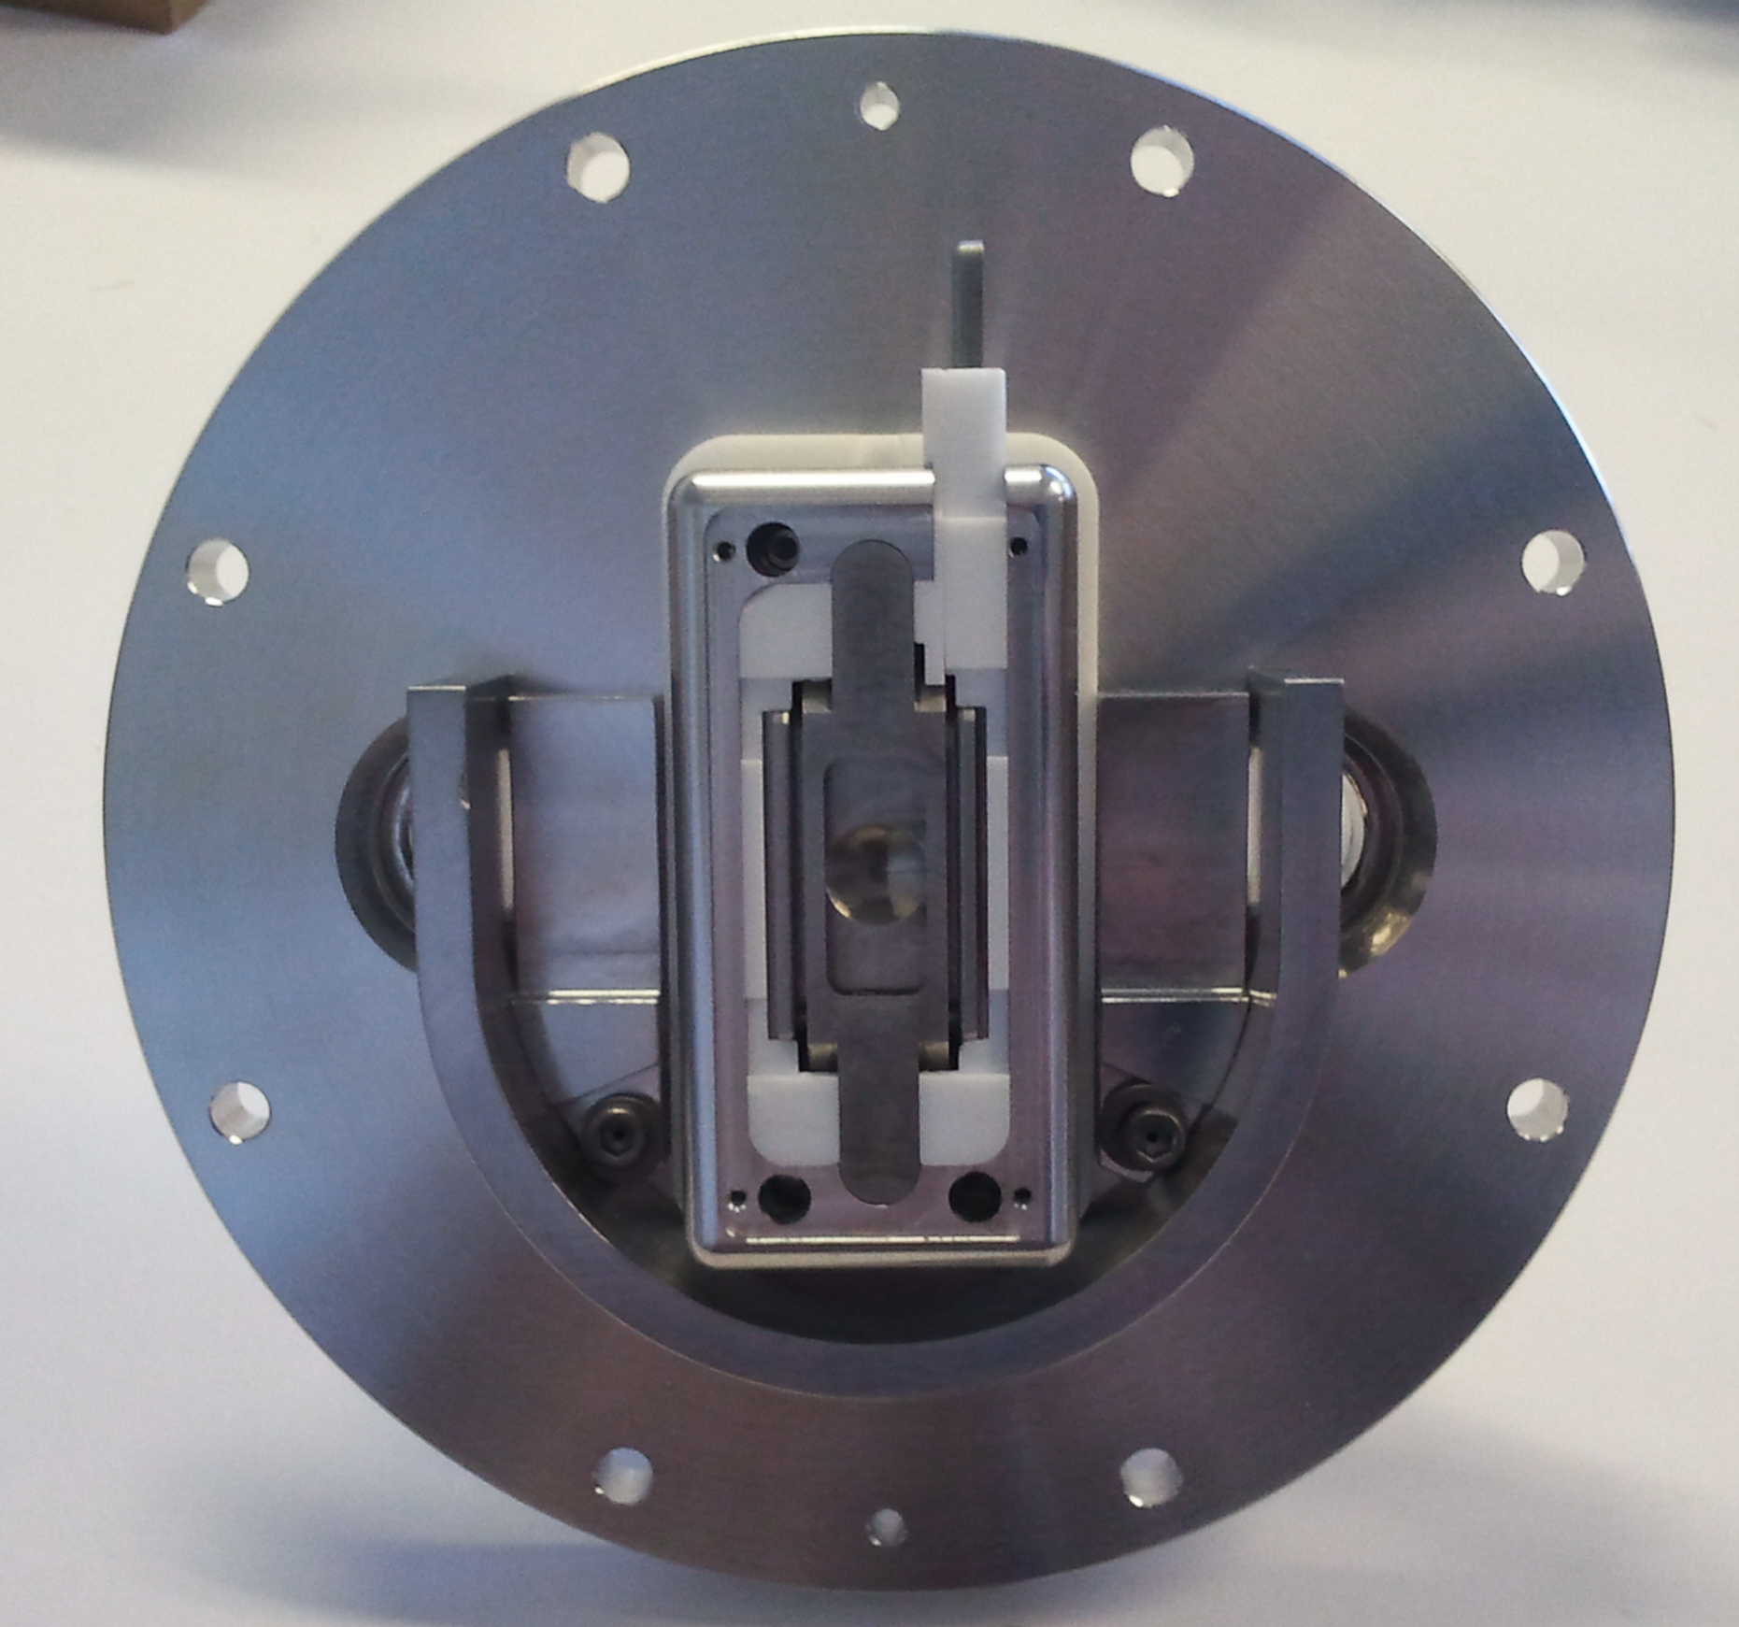
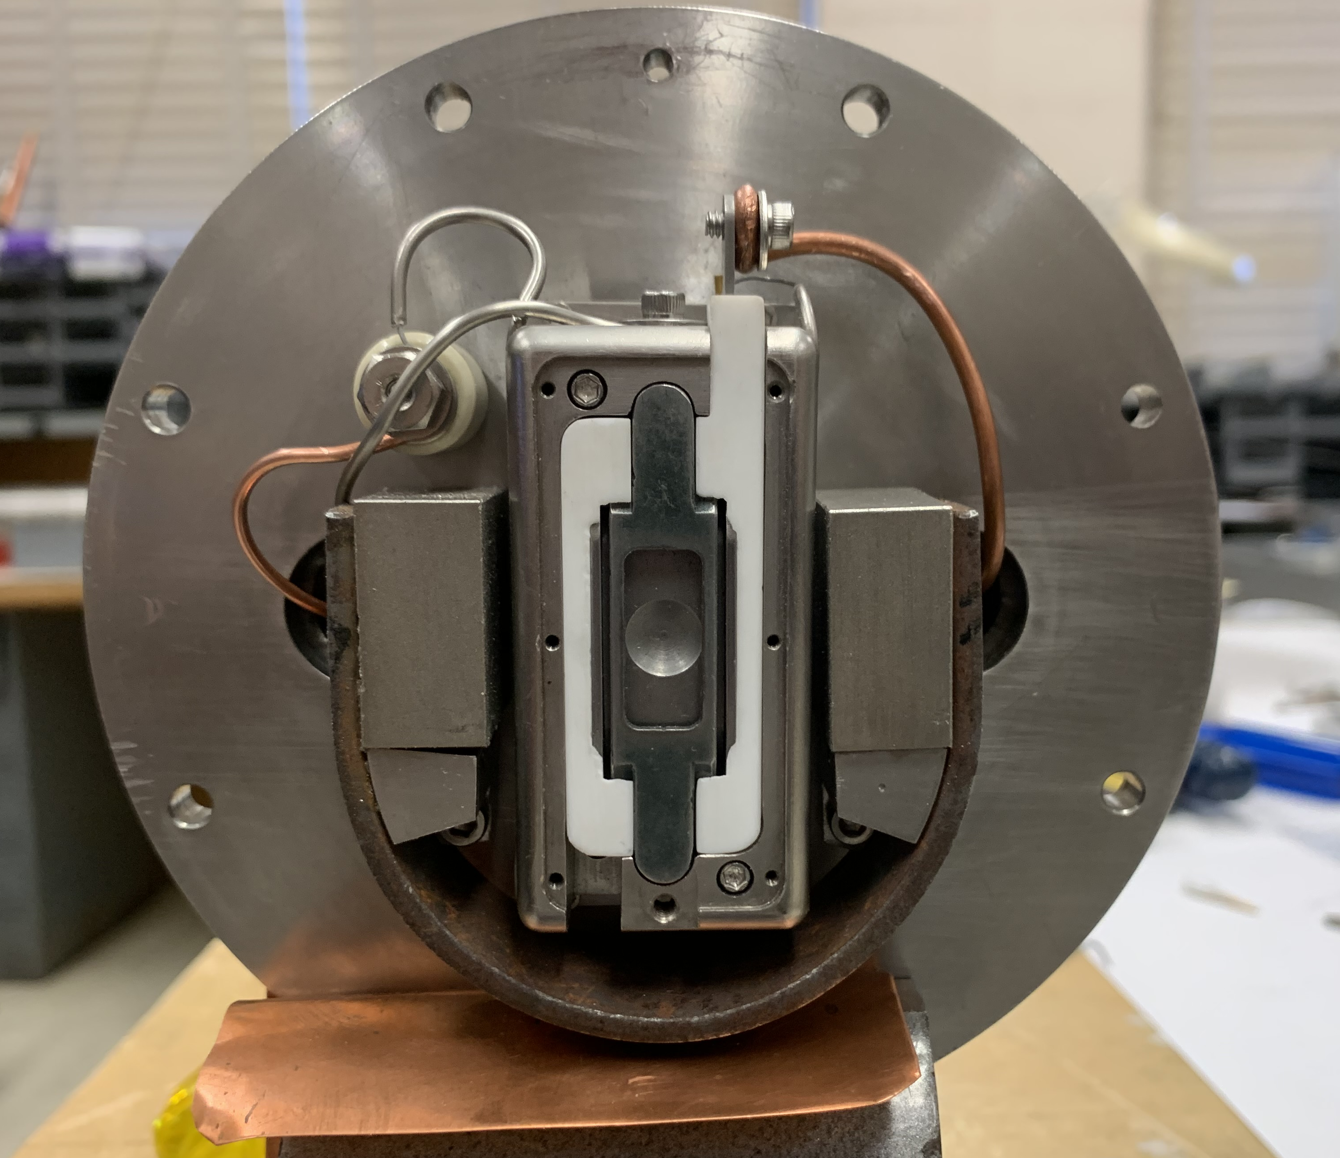
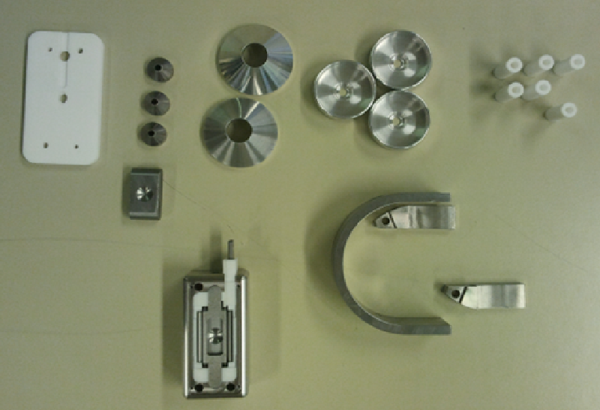
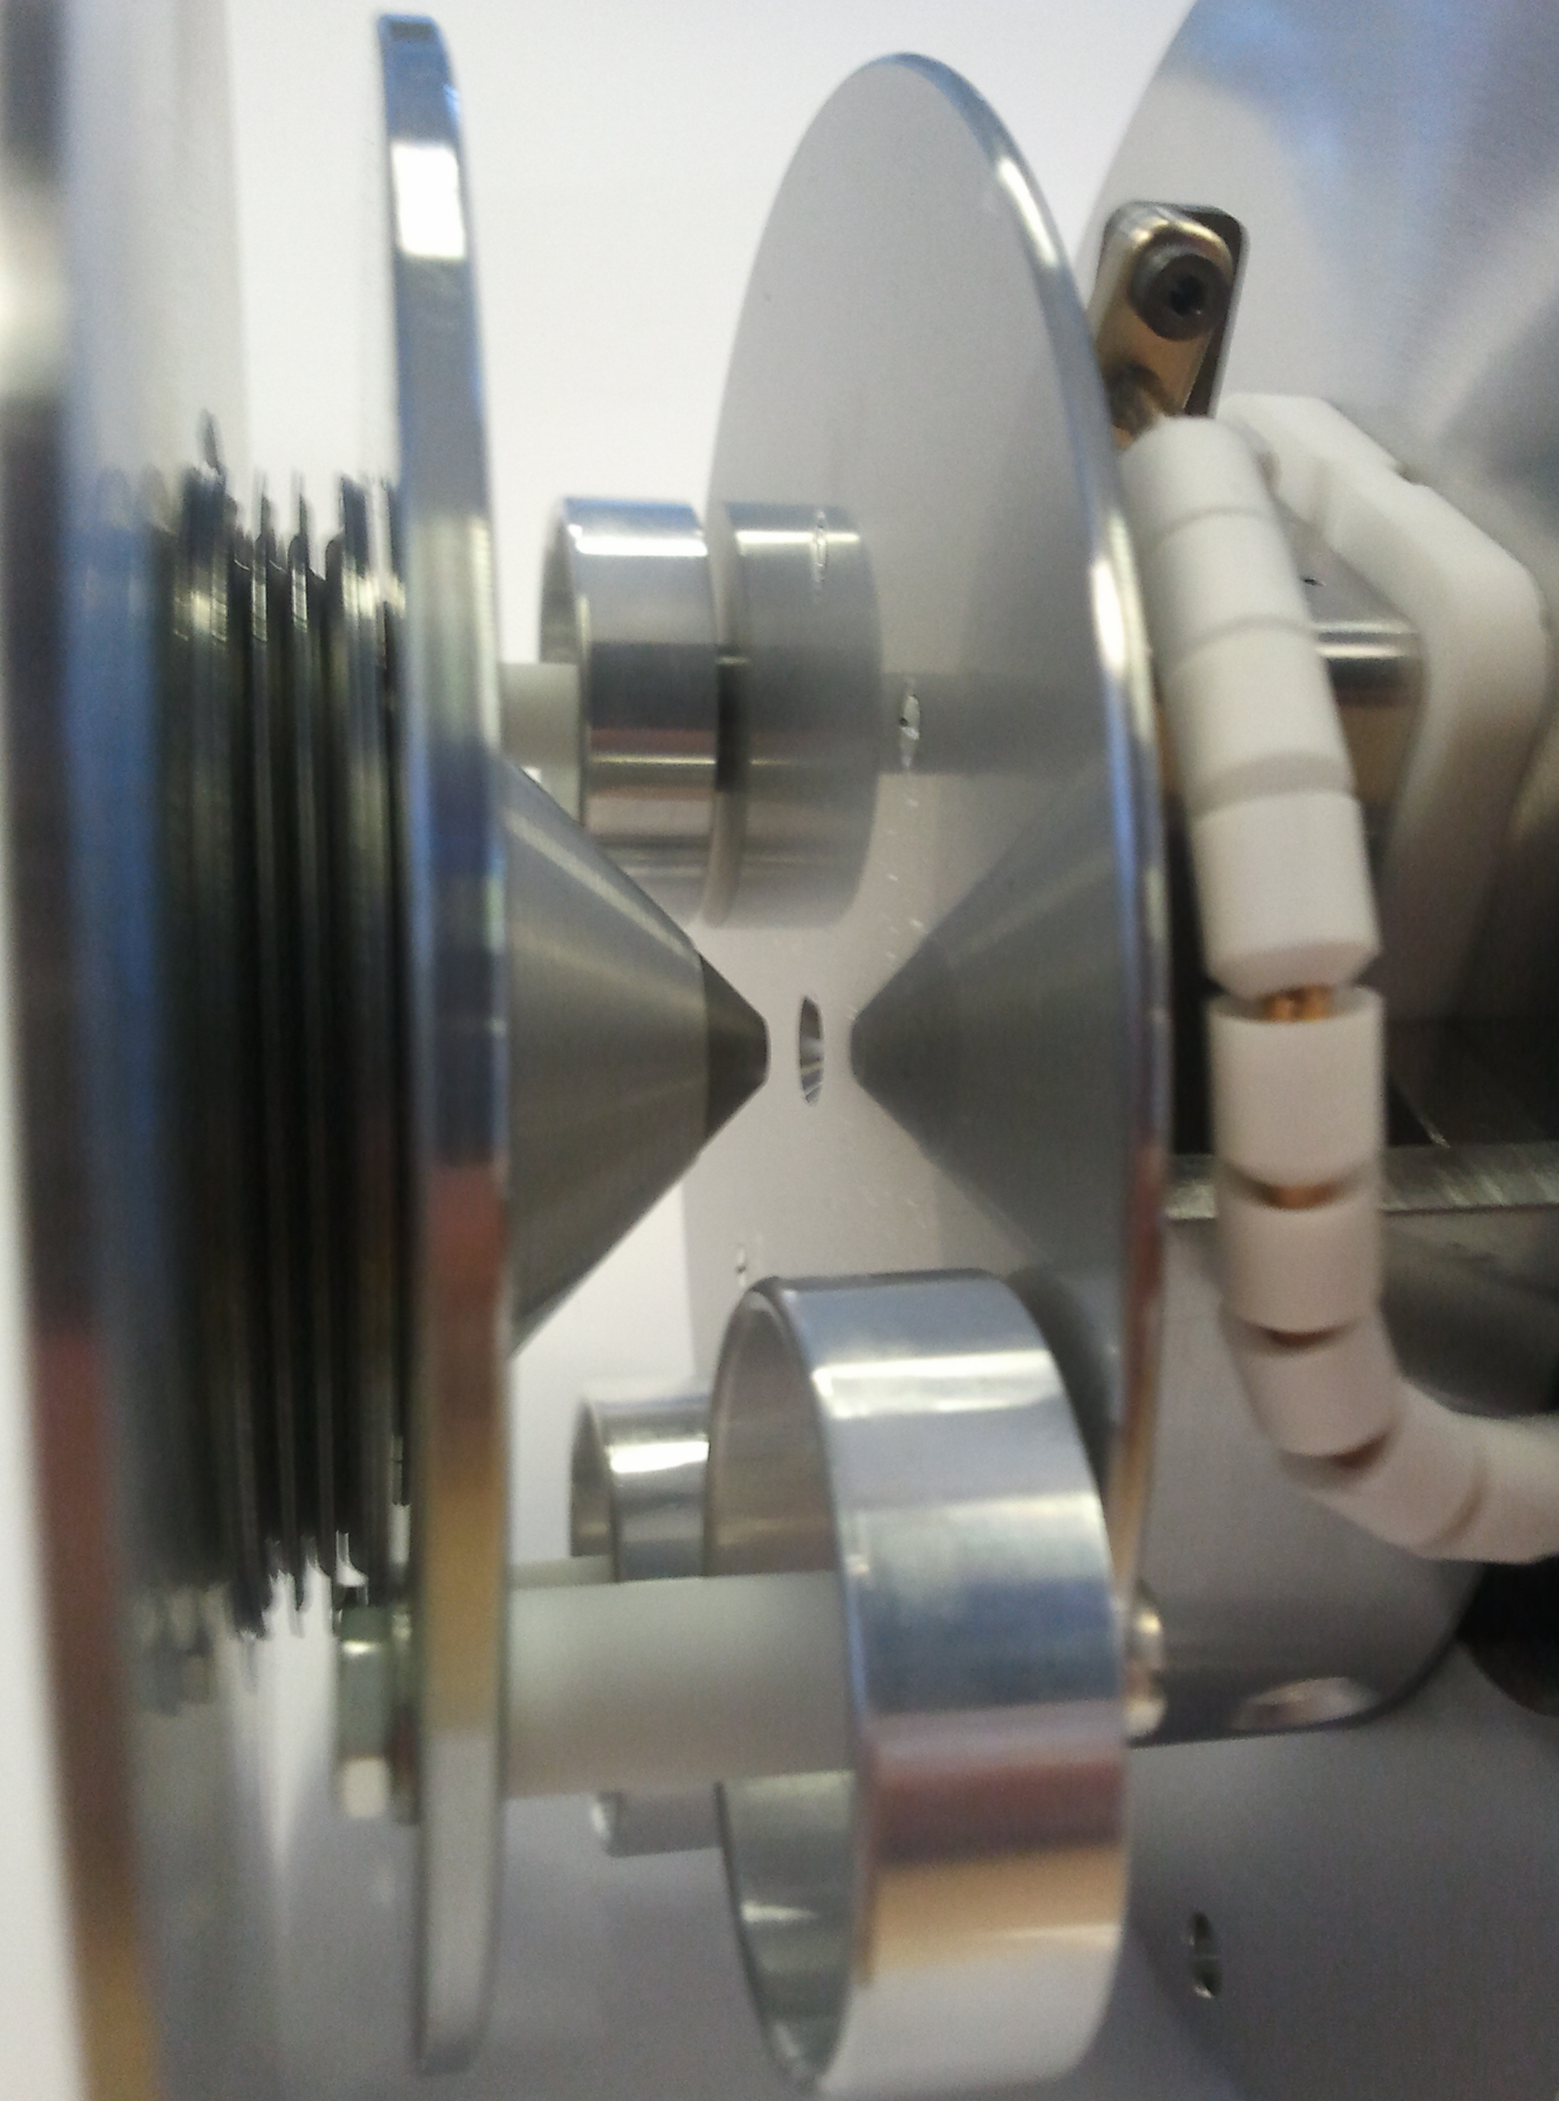
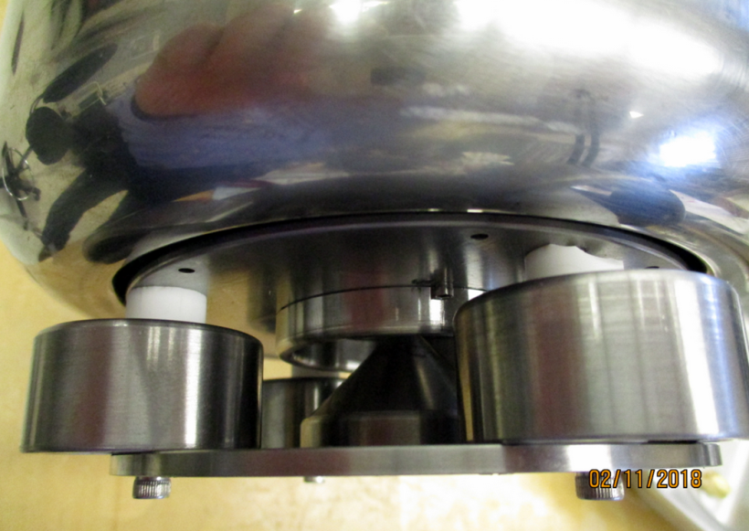
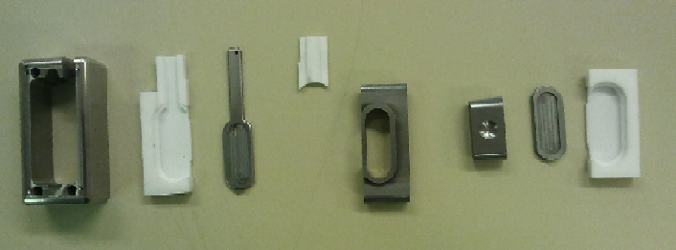
Magnetron and extractor system modifications
Improved the inputs of H₂ gas injection and the Cs evaporation;
replacing the rear ceramic plate of the magnetron with a steel one;
heating the magnetron housing made it possible to achieve greater stabilization of temperature control.
The magnetron is assembled from 10 parts, 9 of them are modified.
Ion-optical source system is extended to reduce the chance of spark.
Improved protection against tungsten sputtering on insulators (high voltage spark prediction).
a
b
c
d
e

Slide 12
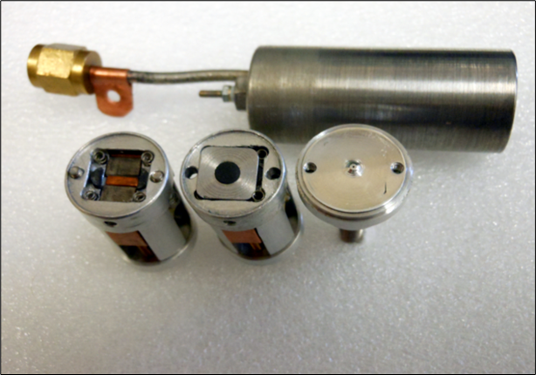
BINP Electromagnetic pulsed gas valve upgrades
The gas injection is very critical for optimal source operation. The pulsed valve operation is essential for the stable source operation at the best performance and the source gas efficiency. We used the original BINP, Novosibirsk valve as a prototype and made a number of improvements:
The main improvement is the replacement of the rubber compression parts with the miniature springs.
This change improved valve temperature stability and simplified valve assembly and tuning.
The valve outlet hole was reduced to 0.13 mm. As a result, we obtained reliable valve operation and somewhat reduced total gas flow.
We also developed a new power supply for the valve (with current stabilization and pulse duration control). This helped to increase pulse duration of the beam to 1000 us.

Slide 13
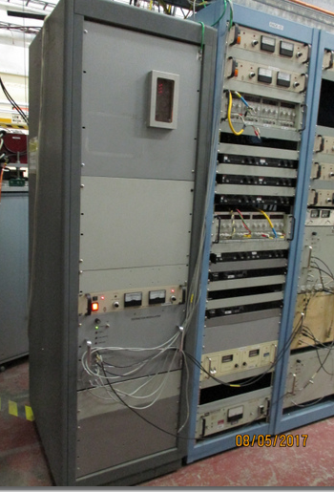
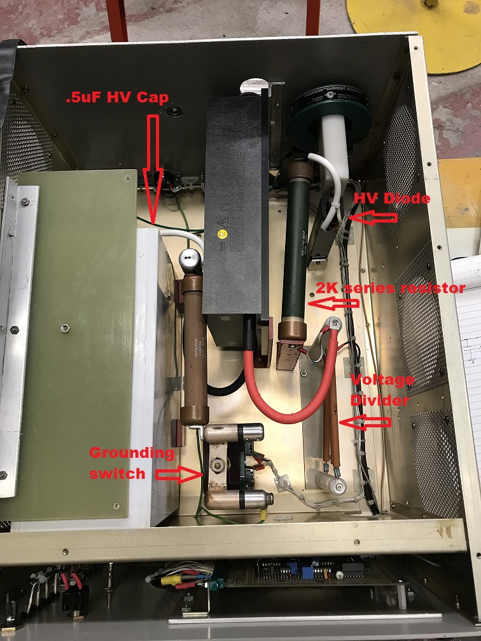
New extractor based on 50 kV Behlke switch
The extractor based on HV TUBE 4PR2-50
Advantage:
We have made three extractors based on tube and have experience with them (over 15 years).
Disadvantages:
The extractor design occupies the entire rack and cannot be located close to the magnetron source (long high voltage cable, higher inductance)
Service life ~ 6...7 months and price ~ 7500 dollars.
The modulator based on HV BEHLKE switch
Advantage:
We have made ~5 modulators based on Behlke switch and have experience with them (over 15 years).
The design of the modulator can be made compact and placed directly above the PS rack on the source bench.
We have good experience of 2 weeks fine working modulator based on new MOSFET HV Behlke switch HTS 501-10-LC2.
Disadvantages:
We are just getting started with modulator based on the new Behlke switch and more time is needed to finalize the design of the modulator.

Slide 14
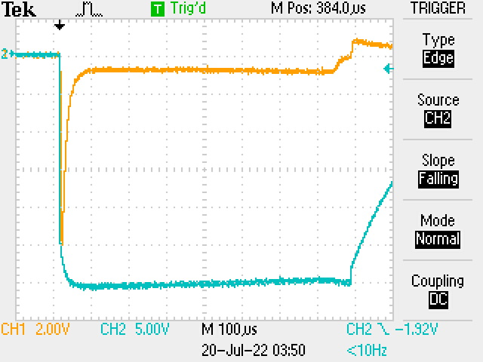
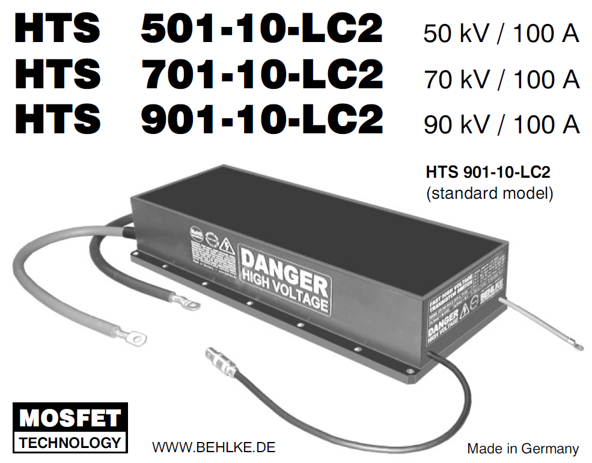
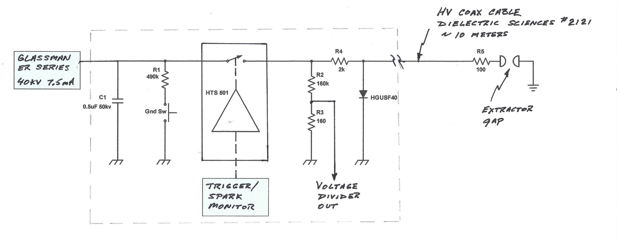
New extractor based on 50 kV Behlke switch
MOSFET HV switch HTS 501-10-LC2
The switch are insensitive for unstable load (e. g. plasma load) and for unstable input voltage. They can resist sparkovers, short circuits and overvoltage transients within their thermal capabilities.
Max. operation voltage- 50kV
Max. turn-on pick current <1ms – 59A
Max. continuous current – 850mA
Max. continuous power dissipation – 32 Watts
Pick current ~2A

Slide 15
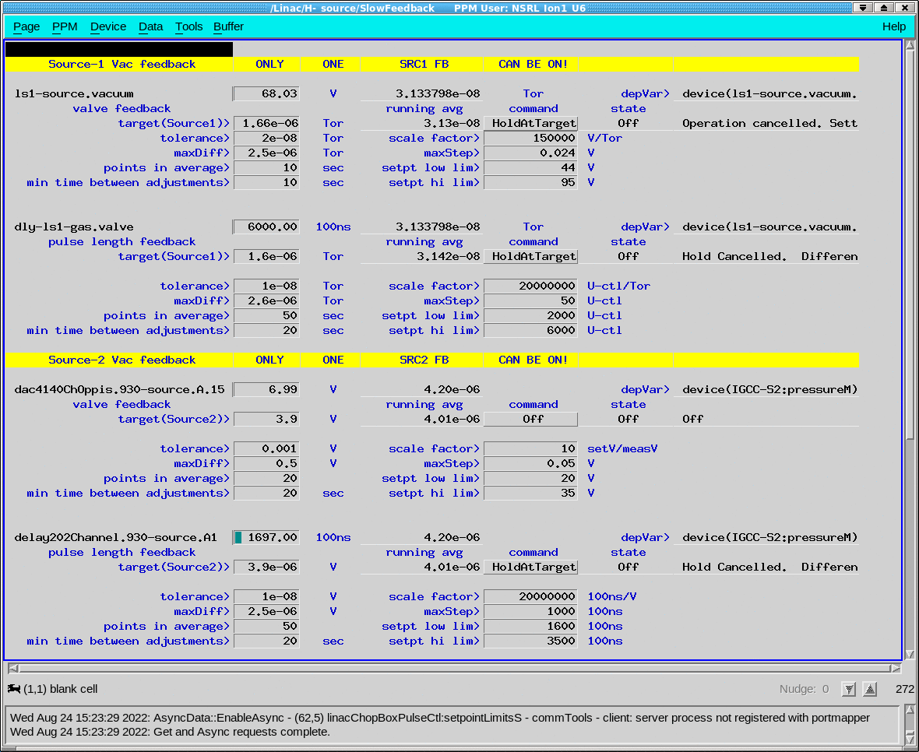
Control of stability by software J. Morris
Stable operation of the source is also carried out programmatically using a good branched control and monitoring system.

Slide 16
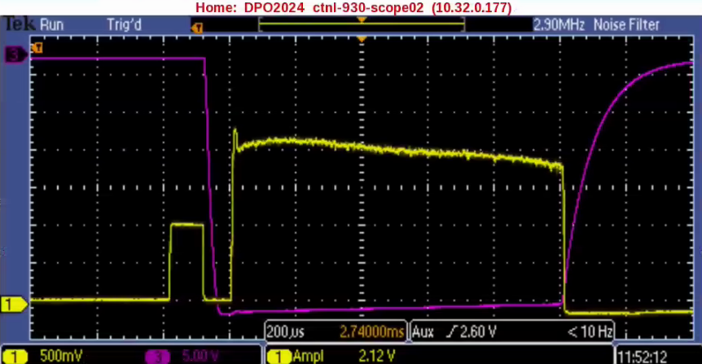
Operation of the magnetron with increasing pulse duration
L1~100 mA
at I_{arc}~14A
We tested the possibility of increasing the duration of the source pulse up to 1000 μs.
The reliable long-term operation was demonstrated at arc-discharge current 10 A and H- ion beam intensity in LEBT L1~90 mA.
The short-term operation at the arc-discharge current 14 A produced 100 mA current, but the magnetron body overheating caused the unstable operation.
We plan to introduce the additional cooling to maintain the magnetron at optimal temperature and ensure reliable long-term operation.

Slide 17
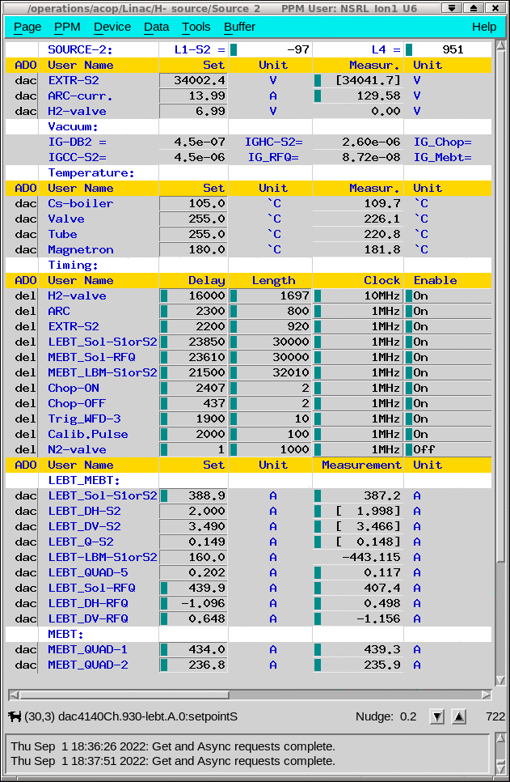
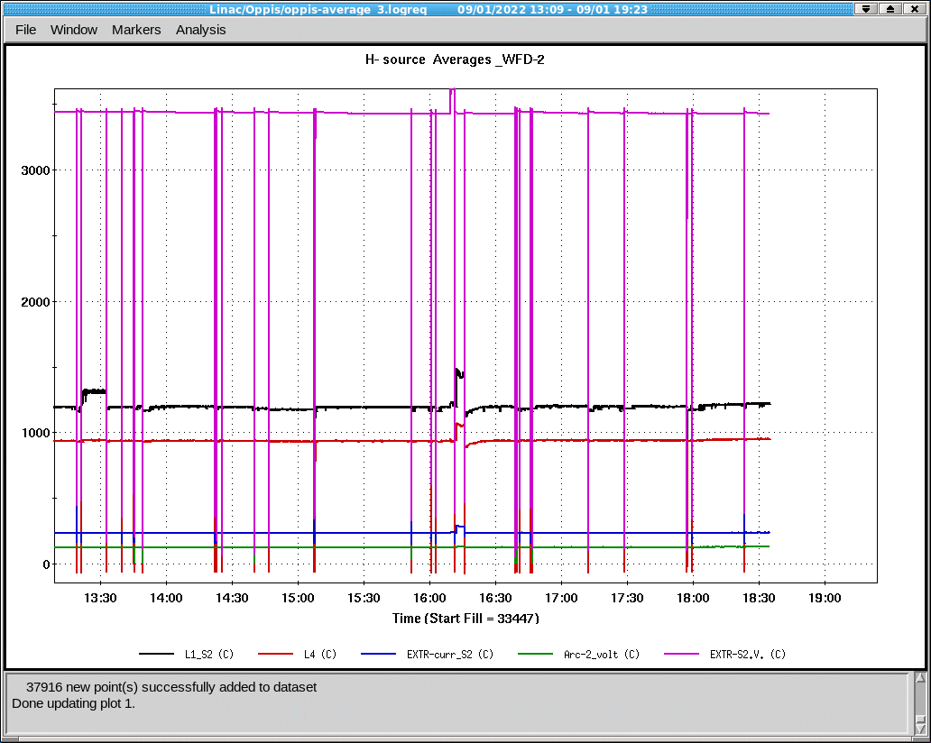
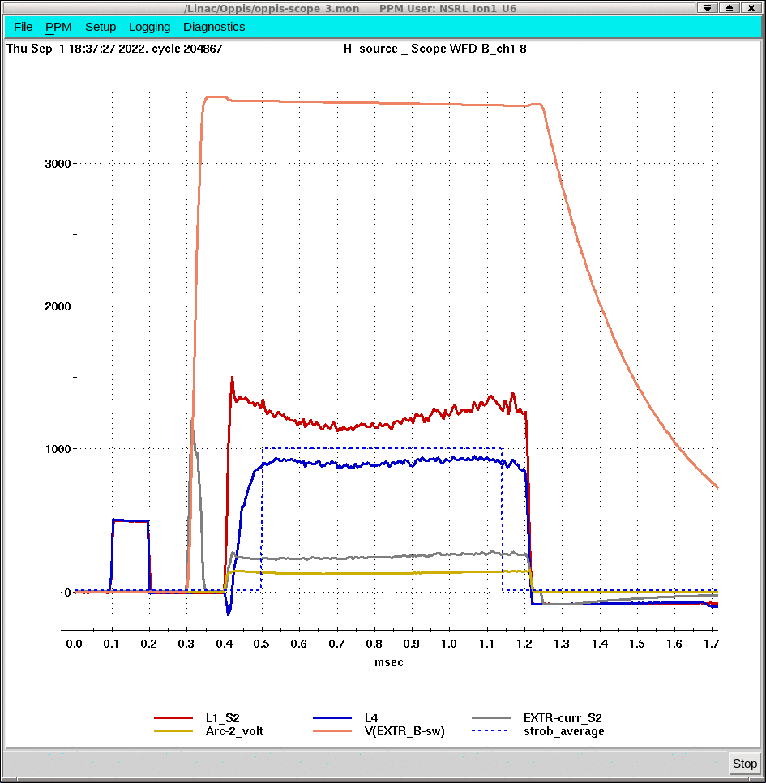
Operation of the magnetron with increasing pulse duration
Arc: I_{arc} ~14A, V_{arc} ~126V, T_{arc} ~ 800mks; Extractor: I_{extr} ~ 180mA, V_{extr} ~34.0kV, T_{extr} ~920mks;
Current before LEBT - T_{L1-S2}~ 800mks, I_{L1-S2}~120 mA; Current before RFQ - T_{L5} ~ 800mks, I_{L5}~90 mA;

Slide 18
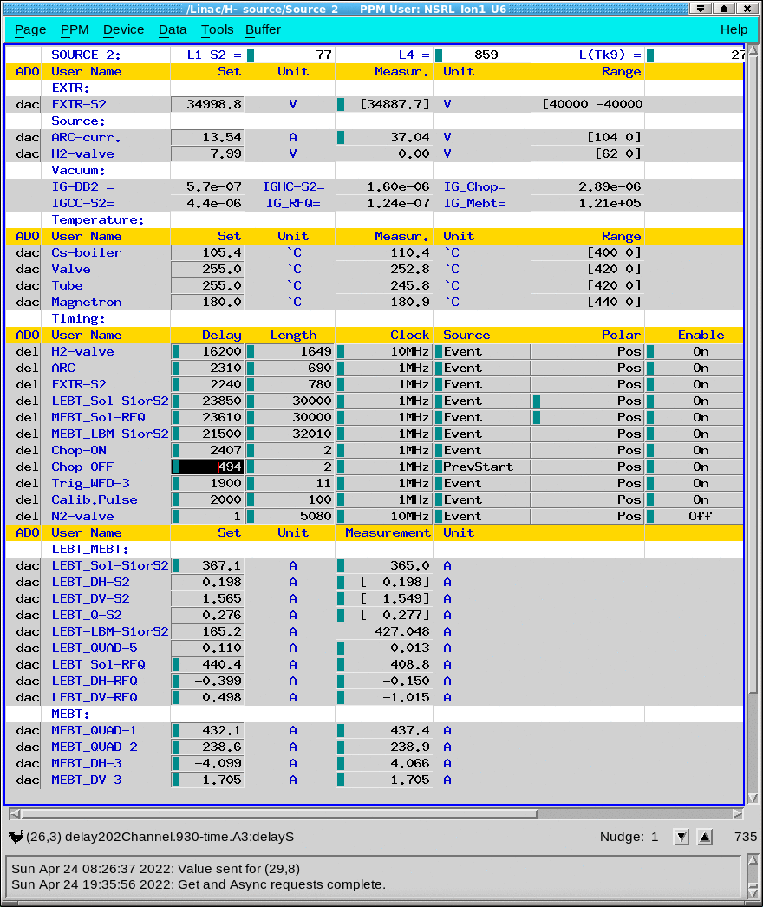
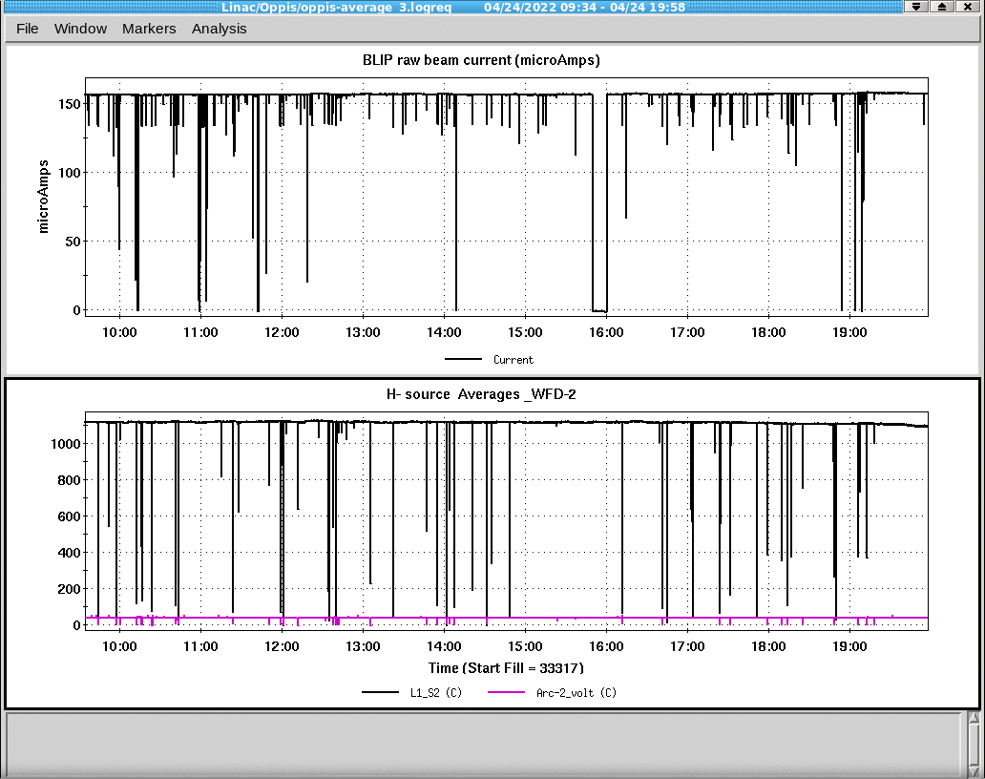
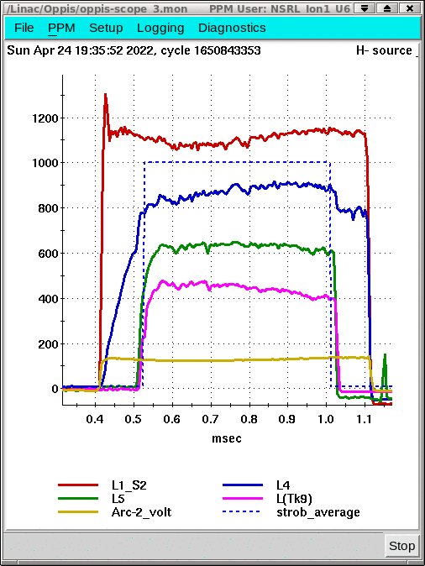
Routinely work parameters of magnetron source
Arc: I_{arc} ~13.5A, V_{arc} ~130V, T_{arc} ~ 690mks; Extractor: I_{extr} ~ 180mA, V_{extr} ~35.5kV, T_{extr} ~780mks;
Current before LEBT - T_{L1-S2}~ 690mks, I_{L1-S2}~110 mA; Current after RFQ - T_{L5} ~ 500mks, I_{L5}~65 mA;
BLIP average current - T~ 500mks, I_{aver}~ 155mkA

Slide 19
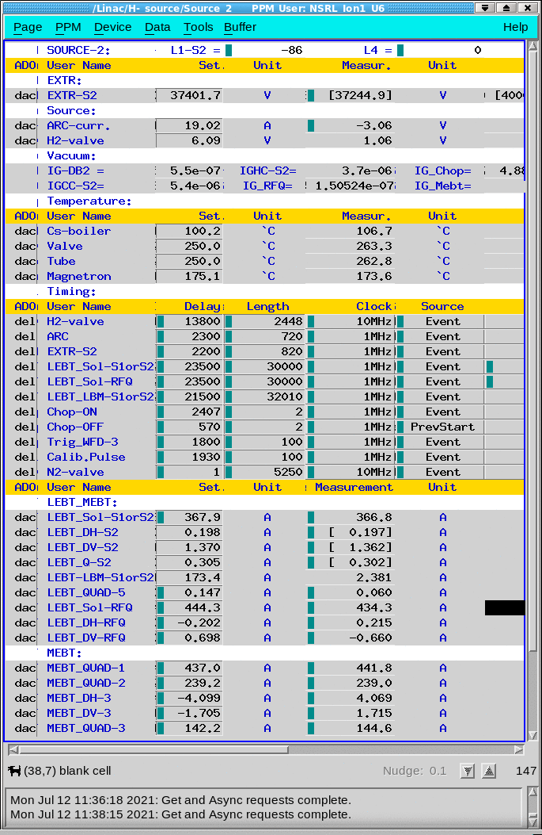
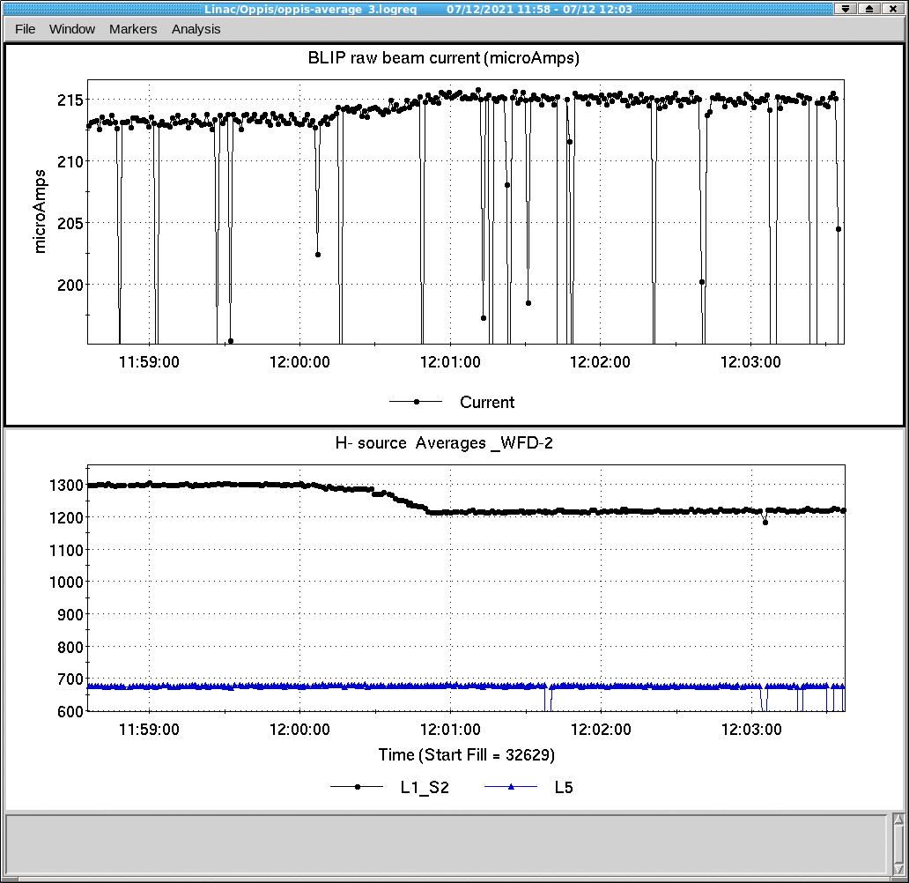
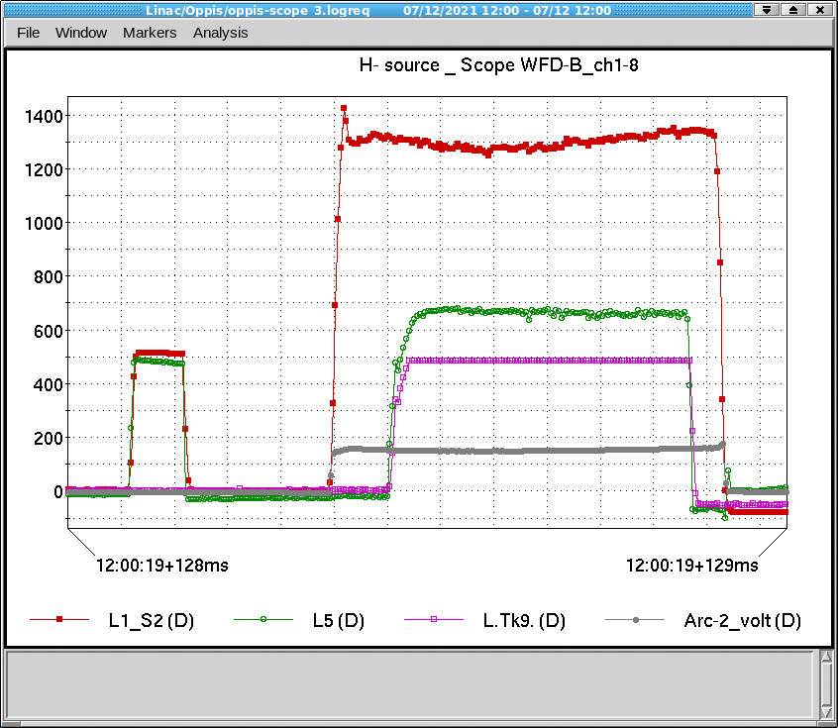
Highest current in BLIP
Arc: I_{arc} ~19A, V_{arc} ~140V, T_{arc} ~ 720mks;
Extractor: I_{extr} ~ 180mA, V_{extr} ~37.4kV, T_{extr} ~820mks;
Current before LEBT - T_{L1-S2}~ 720mks, I_{L1-S2}~130 mA;
Current after RFQ - T_{L5} ~ 580mks, I_{L5}~70 mA;
BLIP average current - T~ 580mks, I_{aver}~ 215mkA

Slide 20
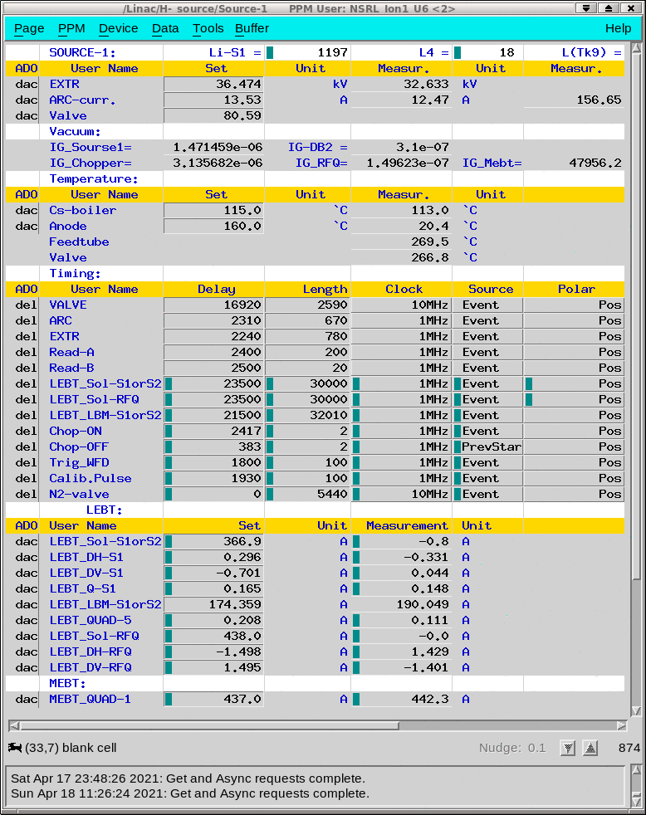
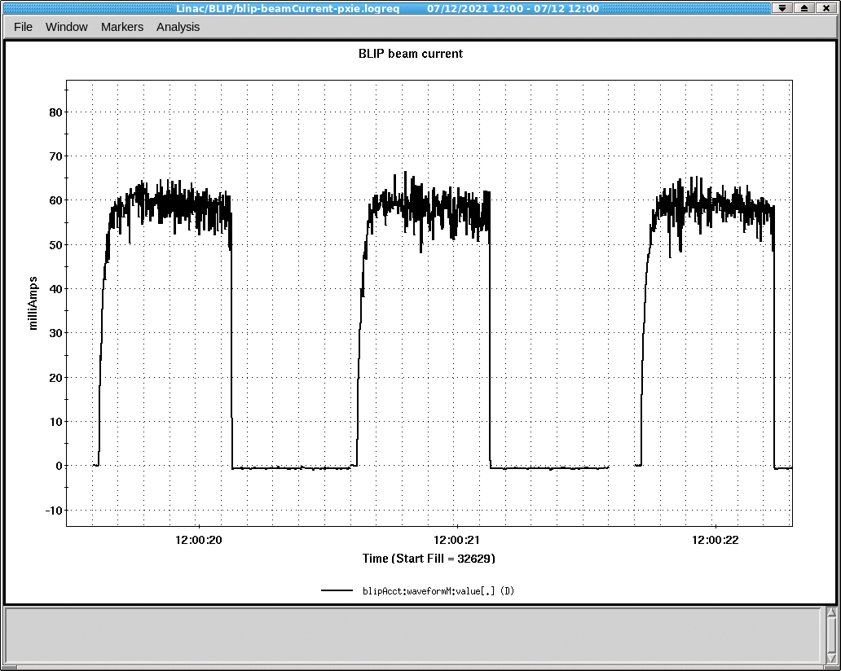
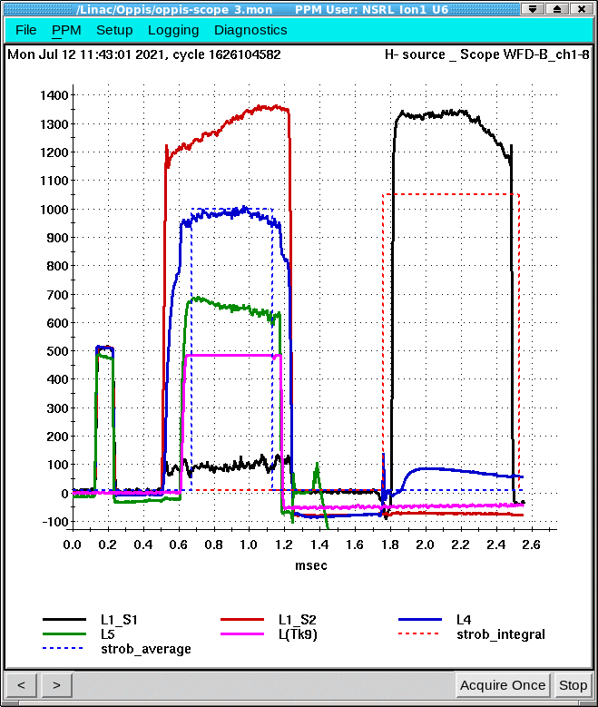
Simultaneous operation of two current sources
We can run, control and monitor both sources at the same time but provide a beam to the RFG from only one of them. Changing time ~10 minutes.

Slide 21
SUMMARY
The BNL magnetron-type H- ion source and the injector had been upgraded to higher duty-factor as a part of Linac intensity increase project.
The Low Energy Beam Transport (LEBT) was upgraded to combine three beams.
The S2 ion source is designed with taking in account to minimize the length of LEBT. The S1 ion source has also been rebuilt to reduce the distance to the RFQ. The high beam transport efficiency about 65% (from the source to 750 keV after the RFQ) was demonstrated for the LEBT with 45° - bend. Beam current of a 75-80 mA (maximum 90 mA) was obtained after RFQ for injection to Linac (85-90% was accelerated and delivered to the BLIP target).
The new design of the magnetron and LEBT makes it possible to provide the required H- ion current by increasing the length and the volume of the arc current pulse.
All source systems were redesigned and rebuilt, which improved source reliability. The BNL magnetron source routinely delivers ≥120 mA H- ion current with 650 us pulse duration and 7 Hz repetition rate.
The time between maintenance exceeds 3 months (5 g Cs load last more 6 months).
The experience of the two magnetron sources layout operation (one source in operation the second source in standby) might be useful for facilities with the high downtime cost (like high-energy collider LHC or multi-user facilities like SNS).
The circular magnetron arc chamber is in preparation for testing.

