Slide 1
RF Systems and Components
Carlos Ramírez Lockward
LIUP2 Director Review
12-14 September 2022

Slide 2
Outline
1 – LINAC RF System Overview
2 – Background
3 – Scope
4 – Proof of Principle
5 – Subsequent Testing
6 – Work Breakdown Structure (WBS) and Cost Estimate
7 – Schedule
8 – Challenges
9 – Risks and Mitigation Strategy
10 – Recent Improvements
11 – LLRF Upgrade: New Pulsing Logic
12 – Summary

Slide 3
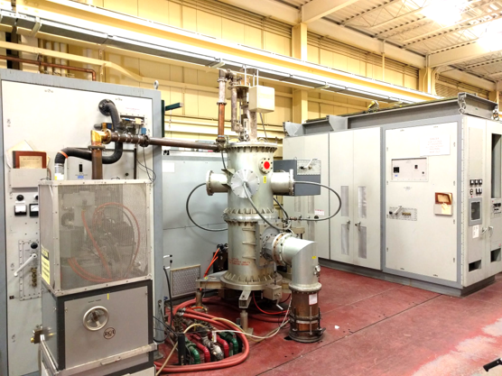
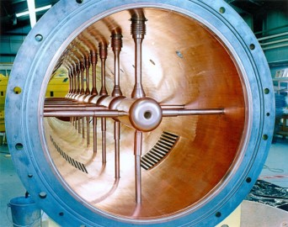
LINAC RF System Overview
LINAC RF System
200 MeV LINAC
LINAC Drift
Tube Tank
Notes:
The Brookhaven 200 MeV LINAC consists of nine RF accelerating stations (drift tube tanks) operating with a 5MW pulse power triode and driven by 200KW tetrode driver. Additionally, there is one 5 KW Buncher and one Radio Frequency Quadrupole. All RF systems operate at 201.25 MHz.
Each drift tube from tank 2 on has 2 or 3 attached stems to the tank side wall. The purpose of these stems is to insure a mode free stable tank resonance at 201 MHz.

Slide 4
Background
Presently LINAC is capable of handling ~165 µA. A huge increase from its first several years of operation.
Some of the changes made throughout the years that allowed for this higher current are:
H-Source
Switch to 5 Hz operation.
RFQ installation
New 12” pressurized Coax System
New Timing system
Vacuum burst I/L instrumentation saving tank RF windows
Major improvements to the RF systems, new 50 KV PS, elimination of DC Charge control at 60 KV, new control system, tube replacements with solid state amps, phase and amplitude control redesigns.
New LEBT / MEBT and Buncher improving both transverse and longitudinal LINAC emittances.
Modifications and repairs to different tanks, with the new collar and spring rings.
New Low Level Pulsing Logic Chassis, instead of the old pulsing logic bucket.
Notes:
This has been accomplished through a series of changes to operational parameters, system improvements and replacements of major injection and support hardware.

Slide 5
Scope
The goal of Phase 2 of the Linac Intensity Upgrade is to provide 250 µA average beam current to BLIP.
This average current level will be accomplished by increasing the beam pulse width, the bunch current and possibly, the beam repetition rate.
beam current
55mA
0
450 𝞵s
900 𝞵s
time
Increasing the average current to 250 uA by doubling the beam pulse width.
Picture adapted from PEP for LIUP2

Slide 6
Proof of Principle
To accommodate the proposed longer RF pulse width (1100 µs), the RF system requires several more modifications. As part of the LIUP1, back in 2016, these upgrades were implemented on Tank 10, our spare RF station for testing and development, which was successfully operated into a dummy load at the desired pulse width.
The required upgrades are the following:
Increase of the 250 kW driver capacitor banks for RF systems 3-9 from 25 µF to 40 µF.
Increase of the 7835-power amplifier anode power supply capacitor banks for RF systems 3-9 from 50 µF to 84 µF.
For all systems, modification of the 4CW 25,000 Anode and Cathode power supplies and the A7 Low Level Electronics in the RF Modulator.

Slide 7
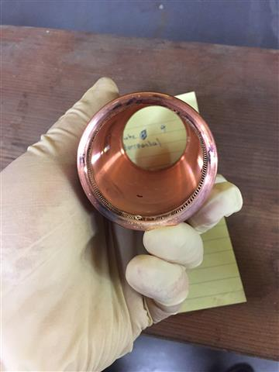
Subsequent testing
An increased pulse width was tested on tank 5. After completing the test, the tank was opened for inspection and several spring rings, stems and collars, were found with burn marks at the junction of the drift tube with the stem collars.

Slide 8
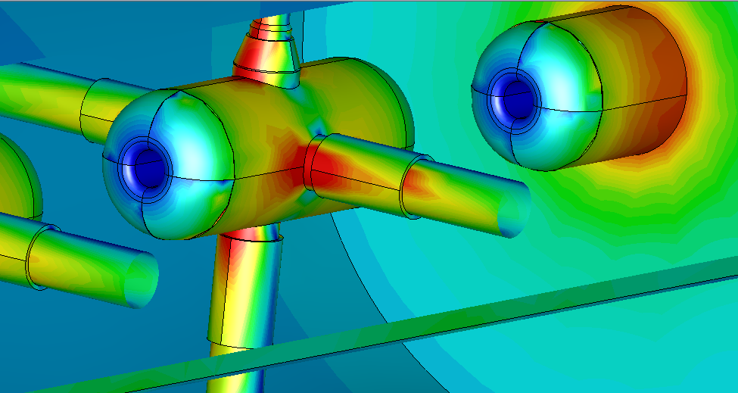
Subsequent testing
CST simulation of four drift tube cavity. The RF current at spring ring are ~ 4000 A/m, about 50 W per collar.
Showing current densities are not symmetric around the stem and collars.
Pictures adapted from PEP for LIUP2

Slide 9
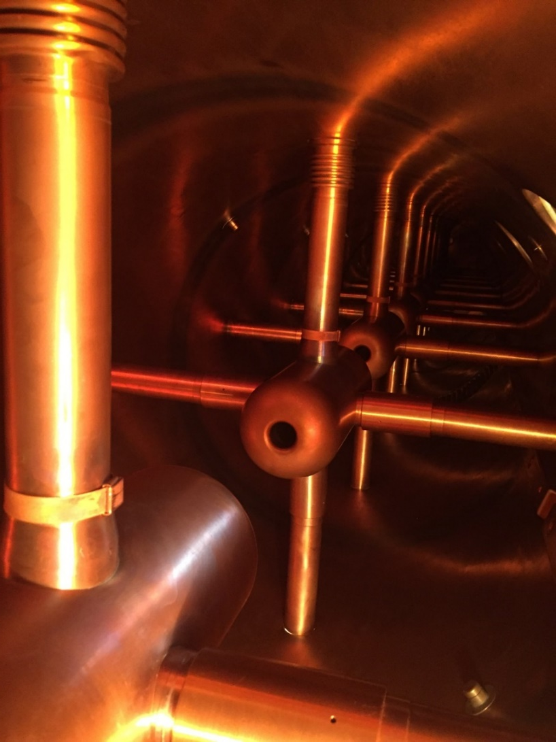
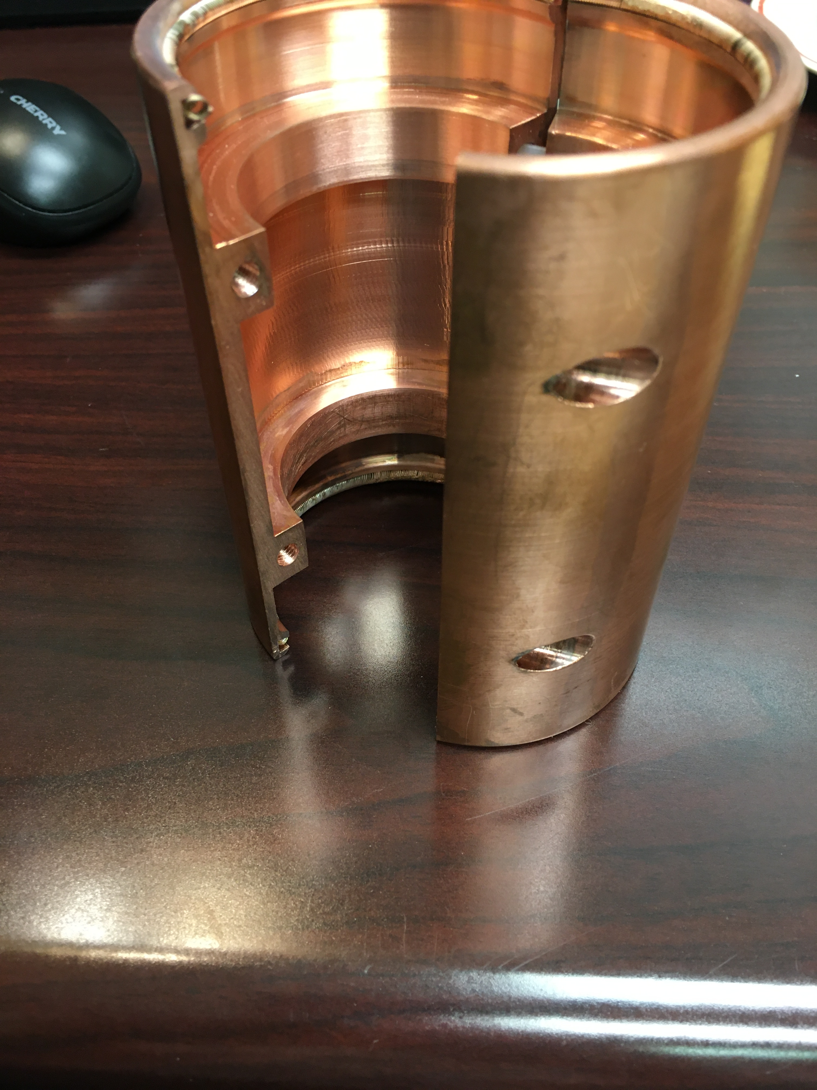
Solution #1:
Using the same collar but making a tighter spring contact. This method involved heating up the collar and forcibly pressing on the DT Stems.
Solution #2:
Using a split collar design. This method allowed for an even tighter spring contact, hence better thermal performance than solution #1. For this reason and the easiness of installment, this is the preferred method.
Notes:
The split collar design was successfully tested on tank 7 with a pulse width of 1100 uS for several weeks. Right now, this is the to go method and on our last job on tank 6, we replaced all front and bottom collars with split collars.

Slide 10
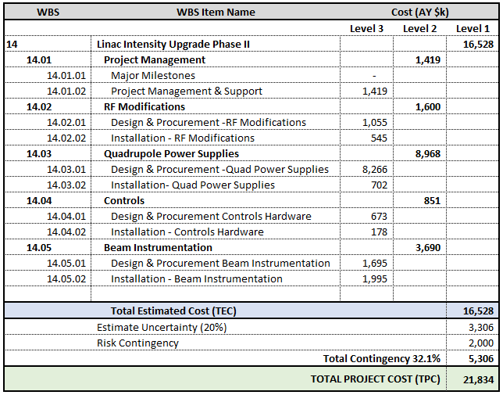
Work Breakdown Structure (WBS) and Cost Estimate

Slide 11
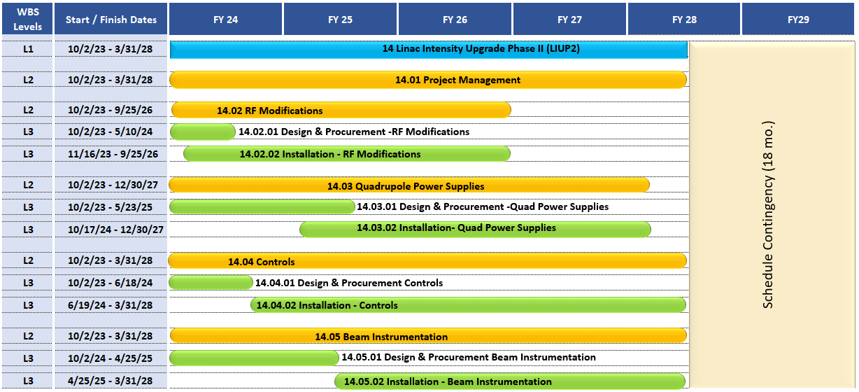
Schedule: Summary

Slide 12
Risks and Mitigation Strategy
Mitigated Risks:
RF Window Breakdown
Stems’ Damage due to sparking
Drift Tube Sparks
Cavity Cooling System Leaks

Slide 13
Most Recent Improvements
A lot has been done already to make our systems capable of handling our desired pulse width, facilitate the support of operations and improve the overall reliability of the LINAC:
1- We are in the process of completing the collar work for tanks 5-9, with 3 of them already done using the split collar method. We are also taking this opportunity to polish the drift tubes and stems while we have each tank open.
2- The PLC System of each tank was integrated to the C-AD Network and an HMI was designed to allow the remote operation and monitoring of the high-level RF System.
3- The LINAC low level and the new digital pulsing logic have decreased significantly the number of mispulses we see during operations as well as adding extra layers of protection and reliability. The LLRF monitors the entirety of the health of each system and in the presence of a fault, turns off pulsing quickly until the fault is addressed. It also includes its own digital RF window that ensures all signal levels comply as expected and gives us the ability to adjust several parameters remotely as needed.
Notes:
Quantify the faults and downtime from previous years and compare them to the present run.
This has rendered the risk of breakdown of an RF window by a particular event to almost nonexistent.

Slide 14
LLRF Upgrade: New Pulsing Logic Chassis
Notes:
Operators, many of you will never have to head out to 930, pet pages are going to be what is important for you guys. I’ll go over whats new and shinny and then we’ll talk about the fault summary page.

Slide 15
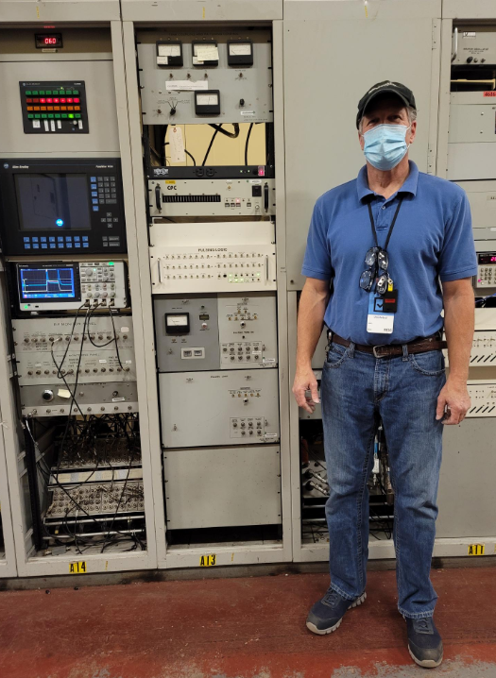
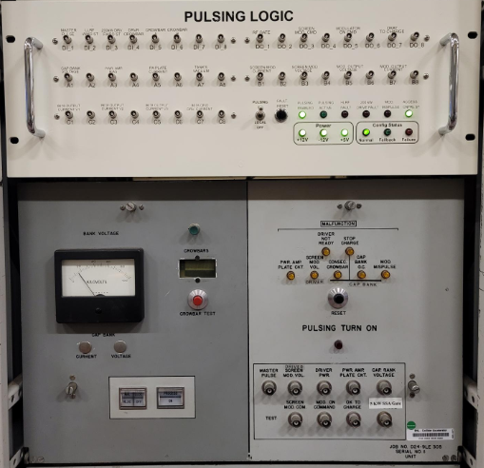
Old vs New
Notes:
So first things first, what's changed, where does the HW live? If you go out to 930 youll find the new pulsing logic box Chassis lives right above the old one and if you look at the new FP next to the old FP, you can see we tried to maintain some semblance of continuity.
The new pulsing logic provides you with all the old monitor points and then some, we have some LED indicator lights, and a lovely push button for reseting consecutive crow bar faults.
You’ll notice that the analog gauge and crow bar counter have been moved to GPM and pet.
the old Comparison slide:
-What is this bucket for:
- Replaces of PL chassis (old HW, can log faults, remote eyes into the system we didn’t have before) -what does it do: ( Fault detection, window protection)
OLD: CONSEC crowbar fault reset button* Freddy will talk to Recep and Vinny about whether MCR can reset this
Similarities: LEDs, Button (on FP),

Slide 16
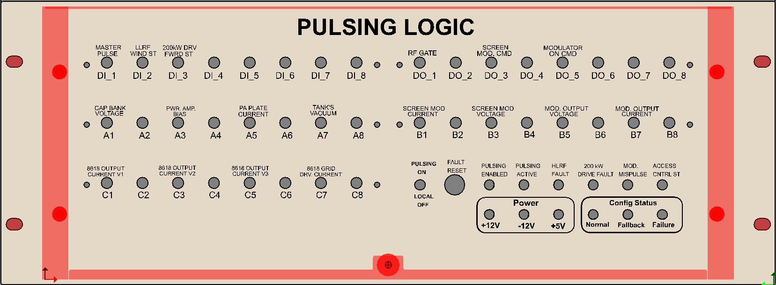
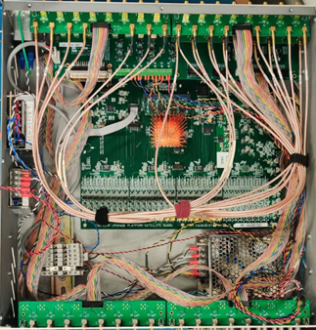
New Hardware
LEMO monitor points
Reset push button, also available on
Pulsing Logic pet page
Pulsing Status LEDs: First and last LED should be solid green, the second will be flickering, the next three are normally out, red means a fault
Toggle Switch: Pulsing ON/OFF
Notes:
Here is a clearer view of the FP: The Digital ins and outs are the top row of LEMOS, Monitor points A-C are all analog signals , and can also be viewed in the GPM on the pet page I will show you later.
Pulsing enabled needs an okay from the PLC and the switch to be flipped in the “on” position.
The push button like I said earlier, can reset Consecutive Crow Bar faults
Pulsing Enabled, Pulsing Active, Access Control Status, these LEDS are all self explanatory
HLRF Faults: Happens if there is a crowbar fault, Plate Current, PA Bias, or a Vacuum fault, (200kW fault lights up its own LED)
Mod Mispulse will filter red if you have a HLRF or 200 kW driver fault: If you only see misplusing by itself, The problem could be just window comparator fault, or that pulsing is disabled (PLC or switch)

Slide 17
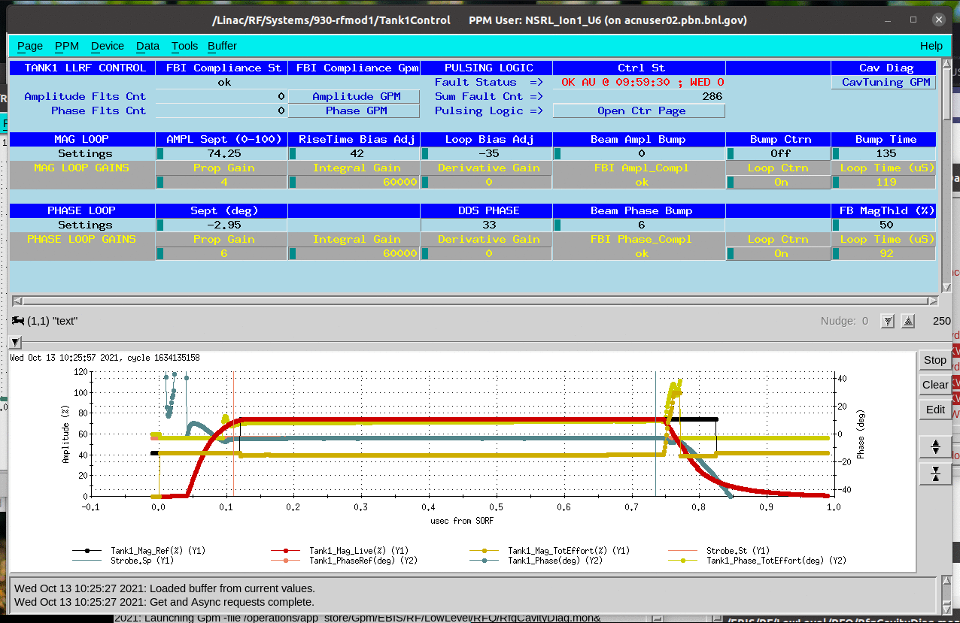
Tank Control
FBI Compliance: Can beam get through the tunnel
Show you the amplitude and phase FBI compliance windows
Pulsing Logic Fault Status
Two elements you need to be within FBI compliance: Amplitude & Phase
Notes:
This is the only page left open at each Tank to display how the tank is regulating. It’s the one you all are probably most familiar with, if at all.
Freddy updated it to display the fault status of the pulsing logic, you can launch the Pulsing logic control page, from here if you need it
For those of you unfamiliar, this page also tells you useful stuff about whether or not you are in FBI compliance, has GPm launchers that can show you were you are with respect to the window of compliance and has read backs for both the Amplitude and Phase Faults.
The GPm shows a red trace which is the live magnitude on the cavity, the black trace is the reference you are asking for, blue and orange are the equivalent signals for live and reference phase, and the yellow traces are the Magntitude and Phase loop efforts. If you want to know more about this page, message me after <3

Slide 18
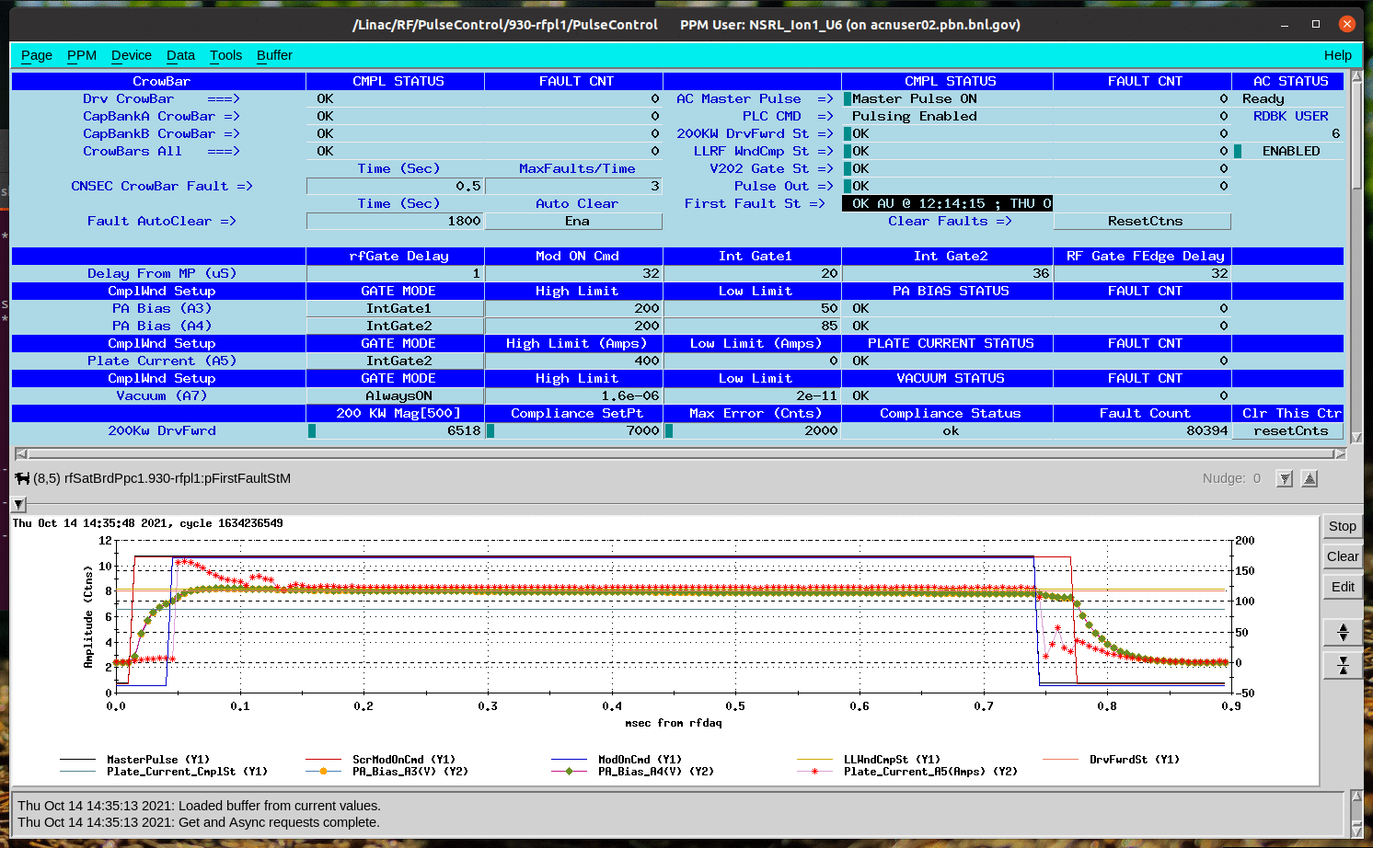
Pulsing Logic Control
Crowbar status and fault count since last reset
First Fault, and time stamp
Master Pulse, PLC and Compliance Statuses
Reset Faults, same as push button on FP
Notes:
This the Pulsing Logic control Page. Its brand New. I mention earlier, No more crow bar counts displayed in the field, they are now on this page, now you can see which of the three Crowbar circuits fired.
This second red box over here outlines the statuses we saw on FP in more detail: You have your Pulsing Enables, your 200kW Drv Status, the Access control status, but also the LLRF window comparator, the V202 gate status and the First fault status. This read back will tell you what is causing you to mis pulse, in what user, and when.
Below that we have the reset button equivalent to the lovely push button I showed you on the FP. We ask that only experts use this pet button. We want you guys to push the button on the FP, so you can hear any resulting loud noises coming from the HV compartment. We haven’t figured out how to bring those into the controls system yet ☺
All the signals listed on the left are visible by default in the GPM below. These are the signals we set compliance windows around.
The Pet page and GPM have access to all other signals on the FP, but you need to hide and show/ on the GPM or scroll down to see them.

Slide 19
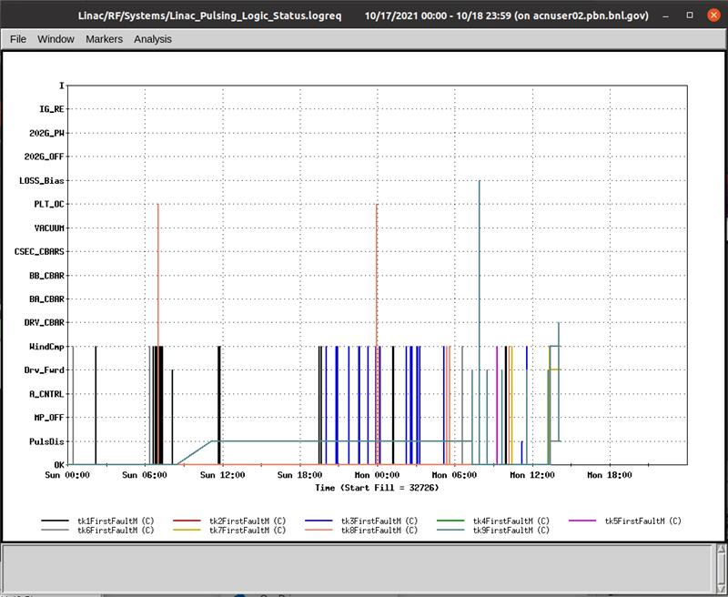
LogView: First Fault Status
First Fault String

Slide 20
Summary
1- We performed all the necessary upgrades to tank 5 and successfully operated the system at the desired 1100 µS pulse width.
2- The A7 Low Level electronics have been updated on all tanks.
3- Aside from the Anode and Cathode PS for the 4CW25000 in tank 5, we have one of each already modified and set as spares. This creates the perfect opportunity to modify the ones in the rest of the systems. We just need to order the parts.
4- We need to order the capacitors needed to upgrade the 250 KW Driver Cap Bank and the 7835 PA Anode Cap Bank for the rest of the systems. A procedure for the installation has already been designed.
5- Several improvements have already been made, with the most noteworthy one being the new digital pulsing logic chassis.

Slide 21
Thank you!

