Slide 1
Beam Instrumentation
Lenny DeSanto, Rob Michnoff
LIUP2 Director Review
12-14 September 2022

Slide 2
Outline
Beam Instrumentation Devices and Cost Estimate
Schedule
Risks
Personnel
Summary

Slide 3
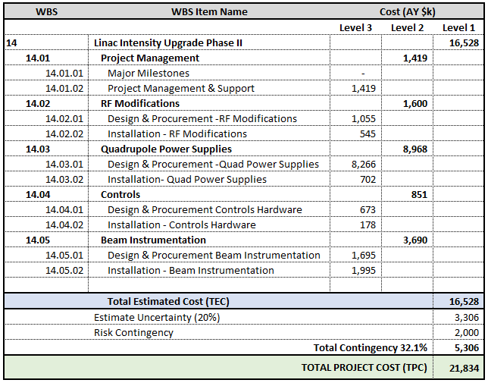
Work Breakdown Structure (WBS) and Cost Estimate

Slide 4
Beam Instrumentation Devices
Device | Comments | Qty
Beam Position Monitor Chambers | Similar to BLIP BPMs. 1 after tank 9, 1 between BM1 and BM2 | 2
Beam Position Monitor Electronics | For existing 7 BPM devices after tanks 2-8 (exc. tank 3), and 2 new BPM chambers | 9
Single Wire Stepped Secondary Emission Monitors (SEM) | Electronics & motion upgrade for HEBT and BLIP. Assume mm resolution pot position readback is adequate. All beamline SEM devices to be reused. | 20
Multiwire (Harp) X&Y | Between BM1 and BM2 dipoles | 1
Beam Current Transformers | Tanks 2-9 (to replace old failed devices), between BM1 and BM2, before booster split | 11
Slit and Collector Emittance Monitor | In front of tank 1. Existing device is a harp with 32H X 32V wires and slit upstream. Both the slit and the harp head will be scanned across the beam using stepper motors. Beam line devices exists, need new motion controls and signal processing electronics. | 2 (1 Vert 1 Horiz)

Slide 5
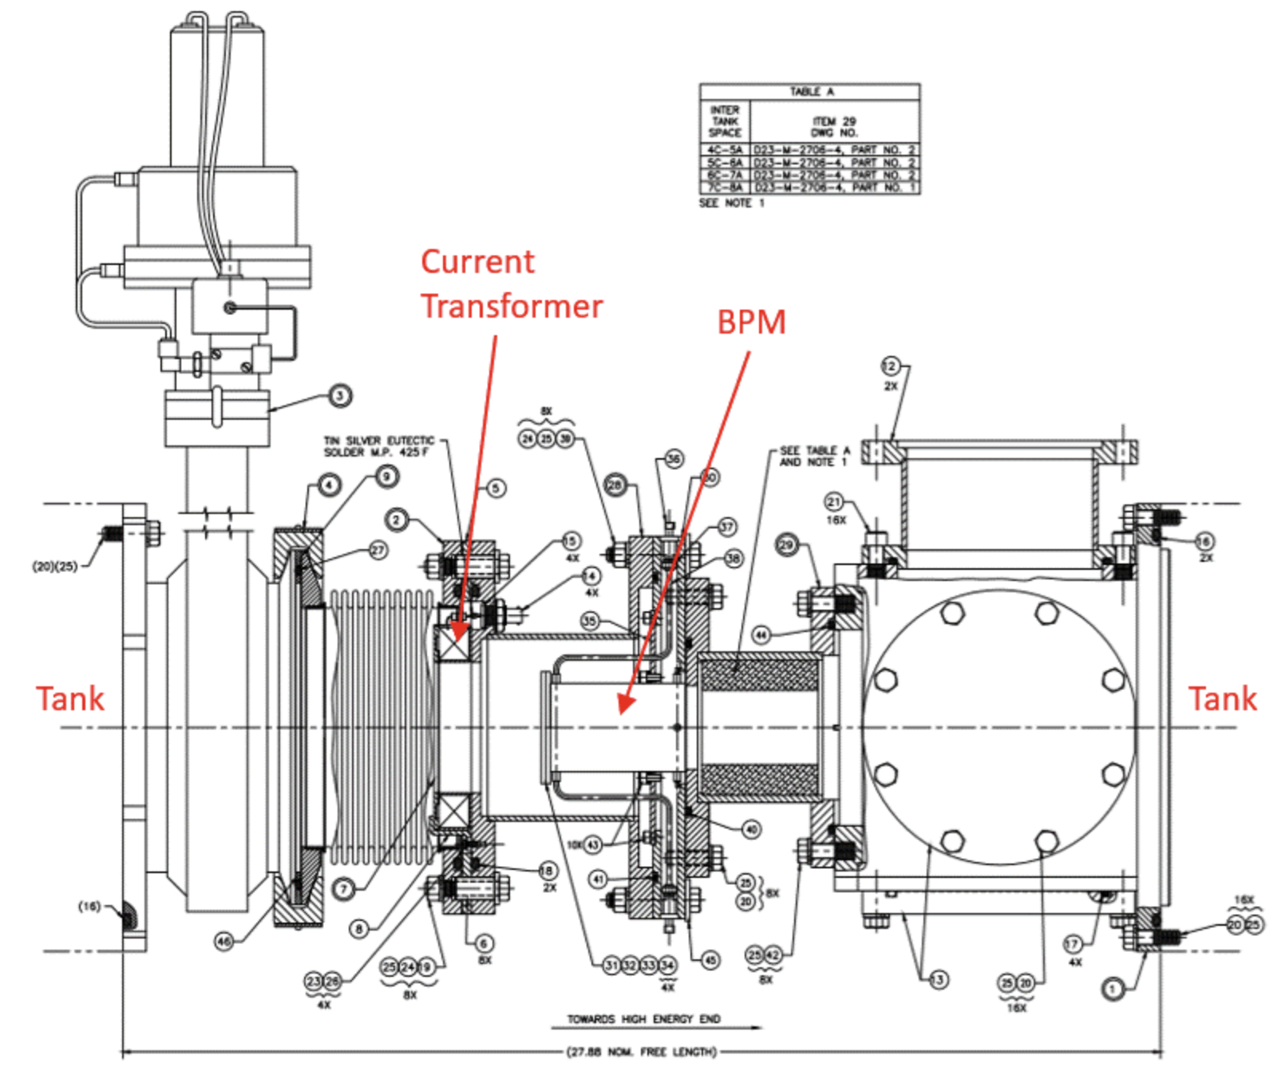
Drawing of Inter-tank BPM and CT

Slide 6
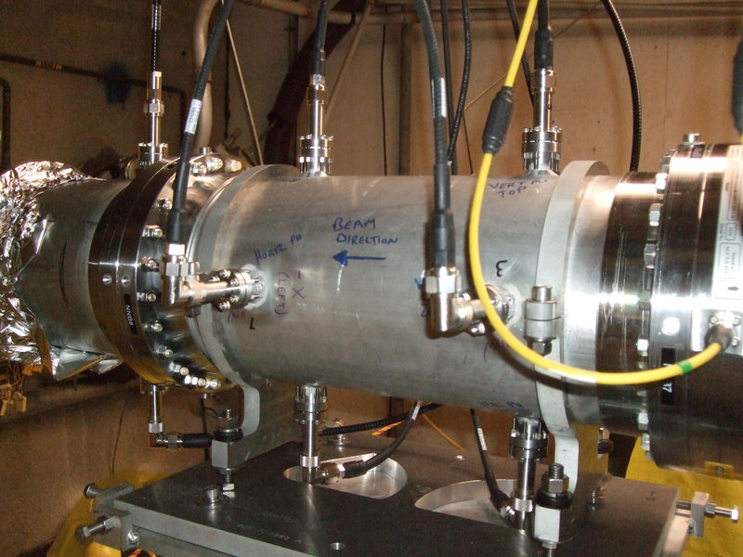
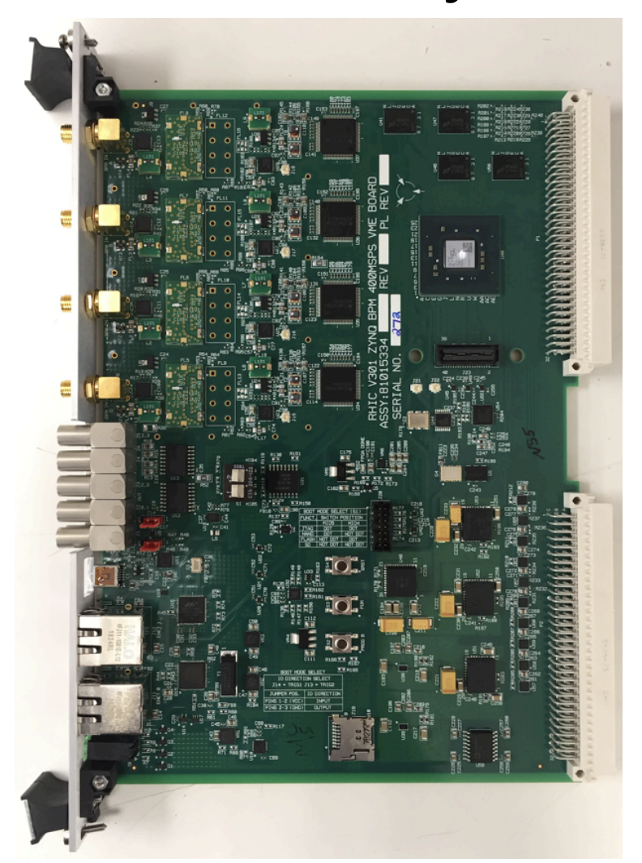
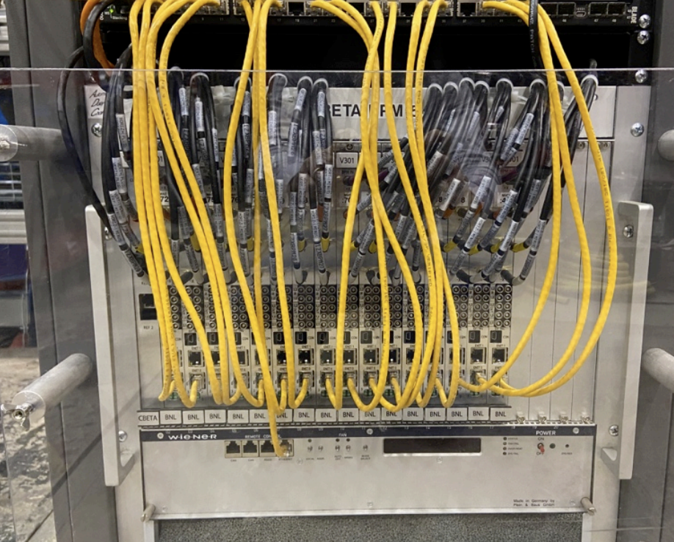
Beam position monitors (BPMs)
BLIP Beam Position Monitor chamber. New BPM chambers to be similar design.
V301 BPM electronic modules in VME chassis
V301 BPM electronics module (BNL in-house design) planned to be used

Slide 7
Digitizer and Processing Electronics
The project estimate is based on proven electronic designs that have been used for previous developments including the BLIP raster upgrade.
New digitizer and processing electronics are planned to be developed for general purpose upgrades throughout the Collider-Accelerator facility, including EIC. This development is not planned to be funded by the LIUP2 project.
If the new electronic designs become available, they will be used for the LIUP2 project, specifically for the multiwire, SEMs, current transformers and slit & collector emittance monitor.

Slide 8
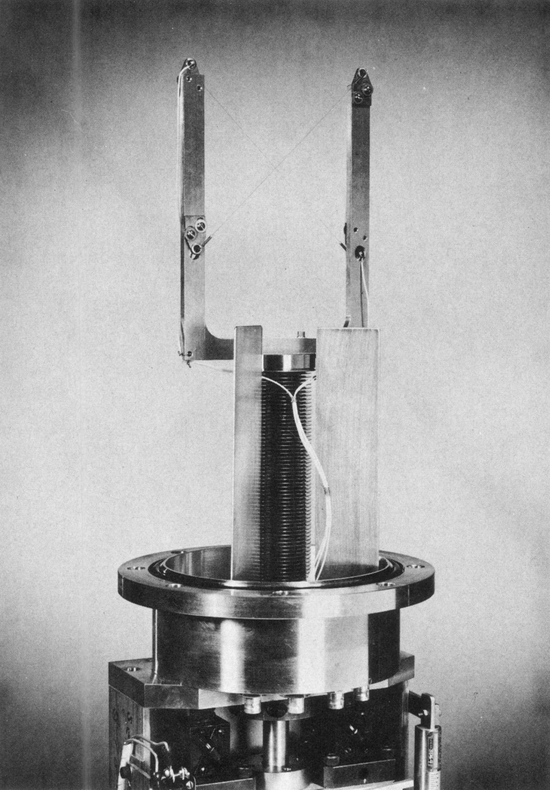
Single Wire Secondary Emission Monitor (SEM)
Typical existing Linac single wire SEM (note 2 diagonal wires - one for horizontal, one for vertical measurments)
New stepper motor control systems to be installed
New digitizer electronics to be installed

Slide 9
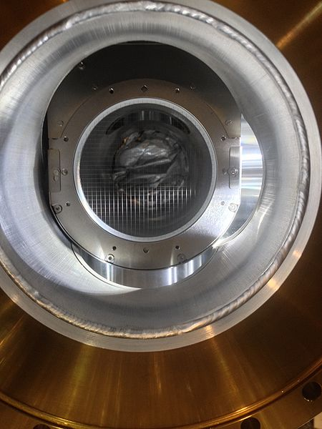
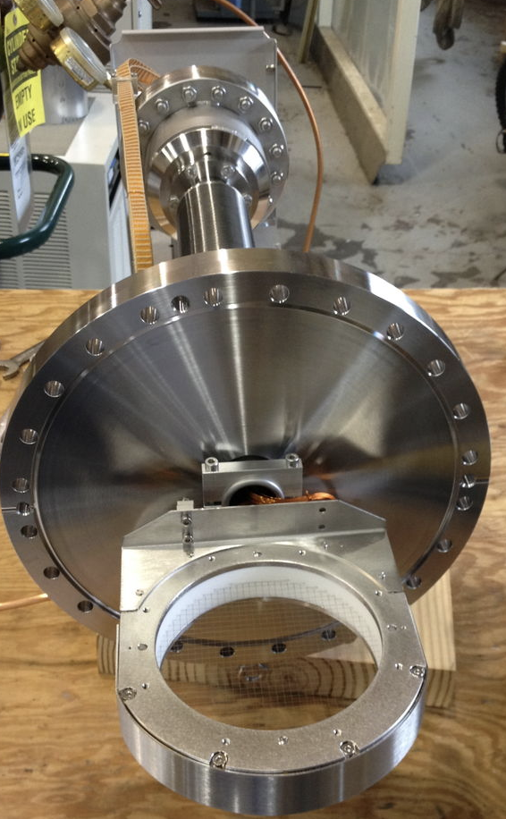
Multiwire
View of multiwire inserted in beam path
Similar multiwire to be procured from outside vendor
Digitizer and processing electronics to be installed
BLIP plunging multiwire assembly (32 horizontal and 32 vertical wires)

Slide 10
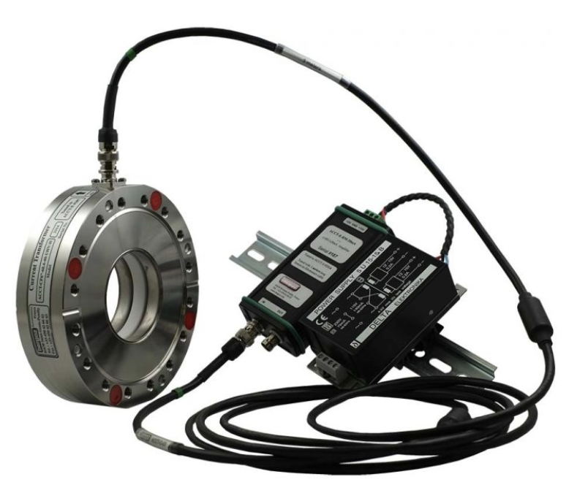
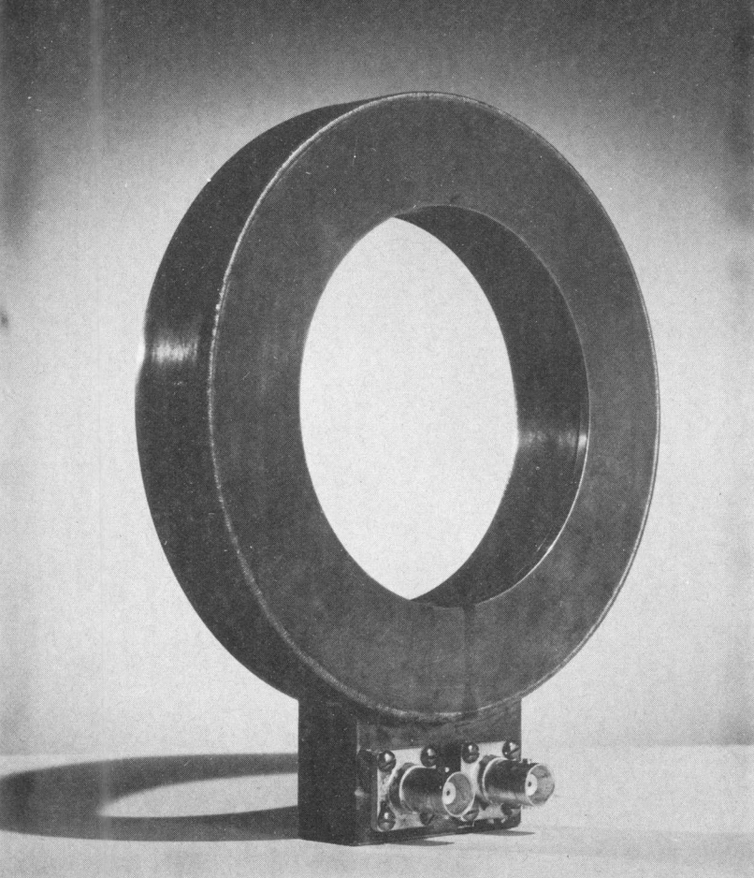
Current Transformers
Typical Bergoz ACCT beam current transformer planned to be used
Typical existing Linac
beam current transformer (from Linac design manual)
New digitizer and processing electronics to be installed

Slide 11
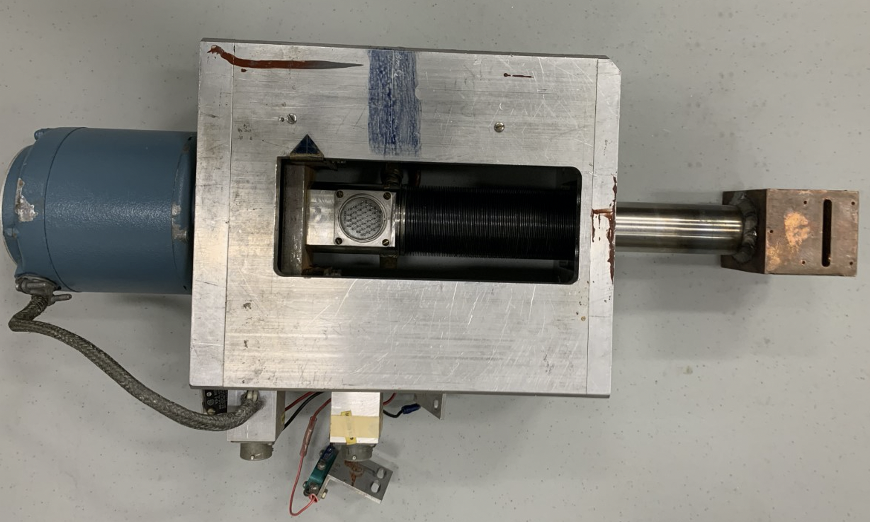
Slit and Collector Emittance Monitor
Existing assembly to be reused
To be installed in front of tank 1
Existing beam line devices to be reused
1 horizontal slit and harp combined unit, 1 vertical slit and harp combined unit
New motion control systems to be installed to scan slit and harp through beam
Digitizer and processing electronics will be similar to multiwire devices

Slide 12
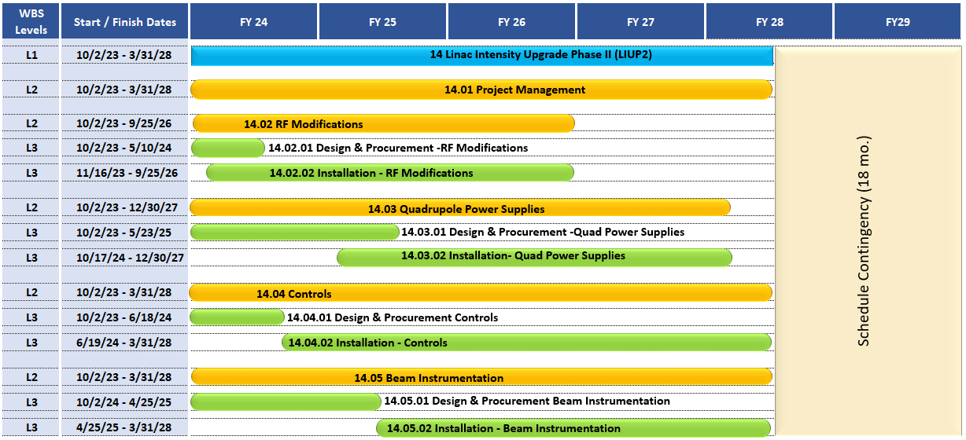
Schedule: Summary
8/1/23 – 9/20/24

Slide 13
Risks
Interfacing with existing beamline hardware may result in unknown surprises

Slide 14
Personnel
Systems Engineer – Lenny DeSanto
BPM system - Rob Hulsart, Tommy Tang
SEM systems – Motion: Lenny DeSanto, Digitizers and processing electronics: Chris Degen
Multiwire – Mechanical – Lenny Desanto, Digitizers and processing electronics – Chris Degen
Beam current transformers - Matt Paniccia, Adam Pramberger, Chris Degen
Slit and Collector systems – Mechanical: Lenny Desanto, Digitizers and processing electronics: Chris Degen

Slide 15
Summary
Planning to use previously proven technology
Several existing beamline devices will be re-used
BPM electronic modules already tested with existing Linac BPMs
If new digitizer and processing electronic designs are available, they will be used for the multiwire, SEMs, current transformers and slit & collector emittance monitor.

