Slide 1
LINAC INTENSITY UPGRADE PHASE II CONTROLS
Omar Gould
09/15/2022

Slide 2
LINAC INTENSITY UPGRADE PHASE II CONTROLS
Omar Gould
09/15/2022

Slide 3
AGENDA
Introduction
LINAC Controls Overview
Rationale For Controls Upgrade
Proposed Controls Technology
Timeline
Summary

Slide 4
Introduction
The Controls Datacon System at the 200 MeV LINAC has been in operation for over five decades.​
Over the years as new accelerator systems have been installed at LINAC, a more modern Controls System has been implemented as an interface.​
The need to significantly expand the capabilities of the LINAC has required a Controls upgrade to meet the new specifications and to maintain reliability.​

Slide 5
Introduction continued
The 200 MeV LINAC currently has two primary types of Controls for its devices:​
Datacon Systems​
Front End Computer Remote I/O Systems (FRIO)​
A test configuration exist in MOD 2 for two Quad power supplies:​
Quad Function Generator PSI Systems (QFG)​
The Datacon System will be removed completely from
LINAC operations and replaced with two primary Controls
Systems.​

Slide 6
OVERVIEW
LINAC CONTROLS

Slide 7
Existing Hardware Controls
The 200 MeV LINAC at BNL currently has two primary types of Controls for its devices:​
Datacon Systems​
Front End Computer Remote I/O Systems (FRIO)​
VME-4140 Analog Output Module 32 Channels​
VME-3122 Analog Input Module 32 Channels​
Existing FRIO systems will remain in operation for the HEBT, BLIP, LEBT and MEBT, Source regions.
Related Exception:​
Quad Function Generator PSI System for BM1 in HEBT beam line​
​
A Test configuration exist in MOD 2 for 2 Quad power supplies:​
Quad Function Generator PSI Systems (QFG)​
V202 Delay Module​

Slide 8
Device Types
Vacuum Systems​
readbacks​
Pulsed Power Supplies​
Setpoints and readbacks​
Functions and readbacks​
DC Power Supplies​
Setpoints and readbacks​
Instrumentation​
Readbacks​
Sources​
Setpoints and readbacks​

Slide 9
RATIONALE
CONTROLS TECHNOLOGY

Slide 10
RATIONALE
CONTROLS TECHNOLOGY

Slide 11
Rationale For Controls Upgrade​
Datacon Systems are in operation for over five decades​
Availability of newer technology​
Noisy​
Serial Communication resulting in slower operation as devices are added​
Obsolete; replacing components is more difficult​
New power supply systems are proposed for the LIUP II ​
Need to accommodate new power supply specifications​
Ease of expanding Controls​
Performance Improvement​

Slide 12
PROPOSAL
CONTROLS TECHNOLOGY

Slide 13
PROPOSAL
CONTROLS TECHNOLOGY

Slide 14
Proposed Controls
Quad Function Generator PSI Systems (QFG) For Quad PS
V233 Quad Function Generator 4 Channels​
100 KHz setpoint/readback rate​
2 to 8 modules per MOD for nine MODs​
PSI 100KHz Power Supply Interface 1 Channel​
8 to 32 modules per MOD for nine MODs​
V202 Delay Modules 8 Channels​
1 to 4 modules per MOD for nine MODs​
​
This system will provide noise reduction in addition to meeting and exceeding the specifications of the devices.​

Slide 15
Software Controls
Existing software will be utilized for interfacing with the upgraded controls.​
Note Python is replacing Java​
Reflected Server is no longer utilized​
Presently being used for the upgraded Controls in MOD 2, BM1, and a few other MODs.​
Applications will remain the same for user interfaces with devices.​
ADOs and applications customizations will be implemented as needed.

Slide 16
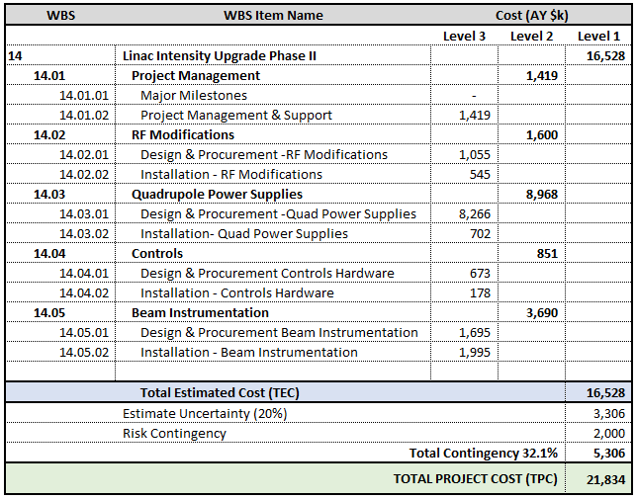
Cost: By WBS​ ​

Slide 17
TIMELINE
CONTROLS IMPLEMENTATION

Slide 18
TIMELINE
CONTROLS IMPLEMENTATION

Slide 19
Schedule: Summary ​

Slide 20
Summary
LINAC CONTROLS UPGRADE

Slide 21
SUMMARY
LINAC CONTROLS UPGRADE

Slide 22
SUMMARY
The proposed Controls System is a proven technology currently in use throughout the Collider-Accelerator Facility. Two power supplies in MOD 2 of the 200 MeV LINAC have proven that the QFG System meets and exceeds specifications.​
The noise reduction is significant resulting in improved and reliable performance.​
The proposed Controls System will support LINAC operations for the foreseeable future.​

