Slide 1
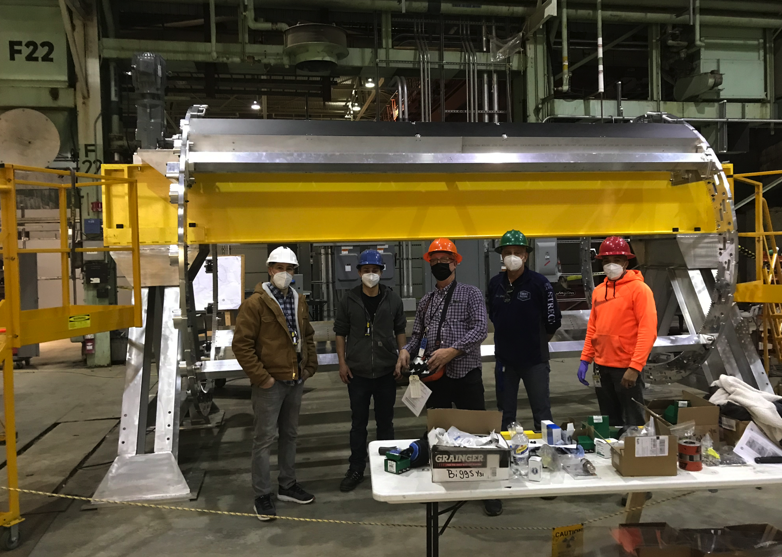
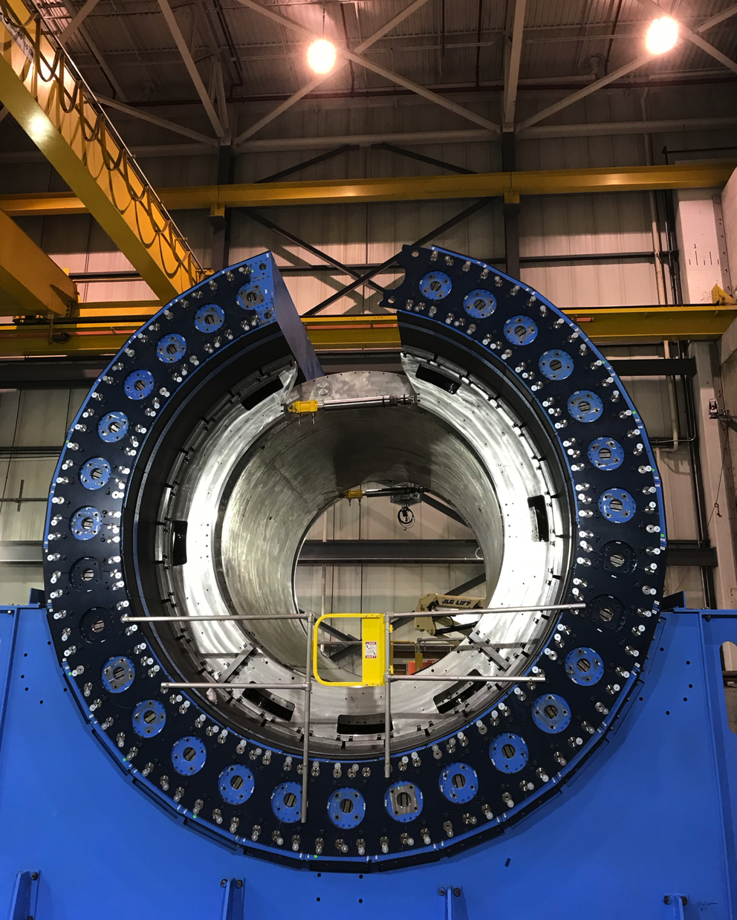
sPHENIX Progress
First Two IHCal sectors on IHCal Barrel
OHCal Sector 29 Installed
Large Support Rings Installed

Slide 2
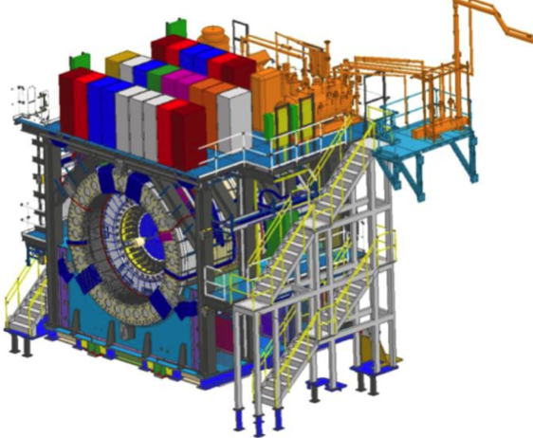
sPHENIX MIE Project Overview
TPC | Project Director | Last CD Achieved | % Complete | CPI | SPI
$27.0M | Edward O’Brien | PD-2/3 | 94.1% BCWP/BAC @ 1/31/2022 | 1.01 | 0.94
Scope
  Detector systems produced, tested and ready for installation: Time Projection Chamber w/ electronics, Electromagnetic Calorimeter w/ electronics, Hadronic Calorimeter w/ electronics, DAQ/Trigger, Minimum Bias Detector, Project Management
Not in scope
  SC-Magnet, Bldg/Det Infrastructure, Installation and System Commissioning
Schedule
  CD-0 received Sept 2016
  CD-1/3A received Aug 2018
  PD-2/3 received Sept 2019
  Early completion May 2022
  PD-4 Dec 2022
Cost
  $27.0M AY TPC 143% contingency on an ETC of $1.50M
Commitments = $1.85 M
The early completion date did not move in December

Slide 3
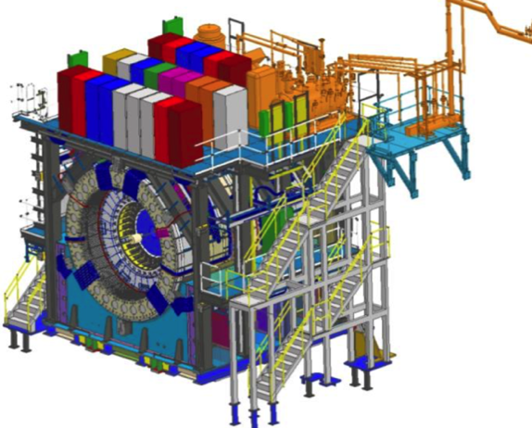
BNL 1008 Infrastructure & Facility Upgrade
TPC | Project Director | % Complete | CPI | SPI
$33.4 M AY | Edward O’Brien | 73.8% BCWP/BAC @ 1/31/2022 | 0.97 | 0.84
Scope
  SC-Magnet support including the Flux Return, Cryogenics into Bldg 1008, Detector Carriage/Cradle, other Bldg 1008 Infrastructure improvements
  sPHENIX Installation, Integration and Commissioning of each Subsystem is part of the scope
Not in Scope
  PreOps prior to RHIC collisions
Schedule
  sPHENIX Ready for Operations (Early Completion) 1/19/23
  First RHIC run of sPHENIX Feb 1, 2023
  0.5 months float in schedule between sPHENIX ORR and
  nominal start of RHIC 2023 run.
Cost
  $33.4 M AY Total Project Cost with 19.6% contingency on ETC of $8.4M
86.7% Costed and Committed
Commitments = $3.32M

Slide 4
High Priority Issues
Installation in 1008.
  The OHCal installation continuing (29/32 installed). Projected end date for OHCal installation is 1st week of March
Keep the EMCal Sectors and IHCal barrel on schedule.
  UIUC block fab completed. EMCal Sectors (57/64) 89% complete. All IHCal sectors assembled.
  IHCal barrel build is underway.
Maintain the sPHENIX technical work force.
Complete TPC Fee slice test. Continue TPC Fee production board testing. Complete development of TPC FELIX and Fee firmware.
Assemble TPC
Keep remaining electronics on schedule (Cal Digitizers, LL1, GL1/GTM, MBD D/S, DCMIIs, JACK board (TPC controller))
Place Remaining procurements

Slide 5
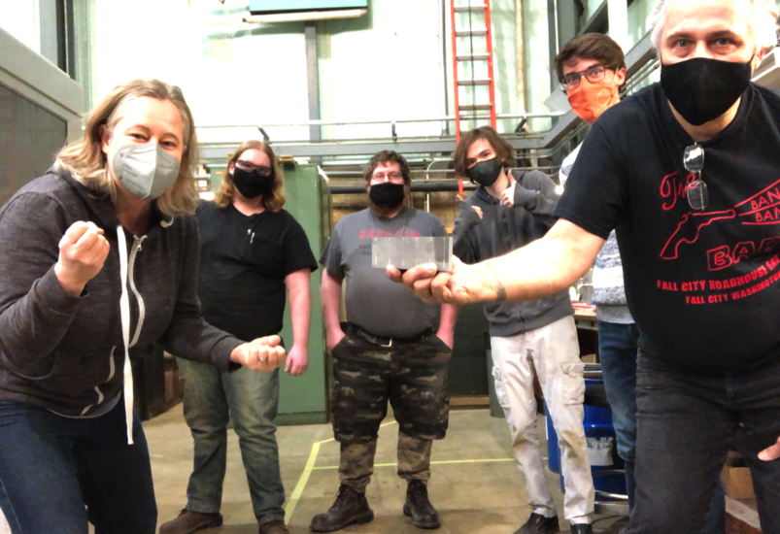
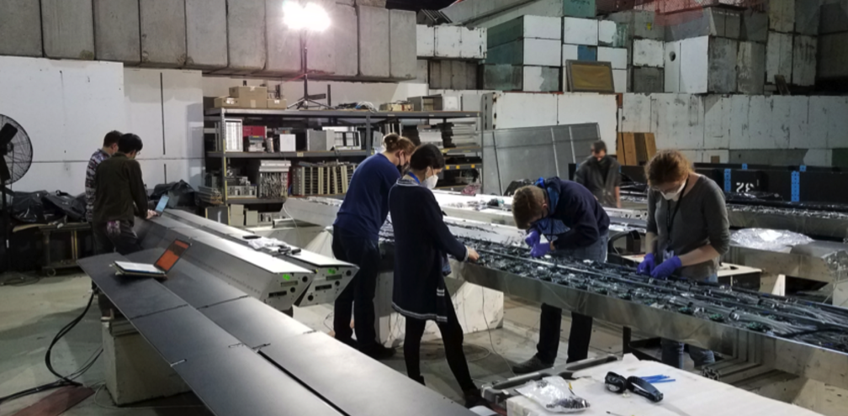
sPHENIX MIE Status
All OHCal sectors complete, tested and ready to install.
All Inner HCal sectors complete and instrumented. IHCal barrel assembly has started.
All EMCal blocks complete at UIUC & Chinese collaborating institutions
EMCal Sectors 89% (57/64) complete at BNL. We’ve assembled all sectors needed for installation prior to the magnet mapping.
All TPC ASICs complete, tested and at BNL. TPC Fee boards & DAM boards 100% assembled. Testing and firmware development underway.
All EMCal and OHCal on-detector electronics received at BNL. Calorimeter digitzer assembly has begun at the vendor
All GEM framing for TPC at WSU, WIS, Vanderbilt, Temple. Quad-GEM module assembly 100% complete at SBU
Major DAQ/Trigger orders: Large switch, DAQ computers and Buffer Boxes are delivered to BNL.
UIUC EMCal Block factory
Final EMCal block
IHCal factory at BNL

Slide 6
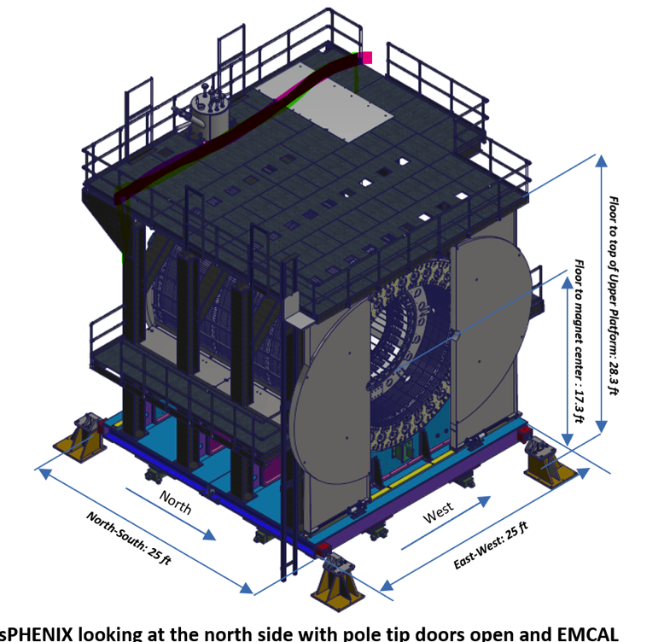
1008 Infrastructure and Facility Upgrade Status
Carriage/Cradle assembled in 1008
XY Carriage tables, Carriage Hydraulics installed
SC- Magnet installed in 1008
EMCal Installation fixture completed at SBU
IR track reinforcement complete.
Large Support Rings installed
LHe cryo components part delivered installation begun
LN2 & warm piping part delivered installation begun
IHCal assembly fixture complete
Magnet pole tip/end cap in production (due at BNL mid-late Feb)
Rack Platform in fab (parts due at BNL mid-Feb thru mid-March)
IHCal installation fixtures in production (due at BNL mid-March)
sPHENIX Beam Pipe at vendor for modification (due at BNL mid-April)

Slide 7
Key Remaining Orders: MIE
DAQ/Trigger: GL1/GTM FFO board (Order started. Due date April)
TPC: JACK board ( Parts ordered. PCB being laid–out. Assembly not yet ordered)
TPC: Laser servomotors and mechanics (line laser) (SBU contract amendment submitted to PPM )
TPC: optical fibers (Commercial order to be placed. First article to be delivered this week)
TPC: Fiber sort-out box (First article ordered. Production boxes not yet ordered)
Additional laser parts (Will order soon)
Need all of these items to complete the MIE deliverables

Slide 8
Key Remaining Orders: 1008 I&F
TPC installation fixtures and bracketry (SBU order . Waiting for SBU docs)
INTT brackets and installation fixtures (SBU order. Waiting for SBU docs)
Beam pipe, MBD, sEPD supports, N&S platforms (Designs in process)
Magnet Mapping (Draft SOW exists)
Fiber Optics trunk cables (commercial order to be placed. First article ordered)
HVAC Improvements (scope of work define, vendor identified, need to place req)
Seismic restraints (design mature, needed late in schedule)

Slide 9
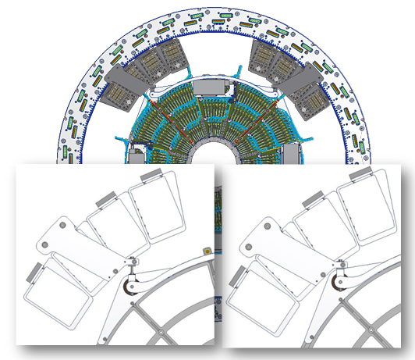
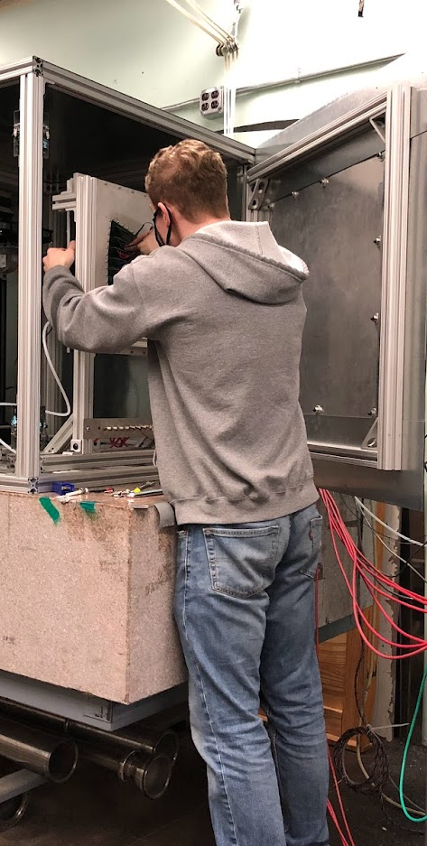
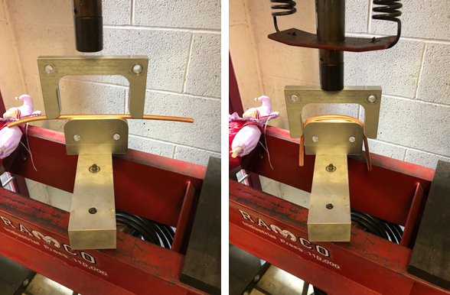
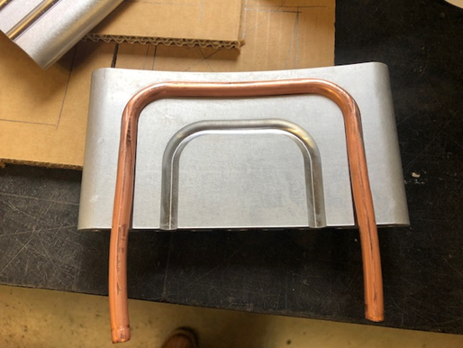
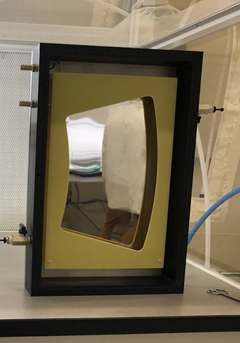
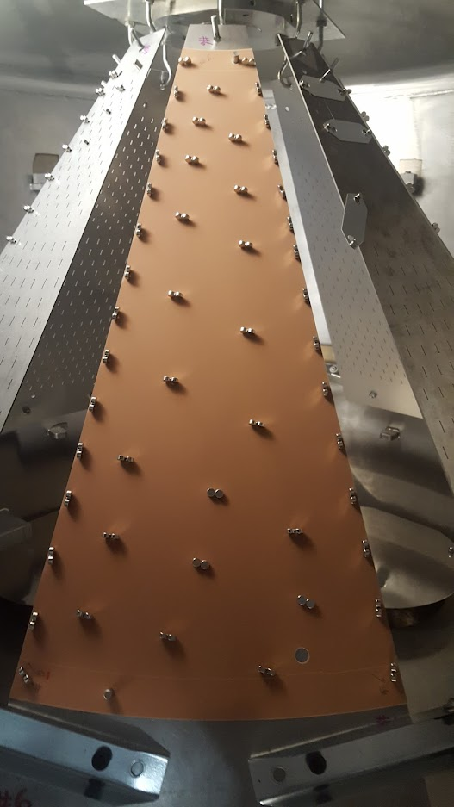
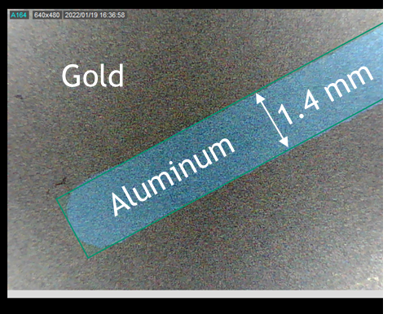
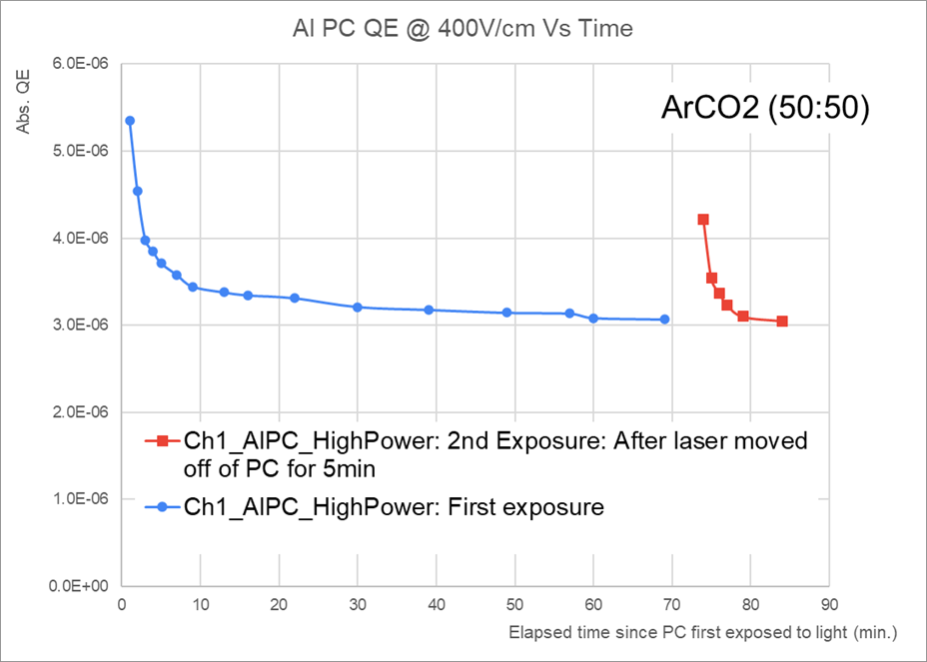
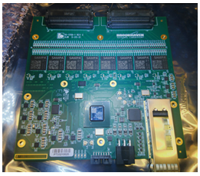
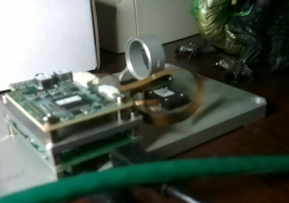
TPC Status
Module assembly & HV test done.
Xray calibration ongoing.
Installation package
goes out ~next wk
FEE cooling blocks Vanderbilt (SBU too busy)
FEE tests of fixed Xtall
  Unsatisfactory.
Switch to PLL
  Fully robust/tested
  Remove two components
  Place one component.
Use outside rework house.
Order now…
  Supply chain
Rotating
Carousel
Central Membrane Petals 30/36 finished
Critical Path for field cage completion.
QE verified each evap. on absolute scale.
Assembly in BNL Instrumentation ~March
Peizo motor test stand
Live Link
FEE is the critical path item (next closest: central membrane)
Optical fiber splitter (chosen fiber bubbled → known good alternative)

Slide 10
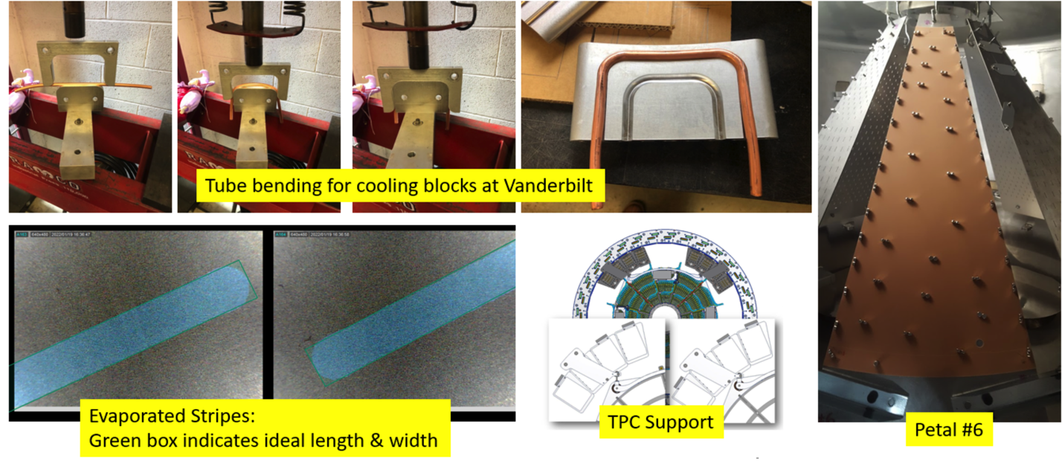
TPC Status -continued
All 72 GEM modules assembled at SBU, HV and QA tested.
  Major GEM fab contributions from WSU, Vanderbilt, Temple and WIS
GEM module calibration measurements underway at SBU for gain and IBF mapping with X-ray gun test bench
Aluminum deposition on TPC central membrane underway at SBU.
Test evaporation onto central membrane “pedal” a success. Clean deposition with sharp edges to the shape of the stripe.
Cooling blocks for TPC Fee being fabbed at Vanderbilt
All TPC FELIX boards complete and tested. Firmware development underway.
All TPC Fee boards assembled and delivered to BNL by vendor. Waiting for delivery of PLL chip. Fee testing underway.
Need to produce 30 “JACK” boards. Parts ordered, layout underway.

Slide 11
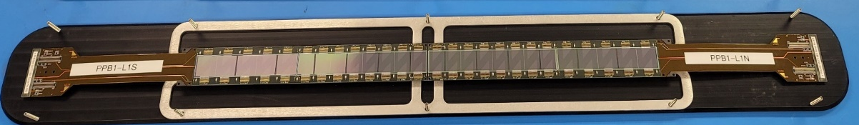
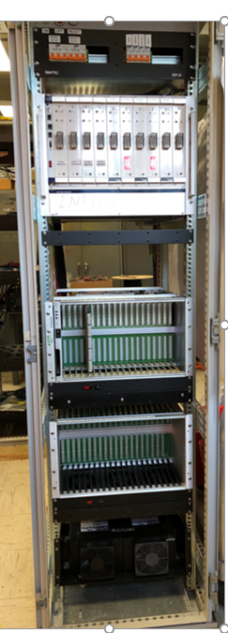
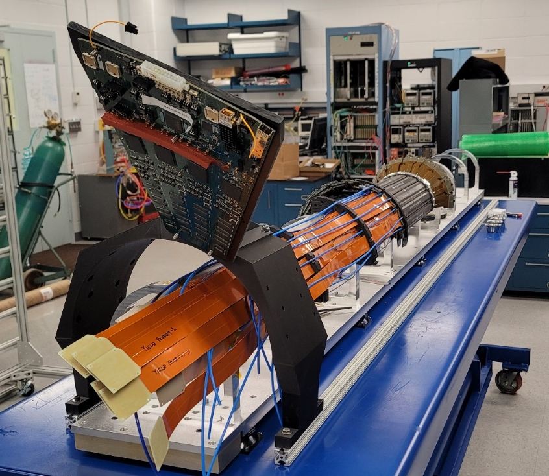
Status of the Intermediate Silicon Tracker (INTT)
Ladder Mass Production (84) at BNL achieved successfully:
→ Ladder assembly done at Physics Department, wire-bonding
and encapsulation accomplished at Inst. Div.
→ Plus 40 spares ladders are in production in Taiwan.
FDR Barrels Assembly achieved successful May 25th, 2021
CFC Barrels Support Structure PO submit for the Bid on the SAM.GOV web Site on February 15th, 2022
→ There was a delay in submitting the PO due to the INTT funding causing some delay in the schedule.
PO for Auxiliaries’ parts of Barrels’ assembly PO submitted to Xometry Co. on February 16th, 2022
Extender bus cables half of production will be delivered in JPY21 and second half will be delivered in JPY22 (May)
Readout Electronic Review achieved successfully July 28, 2021
Readout Electronic using Felix Boards is making excellent progress (manpower and funding were made available)
→ Readout Electronic Review set for March 28th, 2021
LV/HV systems: two racks were assembled successfully
Beam test at Tohuko Uni (Japan) using production ladders achieved successfully (Dec 16th, 2021)
Classification (BNL ladders) | Barrel 1 (24 needed) | Barrel 2 (32 needed)
Class 1 (<= 0.5%) | 31 | 41
Class 2 (> 0.5% && <= 1.0%) | 0 | 2
Class 3 (> 1.0% && <= 2.0%) | 0 | 1
Class 4 (> 2.0% && <= 3.0%) | 3 | 6

Slide 12
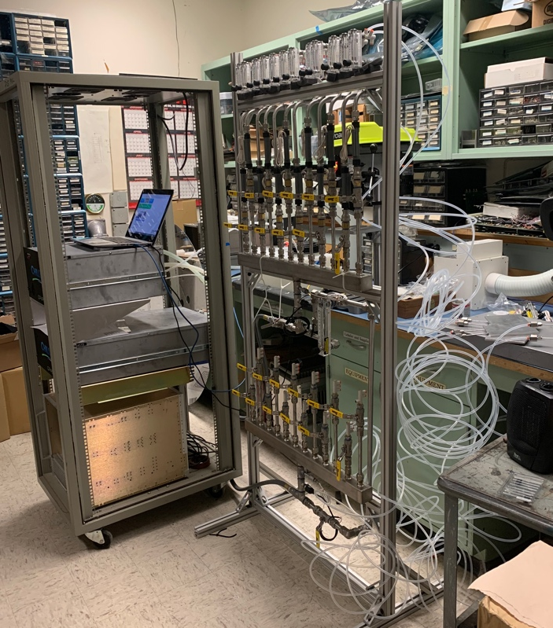
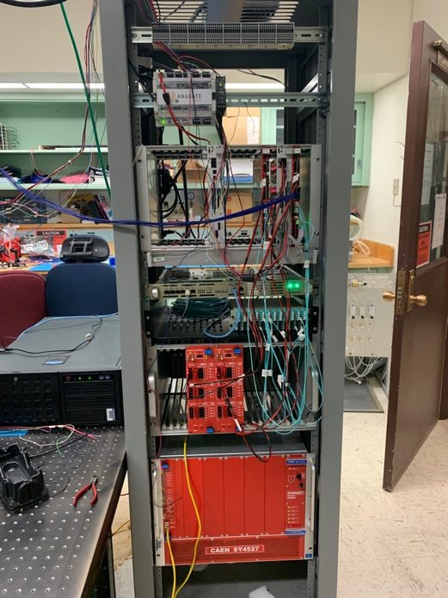
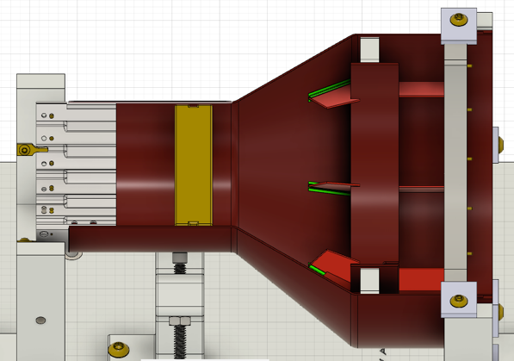
MVTX Status, 02/15/2022
Readout and electrical control system
  Implemented new data format for continuous readout;
  Implemented full 8-DMA readout per FELIX, all 6 AMD FELIX servers in hand;
  Replacing RU VTRx transceivers flex cables in progress at CERN, complete by May 2022
  Most CAEN power system in hand, delays in last a few power module delivery, by March 2022
  Detector safety monitoring and slow control system designed, PLC procurement in progress, some delays in electronics, ETA, Feb. 26 2022
  All inside-detector signal and power cables produced and tested for half-detector assembly, long cables will be delivered in March 2022
Mechanical system
  Carbon Fiber composite structures produced and CMM’ed;
  Assembly jigs fabricated and procedures practiced
  Improving out-of-tolerance Al South End-Wheels for final assembly at LBNL, possible delay to complete 2 half-detectors by ~a few weeks (TBD); still on track for on-time installation
Services
  Cooling system designed and reviewed, system testing at LANL and MIT
  Power system, service cable layout plan developed and reviewed
MVTX detector insertion system prototyped and reviewed
  Final design improvement in progress
Detector commissioning plan developed:
  Phase-I commissioning plan developed to QA half-detectors at BNL after delivery from LBNL, MVTX experts are working at BNL to setup clean tent for the testing
  Phase-II full detector pre-installation commissioning: preliminary plan developed, including full scale detector insertion mockup
  Experts’ BNL on-site work plan approved for travel
Full readout and control integration
-Staves
-RUs
-FELIX/AMD
-mGTM
-CAEN power
MVTX cooling system test:
Chiller
Patch panel
Cooling plates
MVTX commissioning phases #1, #2
South-EW and CFC
CMM surveyed at LBNL
Improving South End-Wheel and CFC structure glue bonding:
- work in progress

Slide 13
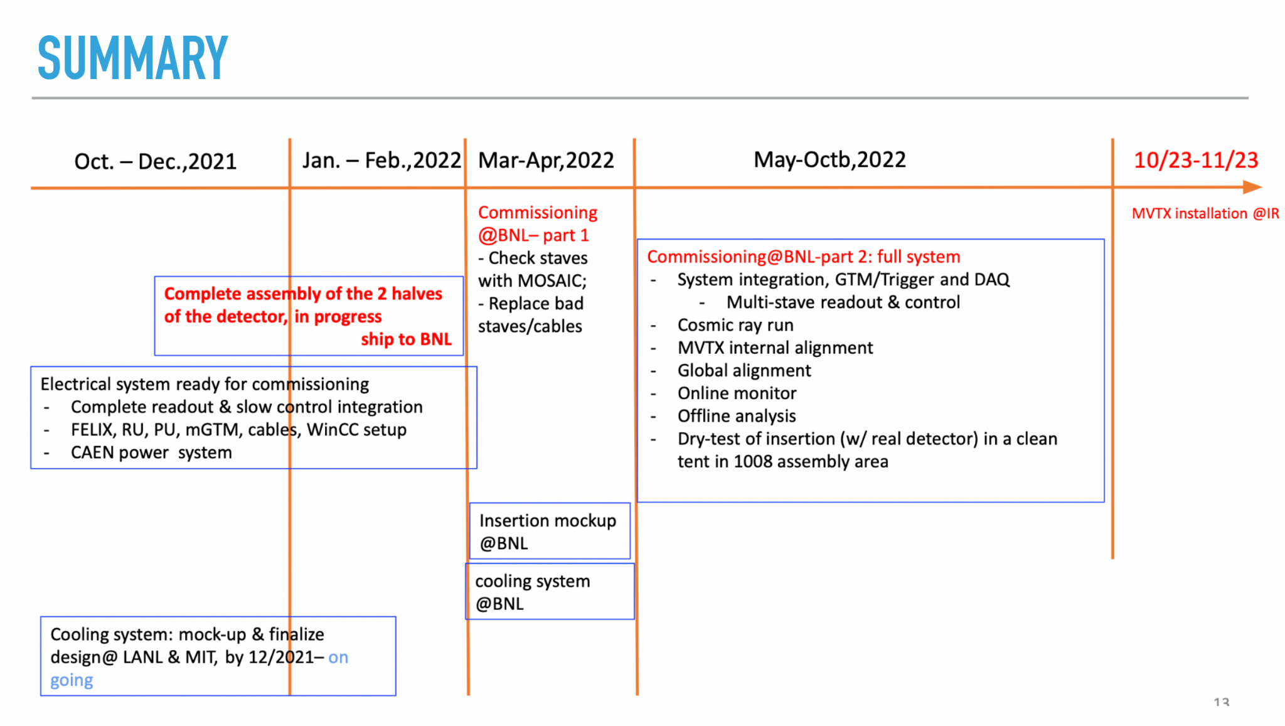
MVTX: Remaining Key Tasks and Schedules
Schedule presented 1/6/2022
sPHENIX collaboration meeting
(Possible delay ~1 month?)
Plan to set up a BIG clean tent in the sPHENIX assembly area in May:
for the full insertion mockup
Full half-detector commissioning
Delay in half-detector assembly … by ~1 month?
Still on track for on time installation

Slide 14
Summary
sPHENIX installation is proceeding well.
  The 29/32 OHCal sectors installed. Number 30 to be installed this week.
  IHCal barrel build has started. 2/32 IHCal sectors installed.
  EMCal block production done. Sector production 57/64 complete. Complete 2nd half of March.
  Most detector components complete.(OHCAL, IHCal, EMCal blocks, TPC electronics, Calorimeter on-detector electronics, DAQ/Trigger network/servers
  Many major 1008 I&F parts are complete or on order.
  We have a small but important subset of I&F orders to place including: Magnet mapping contract w/CERN, TPC installation fixtures, MBD/sEPD/beampipe/INTT bracketry, maintenance/access/chiller platforms, HVAC upgrade, fiber optic trunk lines.
We have been successful in borrowing technicians and engineers from other parts of BNL: CAD, IO, SMD, NSLSII
  Need to maintain this level of technical support until the start of RHIC run 2023.
  sPHENIX Collaborators continue to make critical contributions in the factories and home institutions.

Slide 15
Back Up

Slide 16
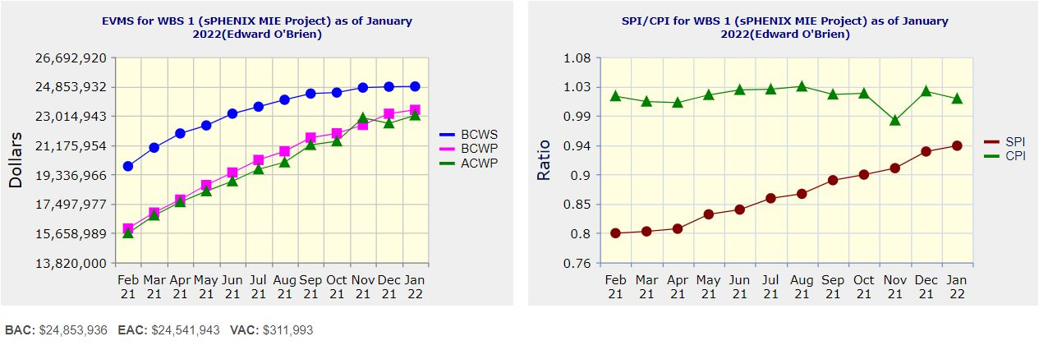
Performance Indices – sPHENIX MIE
Cumulative SPI | Cumulative CPI
0.94 | 1.01
Cumulative BCWS (Scheduled) | $24,853.936
Cumulative BCWP (Performed) | $23,387.375
Cumulative ACWP (Actual) | $23,044,691
DOE SPI or CPI Value Thresholds
0.90 to 1.15
0.85 to 0.89 or 1.16 to 1.25
<0.85 or >1.25

Slide 17
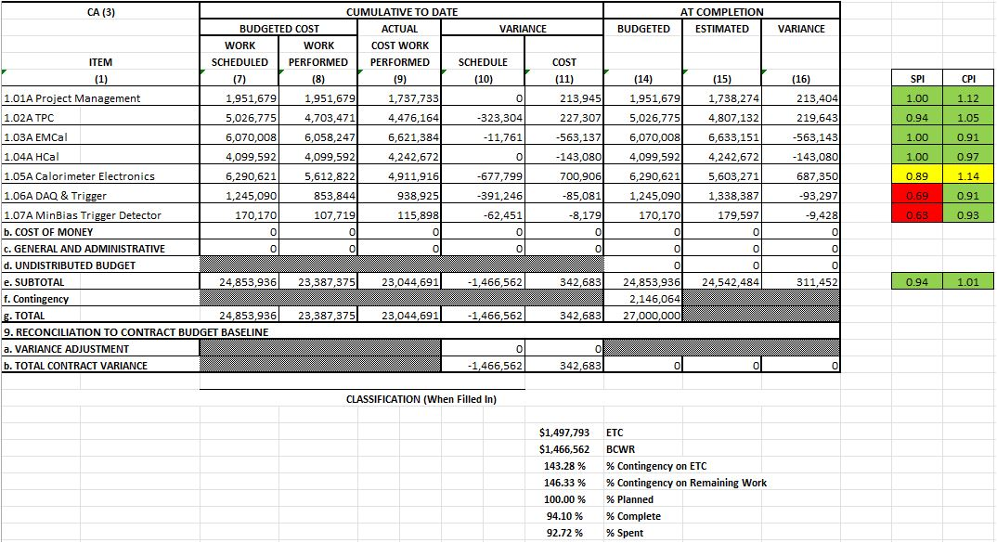
Cost Performance Report (CPR) – sPHENIX MIE
DOE SPI or CPI Value Thresholds
0.90 to 1.15
0.85 to 0.89 or 1.16 to 1.25
<0.85 or >1.25
*Highlights in table above takes variance $ into consideration, not just Indices

Slide 18
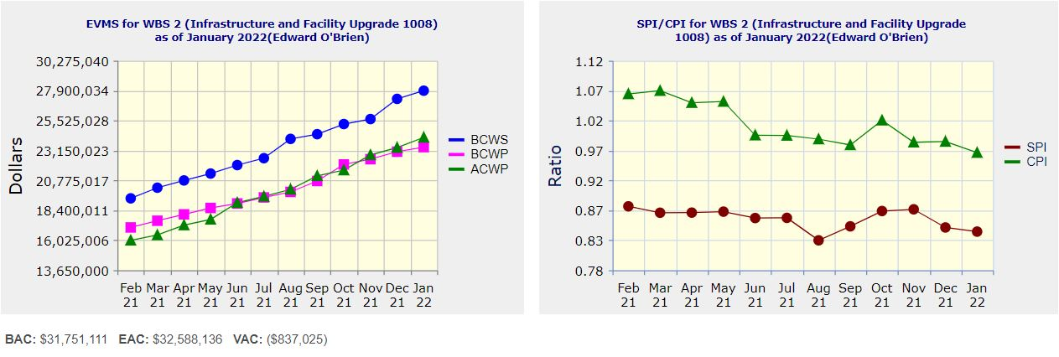
Performance Indices – 1008 Infra and Facility Upgrade
Cumulative SPI | Cumulative CPI
0.84 | 0.97
Cumulative BCWS (Scheduled) | $27,900,764
Cumulative BCWP (Performed) | $23,421,255
Cumulative ACWP (Actual) | $24,192,905
DOE SPI or CPI Value Thresholds
0.90 to 1.15
0.85 to 0.89 or 1.16 to 1.25
<0.85 or >1.25

Slide 19
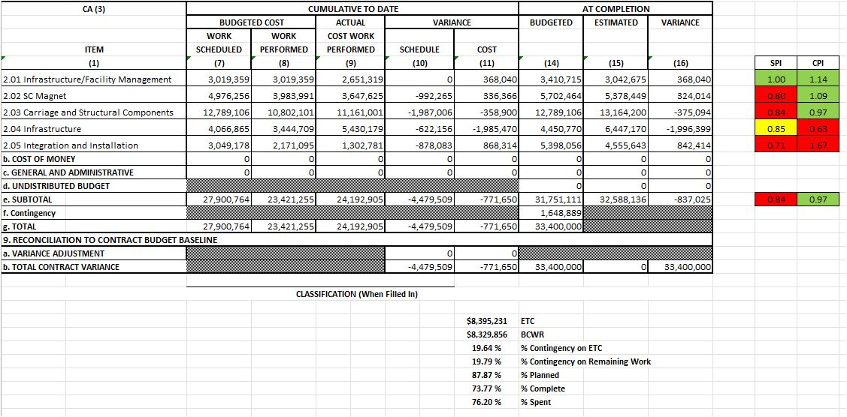
Cost Performance Report (CPR) – 1008 Infra and Facility Upgrade
DOE SPI or CPI Value Thresholds
0.90 to 1.15
0.85 to 0.89 or 1.16 to 1.25
<0.85 or >1.25
*Highlights in table above takes variance $ into consideration, not just Indices

Slide 20
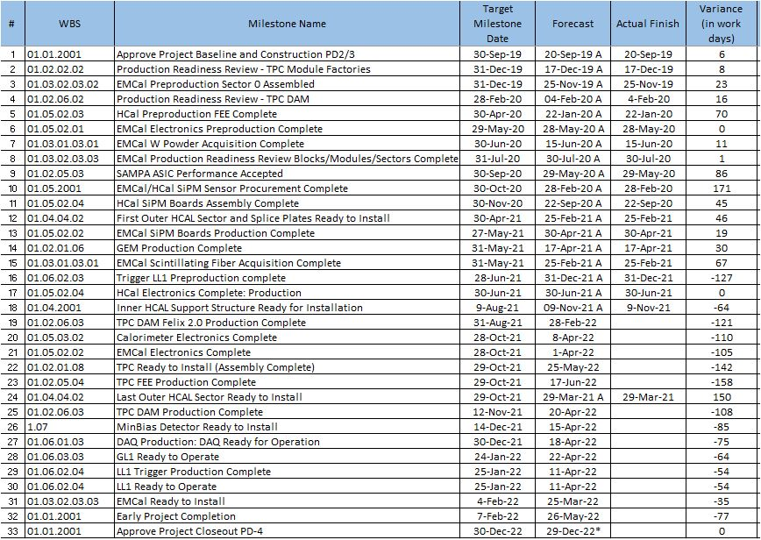
Milestones Status – sPHENIX MIE

Slide 21
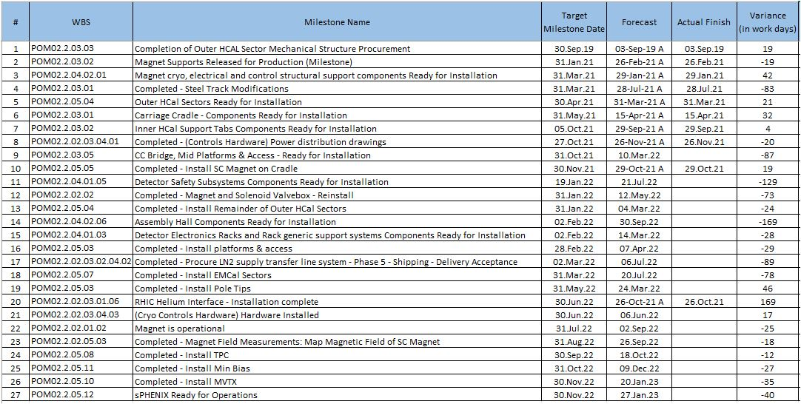
Milestones Status – 1008 Infra and Facility Upgrade

Slide 22
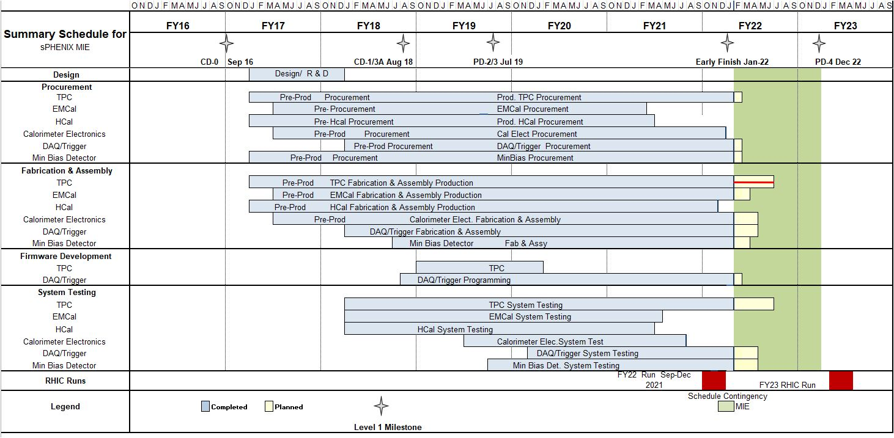
Summary Schedule – sPHENIX MIE

Slide 23
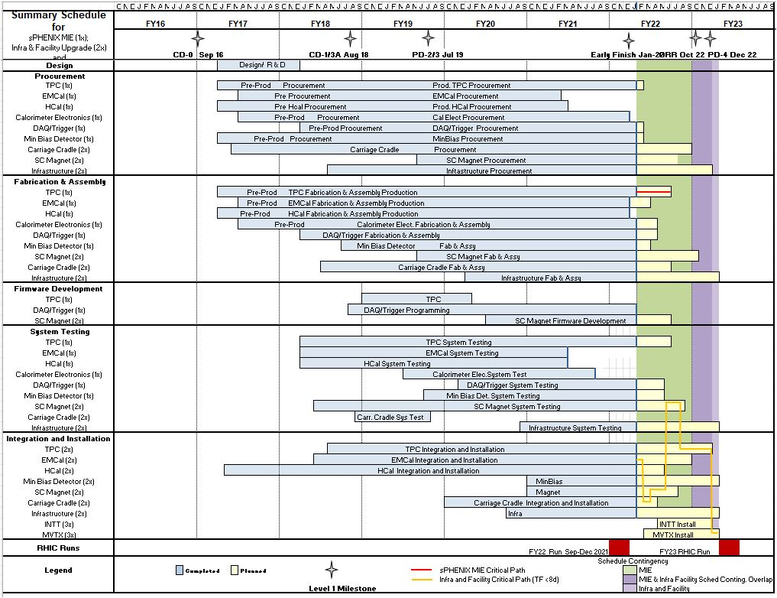
Summary Schedule – sPHENIX MIE and 1008 Infra and Facility Upgrade

Slide 24
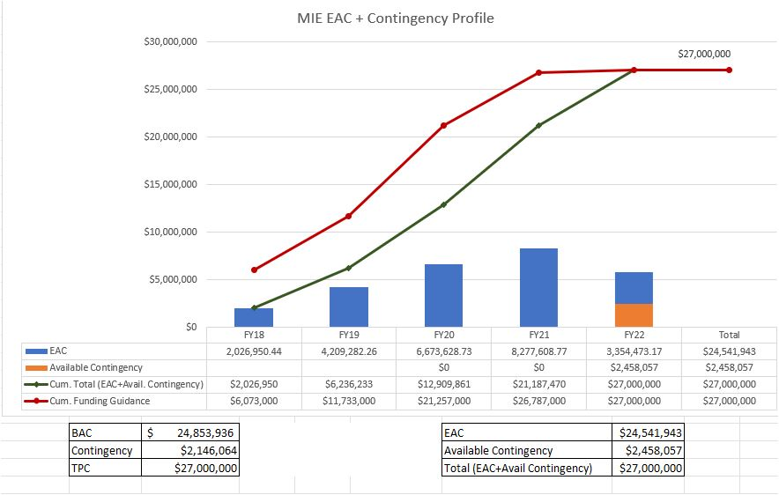
EAC and Contingency Profile – sPHENIX MIE

Slide 25
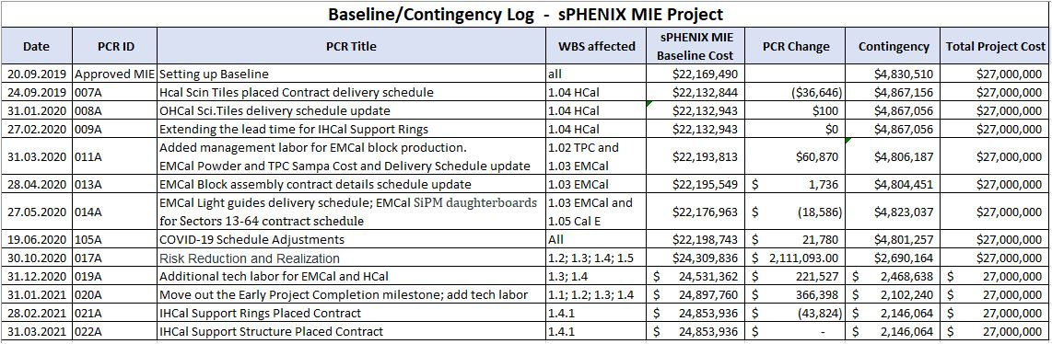
Baseline/Contingency Log and ETC adjustment Log - MIE
ETC Adjustments
Control Account | Aug’21 | Sep’21 | Oct’21 | Nov’21 | Dec’21 | Jan’22
1.02 | $326,377 | $556,377 | $716,238 | $725,089 | $722,064
1.03 |  |  |  | $34,439 | $18,420
1.05 | $22,833 | $22,833 | $219,343 | $414,468 | $250,807
1.06 | $79,352 | $79,352 | $26,259 | -$62,490 | -$63,278
1.07 | $25,705 | $25,705 | $16,041 | $16,575 | $8,731
Total | $454,267 | $684,267 | $977,880 | $1,128,081 | $936,744

Slide 26
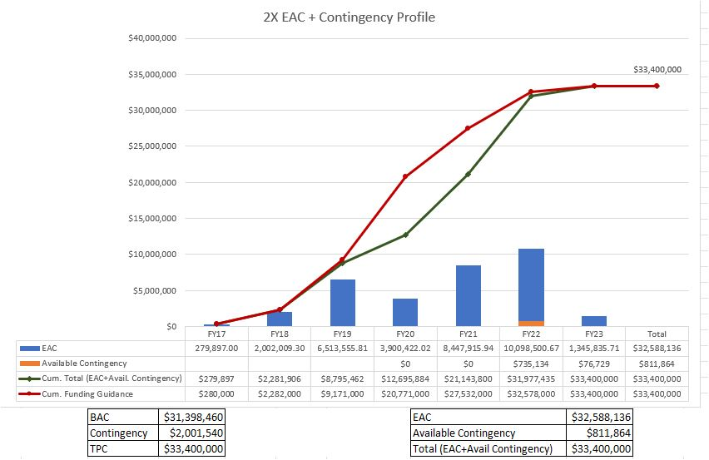
EAC and Contingency Profile – 1008 Infra and Facility Upgrade

Slide 27
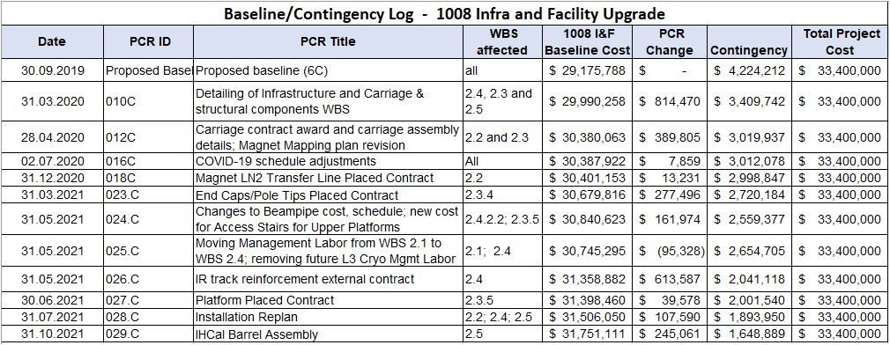
Baseline/Contingency Log and ETC adjustment Log – 2.X
ETC Adjustments
Control Account | Sep’21 | Oct’21 | Nov’21 | Dec’21 | Jan’22
2.3 | $90,775 | $70,349 | $125,472 | $102,957
2.4 | $70,160 | $350,388 | $152,069 | $69,283
2.5 | - | $73,413 | $63,117 | $161,496
Total | $160,935 | $494,150 | $340,658 | $333,737

Slide 28
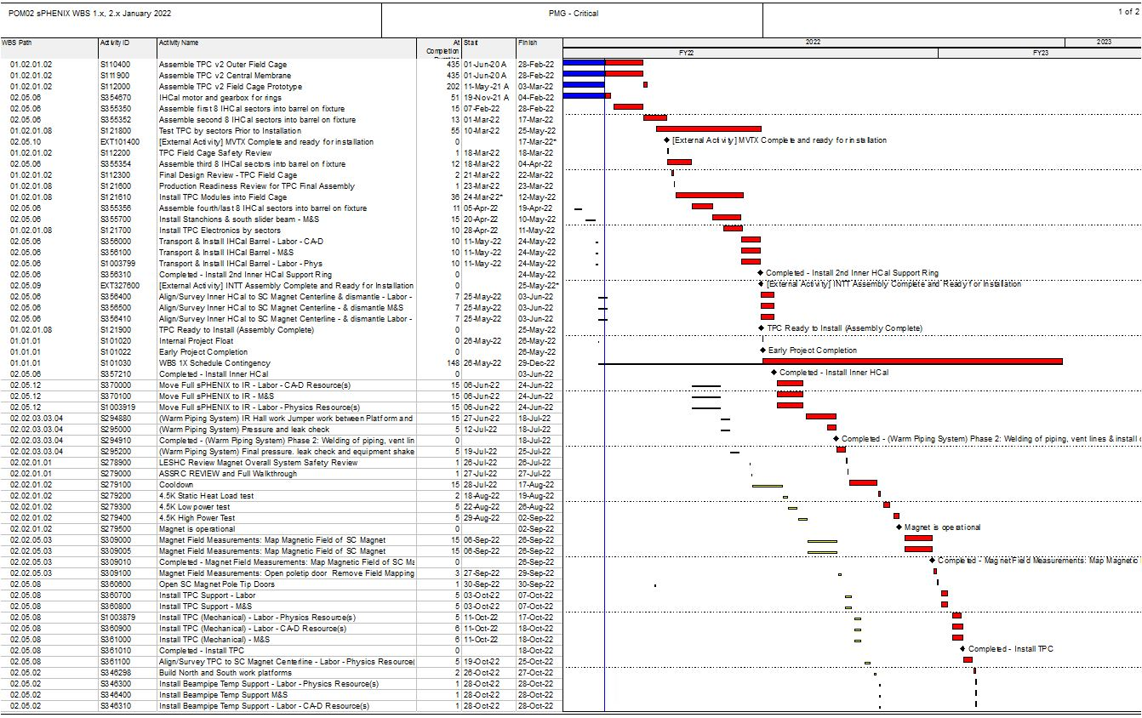
Critical Path (1x, 2x and 3x Combined)

Slide 29
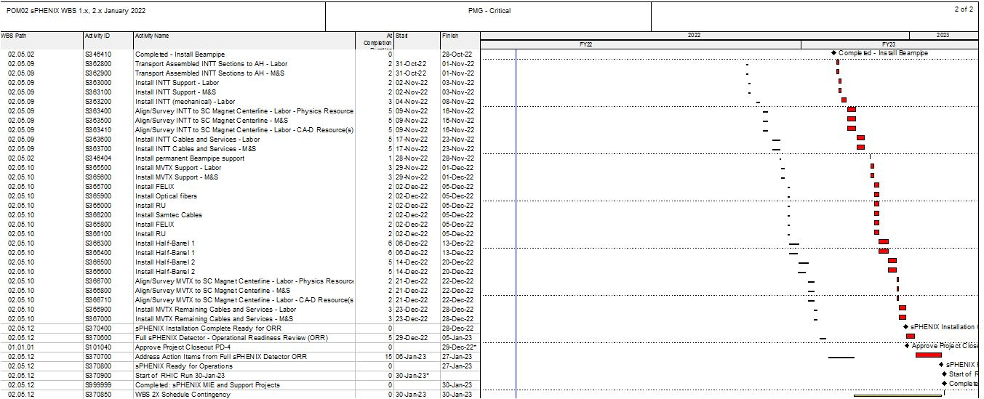
Critical Path (1x, 2x and 3x Combined)

