Slide 1
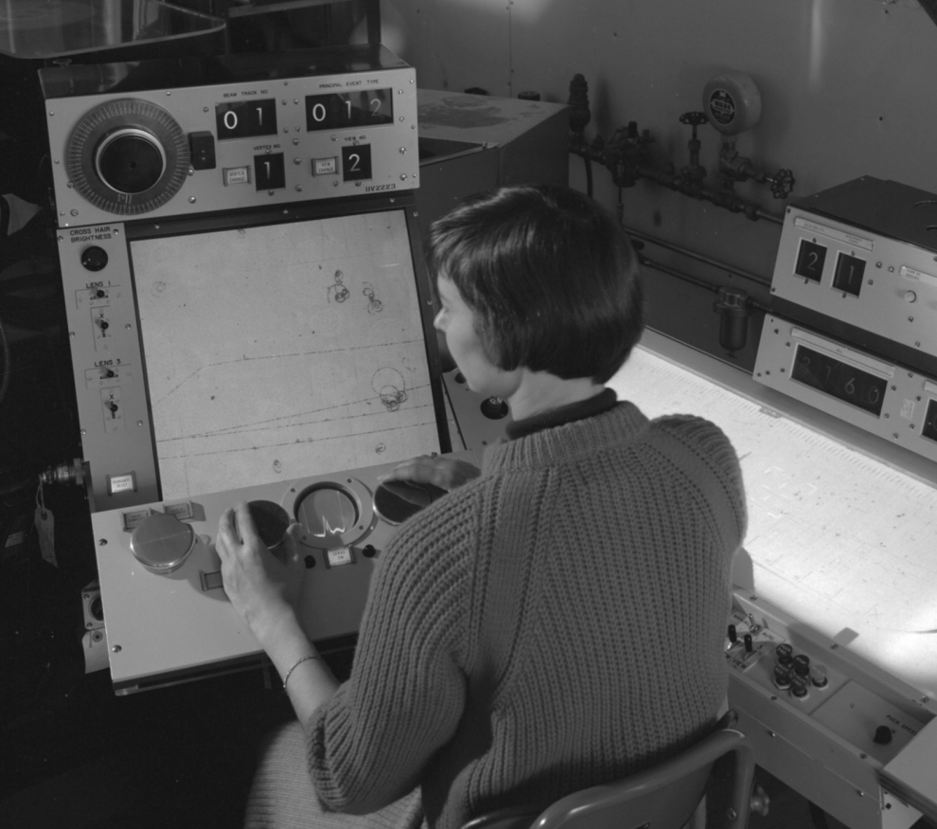
Bi-Weekly Meeting Thursday 2022-02-24
The Software and Computing WG Conveners: Andrea Bressan (University of Trieste and INFN) , Dmitry Romanov (Jefferson lab) , Sylvester Joosten (Argonne National Laboratory) , Whitney Armstrong (Argonne National Laboratory) , Wouter Deconinck (The University of Manitoba)
https://indico.jlab.org/event/505/contributions/9207/attachments/7478/10398/pivarski-jlab-history-programming-languages.pdf

Slide 2
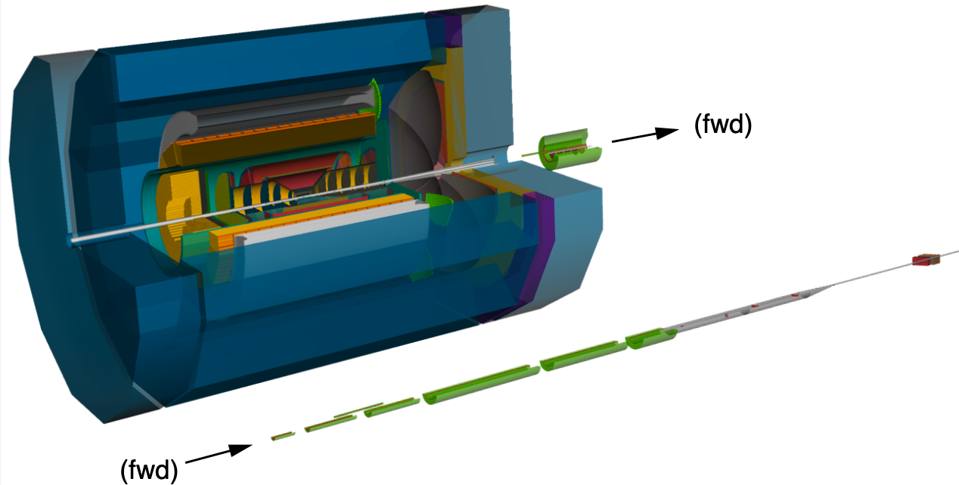
Simulation status

Slide 3
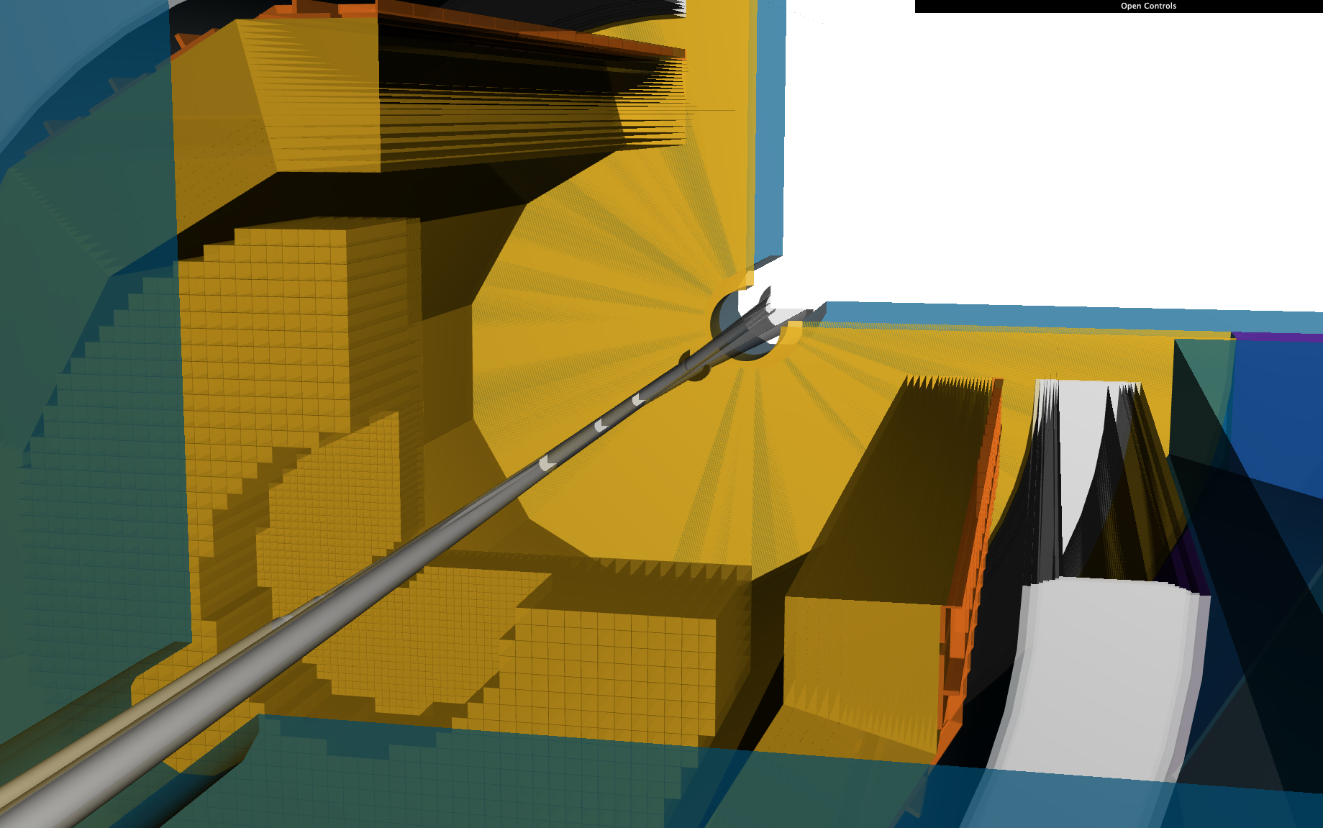
Simulation status: central calorimetry
✅🚧Electromagnetic calorimetry
✅ nECal ❌ nECal support
✅🚧 bECal minor tweaks for realism
🚧pECal realism and performance tweaks
🚧 Hadronic calorimetry
🚧 holistic pECal + pHCal validation
🚧 bHCal and nHCal validation and improved realism

Slide 4
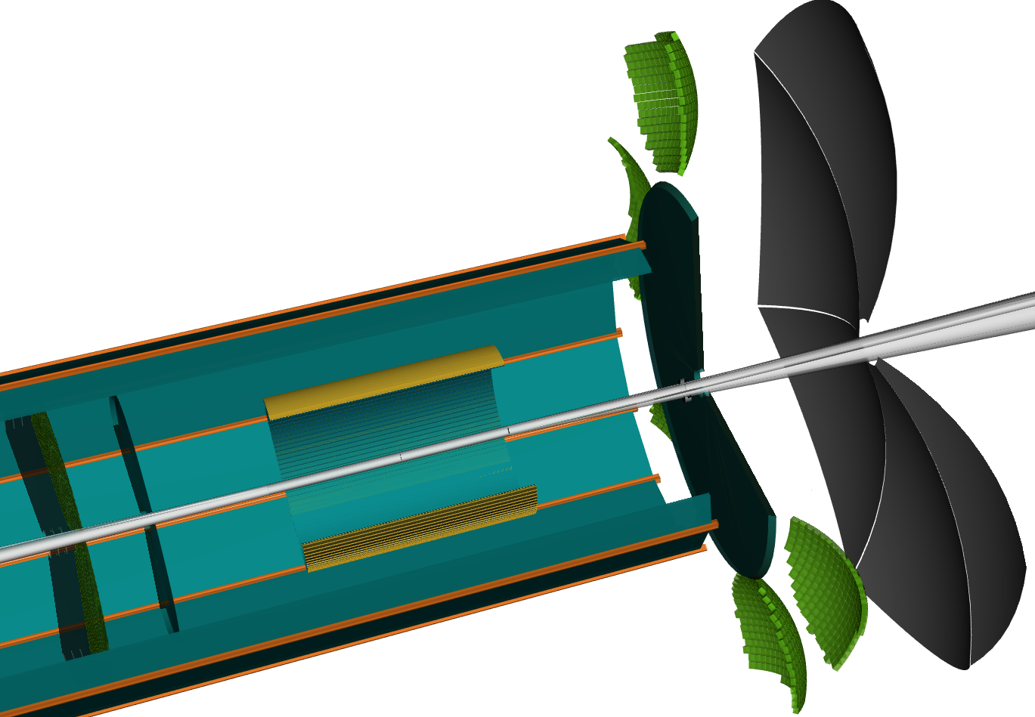
Simulation status: central PID
✅ RICH detectors
✅ dRICH and pfRICH fully functional
🚧 DIRC
✅ Still using material stand-in
🚧 Finalization of realistic DIRC plugin (fix overlaps and final validation with DIRC experts)
✅ ❌ bTOF
✅ Realistic detector
❌ bTOF support and services
❌ Holistic reoptimization of bTOF + tracking system

Slide 5
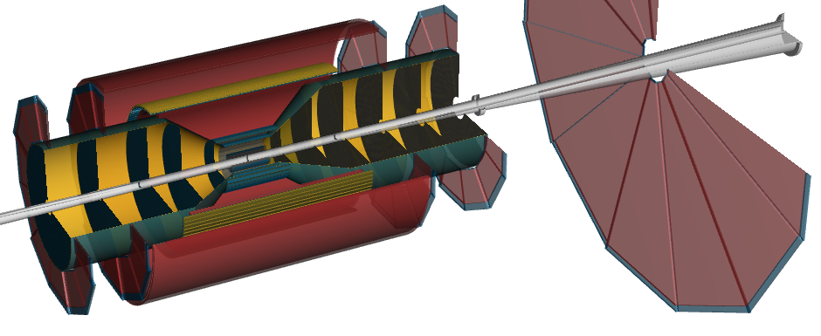
Simulation status: central tracking
✅🚧 Vertex tracker
✅ Approximate implementation due to (older) ACTS limitations
🚧 Proper cylindrical implementation
❌ Additional details: foam rings, connection to tracker services
✅ Silicon trackers
✅ Realistic implementation including services
❌ Additional details: connect detectors to services/support (service rings), mechanical support connected to rest of detector
✅🚧 MPGD rings
✅ Trapezoid implementation
🚧 Minor geometry optimization (rounded inner radius, better support)
❌ Additional support details?
❌ bTOF (See PID)
❌ Integrate bTOF into tracker services/support
❌ Holistic reoptimization of bTOF + tracking system
❌ bECAL imaging layer 1
❌ Integrate first imaging layer into ACTS tracking geometry

Slide 6
Simulation status: central beamline and far-forward/backward
✅ Beamline
✅ Direct translation from project CAD (Be + Au)
✅ Far-forward instrumentation
✅ Magnet system accurately reproduces machine lattice
✅ Beampipe and drift section between B1apf and B2apf consistent with preliminary design concept.
✅ RPs and OMDs with service/support (including RF shielding)
✅ Realistic ZDC ECal & HCal implementation
❌ Additional details: motors and detector frames (require more mature magnet design)
❌ Far-backward instrumentation
✅ Stand-alone DD4hep implementation in Far-Backward working group (not under umbrella of SWG)
❌ Urgent TODO: needs to be merged into the rest of the ATHENA geometry for completeness!

Slide 7
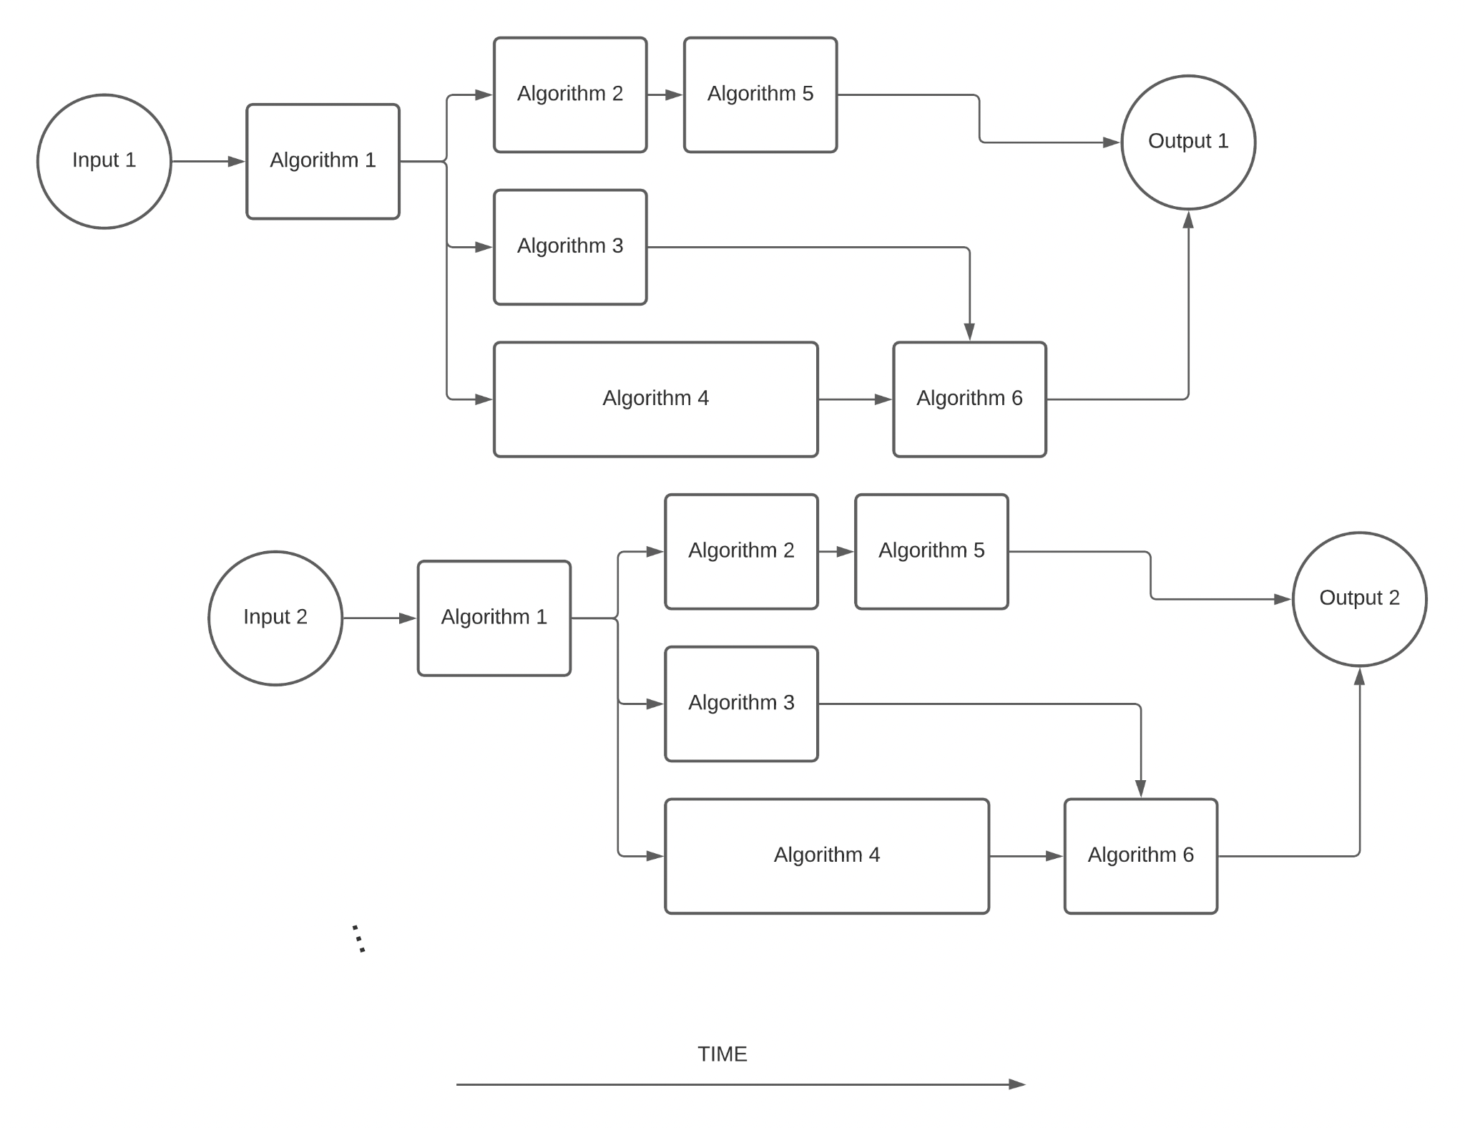
Reconstruction status

Slide 8
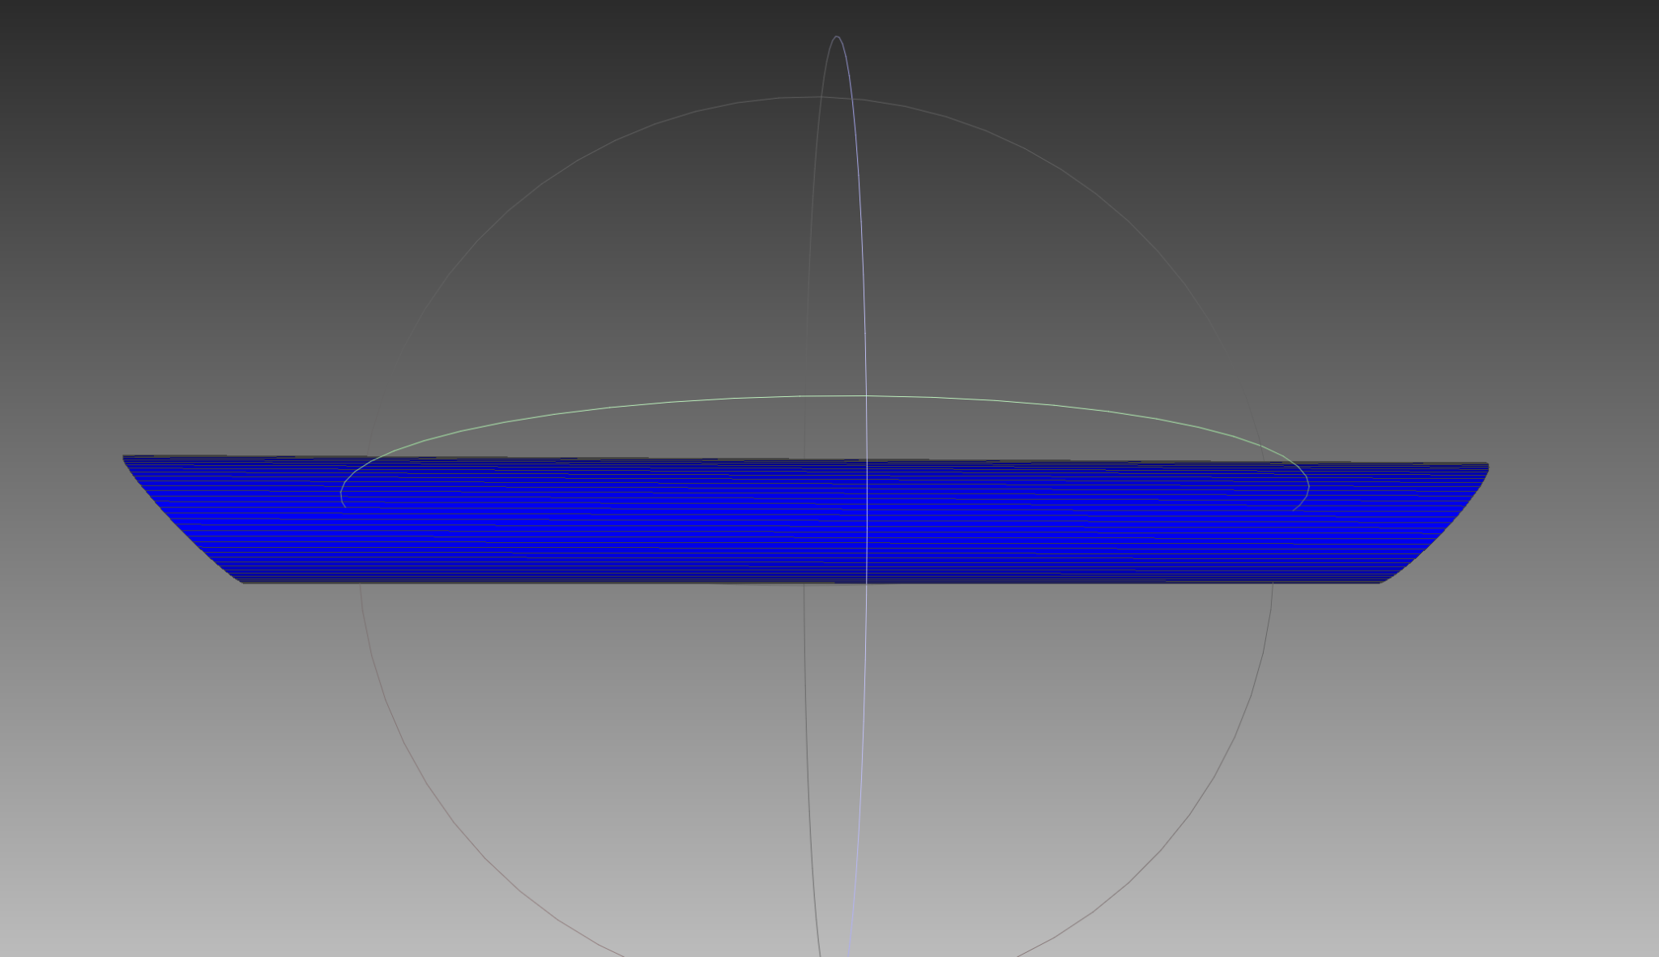
Track Reconstruction
Regular meetings with Acts developers
Monday 10:30 Eastern (~weekly)
Attended by team of 5 core Acts developers
Recent discussions:
Vertex finder (Wenqing Fan, Yue Shi Lai)
B0 tracker support (Sakib Rahman)
Data model representation for Acts objects (Sylvester Joosten)
Main goals:
Sandbox development of vertex finding must be integrated into main repository

Slide 9
Reconstruction status
LEGEND:
✅ : done
🚧 : ongoing
❌ : task not allocated to anyone or not fully defined
https://eicweb.phy.anl.gov/EIC/eicd/-/blob/master/eic_data.yaml
https://eicweb.phy.anl.gov/EIC/juggler
JUGGLER
GAUDI
Status (incomplete)
✅🚧 Basic calorimeter reconstruction
🚧 Validate/improve ECal calorimetry reconstruction
🚧 HCal reconstruction and particle flow
🚧 Integrate AI algorithms in main reconstruction
✅ Tracking with ACTS working well
🚧 Provisions for B0 geometry
🚧 Arbitrary track projections
🚧 Realistic track seeding
🚧 Realistic vertexing
✅ Basic neutral particle reconstruction
🚧 Realistic PID
✅ Truth PID for all particles
🚧 Integrate IRT for dRICH/pfRICH in main framework (major effort)
❌ DIRC reconstruction
❌ Realistic e/π separation
🚧 kinematic reconstruction
🚧 Tune algorithms for inclusive kinematics
❌ Integrate SIDIS reconstruction, particle flow, …
🚧 FF reconstruction
✅ Fast FF reconstruction
✅ RP/OMD proton reconstruction
✅ ZDC reconstruction (NEW!)
Will discuss reconstruction work prioritization and task distribution during next SWG meeting
(SWG will resume bi-weekly meetings Thursday March 3 at 12:00pm EST)

Slide 10
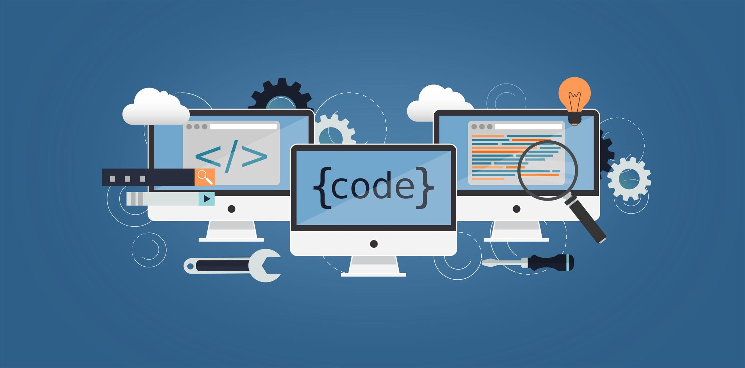
Infrastructure updates

Slide 11
(Internal notes)
Software updates and what it buys us
Acts 15 -> 17: eta-binned chi2 limits, off-axis cylinders for B0, improved ITK seed finder
DD4hep 1.18 -> 1.20: diquark bugfixes, optical materials, geant4 11+ support
Podio 0.14 -> 0.15: mutable types
Transition to EDM4hep data model
Simulations up to start of reconstruction: mcparticles -> MCParticles
Reconstruction starting with digitization
Far forward updates:
ZDC clustering enabled now
GPU acceleration:
CUDA on eicweb
Concurrent gaudi tests
ML integration in reconstruction:
Tensorflow Lite
Vertex seeding
PID IRT algorithms
Multiple containers like eic-shell (eic-shell --xl, eic-shell --ml)

Slide 12
Dependency Upgrades
base system:
debian version December 2021
new gcc@11 compiler (from gcc@10)
acts@15 (from @17)
eta-binned chi2 limits, off-axis cylinders for B0, improved ITK seed finder
DD4hep@1.20 (from @1.18)
diquark bug fixes, optical materials, geant4 11+ support
podio@0.15 (from @0.14)
separation of const and mutable codes
used by current EDM4hep data model
Development of a multiple eic-shell containers, e.g. eic-shell --ml
Dependencies: spack.yaml
Debian “bookworm”
ATHENA software
ATHENA
geometry

Slide 13
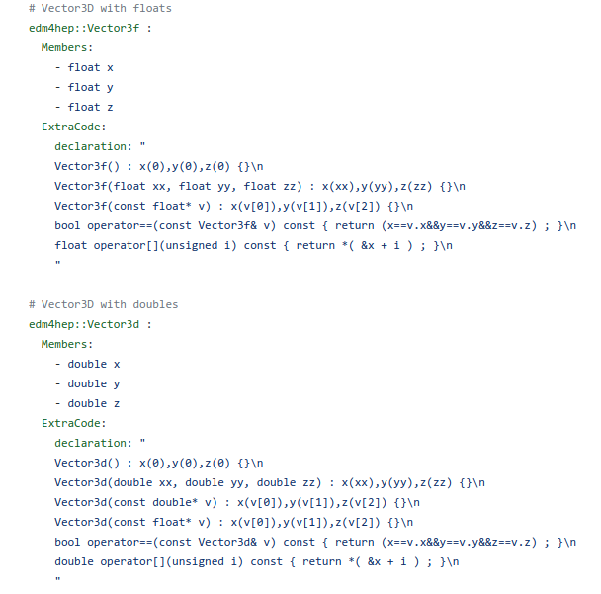
Transition to EDM4hep
Aspects involved in this transition:
Different output from geant4 simulations:
dd4pod.yml to edm4hep.yml
mcparticles to MCParticles (more than just a change to uppercase, though)
*Hits collections are different, but primarily needs changed support in digitization algorithms
Different output from reconstruction:
eicd.yml to edm4hep.yml
Most algorithms need modifications
Most written data structures will have minor to major changes
Status: writing .edm4hep.root files, algorithm conversion nearing completion, completion early next week

Slide 14
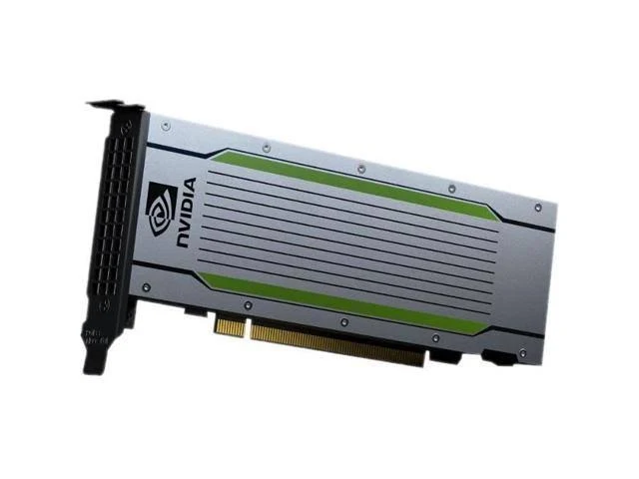
Heterogeneous Computing (GPUs)
Hardware: eicweb GPU acceleration
dual Nvidia T4 (2 x 2560 cores)
eicweb now has GPUs accessible to jobs (tag: gpu)
use for tensorflow training (x50 faster training for imaging_shower_ML benchmarks
Check with `nvidia-smi` whether your jobs is GPU-enabled
Software: CUDA containerization
proof of concept of running jug_xl with CUDA acceleration inside the container
large develop environment
small runtime environment
software that currently supports CUDA ‘out of the box’
acts, veccore, vecgeom, vecmem
benchmarking of run times
unlikely to speed up enormously with current scop
operational issues to explore
OSG running on disparate hardware
future directions where it does matter
calorimetry clustering
AI/ML training and inference

Slide 15
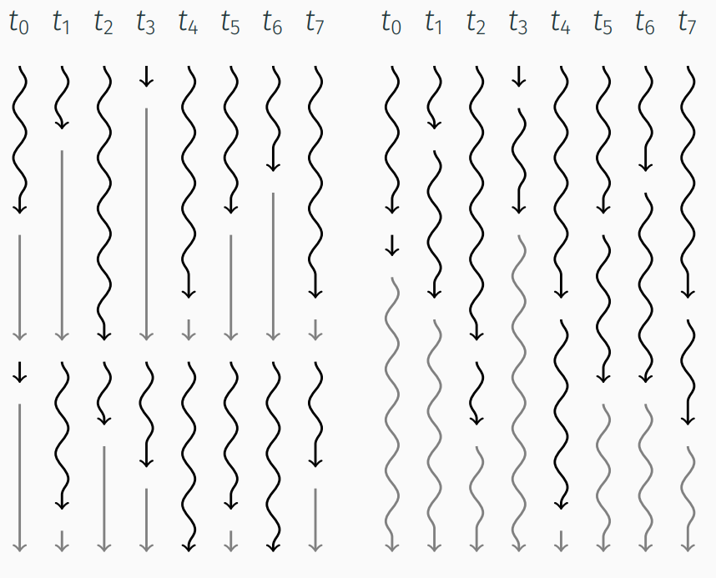
Heterogeneous Computing (Avalanche Scheduler)
Our main goal of using Gaudi:
claim all cores on a node
let Gaudi schedule tasks to occupy all cores simultaneously
optimization through small algorithms that allow flexibility in their scheduling
requires thread-safe algorithms
Our actual use of Gaudi until now:
single threaded running, linear operations
Near term goals:
verify thread-safety of algorithms
start running with avalanche scheduler by default
stricter rejection of algorithms that are thread-unsafe
Notes:
Image source: https://indico.cern.ch/event/1129245/contributions/4739110/attachments/2394069/4093122/Statistical_Models_for_the_Overhead_of_Thread_Divergence_in_Variable_Length_Workloads_on_SIMT_Architectures.pdf

Slide 16
Artificial Intelligence and Machine Learning
Platform of choice (training): tensorflow
well aligned with POD data model
supported by data science community
Status of implementation:
Currently `pip install tensorflow` inside CI
Working on development of jug_ml container that has tensorflow preinstalled
Platform of choice (inference): tensorflow-lite
only does inference, no training
intended for microcontrollers, embedded systems, predictable running times
GPU acceleration using OpenCL
requires tflite model conversion, not full tensorflow model, some limitations on available operations (e.g. no SeLU)
Status of implementation:
proof of concept gaudi algorithm for imaging calorimeter PID implemented

Slide 17
Software support and training

Slide 18
Office Hours and Spack Helpdesk
Regular office hours (3x/week), 2pm Eastern on MWF
Please ask questions in spack #software-helpdesk (preferably not the #general channel since that is sometimes perceived as noise by others)

Slide 19
Trainings and Tutorials
ATHENA SOFTWARE TUTORIAL March 4, 2022, 10am EST
Planning new software tutorials after the conversion to EDM4hep is complete and functional.
Need input from all WGs by this weekend
Contact person for each WG who can help with tutorial facilitation
List of specific training use cases to aid in prioritization between the following:
DD4hep geometry coding in xml
DD4hep plugins in c++
Running small-scale simulations
Adding Gaudi algorithms
Tuning Acts track strategies
…
Many other topics are possible
Tutorial timeline
Friday March 4
10am EST, 9am CST, 7am PST, 4pm CET
Tentative agenda
Running DD4hep with current geometry
No additional geometry coding
Running Gaudi with existing algorithms

Slide 20
Useful dates and meetings
(Almost) weekly ACTS meeting Monday’s at 10:30am EST
NA-friendly key4HEP meeting on Tuesday March 1 at 10:00am EST
SWG will resume bi-weekly meetings Thursday March 3 at 12:00pm EST
SWG Tutorial session March 4 at 10:00 am EST
… and SWG office hours every Monday-Wednesday-Friday at 2:00pm EST

