Slide 1
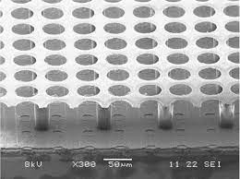
GridPIX (aka MiniTPC): Brief Introduction
TK Hemmick
Main discussion in PID group.
Selected as “upgrade path” for ATHENA.
Provides:
PID (pi-K-p) from 100 MeV/c to 800 MeV/c
ROBUST tracking (enormous number of hits per track)
Field Cage
1% radiation length, entrance and exit
Silicon Pixel Readout
$$55 μm ×55 μm$$
4% radiation length
(dominated by cooling)
DD4HEP
Gas Volume
Readout
High Voltage (-10kV)
Low radiation Length
Sanghwa and Dmitry
T2K gas (low diffusion)

Slide 2
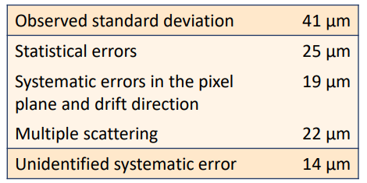
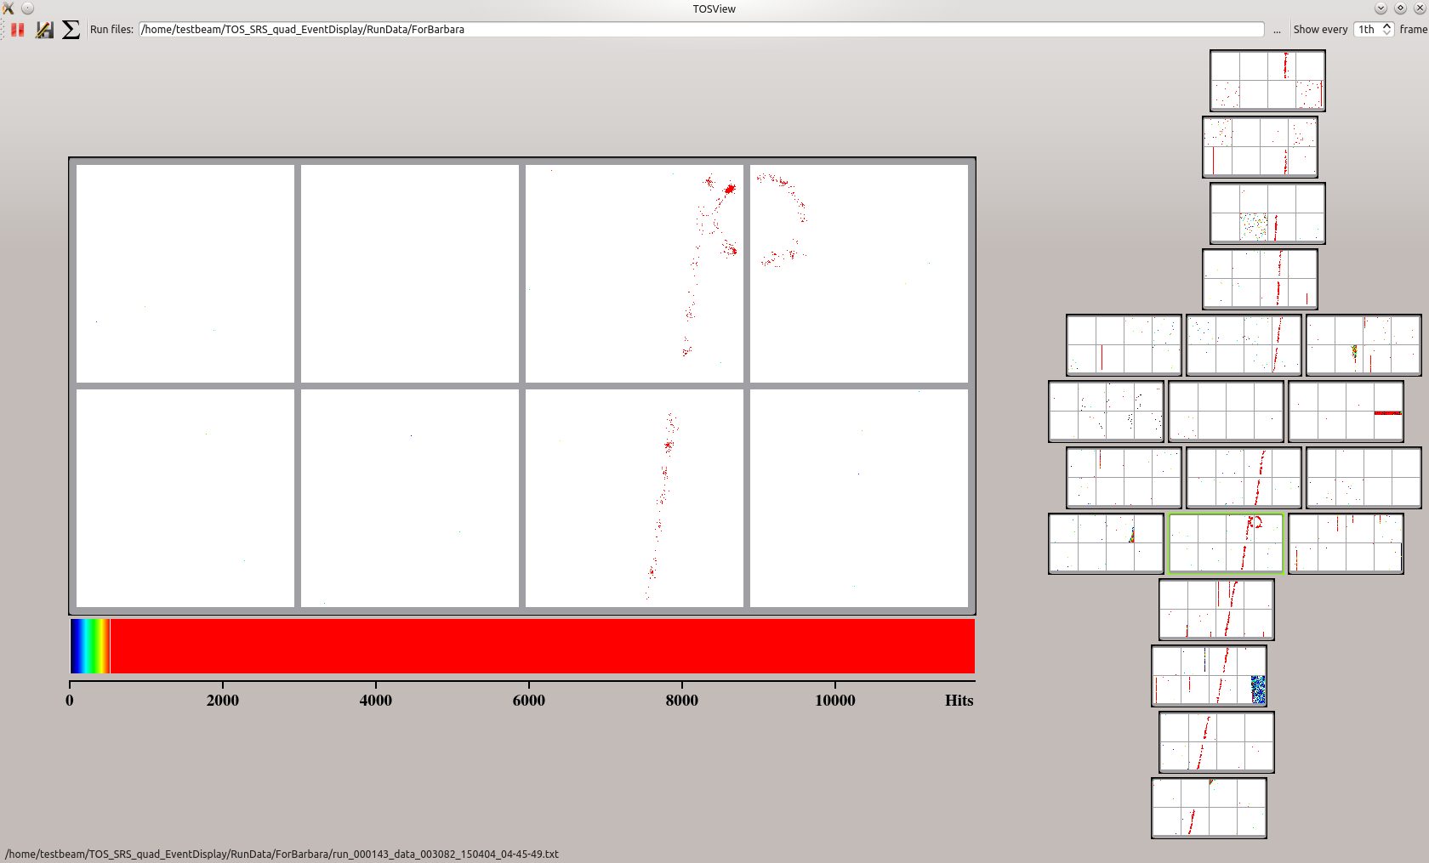
GridPIX Overview
3D e-by-e tracking
Pros:
Known/Proven Technology
Active further development (Bonn)
Best $\frac{dE}{dx}$possible (~count each electron)
Affordable for a small area
High resolution tracking
Low mass in electron arm
Continuous (aka streaming) readout
Cons:
3 kW of power:
Must find a low pass way to handle.
Services “bulky” (compared to just Si)
Gas
HV membrane
Cooling
DC power lines (3kV goes in too)
Ultimate dE/dx device.
Avalanche grid in front of 55 x 55 μm² pixels.
>90% efficiency for single electrons.
Goals:
Enough diffusion to get every electron into a different hole.
Count electrons one-by-one.
Three generations of development and continuing.
Large area VERY expensive, small area not so much.
1800 chips (order/produce/test 3600) = $716k
Careful: 1.2-5.4 kW of power (occupancy dependent).

Slide 3
June 2021
Overview:
Segmentation: $\frac{55 μm}{25 cm}=4500$
70% active area → 3150 “rows”
2400 primaries in 25 cm for a MIP.
Thousands of hits per track.
Extremely robust patterns.

Slide 4
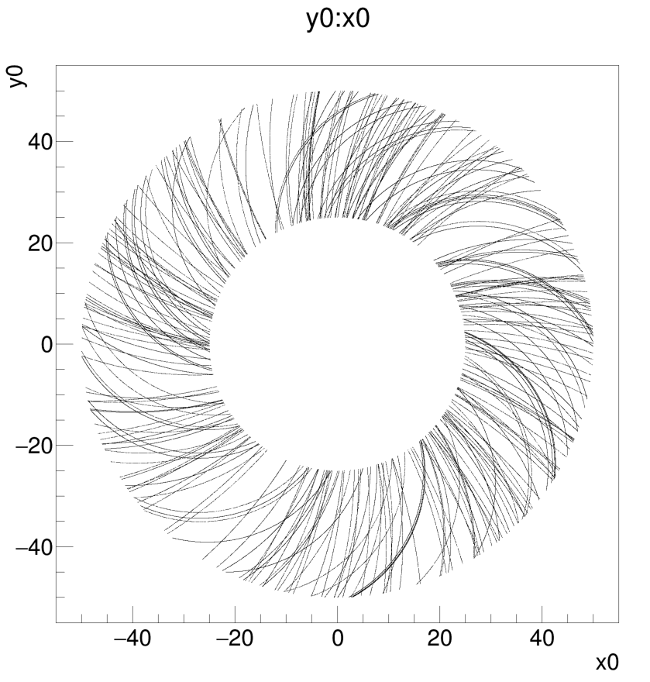
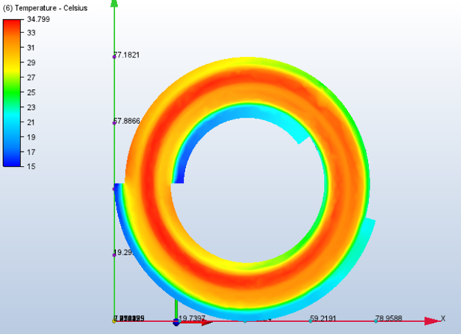
Garfield & Cooling
Temperature Profiles: 3 kW
4% Radiation Length
Coolant above the dew point
These are not lines! They are dots!

Slide 5
NOTE:
Initial implementation = “Layers of Gas Cylinders”
One hit per layer “under-values GridPIX”
Probably still very robust w.r.t. pattern finding.

Slide 6
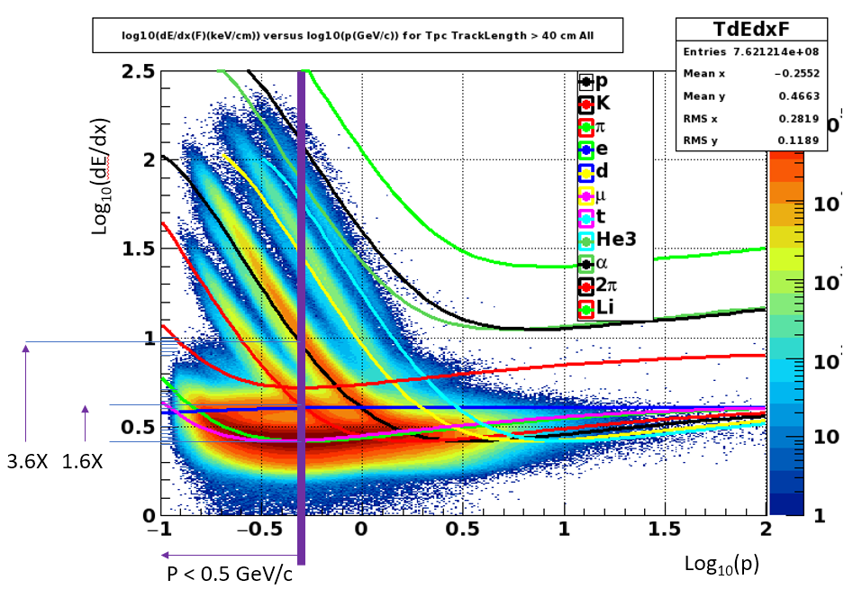
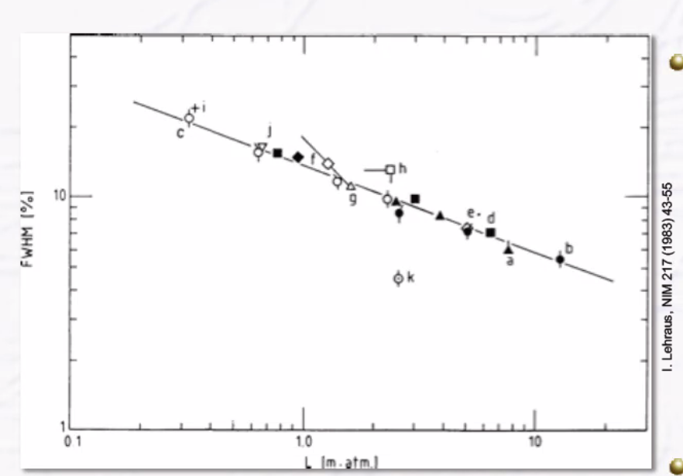
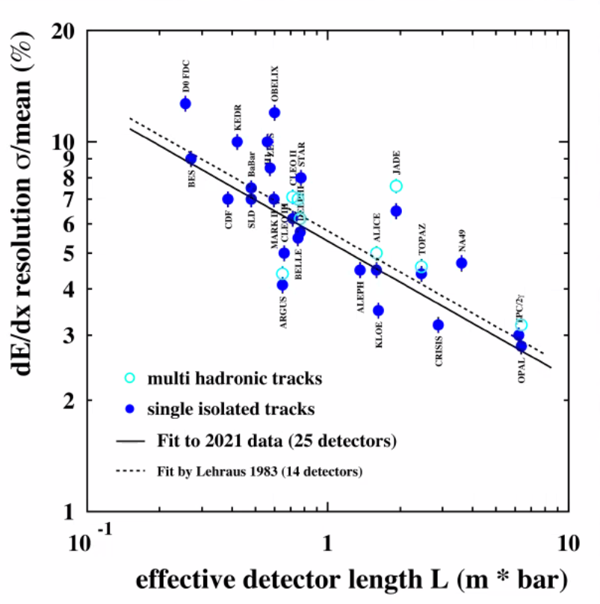
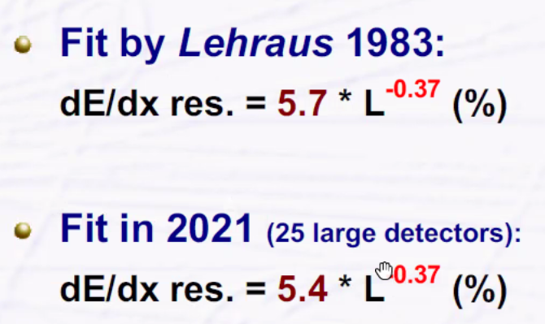
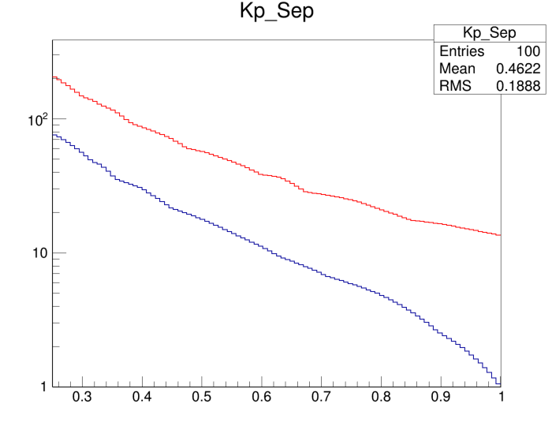
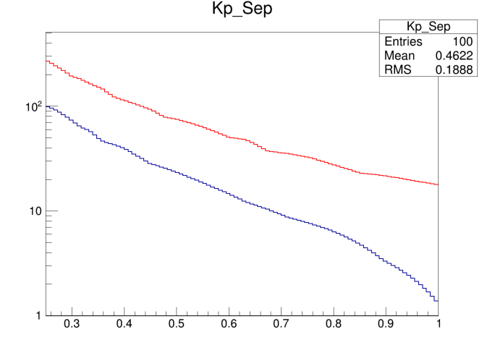
Anticipated dE/dx Resolution
easy
hard
Lehraus Plot
Using 5.4 as a standard TPC
5.4*(0.25)^{-0.37} = 9.0
Measured for GridPIX (truncated Mean)
4.1% at 1 meter
4.1*(0.25)^{-0.37} = 6.85
This was the prior assumption quoted by us.
Roughly 20 sigma at 0.5 GeV/c
Useful range overlaps with DIRC
#σ
#σ
9.0%
6.85%
K-p
K-p
π-K
π-K
Momentum
Momentum

Slide 7
Summary
GridPIX is silicon-base gas chamber readout.
Makes for the “ultimate” TPC:
Ultimate in pattern recognition: electron-by-electron
Ultimate in dE/dx resolution.

Slide 8
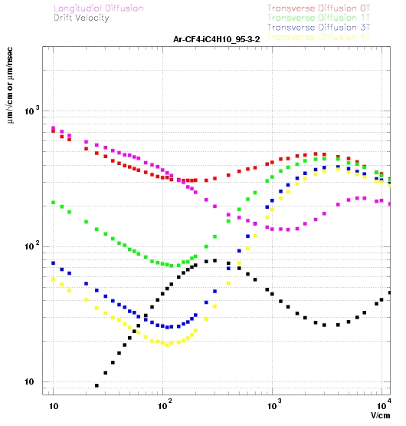
Overly Simplified Momentum Resolution
Figure of Merit:
$σ_{p}∝ \frac{σ_{hit}}{\sqrt{N_{meas}}} ≡Figure of Merit$
Can be compared to Silicon with detailed Monte Carlo
Here is simple-minded estimate
$Figure of Merit(Si)= \frac{{10 μm}/{\sqrt{12}}}{\sqrt{4}}=2.9 μm$
Gas:
Including efficiency ~3000 electrons (minimum!) per track
Each suffers digitization (σ = 55 μm/sqrt(12) = 16 μm)
Diffusion(Length) = $25\frac{μm}{\sqrt{cm}} \sqrt{L}$
D(2cm) = 35 μm ➔ FOM = 0.70 μm
D(25cm) = 125 μm ➔ FOM = 2.3 μm
D(50cm) = 176 μm ➔ FOM = 3.2 μm
D(100cm) = 250 μm ➔ FOM = 4.6 μm
Although ignoring many significant effects, initial result is on the order of the layers of silicon.

Slide 11
June 2021

Slide 14
