Slide 1
EIC Silicon Considerations
Vertex layers vs reticle size
Some considerations for tiling disks
Jim Fast (JLab)

Slide 2
Vertex layer radii vs reticle width
For curved silicon with a reticle width, w, the radii, R, of the vertex layers must be:
R=n*w/π, where n is an integer (I have imposed an even split of halves around beampipe)
ER1 sensors are planned to have w=14 mm
Well matched to ALICE desired radii (n=4,5,6 provide R=17.8, 22.3, 26.7 mm)
EIC L0 target is 33 mm (this is also lower limit)
n=7 implies R=31.2 mm – too small for EIC
n=8 implies R=35.7 mm – smallest radius possible for EIC L0 using ER1 sensor width
Optimized reticle width for EIC: w=17.6 mm
CORE/ECCE-like layout: R=33.6, 50.4, 84.0 mm for n=6,9,15, respectively.
Note that these are all diced 3-wide with m=2,3,5 pieces in φ per half shell.
ATHENA-like layout: R=33.7, 44.9, 56.1 mm for n=6,8,10, respectively
Note that these are all diced 2-wide with m=3,4,5 pieces in φ per half shell.
ALICE with w=17.6 mm reticle width (target radii are 18, 24, 30 mm)
R=16.8, 22.4, 28.0 mm for n=3,4,5; I suspect R=16.8 mm is too small for ALICE beam pipe
Joint EIC/ALICE optimization requires narrower sensors, e.g. w=9.5 mm
For ALICE, R=18.1, 24.2, 30.2 mm for n=6,8,10
For EIC, R=33.3, 45.4, 54.4 mm for n=11,15,18 or R=33.3, 48.4, 84.7 mm for n=11,16,28
Having a large prime number is not ideal as it implies multiple dice width in L0, e.g. 4+3+4 = 11

Slide 3
Reticle length
Optimal reticle length is tied to width of dice desired for vertex layers
28.0-28.5 mm is about right for EIC to fit L0 sensors on 300 mm wafers
Stitch 10 sensors long to cover 280-285 mm in Z
Using 28.5 mm (285 mm total length – upper limit)
ATHENA: Largest diagonal with azimuthal dice from prior slide is 287.2 mm
CORE/ECCE: Largest diagonal with azimuthal dice from prior slide is 289.9 mm
MR1 reticle length is 25.5 mm
Stitch 11 long to get 280.5 mm total length; this seems to be OK for EIC vertex layers
Would need to look at each detector stave length target to see how close one can come
ATHENA L4 and L5 would be 357, 484.5 mm; closer to target lengths
CORE L6 looks difficult, but L4 and L5 are good
ECCE L4 and L5 would need to be 561 or 586.5 mm long (vs 570 mm currently)
How one actually stitches staves will depend a great deal on yield
A number of good thoughts were presented last meeting

Slide 4
Staves – how to do dicing
Assuming w=17.6 mm reticle (optimized for EIC)
For CORE/ECCE, dice stave sensors 3-reticle wide (52.8 mm dice)
Build all staves at this width
CORE 10, 16, 22 per half cylinder
ECCE 12, 13 per half cylinder
For ATHENA, dice stave sensors 4-reticle wide (70.4 mm dice)
5, 6, 8 staves per half cylinder
Could dice 2-reticle wide and use 10, 12, 16 staves per half if more cylindricity is desired
In Z, dicing is going to be driven by yield. If yield is very high

Slide 5
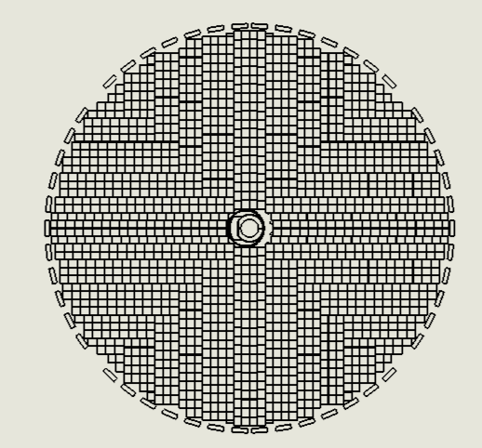
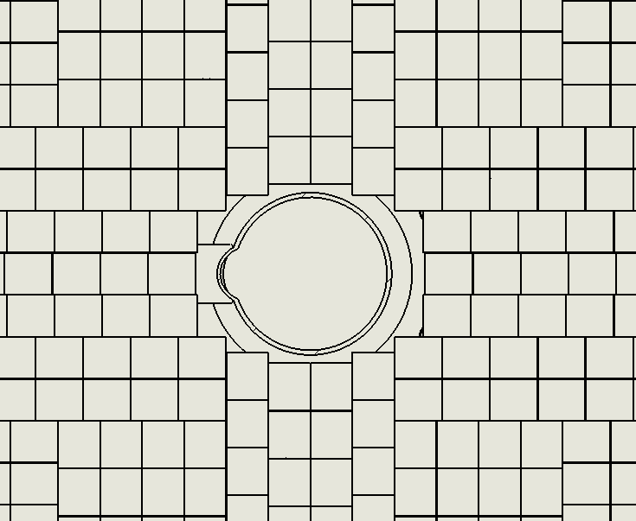
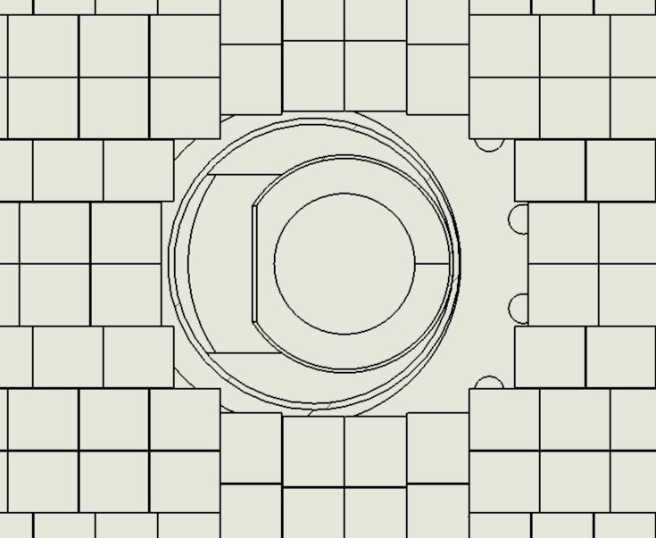
Disks – a bit of a mess
I have taken a crack at this and frankly don’t see a great path here
For each disk, given the unit sensor (reticle) size:
Start around beam pipe opening to try to minimize gaps
There are two basic configurations: straight split or offset split
Stitch outwards, ideally to edge of disk, in vertical and horizontal directions
Use “herringbone” pattern to fill in sectors at 45 degree angles
Significant edge effects for smaller disks (perimeter gaps)
Disk 4, h-direction
Straight split
Fill or leave symmetric?
e-direction
h-direction
Offset split

