Slide 1
Modular RICH Detector Design Using Autodesk
Cheuk-Ping Wong and Sawaiz Syed
Georgia State University
10-19-2015

Slide 2
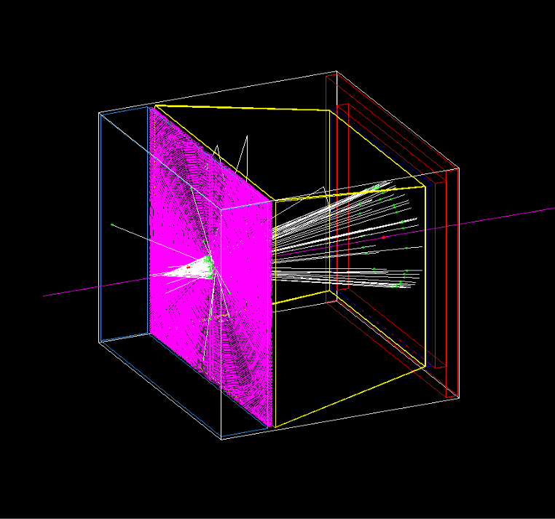
Modular RICH Detector in GEMC
Silica Aerogel (SiO₂) -- Radiator
Density 0.02 g/cm3
Refractive index: n=1.025
Read-out
mirror
Fresnel lens -- Focus Cherenkov radiation on the photonsensor
Acrylic, C5H8O2, 1.19 g/cm3
Four sections, G4Polycon
100 grooves
aerogel
Fresnel lens
photonsensor
10 cm
Mirror -- Reflector
Four sections: left, right, top and bottom
Reflectivity index : 0.95
10 cm
Photosensor & Readout
Block of aluminum
2 cm
8 cm
5 cm
Notes:
This is the modular RICH detector simulation setup. The beams first pass through a 2cm thick aerogel and emit Cherenkov radiation. Then the emitted photons are focused by a fresnel lens with 100 grooves, and finally arrive at the photosensor. Four pieces of mirrors locate on the left, right, top and bottom of the detector and act as reflectors.

Slide 3
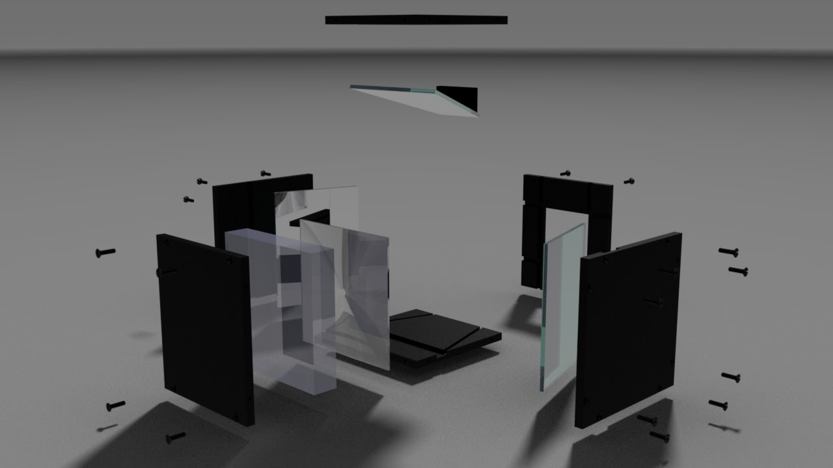
Modular RICH Detector Design Using Autodesk
Opening for mounting Hamamatsu H12700A module
Mirror
Aerogel
Fresnel Lens
Black pieces – Detector holder and light tight

Slide 4
Modular RICH Detector Design Using Autodesk
The bottom mirror is missing in the picture. Picture will be updated on GSU NP webpage.

Slide 5
Modular RICH Detector Design Using Autodesk
To keep the positions of the Fresnel lens and the mirrors, we make rails on the inner sides of the holder (see next slide), and also two little pieces of block for the top and bottom mirrors.

Slide 6
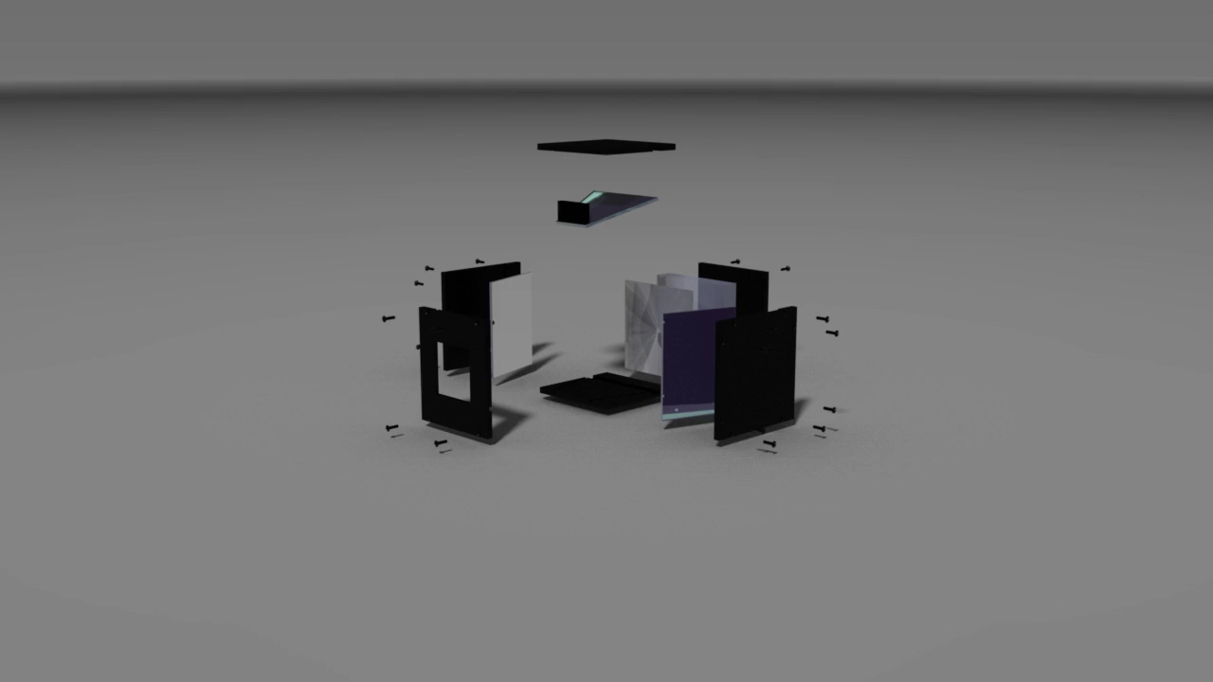
Modular RICH Detector Design Using Autodesk

Slide 7
Dimensions of Fresnel Lens and Hamamatsu H12700A module
Fresnel Lens
Dimension 6.7”x6.7”
Groove density 100 (grooves/inch)
Focal length 3”
From Edmund Optics
Hamamatsu H12700A module
Effective Area 48.5mm x48.5mm

Slide 8
Summary
We have received H12700A module and need help on reading it out
We submitted orders for a Fresnel lens from Edmund Optics and the black pieces.

Slide 9
Back Up

Slide 10
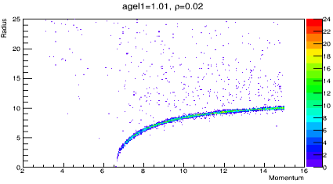
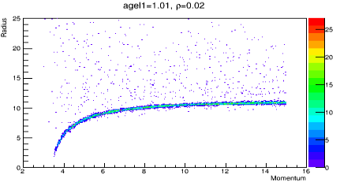
Typical Cherenkov Ring Radius
Aerogel refractive index =1.01
Density of aerogel =0.02
➔Typical Cherenkov Ring Radius (in momemtum range 3 to 15 GeV) is smaller than 12 mm
Pion-
Kaon-

