Slide 1
Electron Attachment in LAr
Craig Thorn
6/7/2020

Slide 2
Electron Attachment
Units
Measured attachment rates
Calculating attachment rates
Maxwell-Boltzmann distribution
Attachment cross sections
Direct (radiative) attachment
Electron affinity and electron attachment
Dissociative attachment
Calculated attachment rates
Electron Attachment to H₂O in LAr
Henry’s Coefficient for H₂O in LAr
Attachment rates from measured lifetimes
Comparison to Attachment in GAr
Summary

Slide 3
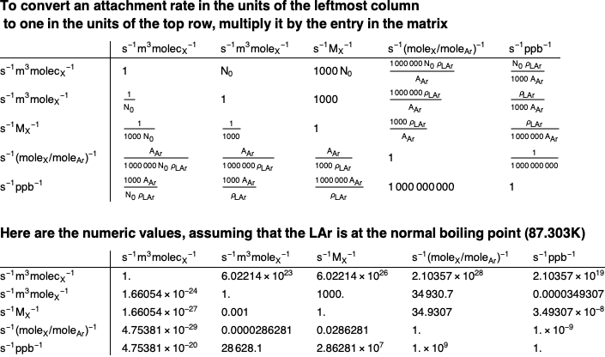
Units of Attachment Rate
Notes
M_{X} is the molarity of X (mole of X/liter of solution)
s⁻¹(mole_{X}/mole_{Ar})⁻¹ is generally abbreviated to s⁻¹

Slide 4
Values for Electron Attachment to Impurities in LAr from the Literature

Slide 5
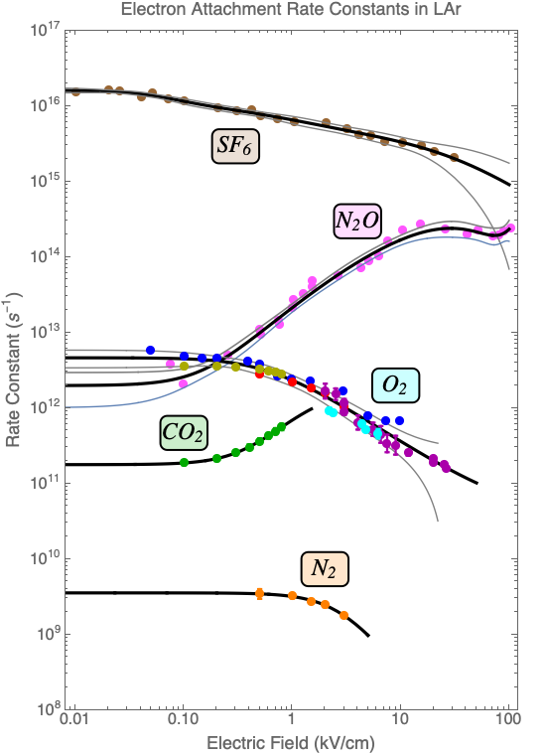
Measured Attachment Rates in LAr
SF₆: Ref 1
N₂O: Ref 1
O₂: Ref 1, 2, 3, 4, 5
CO₂: Ref 2
N₂: Ref 5
G. Bakale, et al., J. Phys. Chem. 80 (1976) 2556.
A. Bettini, et al., NIM A305 (1991) 171.
W. Hofmann, et al., NIM 135 (1976) 151.
Adams, et al., NIM A545 (2005) 613.
Biller, et al., NIM A276 (1989) 144.
Lines are best fit with 1σ confidence band.
Note the order of k_{A} at low field:
SF₆ > N₂O ~ O₂ > CO₂ > N₂

Slide 6
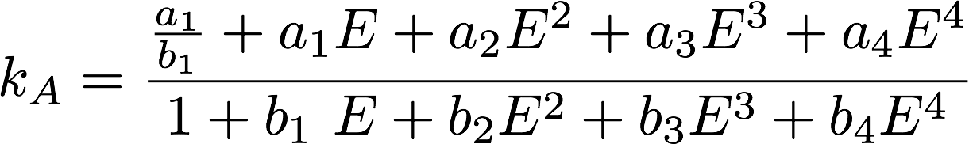
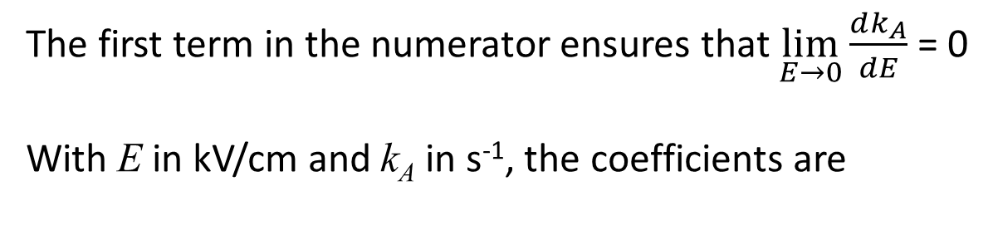
Best Fit for Measured Attachment Rates
The first term in the numerator ensures that $\lim_{E→0}{\frac{dk_{A}}{dE}}$ = 0
With E in kV/cm and k_{A} in s⁻¹, the coefficients are
For O₂ the 1σ error bands are the best fit plus or minus

Slide 7
Data and Best Fit for Attachment to O₂

Slide 8
Calculation of Electron Attachment Rates from Measured Electron Attachment Cross Sections

Slide 9
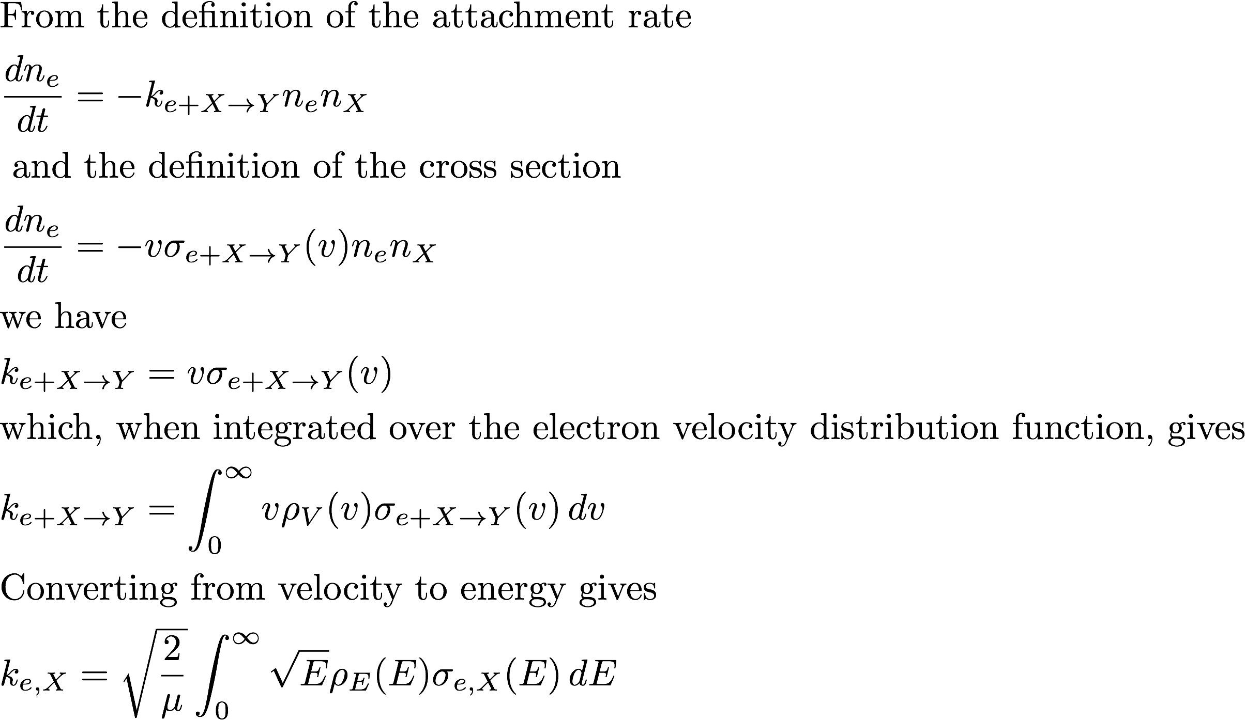
Rates from Cross Sections
see slides 9 &10
see slide 15

Slide 10
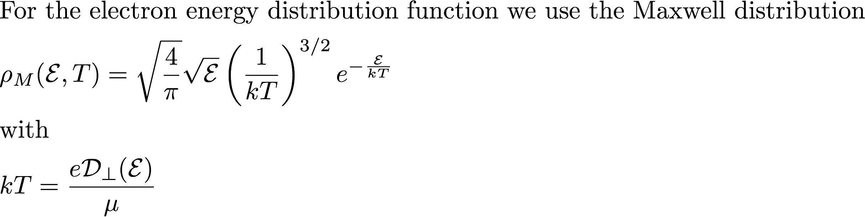
Electron Energy Distribution Functions
When the electrons are in thermal equilibrium with the atoms the EEDF, ρE(E), is given by the Maxwell distribution.
In the presence of an applied external field, the electrons are heated by collisions, and the EEDF is obtained as the solution of the Maxwell-Boltzmann equation using the actual atomic scattering cross sections, σ(E), for electron scattering in LAr.
For gasses, the solution can be obtained from the computer program MagBoltz – see http://magboltz.web.cern.ch/magboltz/
For liquids there is additional coherent scattering from atomic correlations in the liquid. Re-writing MagBoltz for liquids is not trivial.
As simple-minded substitute, we use the Maxwell distribution with a field-dependent electron energy
The measured transverse diffusion gives the electron temperature through the Einstein relation.
See Bakale, et al., J. Phys. Chem. 80 (1976) 2556 for a more rigorous, but still semi-empirical approach,
and Atrazhev and Timoshkin, IEEE Trans. Dielectrics and Electrical Insulation 5 (1998) 450 for the solution of the Boltzman equation in liquid, including coherent scattering.

Slide 11
Transverse Diffusion of Electrons in LAr Transverse diffusion measures the electron temperature.
V. M. Atrazhev and I. V. Timoshkin, Transport of Electrons in Atomic Liquids in High Electric Fields, IEEE Trans. Dielec. Elect. Insul. 5 (1998) 450.

Slide 12
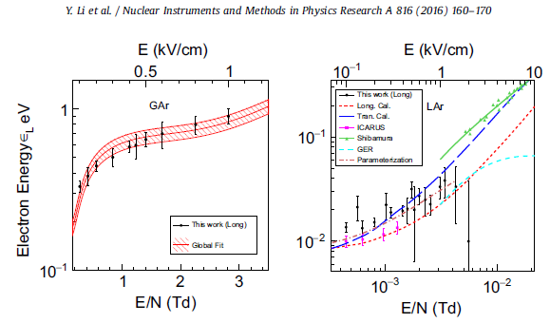
Measured Transverse Diffusion of Electrons in LAr Measurements are consistent with Atrazhev calculation

Slide 13
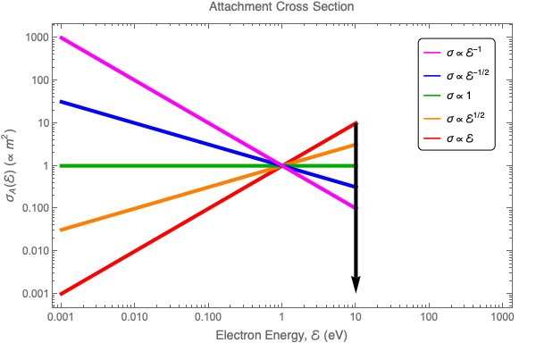
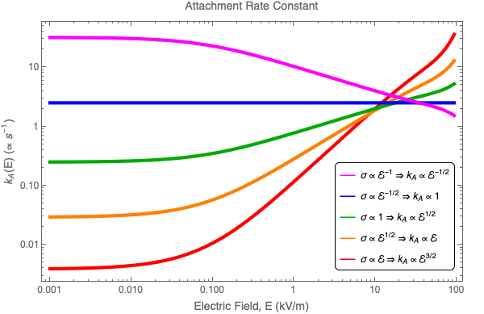
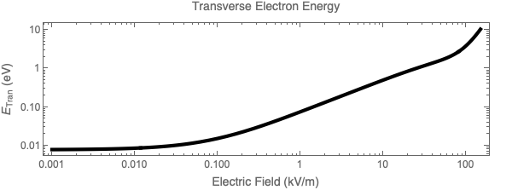
Zero Field Attachment Rate (analogue of zero field mobility)
Folding Cross Sections with Electron Energy Distributions
Electron Attachment Cross Section
Attachment Rate

Slide 14
Electron Attachment Cross Sections

Slide 15




Attachment Mechanisms
Single step processes
1. Direct Radiative (resonance) attachment
2. 3-body attachment
3. Dissociative attachment
Multi-step processes (to keep things simple we do not consider these)
Multiple simultaneous and sequential single step processes
See e.g. Christophorou, Chem Rev 76 (1976) 409.
Equilibrium
Attachment is in equilibrium with detachment: detailed balance applies
$$e^{− }+X→{X_{}^{−}}^{∗}→X_{}^{−}+h$$
$$e^{− }+X+M→X^{−}+M+k.e.$$
$$e^{− }+XY→X^{−}+Y+k.e.$$
$a→b→c$ implies $\frac{1}{k}=\frac{1}{k_{ab}}+\frac{1}{k_{bc}}$ and $\begin{matrix}a→b \\ a→c\end{matrix}$ implies $k=k_{ab}+k_{ac}$
$\begin{matrix}a→b \\ a←b\end{matrix}$ implies $\frac{k_{ba}}{k_{ab}}=\frac{2j_{a}+1}{2j_{b}+1} exp⁡(\frac{{ΔE}_{ba}}{k_{B}T})$

Slide 16
Attachment Mechanisms Summary
We consider only two processes
Radiative (resonance) attachment
Dissociative attachment
Direct attachment cross sections are not measured:
Therefore, we assume a Hauser-Feschbach type process for radiative attachment, and scale the magnitude to match the measured attachment at low field.
We take the dissociative attachment cross sections from the literature. See www.LxCat.net.

Slide 17
Direct Attachment

Slide 18
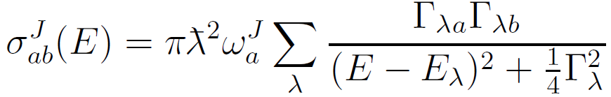

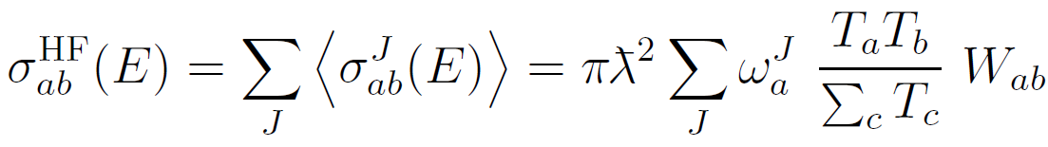
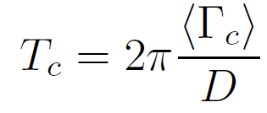
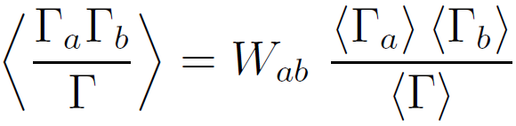
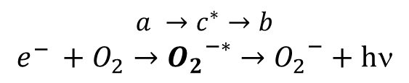
Direct Radiative Attachment Maximum cross section
This is a compound state problem: a reaction from state a to state b through a resonant compound (molecular) state c*.
$$a →c^{∗}→b$$
$$e^{− }+O_{2}→{O_{2}}_{}^{−∗}→{O_{2}}_{}^{−}+h$$
The cross section through an isolated compound state of spin J is
and
where E is the incident energy, λ is the reduced wavelength in the incident channel, ω_{a}^{J} is a statistical factor, Γ_{λa} and Γ_{λb} are the partial widths of Breit-Wigner resonance λ in the incident and exit channels, E_{λ} is the energy of the resonance and Γ_{λ} is its total width, the sum of the partial widths in all channels.
The cross section averaged over all resonances is given by Hauser-Feschbach theory:
Channel transmission coefficients T_{c} and width fluctuation parameters W_{ab} are given by
and
D is the average resonance spacing.

Slide 19
Direct Attachment and Electron Affinities

Slide 20
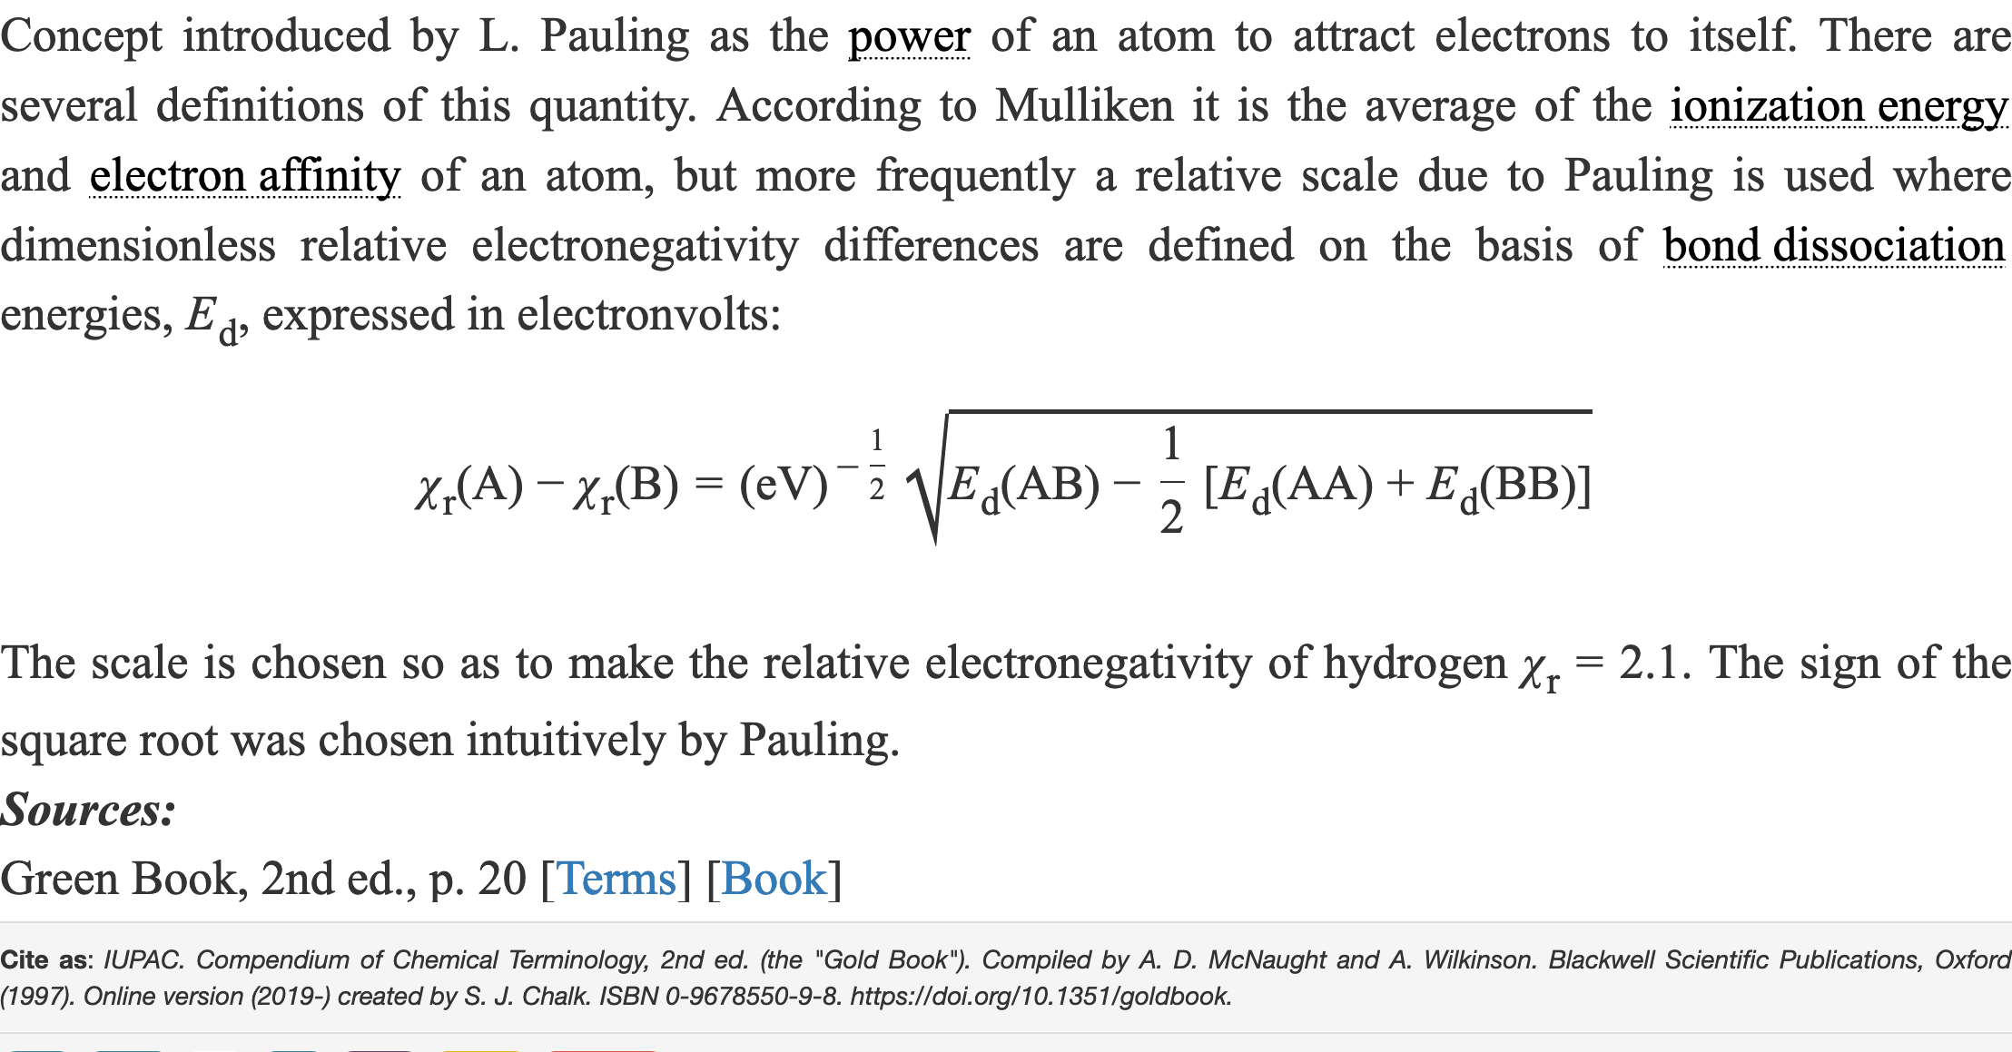
Electron Affinities vs. Electronegativity Electronegativity is generally defined only for elements. It is measured in several different ways.
Electron affinity is the energy of this reaction: e⁻ + X → X⁻ + ΔE_{EA}
Electronegativity:
Ne, He, F, O, Ar, and N are the most electronegative elements (on the Allen scale), in decreasing order.

Slide 21
Electron Affinities and Dissociation Energies They are a proxy for cross sections.
Species | E_{A} (eV) | E_{Diss, Mol} (eV)
SF₅ | 3.66
Cl | 3.61 | n/a
F | 3.40 | n/a
SF₃ | 3.07
F₂ | 3.01 | 1.60
Cl₂ | 2.38 | 2.48
SF₄ | 2.35
NO₂ | 2.27
O₃ | 2.10
OH | 1.83 | 4.39
O | 1.46 | n/a
SO | 1.13 | 5.36
SO₂ | 1.11 | 5.67
SF₆ | 1.07 | 3.38
H | 0.75 | n/a
O₂ | 0.45 | 5.12
NH | 0.22 | 3.51
N₂O | 0.22 | 1.71
(H₂O)₂ | 0.03 | 3.27, 3.56, …
NO | 0.026 | 7.59
H₂O | 0 | 3.27, 3.56, …
NH₂ | 0 | 4.23
NH₃ | 0 | 4.66
N | -0.07 | n/a
CO₂ | -0.6 | 5.45
N₂ | -1.6 | 9.76
CO | -1.8 | 11.10
H₂ | -2.5 | 4.48
Electron affinity is the energy of this reaction:
e⁻ + X → X⁻ + ΔE_{EA}
Dissociation energy if the energy of this reaction:
XY + ΔE_{Dissoc} → X +Y
For dissociative attachment
e⁻ + XY → X⁻ +Y + ΔE_{Dissoc}
The threshold energy is
ΔE_{Dissoc}(XY)- ΔE_{EA}(X)
Similar order to that for attachment rate:
SF₆ > N₂O ~ O₂ > CO₂ ~ H₂O > N₂
J.C. Rienstra-Kiracofe, Atomic and Molecular Electron Affinities: Photoelectron Experiments and
Theoretical Computations, Chem. Rev. 102 (2002) 231.
G.R. Somayajulu, Dissociation Energies of Diatomic Molecules, J. Chem. Phys. 33 (1960) 1541.

Slide 22
Comments on the Electron Affinities of N₂, H₂O, and CO₂
“While every atom and molecule has an IP, they need not have an EA. There is a large class of anions which are not bound species. Many common molecules such as N₂, H₂O, and C₆H₆ do not form stable anions. In the gas phase H₂O⁻ decays to H₂O plus a free electron and C₆H₆ ⁻ is not stable with respect to benzene and e⁻. The carbon dioxide anion is metastable for roughly 100 μs before it disintegrates: CO₂→CO₂ + e⁻. Generally, radicals, such as OH, CH₃, or CH₂=CH, bind an electron into their “half-filled molecular orbital” and form stable anions. In contrast, many closed-shell species, such as N₂, H₂O, and C₆H₆, have filled valences and do not bind an electron.”
J.C. Rienstra-Kiracofe, et al., Atomic and Molecular Electron Affinities: Photoelectron Experiments and
Theoretical Computations, Chem. Rev. 102 (2002) 231.
“… the calculated binding energy of the excess electron is so small in the Franck-Condon region (a maximum of about eV) that calculations not invoking the Born-Oppenheimer
approximation would be required to determine whether H₂O⁻ is truly a stable species.”
D.M. Chipman, Effect of Molecular Geometry on the Electron Affinity of Water, J. Phys. Chem. 82 (1978) 1080.
Therefore, we have EA = 0 for the H₂O molecule in the above table.

Slide 23
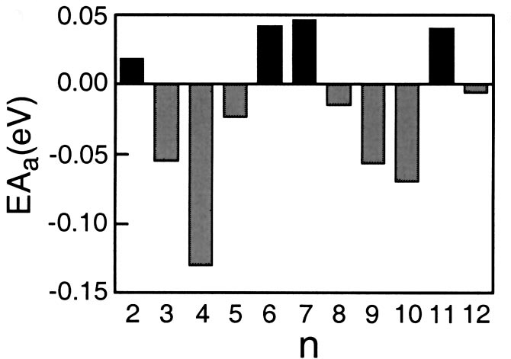
Further Comments on the Electron Affinities of H₂O Part 1
However, in the condensed phases of H₂O (water and ice) clusters of molecules do attach electrons to form stable anions, such as (H₂O)₂ with an electron affinity of 30±4 meV.
(H₂O)_{n}⁻
Ref 1
Ref 2
See:
1. H.M. Lee, et al., Origin of the magic numbers of water clusters with an excess electron, J. Chem. Phys. 122 (2005) 044309.
2. Y. Bouteiller, et al., Structure and intermolecular motions of the water dimer anion, J. Chem. Phys. 105 (1996) 6420.
3. A.P. Gaiduk, et al., Electron affinity of liquid water, Nature Communications 9 (2018) 247.

Slide 24
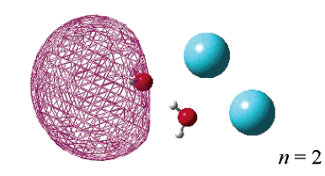
Further Comment on the Electron Affinities of H₂O Part 2
In addition, it has also been observed that stable anions are formed by water dimers bound with multiple Ar atoms, as (H₂O)₂Ar_{n}⁻ with n = 1 thru 9 and 11 and 12. The electron affinities are similar to those for (H₂O)₂ when n< 6.
See M.-K. Tsai, et al., Electron Attachment to (H₂O)₂Ar_{n} Clusters, J Phys Chem A108 (2004) 2912.
It therefore remains a possibility that anions of (H₂O)₂ clusters, with or without multiple bound argon atoms, play a significant role in electron attachment by water in LAr. However, since the electron affinities of these species are all less than 0.05 eV, we assume that the direct electron attachment cross section is small.

Slide 25
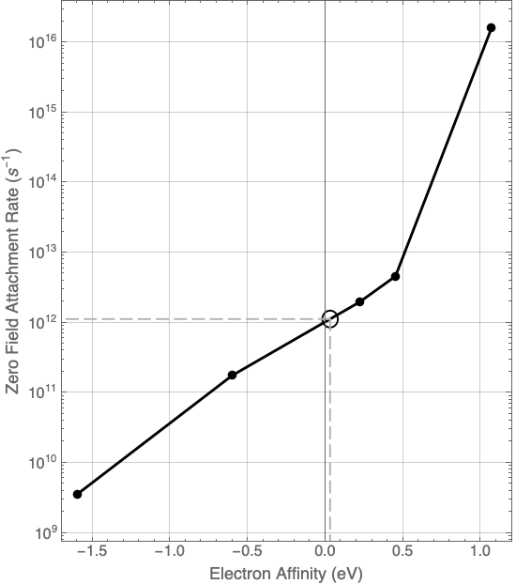
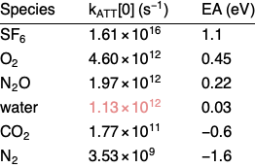
Observed Correlation between Electron Affinity and Electron Attachment Rate High electron affinity is associated with large direct attachment cross section.
Measured attachment rates (at zero field) and measured electron affinities (negative numbers are calculations). The attachment rate for (H₂O)₂ is found by interpolation to be 1.13 x 10¹² s⁻¹.

Slide 26
Dissociative Attachment Cross Sections and Total Cross Section for Calculating Attachment Rate

Slide 27
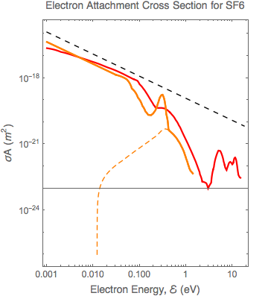
Measured Attachment Cross Sections for SF₆ high electron affinity is associated with large direct attachment cross section
Optical model limit
Christophorou
Direct
LxCat
Direct
Christophorou
e⁻+SF₆→SF₅⁻+F
Data from www.LxCat.net downloaded 10/16/2017
L. G. Christophorou, et al., Cross Sections for Electron Attachment Resonances Peaking at Subthermal Energies, J. Chem. Phys. 54 (1971) 253.

Slide 28
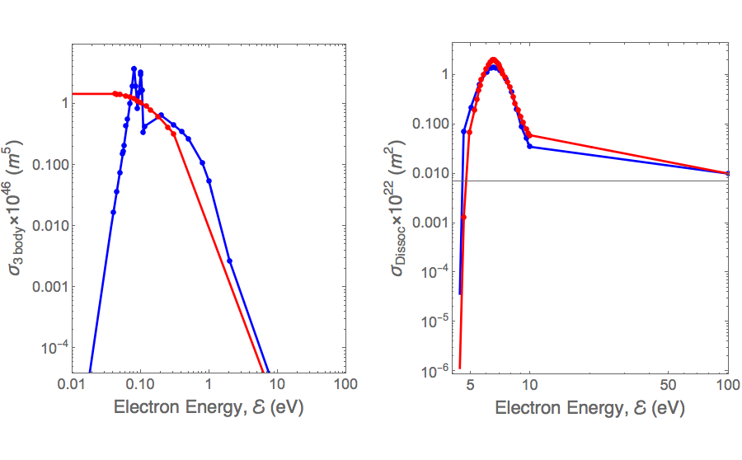
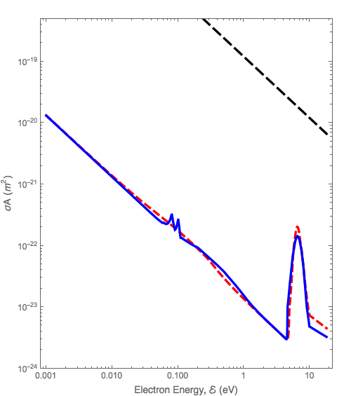
Attachment Cross Sections for O₂
Sum of
1.1x10⁻⁴ of Radiative
0.02 of 3-Body
Single Dissociative Channel
3-Body
Dissociative
[3]
[2]
[3]
[1]
D.L. McCorkle, L.G. Christophorou, and V.E. Anderson, J. Phys. B5 (1972) 1211.
L.G. Christophorou, D.L. McCorkle, and V.E. Anderson, J. Phys. B4 (1971) 1163.
Biagi (Magboltz versions 8.9 and higher) from www.LxCat.net downloaded 10/16/2017

Slide 29
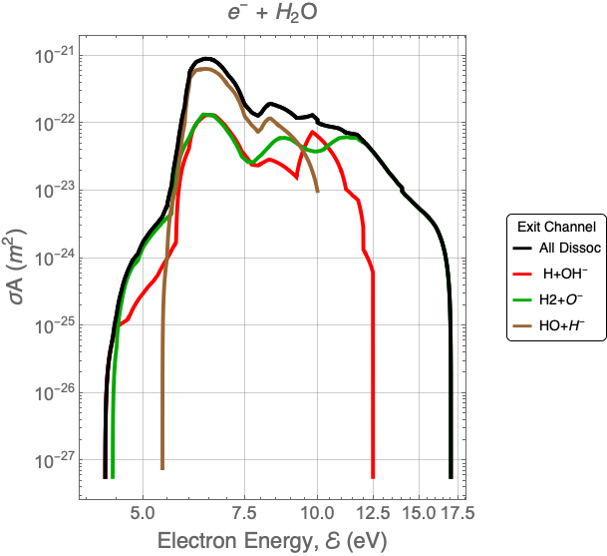
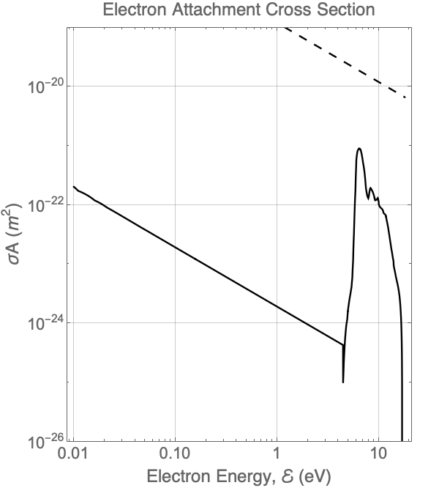
Attachment Cross Sections for H₂O: Dissociation Dominates
Sum of
1.69 x 10⁻⁵ of Radiative
All Dissociative Channels
Dissociative channels only
Data from www.LxCat.net downloaded 10/16/2017

Slide 30
Calculated Attachment Rates

Slide 31
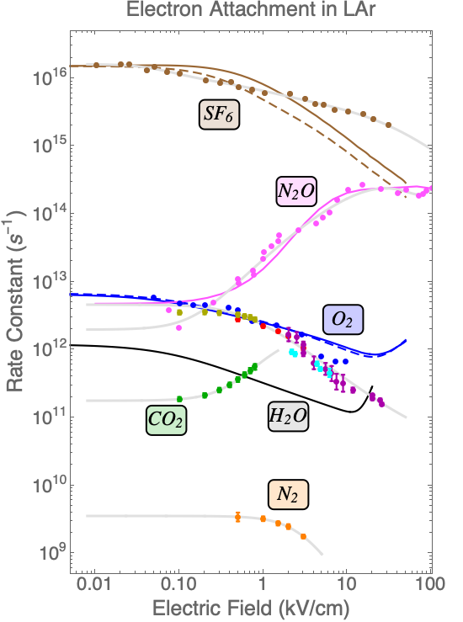
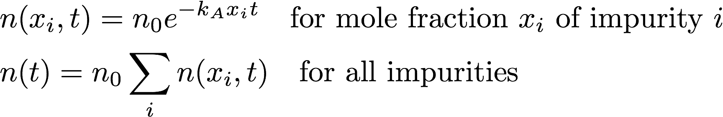
Calculated Attachment Rates
Light gray curves are best fit to Pade function constrained to have zero derivative at x=0.
Solid and dashed curves are calculated from cross sections and modified Maxwell energy distribution.

Slide 32
Electron Attachment to H₂O in LAr

Slide 33
Attachment Rate for H₂O in LAr
No measured attachment rate for H₂O in LAr is reported in literature.
Measurements of electron lifetime in LAr and H₂O concentration in gas exist
But to convert lifetime to attachment rate, we must have the concentration in the liquid
Ratio of an impurity in the gas to that in the liquid is Henry’s coefficient:
x_{i} , y_{i} are the concentrations, expressed as mole fractions, of impurity in the liquid and gas phases, respectively
The attachment rate, in terms of the lifetime and gas concentration, is:
So, what is Henry’s Coefficient for H₂O?
Conventional notation is:
x denotes mole fraction in liquid
y denotes mole fraction in gas

Slide 34
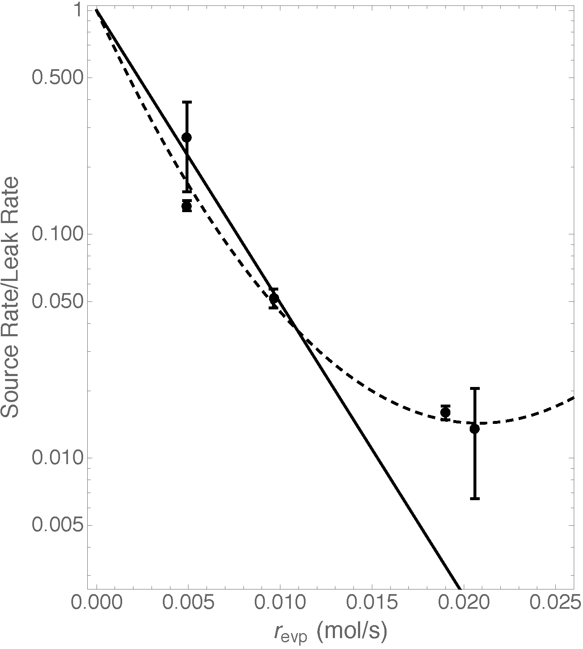
Concentrations in the Gas
We have found the impurity concentration to be non-uniformly distributed in the gas volume.
The attachment rate in terms of lifetime and observed gas concentration is:
The concentration at the liquid surface (which is in equilibrium with the liquid) is not the same as the concentration above. This is caused by the flow of evaporation gas away from the surface, against which the impurity must diffuse. We call this the “baffle effect”.

Slide 35
Henry’s Coefficient for H₂O in LAr

Slide 36
Henry’s Coefficient for H₂O in LAr
Here is what we know about Henry’s coefficient of H₂O in LAr:
NIST program REFPROP v8 [1] gives 3x10⁻⁹ at 90 K , and REFPROP v10 [2] gives 4.1x10⁻³ at 90 K. However, they report the latter value for H₂O concentrations in the liquid of up to 10 ppm, which we believe is well above the actual saturation concentration of H₂O in LAr.
Andrews, et al. [3] report 500 without any explanation; however this is certainty not measured in equilibrium conditions, and, because of the “Baffle effect”, is probably much larger than Henry's coefficient.
We have observed Henry’s coefficient in LAr to be between 1 and 4, although these are probably not true equilibrium measurements either. In the next slide, we will briefly explain our measurements. Then, in the following slides, we will comment on the fact that values are unexpectedly large.
https://www.nist.gov/srd/refprop
Same source as above, but v10 uses new mixing parameters from J. Gernert and R. Span, J. Chem. Thermodyn., 93 (2016) 274: DOI:10.1016/j.jct.2015.05.015
R. Andrews, et al., NIM A608 (2009) 251.

Slide 37
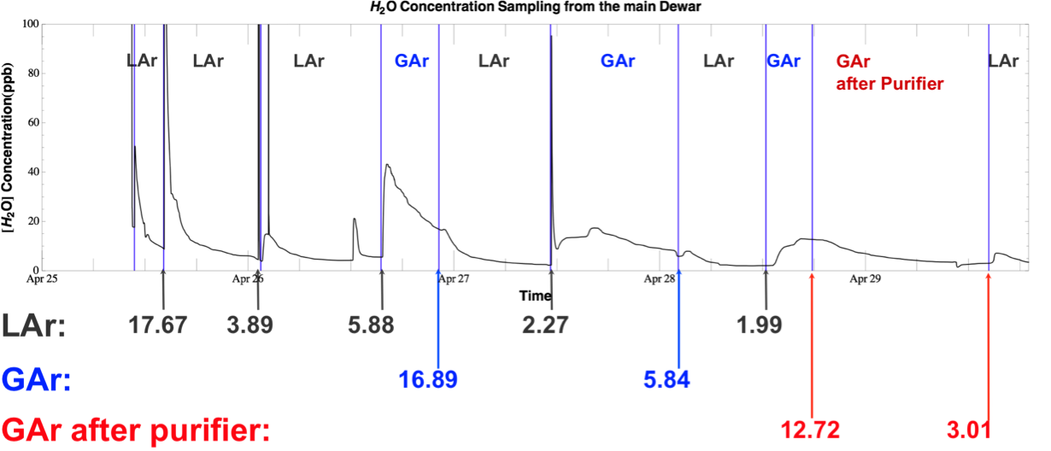
Henry’s Coefficient for Water in LAr

Slide 38
Henry’s Coefficient for Water in LAr
We have measured Henry’s coefficient for water in LAr by two different methods:
By alternately measuring the water concentration in a flow of gas from a tube terminating in the liquid, and a tube terminating in the gas a fewl inches above the liquid. This gives a value of 3.5±1.9
By measuring the fractional rate at which the water concentration in the liquid decreases with time as the evaporation gas is purified by a molecular sieve and is re-condensed into the liquid. Henry’s coefficient is given approximately by
This gives a value of about 1.0.
The value determined by the first method is larger because water vapor enters primarily from leaks in the top flange of the cryostat and diffuses downward to the liquid surface against the upward flow of evaporation gas, creating a concentration gradient increasing from the surface to the top flange. Thus the gas concentration becomes larger than the equilibrium concentration at the surface.

Slide 39
Henry’s Coefficient for Impurities in LAr from Dalton’s and Raoult’s Laws
Dalton’s Law is
Raoult’s Law is
Therefore, for the gas phase of a two component (Z in LAr)
x is mole fraction in liquid
y is mole fraction in gas
x₁=1-x₂
And Henry’s coefficient is
This is the result for an Ideal Solution, in which both components in both phases behave as ideal gases, and there is no heat of mixing (that, never the less, condense).

Slide 40
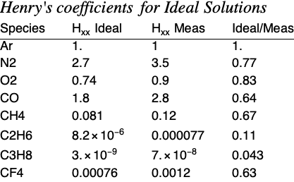
Henry’s Coefficient for Impurities in LAr for Ideal Solutions
Henry’s coefficient for Ideal Solution is

Slide 41
Henry’s Coefficient for H₂O in LAr for an Ideal Solution
Henry’s coefficient for H₂O in LAr is
For the vapor pressure of ice, see Rainer Feistel, and Wolfgang Wagner, Sublimation pressure and sublimation enthalpy of H₂O ice Ih between 0 and 273.16 K, Geochimica et Cosmochimica Acta 71 (2007) 36.
The range of the measured data set is stated to be 273.15K  T  130K, corresponding to pressures ranging from 6.11x10⁻³ bar to 4.78x10⁻¹³ bar. There are 216 data points in the set. Below 130K the sublimation pressure is constrained by thermodynamic relations.
From their Table 4, the vapor pressure of ice at 90K is 1.39x10⁻²² bar.
The vapor pressure of LAr at 90K is 1.33 bar.
This gives Hxx = 1.04x10⁻²² at 90K
Conclusion: There is a (large) chemical interaction between water and LAr.
This is also true for water vapor in air – absolute humidity is not the vapor pressure of water divided by atmospheric pressure.

Slide 42
Henry’s Coefficient for a Regular Solution
A Regular Solution considers heat of mixing, but requires that the entropy change be that of the ideal solution, namely –R x_{i} ln(x_{i}) per mole.
Henry’s coefficient for impurity 1 in solvent 2 is
where
where
and
molar volume of i
c_{ii} is the “cohesive energy” of component i.
c_{i2} = (1-L₁₂ ) (c₁₁ c₂₂ )^{1/2} defines L₁₂, a parameter that is near zero when solute and solvent are similar.
J.H. Hildebrand and R.L. Scott, Regular Solutions, Prentice Hall, NJ (1962)
R.C. Reid, J.M. Prausnitz, and B.E. Poling, The Properties of Gases and Liquids, 4th ed., McGraw - Hill, NY (1987)
E.R. Bazua and J.M. Prausnitz, Vapor - liquid equilibria for cryogenic mixtures, Cryogenics 11 (1971) 114.

Slide 43
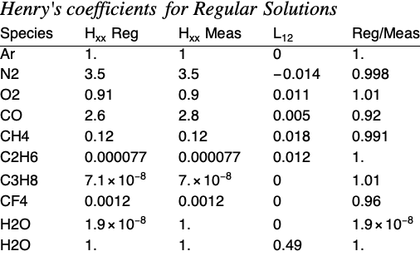
Henry’s Coefficient for Impurities in LAr for Regular Solutions
Henry’s coefficient for Regular Solution is

Slide 45
Estimates of Attachment Rate to H₂O in LAr from Measured Lifetimes

Slide 46
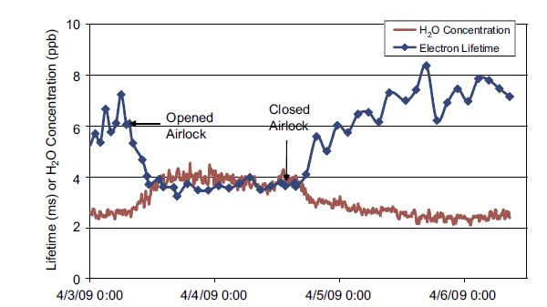
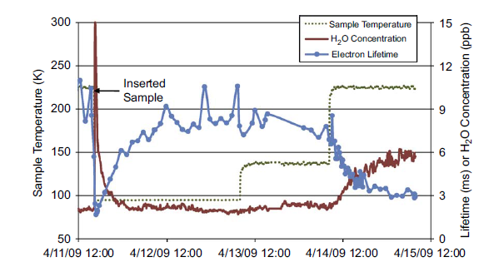
Estimate of Attachment Rate for H₂O
R. Andrews, et al., NIM A608 (2009) 251.
“The argon vapor was monitored for moisture because the moisture analyzer was not sensitive to concentrations in the liquid. For example, when using the sintered metal return and operating the internal filter, we estimate the water concentration in the liquid is 1/500 of that in the vapor.” (italics added)
Estimate k_{A}(H₂O) = (4.4±0.7) x 10¹³ s⁻¹
Estimate k_{A}(H₂O) = (4.9±0.5) x 10¹³ s⁻¹
These measurements of electron lifetime and H₂O concentration in the gas, plus the statement that the concentration in the liquid is 500 times smaller, are used to obtain the above estimates of attachment rates. We assume no contribution of attachment to O₂. The paper does not specify an electric field. We take the field to be 10 V/cm; the attachment rates at fields below 100 V/cm are relatively constant.

Slide 47
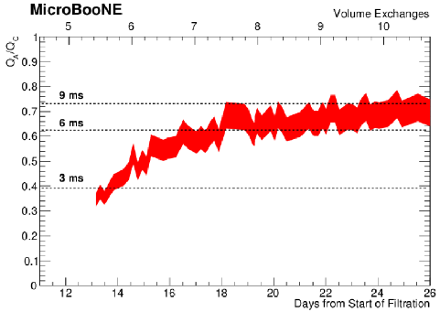
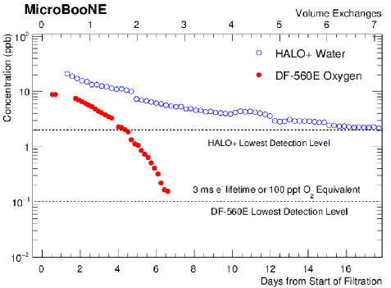
Estimate of Attachment Rate for H₂O
B. Carls and M. Zuckerbrot, MicroBooNE docDB 4823, 10/27/2015.
Estimate k_{A}(H2O) = (6.9±0.3) x 10¹⁰ s⁻¹
Estimate is made as in the previous slide, but we use a value of 1 for Henry’s constant. The factor of 500, used in the Andrews data set, was a result of the specific conditions of that measurement (condenser efficiency and flow rate through the filter), and does not apply here. The contribution of O₂ to the measured lifetime is negligible. The electric field is 32V/cm, as deduced from the drift velocity as indicated by the time shown in Figure 5 of the technote (the public version is in docDB 4928-v16).

Slide 48
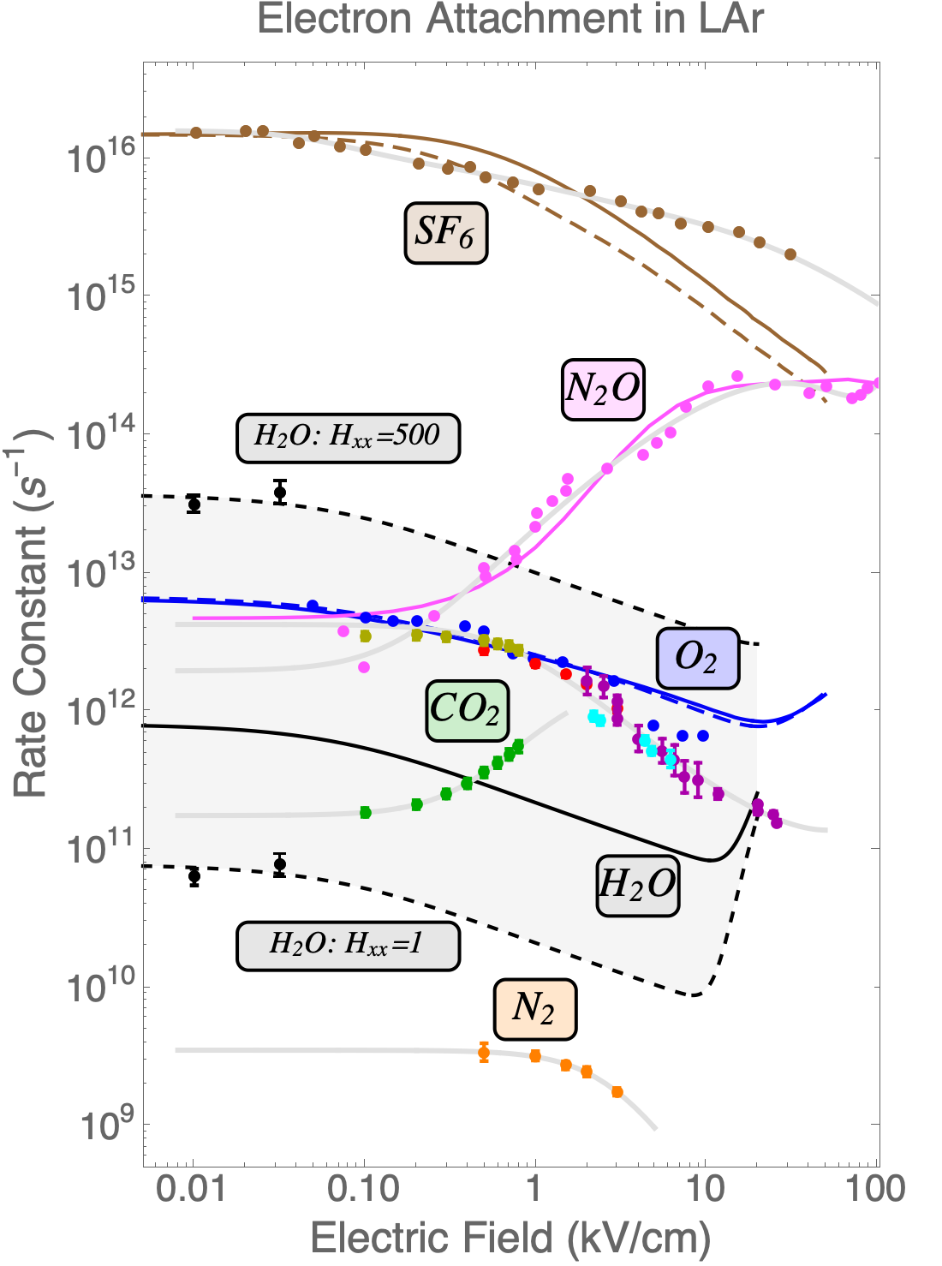
Calculated Attachment Rates
Light gray curves are best fit to Pade function constrained to have zero derivative at x=0.
Solid and dashed curves are calculated from cross sections and modified Maxwell energy distribution.
For H₂O three calculations are shown, each using a different magnitude of the radiative attachment cross section, but the same dissociative attachment cross section.
The solid black line matches the low field attachment implied by the measured electron affinity (see slide 25)
The two dashed black lines match the minimum and maximum values implied by our analysis of the Carls and the Andrews data, respectively.

Slide 49
Comparison to Attachment in GAr

Slide 50
Electron Attachment to Water in GAr is Very Small
Huk, et al. have attempted to measure attachment to water in Ar/CH₄ gas mixtures at room temperature, and they find that:
“In all cases the charge attenuation was rather small, and consistent with the one of the ‘zero measurement’, without water or methanol. This negative result can be expressed as an upper limit for the attachment coefficient:
C_{water, M} < 2 μs⁻¹ bar⁻²,
C_{methanol, M} < 2 μs⁻¹ bar⁻²,
valid for the whole experimental range of E/P.”
This is 40x smaller than their measured attachment rate for O₂ at low field.
M. Huk, et al., Electron Attachment to Oxygen, Water, and Methanol in Various Drift Chamber Gas Mixtures , NIM A267 (1988) 107.

Slide 51
Measured Attachment Rate to Water vapor
J.E .Parr and J.L. Moruzzi, Electron attachment in water vapour and ammonia, J Phys D: Appl Phys 5 (1972) 514.
See also R.W. Crompton, J.A. Rees, and R L. Jory, The Diffusion and Attachment of Electrons in Water Vapour, Aust. J. Phys. 18 (1965) 541.
k_{A}(Water in LAr) = 6 x 10⁶ s⁻¹ at 8 kV/cm by scaling from density of GAr to LAr

Slide 52
Summary
There is a direct, monotonically increasing, relation between the attachment rate in LAr and the electron affinity of the impurity.
The electron affinity of the H₂O molecule is zero.
Water interacts strongly with LAr in solution, forming H₂O - Ar complexes.
The electron affinity for the (H₂O)₂Ar_{m} complexes are positive for 0 ≤ m ≤ 9 and for m = 11 and 12, and these complexes are probably the dominant species that attach electrons to any water present in LAr.
The attachment rate for water is probably less than that for oxygen.

Slide 53
Electron Affinity vs. Vertical Detachment Energy
VDE > EA > VAE

