Slide 1
EIC Hadron Polarimetry needs a home
Elke-Caroline Aschenauer (BNL)

Slide 2
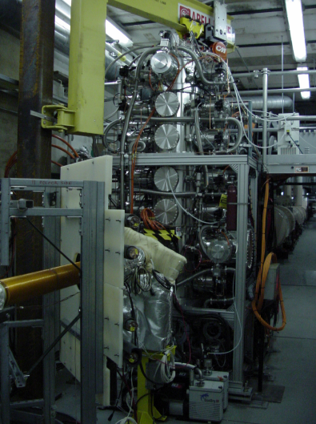
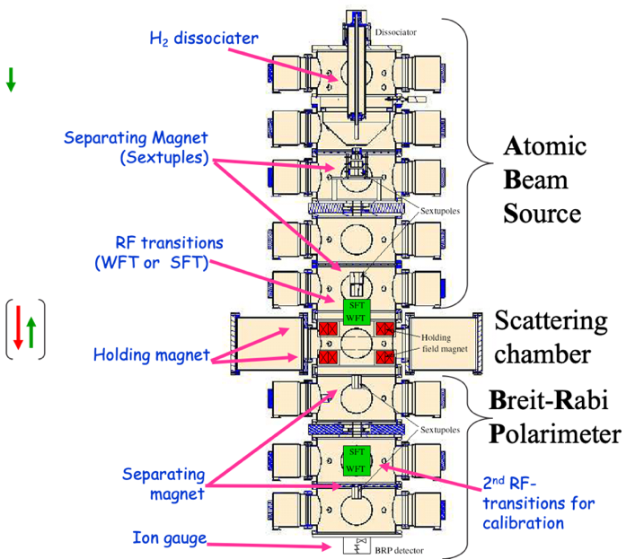
What are the Issues
What do we have now in RHIC
  H-Jet and and pC-polarimeters sit in IP-12
    H-Jet right at the IP
    pC polarimeters sit ~70m towards IP-2 from the HJet
    there are several machine elements (dipoles & quads) between them

Slide 3
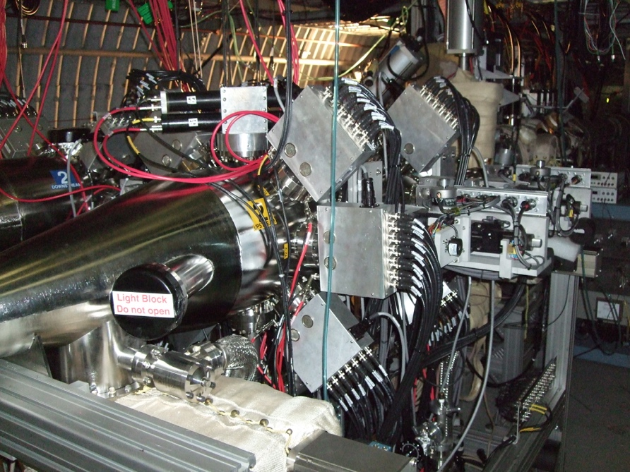
What are the issues
What is the problem at EIC
  IP-12 is super busy, RCS to ESR injection and other new equipment
    → no space left for the polarimeters → need to find a new home
  Requirements:
    need space, which fits both H-jet and pC
    we want no optics elements between the H-Jet and the pC
      this avoids relying on simulations how the spin processes between the H-Jet and pC
    need space for the taggers to veto He-3 break-up downstream of the H-jet
→ current contenders IP-4 (see Zhengqiao’s talk) and section 5 at IP-6

Slide 4


