Slide 1
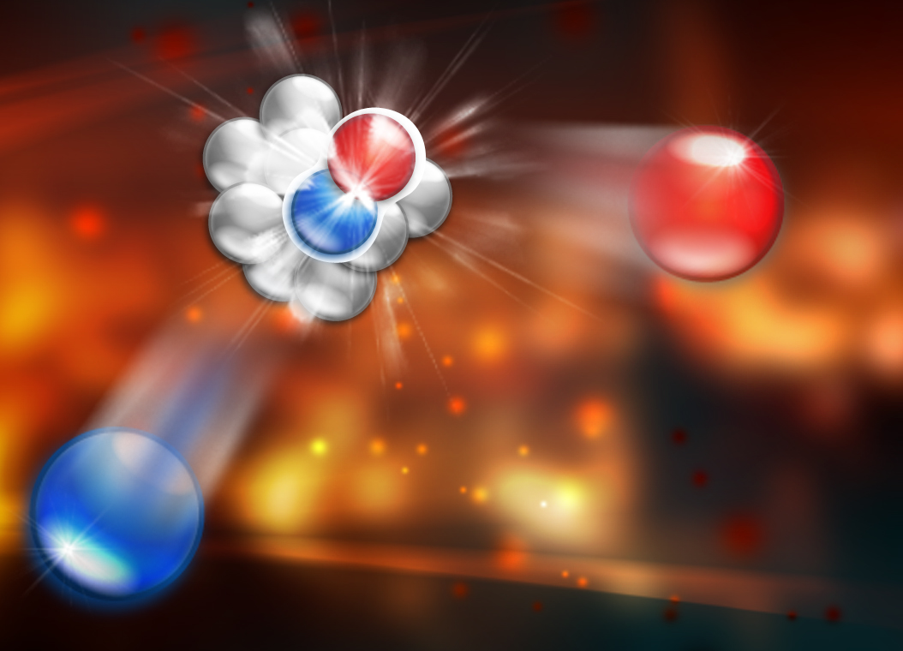
Experiment Lecture: Tracking
By Douglas Higinbotham with thanks to Brad Sawatzky (JLab)

Slide 2
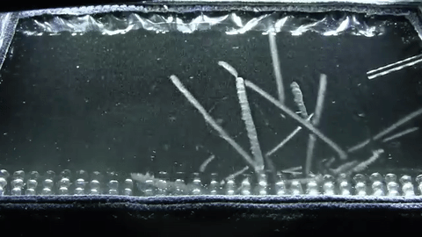
Cloud Chamber (see the cosmic rays)
Supersaturated vapor, typically of water or alcohol.
When a charged particle passes through the the mixture, the fluid is ionized, and tracks are formed as ion act as a condensation points.
1

Slide 3
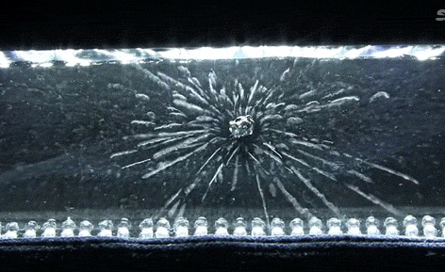
Particle Detectors (cloud chamber)
Instead of cosmic rays, one can also put a radioactive source in the mixture.
2

Slide 4
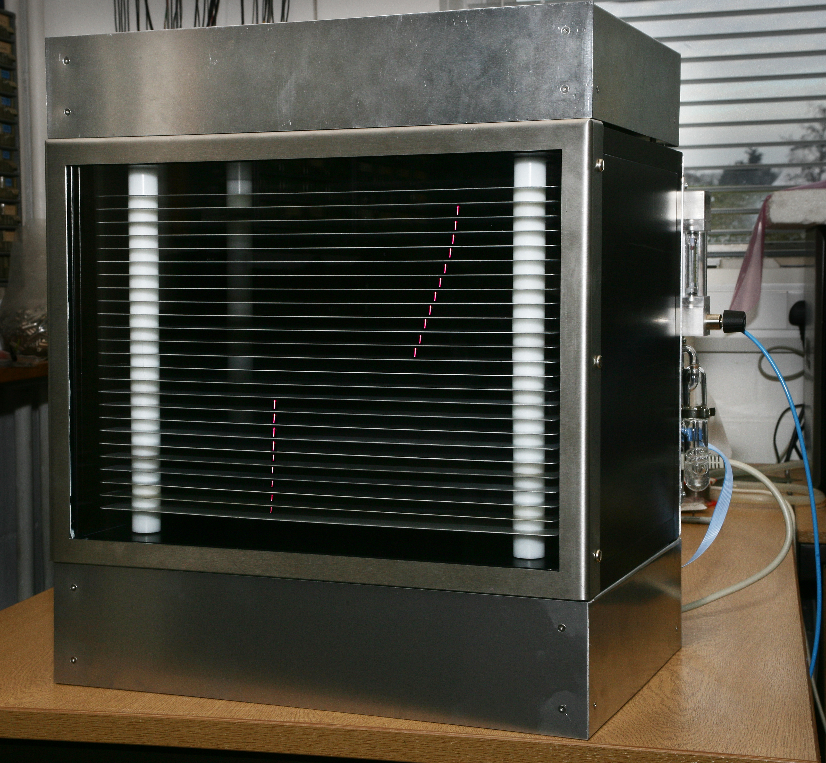
Spark Chambers Too . . .
3

Slide 5
Modern Particle Detectors
The classic detectors are nice to “see” the passage of particles through matter, they are slow. (i.e. we want to see even more!)
We now try NOT to spark are detectors.
Use sensitive electronics to detect small amount of charge.
Huge advantage in the rate the tracking detectors can handle while still being very efficient.
4

Slide 6
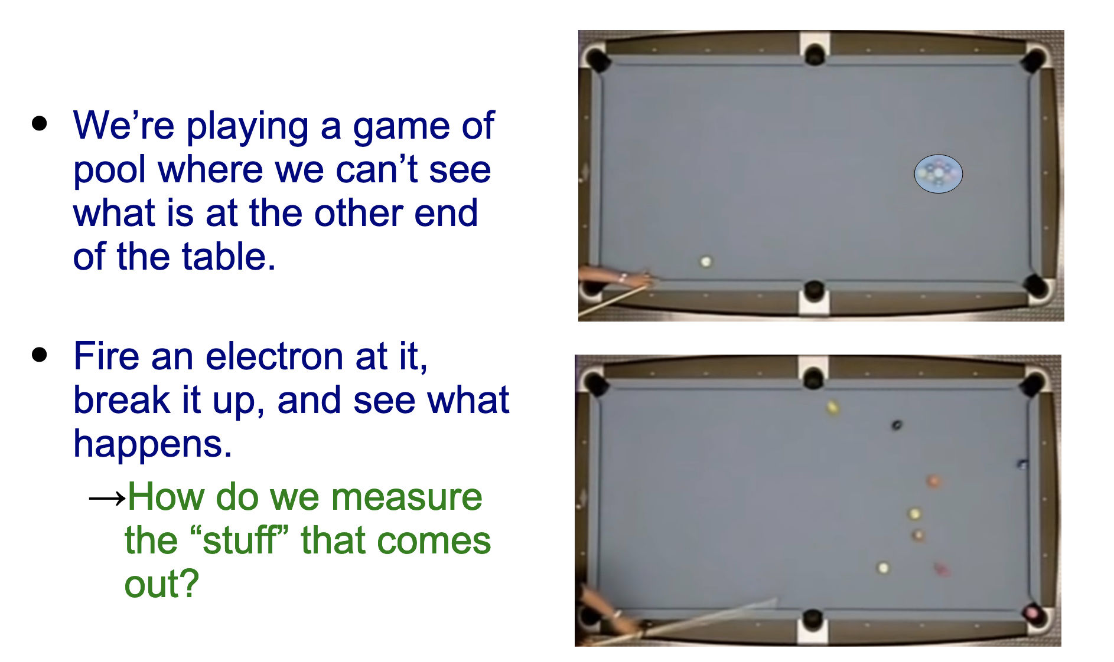
Electron Scattering Is Like A Fancy Game of Pool
The nice part of this pool game is the QED are extremely well known, so makes it easier to
understand / extract details about the initial-state from the final-state observables.
5

Slide 7
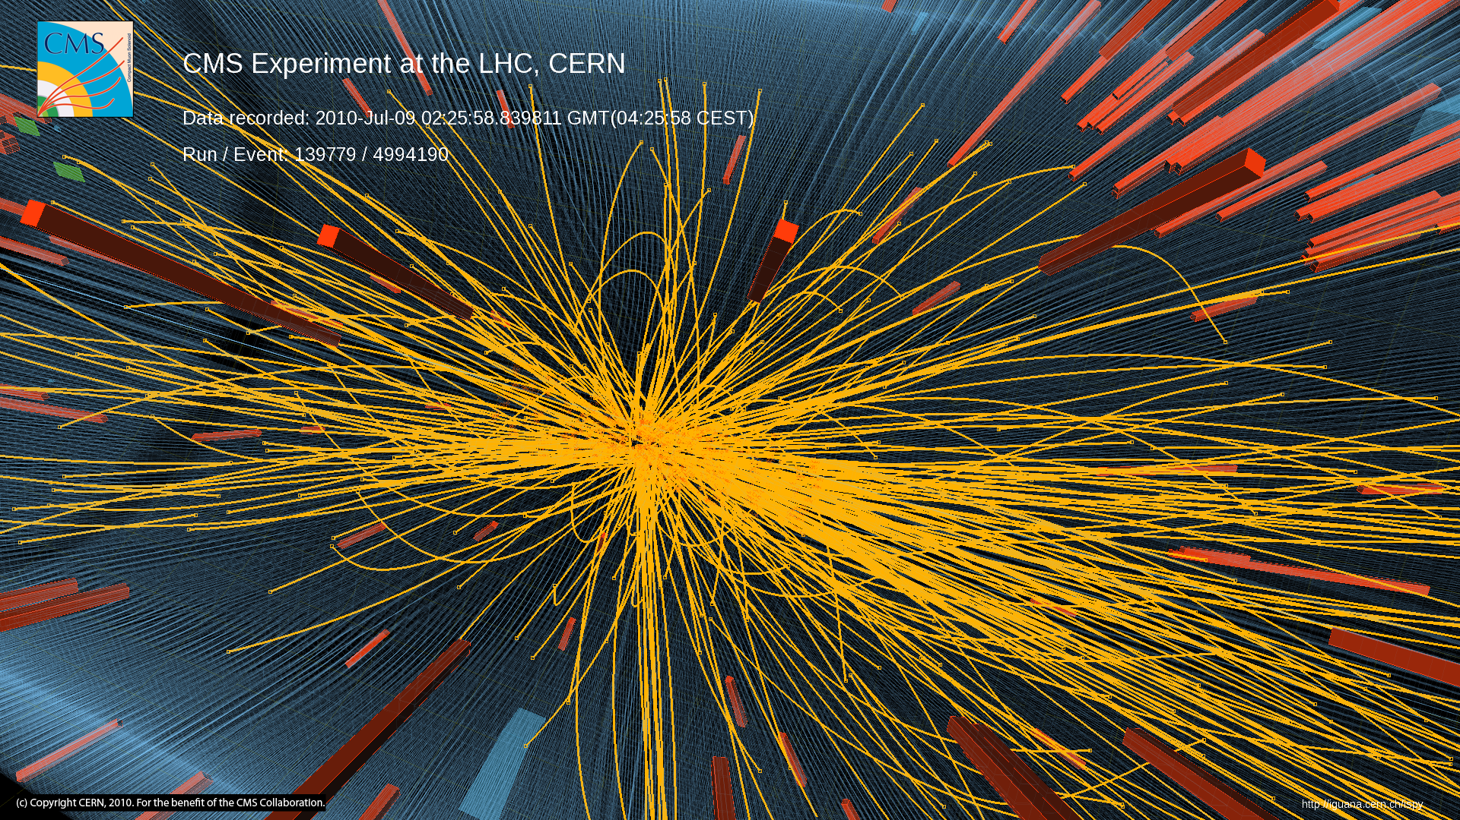
A Collision from CMS at CERN
For the hard core pool players.
6

Slide 8
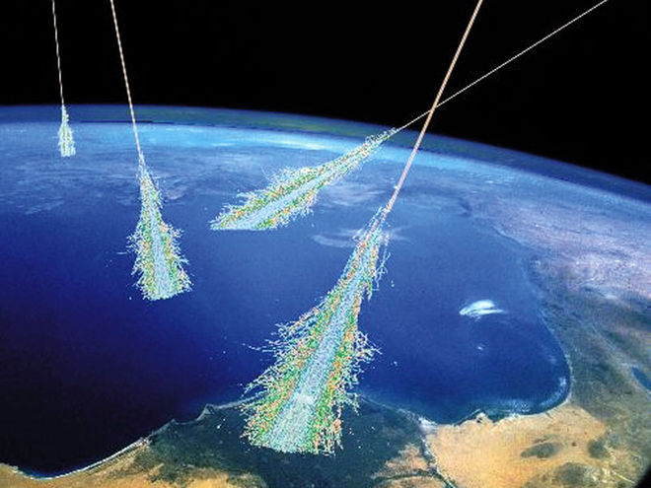
Cosmic Radiation
At sea level ~100 particles per second per m².
7

Slide 9
Cosmic Rays vs. CERN
CERN 13.6 Tera-eV (13.6 x 10¹² eV)
  The energy of approx. 13 million protons
Cosmic measured to 1 Exa-eV (1 x 10¹⁸ eV)
  The energy of one million million protons!
8

Slide 10
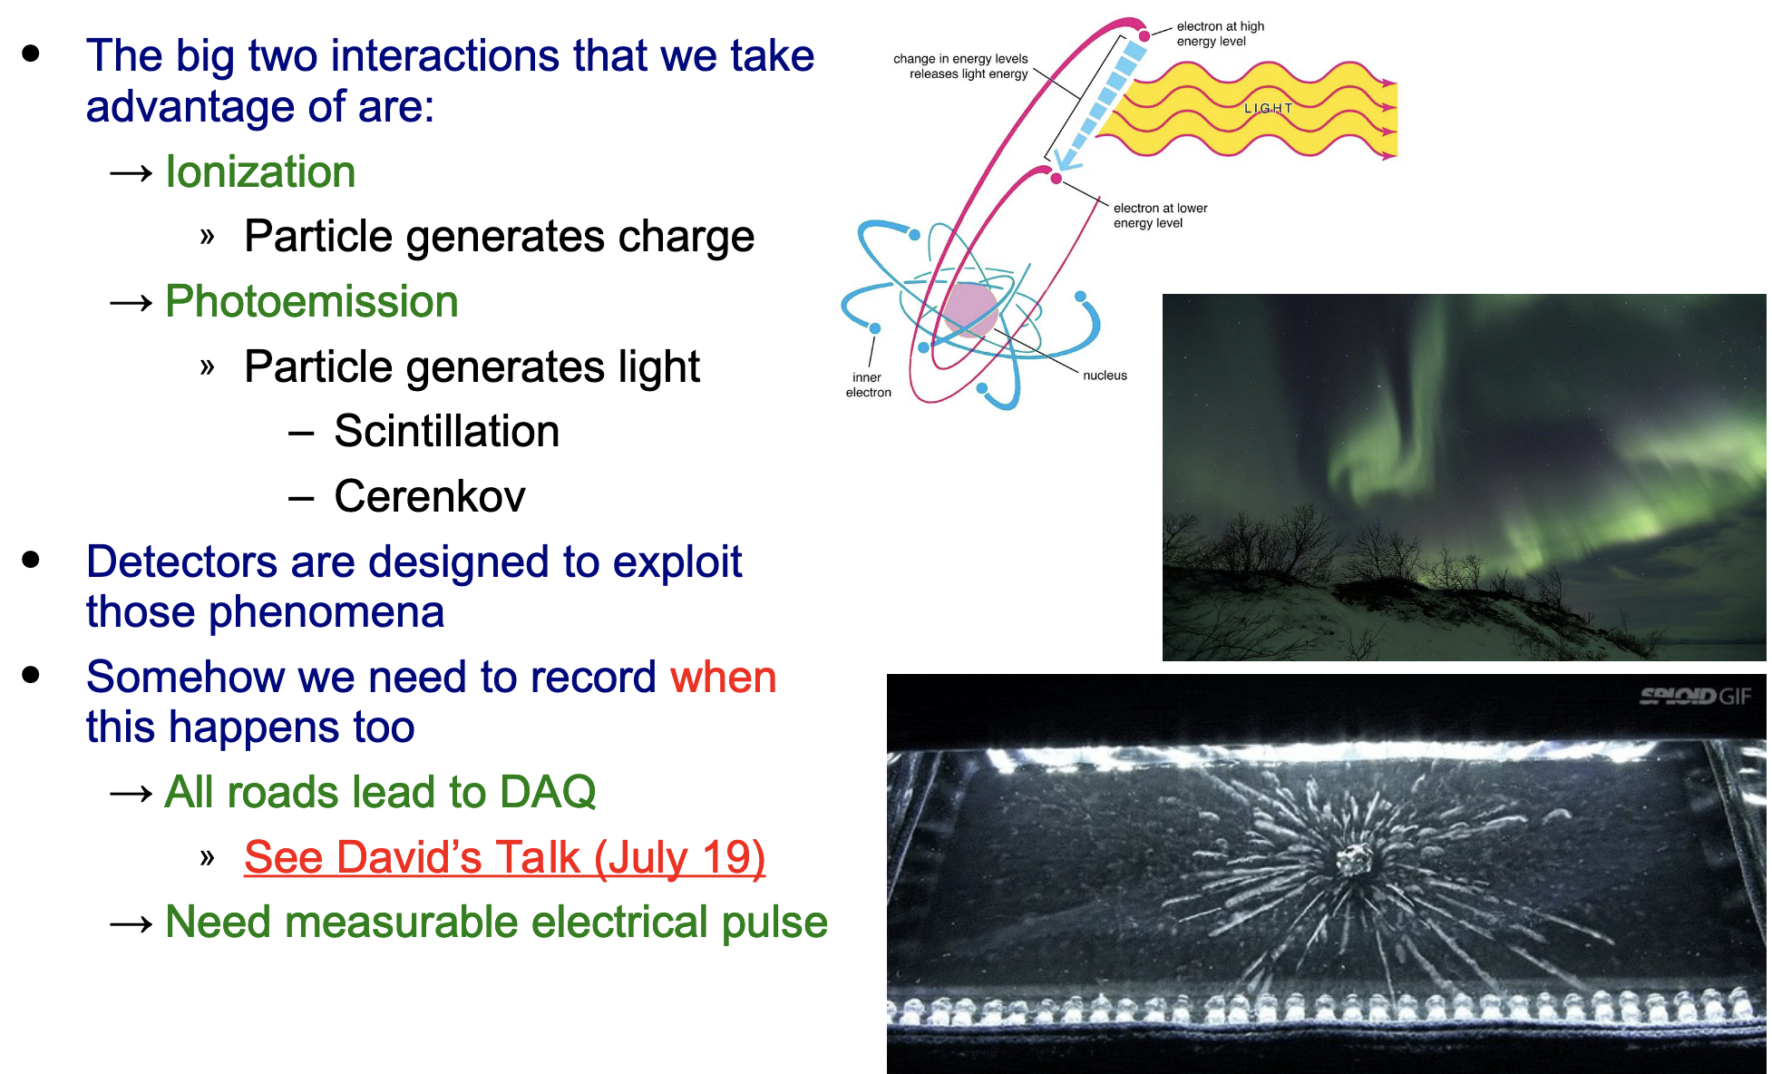
Energitic Particles Interact with Matter
9

Slide 11
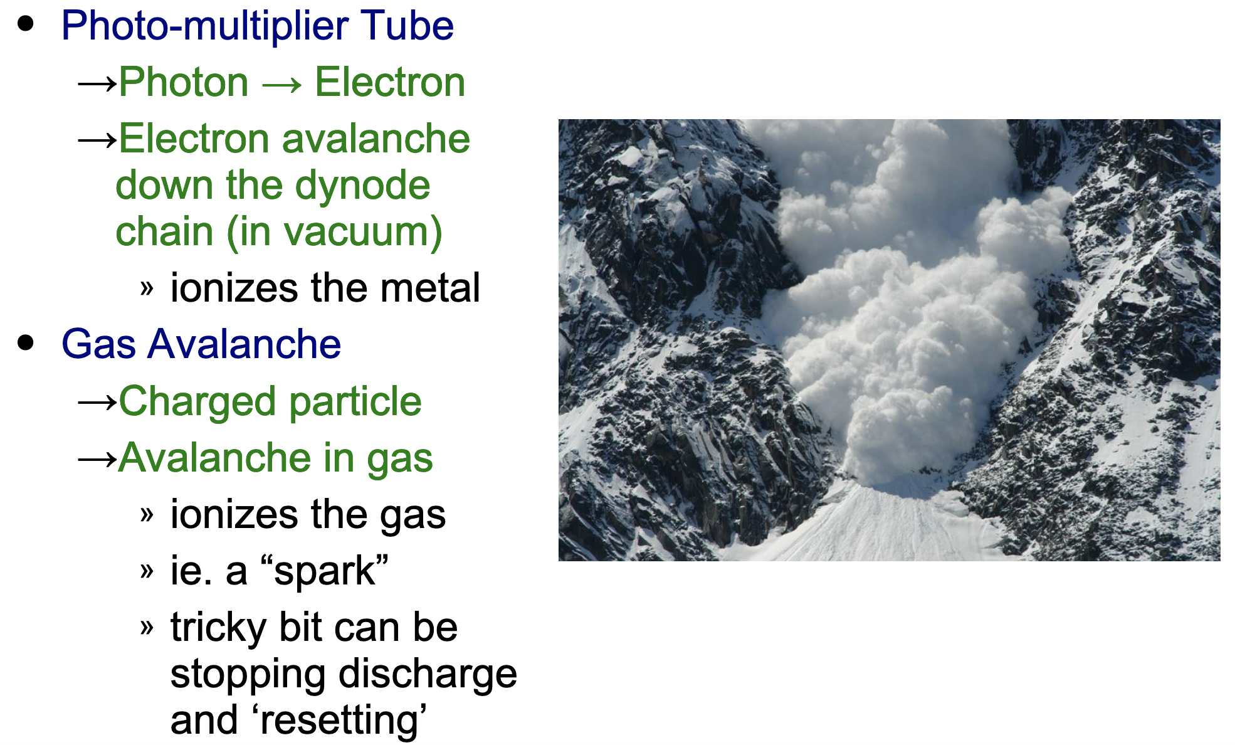
Avalanche Multiplication

Slide 12
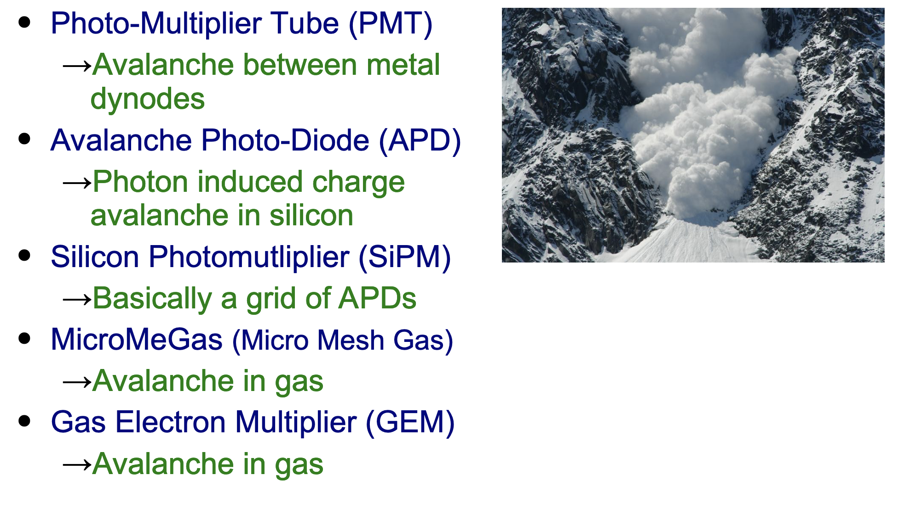
Avalanche Multiplication

Slide 13
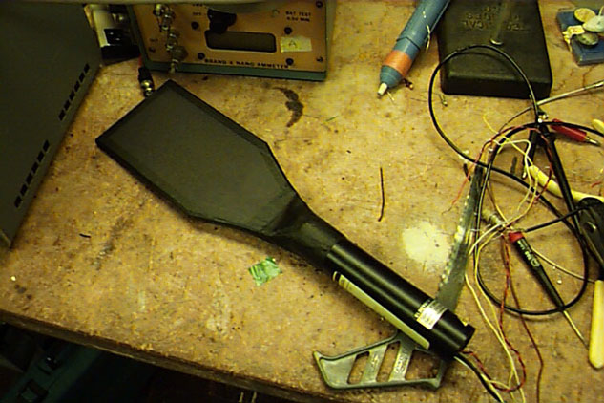
Scintillators (trigger device)
In general, we cannot record all data from tracking detectors, so we often need a trigger.
You all are getting to see the transformation to streaming readouts, but still we cannot store all information, so even if it is in software, will still need a way to decide on the events / information to store.
12

Slide 14
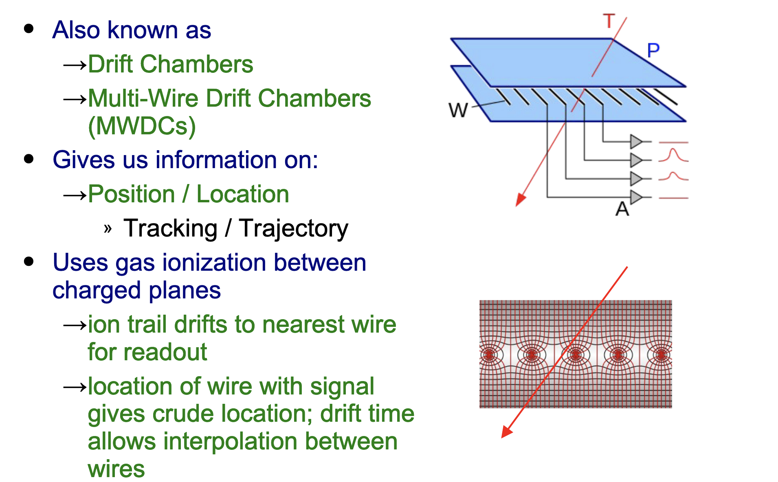
Wire Chambers

Slide 15
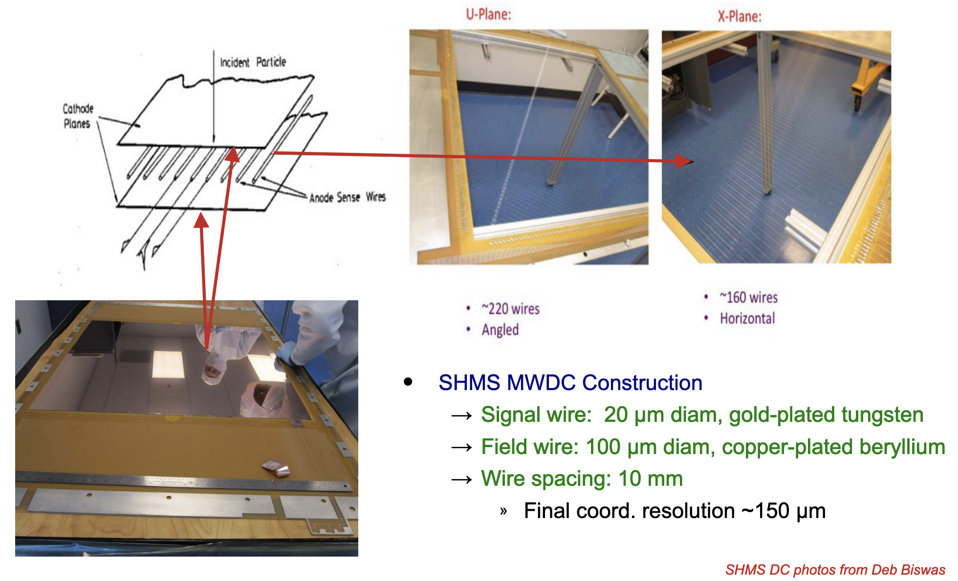
Multi-Wire Drift Chamber

Slide 16
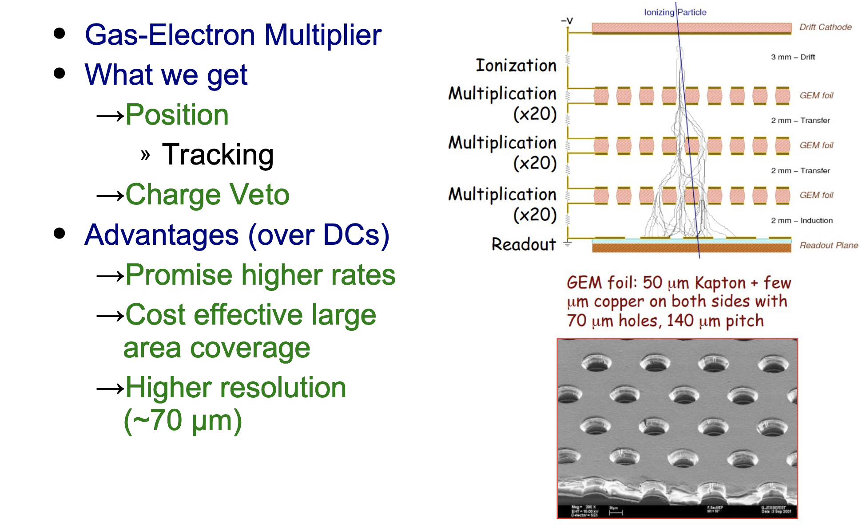
GEM Trackers

Slide 17
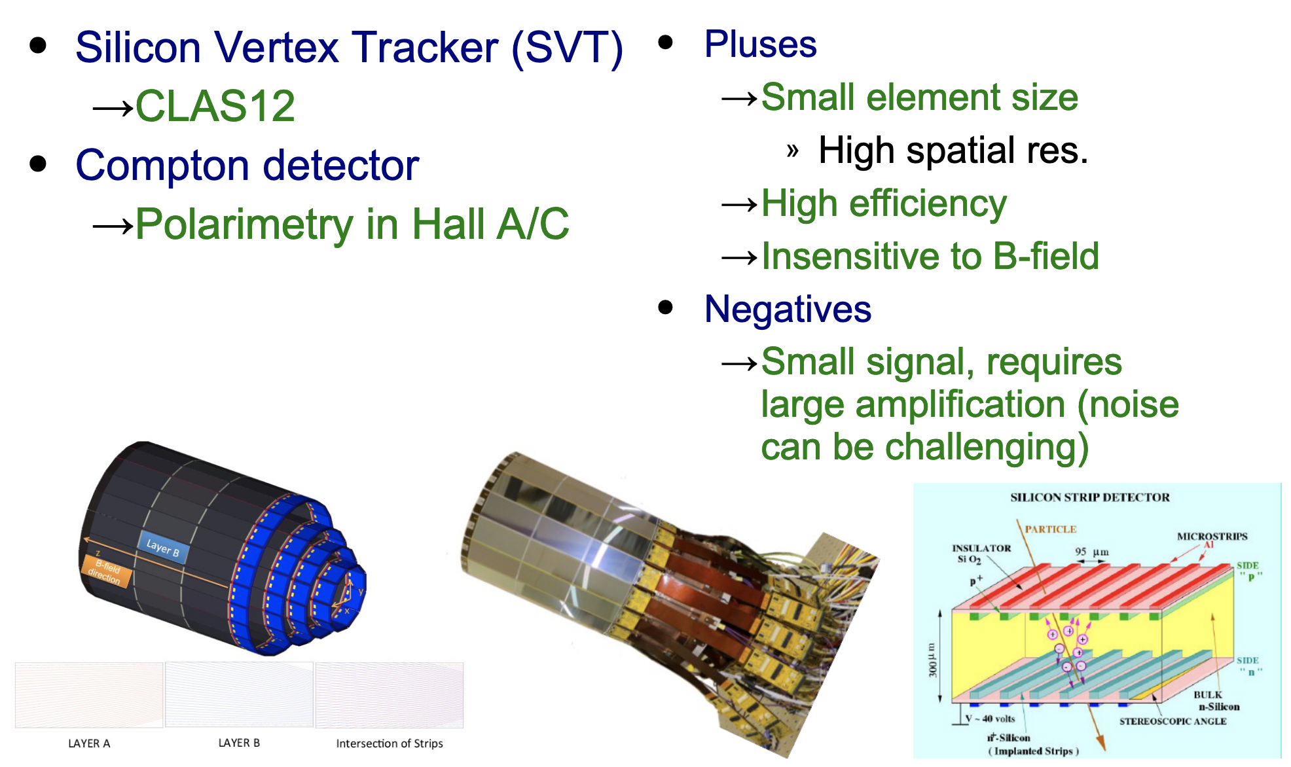
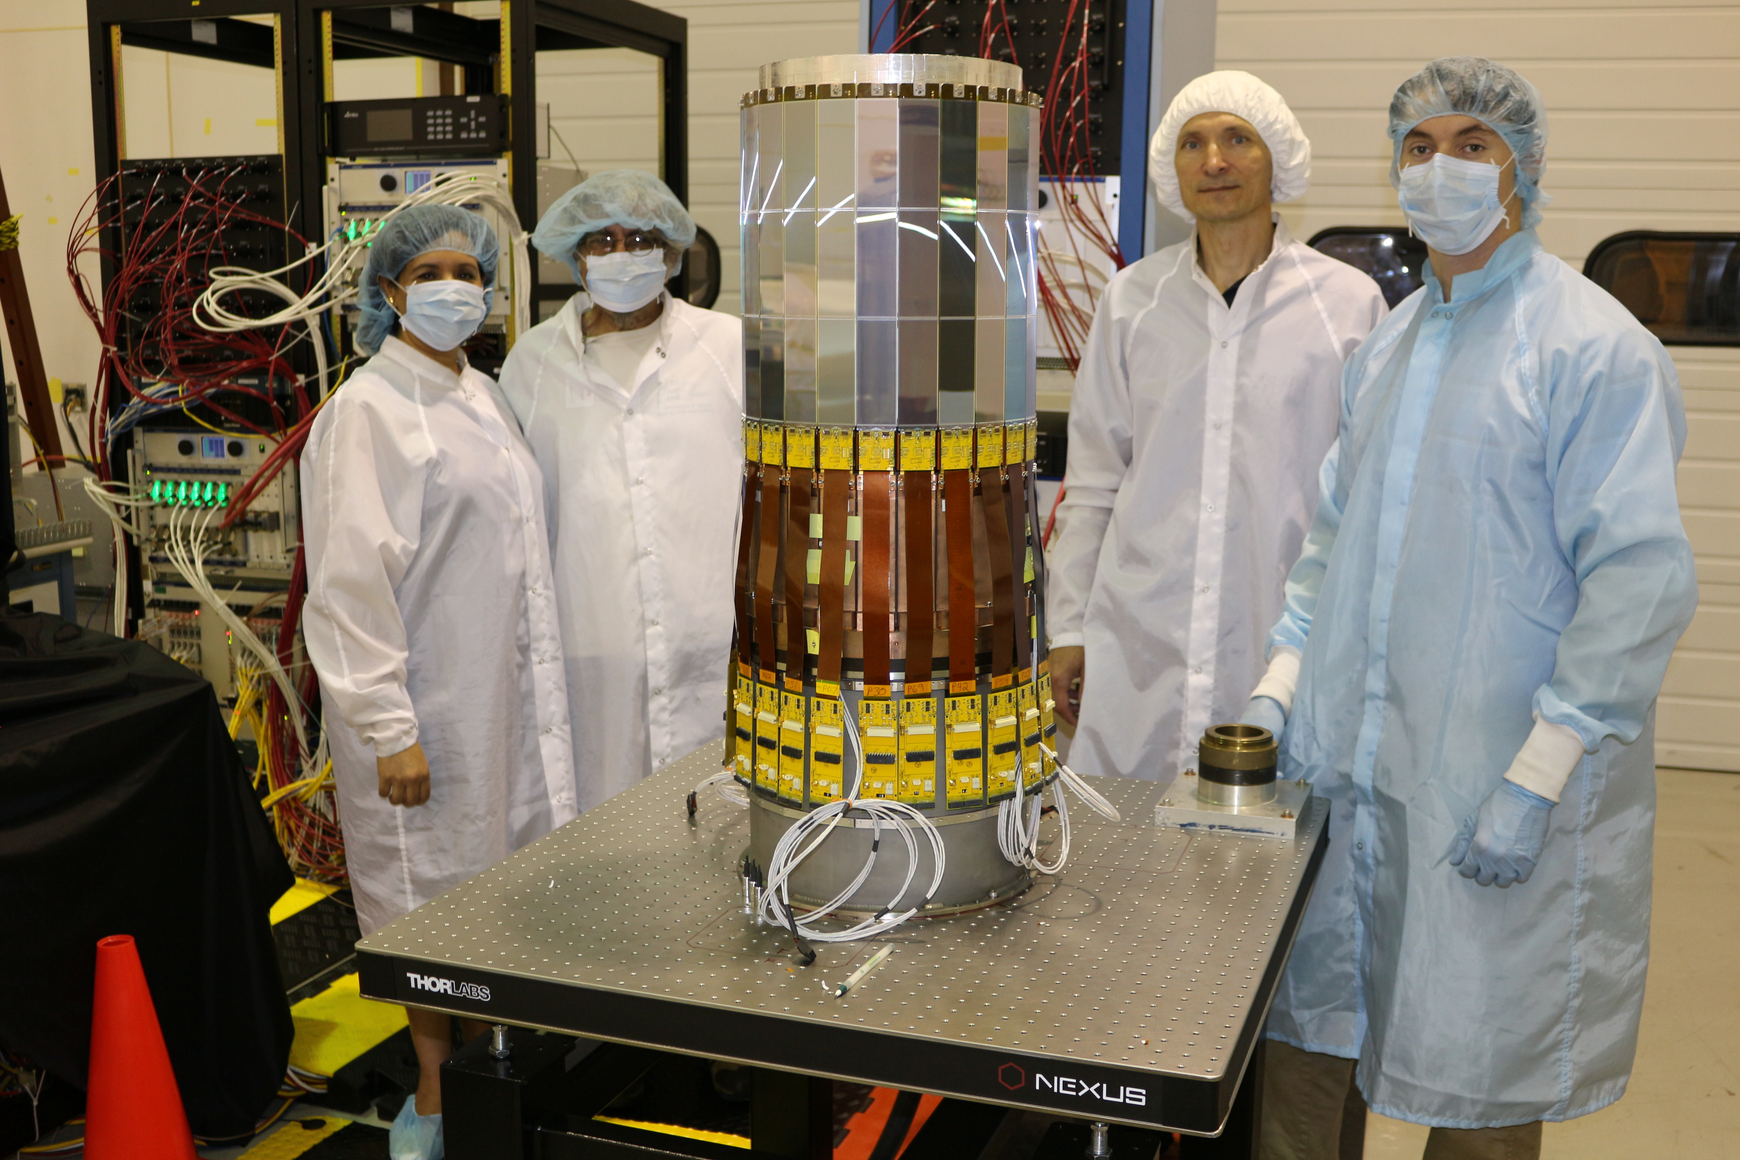
Silicon Strip Detectors
S
S
Silicon tracking detectors for the EIC are going to be fun/challenging to build & install.

Slide 18
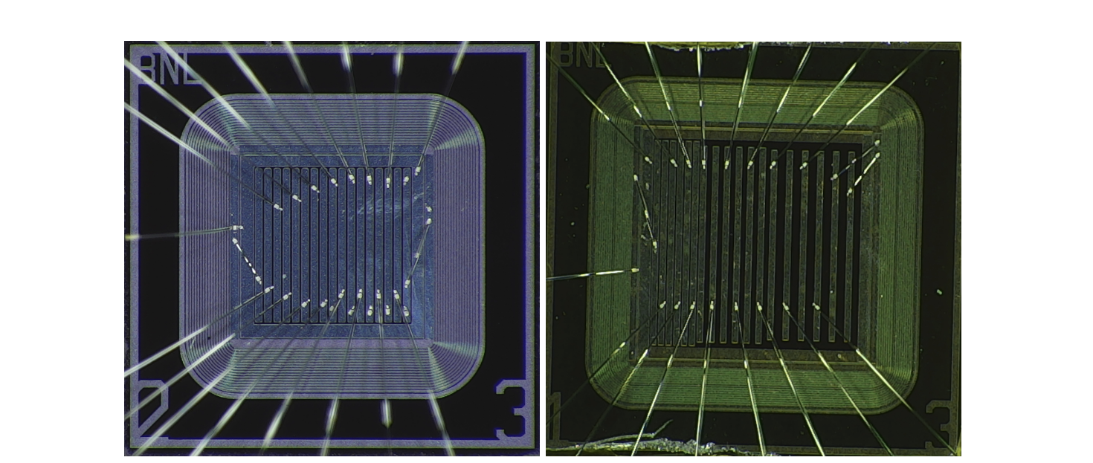
AC-LGAD: Position & Timing Information
https://doi.org/10.48550/arXiv.2201.07772
AC coupled Low Gain Avalanche Detectors
Having your cake and eating it too!
  6-10 micron position
  30 picosecond timing resolution
BNL manufactured sensors tested at FNAL.
17

Slide 19
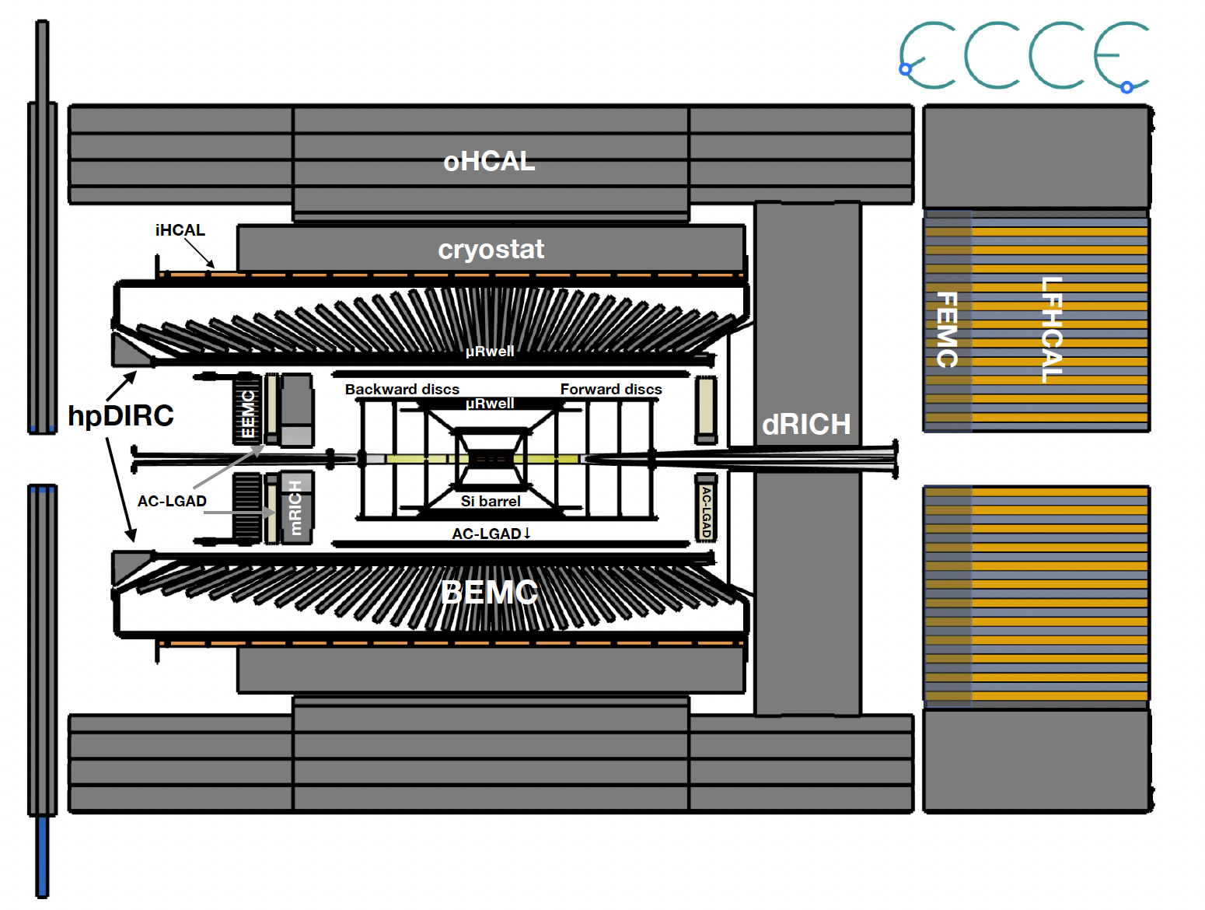
ECCE Detector: Now Morphing Into Detector One ( new name pending )
18

Slide 20
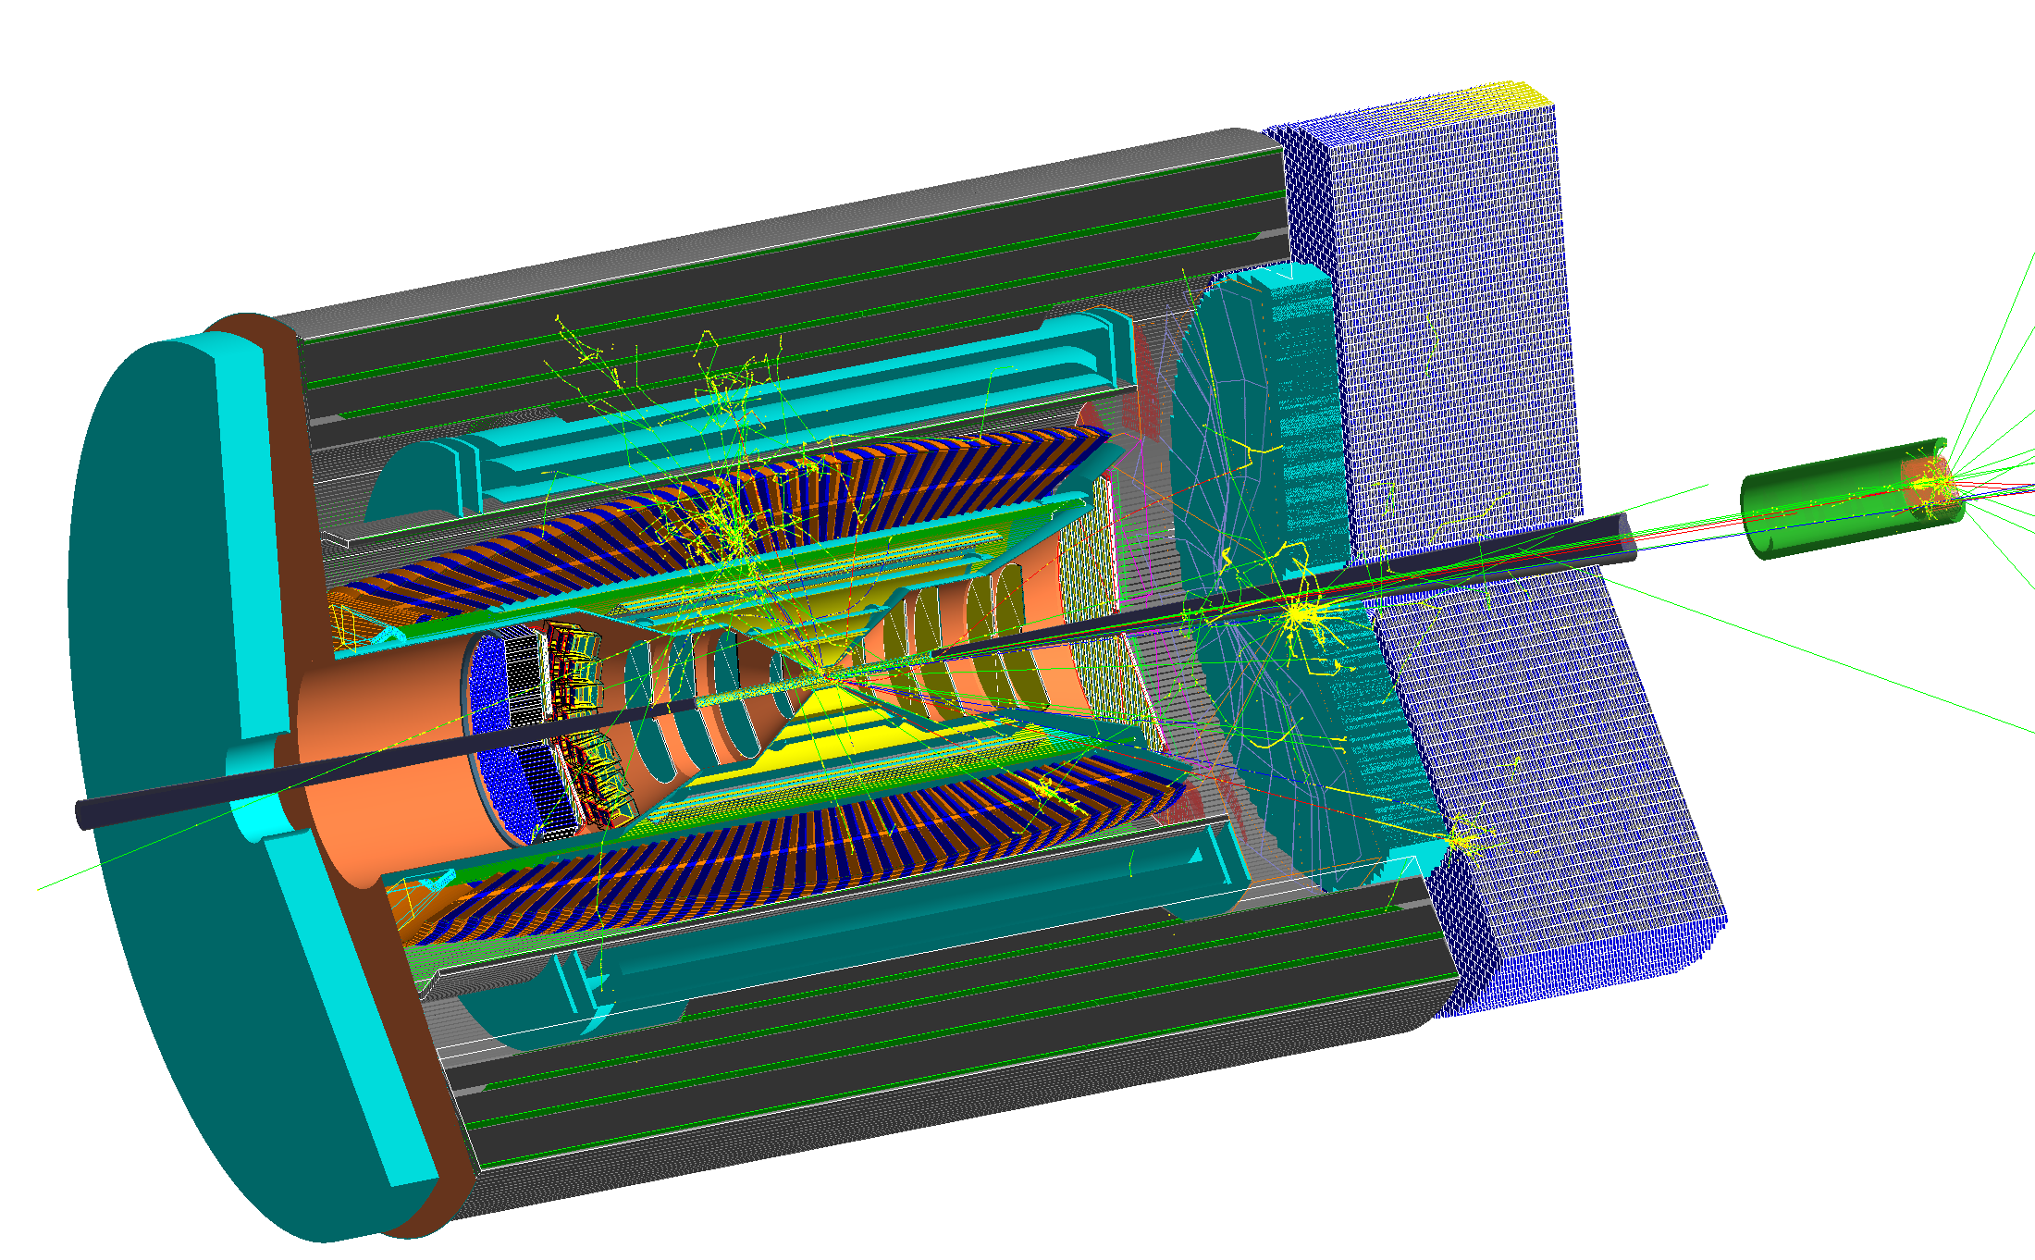
Simulated Event (NOT WHAT WE SEE!)
19

Slide 21
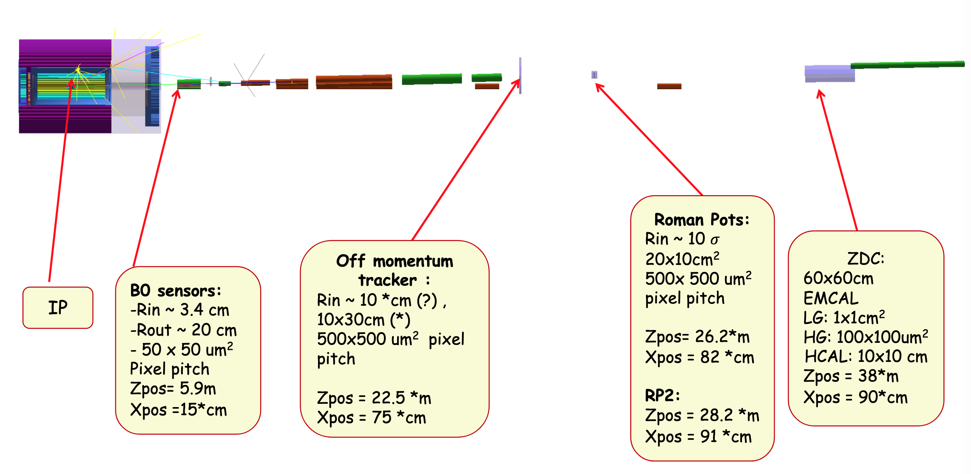
Far Forward Detection Systems ( my favorite part of the EIC)
Detectors located tens of meters from the main EIC detector and are small in size.
The optics of this part of the EIC detector system acts like a spectrometer!!
20

Slide 22
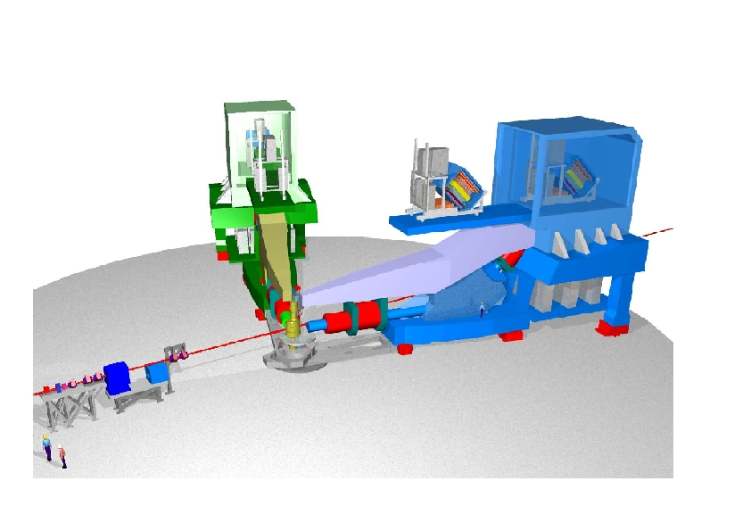
Jefferson Lab’s Hall A
21

Slide 23
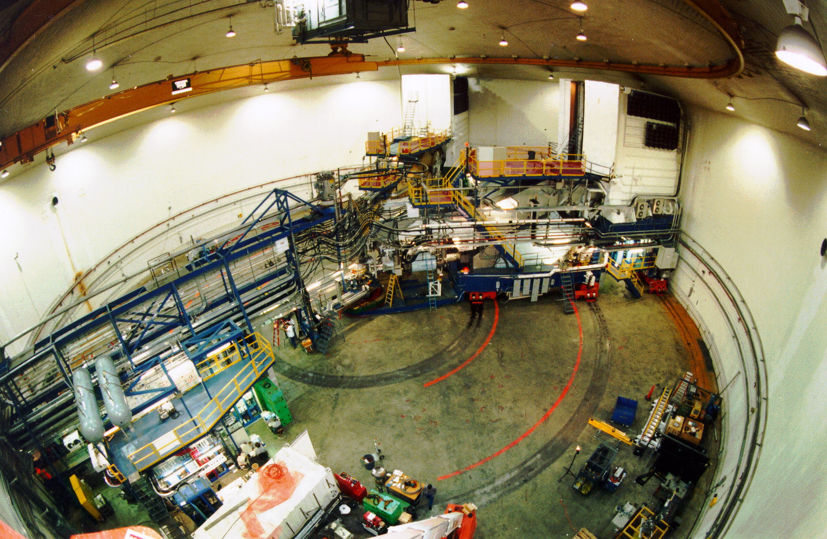
Jefferson Lab’s Hall A
22

Slide 24
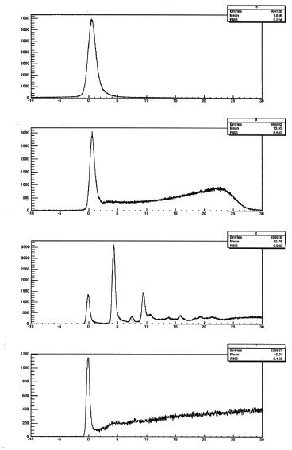
Online Spectra (Elastic Scattering)
EXTREMELY Simple Pool Shots
H
Energy = 687 MeV
Angle = 25.5 Degrees
Q = 0.3 GeV
D
Counts
C
Ta
Excitation Energy [MeV]
23

Slide 25
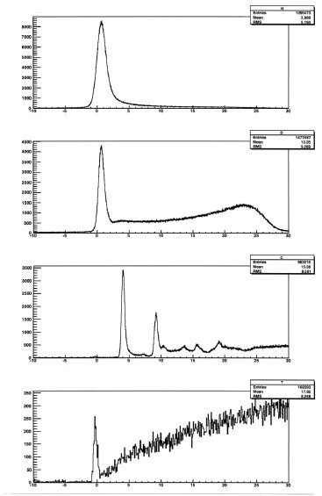
Online Spectra
H
Energy = 687 MeV
Angle = 30.5 Degrees
Q = 0.35 GeV
D
Counts
C
Ta
Excitation Energy [MeV]

Slide 26
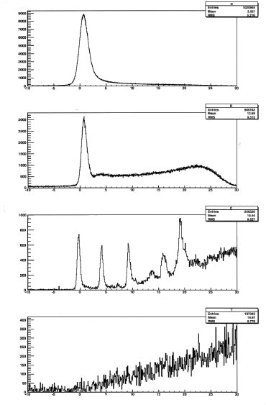
Online Spectra
H
Energy = 687 MeV
Angle = 40 Degrees
Q = 0.45 GeV
D
Counts
C
Ta
Excitation Energy [MeV]
25

Slide 27
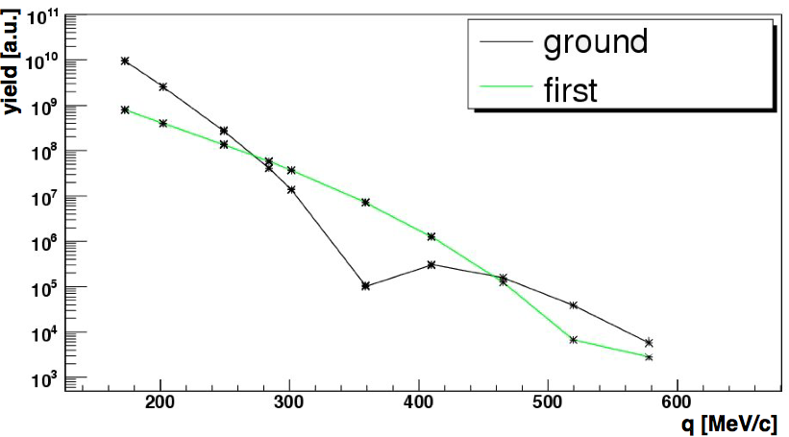
Online Spectra
Energy = 687 MeV
Angle = 40 Degrees
Q = 0.45 GeV
H
D
Online Carbon Elastic
Counts
C
Ta
Excitation Energy [MeV]

Slide 28
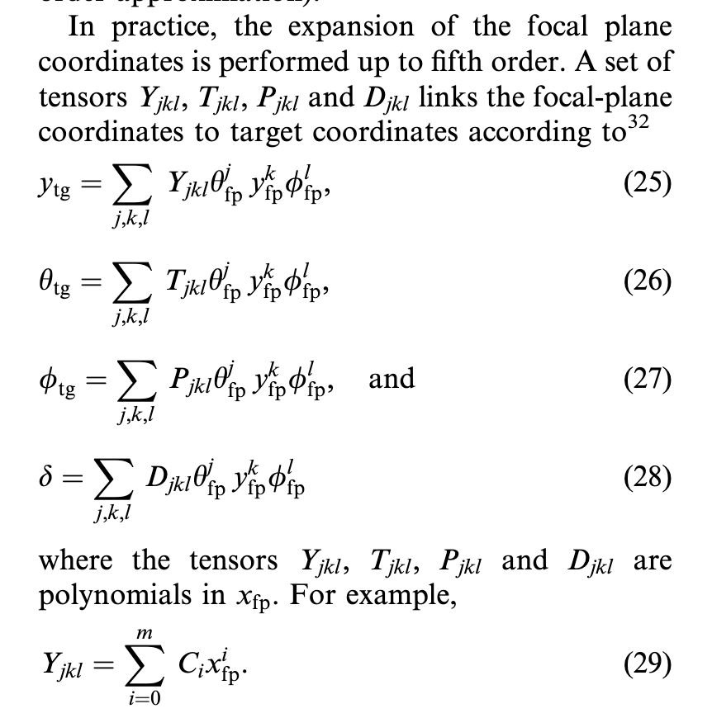
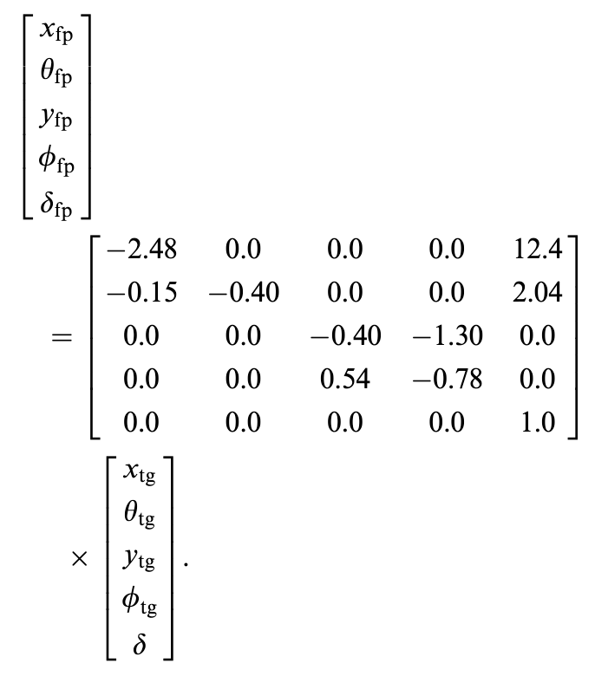
Beyond Simple Matrix Transformations
Fun Student / Postdoc Project To Work Out How To Do This For The Far Forward Detectors!
Simple Approximation
Rational functions should work even better then polynomials.
27

Slide 29
So what, I get my data and everything is fine.
( or how to make a giant mistake by not thinking )
Also a real world example of how to publish a Phys. Rev. Lett. by doing a simple estimate on the back of an envelope.

Slide 30
Nuclear Scaling Plateaus from CLAS
K. Sh. Egiyan et al., Phys. Rev. C 68 (2003) 014313.
Originally done with SLAC data by Frankfurt et al., Phys. Rev. C 48 (1993) 2451.
x_{B} = Q² / ( 2 m (E – E’ ))
29

Slide 31
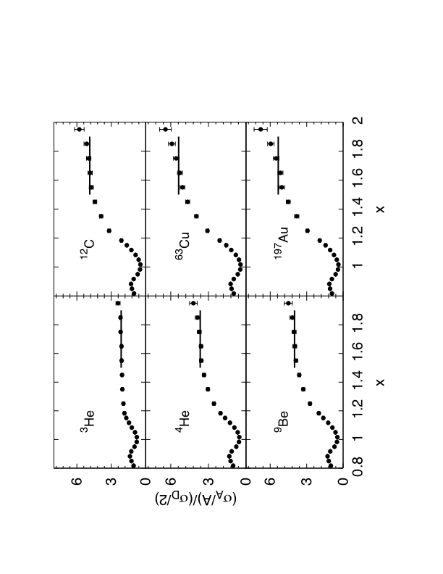
Results From JLab Hall-C
N. Fomin et al., Phys. Rev. Lett. 108 (2012) 092502.
x_{B} = Q² / ( 2 m (E – E’ ))

Slide 32
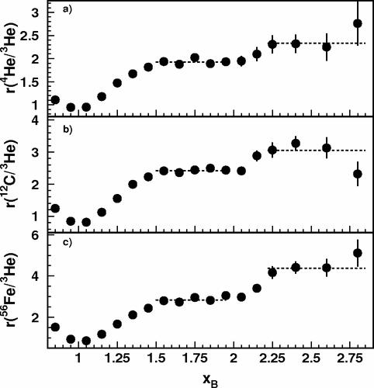
CLAS x_{B} > 2 Three Nucleon Plateau
I used to show this plot at conferences and tell a story about 2 and 3 nucleon correlations.
https://doi.org/10.1103/PhysRevLett.96.082501
Then when the Hall C preliminary results only agreed with the xB < 2 data, I thought hard about what was going on . .

Slide 33
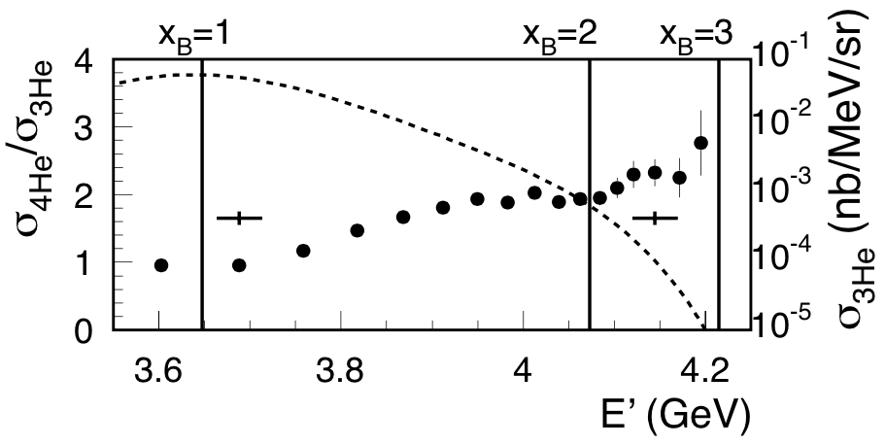
Plotting CLAS Results vs. E’ instead of x_{B}
D. H. and O. Hen, Phys. Rev. Lett. 114 (2015) 169201.
https://doi.org/10.1103/PhysRevLett.114.169201

Slide 34
“An ever increasing amount of computational work is being relegated to computers, and often we almost blindly assume that the obtained results are correct.” - Simon Širca & Martin Horvat

Slide 35
Summary and Outlook
Particle tracking is a key comment of the EIC detector system
With reconstruction, we can determine the position of an event as well as its momentum due to the 1.5 T field of the magnet (note: 3T field in a detector at IR2 would be great!!)
Tracking goes hand-in-hand with reconstruction.
What I didn’t cover today, BUT I think is exciting, is making use of AI to optimize the detectors.
See talks by Cristiano Fanelli:
  http://web.mit.edu/2022nnpss/lectures/CF_NNPSS_lec1.pdf
  http://web.mit.edu/2022nnpss/lectures/CF_NNPSS_lec2.pdf
  http://web.mit.edu/2022nnpss/lectures/CF_NNPSS_lec3.pdf
It was with these techniques that we squeezed the optimal performance from a 1.5 T magnet.

