Slide 1
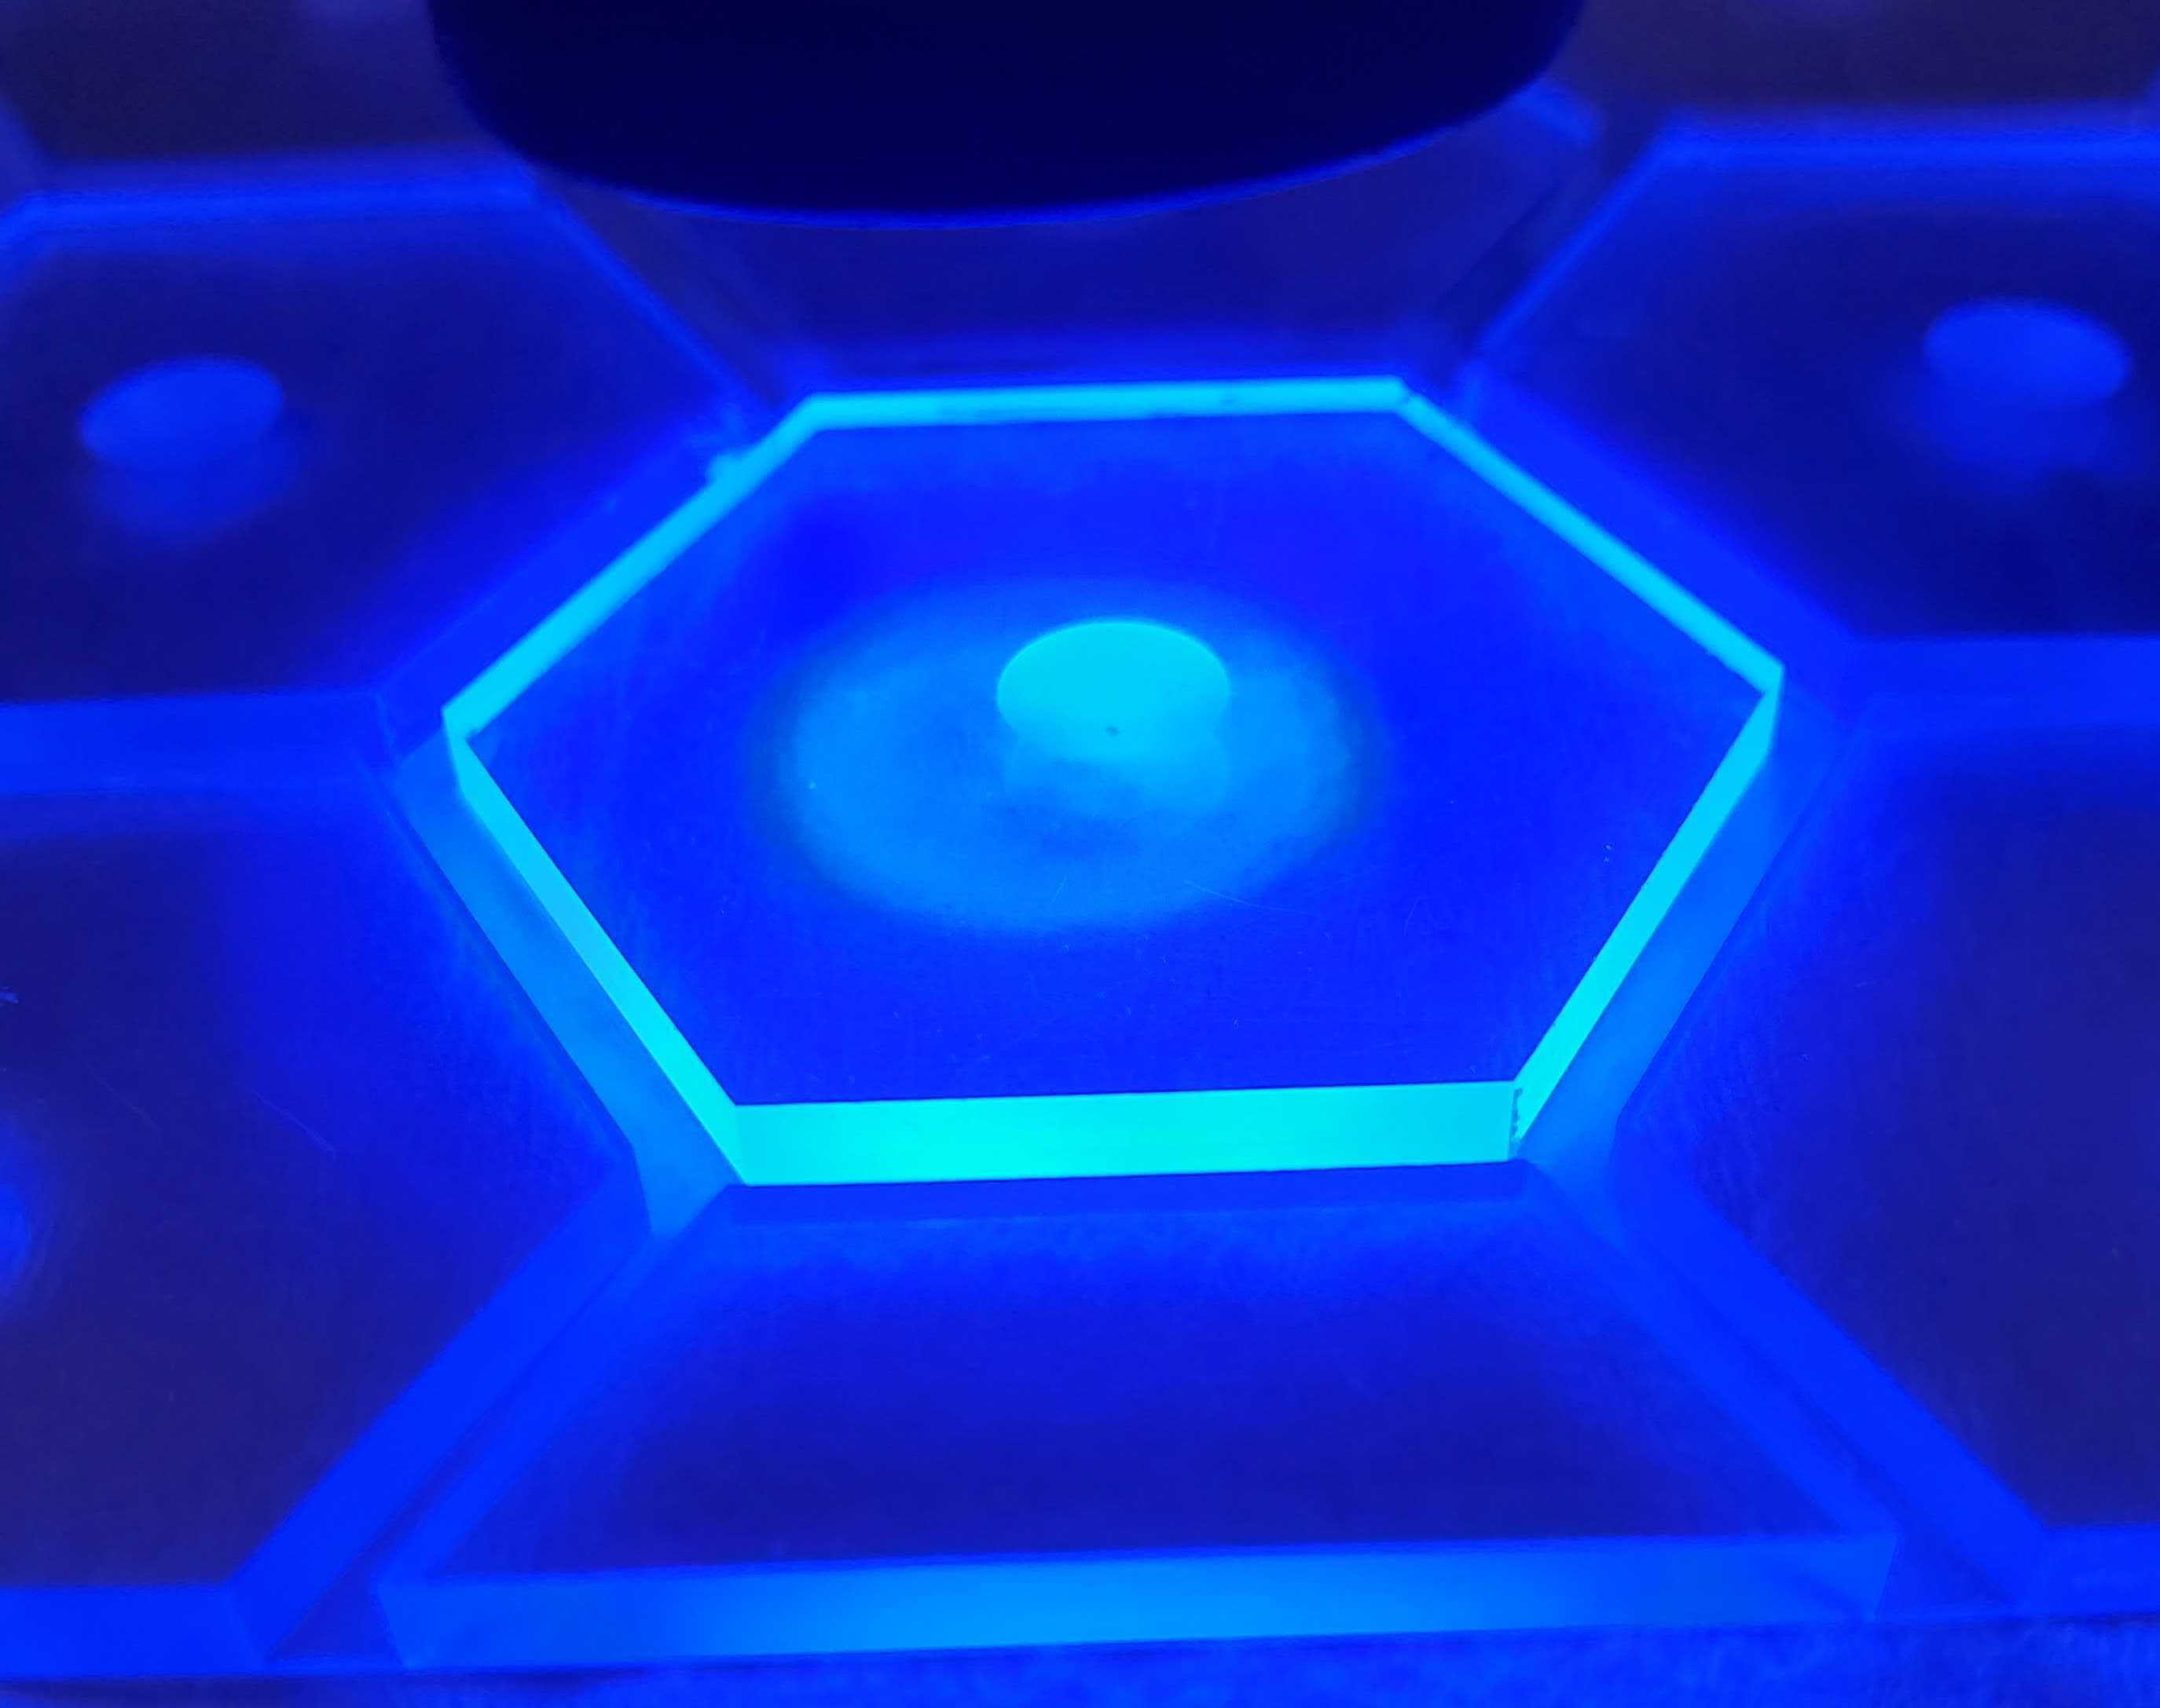


SiPM on Tile Uniformity and Cross-Talk Measurements
7/21/2022
Sean Preins

Slide 2
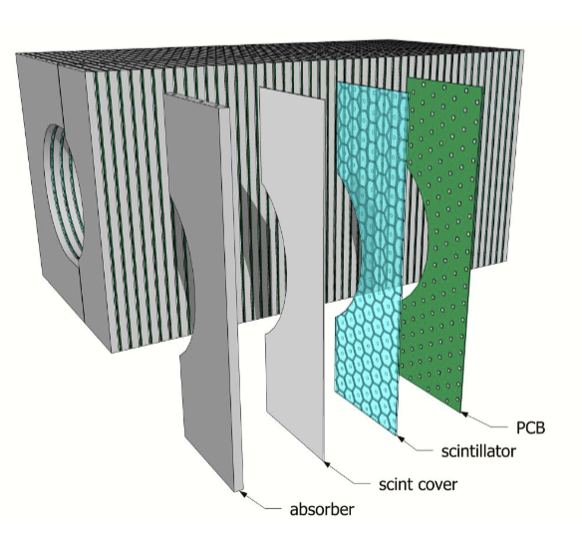
Scintillating Tiles for the HCAL Insert
The high granularity insert design uses EJ-200 plastic scintillating tiles segmented into hexagonal cells
Each cell is centered on a silicon photomultiplier
To properly characterize the performance of these tiles for simulations, we must determinize uniformity and cross-talk
We will also investigate methods of improving these properties
Photo Credit: Sebouh Paul

Slide 3
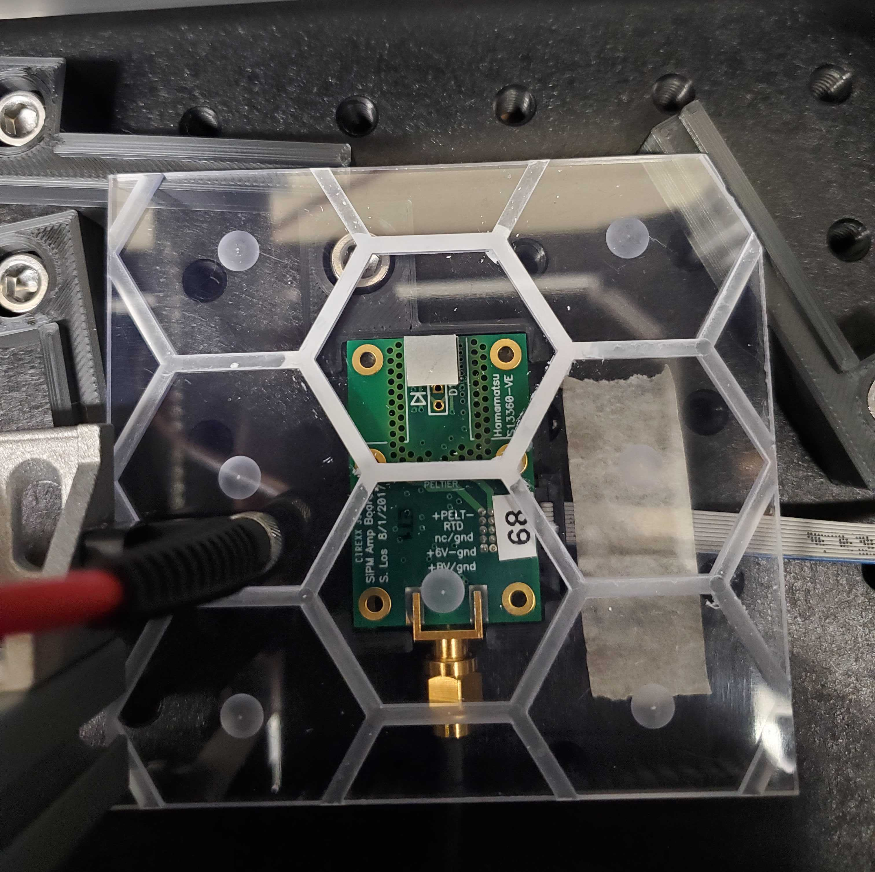
Methodology Overview
Within a dark box, place a scintillating tile on top of a SiPM
Adjust the UV LED intensity / SiPM bias voltage for the dynamic range to cover the portion of the tile of interest
Using a low intensity LED, calculate the signal voltage to photoelectron conversion factor
Use XY stage stepper motors to scan the surface of the tile
Scan the surface of a non-scintillating tile to determine background

Slide 4
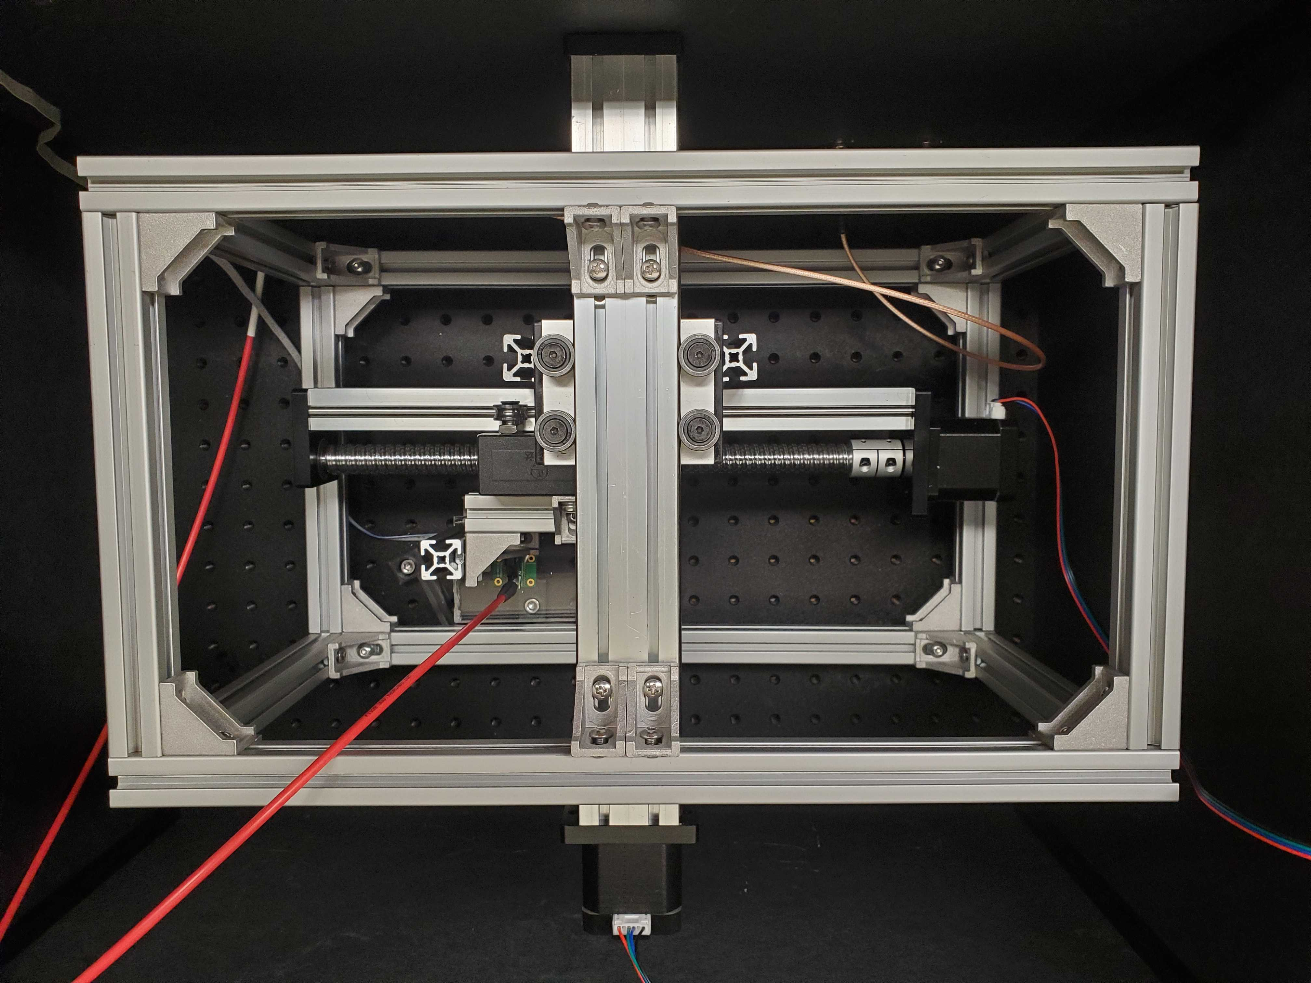
Apparatus Overview

Slide 5
Dark Box
Arduino and CNC Shield
2D Stage Stepper Motors
41.5 V
Bias
Tile
SiPM
Amp
6 V
DRS4 Digital Oscilloscope
Ch 1
UV Fiber-Optic Cable
Ch 4
Computer
CAEN SP5601 Led Driver

Slide 6
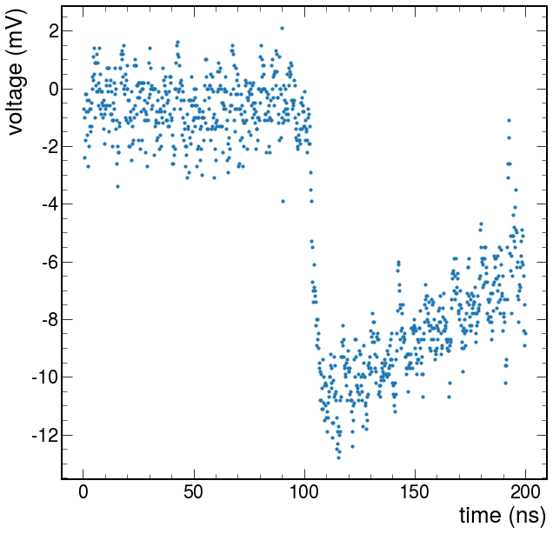
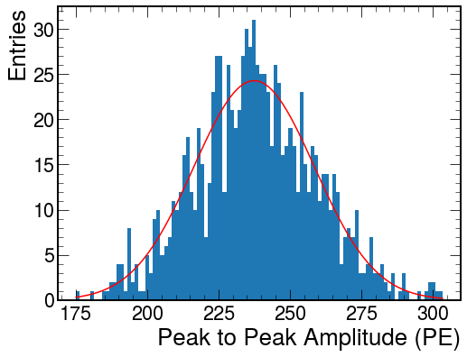
Data Acquisition
Used a DRS4 Digital Oscilloscope for SiPM readout, and recorded the waveforms using the RCDAQ data acquisition software
Triggered the data acquisition using a pulsed UV LED source
Recorded 1,000 waveforms for each point on the tile, and fit the distribution of peak-to-peak values to a gaussian
The signal strength at a point on the tile is defined by the mean of the gaussian

Slide 7
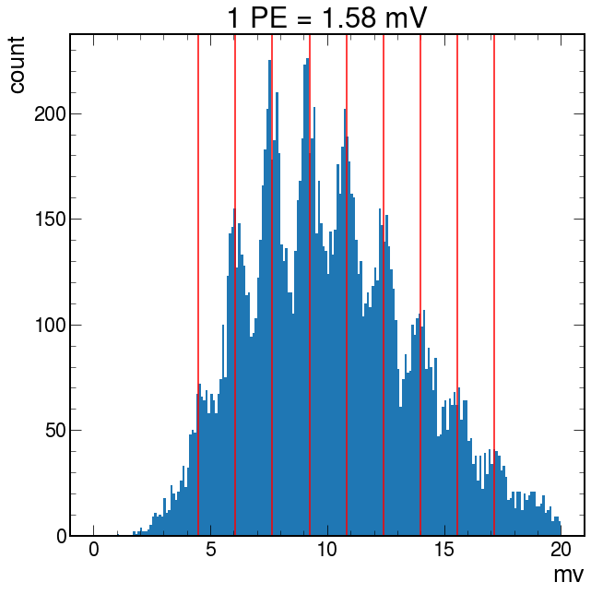
Photoelectron Conversion
Once a bias voltage is determined, we converted the voltage output from the SiPM to photoelectrons by analyzing a finger spectrum
We pulsed the UV LED onto the SiPM, and observed the discretization of baseline-to-peak values

Slide 8
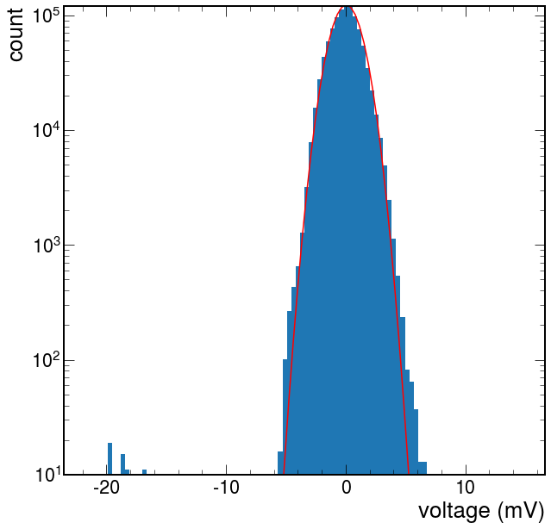
Noise Runs
Before each scan, we recorded noise runs with the SiPM bias turned off, and the LED moved far off to the side
The voltage distributions were measured as the difference between the value at a point in the waveform, and the average voltage for the entire waveform, across 1k waveforms
The noise was found to be gaussian, with sigma = 1.2 mV (converts to 0.76 PE)

Slide 9
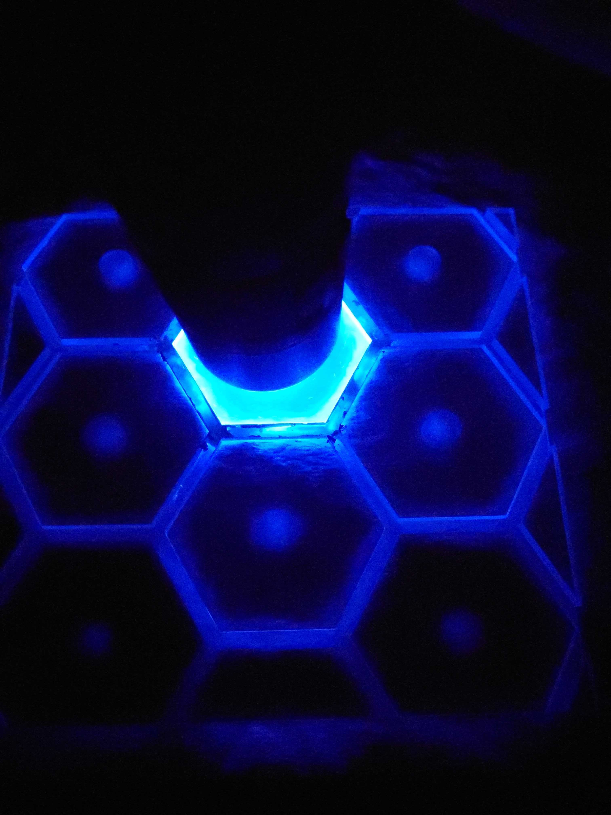
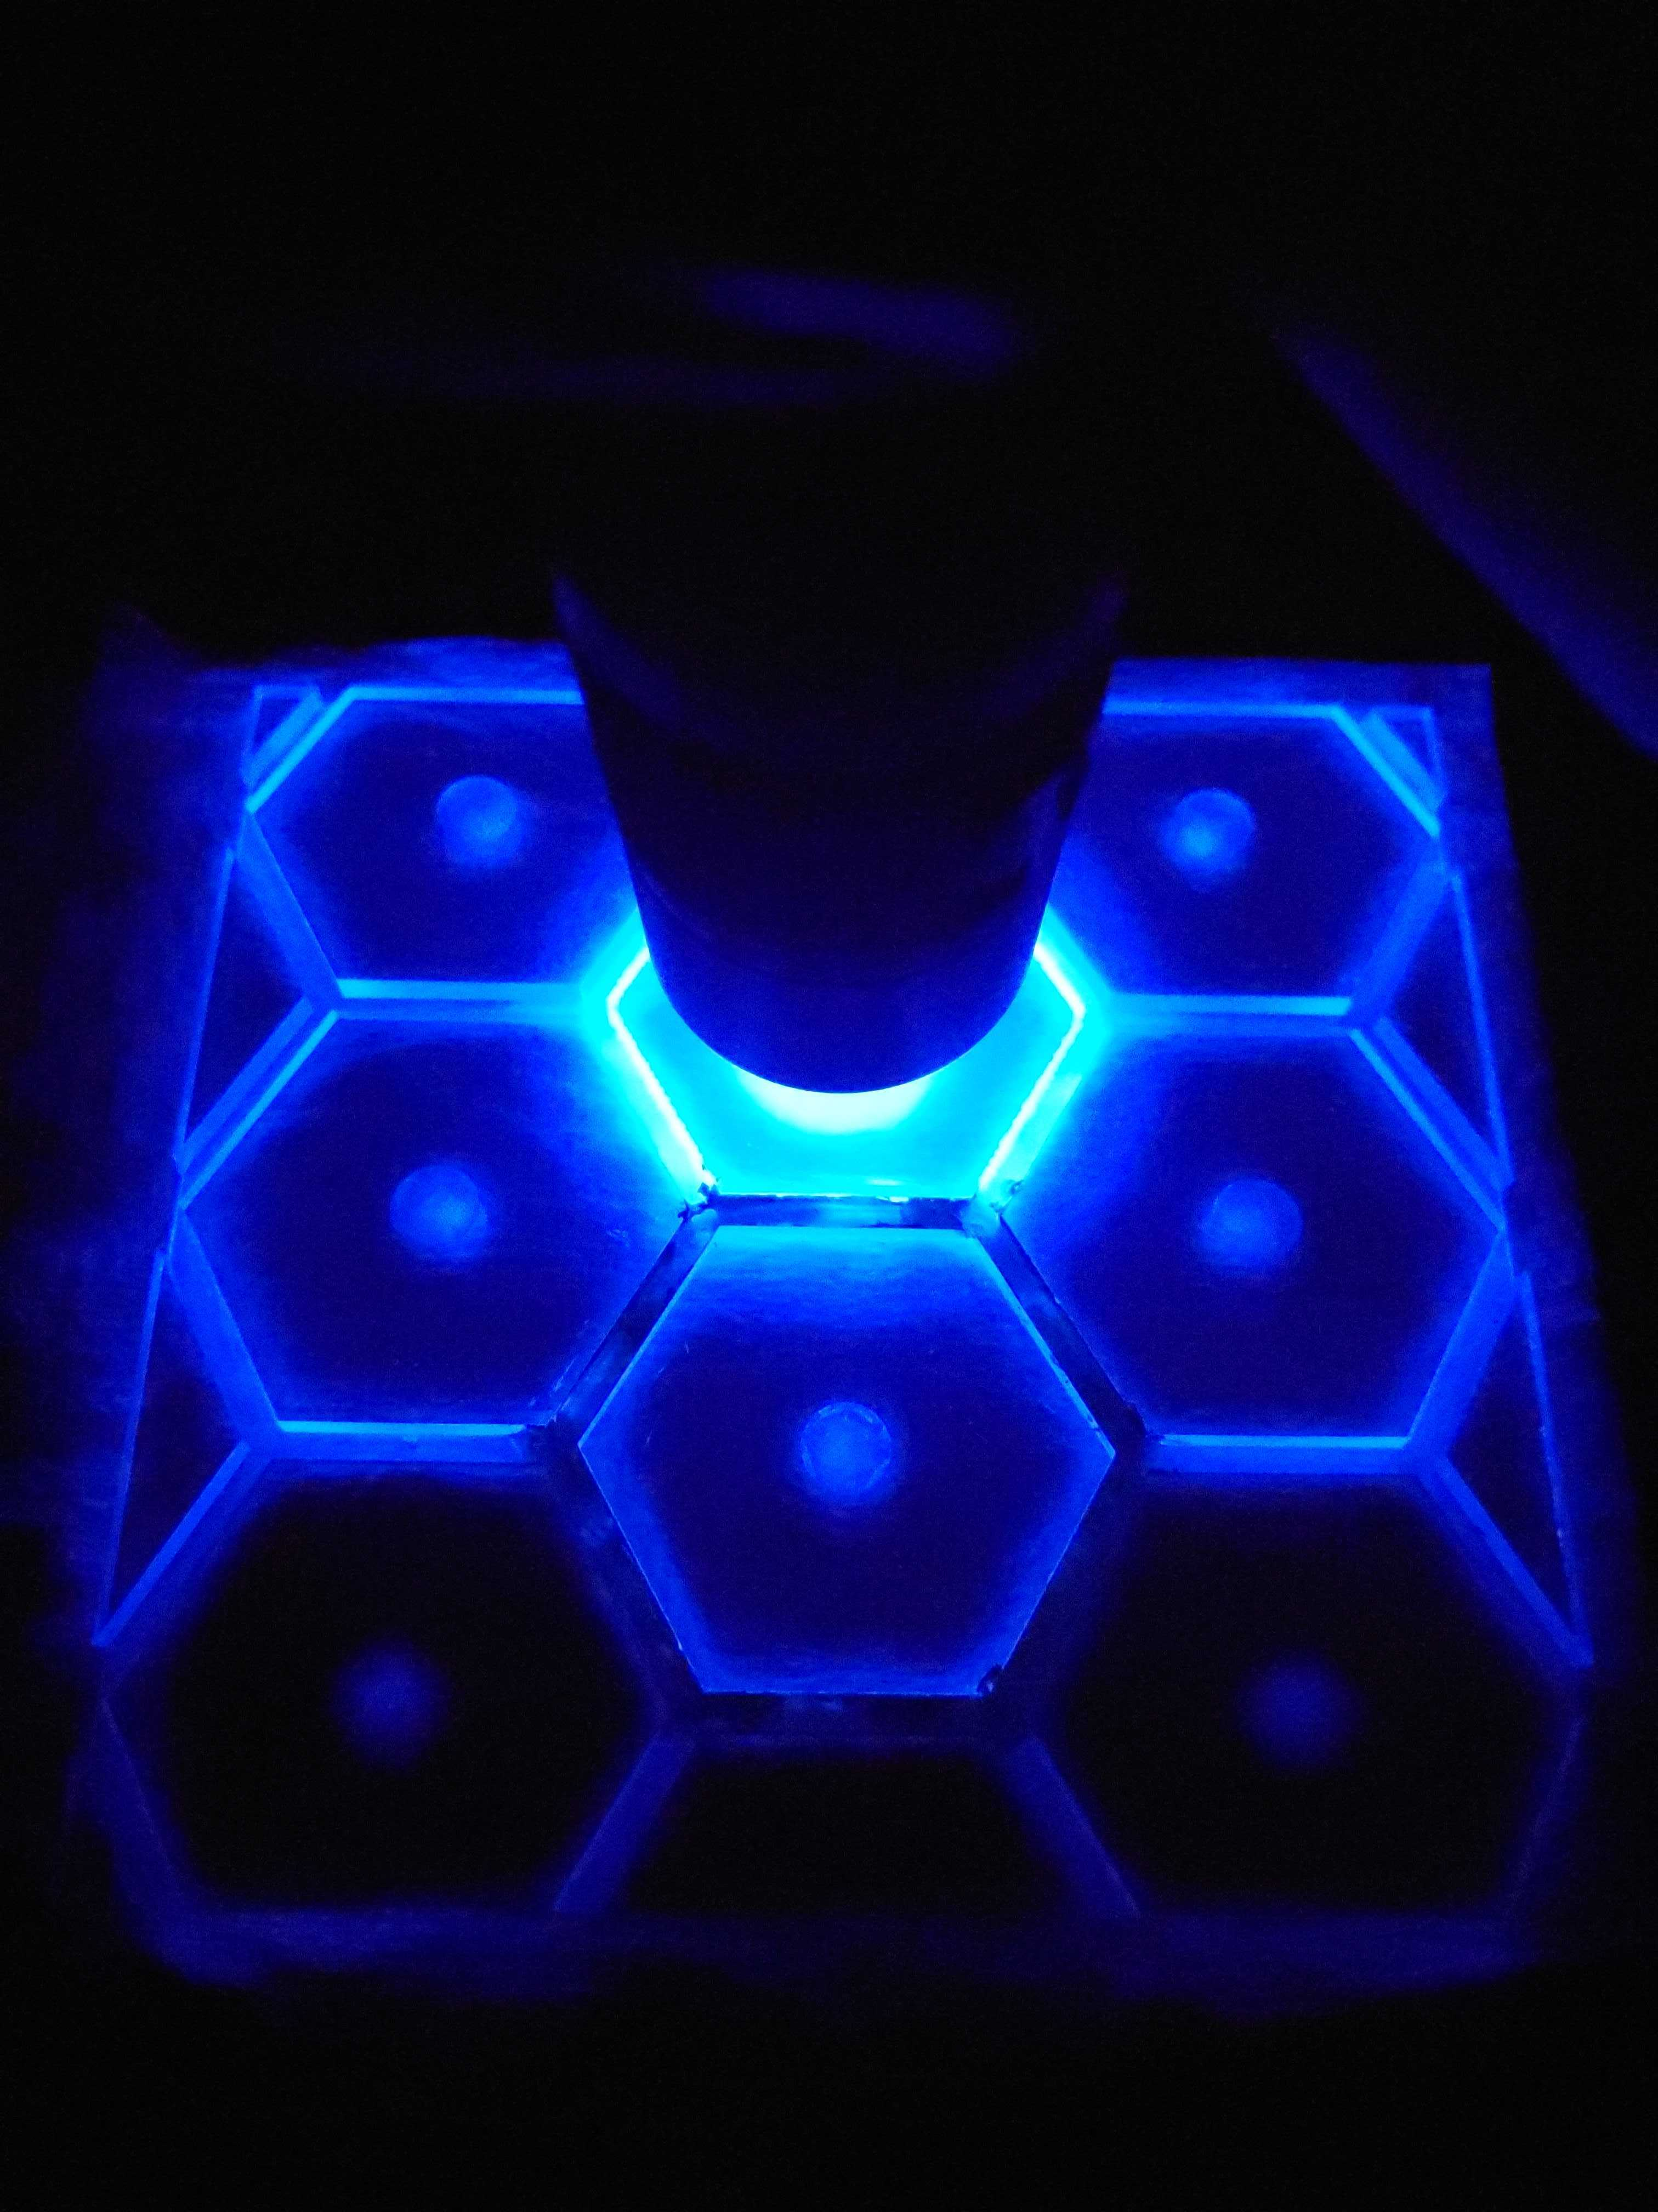
Tile Boarder Painting
We painted the boarder of a single cell to test how this improves signal containment and yield
We used highly reflective white SAINT-GOBAIN paint

Slide 10
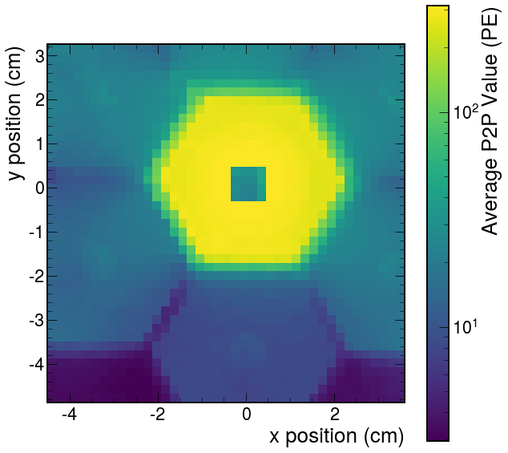
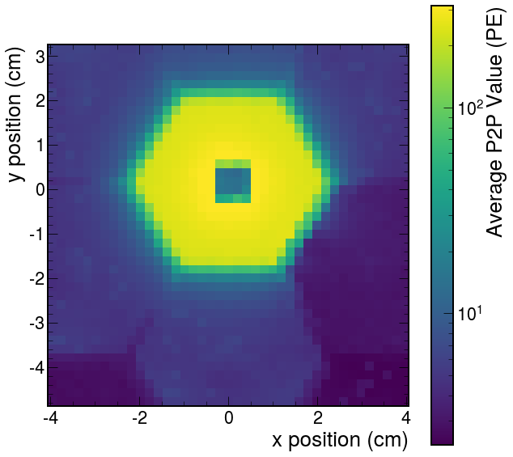
Unpainted
Painted

Slide 11
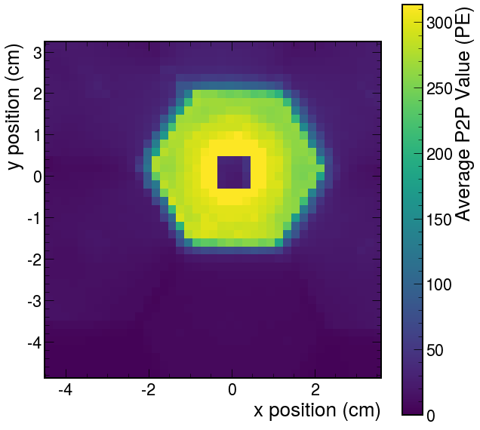
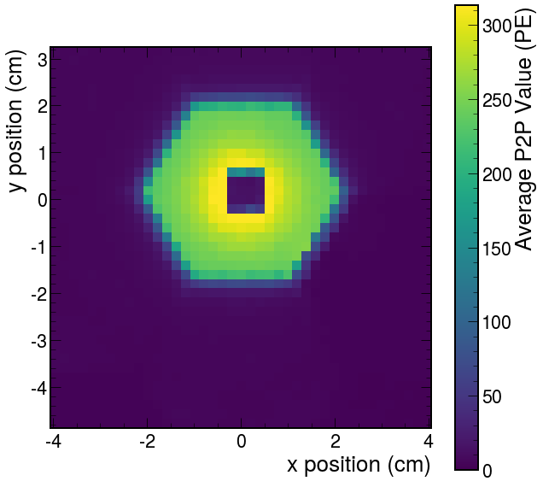
Unpainted
Painted

Slide 12
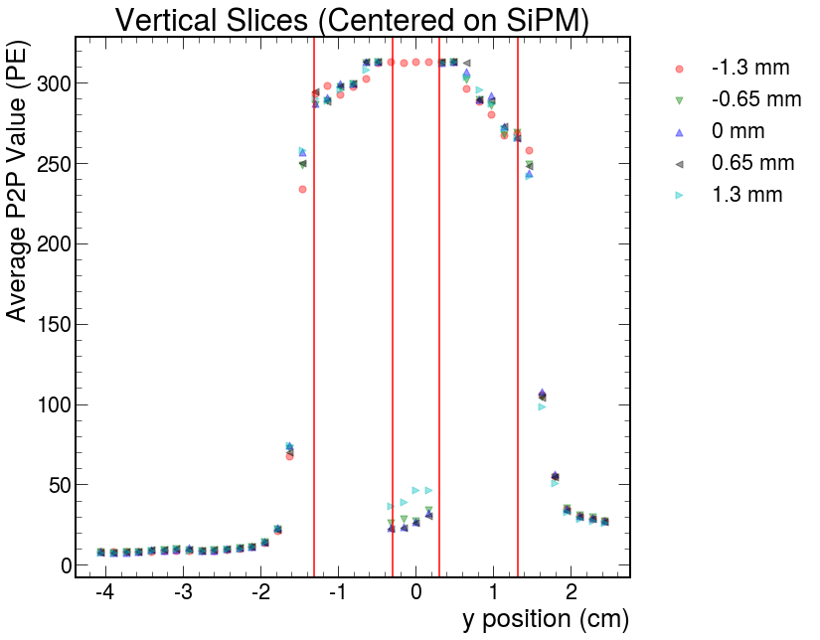
SiPM Centered on Unpainted Cell
Nonuniformity: 280 +/- 30 PE (excluding SiPM region)

Slide 13
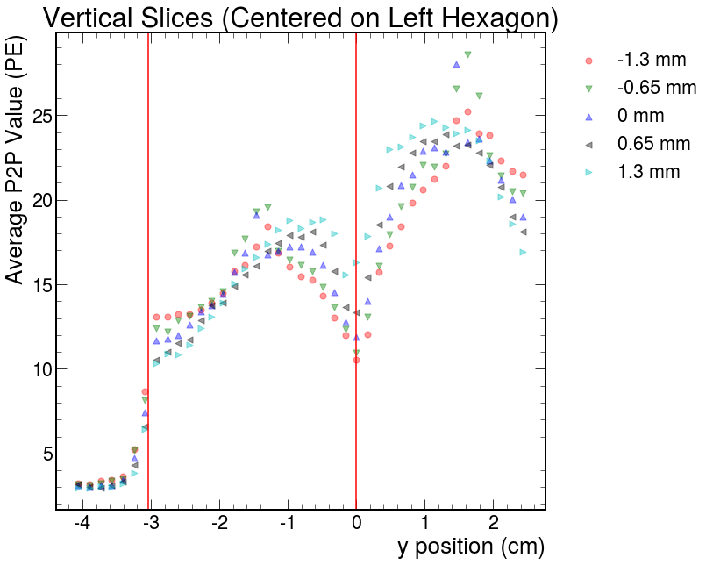
SiPM Centered on Unpainted Cell
280 PE -> 21 PE or 14 PE
7.5% or 5% crosstalk
The significant difference in signal strength is likely caused by the nonuniform application of paint

Slide 14
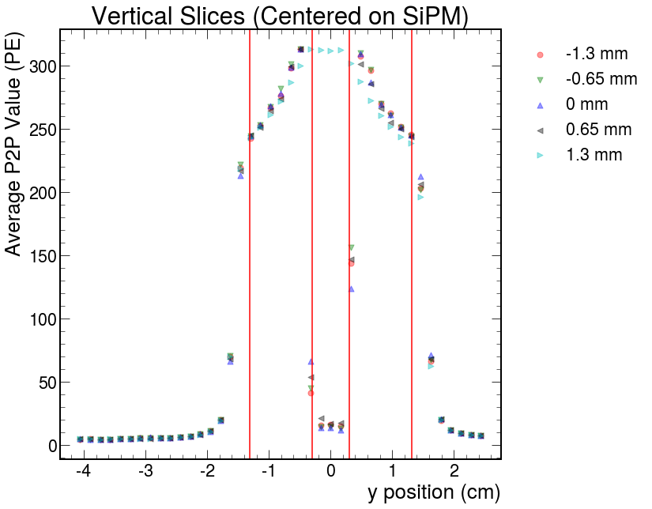

SiPM Centered on Painted Cell
Nonuniformity: 280 +/- 30 PE (excluding SiPM region)

Slide 15
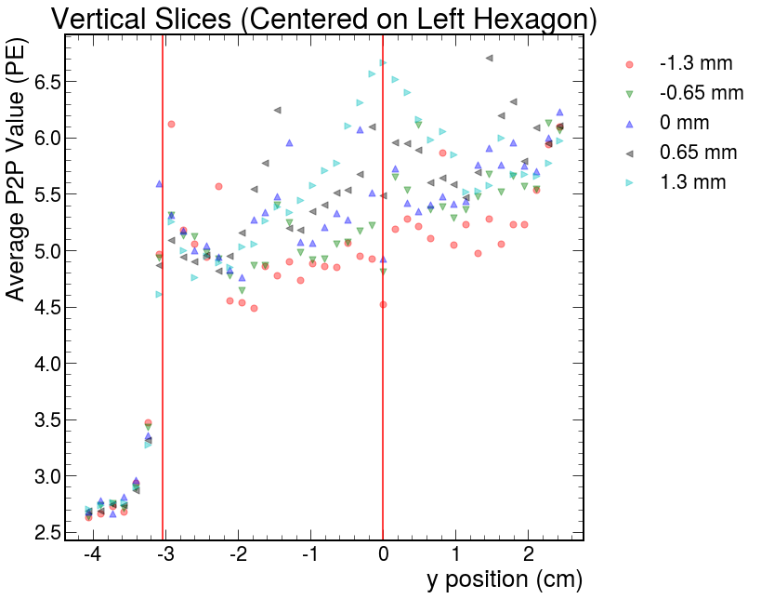
SiPM Centered on Painted Cell
280 PE -> 5.5 PE
2% crosstalk

Slide 16
Preliminary Painted Tile Results
Painting the tile resulted in a ~61% to ~73% decrease in signal strength from adjacent cells
The total nonuniformity within the painted cell did not measurably improve, although the region directly above the SiPM was not measured, and the area immediately around it was likely influenced by a “spotlight” effect

Slide 17
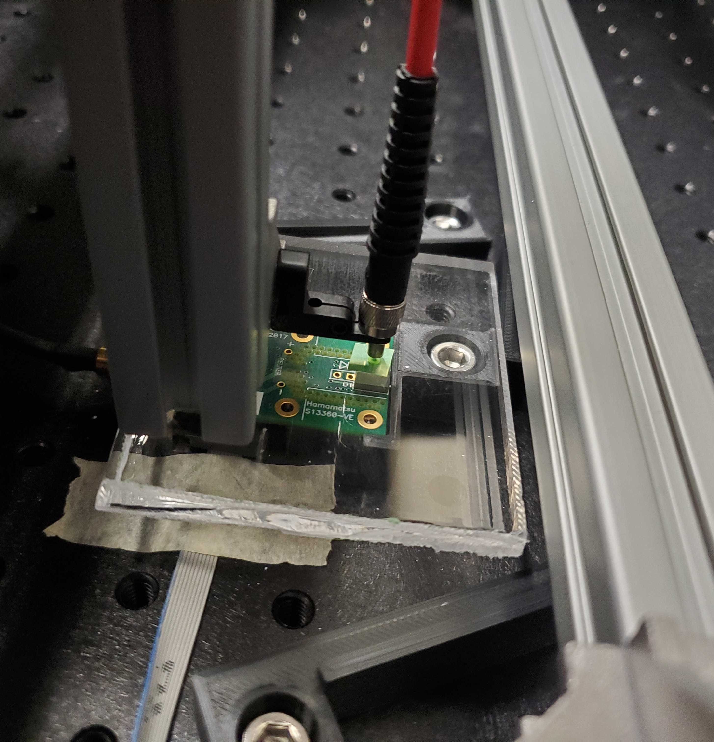
Background Scan
To estimate the effects of a “spotlight effect” from the LED (light traveling directly into the SiPM without scintillating), we scanned an acrylic tile
We will want to repeat this study with a tile of similar thickness to the scintillating tile, and determine the relative opacities between the two materials at the wavelength generated by the UV LED
Once these are determined, we will be able to scale the signals appropriately and subtract out the background generated by this spotlight effect
Before then, this scan determines the affected region

Slide 18
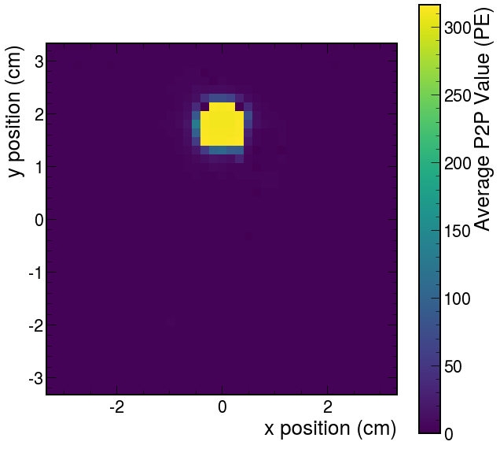
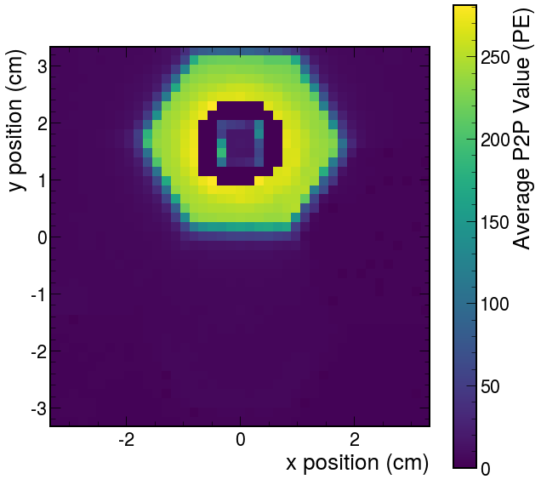

Slide 19
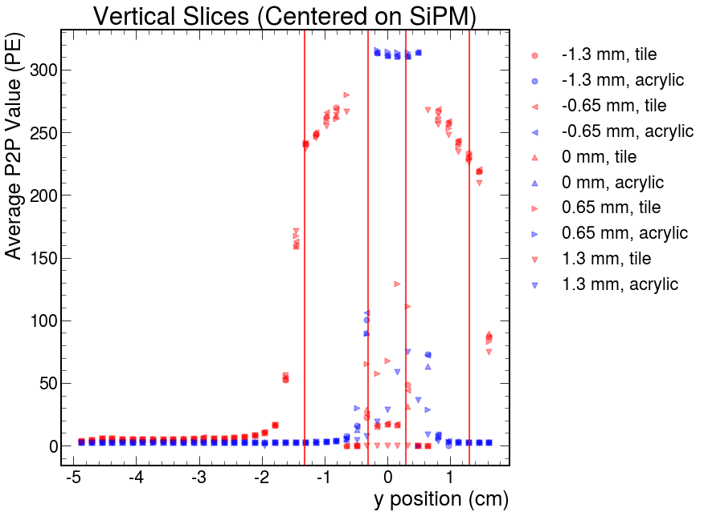
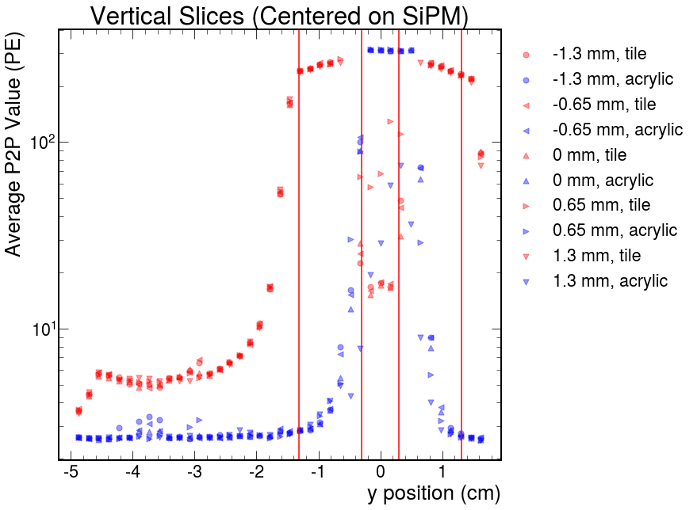
The ”spotlight effect” appears limited to the region directly above the SiPM

Slide 20
Plans
Optimize the new fitting method to determine signal strength values
Add reflecting foil across nearly the entire front and back of the tile, leaving a small slice open to do a vertical scan down the middle
Repeat the acrylic background scan using an appropriate tile, foil, and LED intensity
Adjust the various parameters of the apparatus to achieve a wider dynamic range, or limit the scans to specific regions within the tile
With a clean tile and using foil, study the impacts of painting boarders, and polishing the dimples

