Slide 1
Agenda
Schedule
  We’ve got a 8 day window to do the field joint
Pressure test (R. Ceruti)
  Leak tolerable (R. Than)
  A. Franz’s slides
  AOB

Slide 2
Work sequence and timeline
ERL gun cavity conditioning: 10/16 to 10/23.
Gun cavity HOM measurement: 10/26 to 10/28.
Cathode stalk conditioning: 10/29 to 11/6
Short stalk conditioning and Cathode deposition: 11/6 to 11/20 .
Solenoid replacement: 11/14 to 11/20 (shutdown window)
(Short stalk deposition and) Beam test: 11/23 to 12/23
New laser installation: 12/23 to 1/23
Beam test: 1/23 to modification of gun cavity to booster cavity. Every one month will have 1.5 weeks down time for cathode exchange.
May slip a week … ?!

Slide 3
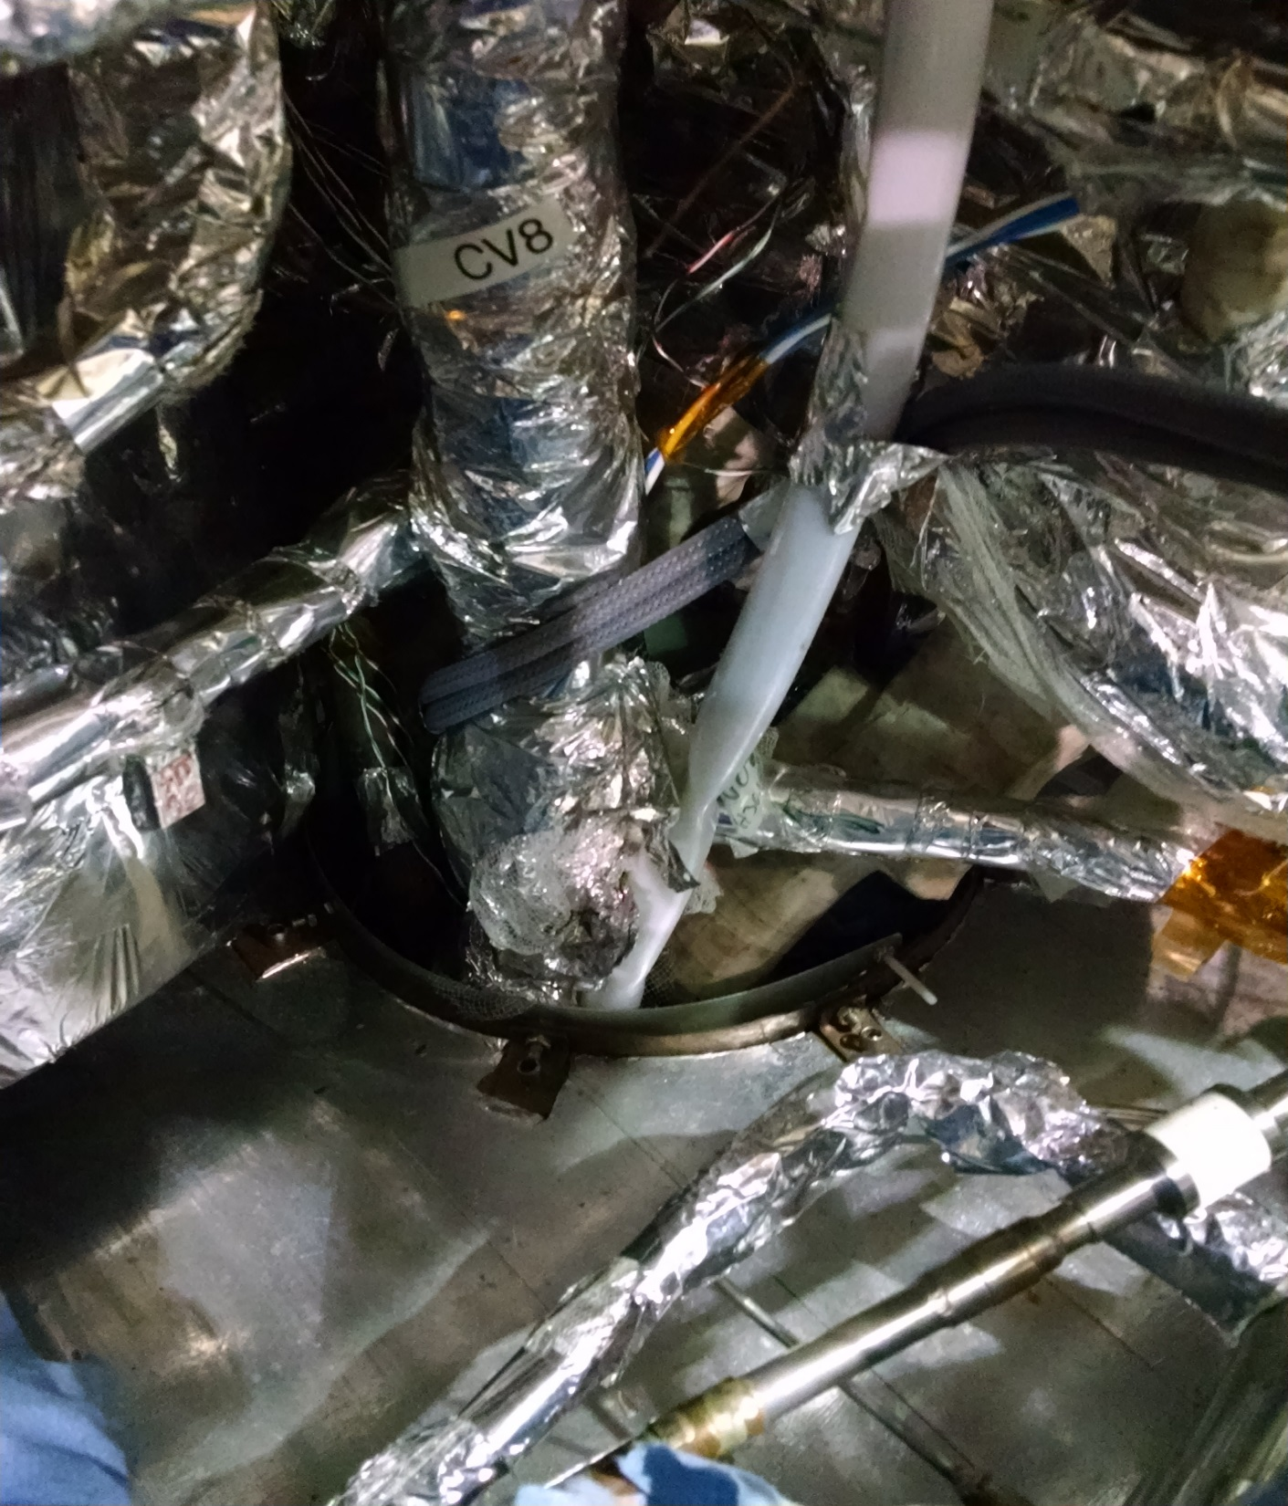

Slide 4
The test began with a leak detector reading of: 7.3 X 10-9 on the insulating vacuum and no helium applied.
After 10 minutes of 81 PSI helium applied to the internal system,-------------- the detector reading dropped to and leveled off at: 2.7 X 10-6
Not listed on the formal test we lowered the pressure to 40 PSI and held it for 20 minutes. The detector reading leveled off at: 2.9 X 10-7
We then lowered the pressure to 20 PSI and held for another 20 minutes,----------------------The detector reading leveled off at: 2.2 X 10-7
2.2E-7 at room temperature and 35 psia: Gas density: about 0.4 kg/m3
At liquid density: 120 kg/m3
Factor of 300 increase in leak, if opening stays the same.
6.6E-5 Torr-L/s leak cold
Net pumping speed of 100 L/s
6.6E-7 Torr
Good for insulating vacuum
If leak opens up 10x larger
6.6E-6 Torr
Just sufficient for MLI performance.
Ray Ceruti
Roberto Than

