Slide 1
Preliminary Thoughts on ECCE Jets

Slide 2
ECCE Calorimeter Resolutions
ECCE calorimeter resolutions as listed in their proposal
ECCE Ecal performance is somewhat better than what we quote
OHCal Resolution is compatible with sPHENIX

Slide 3
ECCE Calorimeter Resolutions Cont.
HCal resolutions are again a fit to Reco/True particle energy using Crystal Ball function
The ECCE proposal lists the mid-rapidity Outer HCal resolution as 75%/Sqrt[E] + 14.5%, in line with sPHENIX quotes
However, the calorimeter supplemental material goes into detail on the simulation of the OHCAL and quotes a much smaller stochastic term, roughly 33%/Sqrt[E]
Not clear to me where this discrepancy comes from or what value is ultimately used to determine their jet response

Slide 4
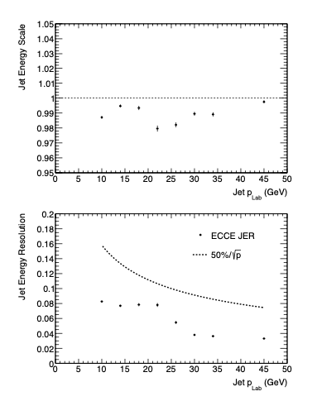
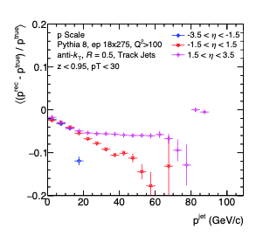
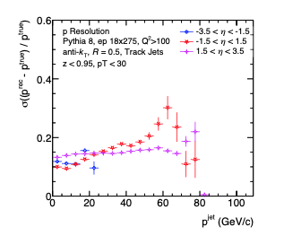
ECCE Jet Resolutions (Supplemental)
The ECCE proposal did not show jet performance, but it was treated in two areas in the supplemental materials
One dealt with ‘traditional’ anti-kt track-only and tower-only jets (above) - results seem reasonable
The other looked at jets found using the Centauro algorithm and track+clusters – quite good resolution

Slide 5
Jet Energy Resolution Comparison
ATHENA (Fig 3.6)
ECCE
ECCE Res figure from their response to DPAP homework G-3
Centaro algorithm (R=0.8) with tracks, ECal, mid and forward HCal clusters as input
No particle flow combination and no HCal for eta < -1 -> hard to believe JES is so good without negative HCal

Slide 6
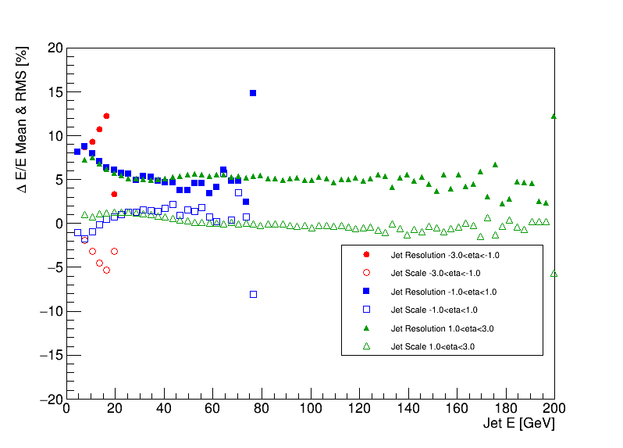
‘ECCE’ Jet Performance in Delphes

Slide 7
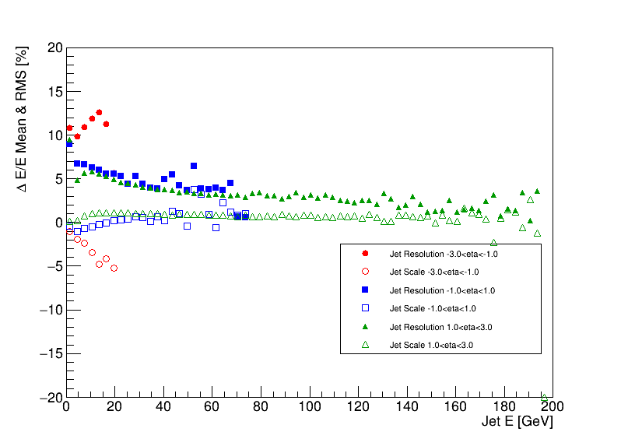
‘ECCE’ Jet Performance in Delphes
Centauro

