Slide 1
Search for a Dark Z Boson with Machine Learning at ATLAS
Savannah Thais, Daniela Parades, Keith Baker
Yale University
Dark Interactions Workshop 2016

Slide 2
Dark Sector at the LHC
Many BSM theories introduce a dark sector through an additional U(1)_{d} gauge symmetry
Can use different portals to search for this sector at LHC: vector, neutrino, photon, Higgs
Notes:
What to call this slide

Slide 3
Higgs Portal
Higgs portal introduces:
New gauge field with kinetic mixing ε with hypercharge gauge boson
In the case of broken U(1)_{d} symmetry, a new Higgs with mass mixing κ with SM Higgs, leading to new Higgs doublet and mass mixing δ between SM Z and dark sector
In the case, kinetic mixing dominates, mass of new particle is higher, interpreted as a dark Z (Z_{d}) that couples to the dark charge

Slide 4
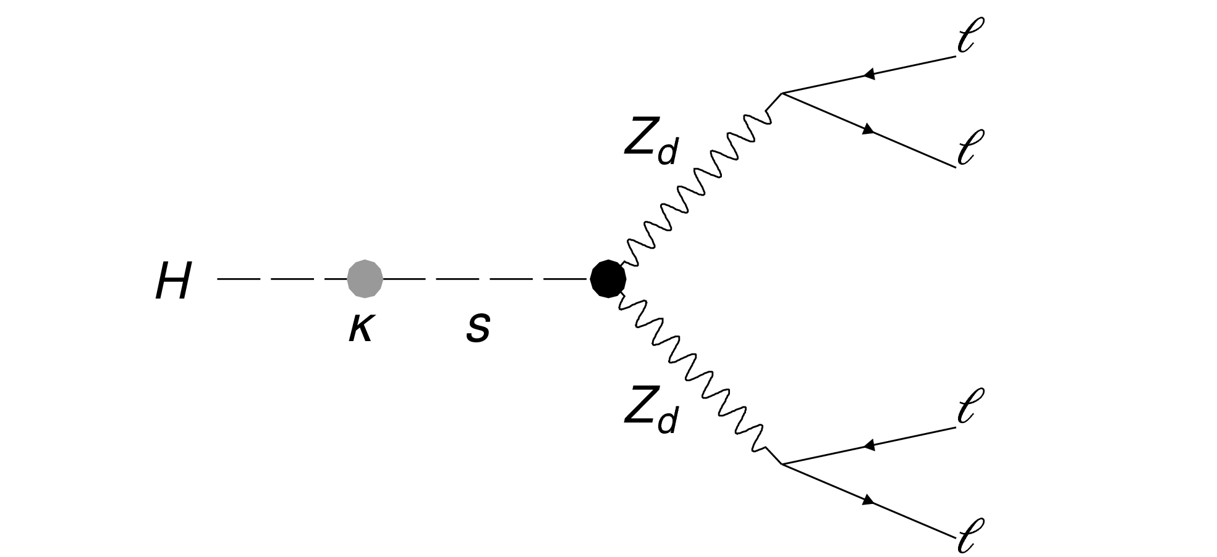
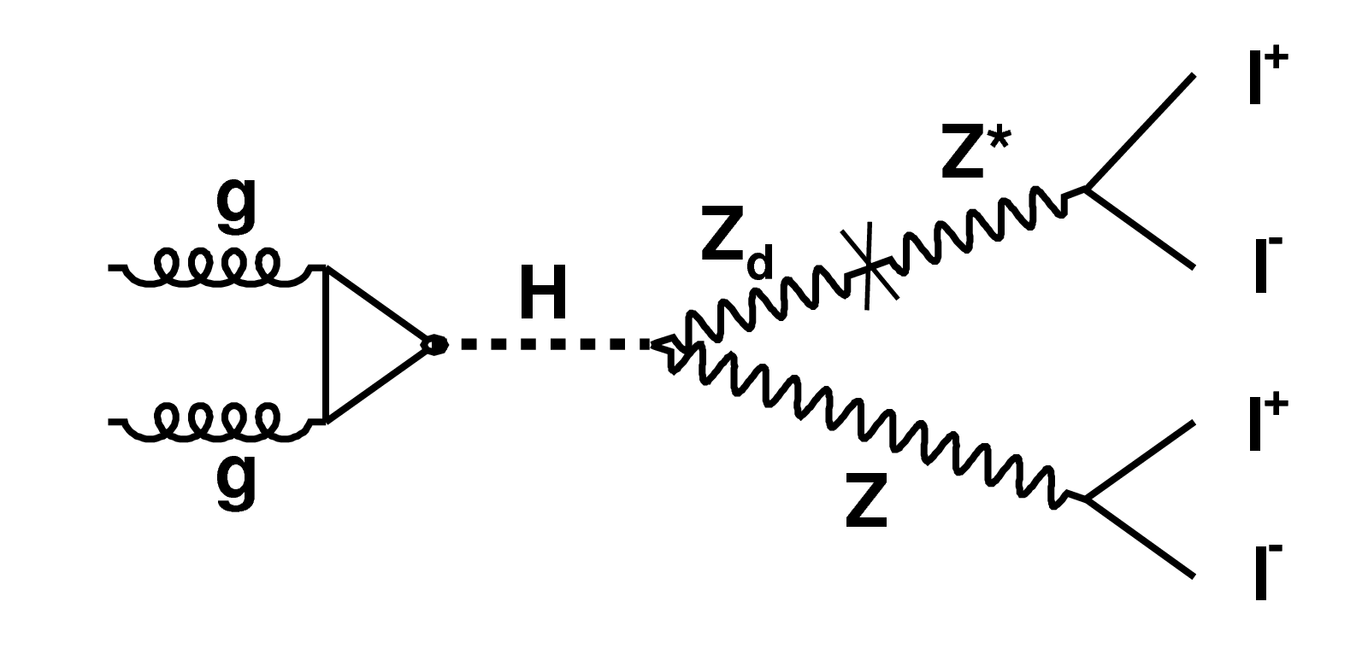
Higgs Portal at ATLAS
Can infer the existence of Z_{d} through:
Deviations of SM predicted Drell-Yan rates
Higgs decays through exotic intermediate states
In particular, allows for new processes with 4l final states: and
Not ruled out by electroweak constraints on ε
Notes:
List what parameter spaces each can probe
Not ruled out by electroweak constraints on epsilon

Slide 5
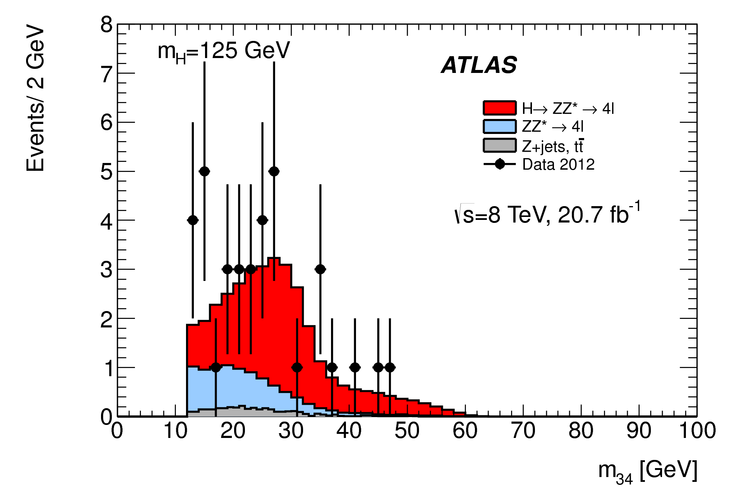
Analysis Strategy
Apply event selection:
Run 1: Same event selection as analysis
Run 2: Selection will be further optimized for analysis
Look at spectrum, apply LH fit to search for narrow peak about featureless SM background
In absence of excess, set limits
on
Notes:
Should I include the event selection here? backup?
explain what m34 is, same flavor opposite sign
mu is normalization of ZZ*, p is related to ZZd, product is normalization of signal

Slide 6
Run 1 Analysis
Simulated signal with 15-55 GeV in 5 GeV steps (interpolated between steps) from ggF H using Hidden Abelian Higgs Model (Z_{d} is on shell)
Relevant backgrounds ( ) simulated and normalized to data (or SM cross section)
Dominant uncertainties from lepton ID, background normalizations

Slide 7
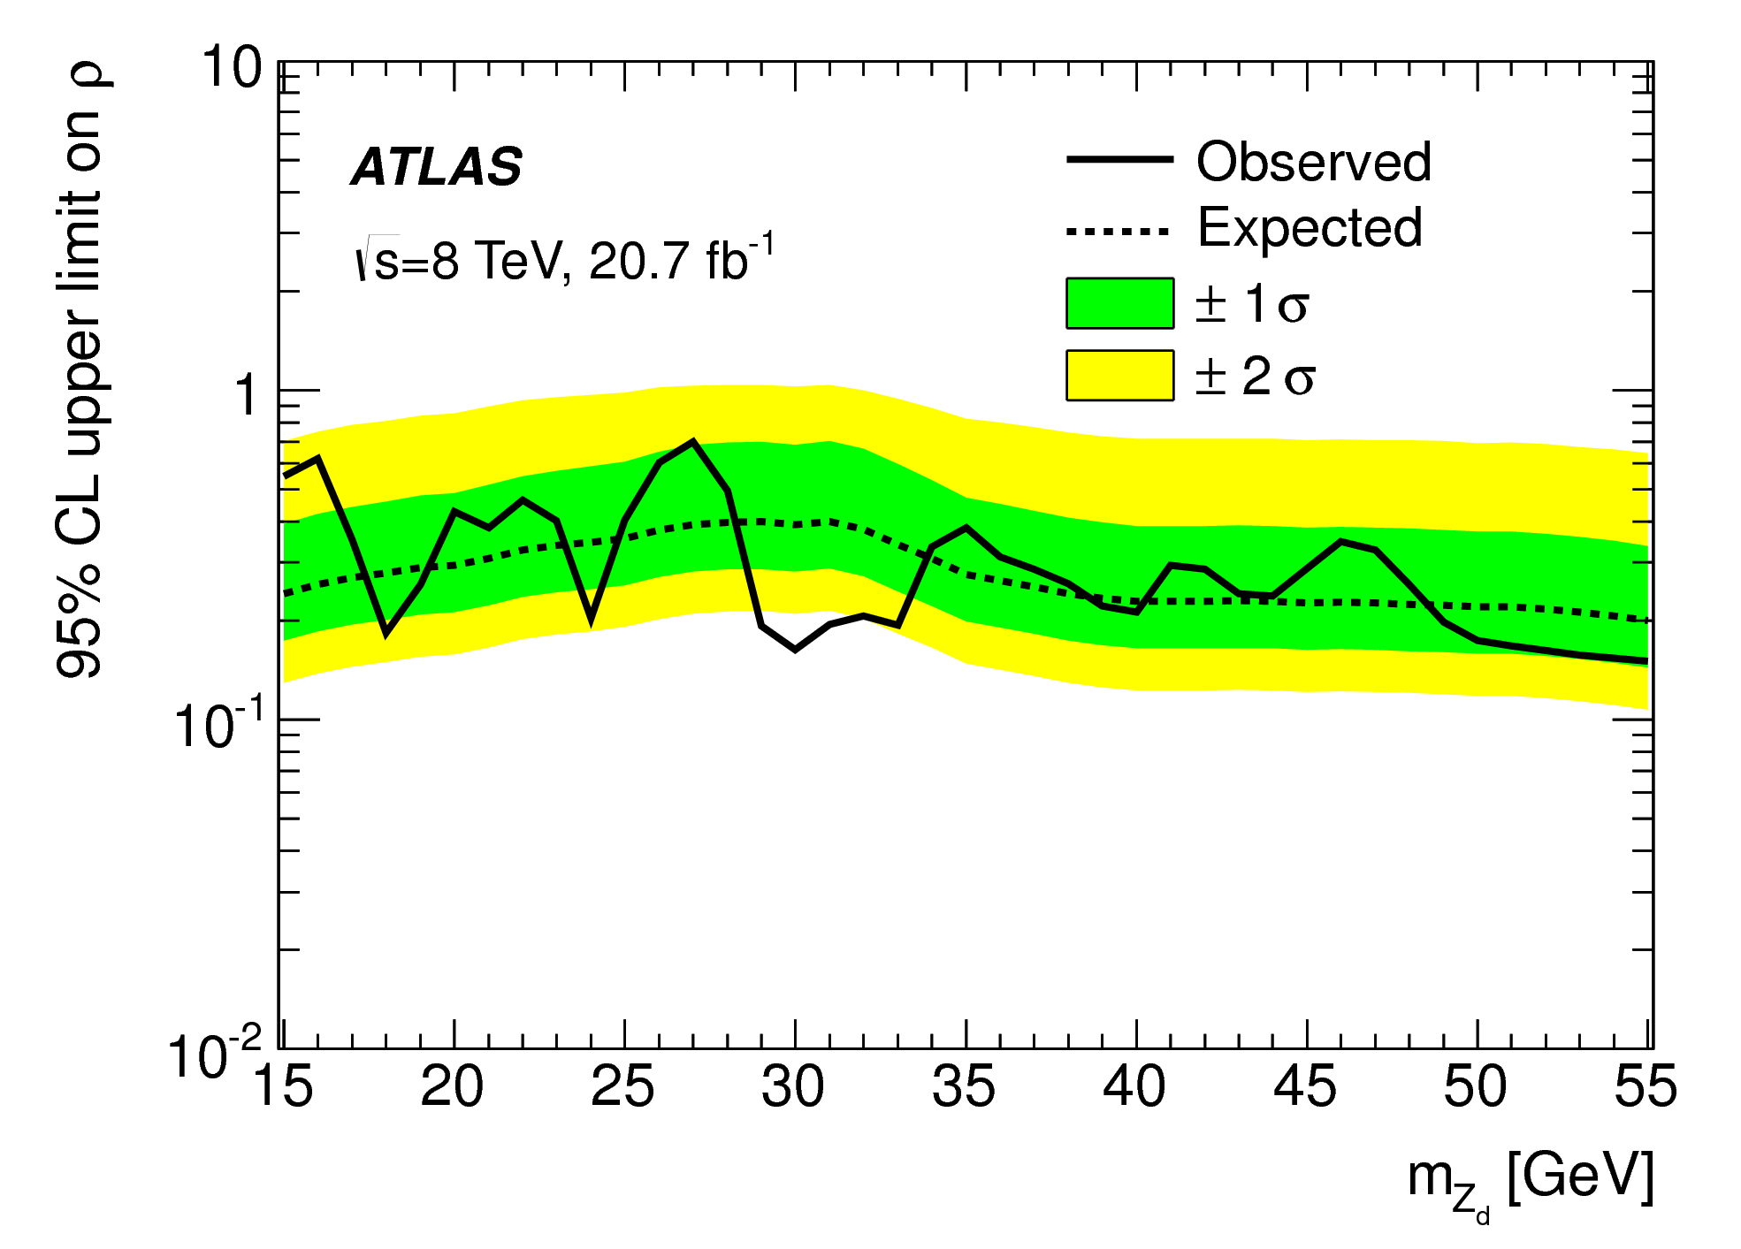
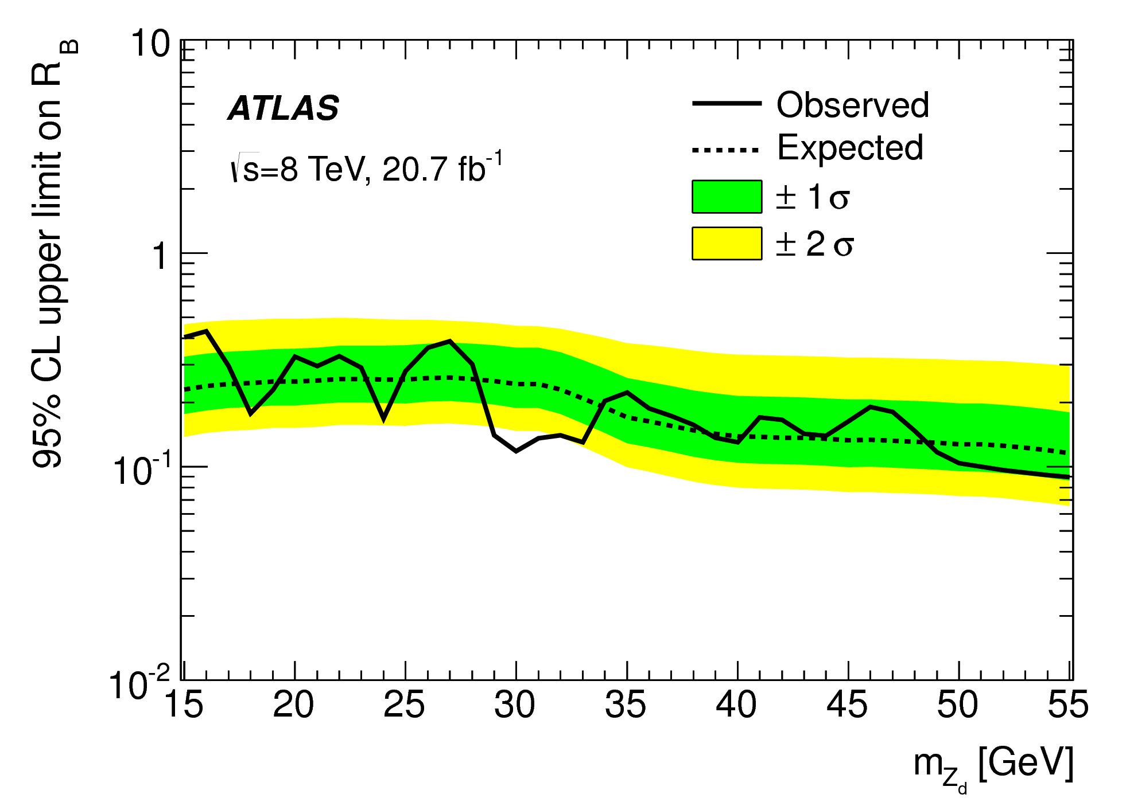
Run 1 Results
No significant deviations from SM expectations ☹
Can extract limits on ρ from LH fits
Using can extract limits on R_{B}
Notes:
C is the ratio of of products of acceptances and reconstruction efficiencies for ZZ* and ZZd

Slide 8
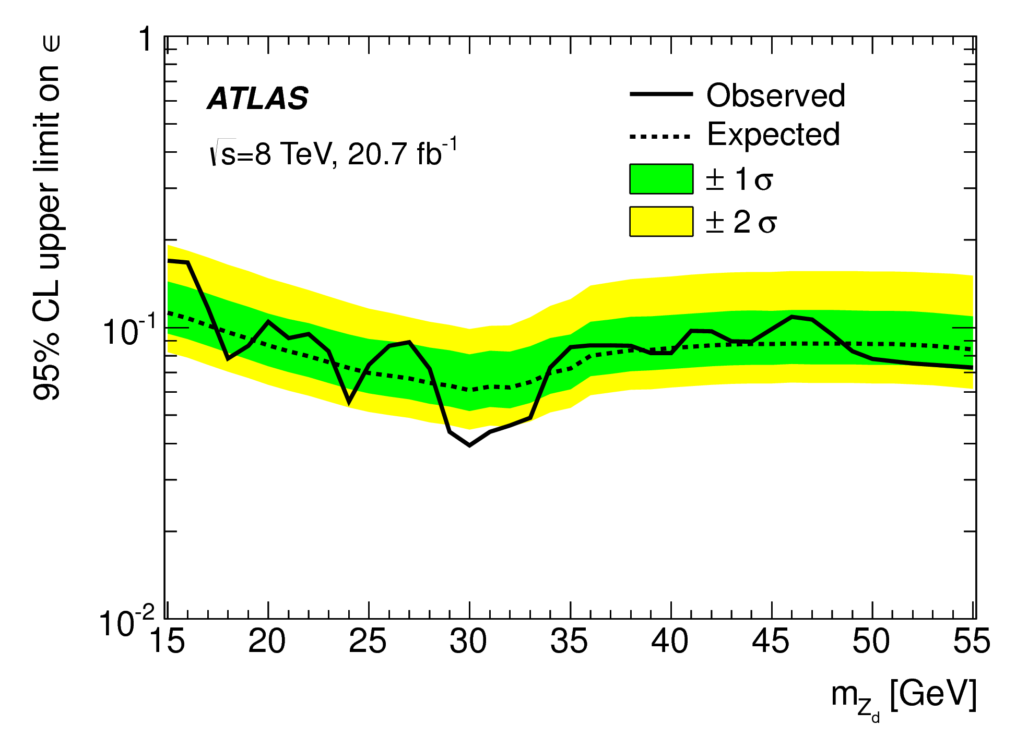
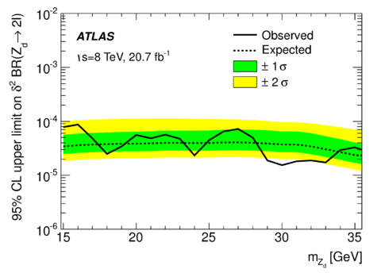
Run 1 Results
By assuming SM cross section of , can extract limits on ε
By approximating can extract limits on δ
Notes:
consistent excess around 30, but not statistically significant

Slide 9
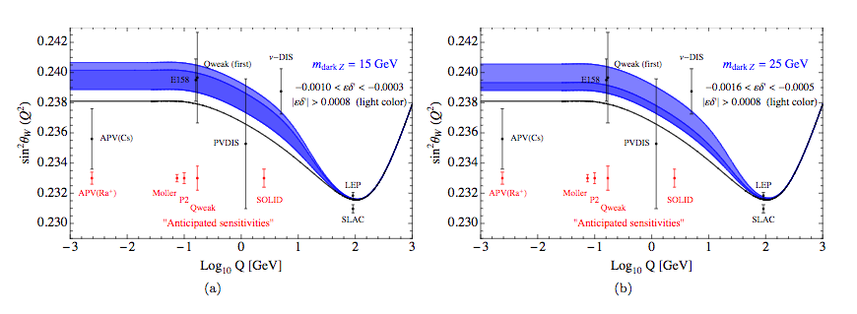
Applications
SM predictions for the running of weak mixing angle with Q² does not match data
Z_{d} with mass in our search range could improve agreement
Notes:
done here at BNL
what is Q2? momentum transfer
w is angle to which spontaneous electroweak symmetry breaking rotates W0 and b0 to create photon and Z and W

Slide 10
Run 2 Improvements
Optimize the Higgs mass window for ZZ_{d} decays (in progress)
Consider lifetime of Z_{d} (possible displaced vertices)
Consider lower (in progress)
Aided by lowering lepton ID threshold
Improve event selection and signal yield using machine learning
Notes:
Because ZZd and ZZ* kinematically compatible, hardest background to remove

Slide 11
Machine Learning
Machine Learning allows algorithms to ‘learn’ parameters without being explicitly programed
Can be used for classification, dataset generation, high level vector space transformations, unsupervised grouping, taking over the world…
Already used in a few LHC analyses, triggers, reconstructions, and IDs
Usually relatively simple
algorithms: LHs and BDTs
Notes:
Should I include a slide on BDTs?

Slide 12
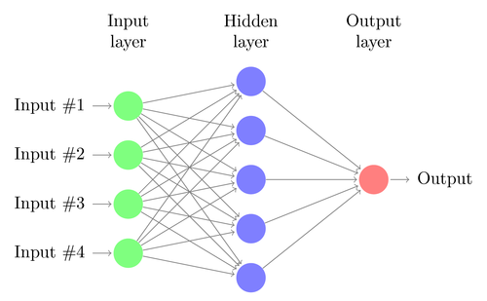
Deep Neural Networks
Layered graph of multi-dimensional linear transformations
Classification error is back-propagated using gradient descent based on cost function
Able to learn highly abstracted representations of data and extract high level patterns
Notes:
Inspired by biological systems

Slide 13
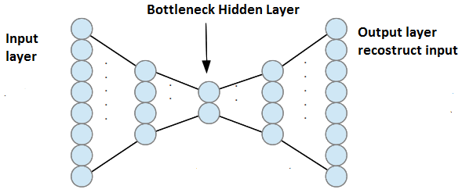
Deep Neural Networks with Autoencoders
NN performance is highly hyperparameter dependent
One way to mitigate this is unsupervised pre-training
Autoencoders create a “bottleneck of dimensionality”
Goal is to accurately encode and decode information at each layer according to and
Encoder weights are used as preliminary NN weights
Notes:
and to avoid falling into a local minima

Slide 14
Machine Learning for Z_{d} Search
Two options for applying ML to this analysis:
Use ML to optimize the event selection
Goal to increase statistics in m₃₄ distribution
Use trained algorithm after/instead of event selection
Goal to resolve peak in m₃₄ distribution
Would help remove remaining non-resonant ZZ* background and background outside of Z_{d} mass range
More difficult because processes have identical kinematics in
range.
Can combine both techniques
Option 1 currently being studied with pre-trained DNNs, have demonstrated clear improved event selection efficiency (for Run 1 data)

Slide 15
Conclusions
Search for a dark sector vector boson in the intermediate mass range where kinetic mixing dominates is well motivated and accessible at the LHC
Run 1 found no significant excess in Z* spectrum, set improved limits on R_{B} and mixing parameters
Machine learning is a promising way to increase search sensitivity in Run 2
Many thanks to Daniela, Keith, Luke de Olivera
This work is supported by the National Science Foundation Graduate Research Fellowship

Slide 16
Backup

Slide 17
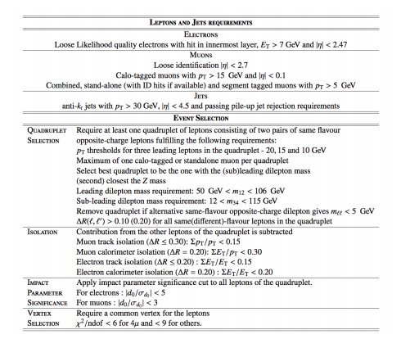
Higgs to 4l Standard Event Selection

Slide 18
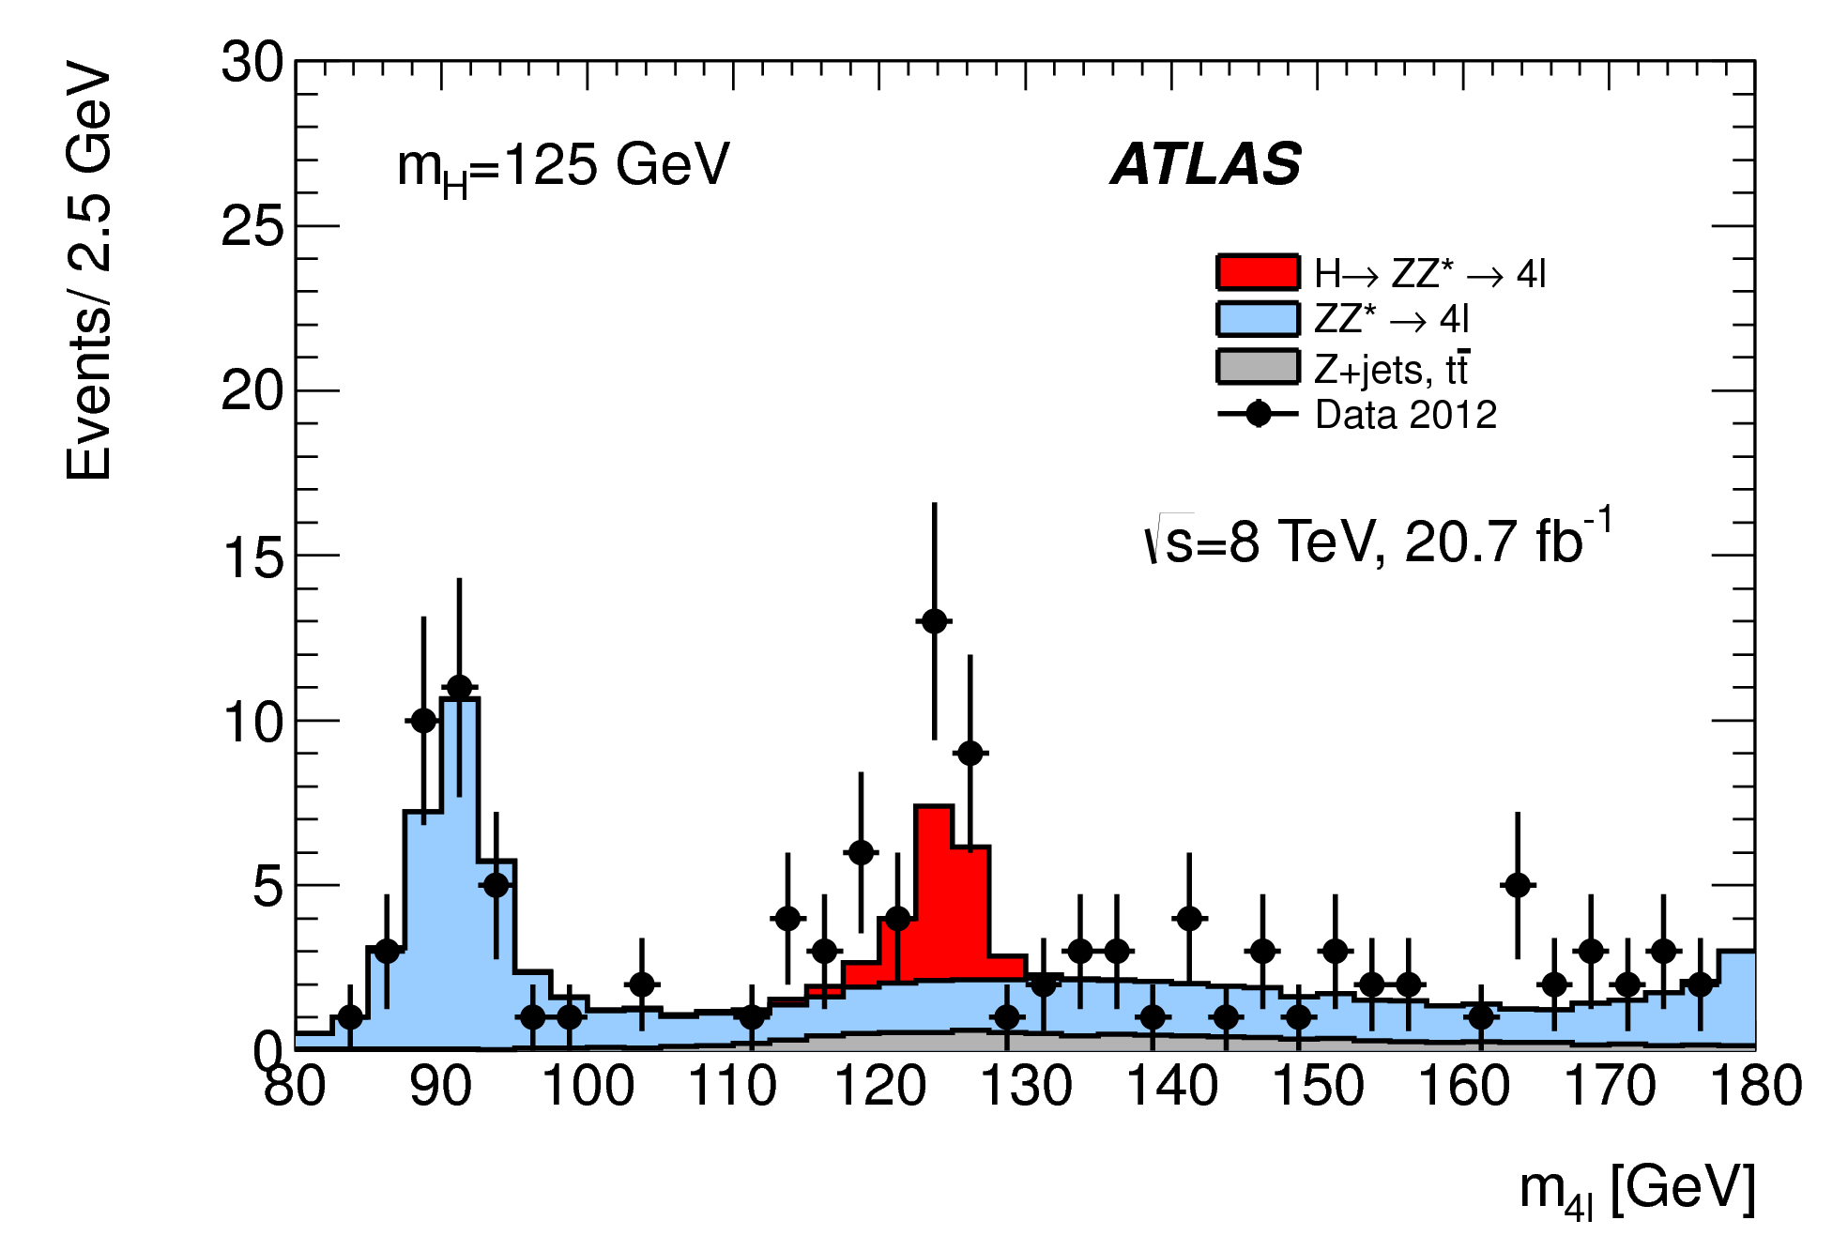
M4l Distribution Run 1

Slide 19
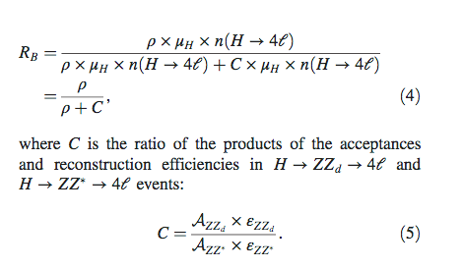
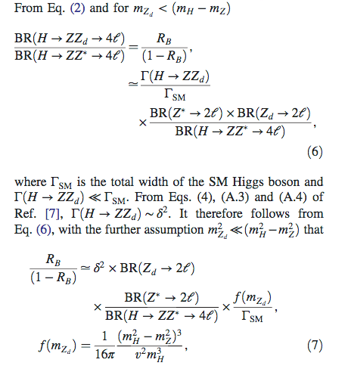
Deriving Limit Setting Equations
Setting R_{B} limits from LH parameters
Deriving limits on mass mixing from R_{B}

Slide 20
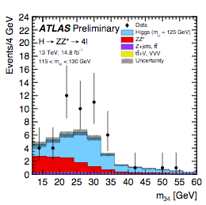
M₃₄ Spectrum from Run 2

