Slide 1





Search for Dark photons at the SeaQuest E906 Experiment
Arun Tadepalli*
Rutgers University
*This work supported in part by US National Science Foundation grant 1306126

Slide 2
Contents
Indirect evidence for Dark matter
Dark matter and standard model coupling
The SeaQuest experiment
SeaQuest dark photon search strategy
Current status
Summary and Outlook

Slide 3
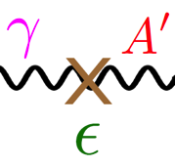

Energy budget of the Universe
Dark energy
68.3%
4.9%
26.8%
Standard model matter
Dark matter
Nucleons and Nuclear structure
Dark forces & Hidden sector
Issues in Nuclear structure
Dark photons
Spectrometer
Current status & results

Slide 4
What’s the matter?
Dark matter is:
one of the greatest unsolved mysteries of modern physics
a central element for cosmology and astronomy
about 27% of the energy density of the Universe
Dark energy
68.3%
26.8%
4.9%
Dark matter
Ordinary matter

Slide 5
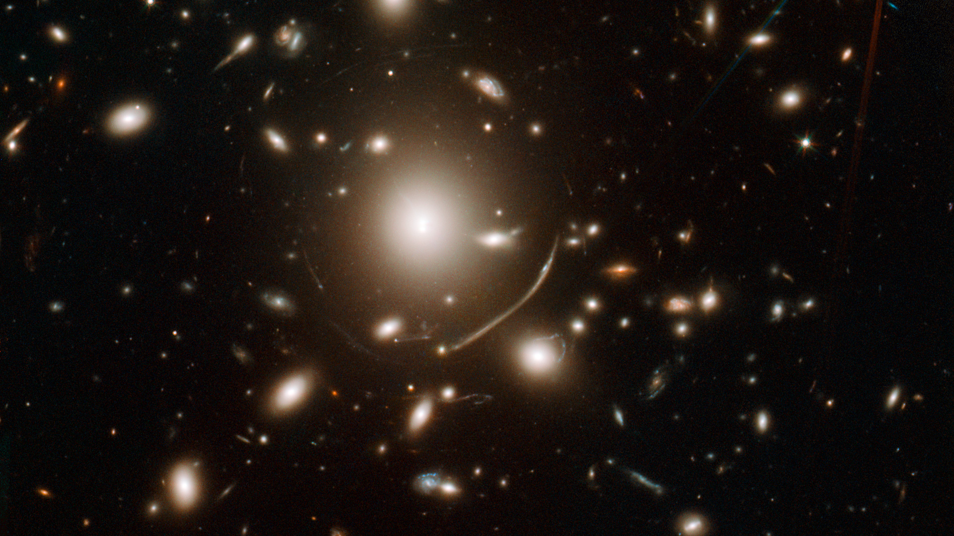
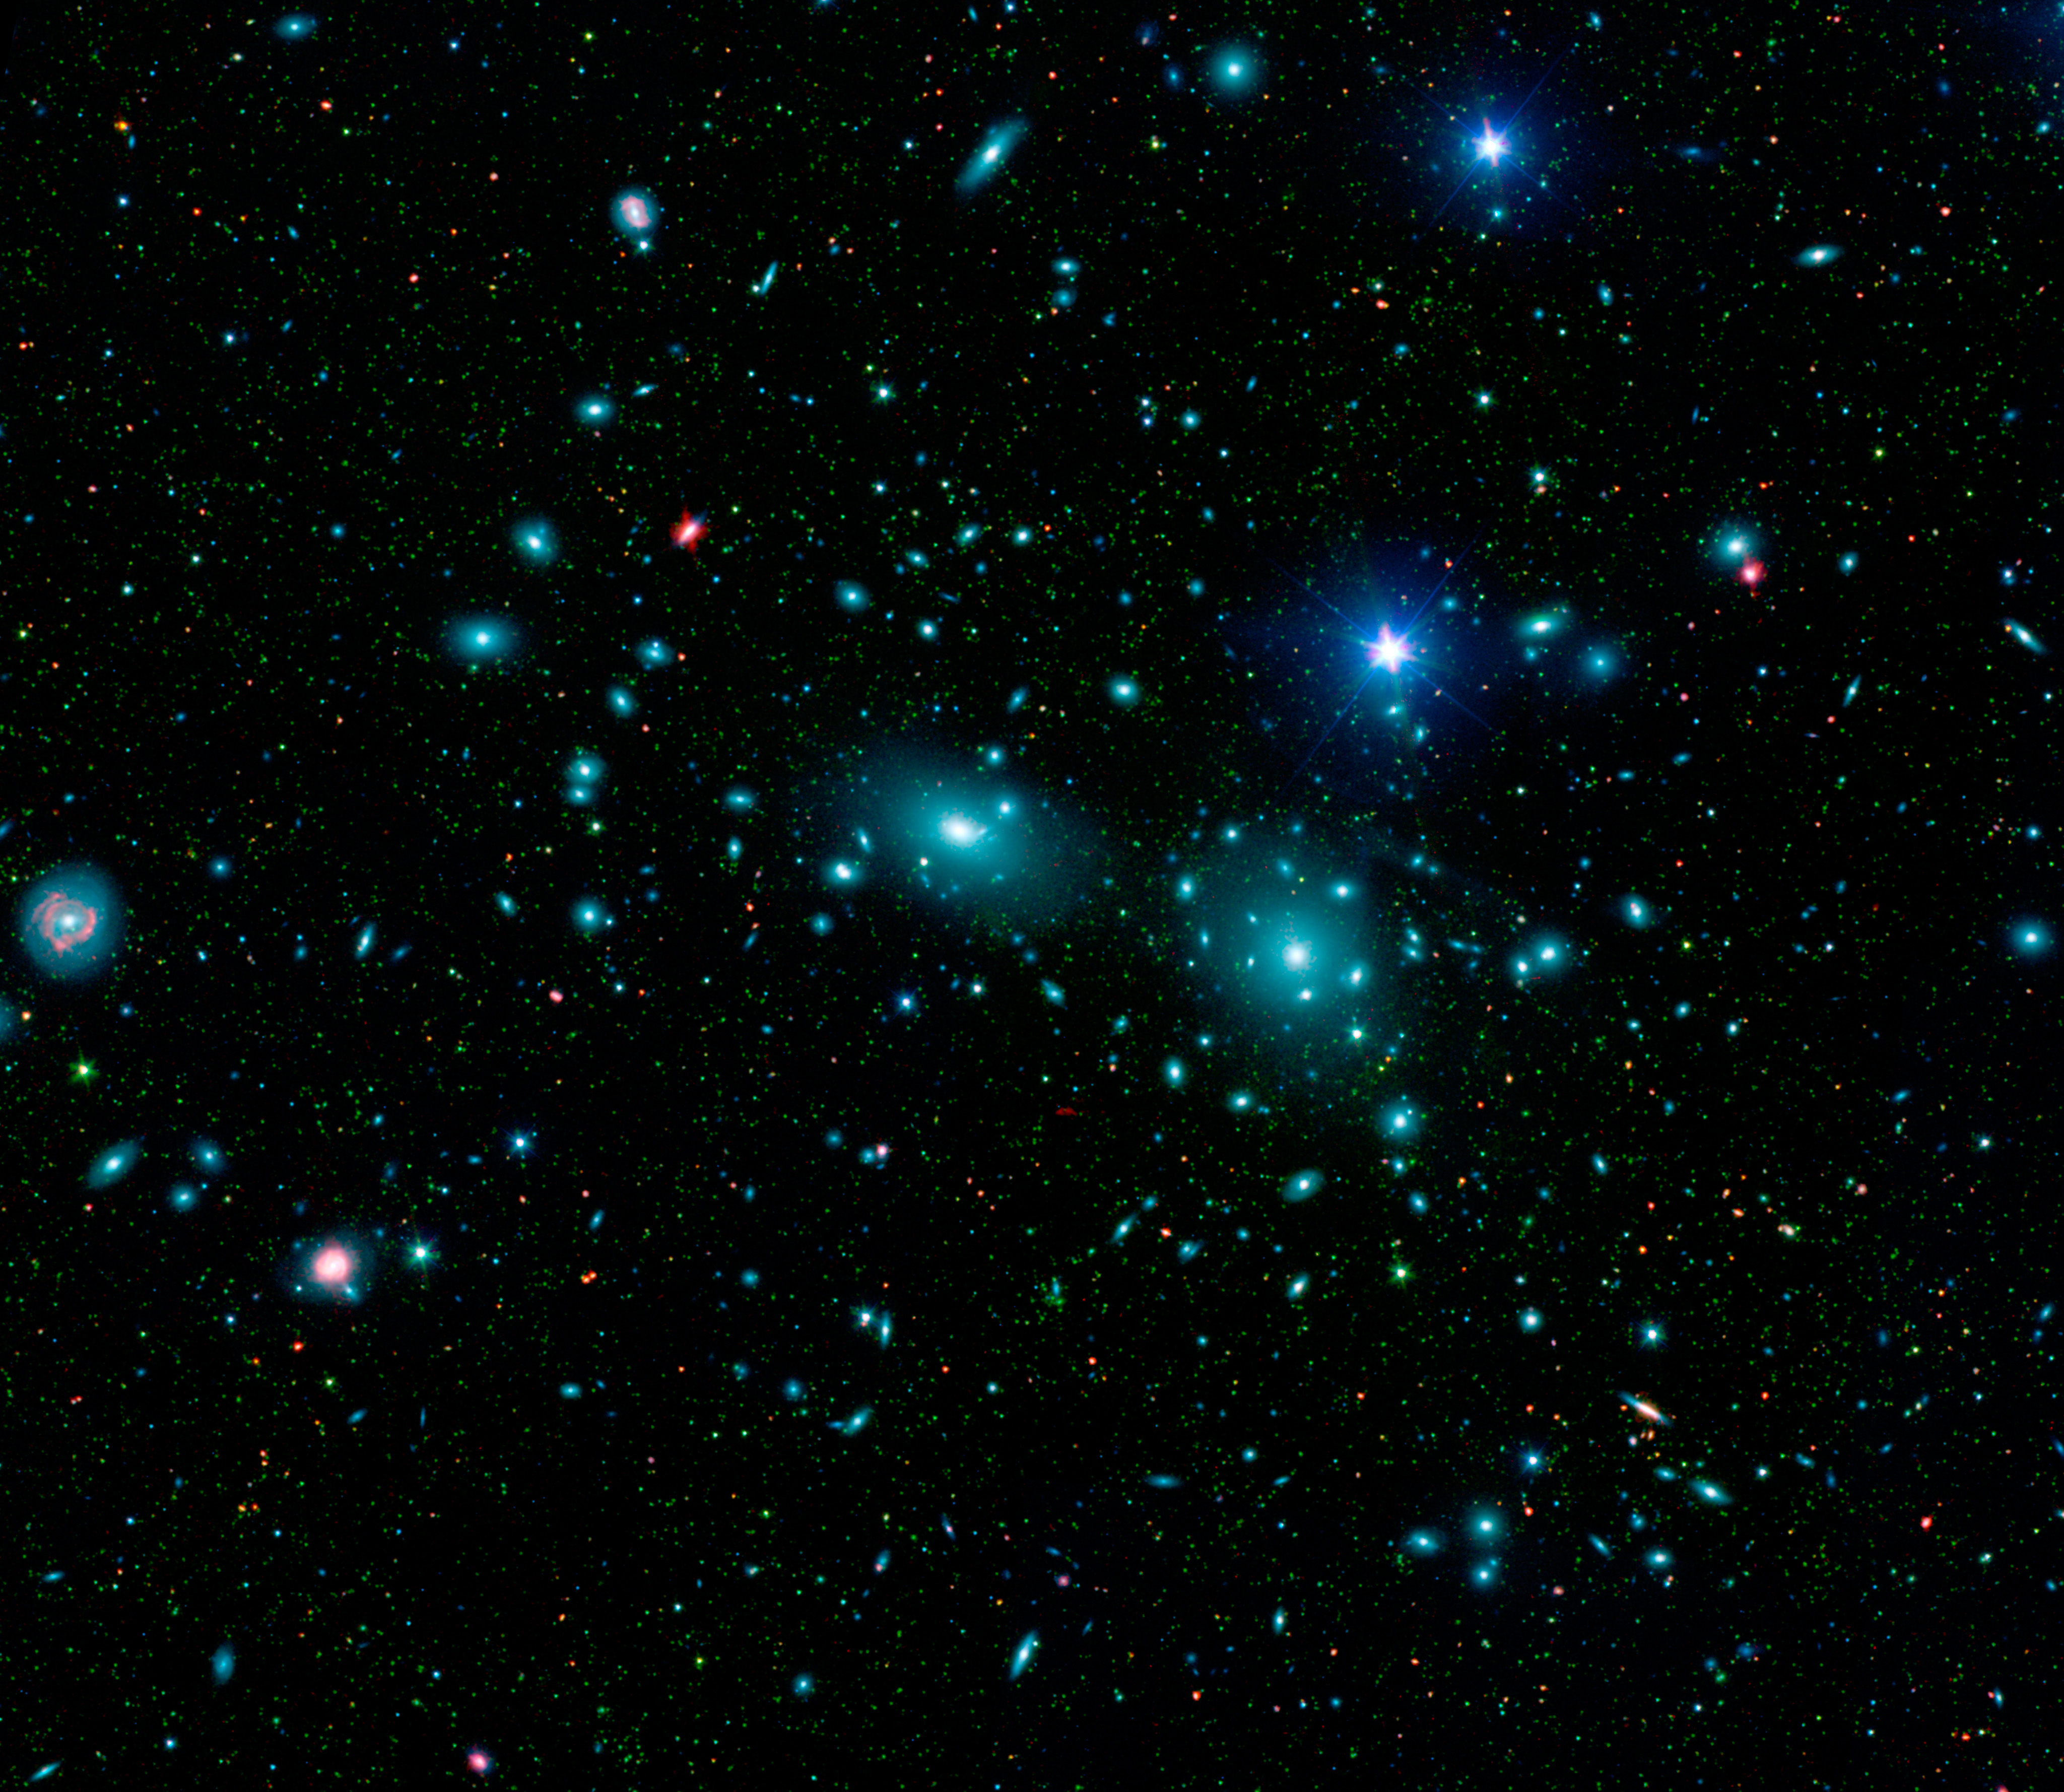
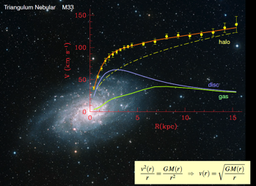
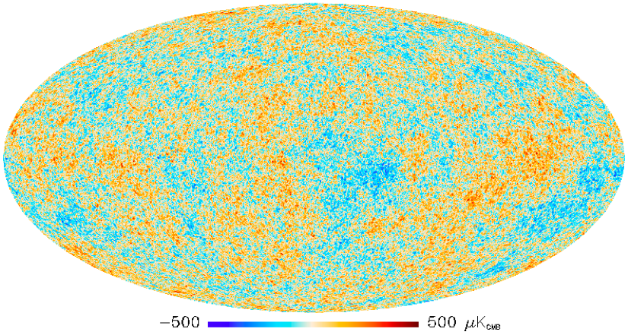

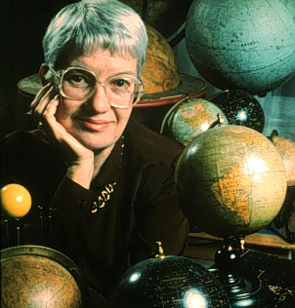
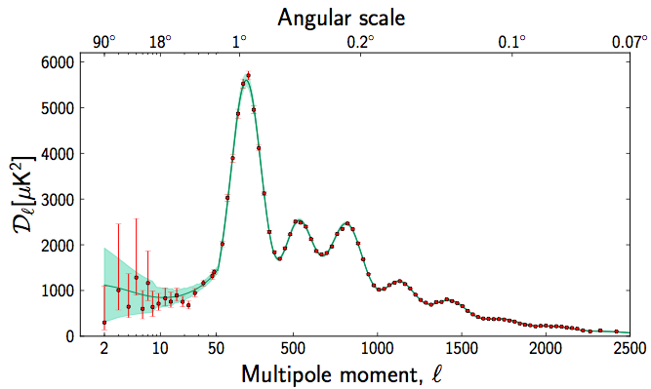
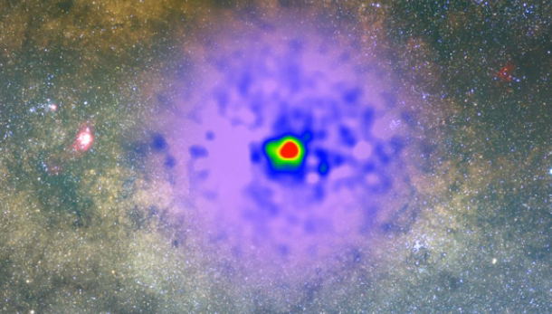
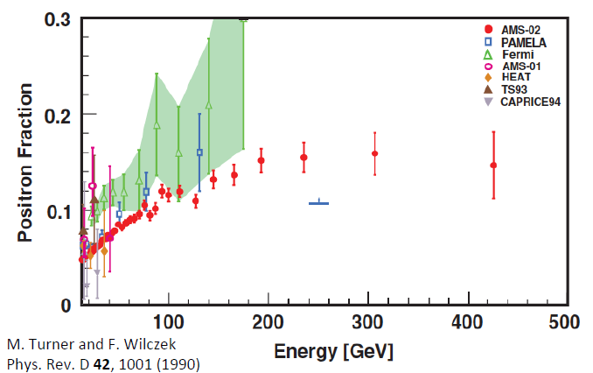
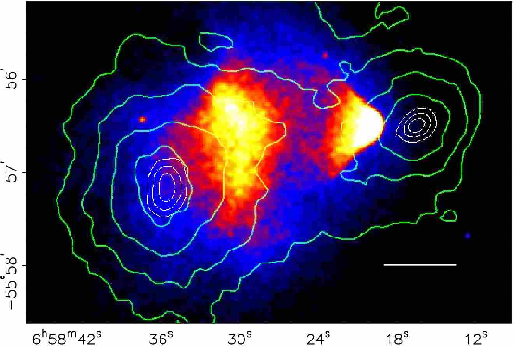
Dark matter - motivation
F. Zwicky, ApJ 86 (1937) 217
Gravitational lensing of galaxies
V. Rubin et al, ApJ 238 (1980) 471
Motion of individual galaxies in coma clusters
Rotational curves of individual galaxies
CMB – power spectrum
FRITZ ZWICKY
The Economist, April 12, 2014
VERA RUBIN
Dai, De-Chang et al. Phys.Rev. D78 (2008) 104004 arXiv:0806.4319
M. Aguilar et al., PRL 113 (2014) 121101
P. Agrawal et al., arXiv: 1404.1373
T. Daylan et al, arXiv: 1402.6703
Hooper and Linden, PRD,
arXiv:1110.0006
B. D. Fields, S. L. Shapiro, J. Shelton,
PRL 113 (2014) 151302
5
Positron fraction excess
Bullet clusters - aftermath

Slide 6
Evidence for Dark matter
Indirect:
  Rotation curves of galaxies
  Gravitational lensing
  Bullet clusters
  Surveys of cosmic microwave background
  Positron excess in the universe
  Gamma ray excess from the galactic center
  …
Direct:
  pending…
Dark matter interpretations of astrophysical anomalies
Indicates that dark matter couples to ordinary matter more than gravitationally

Slide 7
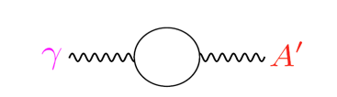
Dark sector and Standard model coupling
Standard Model
Quarks, leptons
g W Z γ
Hidden Sector
dark matter
A’
Dark sector could interact with the standard model sector via a hidden gauge boson (A’ or “dark photon” or “para photon” or “hidden photon”)
Dark photons can provide a portal into the dark sector
Dark photons could couple to standard model matter with α’ = αε²
A’ produced via a loop mechanism
B. Holdom, PLB 166 (1986) 196
J. D. Bjorken et al, PRD 80 (2009) 075018

Slide 8
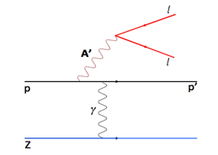
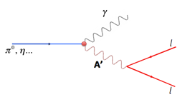
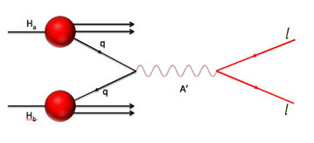
Possible A’ production mechanisms
Proton Bremsstrahlung
η … decay
Dark Drell-Yan process

Slide 9
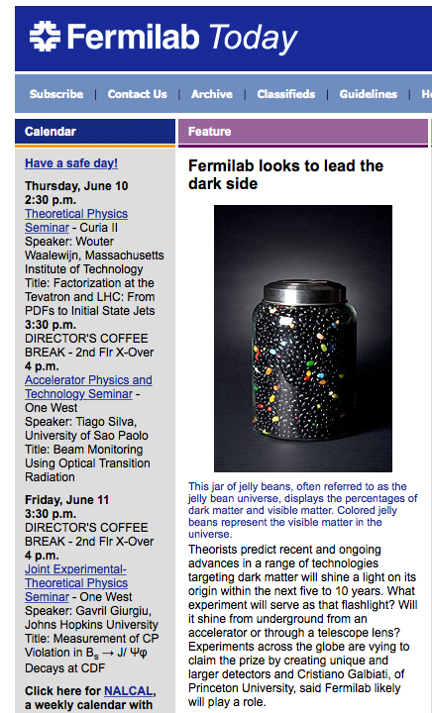
The Experiment
120 GeV proton beam from the Main Injector at Fermilab
Fixed target experiment that uses cryogenic and nuclear targets
Uses the Drell-Yan process as a probe into the nucleus
Optimized for detecting high rate di-muons

Slide 10
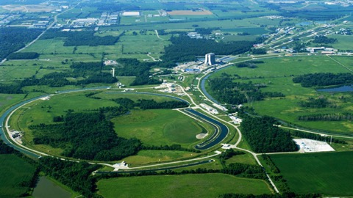

SeaQuest
Fixed Target Beam lines
Tevatron 800 GeV
Main Injector 120 GeV

Slide 11
Fermilab E906/SeaQuest Collaboration
Abilene Christian University
Ryan Castillo, Michael Daugherity, Donald Isenhower, Noah Kitts, Lacey Medlock, Noah Shutty, Rusty Towell, Shon Watson, Ziao Jai Xi
Academia Sinica
Wen-Chen Chang, Shiu Shiuan-Hao
Argonne National Laboratory
John Arrington, Don Geesaman*, Kawtar Hafidi,
Roy Holt, Harold Jackson, Michelle Mesquita de Medeiros, Bardia Nadim, Paul E. Reimer*
University of Colorado
Ed Kinney, Po-Ju Lin
Fermi National Accelerator Laboratory
Chuck Brown, Dave Christian, Gabriele Garzoglio, Su-Yin (Grass) Wang, Jin-Yuan Wu
University of Illinois
Bryan Dannowitz, Markus Diefenthaler, Bryan Kerns, Hao Li, Naomi C.R Makins, Dhyaanesh Mullagur R. Evan McClellan, Jen-Chieh Peng, Shivangi Prasad, Mae Hwee Teo,
Mariusz Witek, Yangqiu Yin
KEK
Shin'ya Sawada
Los Alamos National Laboratory
Gerry Garvey, Xiaodong Jiang, Andreas Klein, David Kleinjan, Mike Leitch, Kun Liu, Ming Liu, Pat McGaughey
Mississippi State University
Lamiaa El Fassi
University of Maryland
Betsy Beise, Andrew (Yen-Chu) Chen
University of Michigan
Christine Aidala, McKenzie Barber, Catherine Culkin, Vera Loggins, Wolfgang Lorenzon, Bryan Ramson, Richard Raymond, Josh Rubin, Matt Wood
National Kaohsiung Normal University
Rurngsheng Guo
RIKEN
Yuji Goto
Rutgers, The State University of New Jersey
Ron Gilman, Ron Ransome, Arun Tadepalli
Tokyo Tech
Shou Miyaska, Kei Nagai, Kenichi Nakano, Shigeki Obata, Toshi-Aki Shibata
Yamagata University
Yuya Kudo, Yoshiyuki Miyachi, Shumpei Nara
*Co-Spokespersons

Slide 12
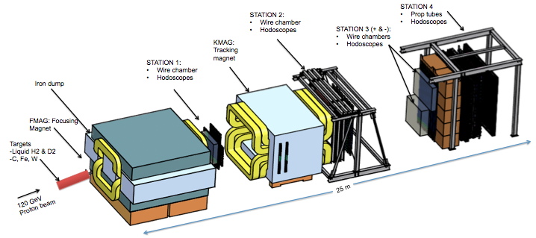
The SeaQuest Spectrometer
3500 wires
550 prop tubes
350 hodo paddles

Slide 13
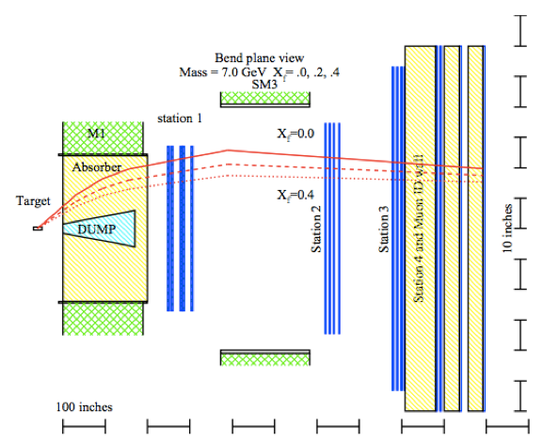
hit
Accept this path
hit

Slide 14
hit
Reject this path
hit

Slide 15
hit
Signal is a coincidence of μ⁺ & μ⁻ paths
hit

Slide 16

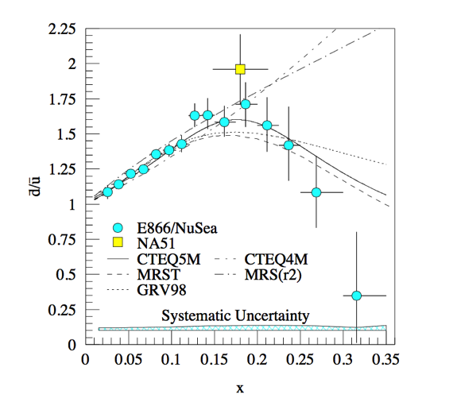
SeaQuest physics goals
What is the origin of the nucleon sea?
Is the nucleon sea flavor symmetric?
What about TMDs?
Do we know what causes EMC effect?
Did you just say dark photons??
J/ψ and ψ’ suppression in cold nuclear matter
Do partons lose energy in cold nuclear matter?

Slide 17
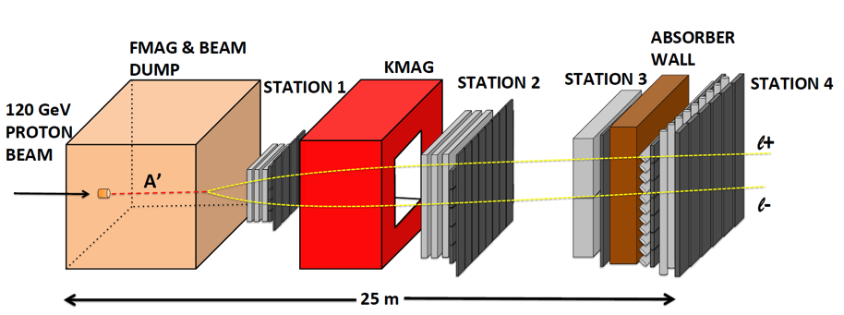
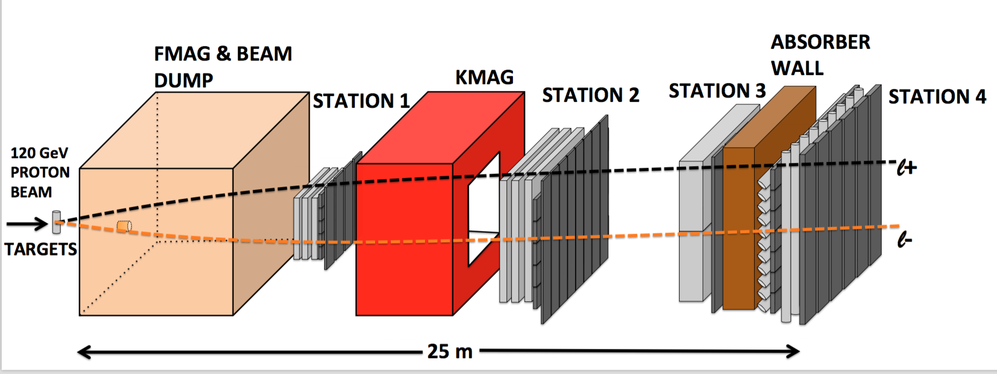
CARTOON OF A DARK PHOTON EVENT
CARTOON OF A DRELL YAN EVENT

Slide 18
Background events
Purple – Drell Yan like events produced at the target which cross over
Yellow – A’ events

Slide 19


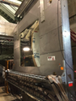
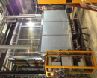
Timeline of SeaQuest
Dark Interactions BNL
March 2012
I
REST
Nov 2013
REST
Nov 2014
REST
II
III
IV & V
VI?
See Ming’s talk – cool detector upgrades to access unique parameter space!
Main injector upgrades
Stable operation of all detector sub systems
Dark photon road sets included into the trigger system
New St3- installed
Improved duty factor
Continue data taking
Installation of new St 1 drift chamber
Scheduled accelerator maintenance
Commissioning run
All detector subsystems work
Issues and upgrades addressed

Slide 20
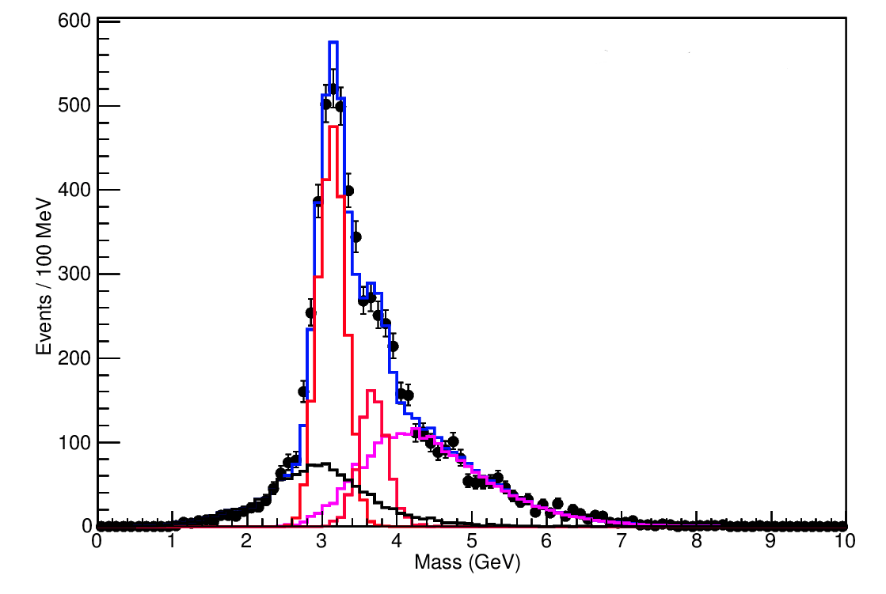

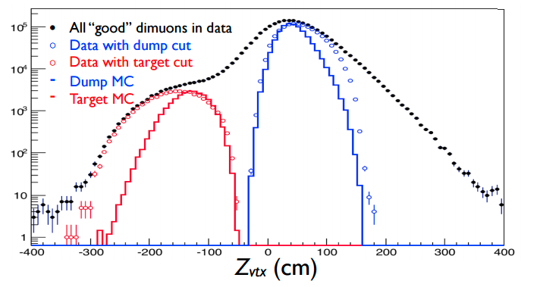
Event selection and reconstruction
Invariant mass spectrum for FY 2015 data
30% of anticipated data
Data agrees well with Monte Carlo (spectrometer works as expected)
Data with Mass > 4.2 GeV are mostly dimuons coming from the Drell-Yan process
E906 preliminary
J/ψ Monte Carlo
ψ’ Monte Carlo
Drell-Yan Monte Carlo
Random Background
Combined MC and bg

Slide 21
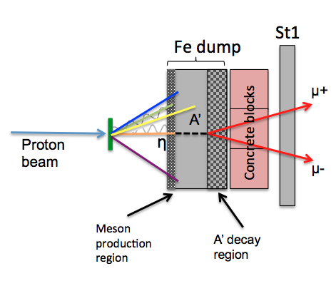
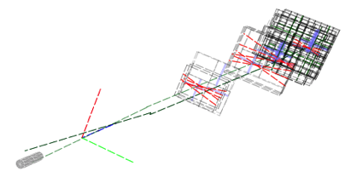
SeaQuest A’ search strategy
A’ generated by η decay and/or proton Bremsstrahlung in the Iron beam dump
A’ could travel a distance l₀ without interacting
A’ decays into di-leptons
Reconstructed di-lepton vertex is displaced, downstream of the target in the beam dump
l₀
Dark photon like event in the event display software

Slide 22
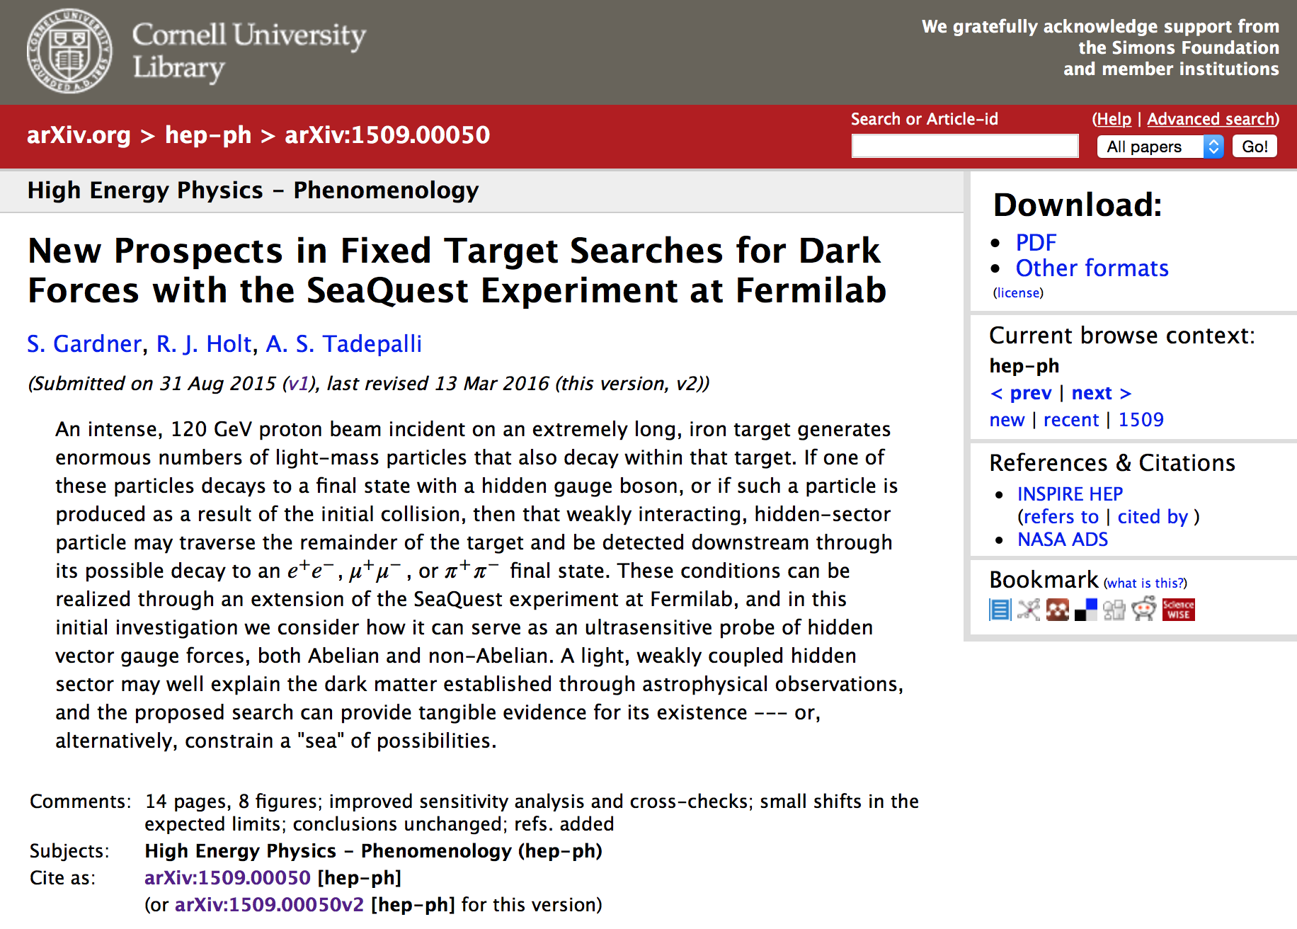
Arxiv submission

Slide 23
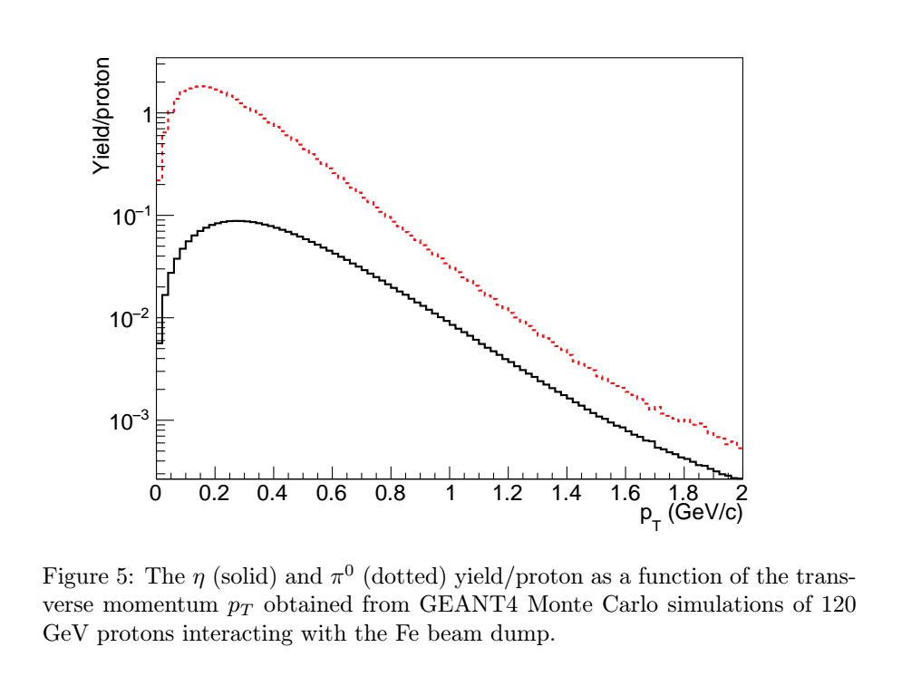
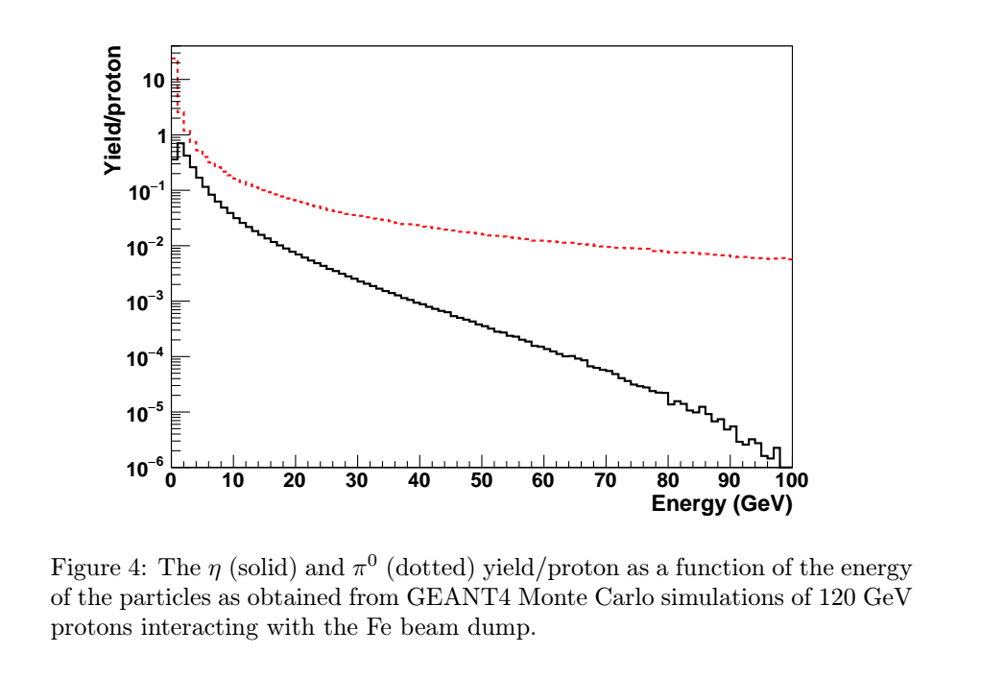
Dark photon - Monte Carlo simulations
There is no data for 120 GeV proton beam on Fe beam dump
  GEANT4 simulations to estimate pion and eta cross section per nucleon generated in the beam dump
  Extracted various kinematic parameters and used them as inputs to estimate the dark photon cross section
S. Gardner, R. J. Holt, A. Tadepalli, arXiv 1509.00050

Slide 24
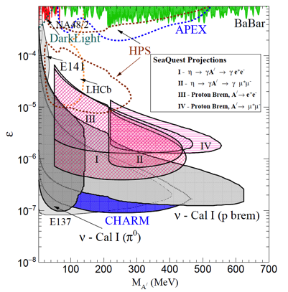
A’ sensitivity region for SeaQuest
2E12 ppp
200 days
10 event contours
J. D. Bjorken et al, PRD 80 (2009) 075018
preliminary
E₀ = energy of the A’
N_{eff} = no. of available decay products
l₀ = distance that A’ travels before decaying
ε = coupling constant between standard model and dark sector
m_{A’} = mass of A’
S. Gardner, R. J. Holt, A. Tadepalli, arXiv 1509.00050

Slide 25
A’ sensitivity region for SeaQuest
10 events in 200 days
2E12 ppp at 100% detection efficiency
Yet to be sculpted by acceptance, tracking efficiencies, GMC simulations etc..
Analysis underway
preliminary
See Ming’s talk – cool detector upgrades to access unique parameter space!
S. Gardner, R. J. Holt, A. Tadepalli, arXiv 1509.00050

Slide 26
Current status and analysis outlook
Including the different mechanisms in the MC simulations
  Proton Bremsstrahlung
  Eta decay
  Dark Drell-Yan process
Modifying the tracker to search for dark photon like events which have a displaced vertex downstream
Study all the background carefully
Determine the systematic errors
Data analysis → reconstruct real data and compare with MC to see if there is any dark photon event and determine best fit and limits for (m,ε)

Slide 27
Summary and outlook
Direct evidence for dark matter is overwhelming. Indirect evidence is pending.
Dark photons could provide a portal into the dark sector
SeaQuest takes advantage of the ηdecay process, proton bremsstrahlung and dark Drell-Yan process to search for dark photons
Preliminary estimates have been made for the range of dark photon coupling constant vs mass parameter space
Analysis in progress
Exciting times ahead!!
Stay tuned!

Slide 28
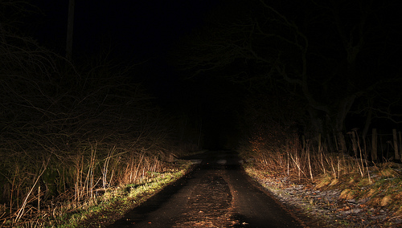
Don’t be afraid of the dark!

Slide 29
Thank you!

Slide 30
BACK UP

Slide 31
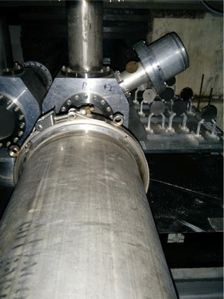
TARGETS
2 liquid targets: hydrogen and deuterium
  20” long, 3” diameter flasks
3 solid targets:
  carbon, iron, tungsten
Background subtraction:
  empty flask, nothing
All targets <15% interaction length
Beam time split roughly:
  LH2 – 44%
  LD2 – 22%
  C, Fe, W – 17%
  random background - 17%
BEAM

Slide 32
Run Plan
Run I - Commissioning run Spring 2012
Discovered instantaneous beam problems, developed Cerenkov monitor
Run II - Nov 2013 - August 2014
Continued commissioning through Feb 2014, then analyzable-quality data
Collected ~2.5E17 analyzable protons!
Run III – July 2015
Collect more analyzable quality data, beam quality improves
Collected ~3.3E17 analyzable protons!
Run IV - Summer 2016
Continue to 2.5E18 protons
Run V – Aug 2016 – 1 year?
Continue to take more data!

Slide 33
Missing mass – Dark matter?
F. Zwicky, ApJ 86 (1937) 217
In 1930s Fritz Zwicky carefully studied the dynamics of individual galaxies in coma clusters
He noted that their visible mass was much less than that needed to keep the galaxies moving around each other
Additional “gravity” is needed to explain the motion of galaxies
FRITZ ZWICKY

Slide 34
Rotational curves of galaxies
In early 1970s, Vera Rubin carefully studied the rotational curves of galaxies
She looked at the red shift of the different parts of the stars rotating in the galaxy
This suggested that there was more “unseen” mass enveloping the galaxy keeping the stars from flying apart
FRITZ ZWICKY
V. Rubin et al, ApJ 238 (1980) 471
VERA RUBIN

Slide 35
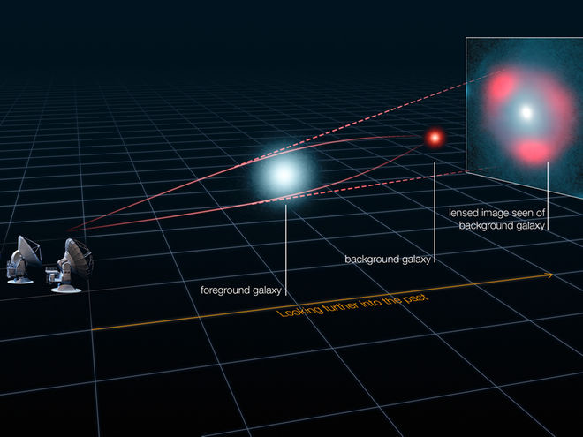
Gravitational lensing of galaxies
Light bends in the presence of a strong gravitational field
Multiple copies of the object in the background are produced
Depends on the geometry of the “gravity” lensing the light from the background
The observed lensing could be used as a “weighing scale” for the background galaxy

Slide 36
Gravitational lensing of galaxies
Mass of the foreground galaxy is estimated based on the observed lensing
The mass of the foreground galaxy can also be estimated using other independent light/mass ratio methods
More “gravity” is needed to explain the observed lensing

Slide 37
Bullet clusters – collision of galaxies
Dai, De-Chang et al. Phys.Rev. D78 (2008) 104004 arXiv:0806.4319 [gr-qc]
Bullet clusters – aftermath of the collision of two galaxies
Chandra telescope used to study emitted x-rays
Weak gravitational lensing of these x-rays suggests that “gravity” is distributed as shown on the green contour lines

