Slide 1
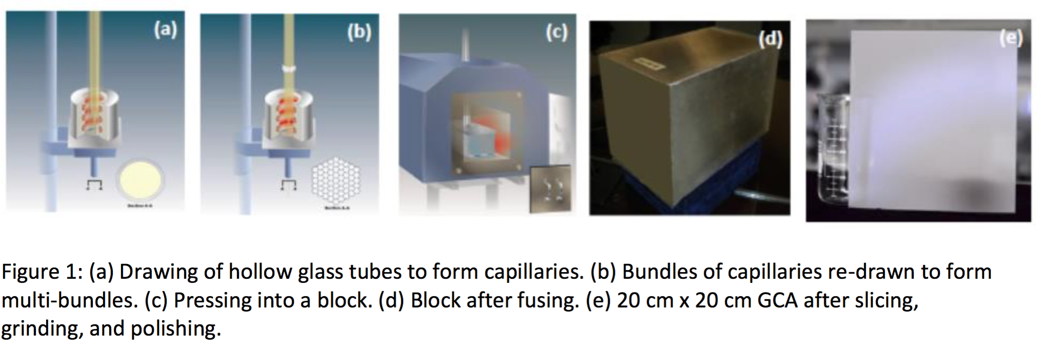

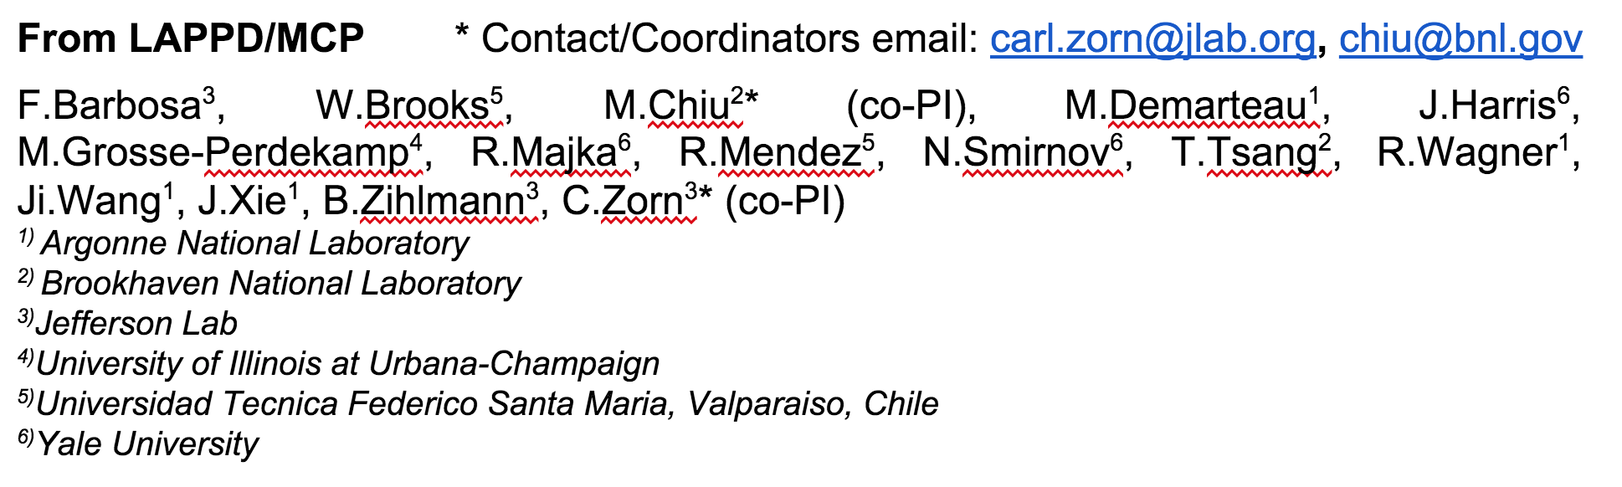
EIC LAPPD Update Santa Fe 2015

Slide 2
Reminder of Proposed Work
Continue performance characterization of base Argonne MCP-PMTS
High B-field test at UVa (or possibly Argonne)
Tests of QE, uniformity, radiation hardness, etc.
Work on UV sensitive photocathodes
Swap in fused silica window and keep standard K₂CsSb photocathode
Try Na₂KSb if that doesn’t improve N.P.E.
Should result in factor of ~2 improvement in N.P.E.
Develop pixelated readout (2017)
Two options: resistive anode or sealing PCB

Slide 3
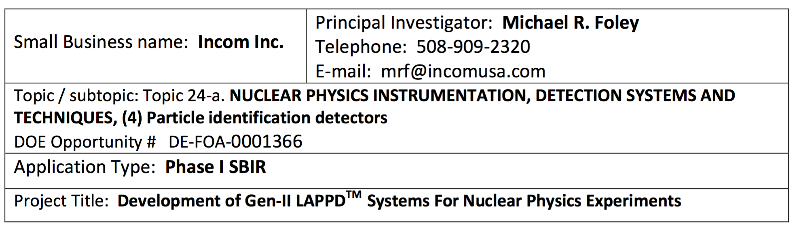
Incom SBIR
Builds on Gen-I LAPPD SBIR Phase-2 proposal
All glass construction, strip-line readout, 20x20 cm² tiles
First pieces by end of year (possibly), and routine production after Q1 2016
Should be able to receive some initial ones for testing
Gen-II versions are largely based on our EIC R&D proposal
Pin free Pixelated readout (using capacitive coupling)
Easier to maintain vacuum
Fused silica window (better UV detection)
More UV sensitive photocathode
Default is K₂CsSb
Next to try is Na₂KSb (w or w/o Cs)
Ceramic package
Cheaper and easier to seal than glass
Expected cost will be an order of magnitude cheaper than existing MCP-PMT (in volume)

Slide 4
UV Improved MCP-PMT Studies
Argonne has been steadily improving the production at their small tile facility
Studying CsI as a UV only, solar blind, photocathode from 120-300 nm
Will start making tiles with fused silica window starting in November
Since their request for a UV spectrometer ($40K) wasn’t funded, it will be much harder and slower to pursue this research
In the meantime, will send produced tiles to BNL for evaluation to evaluate QE from 170-1000 nm.
Also possible, with more effort, down to 112 nm limit of MgF₂.
High priority to fund UV spectrometer at ANL
BNL (Triveni Rao, Thomas Tsang, John Smedley) will help with photocathode studies
2 cm photocathodes will be studied (in reflective mode), November
Start with QE down to 170 nm for K₂CsSb, then Na₂KSb
Pixelated Readout?

Slide 5
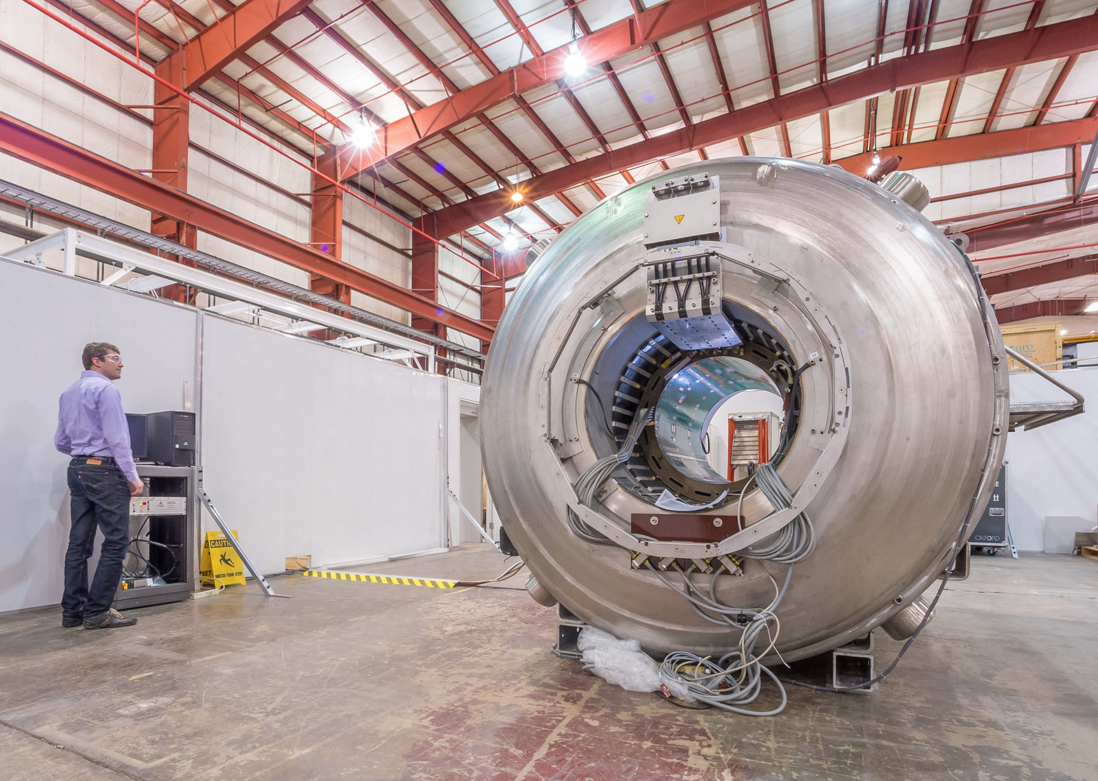
B-field Testing of Large Tiles?
ANL
UVA MRI facility for small tiles
Already Carl’s studies were extremely useful to improve design of LAPPD tiles
Will optimize spacing of elements in , particularly reducing gap in between two MCPs.
For Large tiles, perhaps use Peter Winter’s Large Bore g-2 Magnet Test Facility (ANL)
Up to 4 Tesla
Set up as a test facility for devices (thus might be easier to incorporate MCP-PMTs, including rotations)

