Slide 1
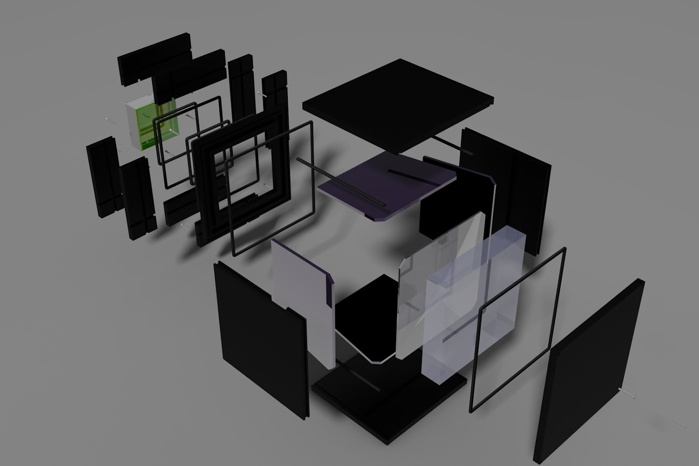
Modular RICH Prototype Design Update
Sawaiz Syed, Cheuk-Ping Wong and Xiaochun He
Georgia State University

Slide 2
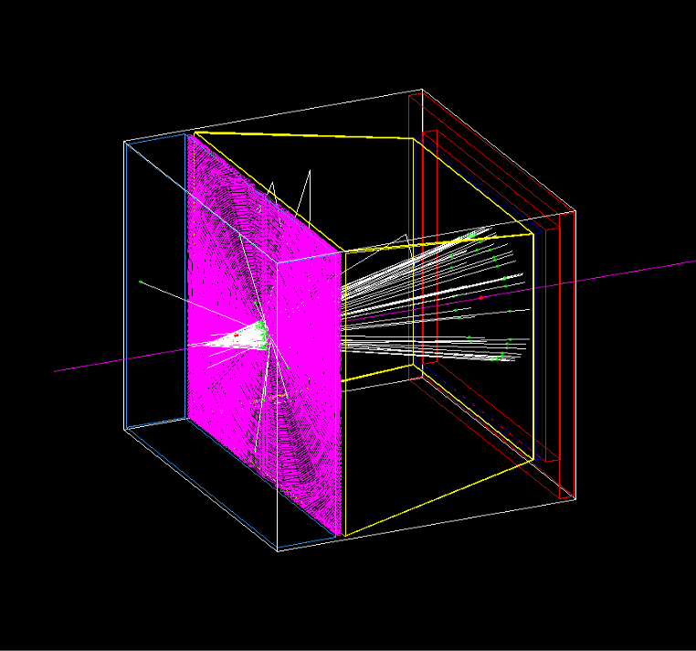
Modular RICH in Simulation
Silica Aerogel (SiO₂) -- Radiator
Density 0.02 g/cm3
Refractive index: n=1.025
Read-out
mirror
Fresnel lens -- Focus Cherenkov radiation on the photonsensor
Acrylic, C5H8O2, 1.19 g/cm3
Four sections, G4Polycon
100 grooves
aerogel
Fresnel lens
photonsensor
10 cm
Mirror -- Reflector
Four sections: left, right, top and bottom
Reflectivity index : 0.95
10 cm
Photosensor & Readout
Block of aluminum
2 cm
8 cm
5 cm

Slide 3
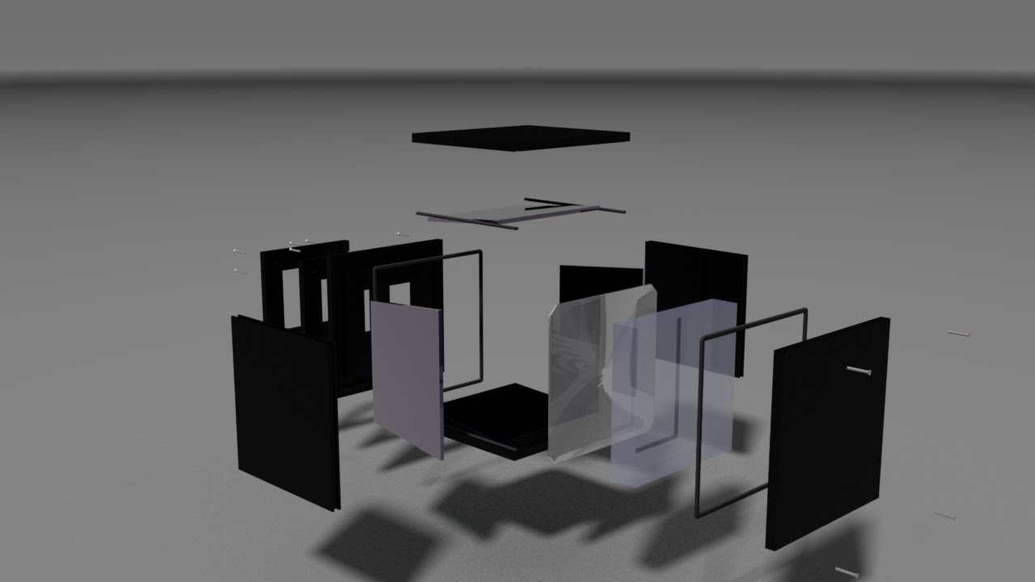
Initial Design Rendering (Reported by Ping a couple of weeks ago)
Too many
Components
Not easy to
Make and
assemble

Slide 4
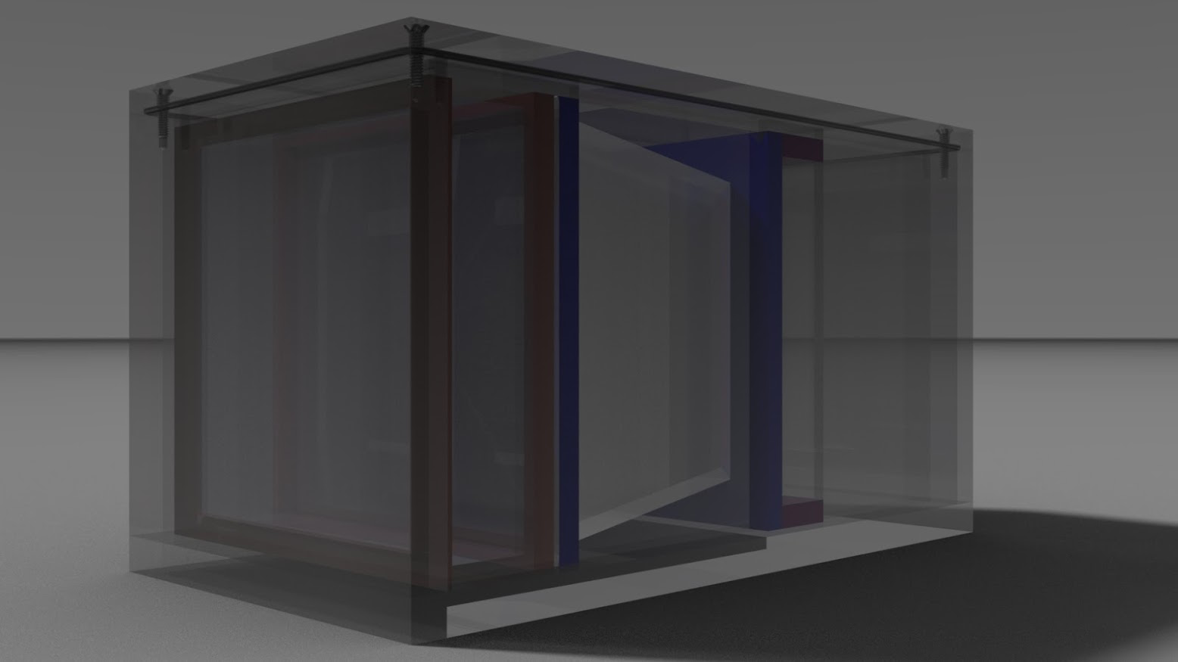
Improved Design (Endorsed by our shop manager)
Light tight
Air tight
Easy to
build

Slide 5
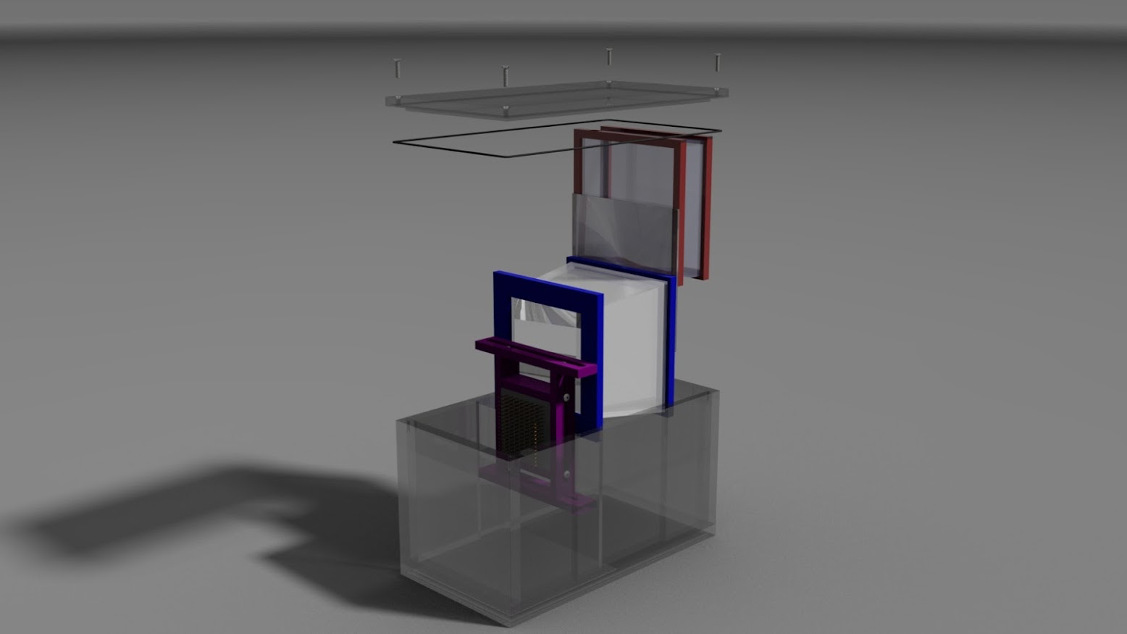
Modular Design
Slide the
components
into the
frame box.
Then close
the top

Slide 6
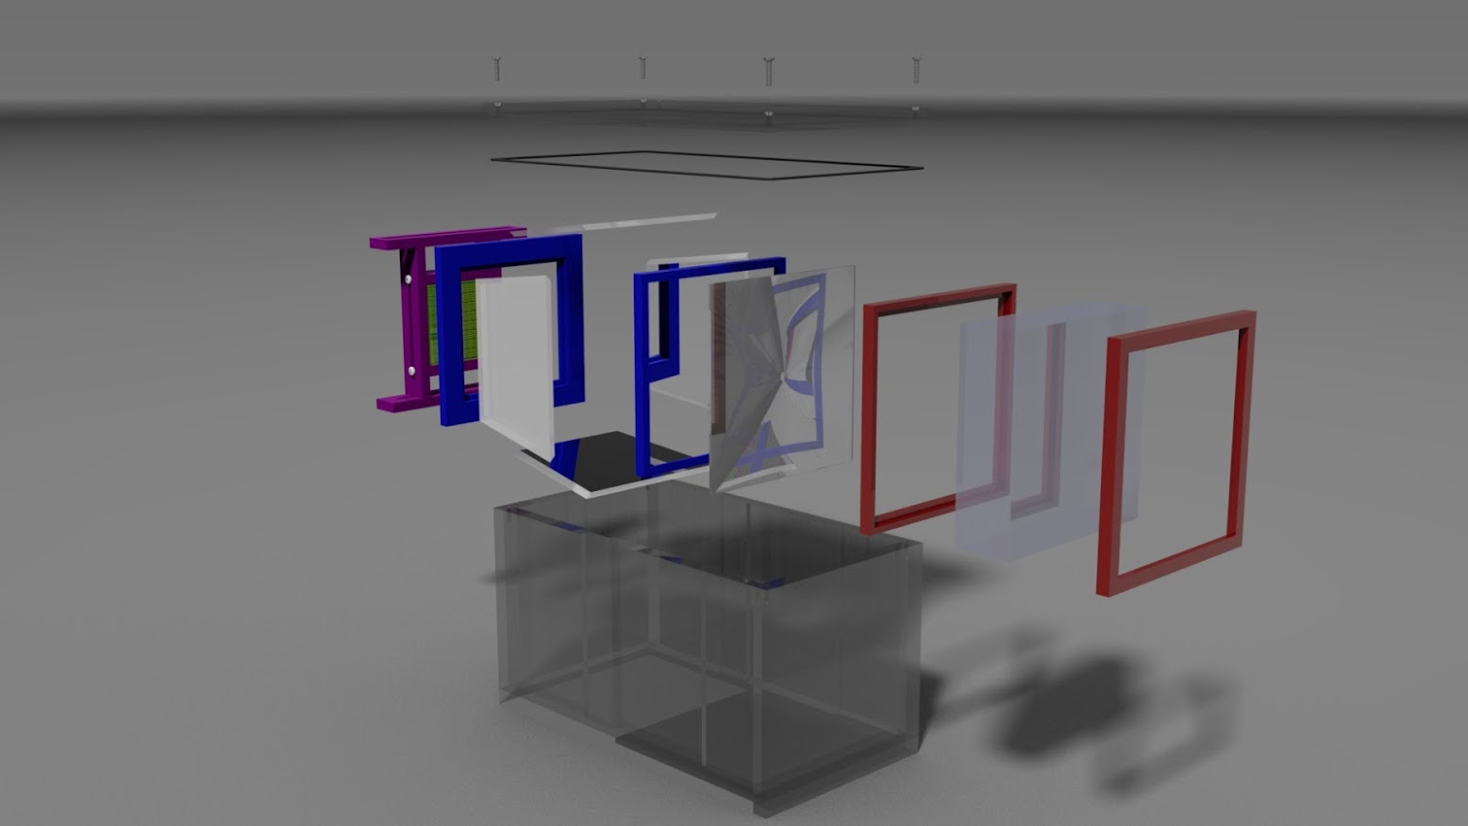
Simpler Assembling with Precision

Slide 7
Components
Aerogel block will come from Jlab. Need to know the precise dimension.
Received H12700A from Hamamatsu already.
Received one sheet of Fresnel lens from Edmund Optics (http://www.edmundoptics.com/optics/optical-lenses/fresnel-lenses/fresnel-lenses/2040/)
Bought a large sheet of black acrylic at ¼” thick for constructing the box frame from McMaster-Carr.
About to order front-side coated mirror from McMaster-Carr. We are not sure about the quality of these mirror but would like to try it.

Slide 8
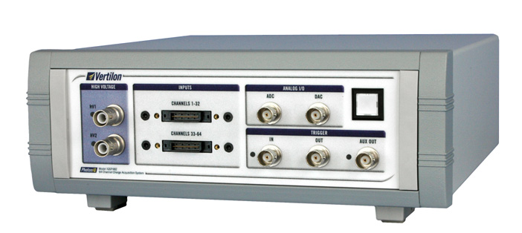
About Readout
We had a few email discussions with Marco, Zhiwen, Chris and Michael since the last presentation. The readout from the CLAS12 RICH project seems ideal. We will wait for the final product from JLab.
There is a potential backup solution if we only readout 64 channels using a ready-to-use DAQ system from Vertilon (http://vertilon.com/). It is pricy!
Cost is about $15k

Slide 9
To do
Continue on finalizing the design. The dimension of the aerogel block from JLab will dictate the design of the frame box sizes. Do we need to fill the box with nitrogen?
We will go back and redo some of the simulation for a 3cm-thick aerogel block.
We need to continue the study of the detector performance with magnetic field.

