Slide 1
sPHENIX Magnet Issue
(i.e. undesirable fast-discharge after some long operation hours/days)
Possibly two problems ?:
Labview (quench-detection) program
Joint in the magnet junction-box (doghouse)
Kin Yip
June 16, 2023

Slide 2
Some common knowledges:
When the magnet trips (i.e., current drops from ~4600 to 0 A), we need to go to 1008B to look at the PLC of the Power Supply to check what have caused it.
You will check the most recent timestamps there to see what caused the trip.
Unfortunately, the resolution is like “1s” and so one may see a few items at the same second.
Basically, I typically look to see whether it’s “quench detector”/”watchdog timer” (both from the quench detector) or other interlock.
There are typically “ground fault” or “dump resistor contactor opened” at the same second.
“Cryo interlock” usually comes some seconds later.

Slide 3
Fast-discharge record
Counter | Date | Time | Descriptioin | hours of staying at full current
1 | 6/2/2023 | 11:54 | Quench Link dropped due to inner/outer coil dropping or PLL-loss check | 48.7
2 | 6/5/2023 | 23:05 | capacitor bank fuse blown | 77.3
3 | 6/6/2023 | 09:26 | Quench Link drop due to Neg_90_deg_offset_jnt | 4.6
4 | 6/11/2023 | 09:58 | Quench Link drop due to Neg_90_deg_offset_jnt | 68
Magnet tripped/fast-discharged at 09:58 Sunday morning (June 11) after running for ~68 hours continuously since 13:56 June 8. [ It also ran almost 15 hours before Maintenance Day on June 7. ]
Since then, we have been running 100-150 A for debugging Labview.
For 1st two, we saw that the quench program just stopped without telling us which voltage tap was responsible.
PLL-Loss might be the cause. We first prevented it from stopping the program at all (June 7); but this week, we had resurrected it and gave it a large window (5 s) and also changed the max. expected freq. from 720 Hz to 730 Hz.

Slide 4
Fast-discharge record
Counter | Date | Time | Descriptioin | hours of staying at full current
1 | 6/2/2023 | 11:54 | Quench Link dropped due to inner/outer coil dropping or PLL-loss check | 48.7
2 | 6/5/2023 | 23:05 | capacitor bank fuse blown | 77.3
3 | 6/6/2023 | 9:26 | Quench Link drop due to Neg_90_deg_offset_jnt | 4.6
4 | 6/11/2023 | 9:58 | Quench Link drop due to Neg_90_deg_offset_jnt | 68
For the last two fast-discharges, the quench-detection program points to “neg_90_deg_offset_jnt”
Monday afternoon, we saw that “neg_90_deg_offset_jnt” seems to have more inductance than “pos_90_deg_offset_jnt” as the former rose during the initial magnet ramp.
We’ve got a little more cooling ~June 8 (though it turned out to be tiny 0.02 K).

Slide 5
Voltage taps (and temperature sensors) …. Not updated but sufficed …
Neg_90_deg_Offset_Jnt is across VT11 and VT20

Slide 6
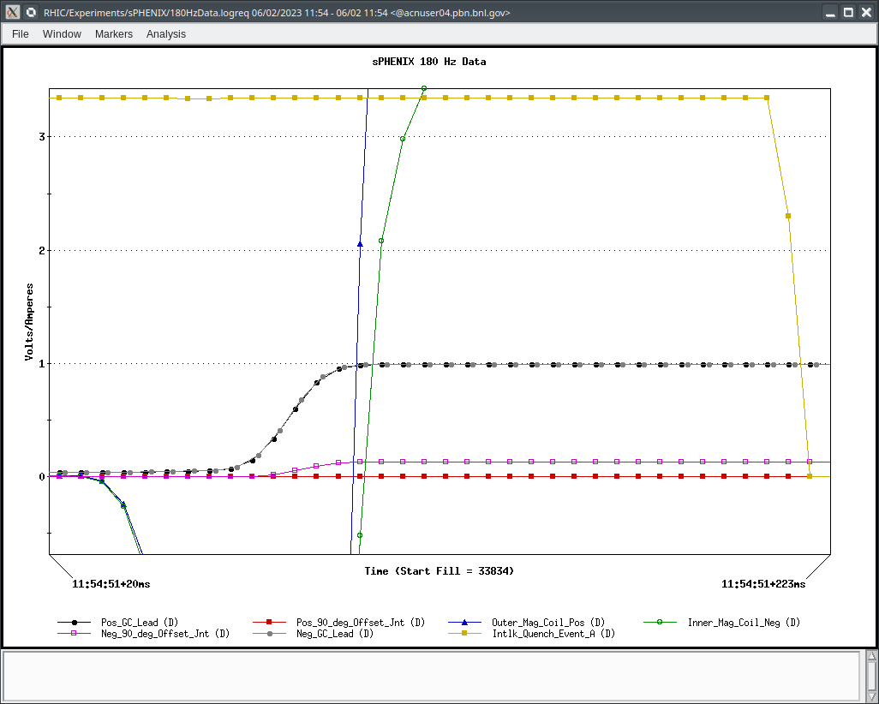
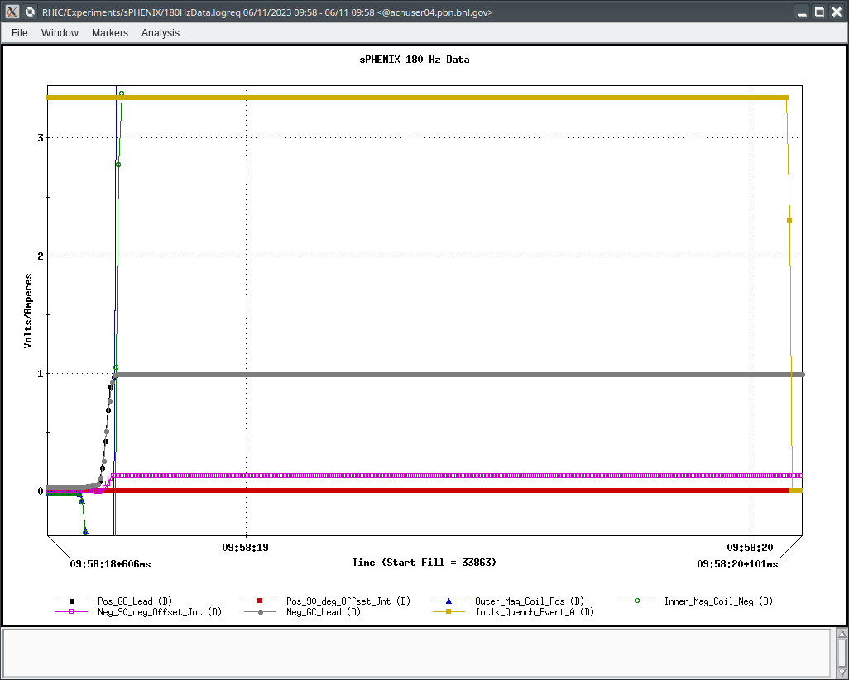
Voltage tap changed before quench-interlock was pulled down (LogView) :
June 2 or June 11 are not really that different (though Labview told us “program stopped” on June 2).

Slide 7
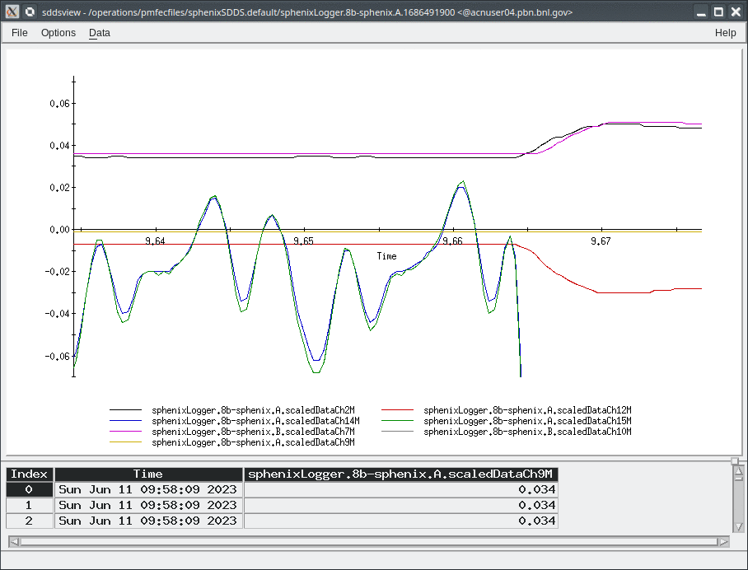
From SDDSView:
Inner/Outer Magnet Coil
+/- Gas-cooled Lead
-ve 90_deg_offset_jnt
+ve Gas-cooled Lead
-ve Gas-cooled Lead
+ve 90_deg_offset_jnt

Slide 8
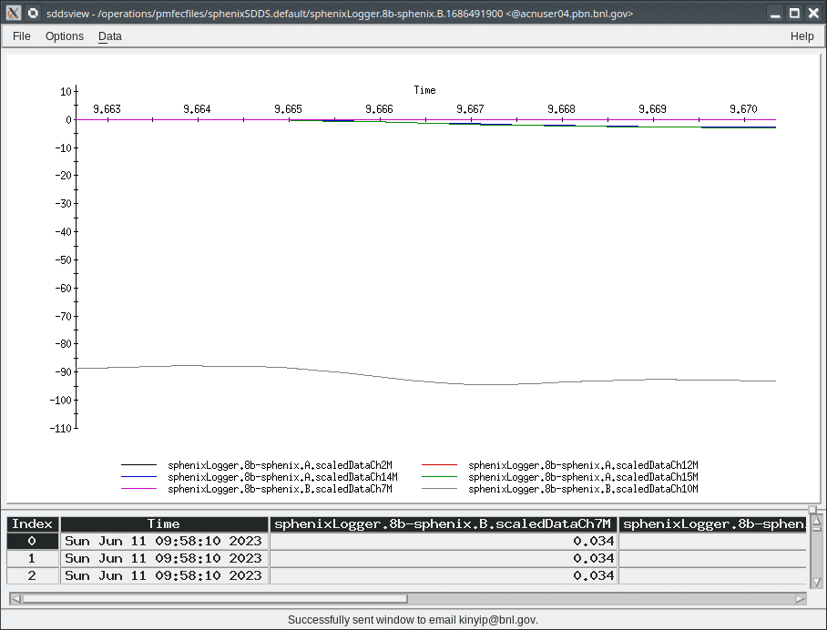
SDDSVIEW: PS_Voltage came down ~same time or before the outer/inner coil .
-ve Gas-cooled Leak

Slide 9
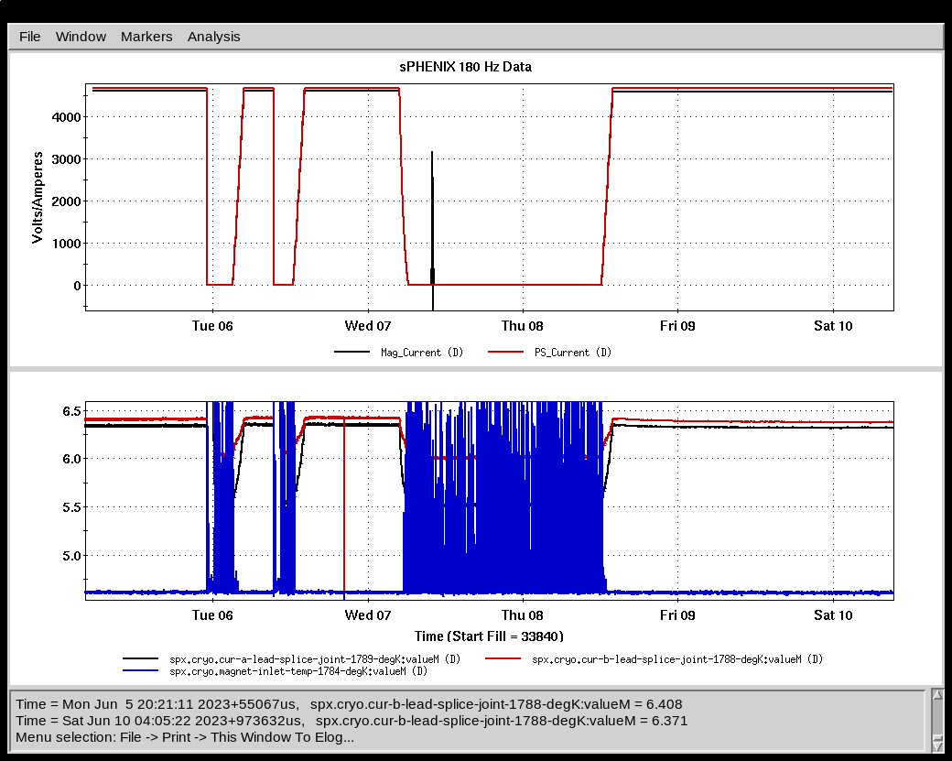
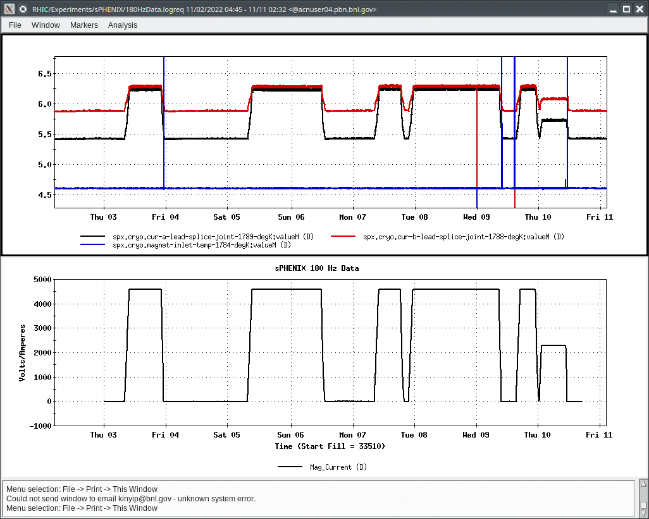
Temp. sensors ~ June 2023
Temp. sensors ~ Nov. 2022
Roberto (0.02 K)

Slide 10
Possible actions:
Roberto Than: may give us some further cooling … further decrease in the order of 0.0x K ?
Carl Schultheiss: measure the resistance of the joint (between V11 and V20) in the Magnet doghouse …
Need help to solve the issues in Labview program …

Slide 11
Backup

Slide 12
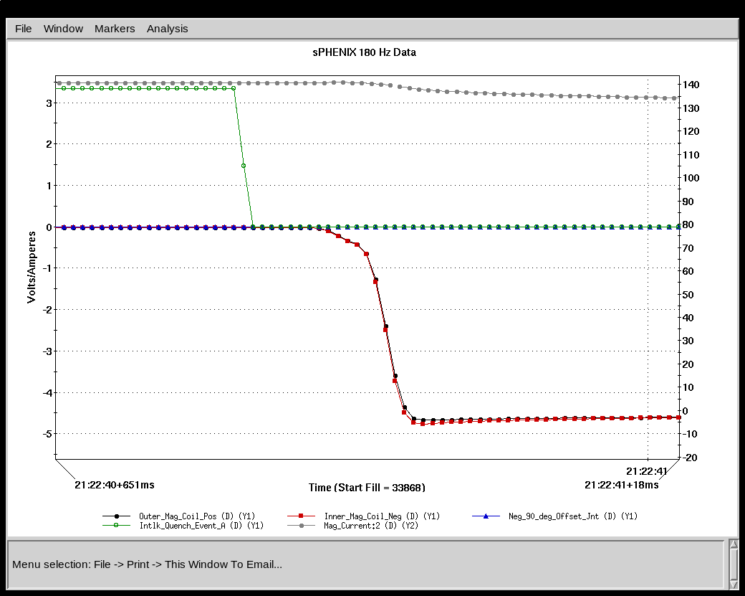
“Real” 150 A trip due to PLL-Loss

Slide 13
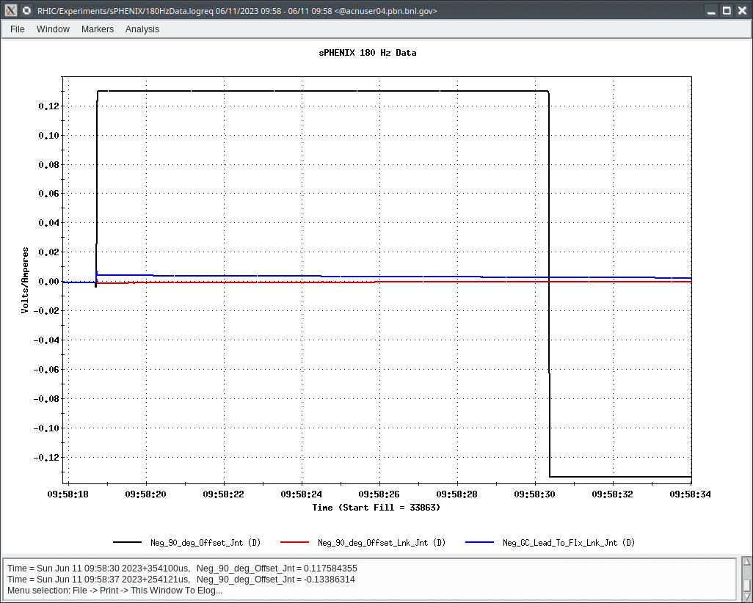
Why that neg_90_deg_offset_jnt changed sign ?

