Slide 1
Quantum Machine Learning –Tools and Applications
Iordanis Kerenidis
Head of Algorithms
iordanis.kerenidis@qcware.com

Slide 2
Quantum Machine Learning – Introduction

Slide 3
Quantum Machine Learning
What do we know so far?

Slide 4
Quantum Machine Learning
What do we know so far?
Large-scale quantum computers offer provable advantages
1. Quantum machine learning with subspace states – arXiv:2202.00054, 2022 2. Quantum Reinforcement Learning via Policy Iteration – arXiv:2203.01889, 2022
3. Low depth amplitude estimation on a trapped ion quantum computer, Physical Review Research, 2022
4. Improving quantum linear system solvers via a gradient descent perspective –arXiv:2109.04248, 2021
5. Medical image classification via quantum neural networks – arXiv:2109.01831, 2021
6. Nearest centroid classification on a trapped ion quantum computer – nature pj QI 2021
7. Experimental demonstration of quantum advantage for NP verification – Nature Comm 2021
8. Quantum spectral clustering – Physical Review A, 2021
9. Quantum algorithms for SOCP and Support Vector Machines, Quantum 2021
10. Classical and quantum algorithms for orthogonal neural networks – arXiv 2021
11. Low depth algorithms for quantum amplitude estimation – arXiv 2021
12. Prospects and challenges of quantum finance – arXiv 2020
13. Quantum Algorithms for Deep Convolutional Neural Networks – ICLR 2020
14. Quantum Expectation-Maximization for Gaussian Mixture Models – ICML 2020
15. Quantum algorithms for feedforward neural networks – ACM ToQC 2020
16. Quantum classification of the MNIST dataset via Slow Feature Analysis – PRA 2020
17. Quantum gradient descent for linear systems and least squares – PRA 2020
18. q-means: A quantum algorithm for unsupervised machine learning – NeurIPS 2019
19. Quantum recommendation systems (2017) – Innovations on TCS 2017

Slide 5
Quantum Machine Learning
What do we know so far?
Large-scale quantum computers offer provable advantages
We have developed many of these algorithms — Classifiers, Recommenders, …
We have more and more concrete methods for bringing QML closer to reality
Data Loaders
Distance Estimators for Similarity Learning
Linear algebra for Machine Learning
Quantum Neural Networks

Slide 6
Quantum Machine Learning
What do we know so far?
Large-scale quantum computers offer provable advantages
We have developed many of these algorithms — Classifiers, Recommenders, …
We have more and more concrete methods for bringing QML closer to reality
Data Loaders
Distance Estimators for Similarity Learning
Linear algebra for Machine Learning
Quantum Neural Networks
It will still take some time before quantum hardware becomes good enough, but the competitive advantage will come from algorithms development

Slide 7
Quantum Linear Algebra – Basic tools

Slide 8
Quantum Linear Algebra
Singular Value Estimation [Kerenidis,Prakash 17]
Given quantum access to $A=\sum_{i=1}^{n}{λ_{i}}\left.\left|v_{i}\right.\right\rangle \left\langle \left.v_{i}\right| \right.$ and eigenvector $\left.\left|v_{i}\right.\right\rangle$,
we can perform $\left.\left|v_{i}\right.\right\rangle \left.\left|0\right.\right\rangle →\left.\left|v_{i}\right.\right\rangle \left.\left|λ_{i}\right.\right\rangle$ in time O(κ, μ, 1/ε)
Singular Value Transformation [GSLW 19]
Given quantum access to $A=\sum_{i=1}^{n}{λ_{i}}\left.\left|v_{i}\right.\right\rangle \left\langle \left.v_{i}\right| \right.$ and eigenvector $\left.\left|v_{i}\right.\right\rangle$,
we can perform $\left.\left|v_{i}\right.\right\rangle →\left.f(λ_{i})\left|v_{i}\right.\right\rangle$ in time O(κ, μ, log(1/ε))
Applications
Matrix-Matrix multiplication, Linear Systems [Harrow, Hassidim, Lloyd 09, GSLW 19]
Projections on sub-eigenspaces [Kerenidis,Prakash 17]

Slide 9
Recommendation Systems [Kerenidis, Prakash, ITCS 17]
Singular Value Estimation
Singular Value Estimation
Products
? | 1 | … | ?
? | 0 | … | ?
… | … | … | …
1 | ? | … | 0
Step 1
Step 2
Users
Step 3
Quantum computers provide competitive recommendations fast!
Efficient quantum algorithm for Singular Value Estimation

Slide 10
Recommendation Systems [Kerenidis, Prakash, ITCS 17]
Algorithms | Theory | Parameters Users: 10⁸ Products: 10⁸ types: 100
Quantum | types* log (users*products) | ~ 10³
CUR-based [2002] | (types)² * products | ~ 10¹²
FKV-based [Tang 2018, CGLLTW19] | (types)⁸ * log (users*products) | ~ 10¹⁷
Exponential
Polynomial

Slide 11
Towards practical QML– Tools and Applications

Slide 12
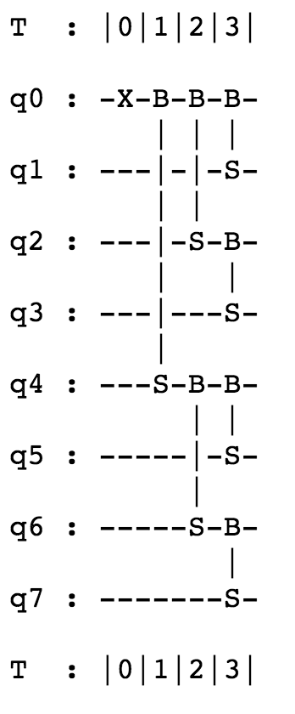
Quantum data loaders
Goal: Load N-dim classical data onto quantum computer
Solution:
Map data point to gate parameters in linear time
Build quantum circuit to run in $logN$ steps
RBS($θ$) = [ 1 0 0 0
0 cos($θ$) sin($θ$) 0
0 -sin($θ$) cos($θ$) 0
0 0 0 1 ]

Slide 13
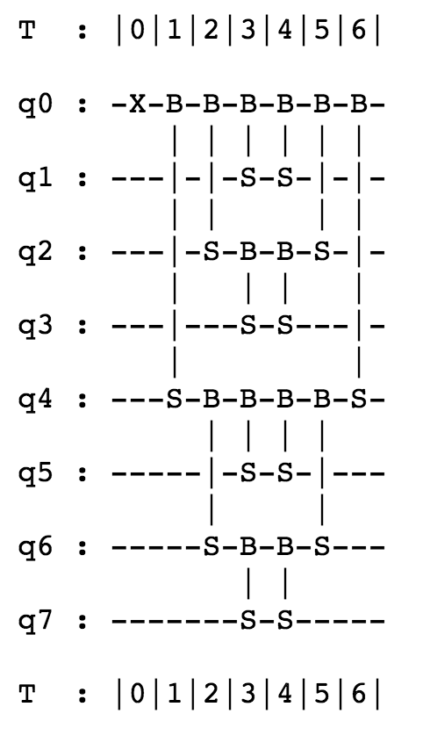
Quantum distance estimation
Goal: Given data points x and y, find their distance
Solution:
Build circuit [loader$(x)$+loader${(y)}^{†}$ ]
to estimate distance in $2logN$ steps
Properties
Shallow and noise robust circuits
$N$ qubits, $2logN$ depth
Can use any optimized data loader
Can be combined with Amplitude Estimation

Slide 14
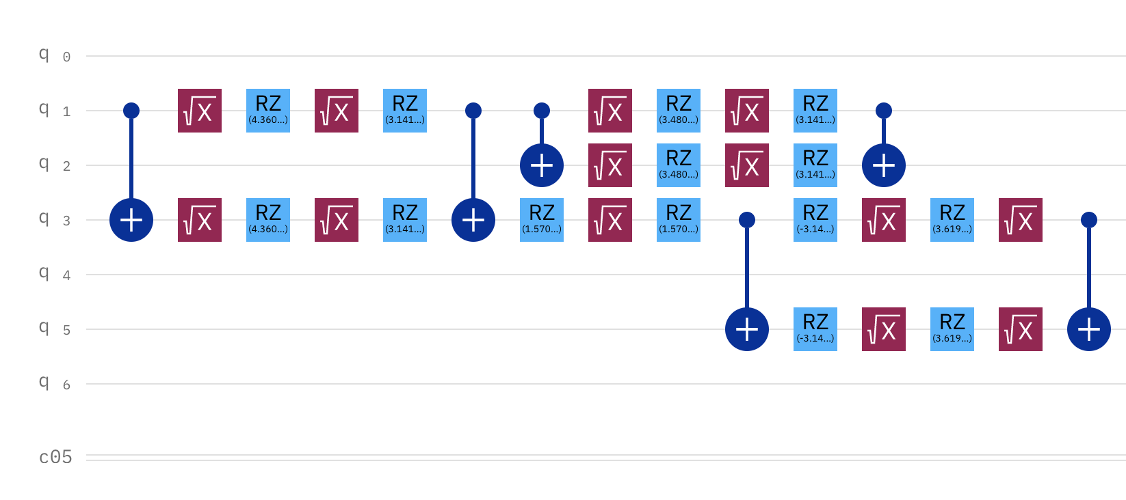
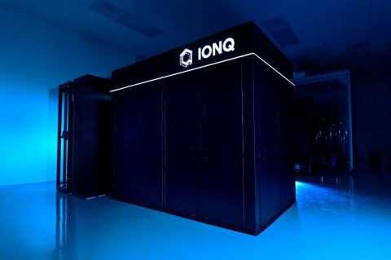
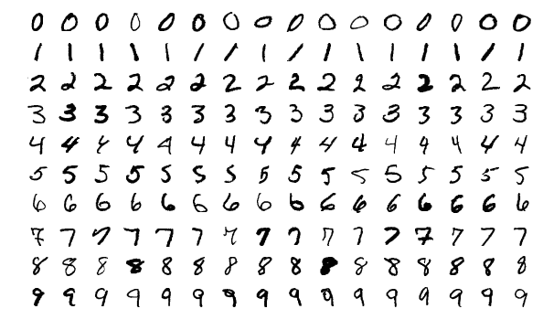
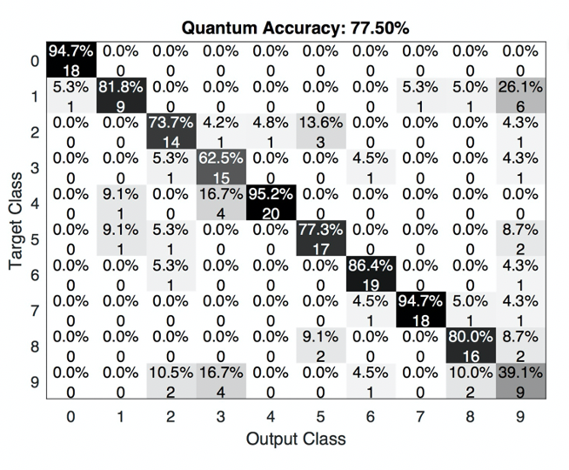
Demonstration of quantum classifier
MNIST digits
Quantum algorithm/software
Quantum computer
→
→
10-class classification on a quantum computer!
nature.com/articles/s41534-021-00456-5

Slide 15
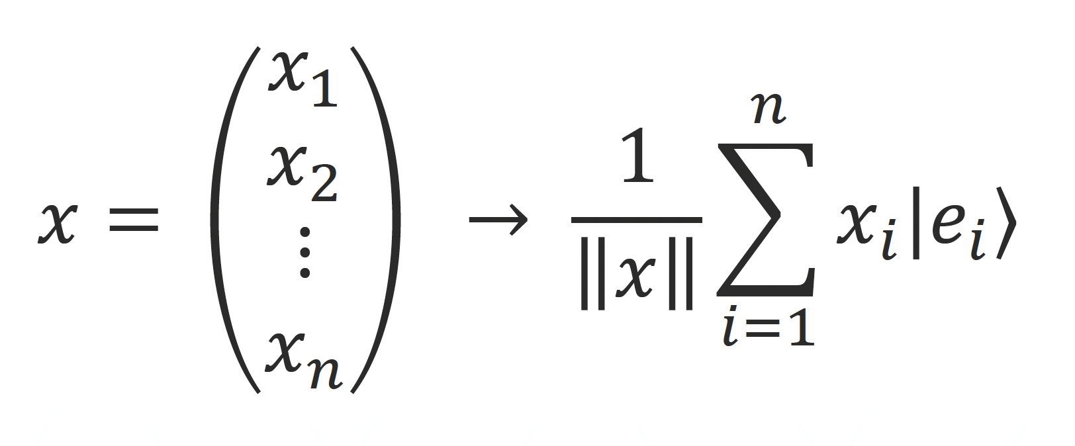
Quantum Neural Networks
Tools for quantum deep learning
Unary amplitude encoding
$$:=|x⟩$$
Data Loader
$$|x⟩$$
n qubits ~log(n) depth

Slide 16
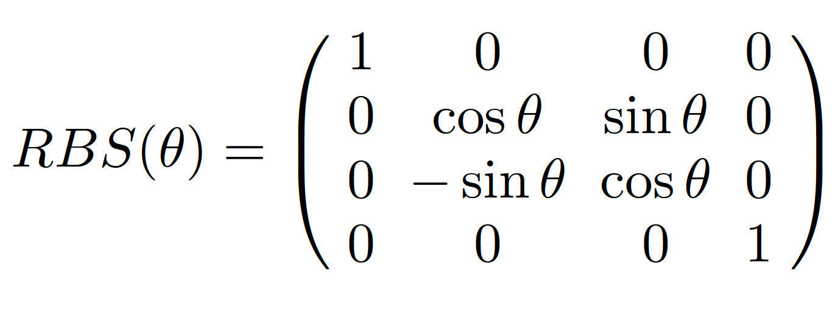
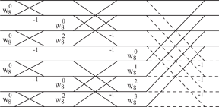
Quantum Neural Networks
Tools for quantum deep learning
Pyramid circuit
Unary amplitude encoding
$$:=|x⟩$$
Two-qubit gate
Data Loader
n² gates ~n depth
Butterfly Circuit
$$|x⟩$$
n qubits ~log(n) depth
nlog(n) gates ~log(n) depth

Slide 17
Quantum Neural Networks
Tools for quantum deep learning
Pyramid circuit
Quantum orthogonal neural networks
In an orthogonal neural network the trained weight matrices are orthogonal matrices, a property that can improve accuracy and avoid vanishing gradients
Quantum inference is quadratically faster than classical.
New classical training in O(n²) instead of O(n³) steps
Characteristics
One qubit per feature
Fast data loading
NISQ architecture with linear-depth circuits
Orthogonality property
n² gates ~n depth
Butterfly Circuit
nlog(n) gates ~log(n) depth

Slide 18
Quantum Neural Networks
Quantum neural layers
Orthogonal linear layers
The trained weight matrices are orthogonal, a property that can improve accuracy and avoid vanishing gradients, and reduce parameters

Slide 19
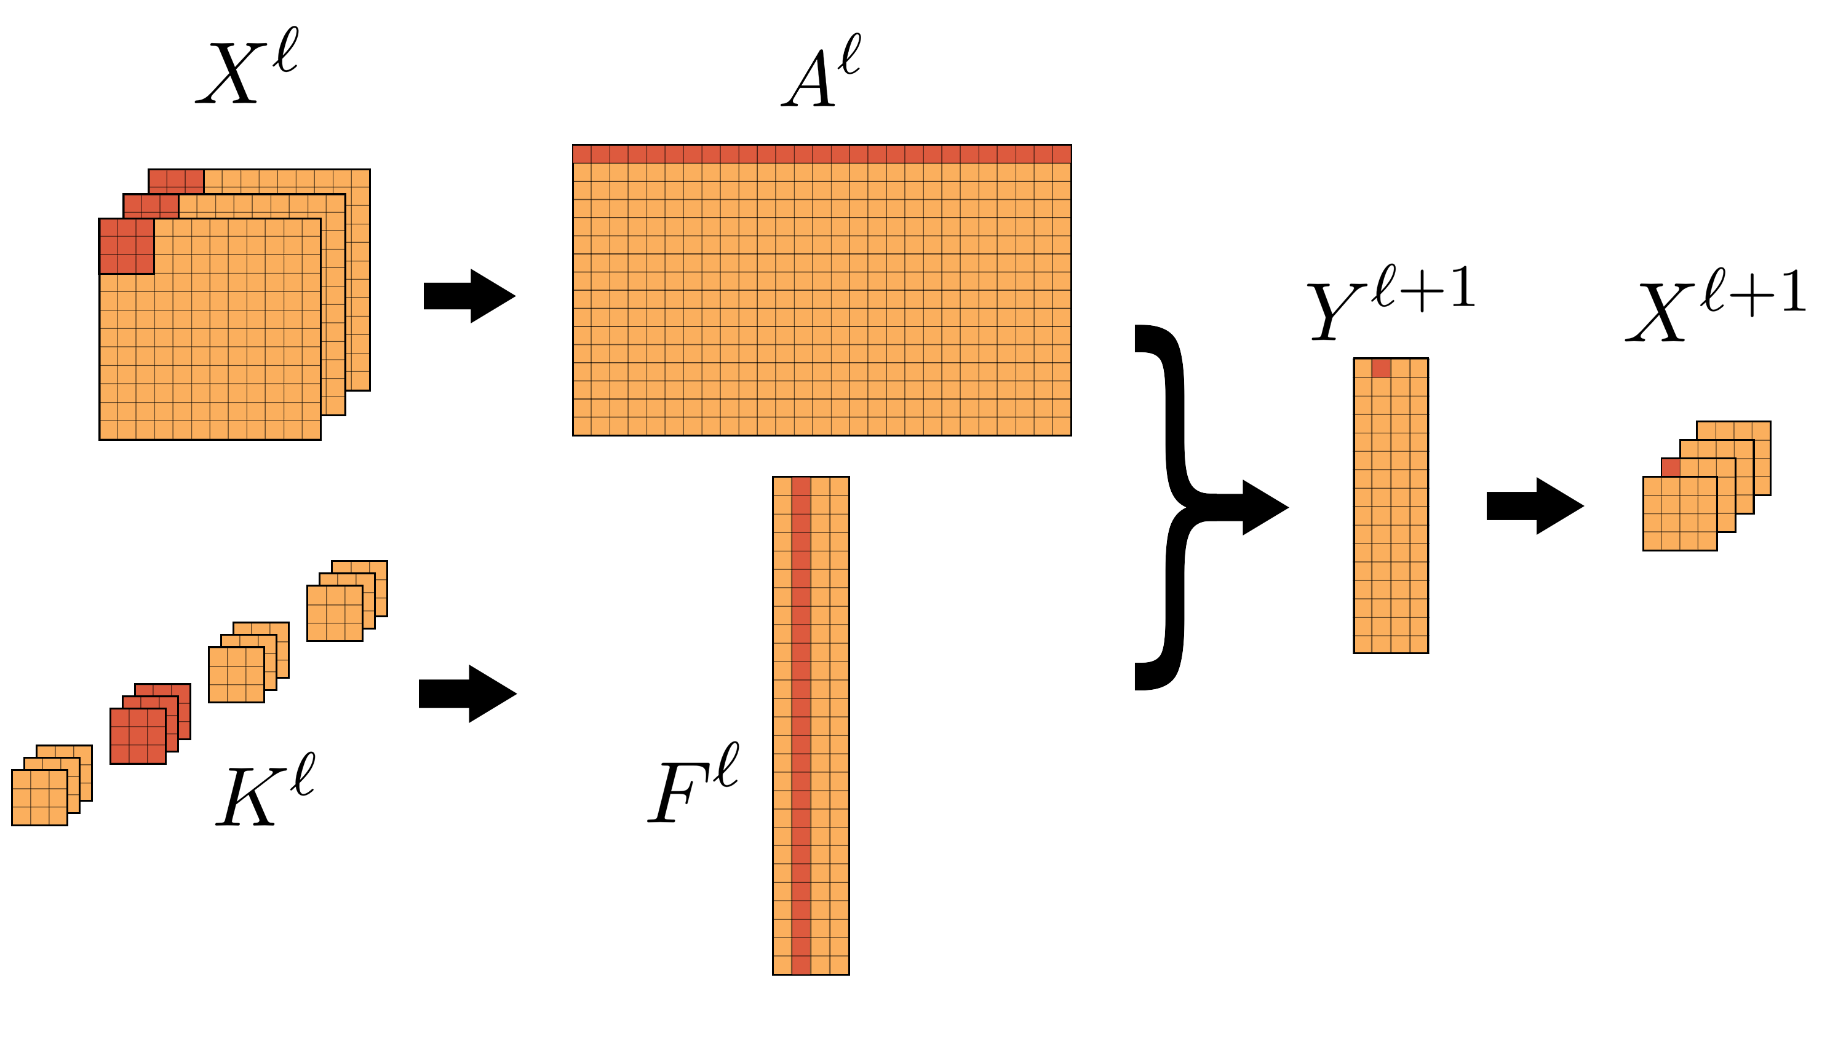
Quantum Neural Networks
Quantum neural layers
Orthogonal linear layers
The trained weight matrices are orthogonal, a property that can improve accuracy and avoid vanishing gradients, and reduce parameters
Orthogonal Convolutional layers
Convolution can be turned into matrix multiplication

Slide 20
Quantum Neural Networks
Quantum neural layers
Orthogonal linear layers
The trained weight matrices are orthogonal, a property that can improve accuracy and avoid vanishing gradients, and reduce parameters
Orthogonal Convolutional layers
Convolution can be turned into matrix multiplication
Orthogonal Fourier layers
Convolution can be turned into matrix multiplication in the Fourier domain
Data Loader
Quantum
Ortho. Matrix
Mult.
QFT
QFT⁻¹

Slide 21
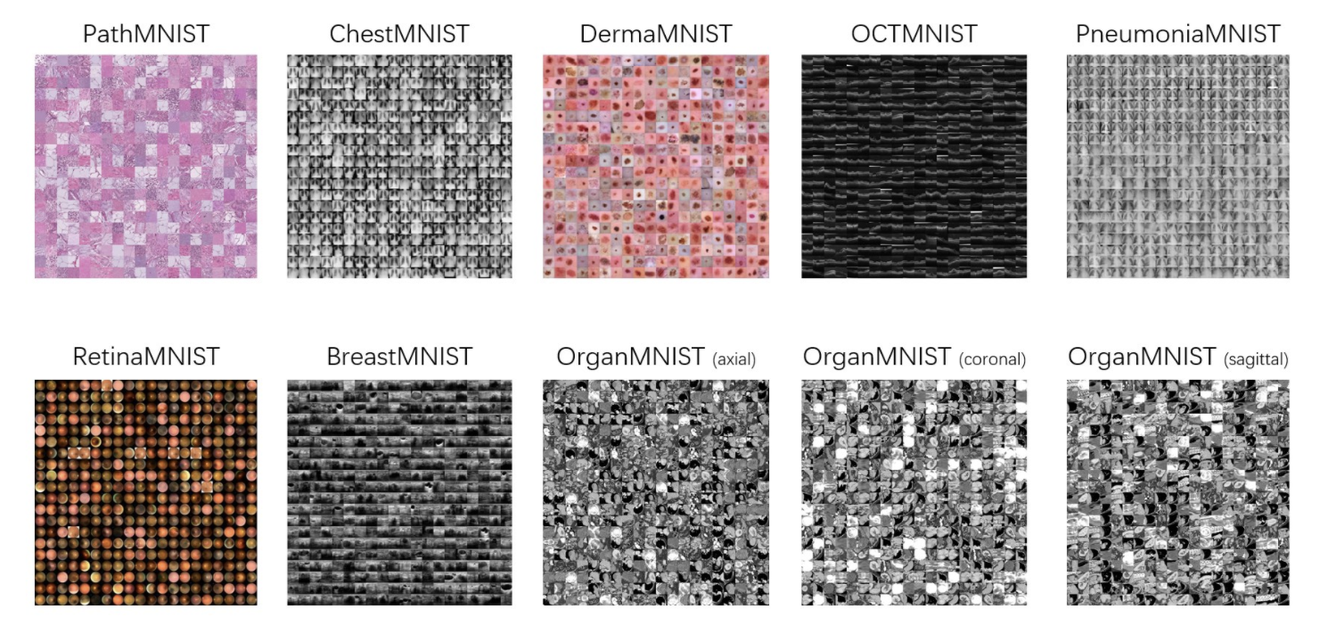
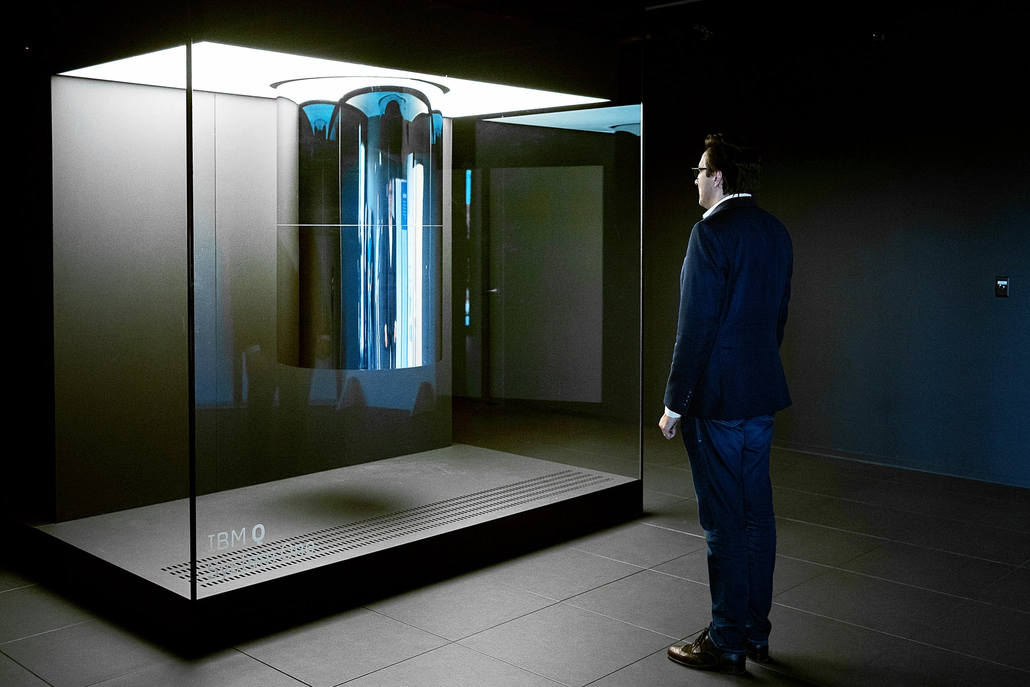
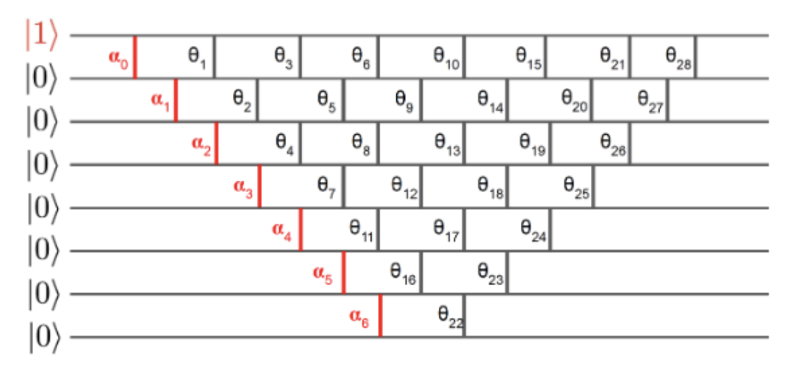
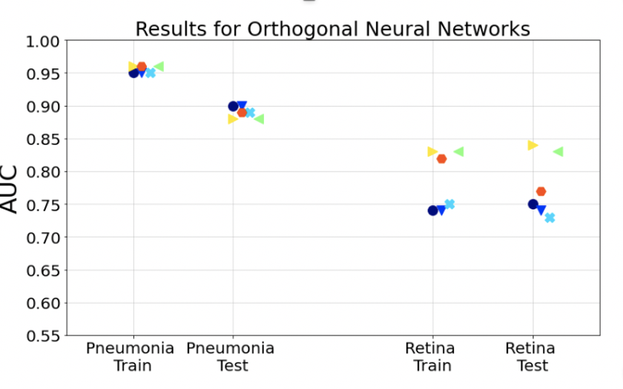
Quantum neural networks for medical images
Medical images
Quantum neural network
IBM Quantum computer
→
→
More explainable models for medical diagnosis
arXiv:2109.01831

Slide 22
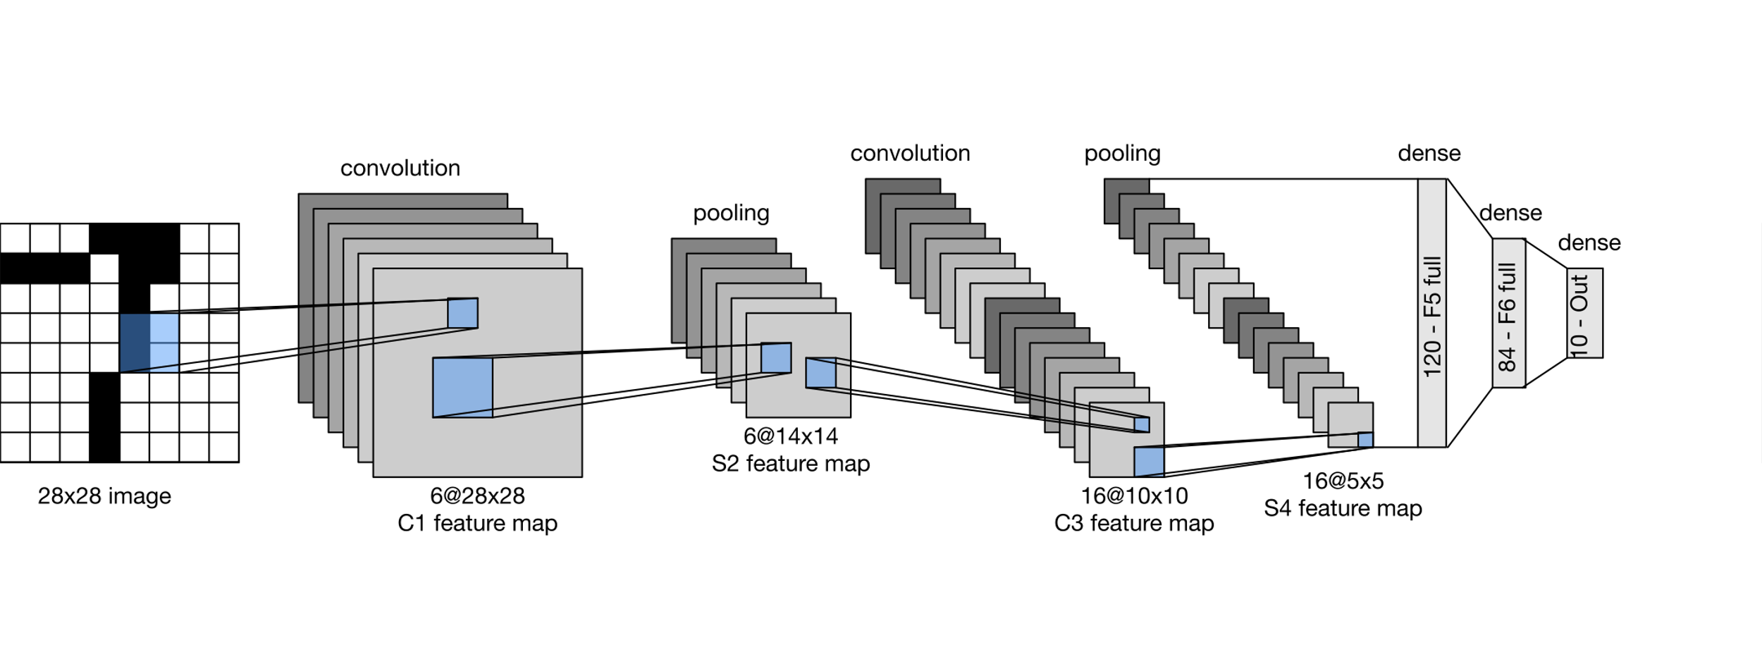
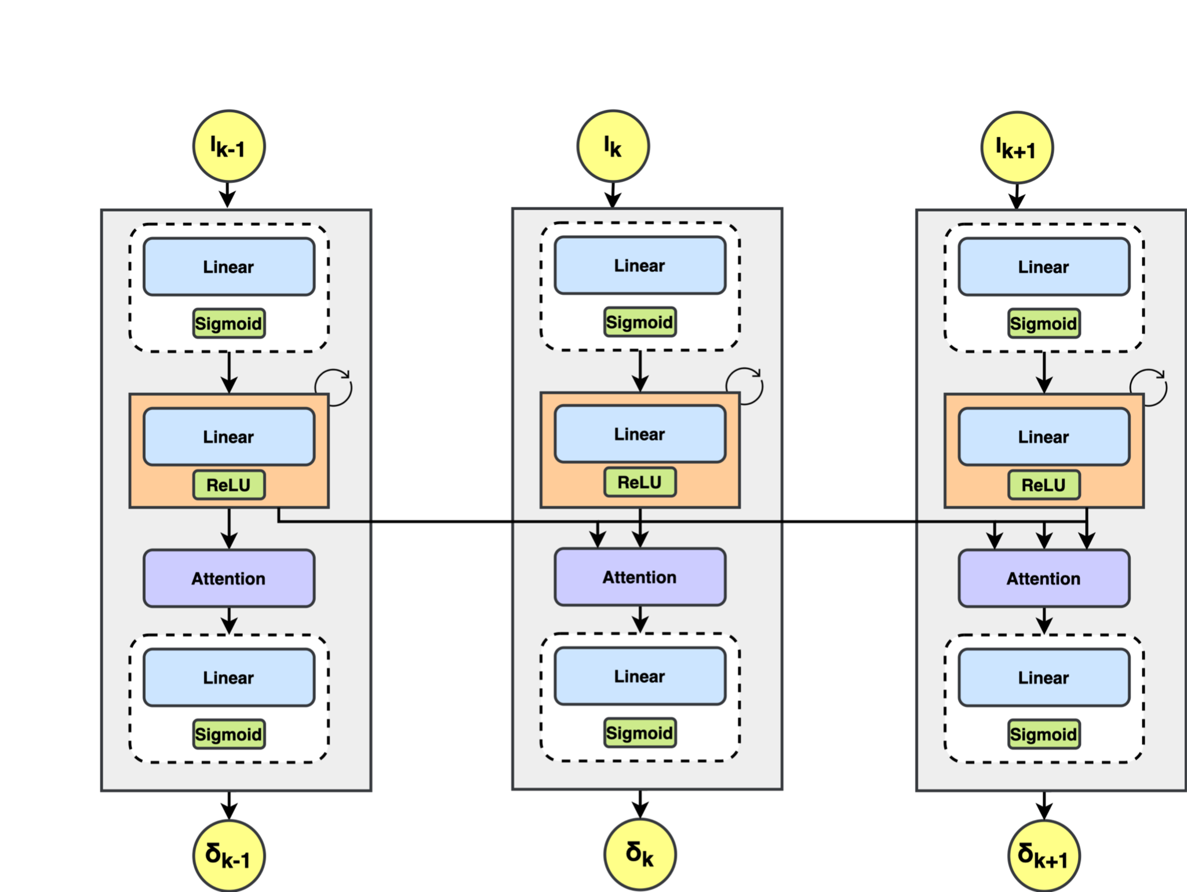
Advanced QNN for medical image classification
+
Top Pharma
Quantum convolutional neural nets Quantum Transformers
Quantum tools
Data loaders
Quantum Convolutional layers
Quantum Transformers
Quantum Attention mechanisms

Slide 23
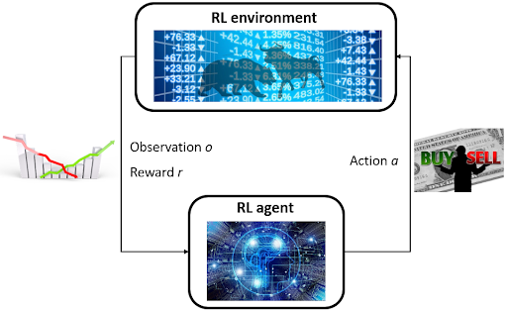
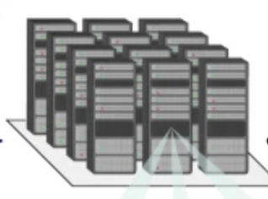
Quantum Deep Reinforcement Learning
+
Top Investment bank
Goal:
Development of quantum Reinforcement Learning techniques for use in finance
(policy iteration, deep RL)
Quantum tools
Quantum data loaders
Orthogonal neural layers
Quantum agents / environments

Slide 24
Quantum Machine Learning – Advanced Linear Algebra Tools

Slide 25
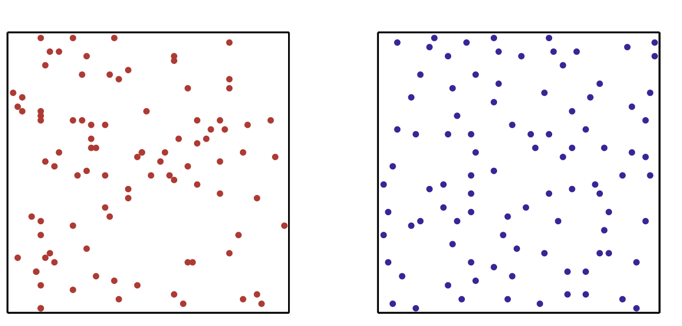
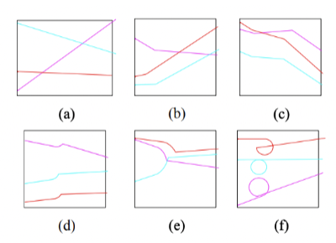
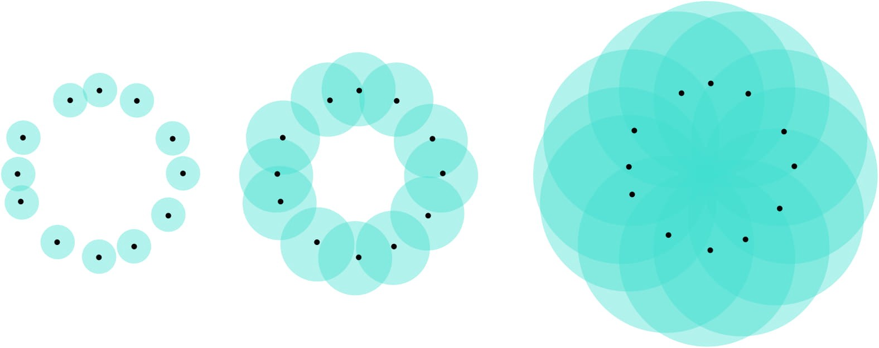
Determinantal Sampling
Subspaces & Compound Matrices
Topological Data Analysis
Polynomial Advantage
Potentially Exponential Advantage
Potentially Exponential Advantage
© QC Ware 2022

Slide 26
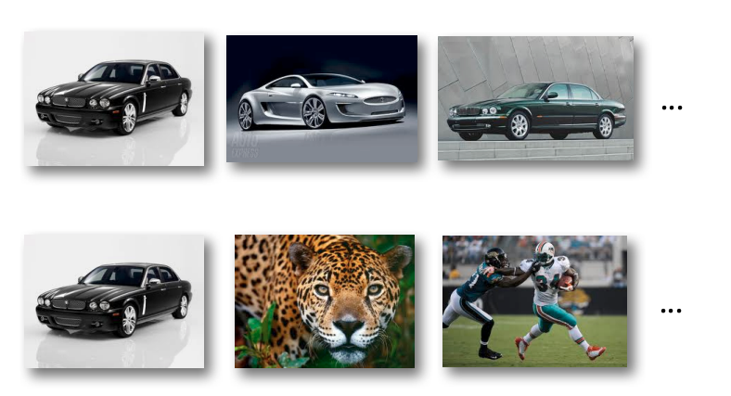
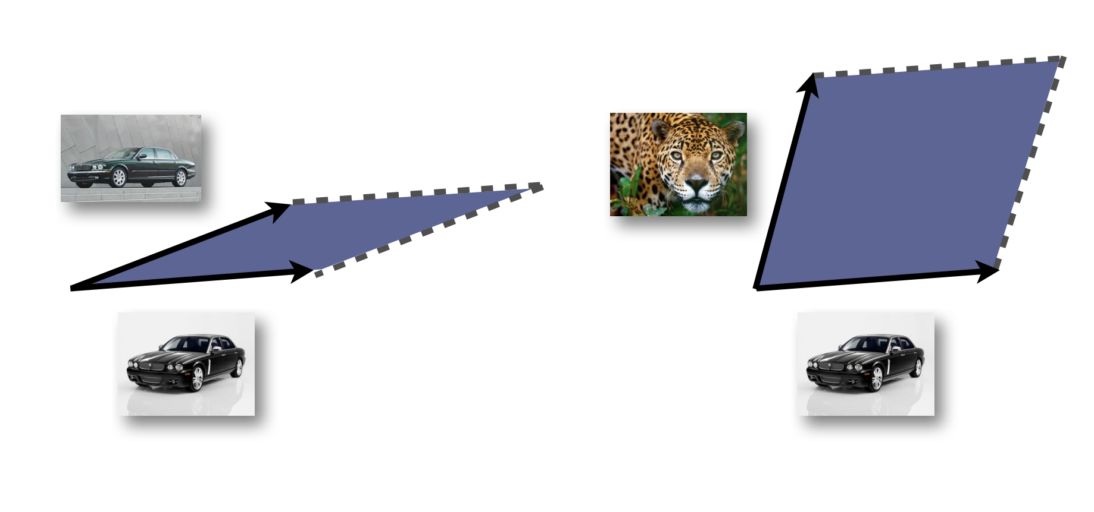
Determinantal Sampling

Slide 27
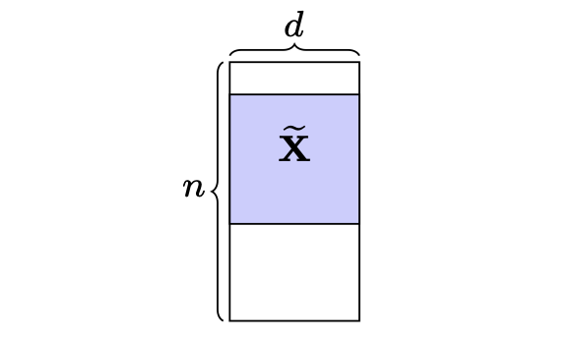
Determinantal Sampling
A = N x D data matrix (users x features)
1
0
1
1
0
0
1
0
1
1
0
0
0
Goal: Select $d$ rows from an $nxd$ matrix

Slide 28
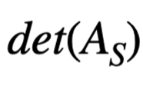
Determinantal Sampling
Distribution:
A = N x D data matrix (users x features)
∝
2
1
Best classical: Õ(d³)
0
1
1
0
0
Equivalent quantum state:
1
0
1
1
0
0
0
Goal: Select $d$ rows from an $nxd$ matrix
Best quantum: Õ(d) depth

Slide 29
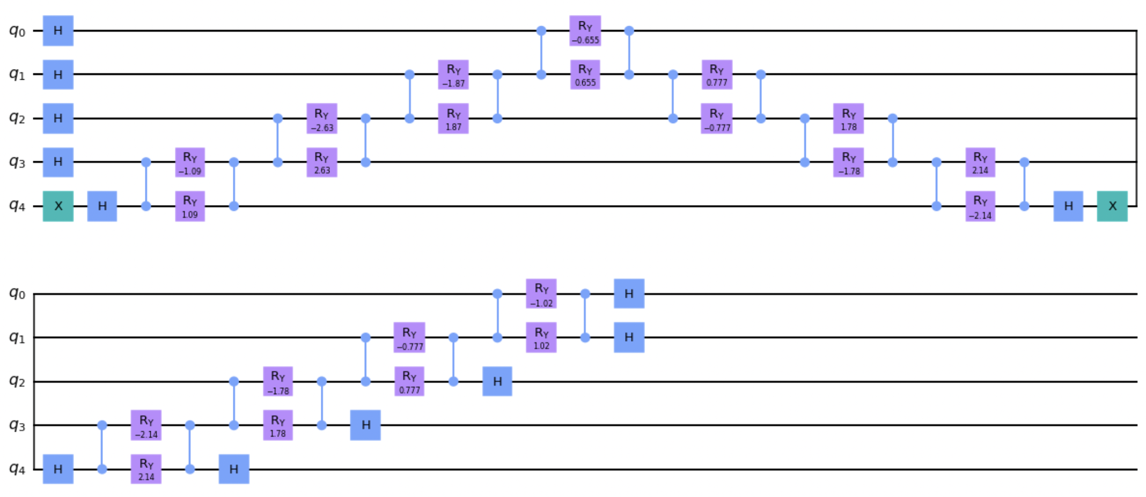
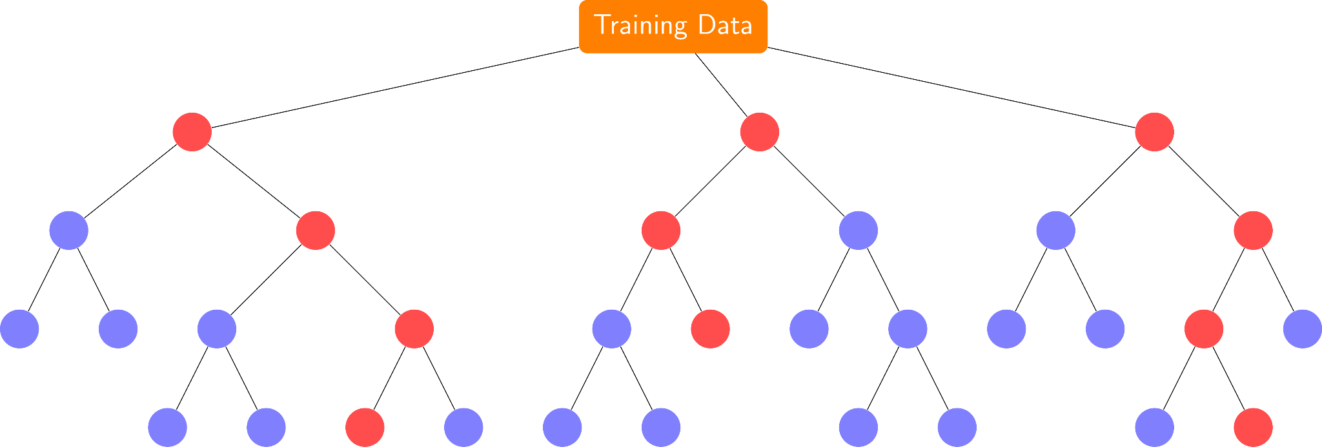
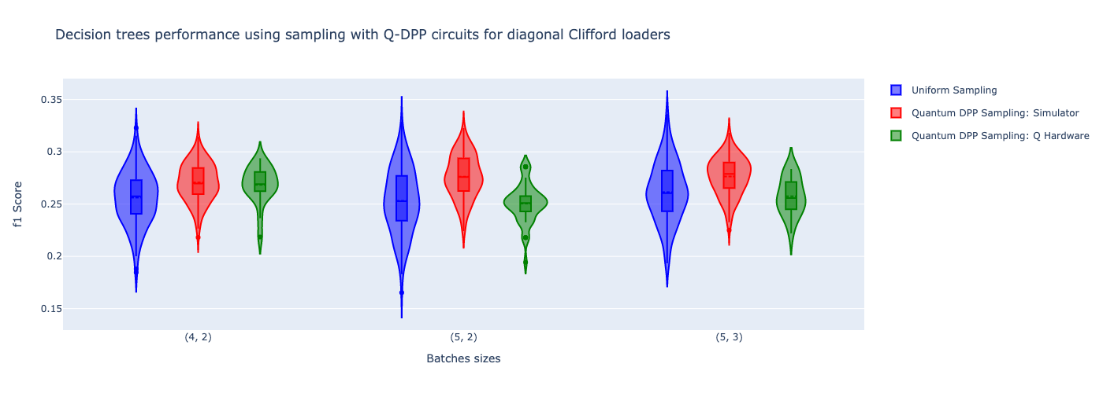
Customer retention
Large bank
User data
QDPP + Random Forest
IBM Quantum computer
→
→
7% improvement
in precision now
Even more on a future quantum computer
© QC Ware 2022

Slide 30
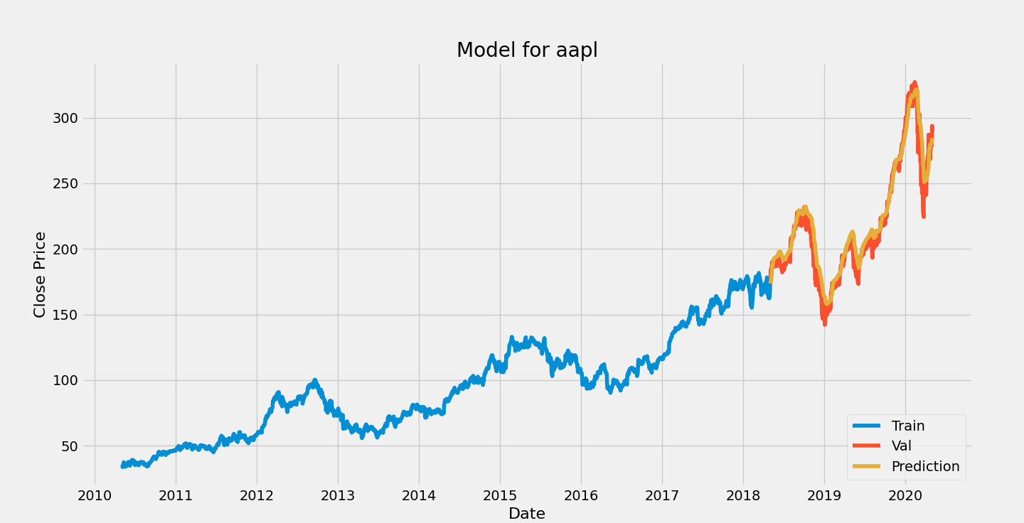
Possible QML applications
Time series predictions
Interpretable models
Customer Value prediction
DPP+ Regression
DPP+ Random Forest
DPP+ ensemble methods

Slide 31
Determinantal Sampling
Subspaces & Compound Matrices
Topological Data Analysis
Polynomial Advantage
Potentially Exponential Advantage
Potentially Exponential Advantage
© QC Ware 2022

Slide 32
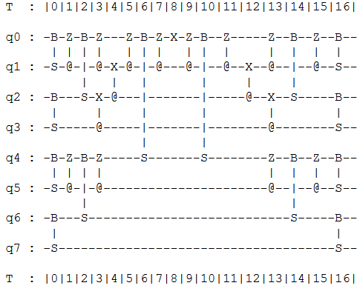
Subspace states
Clifford loaders for substate states
Definition: Given with orthonormal columns, a quantum subspace state is defined as
Clifford loader
A Clifford loader C enables for an efficient loading of a subspace state
$$X∈ℝ^{n×d}$$
$$|𝒳⟩=|Col(X)⟩=\underset{|S|=d}{∑}det(X_{S})|S⟩.$$
$$|Col(X)⟩=C(x_{d})C(x_{d−1})⋯C(x_{1})|0^{n}⟩.$$

Slide 33
SVD for Compound matrices
The k-th order compound matrix corresponding to is the matrix indexed by size-k subsets I, J of the rows/columns of A and with
The compound matrix is an exponentially large matrix with the minors of the matrix as entries.
Naively, classical algorithms would have complexity for compound matrix SVD
$$𝒜^{k}$$
$$A∈ℝ^{n×n}$$
$$𝒜_{I,J}^{k}=det(A_{I,J}).$$
$$O(n^{k})$$
THEOREM: THERE is A QUANTUM ALGORITHM FOR SINGULAR VALUE ESTIMATION/ TRANSFORMATION FOR COMPOUND MATRICES WITH COMPLEXITY O(poly(n)).
© QC Ware 2022

Slide 34
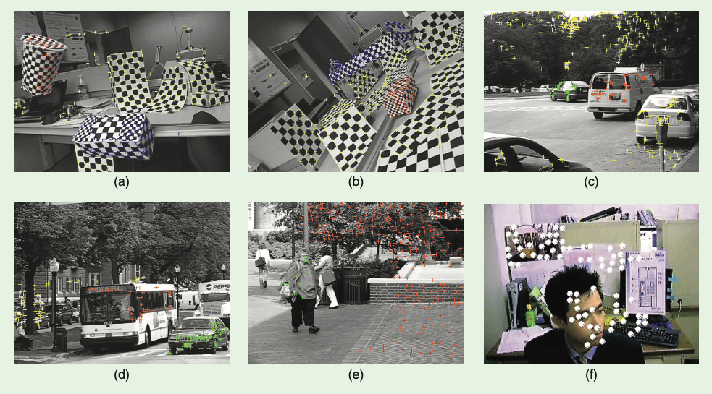
Possible QML applications
Time series predictions
Interpretable models
Customer Value prediction
DPP+ Regression
DPP+ Random Forest
DPP+ ensemble methods
Motion segmentation
Lower complexity

Slide 35
Determinantal Sampling
Subspaces & Compound Matrices
Topological Data Analysis
Polynomial Advantage
Potentially Exponential Advantage
Potentially Exponential Advantage
© QC Ware 2022

Slide 36
Topological Data Analysis
Simplicial complexes generalize graphs, besides vertices and edges they have higher order faces. The Vietoris-Rips complex VR(X, n, d) includes all point sets with diameter at most d.
A Dirac operator D and the Laplacian L= DD*+ D*D can be defined for every simplicial complex.
The Betti numbers are the dimensions of the kernel of the Laplacian. The persistent Betti numbers for the VR complexes capture non-trivial features of the data-set.
The Dirac Operator is an exponentially large sparse operator, hence Hamiltonian simulation can be used for quantum TDA [LGZ 16]. Latest, overhead O(n) for Dirac operator simulation
THEOREM: THERE is A O(log N) depth embedding for the DIRAC operator, that yields a quantum TDA algorithm with poly-logarithmic overhead.
© QC Ware 2022

Slide 37
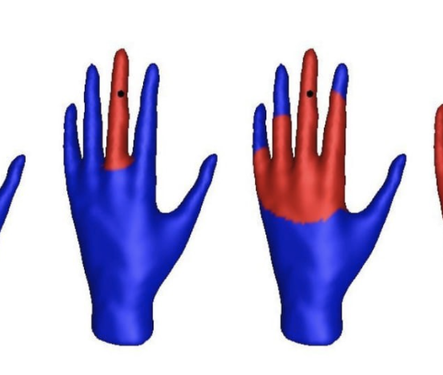
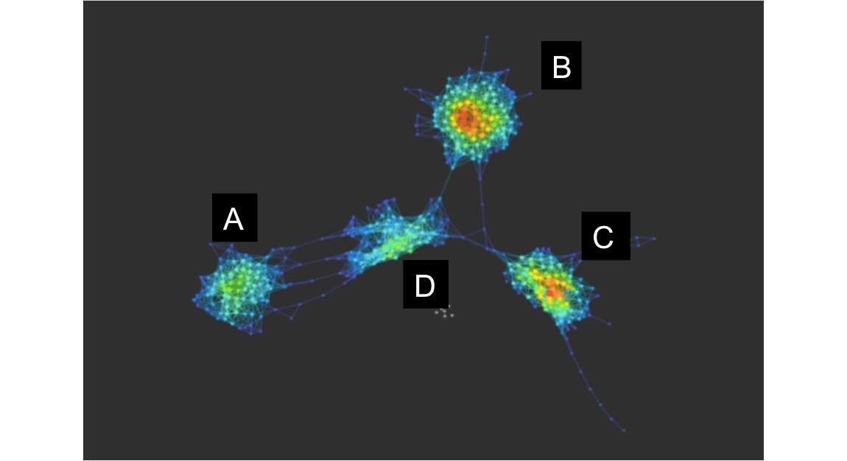
Possible QML applications/projects
Time series predictions
Interpretable models
Customer Value prediction
DPP+ Regression
DPP+ Random Forest
DPP+ ensemble methods
Motion segmentation
Convex Segmentation
Clustering
Efficient reconstruction of 3D structure
Lower complexity
Intuitive structure-finding

Slide 38
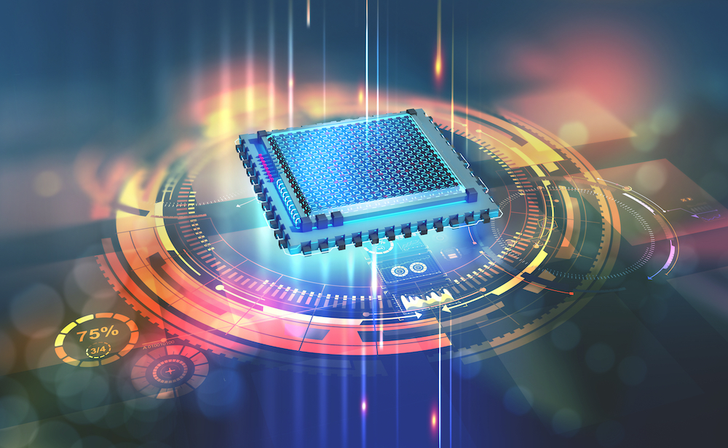
Conclusions
Quantum computing will soon impact most industry sectors
Real advances will come from novel algorithmic design
It is necessary to bring together quantum and domain experts

Slide 39
Thank you!
Iordanis Kerenidis
Head of Algorithms, QC Ware
iordanis.kerenidis@qcware.com

