Slide 1
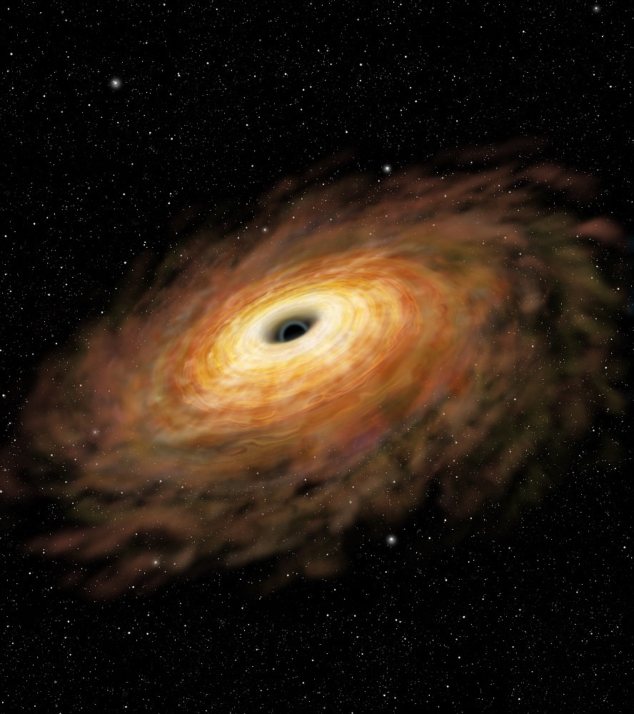
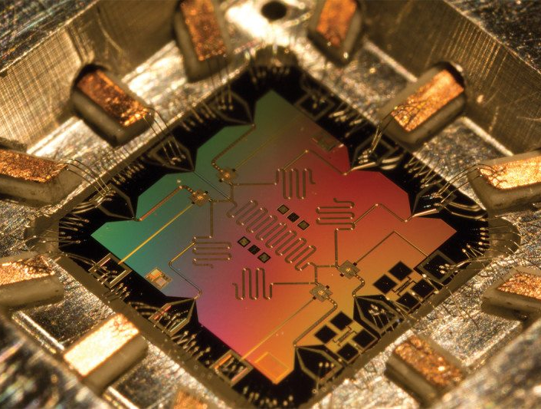

Quantum Compiling, Black Holes, and a Quantum LHC
Andrew T. Sornborger, and many collaborators
June 1, 2022
LA-UR-22-24982
Notes:
You might have noticed that in the original advertisement I was using the phrase variational quantum algorithm not QNN. In preparing it, I decided to switch to Quantum Neural Network because the results also apply more generally to many QML methods using training data. And I wanted to stress that.

Slide 2


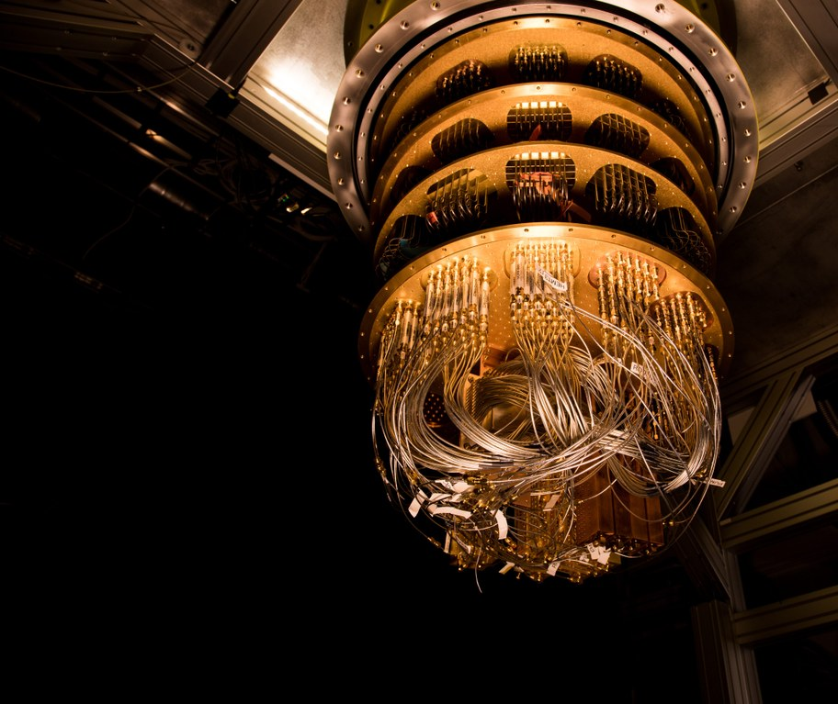
Quantum Machine Learning (QML) &
Variational Quantum Algorithms (VQAs)
training data
Classical
Computation
Quantum Computation
Optimization Loop
For the purpose of this talk I will focus on:
“Any method that optimizes a QNN (i.e. a parameterized quantum circuit) by minimizing a quantum cost function (potentially using training data)”
Encapsulates: VQAs + some (but not all) QML methods
Notes:
For the purpose of this talk, I am going to focus on: “any method that optimizes a parameterized quantum circuit by minimizing a problem-specific cost function with or without the help of quantum training data”.
This encapsulates most VQAs + some (but not all) QML methods
I warn you in advance I will use the terms QNN and parameterized quantum circuit pretty interchangeably.

Slide 3
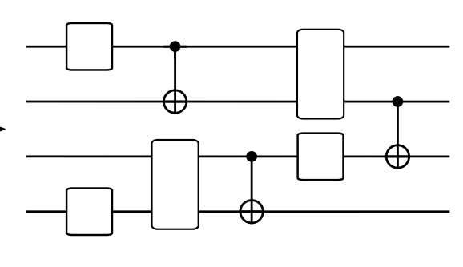
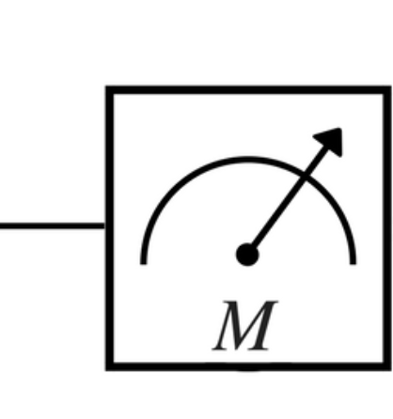
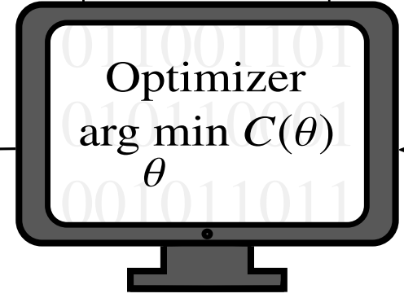





Goal: Train a QNN to minimize a problem-specific cost function
Pick cost + QNN s.t. if successfully trained: the optimal parameters/circuit/cost = approx. solution to problem
Quantum Computation
Measured
Cost
Classical Computation
$$θ_{1}$$
$$θ_{4}$$
$$θ_{5}$$
$$θ_{3}$$
$$θ_{2}$$
Update
parameters
Parameterised
Quantum Circuit/QNN
How do you train? Using a hybrid-quantum classical optimization loop
Notes:
So just to spell out in a little more detail how these methods work…
The goal is to train a QNN to minimize a cost function. The QNN here is a parameterized quantum circuit. The QNN and cost is chosen such (if successfully trained) then the trained QNN, or the optimal parameters, or the minimum cost is a solution to the problem you want to solve.
How do you train your QNN. Using a hybrid quantum classical optimization loop. That is, you run your favourite optimization algorithm on your classical computer (this could be gradient decent, or a Bayesian methods or whatever your favourite optimization technique is) but with the cost function evaluated on your quantum computer.
You tell the quantum computer to run your circuit (a parameterized quantum circuit) to evaluate a cost function with a particular set of parameters.
The quantum computer runs that circuit and spits out the measured cost function for that set of parameters.
Then then classical computer decides which parameters to try next and tells the quantum computer which circuit to run.
You then keep on looping around until you’ve minimised the cost function.

Slide 4

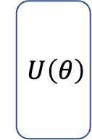
Example: Learning an unknown unitary (quantum compilation)
Quantum Computation
Measured
Cost
Classical Computation
$$U\left(θ\right)$$
$${ V}^{†}$$
Update
parameters
Parameterised
Quantum Circuit
Pick cost such that unitary that minimizes it matches the target unitary
Task:
Optimised
quantum circuit
Target unitary
Notes:
To make this more concrete, I’m going to run through one example that I think will be helpful to have in mind for the first half of my talk, and one that will be central to the second half.
This is to learn a unitary, i.e. here is to train a parameterized quantum circuit such that the optimized circuit, approximates some unknown target unitary.
To learn a unitary in this way, you need to pick a cost function such that the unitary that minimizes it matches the target.
Now there are a whole mix of different costs that you could possibly use to do this…

Slide 5
Example: Learning an unknown unitary (quantum compilation)
Quantum Computation
Measured
Cost
Classical Computation
$$U\left(θ\right)$$
$${ V}^{†}$$
Update
parameters
Parameterised
Quantum Circuit
QML approach: optimize cost over a set of training data
Task:
Optimised
quantum circuit
Target unitary
Notes:
but I’m going to outline a QML type approach using training data.
That is one can construct a cost from training data composed of N pairs of input states and an output state that equals the input state evolved under the target unitary.

Slide 6
Example: Learning an unknown unitary (quantum compilation)
Quantum Computation
Measured
Cost
Classical Computation
$$U\left(θ\right)$$
$${ V}^{†}$$
Update
parameters
Parameterised
Quantum Circuit
Training data:
QML approach: cost becomes a function of the training data
Task:
Optimised
quantum circuit
Target unitary
Notes:
A natural choice would be formulate in terms of the average distance between the output state V |psi_i> and your guess state, i.e. the input state evolved under your guess unitary U(theta)

Slide 7
Example: Learning an unknown unitary (quantum compilation)
Quantum Computation
Measured
Cost
Classical Computation
$$U\left(θ\right)$$
$${ V}^{†}$$
Update
parameters
Parameterised
Quantum Circuit
Training data:
Task:
Optimised
quantum circuit
Target unitary
Cost measures average gate fidelity
with
Notes:
This is equivalent to 1 minus the average gate fidelity between the output state and the input state psi_i acted on by your guess unitary U(theta) averaged over a set of states psi_i.

Slide 8
Example: Learning an unknown unitary (quantum compilation)
Quantum Computation
Measured
Cost
Classical Computation
$$U\left(θ\right)$$
$${ V}^{†}$$
Update
parameters
Parameterised
Quantum Circuit
Training data:
Task:
Optimised
quantum circuit
Target unitary
with
Prepare state
Notes:
So how would you measure this. Well you’d just prepare the state |psi_i>

Slide 9
Example: Learning an unknown unitary (quantum compilation)
Quantum Computation
Measured
Cost
Classical Computation
$$U\left(θ\right)$$
$${ V}^{†}$$
Update
parameters
Parameterised
Quantum Circuit
Training data:
Task:
Optimised
quantum circuit
Target unitary
with
Evolve under target unitary
Notes:
You then let that state evolve under the target unitary V.

Slide 10
Example: Learning an unknown unitary (quantum compilation)
Quantum Computation
Measured
Cost
Classical Computation
$$U\left(θ\right)$$
$${ V}^{†}$$
Update
parameters
Parameterised
Quantum Circuit
Training data:
Task:
Optimised
quantum circuit
Target unitary
with
Apply inverse of PQC
Notes:
Then you apply the inverse of your parameterized circuit.

Slide 11
Example: Learning an unknown unitary (quantum compilation)
Quantum Computation
Measured
Cost
Classical Computation
$$U\left(θ\right)$$
$${ V}^{†}$$
Update
parameters
Parameterised
Quantum Circuit
Training data:
Task:
Optimised
quantum circuit
Target unitary
measure
Notes:
Then you perform a measurement to project onto the state psi_i

Slide 12
Example: Learning an unknown unitary (quantum compilation)
Quantum Computation
Measured
Cost
Classical Computation
$$U\left(θ\right)$$
$${ V}^{†}$$
Update
parameters
Parameterised
Quantum Circuit
Many other options:
Pick cost such that unitary that minimizes it matches the target unitary
Task:
Optimised
quantum circuit
Target unitary
Notes:
So that was one approach, but the core idea of a compiling cost is to pick a cost such that the unitary that minimizes it matches the target unitary.

Slide 13
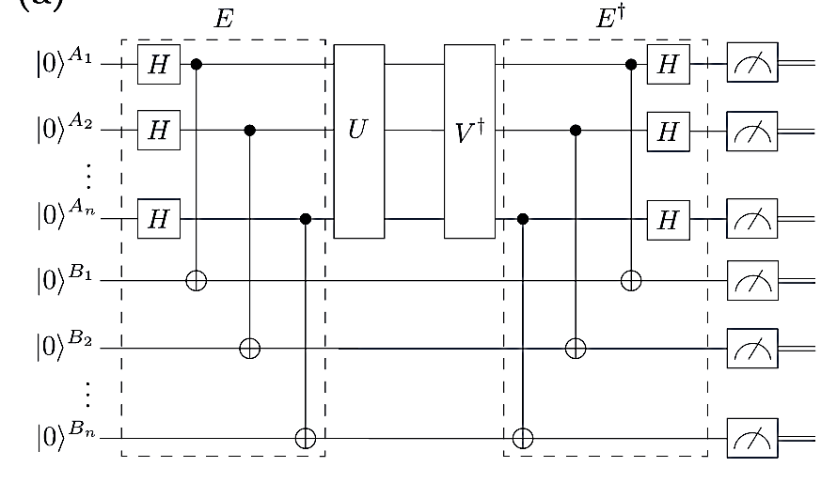





Example: Learning an unknown unitary (quantum compilation)
Khatri, Sumeet, Ryan LaRose, Alexander Poremba, Lukasz Cincio, Andrew T. Sornborger, and Patrick J. Coles. "Quantum-assisted quantum compiling." Quantum 3 (2019): 140.
Sharma, Kunal, M. Cerezo, Zoë Holmes, Lukasz Cincio, Andrew Sornborger, and Patrick J. Coles. "Reformulation of the No-Free-Lunch Theorem for Entangled Datasets." Physical Review Letters 128, no. 7 (2022): 070501.
Volkoff, Tyler, Zoë Holmes, and Andrew Sornborger. "Universal Compiling and (No-) Free-Lunch Theorems for Continuous-Variable Quantum Learning." PRX Quantum 2, no. 4 (2021): 040327.
Quantum Computation
Measured
Cost
Classical Computation
$$θ_{1}$$
$$θ_{4}$$
$$θ_{5}$$
$$θ_{3}$$
$$θ_{2}$$
Update
parameters
Parameterised
Quantum Circuit
Many other options:
Pick cost such that unitary that minimizes it matches the target unitary
E.g. possible to learn with single Bell state & single Bell measurement
Task:
Optimised
quantum circuit
Target unitary
Notes:
For example, you can actually learn a unitary using a single Bell state and measurement. This alternative requires running less circuits but potentially deeper wider circuits.

Slide 14
Barren Plateaus Preclude
Learning Scramblers
Zoë Holmes, Andrew Arrasmith, Bin Yan, Patrick J. Coles, Andreas Albrecht, Andrew T. Sornborger
17th March 2022
LA-UR-21-31141
Notes:
Hi, my name is Zoe. Thanks for the opportunity to present today. The title of my talk is Barren Plateaus Preclude Learning Scramblers.
This is a joint work with Andrew Arrasmith, Bin Yan, Patrick Coles, Andy Albrecht and Andrew Sornborger.

Slide 15
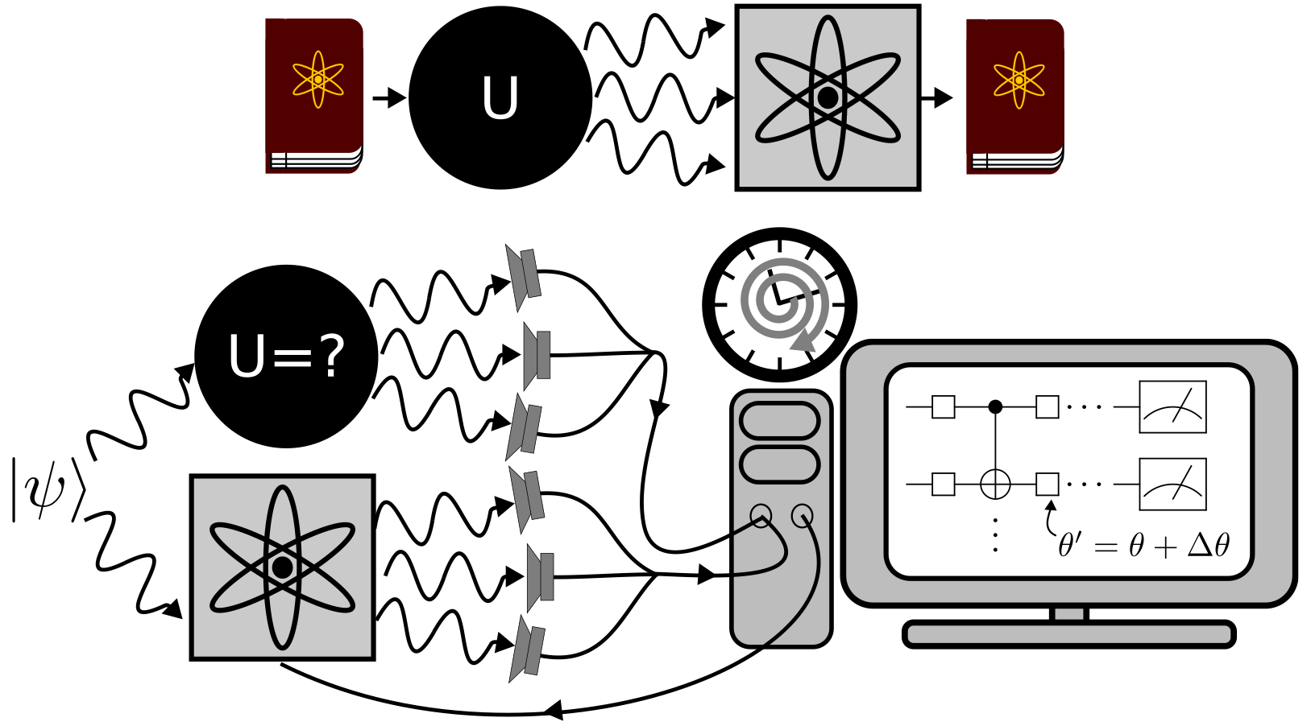
Hayden-Preskill Thought Experiment
Alice throws her diary into a black hole, can Bob recover it?
Notes:
To illustrate and generally add some colour to the result I want to share with you today…. I’m going to start by recalling the Hayden-Preskill thought experiment
In this thought experiment we suppose Alice attempts to destroy a secret diary, encoded in a quantum state, by throwing it into Nature’s fastest scrambler, a black hole. How safe is Alice’s diary? Would an observer Bob be able to recover it?

Slide 16
Hayden-Preskill Thought Experiment
Alice throws her diary into a black hole, can Bob recover it?
(Looks unlikely… ? )
Notes:
So given that the information contained in Alice’s secret is rapidly spread throughout of the black hole, presumably it is pretty safe?

Slide 17
Hayden-Preskill Thought Experiment
Alice throws her diary into a black hole, can Bob recover it?
But actually…. if he knows the scrambling unitary implemented by the black hole, then yes.
Notes:
BUT Hayden and Preskill argued that if Bob knows the unitary dynamics, U, implemented by the black hole, and shares a maximally entangled state with the black hole, it is possible to decode Alice’s secret by collecting a few additional photons emitted from the black hole.

Slide 18
Hayden-Preskill Thought Experiment
Alice throws her diary into a black hole, can Bob recover it?
But actually…. if he knows the scrambling unitary implemented by the black hole, then yes.
But how could he learn that unitary?
Notes:
However, it assumes Bob knows the unitary dynamics implemented by the black hole, well how could Bob learn that?

Slide 19
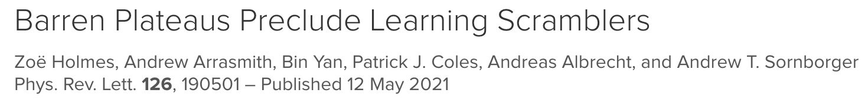
Hayden-Preskill Thought Experiment
Alice throws her diary into a black hole, can Bob recover it?
But actually…. if he knows the scrambling unitary implemented by the black hole, then yes.
But how could he learn that unitary?
Not using quantum machine learning…
Notes:
Well what we have shown is that it couldn’t be learnt with quantum machine learning.
Specifically, the main result I want to present to you today is a no-go theorem for the use of QML to learn scramblers…. and, more generally, typical random unitaries.

Slide 20
Overview
Background:
Notes:
But before we get to that, our main result, I have some background to get through. So hopefully this talk will be quite pedagogical.

Slide 21
Overview
Background:
What are scrambling unitaries?
Notes:
Firstly, I’ll go into more detail about what I mean by a scrambler. And how we identify scrambling unitaries.

Slide 22
Overview
Background:
What are scrambling unitaries?
How can QML be used to learn a scrambling unitaries?
Notes:
I’ll then discuss how QML could be used to learn scrambling unitaries.

Slide 23
Overview
Background:
What are scrambling unitaries?
How can QML be used to learn a scrambling unitaries?
What are barren plateaus and why might they stop us learning a scrambling unitary?
Notes:
I’ll then set out what are barren plateaus and why they might strop us from leaning scrambling unitaries.

Slide 24
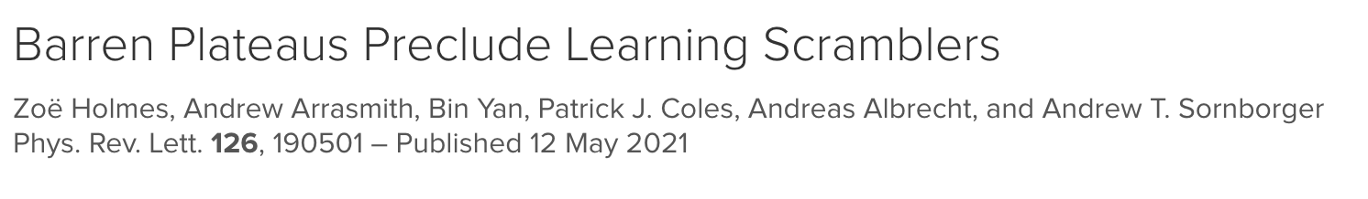
Overview
Background:
What are scrambling unitaries?
How can QML be used to learn a scrambling unitaries?
What are barren plateaus and why might they stop us learning a scrambling unitary?
Main result:
No-Go-Theorem
“Barren plateaus prohibit the learning of scrambling unitaries via training of a Quantum Neural Network”
Notes:
Then I’ll get to our main result which in essence is a proof that: Barren plateaus prohibit the learning scrambling unitaries via training of a Quantum Neural Network

Slide 25
Overview
Background:
What are scrambling unitaries?
How can QML be used to learn a scrambling unitaries?
What are barren plateaus and why might they stop us learning a scrambling unitary?
Main result:
No-Go-Theorem
“Barren plateaus prohibit the learning scrambling unitaries via training of a Quantum Neural Network”
+ Pretty pictures (numerics) to back this up
Notes:
And then I’ll show you some pr

Slide 26
Quantum Scrambling
Scrambling = the rapid spread of entanglement and information through many-body quantum systems.
Notes:
Ok, so in broad terms scrambling is the process by which entanglement and information gets rapidly spread through certain many body quantum systems.

Slide 27
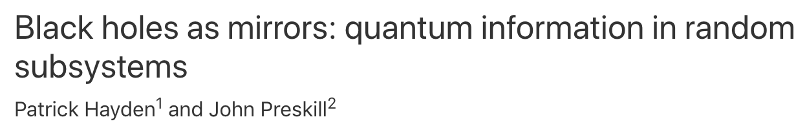
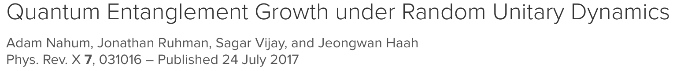
Quantum Scrambling
Scrambling = the rapid spread of entanglement and information through many-body quantum systems.
Central to understanding:
  black hole physics

Slide 28
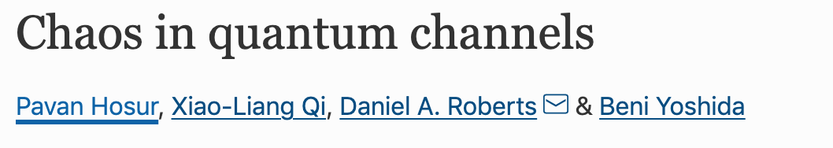
Quantum Scrambling
Scrambling = the rapid spread of entanglement and information through many-body quantum systems.
Central to understanding:
  black hole physics
  quantum information

Slide 29
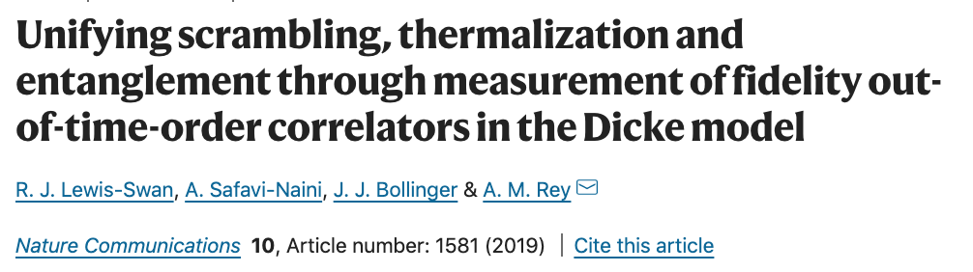
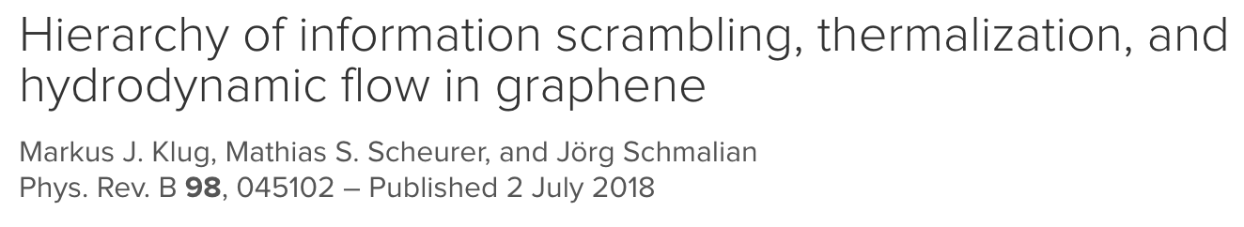
Quantum Scrambling
Scrambling = the rapid spread of entanglement and information through many-body quantum systems.
Central to understanding:
  black hole physics
  quantum information
  thermalization phenomena

Slide 30
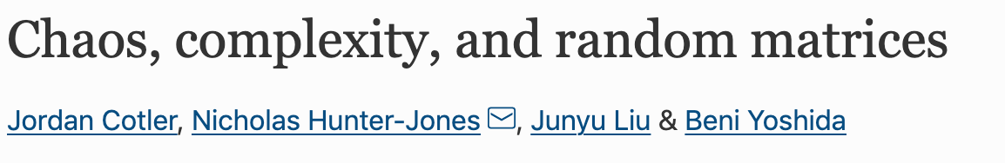
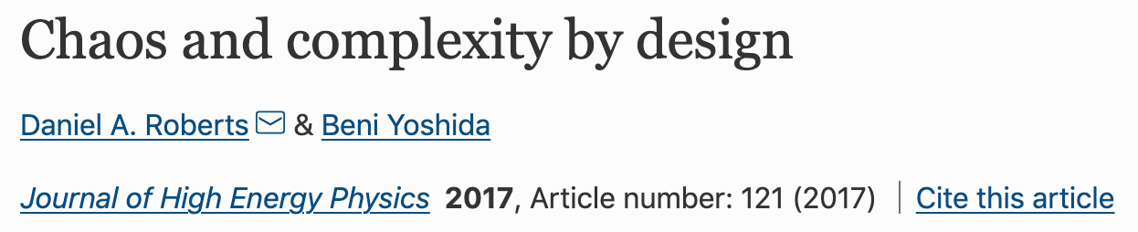
Quantum Scrambling
Scrambling = the rapid spread of entanglement and information through many-body quantum systems.
Central to understanding:
  black hole physics
  quantum information
  thermalization phenomena
  random circuits

Slide 31
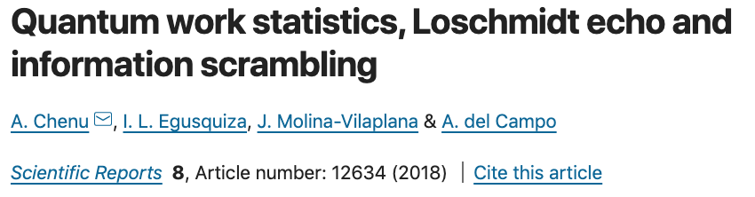
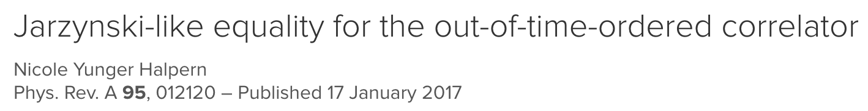
Quantum Scrambling
Scrambling = the rapid spread of entanglement and information through many-body quantum systems.
Central to understanding:
  black hole physics
  quantum information
  thermalization phenomena
  random circuits
  fluctuation relations

Slide 32
Quantum Scrambling
Scrambling = the rapid spread of entanglement and information through many-body quantum systems.
Central to understanding:
  black hole physics
  quantum information
  thermalization phenomena
  random circuits
  fluctuation relations
  And more (that I don’t have space on my slide for) ….

Slide 33
Quantum Scrambling
Scrambling = the rapid spread of entanglement and information through many-body quantum systems.
The out-of-time-ordered correlator (OTOC) diagnoses scrambling
Notes:
Ok that’s why scrambling is interesting. But how is it identified?
Well good diagnostic for scrambling are out-of-time-ordered correlators (or OTOCs).
An especially natural one is given by 1 minus the expectation value of the product of the commutator between two local operators squared. Which is what we have here.

Slide 34
Quantum Scrambling
Scrambling = the rapid spread of entanglement and information through many-body quantum systems.
The out-of-time-ordered correlator (OTOC) diagnoses scrambling
X and Y are local operators
Notes:
Here X and Y are local operators on different subsystems

Slide 35
Quantum Scrambling
Scrambling = the rapid spread of entanglement and information through many-body quantum systems.
The out-of-time-ordered correlator (OTOC) diagnoses scrambling
X and Y are local operators
is the time evolved initial operator X = X(0)
Notes:
X tilde is the Heisenberg evolved initial operator

Slide 36
Quantum Scrambling
Scrambling = the rapid spread of entanglement and information through many-body quantum systems.
The out-of-time-ordered correlator (OTOC) diagnoses scrambling
X and Y are local operators
is the time evolved initial operator X = X(0)
The average is taken over an infinite temperature state
Notes:
and the average is taken over an infinite temperature state.
​
Now, since X and Y act on different subsystems, their unevolved commutator vanishes. ​
​
However, scrambling dynamics evolve these local operators into global ones, inducing a growth of the commutator. ​

Slide 37
Quantum Scrambling
Scrambling = the rapid spread of entanglement and information through many-body quantum systems.
The out-of-time-ordered correlator (OTOC) diagnoses scrambling
X and Y are local operators
is the time evolved initial operator X = X(0)
The average is taken over an infinite temperature state
The OTOC of non-scrambler = 1
Notes:
Therefore the OTOC of a scrambled system rapidly decays

Slide 38
Quantum Scrambling
Scrambling = the rapid spread of entanglement and information through many-body quantum systems.
The out-of-time-ordered correlator (OTOC) diagnoses scrambling
X and Y are local operators
is the time evolved initial operator X = X(0)
The average is taken over an infinite temperature state
The OTOC of scrambler = small
Notes:
Therefore the OTOC of a scrambled system rapidly decays

Slide 39
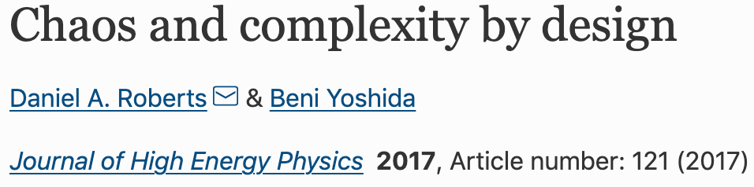
Quantum Scrambling
Scrambling = the rapid spread of entanglement and information through many-body quantum systems.
The out-of-time-ordered correlator (OTOC) diagnoses scrambling
X and Y are local operators
is the time evolved initial operator X = X(0)
The average is taken over an infinite temperature state
The OTOC of a scrambled system takes a minimal value that is equivalent to taking its average over a random distribution of unitaries.
Notes:
More precisely, it the OTOC of a scrambled system tends to a minimal value that is equivalent to taking its average over a random distribution of unitaries.

Slide 40
Quantum Scrambling
Scrambling = the rapid spread of entanglement and information through many-body quantum systems.
The out-of-time-ordered correlator (OTOC) diagnoses scrambling
X and Y are local operators
is the time evolved initial operator X = X(0)
The average is taken over an infinite temperature state
The OTOC of a scrambled system takes a minimal value that is equivalent to taking its average over a random distribution of unitaries.
Can model a scrambling unitary as a typical random unitary
Notes:
And so we can model a scrambling unitary as a typical random unitary.

Slide 41
Quantum Scrambling
Scrambling = the rapid spread of entanglement and information through many-body quantum systems.
The out-of-time-ordered correlator (OTOC) diagnoses scrambling
X and Y are local operators
is the time evolved initial operator X = X(0)
The average is taken over an infinite temperature state
The OTOC of a scrambled system takes a minimal value that is equivalent to taking its average over a random distribution of unitaries.
Only involves 2 copies of
Can model a scrambling unitary as a typical random unitary
Notes:
However, note that the OTOC only involves two copies of V, i.e. it involves up to the second moment of the unitary.

Slide 42
Quantum Scrambling
Scrambling = the rapid spread of entanglement and information through many-body quantum systems.
The out-of-time-ordered correlator (OTOC) diagnoses scrambling
X and Y are local operators (on different subsystems)
is the time evolved initial operator X = X(0)
The average is taken over an infinite temperature state
The OTOC of a scrambled system takes a minimal value that is equivalent to taking its average over a distribution of unitaries that agrees with random distribution up to the second moment (i.e. a 2-design)
Only involves 2 copies of
Can model a scrambling unitary as a typical (pseudo) random unitary
(a unitary drawn from a 2-design)
Notes:
So a pseudo random distribution that agrees with the random distribution only up to the second moment also decays to the same value. Such distributions are known as 2 designs.
This means we don’t need a perfectly random ensemble of unitaries to model scramblers, we can model also model scrambler using a pseudo random distribution of unitaries.
More precisely, we can model a scrambling unitary as a typical (pseudo) random unitary. i.e. a typical unitary drawn from a 2-design.

Slide 43
Quantum Scrambling
Scrambling = the rapid spread of entanglement and information through many-body quantum systems.
The out-of-time-ordered correlator (OTOC) diagnoses scrambling
X and Y are local operators
is the time evolved initial operator X = X(0)
The average is taken over an infinite temperature state
The OTOC of a scrambled system takes a minimal value that is equivalent to taking its average over a distribution of unitaries that agrees with random distribution up to the second moment (i.e. a 2-design)
Only involves 2 copies of
Can model a scrambling unitary as a typical (pseudo) random unitary
(a unitary drawn from a 2-design)
Can we use a QML to learn a target scrambling unitary?
Notes:
Ok, so can we use QML to learn such a scrambling unitary.

Slide 44
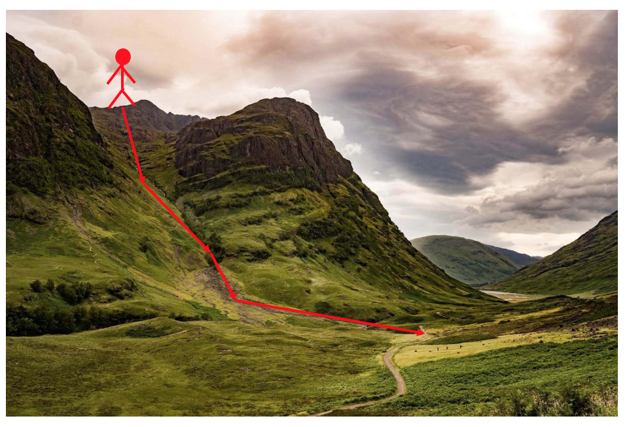
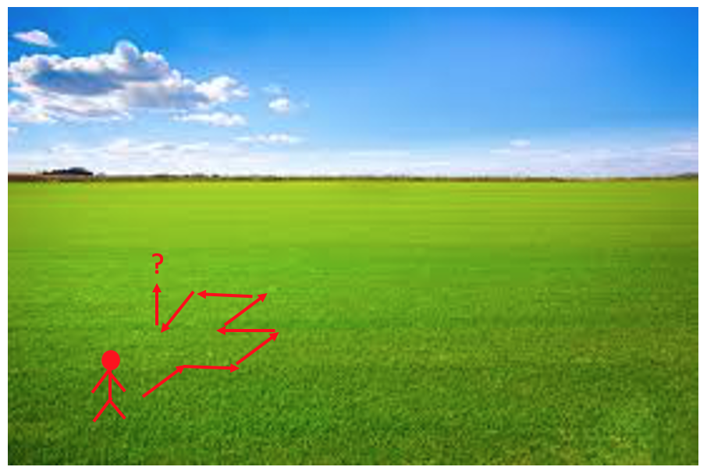
Barren Plateaus
The cost landscape needs to be sufficiently featured to enable training
Notes:
In order to be able to minimize a cost and learn the target unitary we need the cost landscape to be sufficiently featured that it’s possible to employ a search strategy to find the solution.
For the purpose of this talk, I discuss gradient decent methods to optimise the cost…. but most of what I have to say equally applies to other methods.
A good way to picture a gradient descent algorithm is to ask what would be your best technique of getting down off a mountain if you find yourself in the Fog but idiotically you don’t have a map or any idea of where you are…
Well a decent bet would be to just keep on going down! Following the path of steepest descent. Which is actually, roughly what water does naturally… which is why in this figure you end up following the stream…
But this is only going to work if you can figure out which way is the steepest route down. It’s not going to to work if the landscape is largely flat. Imagine trying to find the lowest point of the field on the right….

Slide 45
Barren Plateaus
The cost landscape needs to be sufficiently featured to enable training
Small gradients high precision required to resource intensive
find cost minimizing direction
( shots are required
estimate a cost to precision )
Notes:
This is especially an issue in the context of minimising a quantum cost.
On such really flat landscapes, very precise measurements of the cost are required to detect the path of steepest descent to navigate to the minimum. And now, to assess the value of a quantum cost to a high precision requires a large number of shots….
Remember that the cost is the expectation value of the measurement operator with respect to a quantum state.
So for high precision evaluations of the cost you are going to need many many shots.
SHOTS
Ok, so how do we know what landscape we have? A nice textured one? Or a flat untrainable one?

Slide 46
Barren Plateaus
The cost landscape needs to be sufficiently featured to enable training
So how can we assess whether our landscape is trainable or untrainable?
Notes:
This is especially an issue in the context of minimising a quantum cost.
On such really flat landscapes, very precise measurements of the cost are required to detect the path of steepest descent to navigate to the minimum. And now, to assess the value of a quantum cost to a high precision requires a large number of shots….
Remember that the cost is the expectation value of the measurement operator with respect to a quantum state.
So for high precision evaluations of the cost you are going to need many many shots.
SHOTS
Ok, so how do we know what landscape we have? A nice textured one? Or a flat untrainable one?

Slide 47
Barren Plateaus
Assess trainability of a QNN by studying expected cost gradients
The average cost gradient vanishes
Chebyshev's inequality:
Small variance entails small cost gradients.
Notes:
Well, we can assess the trainability of a VQA by studying its cost gradients.
That is the partial derivative of the cost wrt each of the theta rotation parameters.

Slide 48

Barren Plateaus
Assess trainability of a QNN by studying expected cost gradients
The average cost gradient vanishes
Chebyshev's inequality:
Small variance entails small cost gradients.
Notes:
Now for typical ansatze it is straightforward to show that the average cost gradient vanishes.
This demonstrates the cost landscape is unbiased. You’re equally likely to come across positive and negative gradients.
Or as every one who enjoys walking knows… what goes down, must come up.

Slide 49
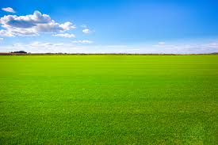
Barren Plateaus
Assess trainability of a QNN by studying expected cost gradients
The average cost gradient vanishes
Chebyshev's inequality:
Small variance entails small cost gradients.
Notes:
However an unbiased cost landscape can be either trainable or untrainable, depending on the extent to which the gradient fluctuates away from zero.
Both these landscapes are unbiased. But the top on is trainable and the bottom isn’t.

Slide 50
Barren Plateaus
Assess trainability of a QNN by studying expected cost gradients
The average cost gradient vanishes
Chebyshev's inequality:
Small variance entails small cost gradients.
Notes:
So to assess the trainability of an ansatz, it’s helpful to recall Chebyshev’s inequality.
This inequality bounds the probability that the partial derivative of the cost deviates from its average of zero.
i.e. the probability that the cost gradient is greater than delta is determined by the variance in the cost gradient.
Hence if the variance of the partial derivative is small for all parameters, then the probability that the partial derivative is non-zero is small for all parameters. i.e. the landscape is very flat

Slide 51
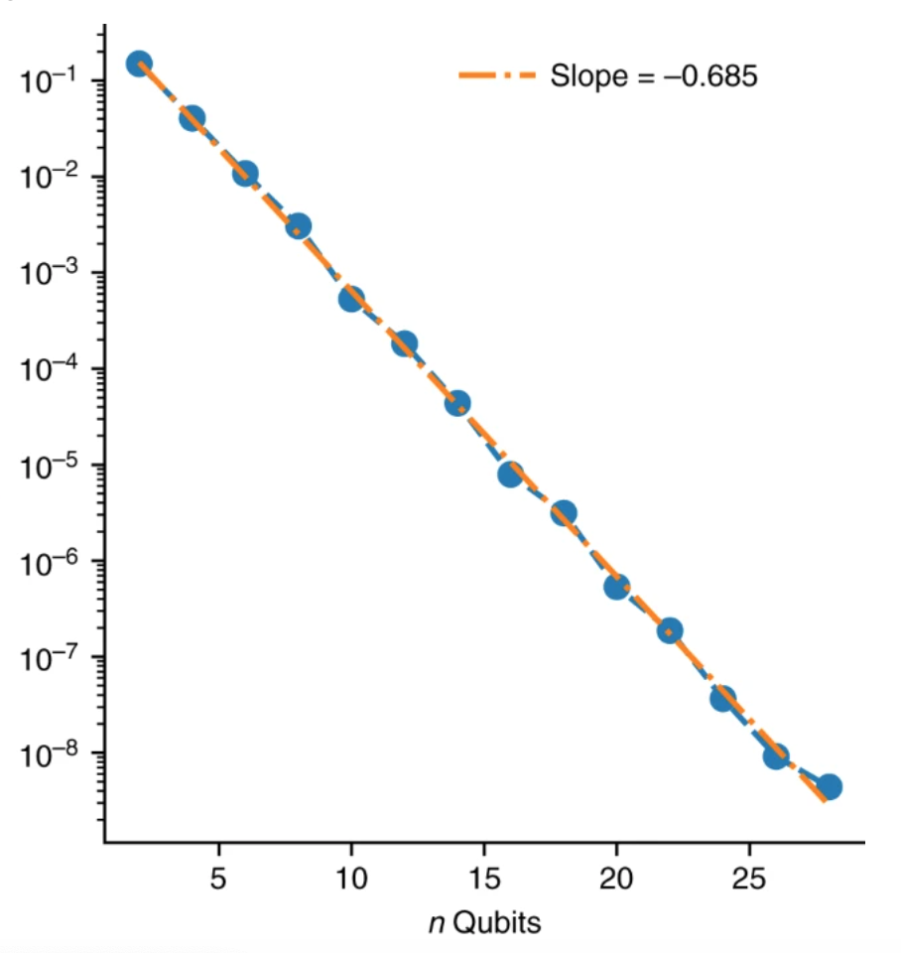
Barren Plateaus
Barren plateau phenomena:
Probability of non-zero gradients vanishes exponentially with problem size.
Shots required for training grows exponentially with problem size.
Notes:
It has recently been showed that for a wide class of quantum machine learning problems, the cost function gradients vanish exponentially with the size of the system. This is known as the barren plateau phenomena.
Specifically it has been shown that the variance in the partial derivative of the cost scales as 1 / 2^n where n is the number of qubits the parameterised quantum circuit acts on. This combined with Chebyshev entails that the probability that the cost function substantially deviates from 0 is vanishingly small.
So for small problem sizes you landscape might be textured enough to effective training… but for larger problems your landscape is going to become very flat.
SHOTS

Slide 52
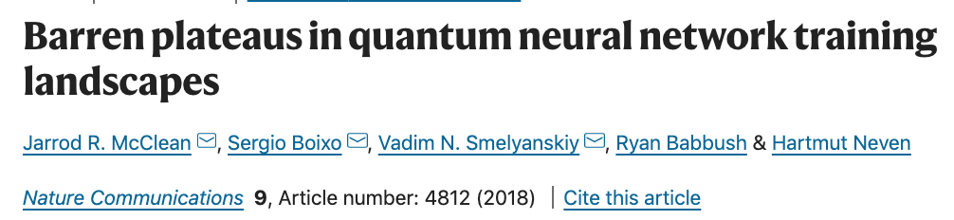
Barren Plateaus
Barren plateau phenomena can be induced by
Choice in circuit:
Notes:
Prior work has established that Barren Plateaus can be induced by using an inappropriate ansatz. This was first shown in this seminal paper by McClean et al.

Slide 53
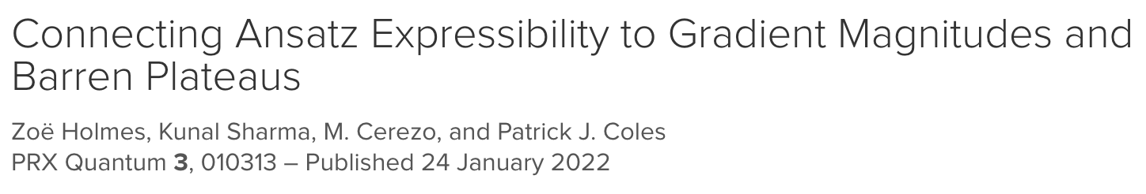
Barren Plateaus
Barren plateau phenomena can be induced by
Choice in circuit:
Too expressive
Contains solutions to problems A and B
Contains solutions to problem A only
Highly expressive ansatze
Less expressive ansatze
Notes:
It was later shown that specifically using too expressive ansatze can induce a barren plateau.
A highly expressive ansatz is one that explores the total space of unitaries well.
This is sketched on the bottom left. The grey oval is the total space of unitaries and the blue oval is the space of unitaries accessible by the ansatz. The blue oval covers most of the grey oval, i.e. the ansatz explores, well the total space of unitaries and so is expressive. The red and green ovals denote solutions to two different problems- problems A and B. And as this ansatz explores the space of unitaries well it contains solutions to both.
In contrast the ansatz on the right is inexpressive. Doesn’t explore the space of unitaries well. Blue oval covers only a small part of the grey oval. That is, it is inexpressive. And correspondingly only contains solutions to problem A and not B.
So, . naively you would have thought that an expressive ansatz would be better to use that inexpressive ansatz because it’s more likely to contain a solution to your problem.

Slide 54
Barren Plateaus
Barren plateau phenomena can be induced by
Choice in circuit:
Too expressive
Highly expressive ansatze have barren plateaus
Less expressive ansatze can be trainable or untrainable
Notes:
But we showed that actually if your ansatz is highly expressive it will have a barren plateau.
But less expressive ansatz can be trainable or untrainable depending on other factors.

Slide 55
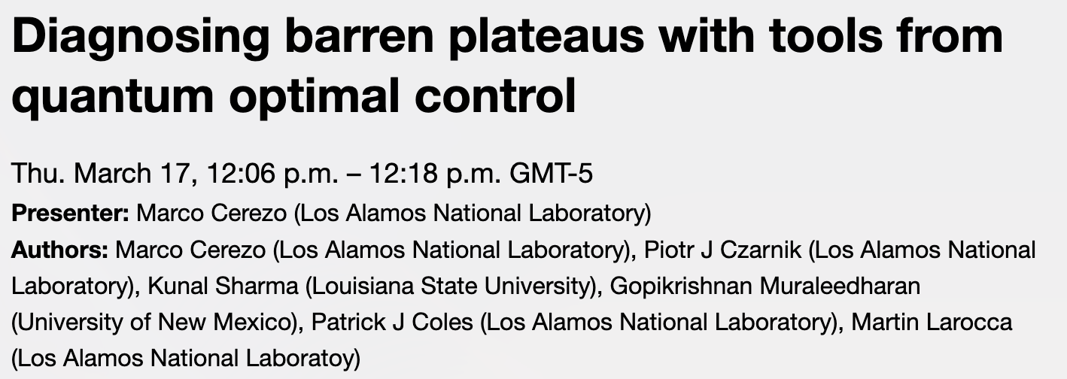

Barren Plateaus
Barren plateau phenomena can be induced by
Choice in circuit:
Too expressive
Marco presented an alternative lie algebraic perspective on a closely related phenomenon
Notes:
Marco presented an alternative lie algebraic perspective on a closely related phenomena
It’s online if you missed it. And he’s in the audience still if you want to poke him.

Slide 56
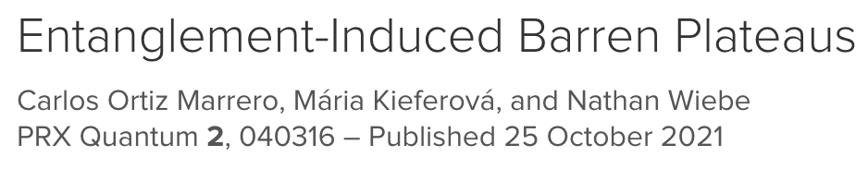
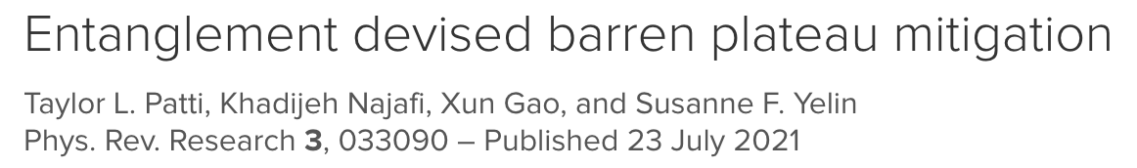
Barren Plateaus
Barren plateau phenomena can be induced by
Choice in circuit:
Too expressive
Too entangling
Notes:
Ok, so expressibility can induce barren plateaus. An alternative perspective, provided by a number of very nice papers that came out at a similar time, showed that entanglement can also induce a barren plateau. That is if the ansatz is too highly entangling you’ll end with a barren plateau.

Slide 57
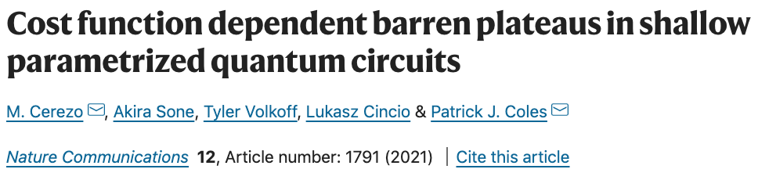
Barren Plateaus
Barren plateau phenomena can be induced by
Choice in circuit:
Too expressive
Too entangling
Choice in cost function (globality of measurement):
Notes:
Finally, it has also been shown that using an inappropriate cost function can generate a barren plateaus.

Slide 58
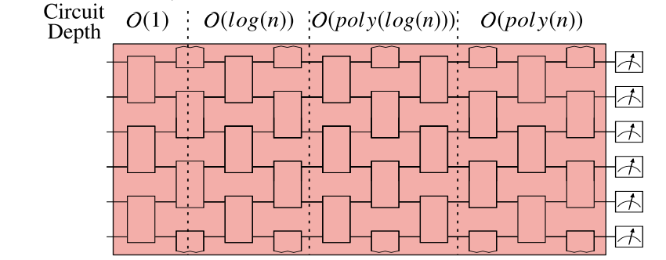
Barren Plateaus
Barren plateau phenomena can be induced by
Choice in cost function (globality of measurement):
Global Cost:
H acts non-trivially on all qubits
Globality induced BP at all depths
(i.e. inexpressive/low-entangling ansatze also untrainable!)
Notes:
Specifically global cost functions involving global measurements on all n qubits of the parameterised quantum circuit can lead to barren plateaus at ALL depths
Crucially with global costs even a logarithm depth circuit or fixed depth ansatz can have a barren plateau. That is even a single layer ansatz (that is highly inexpressive/low-entangling ansatz) can have a barren plateau.

Slide 59
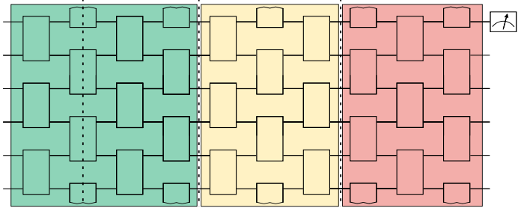
Barren Plateaus
Barren plateau phenomena can be induced by
Choice in cost function (globality of measurement):
Local Cost:
H acts non-trivially on fixed number of qubits
Global Cost:
H acts non-trivially on all qubits
Globality induced BP
Low depth (inexpressive/low entangling) ansatze can be trainable
Expressibility/entanglement induced BPs
(i.e. inexpressive/low-entangling ansatze also untrainable!)
Notes:
So we are going to need to use local costs. And whether these are trainable or untrainable depends on your choice in ansatz, i.e. how deep/expressive/entangling it is.

Slide 60
Barren Plateaus
Barren plateau phenomena can be induced by
Choice in circuit:
Too expressive
Too entangling
Choice in cost function (globality of measurement):
Notes:
Ok, so this is the set of phenomena so far known.

Slide 61
Barren Plateaus
Barren plateau phenomena can be induced by
Choice in circuit:
Too expressive
Too entangling
Choice in cost function (globality of measurement):
Choice in target learning problem
Notes:
What we’ve shown. The result I want to share with you today, is a new way in which barren plateaus can be induced and that is through an innapropriate choice in target learning problem.
Namely learning scrambling unitaries or, equivalently, typical random unitaries.

Slide 62
Barren Plateaus preclude learning Scramblers
Average over ensemble of scramblers (a 2 design)
We prove that for compiling costs to learn a scrambling unitary (i.e. a unitary drawn from a 2 design):
The average cost gradient vanishes
The variance in the gradient of the cost vanishes exponentially
the probability the gradient of the cost is non-zero vanishes exponentially with the size of the problem (n).
Notes:
Specifically we consider compiling costs, of the form I introduced earlier, as used to learn a scrambling unitary.
Here, we model a scrambler as a typical (pseudo random unitary), i.e. one drawn from a 2-design.
We then show firstly, that for such costs as used to learn scramblers, on average the partial derivative of the cost vanishes.
We then show that the variance in the partial derivative of the cost vanishes exponentially in the size of the scrambler, i.e. in n (the number of systems, qubits it acts on).
In both cases, this average is over a 2 design. i.e. an ensemble of pseudo random unitaries/scramblers

Slide 63
Barren Plateaus preclude learning Scramblers
Average over ensemble of scramblers (a 2 design)
We prove that for compiling costs to learn a scrambling unitary (i.e. a unitary drawn from a 2 design):
The average cost gradient vanishes
The variance in the gradient of the cost vanishes exponentially
The probability that the gradient of the cost is non-zero for a typical scrambler vanishes exponentially with the size of the problem (n).
Notes:
So, given Chebyshev’s inequality, the probability that the gradient deviates substantially from zero for a typical scrambler (or typical random unitary) vanishes exponentially.
i.e. the cost exhibits a barren plateau.

Slide 64
Barren Plateaus preclude learning Scramblers
Average over ensemble of scramblers (a 2 design)
Crucially, this holds for any choice in ansatz.
We prove that for compiling costs to learn a scrambling unitary (i.e. a unitary drawn from a 2 design):
The average cost gradient vanishes
The variance in the gradient of the cost vanishes exponentially
The probability the gradient of the cost is non-zero for a typical scrambler vanishes exponentially with the size of the problem (n).
Notes:
Crucially this holds for any ansatz. So no matter what fancy techniques you employ you are not going go to be able to use VQA, or a QML like approach, to learn a scrambler.

Slide 65
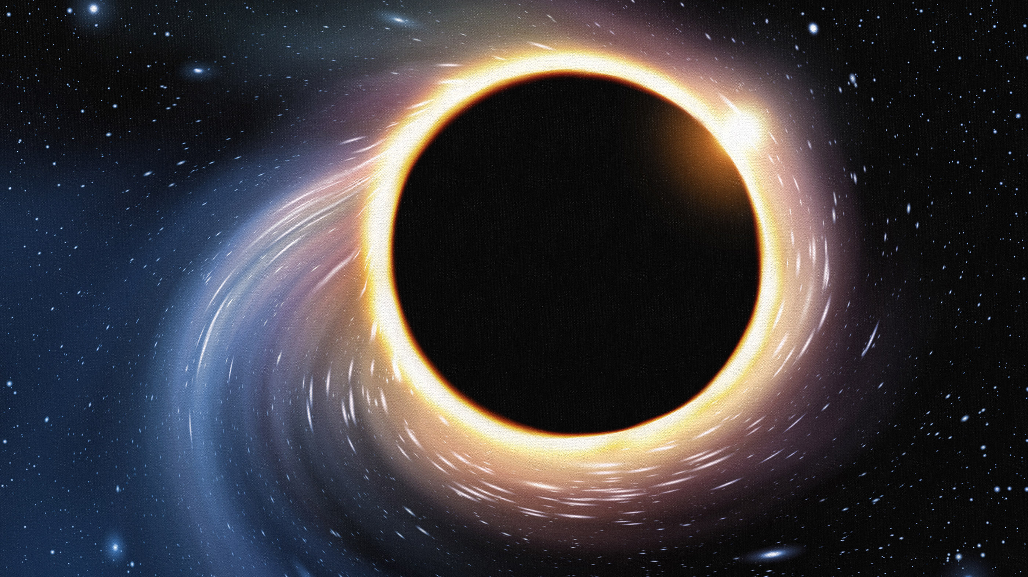
Barren Plateaus preclude learning Scramblers
Average over ensemble of scramblers (a 2 design)
Crucially, this holds for any choice in ansatz.
We prove that for compiling costs to learn a scrambling unitary (i.e. a unitary drawn from a 2 design):
The average cost gradient vanishes
The variance in the gradient of the cost vanishes exponentially
The probability the gradient of the cost is non-zero for a typical scrambler vanishes exponentially with the size of the problem (n).
No go theorem for learning of scramblers by training a QNN
Notes:
This result is essentially a no-go theorem for learning scramblers using QML.

Slide 66
Barren Plateaus preclude learning Scramblers
Strong scramblers: Landscape forms a barren plateau with only a narrow gorge where cost dips to minimum.
Weaker scramblers: Valley wider and plateau more featured allowing for training.
highly scrambling
Model of scrambler/ansatz:
non-scrambling
Belyansky, R., Bienias, P., Kharkov, Y. A., Gorshkov, A. V., & Swingle, B. (2020). Minimal Model for Fast Scrambling. Physical Review Letters, 125(13), 130601.
Notes:
Here are some numerics demonstrating this effect.
Here we plot a cross-section of the cost landscape in the region around the true parameters that minimize the cost.
We model a scrambler using the minimal model of a scrambler introduced by Belyansky et al. This is composed of alternating layers of entangling gates and single qubit rotations. g determines the strength of the entangling gates and t determines the scrambling time. The model is highly scrambling for large g and large t.
In that case, as shown in blue, the majority of the landscape forms a barren plateau with only a narrow gorge where the cost dips down to its minimum. In contrast for weaker scramblers, as shown in yellow, the valley around the minimum is wider and the plateau more featured.
This is a nice visual representation of how the barrenness of the cost landscape depends on the degree to which the target unitary is scrambling.

Slide 67
Barren Plateaus preclude learning Scramblers
Cost gradients decrease with increasing time and so increased scrambling
Exponentially vanishing cost gradients (i.e. a barren plateau) for strong scramblers
Notes:
This plot considers the same minimal model of scrambler and shows that indeed the observed cost gradients decrease with scrambling time.

Slide 68
Barren Plateaus preclude learning Scramblers
Cost gradients decrease with increasing time and so increased scrambling
Exponentially vanishing cost gradients (i.e. a barren plateau) for strong scramblers
Notes:
And indeed, for highly scrambling unitaries, the cost gradient vanish exponentially in n (as predicted by our analytic results).

Slide 69
Black Holes: Hayden-Preskill Thought Experiment
The scrambling nature of black hole that would allow Bob to recover Alice’s diary…
Notes:
Well what we have shown is that it couldn’t be learnt with quantum machine learning.
Specifically, the main result I want to present to you today is a no-go theorem for the use of QML to learn scramblers…. and, more generally, typical random unitaries.

Slide 70
Black Holes: Hayden-Preskill Thought Experiment
The scrambling nature of black hole that would allow Bob to recover Alice’s diary…
Also prevents him from learning the dynamics of the black hole in the first place.
Notes:
Well what we have shown is that it couldn’t be learnt with quantum machine learning.
Specifically, the main result I want to present to you today is a no-go theorem for the use of QML to learn scramblers…. and, more generally, typical random unitaries.

Slide 71
Black Holes: Hayden-Preskill Thought Experiment
The scrambling nature of black hole that would allow Bob to recover Alice’s diary…
Also prevents him from learning the dynamics of the black hole in the first place.
So Alice’s secrets are safer than expected after all….
Notes:
Well what we have shown is that it couldn’t be learnt with quantum machine learning.
Specifically, the main result I want to present to you today is a no-go theorem for the use of QML to learn scramblers…. and, more generally, typical random unitaries.

Slide 72
Conclusions
Barren plateau exhibited by scramblers
Notes:
So we have shown that barren plateaus are exhibited by scrambles
i.e. if you are trying to learn a scrambler you will encounter a barren plateau where the cost functions vanish exponentially with the size of the problem.

Slide 73
Conclusions
Barren plateau exhibited by scramblers and typical random unitaries
Notes:
So we have shown that barren plateaus are exhibited by scrambles
More generally, it’s important to stress that because we model a scrambler as typical random unitary it follows that our results also apply to the learning of typical random unitaries.

Slide 74
Conclusions
Barren plateau exhibited by scramblers and typical random unitaries
Randomness is a barrier to trainability
Notes:
In this sense randomness is a barrier to trainability
But thankfully/luckily most physically interesting processes are sufficiently simple or structured that they do not resemble a typical random (or pseudo-random) unitary. We would really struggle to do physics otherwise! Therefore the our theorem does not condemn quantum machine learning but rather tells us we need to pick our problems carefully.

Slide 75
Conclusions
Barren plateau exhibited by scramblers and typical random unitaries
Randomness is a barrier to trainability
Take home message:
There are fundamental limits to QML.
Notes:
Nonetheless our work stresses that there are fundamental limits to QML. The physics of the problem you apply it to matters.

Slide 76
Conclusions
Barren plateau exhibited by scramblers and typical random unitaries
Randomness is a barrier to trainability
Take home message:
There are fundamental limits to QML.
Further research needed into what systems can be learned.
Notes:
In this sense, further research is required into what physical systems are actually amenable to being studied

Slide 77
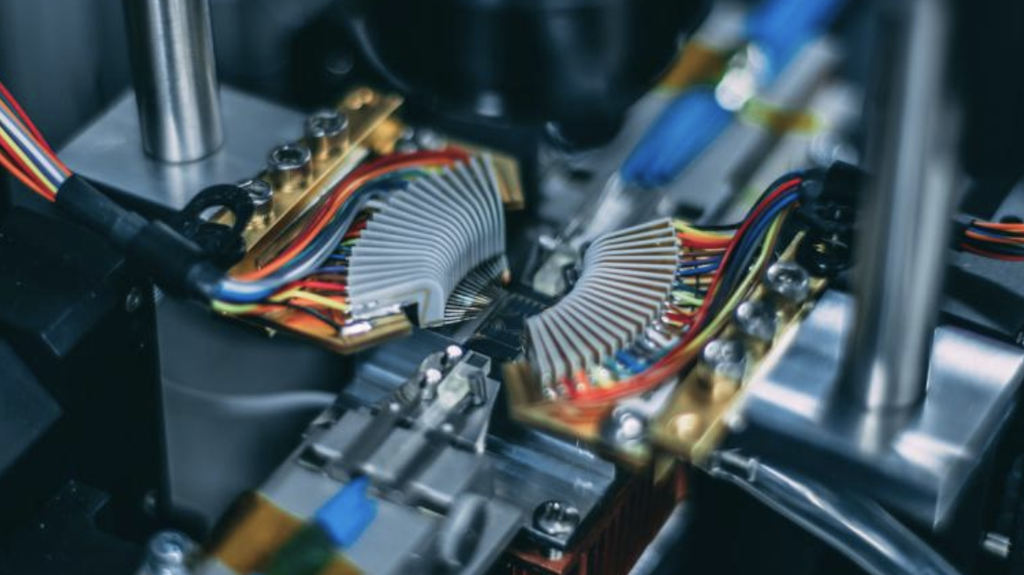

Out-of-Distribution Generalization for Learning Quantum Processes and its Applications for Quantum Simulation.
Joe Gibbs, Matthias C. Caro, Hsin-Yuan Huang, Nicholas Ezzell,
Andrew T. Sornborger, Lukasz Cincio, Patrick J. Coles, and Zoë Holmes
June 1, 2022
LA-UR-21-31141

Slide 78
Overview
Quantum machine learning:
Present an out-of-distribution generalization bound for quantum process learning
2) Dynamical simulation:
New algorithm for efficient near term quantum simulations
Outlook:
These results could impact our understanding of quantum machine learning and its uses for a quantum LHC (process learning) and near-term HEP (quantum simulation)
Notes:
There are really two main parts of my talk. The first half is on the training data requirements for quantum machine learning. Specifically we present an out-of-distribution generalization bound for quantum machine learning.
The second half uses these results to present a new algorithm for efficient near term quantum simulations.
While the second half is to some extent an application of the first, I’m hope the two halves of the talk really also work as stand alone talks.
I’ll end with a bit of an outlook about how the two areas of quantum machine learning and dynamical simulation could benefit each other more generally.

Slide 79
Quantum process learning
Parameterised
unitary
Optimum parameters
Target unitary
(What?)
Notes:
Ok so that was the illustrated picture. Let’s now make this a bit more concrete. So for the purpose of this talk, I’m going to focus on learning unitary processes.
Well the idea is that there is some unknown unitary quantum quantum process. That is given some target unitary U the aim is to find train a parameterized unitary V(alpha) to find some optimized parameters alpha_opt such that V(alpha_opt) = U

Slide 80



Quantum process learning
Parameterised
unitary
Optimum parameters
Target unitary
(How?)
Learning to replicate a process on a single input state
Input state
Unknown quantum process
Output state
Parametrized quantum process
Predicted output state
Input state
Notes:
And then first thing to do is to learn to replicate the process on a given input state. So that is find some V(alpha) such that V(alpha) on |psi> equals psi_out where psi_out is the state you get by acting U on the input psi.

Slide 81
Quantum process learning
Parameterised
unitary
Optimum parameters
Target unitary
(How?)
Learning to replicate a process on a training ensemble
Input state
Unknown quantum process
Output state
Repeat this for a whole set of different input states
i.e. a ‘training ensemble’
Train quantum process
Predict output state
Input state
Notes:
Having learnt on one input state, you then just and learn on the rest of the training ensemble (i.e. a set of N different input states).

Slide 82
Quantum process learning
Parameterised
unitary
Optimum parameters
Target unitary
(How?)
With the hope that we can learn to make predictions on unseen inputs….
Input state
Unknown quantum process
Output state
?
Key question: How well can we use learned process to predict output on unseen inputs?
Learned quantum process
Predicted output state
Input state
Notes:
And in the end you look at a state you’ve not seen before, shown as phi here on the slide. Our learnt quantum process is V(alpha_opt) where alpha_opt are the optimized parameters we have found from training. Our best guess of the output, our prediction, is V(alpha_opt) |phi>.
How well can we expect to be able to make predictions?

Slide 83
Quantum process learning
Parameterised
unitary
Optimum parameters
Target unitary
(How?)
With the hope that we can learn to make predictions on unseen inputs….
Input state
Unknown quantum process
Output state
Key question: How well can we use learned process to predict output on unseen inputs?
?
Learned quantum process
Predicted output state
Input state
Answer: Generalization bounds
(quantify expected prediction performance in terms of training performance)
Notes:
This question can be answered using generalization bounds… which bound the prediction performance in terms of the quality

Slide 84
Generalization bounds
~ quantify how well we can make predictions in terms of training performance
Input state
Unknown quantum process
Output state
Prediction error is the difference between true output and prediction
Learned quantum process
Predicted output state
Input state
Prediction error:
Notes:
How do we quantify prediction performance?
Well the prediction error is the difference between true output and guess output
You could imagine a number of different ways to measure this difference but we chose to measure the distance in terms of the 1 norm squared. This means we then need a factor of ¼ out front to normalize the distance to 1.

Slide 85
Generalization bounds
~ quantify how well we can make predictions in terms of training performance
Input state
Unknown quantum process
Output state
Prediction error is the difference between true output and prediction
Learned quantum process
Predicted output state
Input state
Average prediction error:
(risk)
Notes:
And then the average prediction error (known as the risk) is the average prediction error over the states we want to be able to predict the quantum process over.
We chose to measure the distance in terms of the 1 norm squared. This means we then need a factor of ¼ out front to normalize the distance to 1.

Slide 86
Generalization bounds
~ quantify how well we can make predictions in terms of training performance
Input state
Unknown quantum process
Output state
Prediction error is the difference between true output and prediction
Learned quantum process
Predicted output state
Input state
Average prediction error:
(risk)
Testing ensemble (the ensemble of states we care about predicting the action of the process over)
Notes:
That is, P here here the testing ensemble.

Slide 87
Generalization bounds
~ quantify how well we can make predictions in terms of training performance
But we don’t have access to the risk… only the training cost
Unknown quantum process
Output state
Repeat this for a whole set of different input states
i.e. a ‘training ensemble’
Learned quantum process
Predicted output state
Training cost:
(average error over training data)
Notes:
But we don’t have access to the risk… we can’t measure it because we don’t know the true outputs on all states. If we did we wouldn’t need to do the learning in the first place.
All we have access to is the training cost.
The training cost is the average error over the states trained on. That is, while you are going to try and match the true outputs and guess outputs over the training data, you are typically not going to manage to do so perfectly.

Slide 88
Generalization bounds
~ quantify how well we can make predictions in terms of training performance
But we don’t have access to the risk… only the training cost
Unknown quantum process
Output state
Repeat this for a whole set of different input states
i.e. a ‘training ensemble’
Learned quantum process
Predicted output state
Training cost:
(average error over training data)
Training ensemble (the ensemble of states that the training states are drawn from)
Notes:
Note the Q subscript here. We are going to suppose that the training states are drawn from an ensemble Q.

Slide 89
Generalization bounds
~ quantify how well we can make predictions in terms of training performance
Generalization bounds quantify the risk in terms of training cost
Risk = average prediction error
(what we care about)
Training cost = average error over training data
(what we have access to)
Notes:
Ok, so generalization bounds quantify the risk (the average prediction error- what we care about) in terms of training cost (the average error over training data- what we actually have access to. What we do the training with).

Slide 90
In-Distribution vs. Out-of-Distribution Generalization
In-distribution generalization: Training ensemble = Testing ensemble

Slide 91
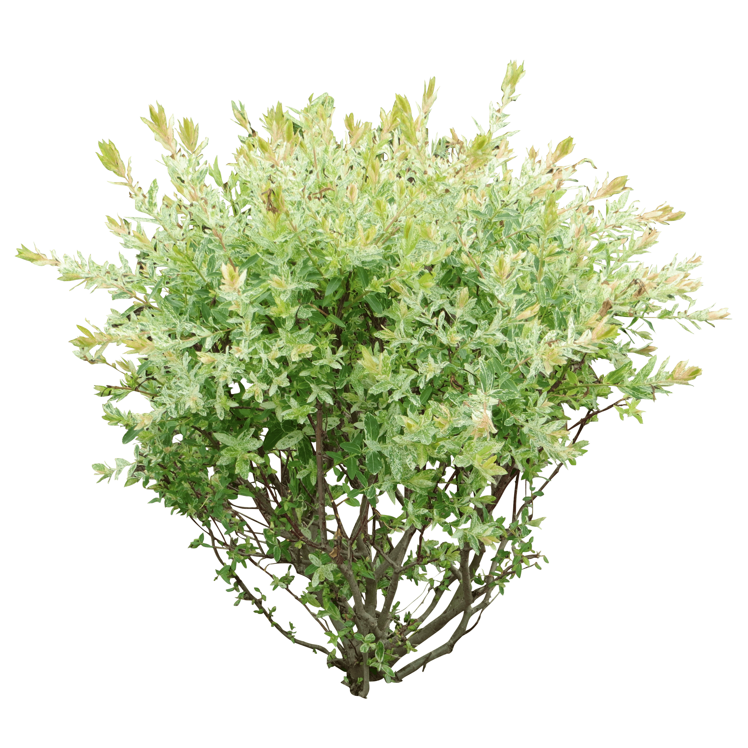
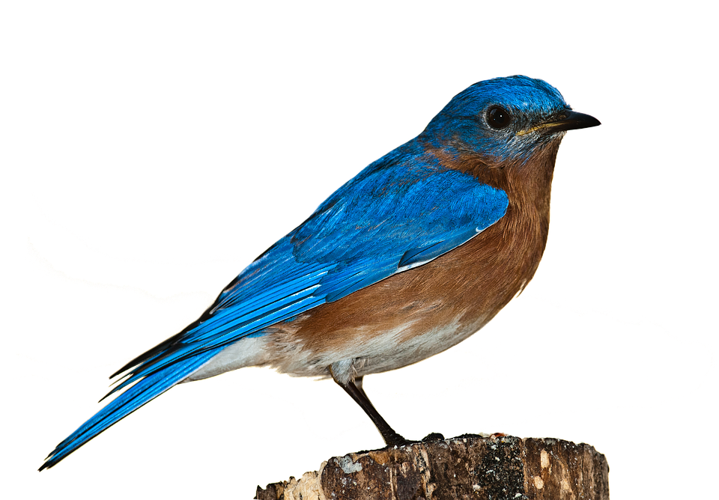
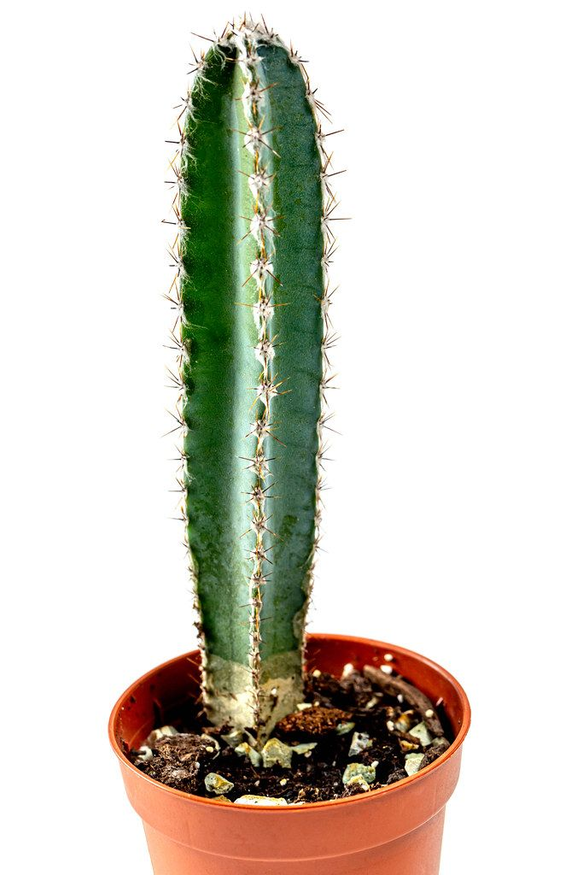
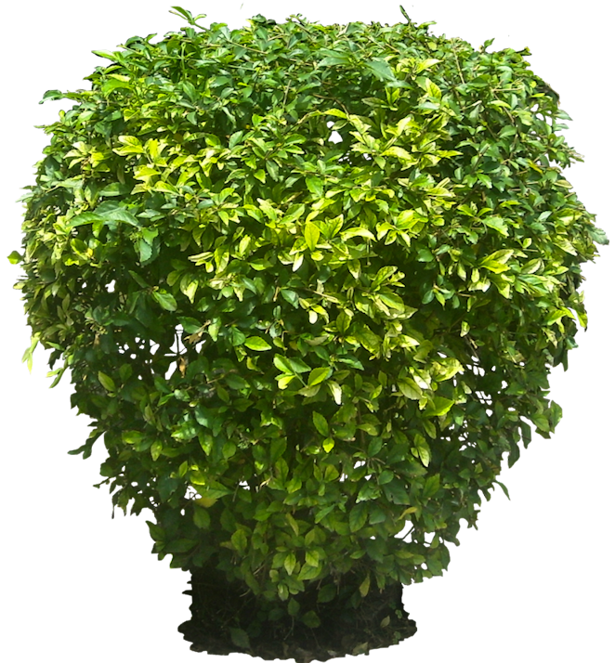
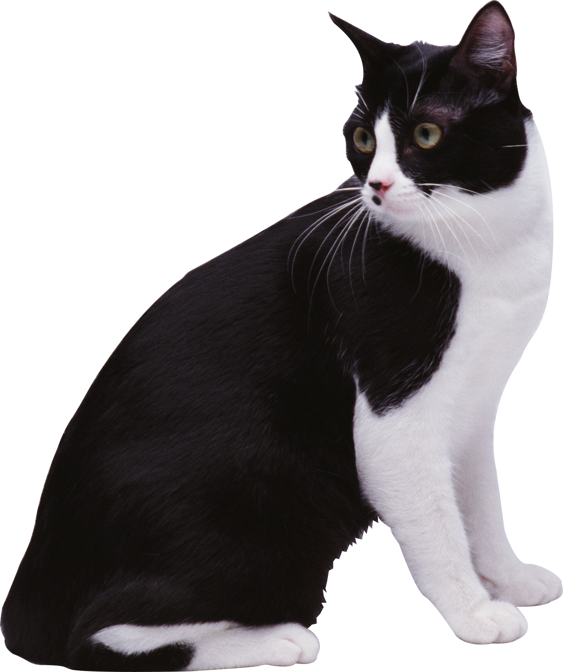
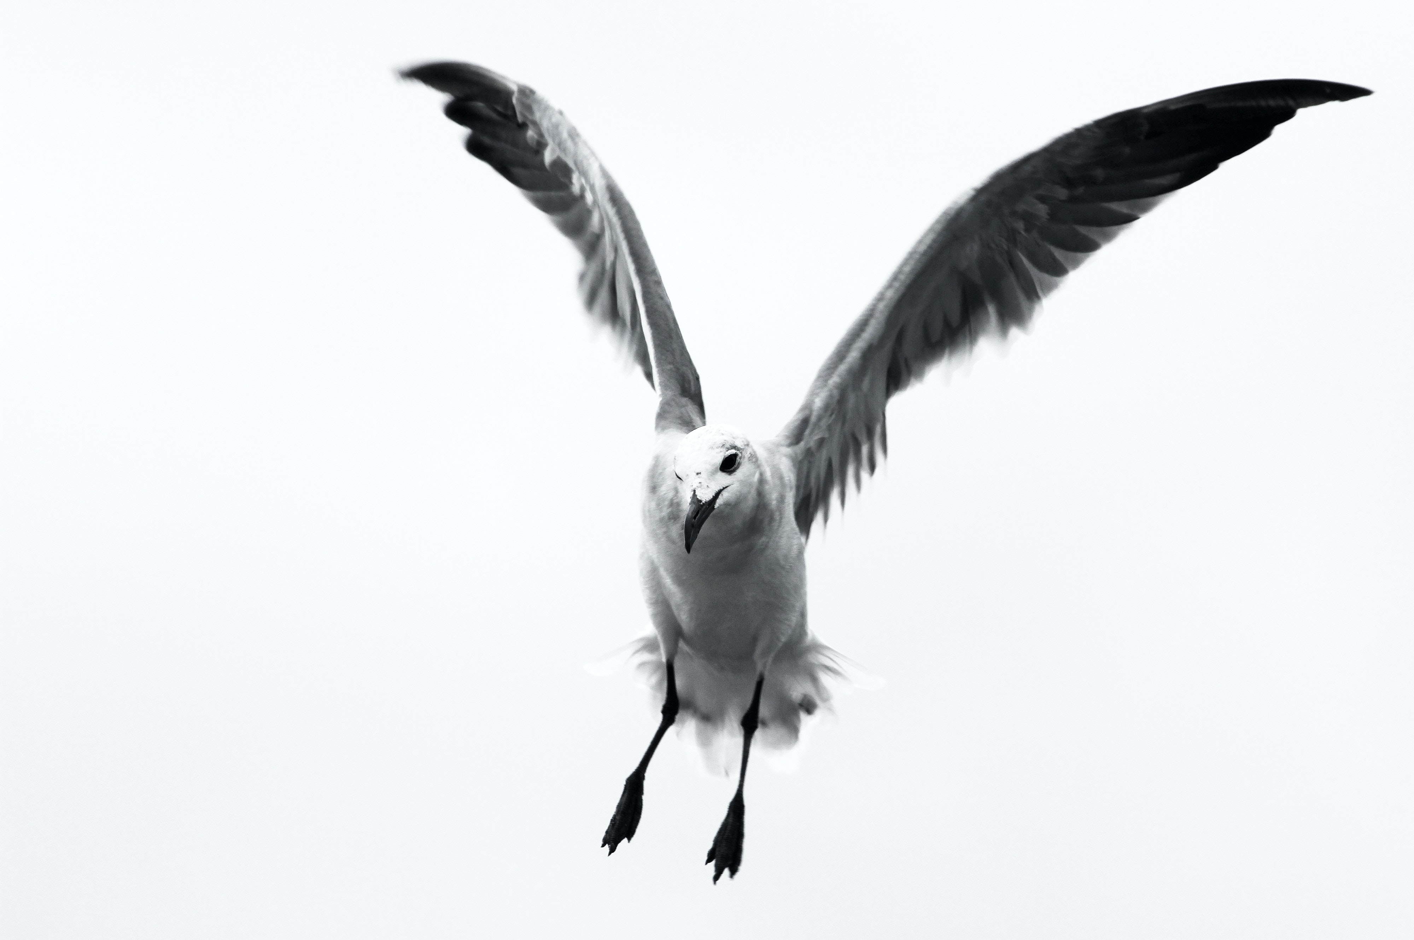

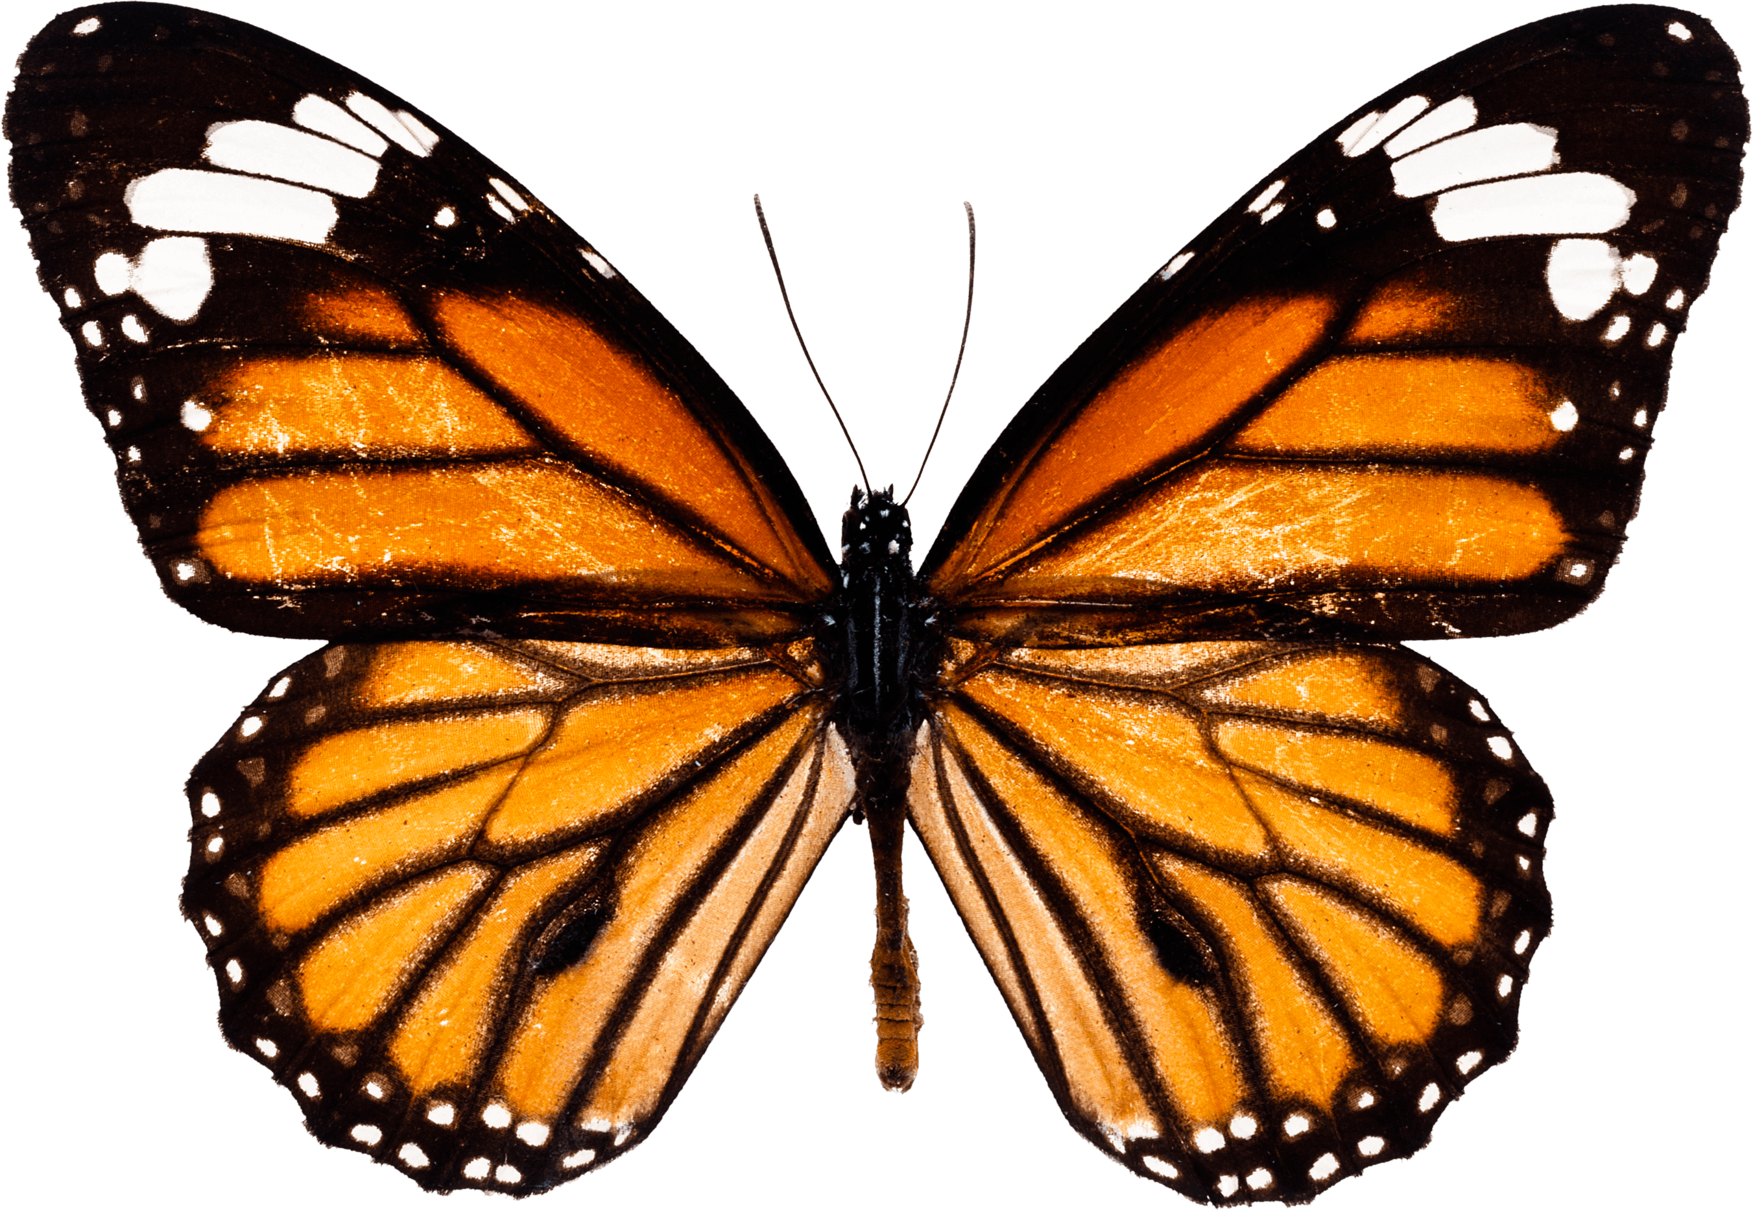

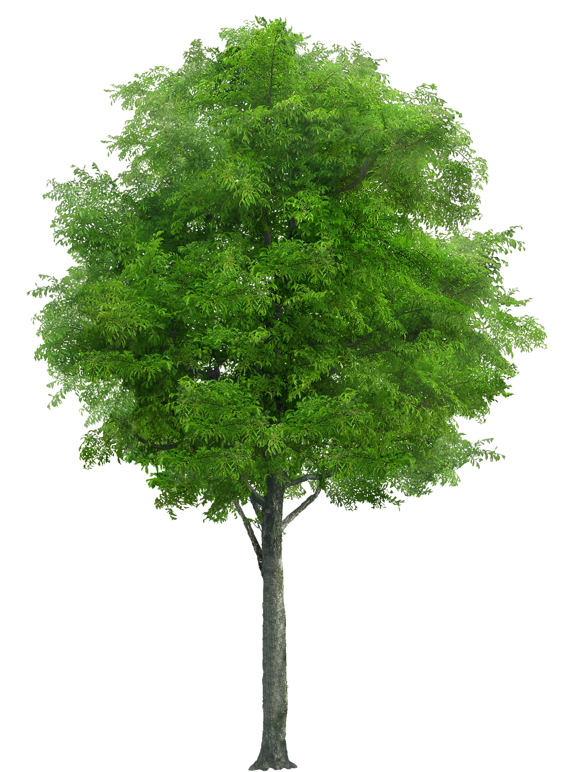
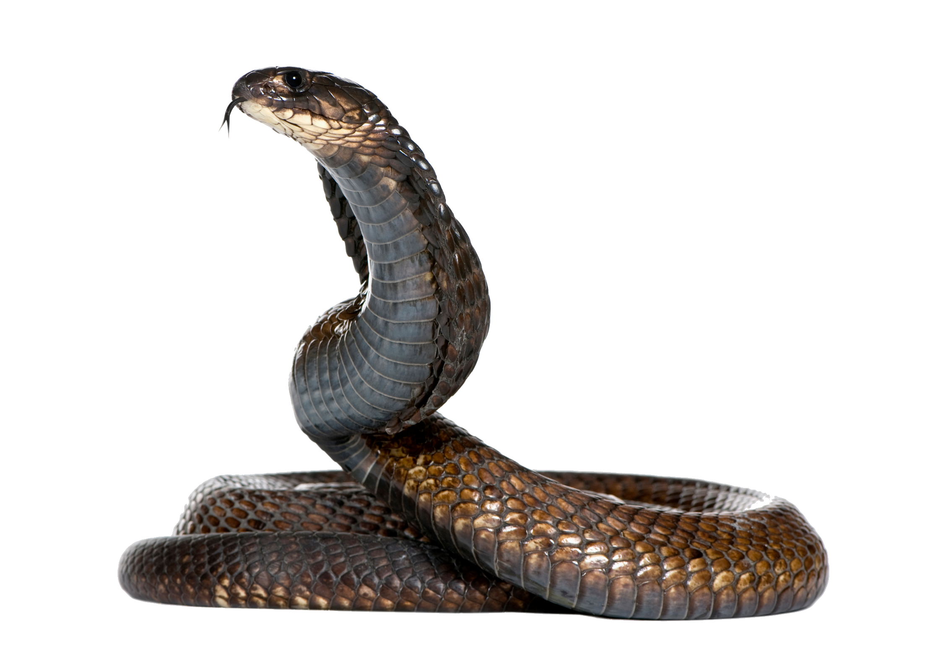
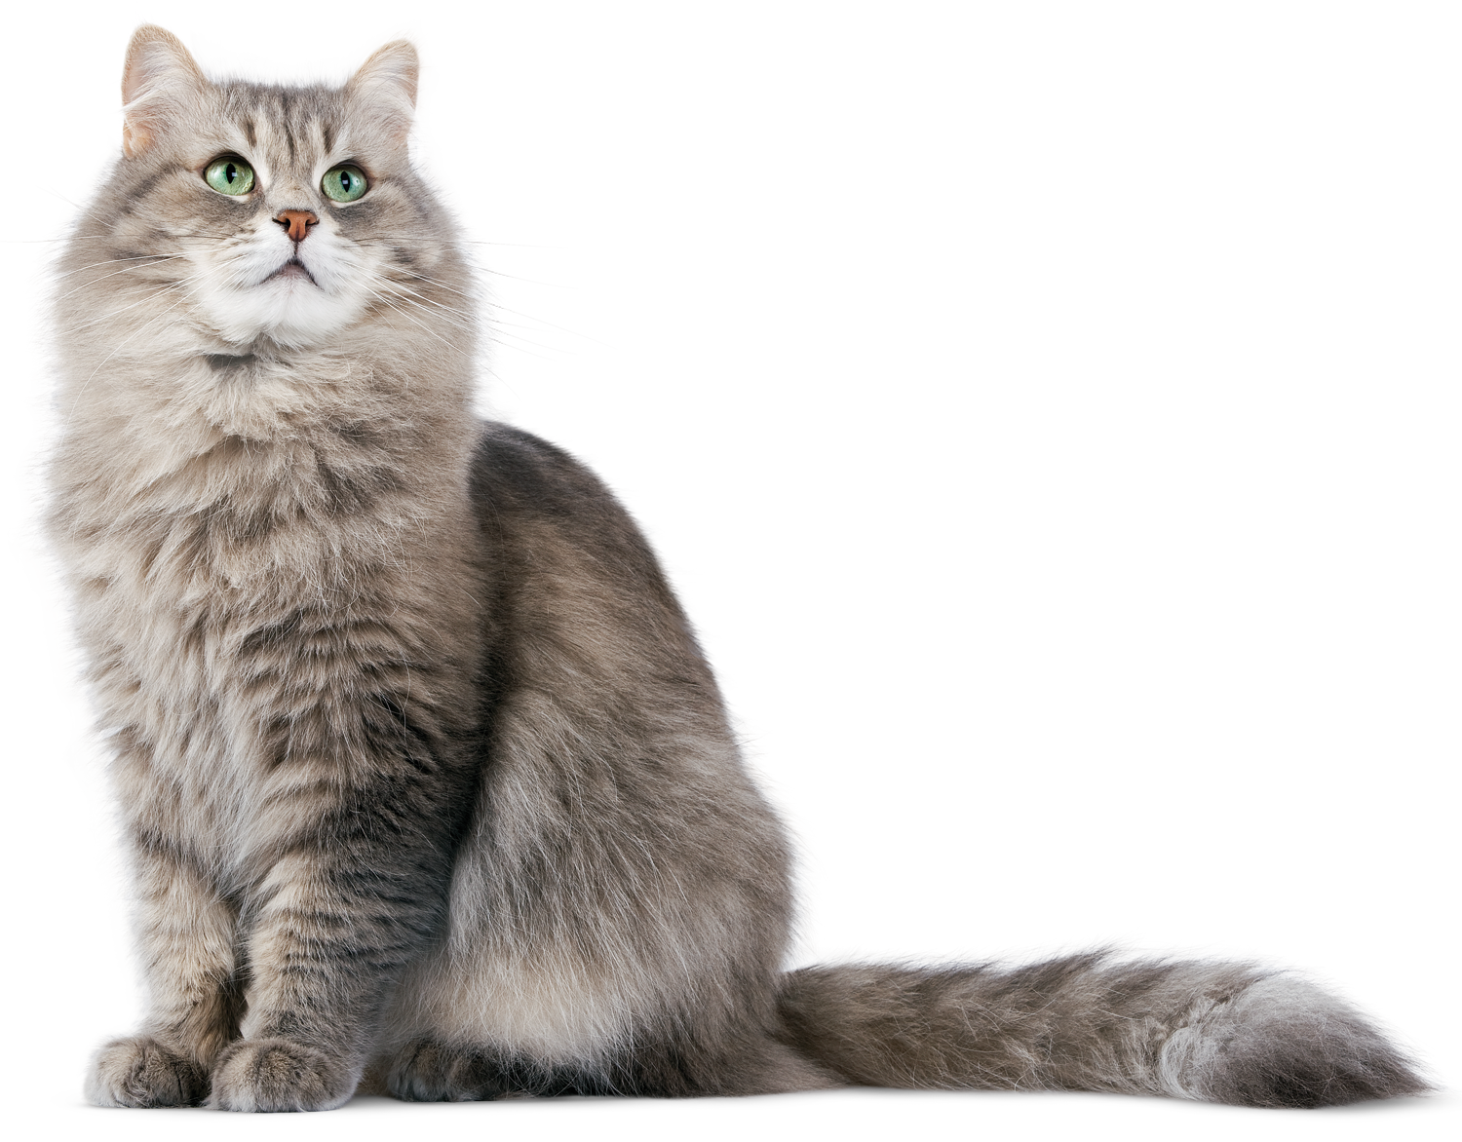
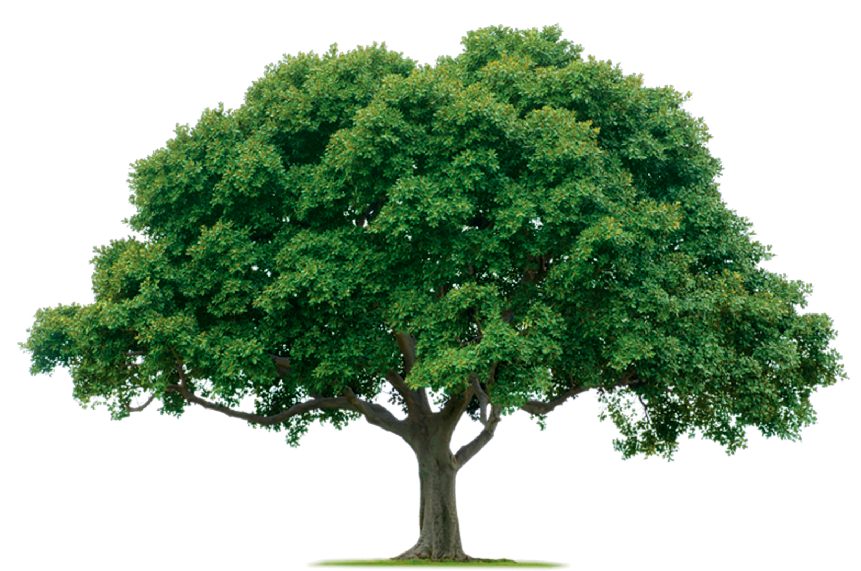
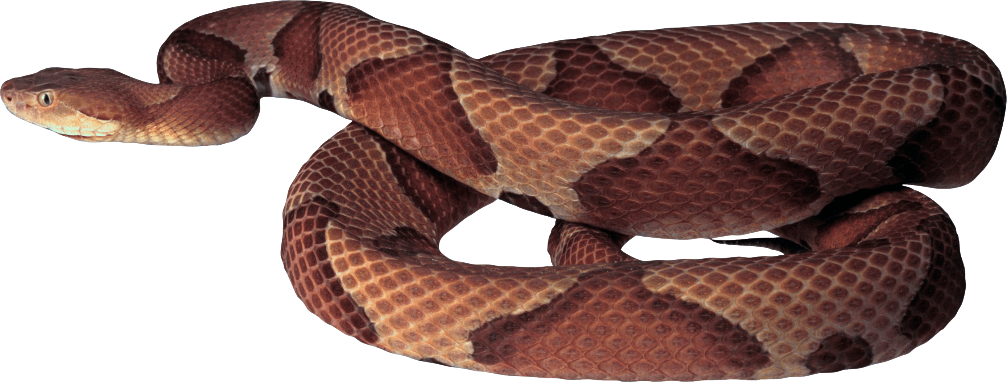


In-Distribution vs. Out-of-Distribution Generalization
In-distribution generalization: Training ensemble = Testing ensemble
Example task: Classify animals vs. plants
Training data
Testing
Notes:
To illustrate this. Consider the task of trying to classify images to say whether they contain an animal or a plant. In this case both the testing a training ensembles would contain lots of images of a mix of different plants and animals.

Slide 92

In-Distribution vs. Out-of-Distribution Generalization
In-distribution generalization: Training ensemble = Testing ensemble
Example task: Quantum process learning
Training data
Testing
Notes:
Or in the case of quantum process learning, the inputs trained on and tested on would look pretty similar.

Slide 93
In-Distribution vs. Out-of-Distribution Generalization
In-distribution generalization: Training ensemble = Testing ensemble
Example task: Quantum process learning
Training data
Testing
(To the best of our knowledge all prior results on generalization in QML are on in-distribution generalization)
Notes:
To the best of our knowledge all prior results on generalization in QML are on in-distribution generalization….

Slide 94
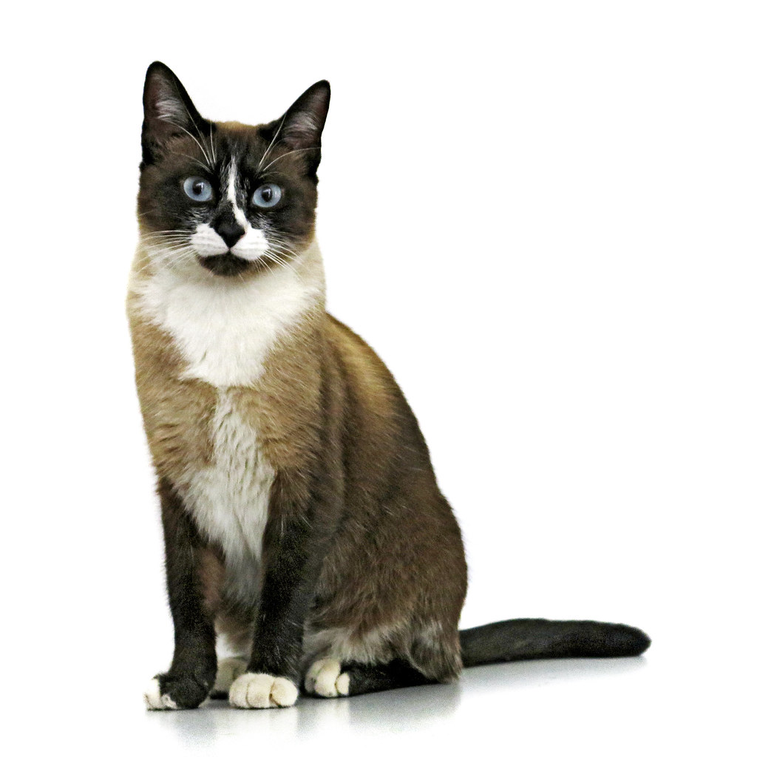

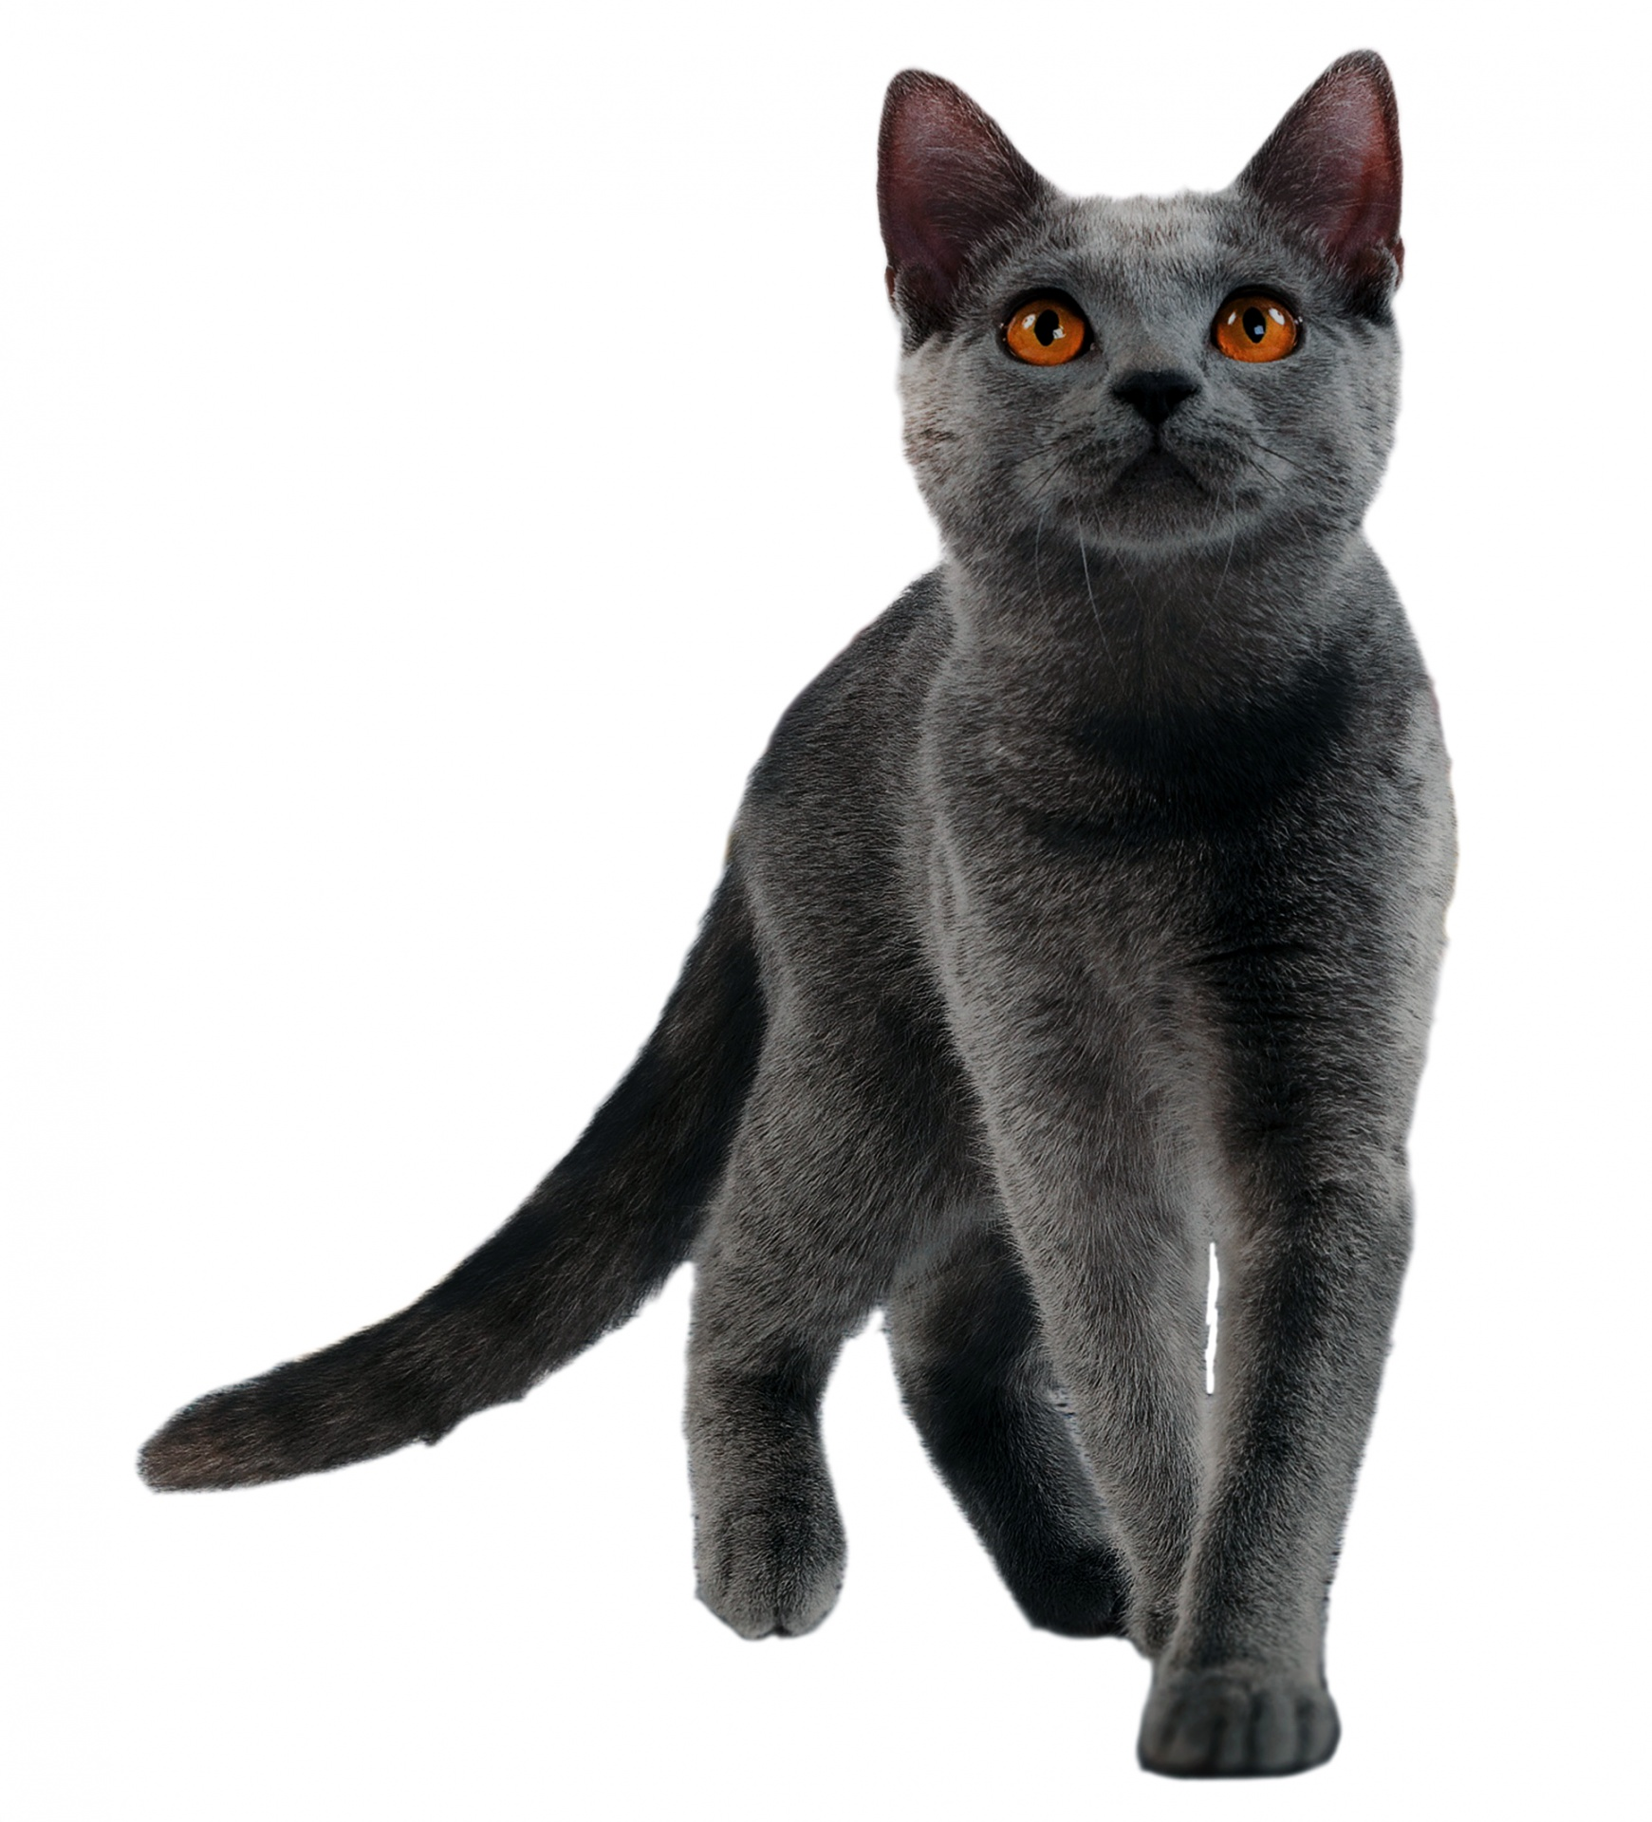



In-Distribution vs. Out-of-Distribution Generalization
Out-of-distribution generalization: Training ensemble $≠$ Testing ensemble
Example task: Classify animals vs. plants
Training data
Testing
Caterpillar = cat or cactus?
(In general would expect this not to work… But would be good if it did so we decided to investigate)
Notes:
So we decided to look at out-of-dist gen where the training and testing ensembles are different. In general one would expect this not to work… I
Imagine again trying to classfy animals vs plants but only training on images of cats and cactuses.
If you then tested your classifier on a picture of a caterpillar it’s likely to struggle!

Slide 95
In-Distribution vs. Out-of-Distribution Generalization
Out-of-distribution generalization: Training ensemble $≠$ Testing ensemble
Example task: Quantum process learning
Training data
Testing
What is the effect of the process on this input?
(In general would expect this not to work… But would be good if it did so we decided to investigate)
Notes:
Or, pictorially, in the case of process learning you might feed in only one ‘sort’ of input (here shown as all red) and then try and test it on a different sort of input (i.e. a blue one)
Is this going to work? Not obviously…. But it could be good if it did so we decided to investigate.

Slide 96
Out-of-distribution generalization
Out-of-distribution generalization: Training ensemble $≠$ Testing ensemble
Why would this be useful?
Our test ensemble might include states that are hard to handle!
So beneficial to use a different (easier!) training ensemble
e.g.
Require deep circuits
Complex gates
Need lots of entanglement
…
Notes:
Why would this be useful?
Well our test ensemble might include states that are hard to handle
e.g. ones that require
Require deep circuits (which would be hard to implement on near term devices)
Complex (hard to implement) gates (which might stop you from learning if you are doing the learning with a bespoke experimental system with a limited gate set)
States that can’t be classically simulated (making classical compilation impossible)
So it may well be beneficial to use a different (easier!) training ensemble

Slide 97
Main result: Product to entangled state generalization
Out-of-distribution generalization is possible using only (relatively few) product states
Testing ensemble = (Haar) Uniform distribution of Quantum States
(e.g. typically highly entangled states)
Training ensemble: Random product states
Require deep circuits
Complete gate set
Need lots of entanglement
…
These states:
Can be prepared using single layer circuit
Require only single qubit gates
Notes:
Our main result was to prove that out of distribution can be possible for learning quantum unitaries.
Specifically product to entangled state generalization can be possible.
That is we suppose our testing ensemble is composed of random states. These states will typically be highly entangled. They cover the entire state space well by construction but require deep circuits to prepare, a complete gate set and can’t be classically simulated.
But our training ensemble are only random product states… which by construction are unentangled. This special subclass of states can be prepared using only a single layer or single qubit gates and can be classically simulated.

Slide 98
Main result: Product to entangled state generalization
Out-of-distribution generalization is possible using only (relatively few) product states
Testing ensemble = Random Quantum States (typically highly entangled states)
Training ensemble: Random product states
Number of trainable parameters in parameterized unitary
Average prediction error
over random states
Training cost using only product states
Number of training states
Notes:
Specifically we prove the following bound. This shows that the average prediction error over random states is upper bounded by the training cost for training using only product states and a correction term that scales as sqrt( T log(T) / N) where T is the number of trainable parameters in the parameteized unitary (i.e. the number of angles, for example, you need to optimize) and N is the number of training states.
So this shows that as long as you have enough training states, where ‘enough’ is not very many, just of the order of the number of trainable parameters you have and then if you train on product states to get the cost low enough you will have automatically well learnt the action of the target unitary on any random state.

Slide 99
Main result: Product to entangled state generalization
Out-of-distribution generalization is possible using only (relatively few) product states
Number of trainable parameters in parameterized unitary
Expected risk
over random states
Training cost using only product states
Number of training states
Punchline: Can learn to predict the effect of a quantum process on any randomly chosen state, after only studying its effect on easy to prepare unentangled states
Notes:
That is, the punchline is that it’s possible to learn to predict the effect of a quantum process on any randomly chosen state, after only studying its effect on easy to prepare unentangled states

Slide 100
Main result: Product to entangled state generalization
Out-of-distribution generalization is possible using only (relatively few) product states
Number of trainable parameters in parameterized unitary
Expected risk
over random states
Training cost using only product states
Number of training states
Punchline: Can learn to predict the effect of a quantum process on any randomly chosen state, after only studying its effect on easy to prepare unentangled states
… which makes learning quantum processes much easier!

Slide 101









Quantum process learning Applications
Use 1: To better characterize an experimental system ( ~ algorithmic version of quantum sensing)
Quantum Computer
Learn a digitalization of an analogue quantum process
is a parameterized quantum circuit
Experimental quantum process
$$θ_{1}$$
$$θ_{4}$$
$$θ_{5}$$
e.g. studying effect of laser pulse in an optical lattice
$$θ_{3}$$
$$θ_{2}$$
Notes:
Ok, I say it makes learning quantum processes easier… but why would we want to do that in the first place?
Well firstly it could be used to learn an unknown experimental quantum process in order to be able to characterize that experimental system.
In this case U would be the unknown dynamics of some closed quantum system.
And the parameterized unitary would be a parameterized quantum set.
so essentially this would amount to learning a digitalization of an analogue quantum process.
For example, one could use this type of approach to perhaps study the effect of a laser pulse in an optical lattice.

Slide 102
Quantum process learning Applications
Use 1: To better characterize an experimental system ( ~ algorithmic version of quantum sensing)
Quantum Computer
Learn a digitalization of an analogue quantum process
is a parameterized quantum circuit
Experimental quantum process
$$θ_{1}$$
$$θ_{4}$$
$$θ_{5}$$
e.g. studying effect of laser pulse in an optical lattice
$$θ_{3}$$
$$θ_{2}$$
Learning on easy to prepare product states makes this application more near term. Experimentalists we’ve spoken to about this are pretty happy about the idea they could get away with just single qubit rotations to prepare their training data…
Notes:
And if this learning could be done using only product states then it’d be less noisy and easier to do on near term devices.

Slide 103
Quantum process learning Applications
Use 2: Compilation (either on a quantum computer or fully classically)
Quantum Computer
Product states induce less noise to generate (unlike typical random states) due to their shorter depth
In this case:
Target unitary is known
And parameterized circuit is designed to replicate using a particular structured form
Is useful for a particular purpose e.g. for quantum simulation
Notes:
If you are doing quantum compilation, product states induce less noise making compilation easier on near term devices.
Alternatively, if you are working classically (and trying to compile a classically simulable unitary) then you are not going to be able to compile them using typical random states because these are not classically simulable. Product states on the other hand are… making the whole compilation tractable classically.

Slide 104
Application to Dynamical Simulation
Why simulate quantum systems?
Quantum Chemistry
Material Simulation
Pharmaceutical development
Designing room temperature superconductors
Basic Science
Technological applications
Notes:
First things first, why simulate quantum systems?

Slide 105
Application to Dynamical Simulation
Why simulate quantum systems?
Quantum Chemistry
Material Simulation
Pharmaceutical development
Designing room temperature superconductors
Why use a quantum algorithm?
Classical simulations of entangled quantum systems grow exponentially with system size.
(Approximate methods for classical simulation of dynamics are not well developed compared to those for energetic structure computations).
Dynamical Simulation
Basic Science
Technological applications

Slide 106

Trotterisation based simulation
Approximate short time evolution using Trotter expansion
Approximate longer time evolution by applying the Trotter expansion iteratively.
S. Lloyd, Science, 273(5278), 1073-1078, 1996; A. Sornborger & E. Stewart, Phys. Rev. A, 60; 1956-1965,1999.
Notes:
You start with the Hamiltonian of the system you are interested in and approximate the short time unitary evolution using the Trotter expansion. To first order this amounts to dropping all terms in the exponential of the Hamiltonian that result from non commutivity.
You can then simulate longer time evolutions by applying the Trotter expansion iteratively, i..e. simulate up to time t by applying the expansion N times where t = N dt.
This is sketched at the bottom of the slide. You calculate some initial gate sequence to simulate a short time evolution… and then repeatedly apply that sequence.
Trotterisation has been used to simulate quantum systems (both classically and quantum mechanically) for many years. However it has a number of limitations…

Slide 107
Trotterisation based simulation
Approximate short time evolution using Trotter expansion
Approximate longer time evolution by applying the Trotter expansion iteratively.
“Coherence Time”
Limited by decoherence and gate infidelities
S. Lloyd, Science, 273(5278), 1073-1078, 1996; A. Sornborger & E. Stewart, Phys. Rev. A, 60; 1956-1965,1999.
Notes:
You start with the Hamiltonian of the system you are interested in and approximate the short time unitary evolution using the Trotter expansion. To first order this amounts to dropping all terms in the exponential of the Hamiltonian that result from non commutivity.
You can then simulate longer time evolutions by applying the Trotter expansion iteratively, i..e. simulate up to time t by applying the expansion N times where t = N dt.
This is sketched at the bottom of the slide. You calculate some initial gate sequence to simulate a short time evolution… and then repeatedly apply that sequence.
Trotterisation has been used to simulate quantum systems (both classically and quantum mechanically) for many years. However it has a number of limitations…

Slide 108

Solution: Diagonalise the Trotter Unitary
Diagonalize initial Trotter unitary:
Then there is no need to apply it iteratively:
Rotation into eigenbasis
Diagonal matrix
“Coherence Time”
Notes:
Our proposed solution is to diagonalise the initial trotter unitary. i.e. write it in the form W D W^\dagger where the matrix W is a rotation matrix into the eigenbasis and D is a diagonal matrix.
Then there is no need to apply the unitary iteratively, rather the “fast forwarding” can be done by hand simply by multiplying the rotation angles of the diagonal matrix (i.e. the gammas) by N.
This is sketched at the bottom of the slide. The resultant gate sequence does not scale with N and so can remain within the coherence time of the QC.

Slide 109
Solution: Diagonalise the Trotter Unitary
Diagonalise initial Trotter unitary:
Then there is no need to apply it iteratively:
Rotation into eigenbasis
Diagonal matrix
What does any of this have to do with out-of-distribution generalization?
“Coherence Time”
Notes:
Our proposed solution is to diagonalise the initial trotter unitary. i.e. write it in the form W D W^\dagger where the matrix W is a rotation matrix into the eigenbasis and D is a diagonal matrix.
Then there is no need to apply the unitary iteratively, rather the “fast forwarding” can be done by hand simply by multiplying the rotation angles of the diagonal matrix (i.e. the gammas) by N.
This is sketched at the bottom of the slide. The resultant gate sequence does not scale with N and so can remain within the coherence time of the QC.

Slide 110
Diagonalize the unitary using Quantum Machine Learning
We can take advantage of our results on product to entangled state generalization to make our lives easier!
Notes:
So just to spell out in a little more detail how these work…
This results in an optimization loop of the type sketched on the slide.
You tell the quantum computer to run some circuit (a parameterized quantum circuit) to evaluate a cost function with a particular set of parameters.
The quantum computer runs that circuit and spits out the measured cost function for that set of parameters.
Then then classical computer decides which parameters to try next and tells the quantum computer which circuit to run.
You then keep on looping around until you’ve minimised the cost function. The parameters which minimize the cost function will be a solution to the problem.
So to diagonlise a unitary in this way, what you need to do is to pick a cost function such that the unitary that minimizes it matches the target (i.e. the Trotter unitary for the system you want to simulate)
And design you parameterized quantum circuit such that it is always in a diagonal form.

Slide 111
Diagonalize the unitary using Quantum Machine Learning
Pick parameterized quantum circuit such that it is always in a diagonal form
Train on product states to match the Trotter unitary .
Notes:
So just to spell out in a little more detail how these work…
This results in an optimization loop of the type sketched on the slide.
You tell the quantum computer to run some circuit (a parameterized quantum circuit) to evaluate a cost function with a particular set of parameters.
The quantum computer runs that circuit and spits out the measured cost function for that set of parameters.
Then then classical computer decides which parameters to try next and tells the quantum computer which circuit to run.
You then keep on looping around until you’ve minimised the cost function. The parameters which minimize the cost function will be a solution to the problem.
So to diagonlise a unitary in this way, what you need to do is to pick a cost function such that the unitary that minimizes it matches the target (i.e. the Trotter unitary for the system you want to simulate)
And design you parameterized quantum circuit such that it is always in a diagonal form.

Slide 112
Diagonalize the unitary using Quantum Machine Learning
Pick parameterized quantum circuit such that it is always in a diagonal form
Train on product states to match the Trotter unitary .
(Product states!)
i.e. aim to minimize the cost
Notes:
So just to spell out in a little more detail how these work…
This results in an optimization loop of the type sketched on the slide.
You tell the quantum computer to run some circuit (a parameterized quantum circuit) to evaluate a cost function with a particular set of parameters.
The quantum computer runs that circuit and spits out the measured cost function for that set of parameters.
Then then classical computer decides which parameters to try next and tells the quantum computer which circuit to run.
You then keep on looping around until you’ve minimised the cost function. The parameters which minimize the cost function will be a solution to the problem.
So to diagonlise a unitary in this way, what you need to do is to pick a cost function such that the unitary that minimizes it matches the target (i.e. the Trotter unitary for the system you want to simulate)
And design you parameterized quantum circuit such that it is always in a diagonal form.

Slide 113
Diagonalize the unitary using Quantum Machine Learning
Pick parameterized quantum circuit such that it is always in a diagonal form
Train on product states to match the Trotter unitary .
(Product states!)
i.e. aim to minimize the cost
Can be rewritten in terms of the average fidelity
Notes:
So just to spell out in a little more detail how these work…
This results in an optimization loop of the type sketched on the slide.
You tell the quantum computer to run some circuit (a parameterized quantum circuit) to evaluate a cost function with a particular set of parameters.
The quantum computer runs that circuit and spits out the measured cost function for that set of parameters.
Then then classical computer decides which parameters to try next and tells the quantum computer which circuit to run.
You then keep on looping around until you’ve minimised the cost function. The parameters which minimize the cost function will be a solution to the problem.
So to diagonlise a unitary in this way, what you need to do is to pick a cost function such that the unitary that minimizes it matches the target (i.e. the Trotter unitary for the system you want to simulate)
And design you parameterized quantum circuit such that it is always in a diagonal form.

Slide 114
Diagonalize the unitary using Quantum Machine Learning
Pick parameterized quantum circuit such that it is always in a diagonal form
Train on product states to match the Trotter unitary .
i.e. aim to minimize the cost
(Product states!)
Can be rewritten in terms of the average fidelity
Using product states to train makes it easy to evaluate on a quantum computer…
Notes:
So just to spell out in a little more detail how these work…
This results in an optimization loop of the type sketched on the slide.
You tell the quantum computer to run some circuit (a parameterized quantum circuit) to evaluate a cost function with a particular set of parameters.
The quantum computer runs that circuit and spits out the measured cost function for that set of parameters.
Then then classical computer decides which parameters to try next and tells the quantum computer which circuit to run.
You then keep on looping around until you’ve minimised the cost function. The parameters which minimize the cost function will be a solution to the problem.
So to diagonlise a unitary in this way, what you need to do is to pick a cost function such that the unitary that minimizes it matches the target (i.e. the Trotter unitary for the system you want to simulate)
And design you parameterized quantum circuit such that it is always in a diagonal form.

Slide 115


The Resource Efficient
Fast Forwarding Algorithm
(REFF)
(A) Input:
(B) Trotter expansion
(C) Unitary Diagonalization using Compiling Cost
Gradient descent optimization loop
Evaluate
Gradients:
Update
Parameters:
Evaluate
Cost:
Termination condition
(D) Output: Fast Forwarded Simulation
Notes:
This is a summary of the algorithm.

Slide 116

Can use generalization results to bound final simulation fidelity
Number of fast-forwarding steps
Final cost function value
Final simulation fidelity
Correction term depending on the number of trainable parameters and training states
Notes:
This is a summary of the algorithm.

Slide 117
Numerical Implementation
XY Spin Chain:
Risk
Perfect alignment between dotted and solid lines indicates perfect alignment between training cost and risk.
i.e. learning diagonalization on product state(s) suffices to learn diagonalization on all states.
Notes:
Here’s some numerical simulations showing that it works in theory. So we simulated the XY spin chain. Z_i and X_i are the Z and X spin operators acting on the ith qubit in the chain.
The data shown here is for a 5 qubit spin chain.
We plot the fidelity of the simulation as a function of time for VFF for a noisy simulation with the cost minimized to lower and lower cost values. You can see that once we get the cost down to 10^-3 we can simulate for up to 100 time steos with a fidelity of over 0.8. Where as the Trotter approach only works for a handful of time steps.
Then did the same on real hardware. On the left in blue is the raw data from the quantum computer as the cost is iteratively minimized and in green is the corresponding noiseless cost for the parameters at each step. On the right is the fidelity of the simulation as a function of time. As you can see VFF substantially outperforms the iterated Trotter method,

Slide 118
Numerical Implementation
XY Spin Chain:
Risk
Simulation error after M time steps
Notes:
Here’s some numerical simulations showing that it works in theory. So we simulated the XY spin chain. Z_i and X_i are the Z and X spin operators acting on the ith qubit in the chain.
The data shown here is for a 5 qubit spin chain.
We plot the fidelity of the simulation as a function of time for VFF for a noisy simulation with the cost minimized to lower and lower cost values. You can see that once we get the cost down to 10^-3 we can simulate for up to 100 time steos with a fidelity of over 0.8. Where as the Trotter approach only works for a handful of time steps.
Then did the same on real hardware. On the left in blue is the raw data from the quantum computer as the cost is iteratively minimized and in green is the corresponding noiseless cost for the parameters at each step. On the right is the fidelity of the simulation as a function of time. As you can see VFF substantially outperforms the iterated Trotter method,

Slide 119
Hardware Implementation
XY Spin Chain:
(Risk)
Notes:
Here’s some numerical simulations showing that it works in theory. So we simulated the XY spin chain. Z_i and X_i are the Z and X spin operators acting on the ith qubit in the chain.
The data shown here is for a 5 qubit spin chain.
We plot the fidelity of the simulation as a function of time for VFF for a noisy simulation with the cost minimized to lower and lower cost values. You can see that once we get the cost down to 10^-3 we can simulate for up to 100 time steos with a fidelity of over 0.8. Where as the Trotter approach only works for a handful of time steps.
Then did the same on real hardware. On the left in blue is the raw data from the quantum computer as the cost is iteratively minimized and in green is the corresponding noiseless cost for the parameters at each step. On the right is the fidelity of the simulation as a function of time. As you can see VFF substantially outperforms the iterated Trotter method,

Slide 120
Conclusions
Out-of-distribution generalization in QML
- Quantum processes can be learned using only product states
- Makes learning quantum processes much easier!
2) QML meets dynamical simulation
Introduce the Resource Efficient Fast Forwarding Algorithm.
Use generalization bounds to bound final simulation error
arXiv:2204.10268
“Coherence Time”
arXiv:2204.10269
Notes:
So just to spell out in a little more detail how these work…
This results in an optimization loop of the type sketched on the slide.
You tell the quantum computer to run some circuit (a parameterized quantum circuit) to evaluate a cost function with a particular set of parameters.
The quantum computer runs that circuit and spits out the measured cost function for that set of parameters.
Then then classical computer decides which parameters to try next and tells the quantum computer which circuit to run.
You then keep on looping around until you’ve minimised the cost function. The parameters which minimize the cost function will be a solution to the problem.
So to diagonlise a unitary in this way, what you need to do is to pick a cost function such that the unitary that minimizes it matches the target (i.e. the Trotter unitary for the system you want to simulate)
And design you parameterized quantum circuit such that it is always in a diagonal form.

Slide 121
Conclusions
Notes:
So just to spell out in a little more detail how these work…
This results in an optimization loop of the type sketched on the slide.
You tell the quantum computer to run some circuit (a parameterized quantum circuit) to evaluate a cost function with a particular set of parameters.
The quantum computer runs that circuit and spits out the measured cost function for that set of parameters.
Then then classical computer decides which parameters to try next and tells the quantum computer which circuit to run.
You then keep on looping around until you’ve minimised the cost function. The parameters which minimize the cost function will be a solution to the problem.
So to diagonlise a unitary in this way, what you need to do is to pick a cost function such that the unitary that minimizes it matches the target (i.e. the Trotter unitary for the system you want to simulate)
And design you parameterized quantum circuit such that it is always in a diagonal form.

Slide 122

Questions?
Notes:
So just to spell out in a little more detail how these work…
This results in an optimization loop of the type sketched on the slide.
You tell the quantum computer to run some circuit (a parameterized quantum circuit) to evaluate a cost function with a particular set of parameters.
The quantum computer runs that circuit and spits out the measured cost function for that set of parameters.
Then then classical computer decides which parameters to try next and tells the quantum computer which circuit to run.
You then keep on looping around until you’ve minimised the cost function. The parameters which minimize the cost function will be a solution to the problem.
So to diagonlise a unitary in this way, what you need to do is to pick a cost function such that the unitary that minimizes it matches the target (i.e. the Trotter unitary for the system you want to simulate)
And design you parameterized quantum circuit such that it is always in a diagonal form.

