Slide 1
Quantum Anomaly Detection for Collider Physics
Sulaiman Alvi^{1,2}, Christian Bauer¹, and Benjamin Nachman¹
Lawrence Berkeley National Laboratory
University of California, Berkeley

Slide 2
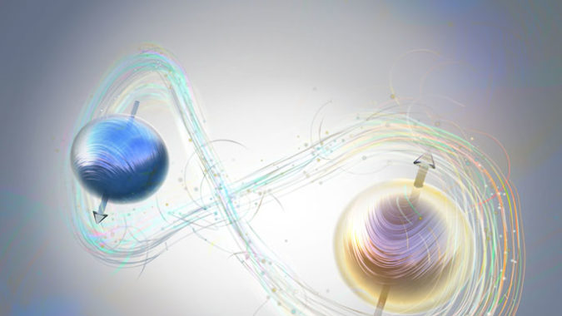
Outline
Current work on QML for classification in HEP
Our QML setups and HEP problem
Results and outlook

Slide 3
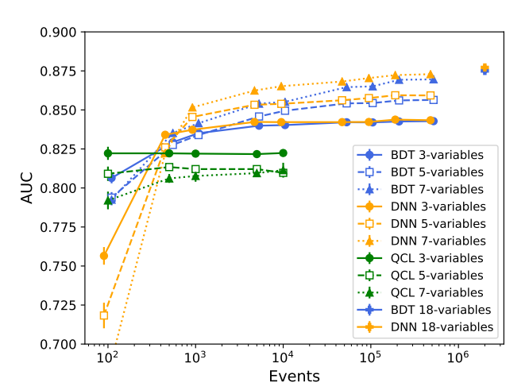
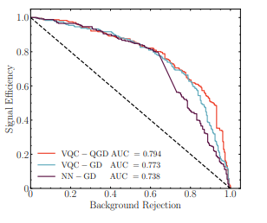
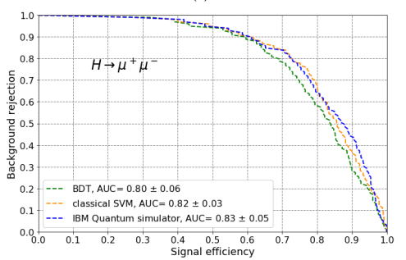
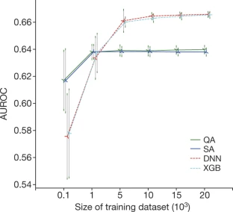
Existing Work on QML for Data-limited Classification
^{[1]}
^{Order of ~1,000 events [2]}
^{[3]}
^{Order of ~100 events [4]}
Terashi et. al., arXiv:2002.09935
Blance, Spannowsky, arXiv:2010.07335
Nature volume 550, p. 375–379 (2017)
Sau Lan Wu et. al, arXiv:2012.11560

Slide 4
Identifying a Suitable HEP Application for QML
Classification
Data-limited
Semi-supervised
Signal model-independent, relies on experiments
Data vs background

Slide 5
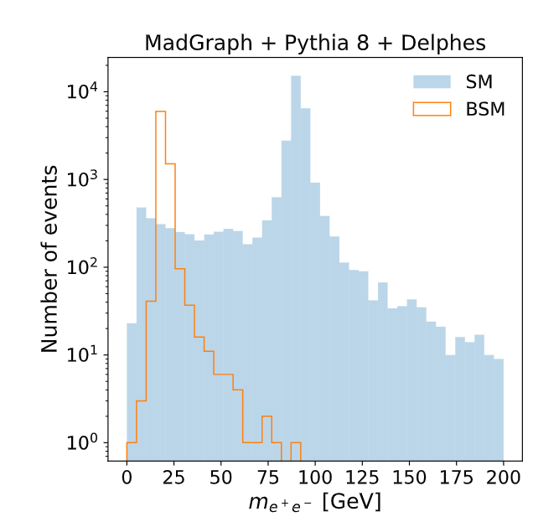
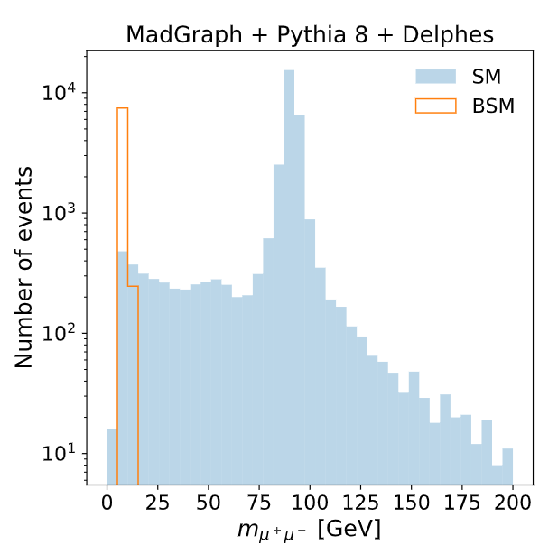
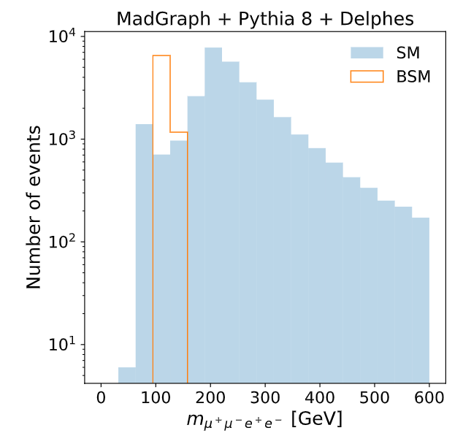
HEP Application
Four lepton final state
Background is well-understood
Rare process
Large parameter space
Higgs decaying into two scalars, three mass parameters
How data was simulated
Notes:
Test

Slide 6
QML Methods for Classification
QML for Classification
Variational Quantum Algorithms
Layers with trainable parameters
Quantum Support Vector Machine
Quantum kernel
VQA
QSVM
VQC
(QGD)
QCL
(QGD)

Slide 7
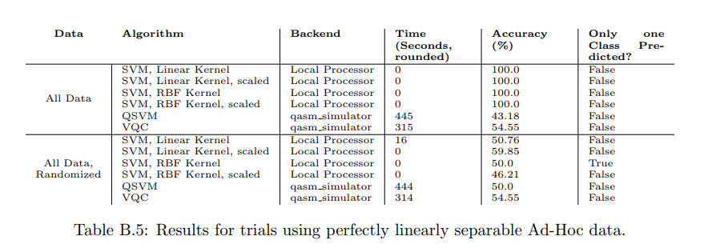
QSVM
Paul-Aymeric McRaea, Michael Hilke, arXiv:2012.03472v1

Slide 8
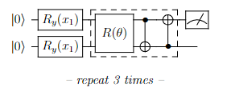
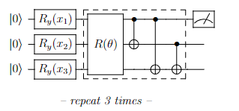
VQC Structure
Start with ground state
3 layers
Output measurement of <Z> on first qubit

Slide 9
QCL Structure
Start with ground state
3 layers
Output measurement of <Z> on first two qubits

Slide 10
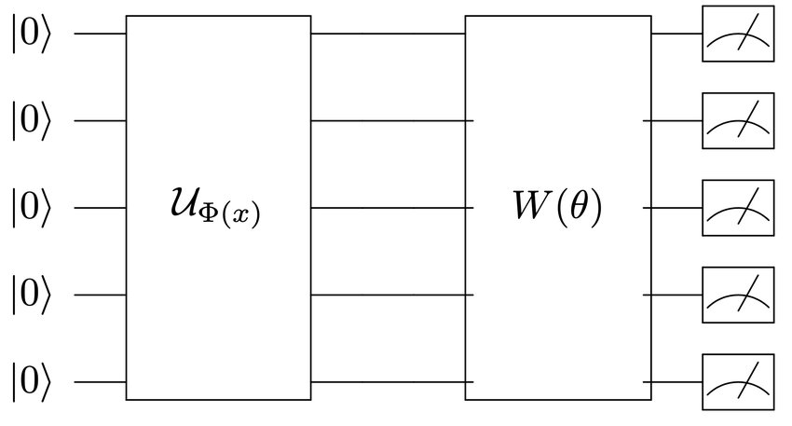
QML Method Parameters
Number of qubits
Input encoding
Circuit Depth
3 each
Number of iterations

Slide 11
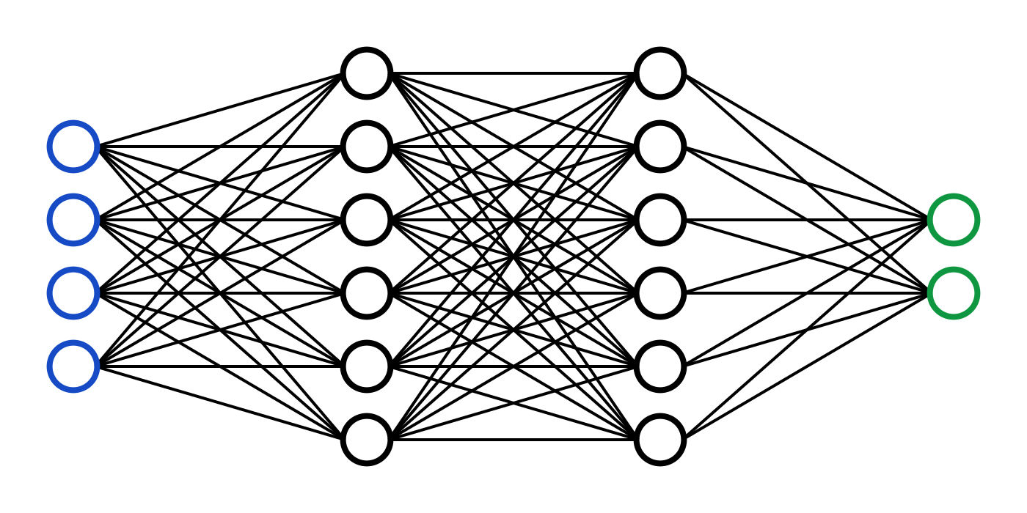
CML Method Parameters
Number of nodes
1x32 “NN low”, 2x32 “NN high”
Optimization algorithm
Number of iterations

Slide 12
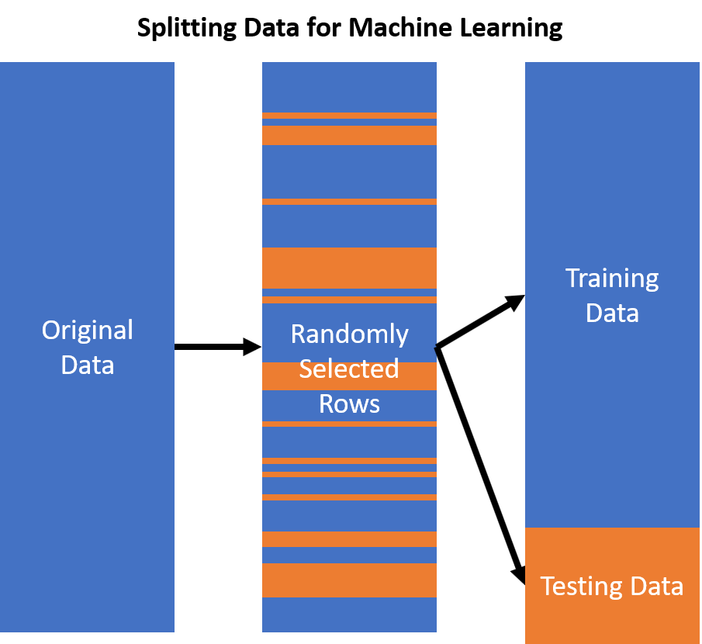
Testing
Trained on background vs signal and background
Tested on background vs signal
Fixed background and increased signal
Fixed signal to background and increased total number of events
8 datasets per signal to background ratio, 10 different tests/dataset
Averaged over signal events and network initializations

Slide 13
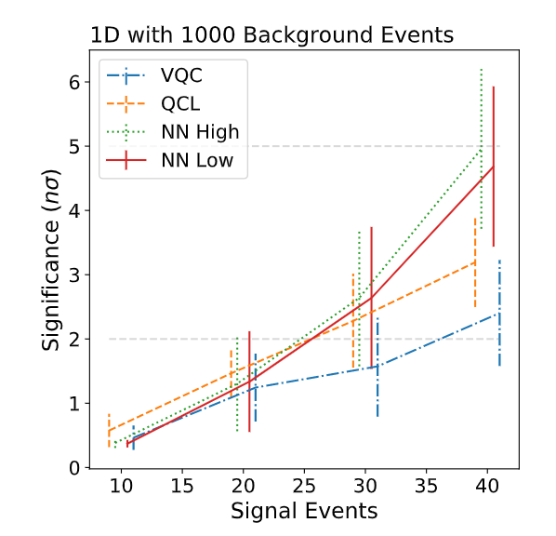
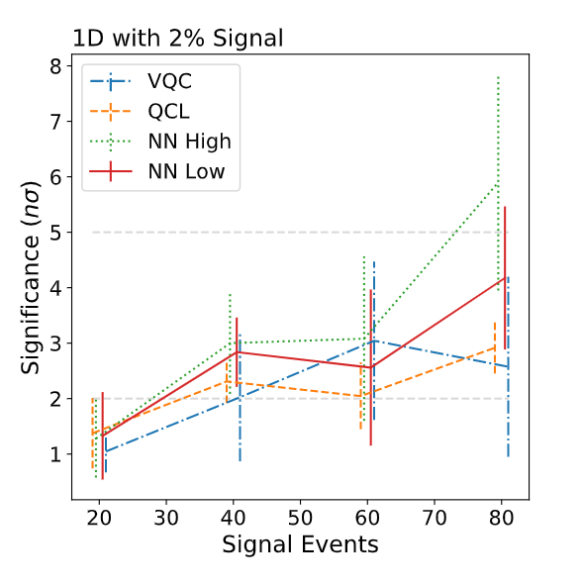
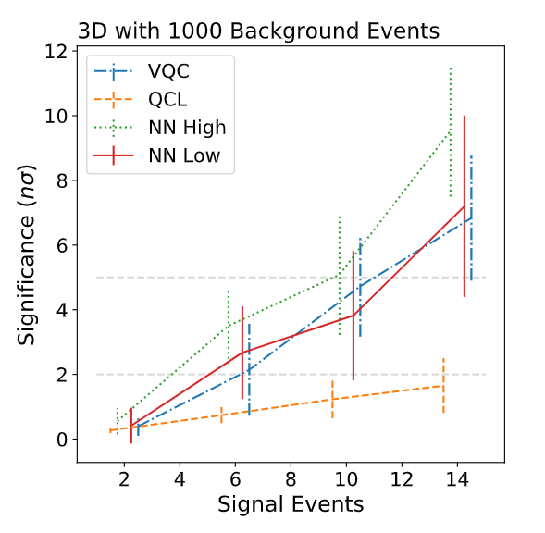
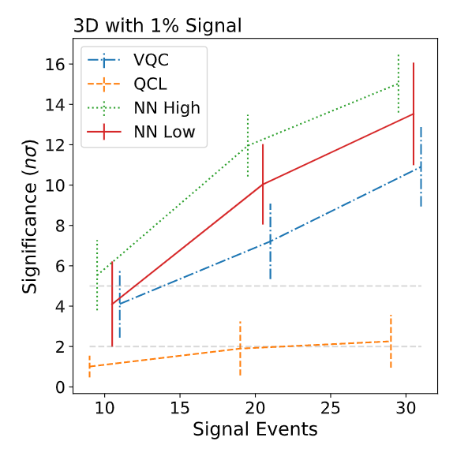
Results
Fixed background, increasing signal events (left, bottom left)
Fixed signal to background, increasing total events (right, top right)

Slide 14
Summary
Identified a problem where potential QML advantage could be applicable
Compared with realistically parameterized CML networks
Broader outlook
Consistent with past studies
No meaningful advantage
Helps contextualize previous work
Perhaps more potential for QC applications in simulation

Slide 15
Further Reading
Katarzyna Krzyżańska, Benjamin Nachman arXiv:2203.09601
Maria Schuld arXiv:2203.01340

