Slide 1
Implementation and Analysis of Quantum Search Methods for Higgs Boson Reconstruction at the LHC
Anthony Alexiades Armenakas
Dr. Keith Baker (Yale)

Slide 2
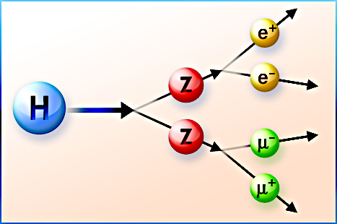
Introduction The Higgs Boson and its Decay Channels

Slide 3
Introduction The Higgs Boson and its Decay Channels
produced in high-energy proton-proton collisions at the LHC
quickly decays into products (γγ or ZZ → 4 leptons)
observed through detection of its products—commonly 4 leptons

Slide 4
Introduction The Higgs Boson and its Decay Channels
produced in high-energy proton-proton collisions at the LHC
quickly decays into products (γγ or ZZ → 4 leptons)
observed through detection of its products—commonly 4 leptons
LHC databases consist of large amount of detector data for millions of events (collisions) → costly analysis
calls for efficient alternatives to classically searching large, classical databases

Slide 5
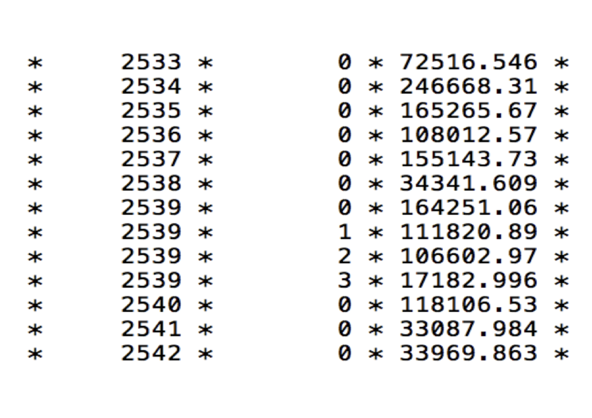
Introduction Quantum Searches for the Higgs Boson
Quantum computing (QC) may offer speedup in filtering, search, and analysis of LHC data
LHC databases can be searched for 4-lepton events using quantum search algorithm — Grover’s algorithm
Part of an ATLAS open database of recorded leptons

Slide 6
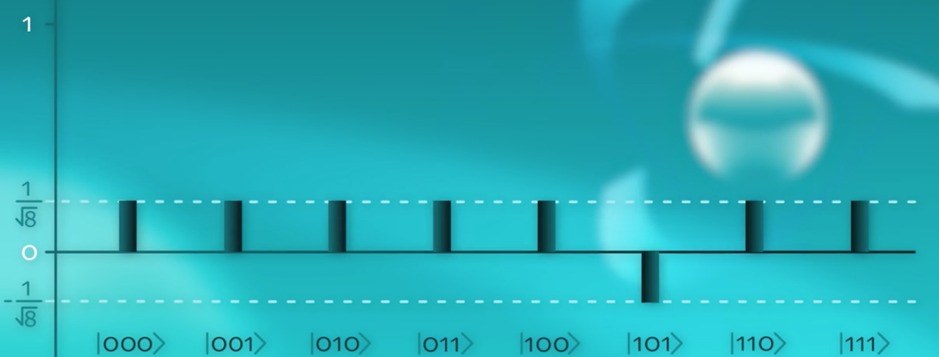
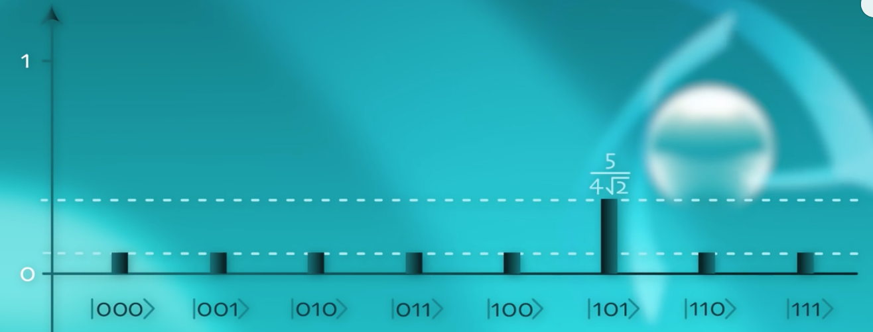
Grover’s Quantum Algorithm
Amplifies the quantum state corresponding to the target entry
quantum register is measured to be in the target state with high probability
Start with equal superposition of data register (all values 0, 1, ... 2^n -1) encoded
quantum oracle marks target state from the 2^n state register, flipping its amplitude
diffusion operator then reflects all amplitudes about the mean, yielding an amplitude peak in the target state
Measure the quantum register — increased probability of measurement in the target state

Slide 7
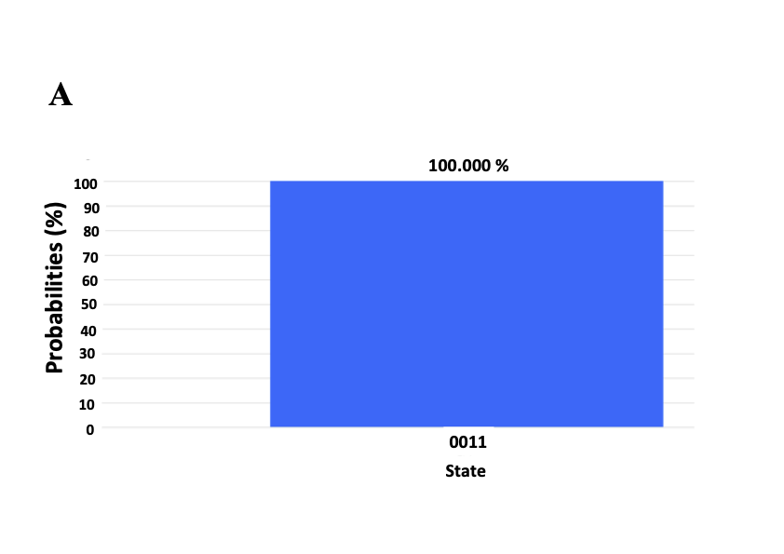
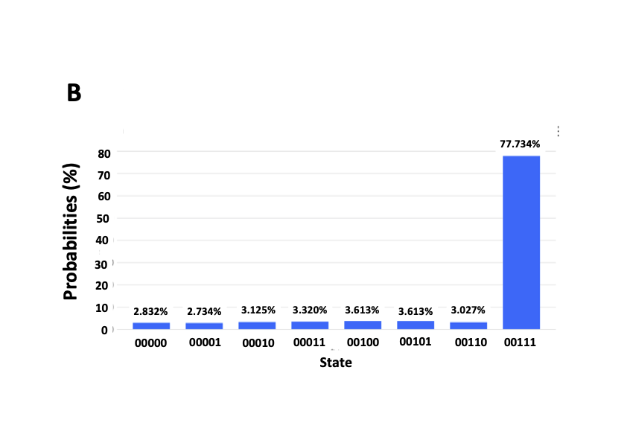
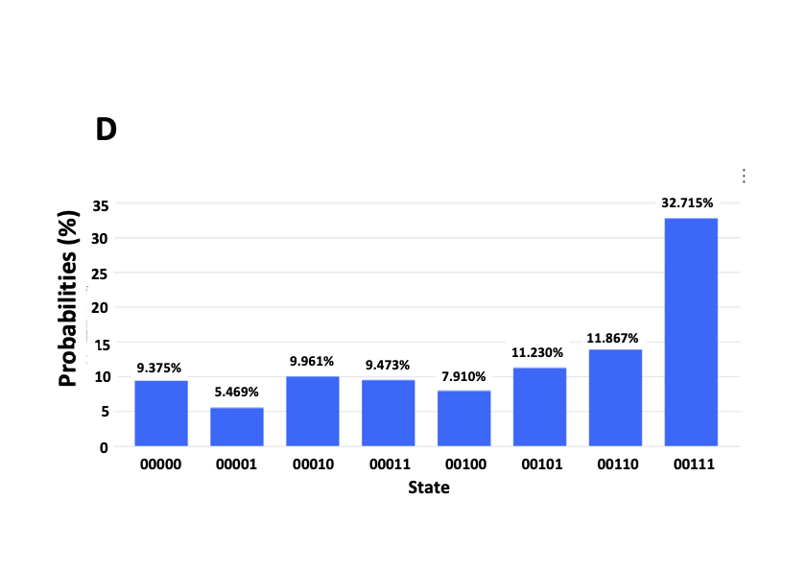
Results of Grover’s Algorithm on 2, 3, 4, and 5 qubits
IBMQ Simulator
IBM Quantum Computer
2 Qubits, marked state |11>
3 Qubits, marked state |111>

Slide 8
Optimal Number of Iterations
Histogram of QC Simulator Results for increasing iterations of 3-qubit GA
$\frac{π}{4}\sqrt{N}$ iterations optimize the algorithm
1
78%
2
95%
3
33%

Slide 9
Encoding Quantum Databases
Index Register
Value Register
Index and Value Register in entangled database
constructed using control gates, with index as control and value as target
Entangled

Slide 10
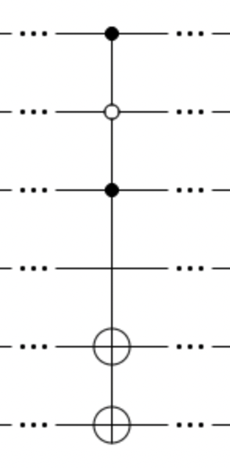
Encoding Quantum Databases
Index Register
Value Register
Index and Value Register in entangled database
constructed using control gates, with index as control and value as target
Entangled
Index Register
Value Register
Data entry (x = 101, f(x) = 011 in quantum form via control-NOT gates

Slide 11
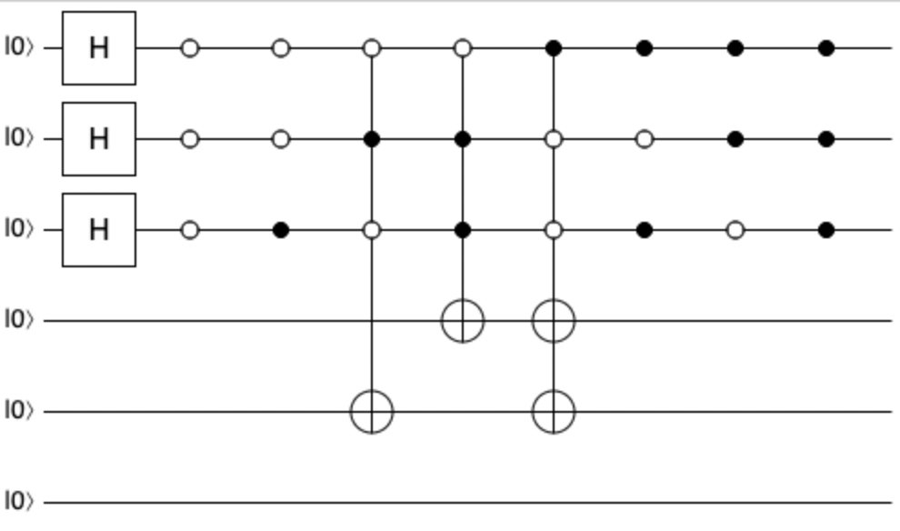
Encoding ATLAS Data into a Quantum Circuit
Index Register
Value Register
Index and Value Register in entangled database
constructed using control gates, with index as control and value as target
Entangled
Index Register
Value Register
Data entry (x = 101, f(x) = 011 in quantum form via control-NOT gates

Slide 12
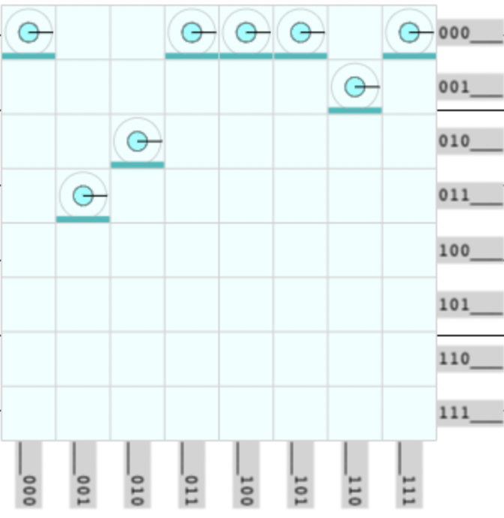
Encoding ATLAS Data into a Quantum Circuit
Value
Index
Representation of encoded 8-entry segment of database

Slide 13
Method
Index
Value

Slide 14
Method
0 1 2 3
00
10
01
11
Index
Value
10
01
11
00
Equal superposition of index register
1 2 3 0
Data Encoded into Quantum Database
*Convention: state |a b> describes state with qubit 0 in state b and qubit 1 in state a

Slide 15
Method
0 1 2 3
00
10
01
11
Index
Value
10
01
11
00
Equal superposition of index register
Oracle
1 2 3 0
Data Encoded into Quantum Database
Oracle marks the entangled target state $\text{|}\text{10} \text{1}\text{1}\text{>}$based on target value, shifting the phase of |01 11>
*Convention: state |a b> describes state with qubit 0 in state b and qubit 1 in state a
$$\frac{1}{2}\left(\text{|}\text{0}\text{0} \text{01}\text{>} +\text{|}\text{0}\text{1} \text{10}\text{>} +\text{|}\text{10} \text{1}\text{1}\text{>} +\text{|}\text{1}\text{1} \text{00}\text{>}\right) → \frac{1}{2}\left(\text{|}\text{0}\text{0} \text{01}\text{>} +\text{|}\text{0}\text{1} \text{1}\text{0}\text{>} \text{–}\text{|}\text{10} \text{1}\text{1}\text{>} +\text{|}\text{1}\text{1} \text{00}\text{>}\right)$$

Slide 16
Method
0 1 2 3
00
10
01
11
Index
Value
10
01
11
00
Equal superposition of index register
Oracle
Diffusion Operator
1 2 3 0
Inverts amplitudes about the mean, amplifying the amplitude of target state
Data Encoded into Quantum Database
Oracle marks the entangled target state |01 11> based on target value, shifting the phase of |01 11>
*Convention: state |a b> describes state with qubit 0 in state b and qubit 1 in state a
$\frac{1}{2}\left(\text{|}\text{0}\text{0} \text{1}\text{0}\text{>} +\text{|}\text{10} \text{01}\text{>} +\text{|}\text{01} \text{1}\text{1}\text{>} +\text{|}\text{1}\text{1} \text{00}\text{>}\right) → \frac{1}{2}\left(\text{|}\text{0}\text{0} \text{1}\text{0}\text{>} +\text{|}\text{10} \text{01}\text{>} \text{–}\text{|}\text{01} \text{1}\text{1}\text{>} +\text{|}\text{1}\text{1} \text{00}\text{>}\right)$ $→ \text{|}\text{10}\text{>}$

Slide 17
Method
0 1 2 3
00
10
01
11
Index
Value
10
01
11
00
Equal superposition of index register
Oracle
Diffusion Operator
Measurement
1 2 3 0
Inverts amplitudes about the mean, amplifying the amplitude of target state
Index Register is Measured, and bit value is index of target value (here, 3)
Data Encoded into Quantum Database
Oracle marks the entangled target state |01 11> based on target value, shifting the phase of |01 11>
*Convention: state |a b> describes state with qubit 0 in state b and qubit 1 in state a
$\frac{1}{2}\left(\text{|}\text{0}\text{0} \text{1}\text{0}\text{>} +\text{|}\text{10} \text{01}\text{>} +\text{|}\text{01} \text{1}\text{1}\text{>} +\text{|}\text{1}\text{1} \text{00}\text{>}\right) → \frac{1}{2}\left(\text{|}\text{0}\text{0} \text{1}\text{0}\text{>} +\text{|}\text{10} \text{01}\text{>} \text{–}\text{|}\text{01} \text{1}\text{1}\text{>} +\text{|}\text{1}\text{1} \text{00}\text{>}\right)$ $→ \text{|}\text{10}\text{>}$

Slide 18
Results
Index
Value
Yields the correct index for the desired value with 100% probability
Index qubits measured in state $\text{|}\text{10}\text{>}$ = |2> (corresponds to entry 2 in database)

Slide 19
Results: 3 Qubit Index Register
Yields the correct index for the desired value with 78.1% probability
Index qubits measured in state $\text{|}\text{100}\text{>}$ = |5> (corresponds to entry 5 in database)

Slide 20
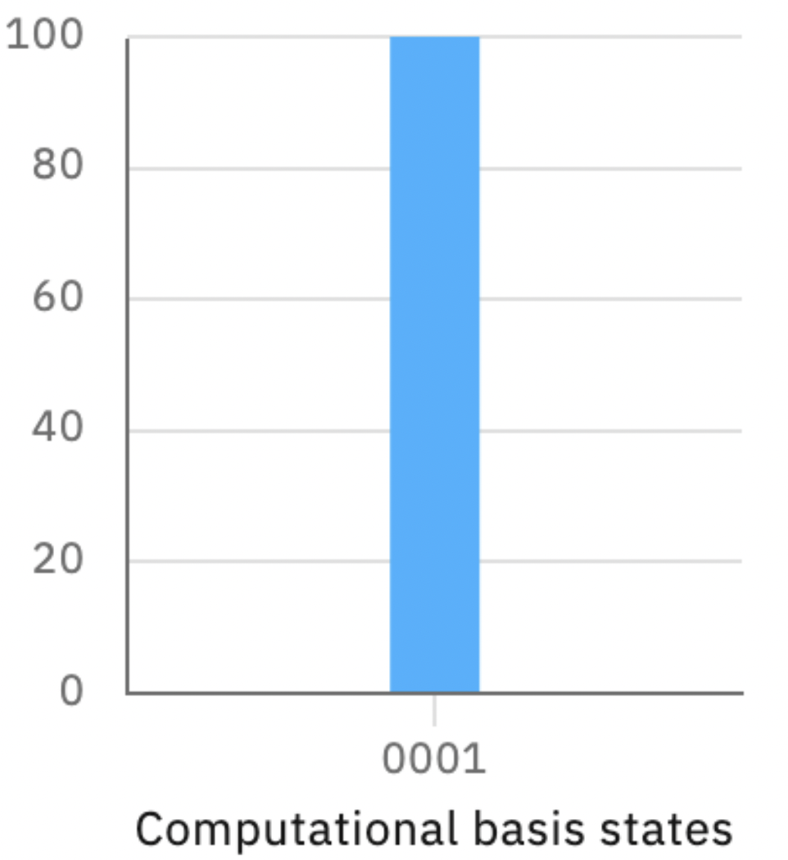
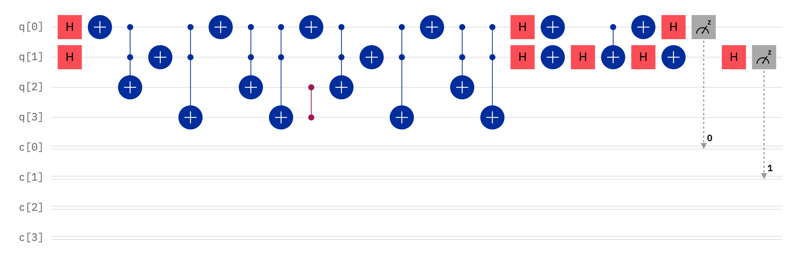
Results: IBM Qiskit
Quantum circuit implementing GA on quantum ATLAS Data
Transpiled circuit to run on IBMQ devices

Slide 21
Results: Searching the Entire Database
Iterate through database, searching portions at a time
Finds events (collisions) that produce 4 leptons with 100% probability (ignoring noise) and lower probability on real hardware
Successfully helps locate events in which the Higgs is likely to have been produced

Slide 22
Conclusions
A proof-of-concept that demonstrates the the theoretical viability of GA on quantum LHC databases
Description of and call for quantum LHC databases
100% success rate of Grover’s Algorithm in the simulated environment in searching the ATLAS opendata in small sets of entries
An example of quantum computing applied to particle physics
Discrepancy between classical and quantum backend results demonstrates effects of decoherence

Slide 23
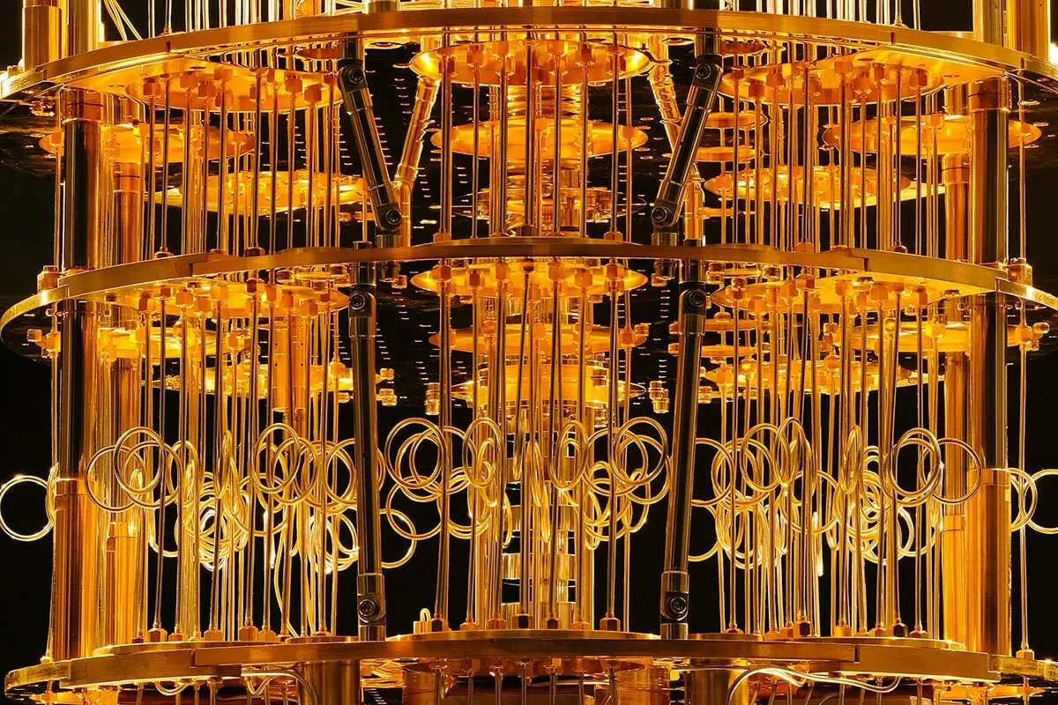
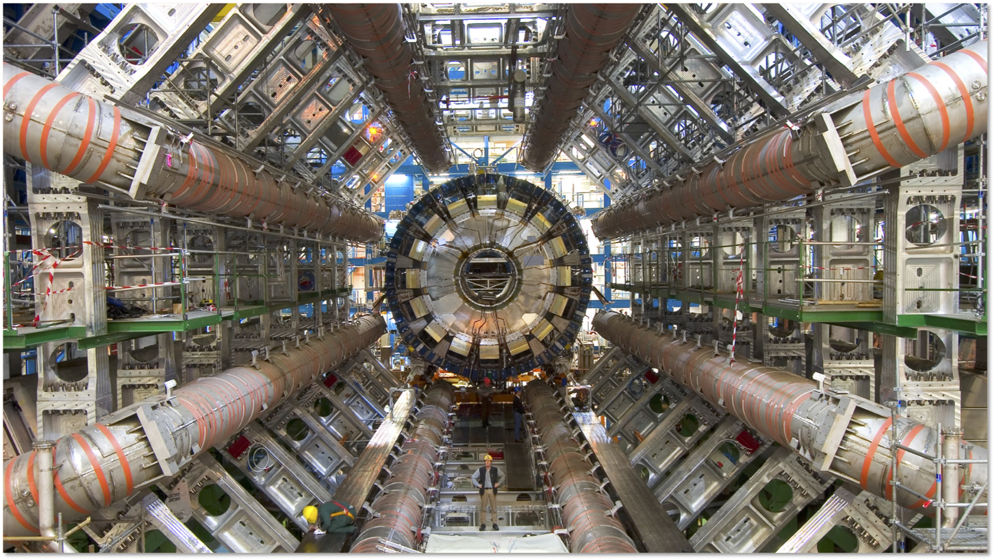
Acknowledgements
https://www.techspot.com/news/81961-ibm-launching-53-qubit-quantum-computer-next-month.html
https://www.nature.com/articles/d41586-021-03476-5
I would especially like to thank...
Dr. Keith Baker (Yale University) for his mentorship and guidance
The Audience ☺

