Slide 1
Exclusive J/ψ production
Peter Steinberg, BNL

Slide 2
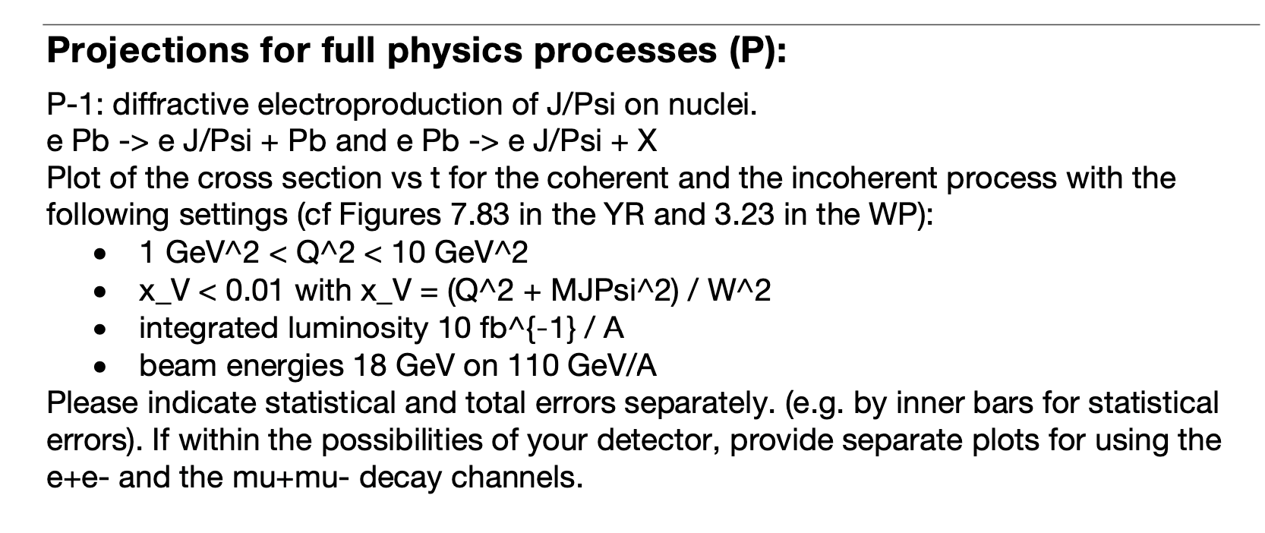
Exclusive J/ψ production
Differences w.r.t. ECCE proposal & comments
  Increase range from Q²=1-10 GeV²
    Some efficiency loss between 1-1.5 GeV²
  Move from x = Q²/W² to x_{V} = (Q²+M²)/W²
    40% signal reduction (cut in J/ ψ rapidity)
    Only 5% for x<0.01
  10 fb⁻¹/A (vs. 20 fb⁻¹/A in proposal)
  Full PID for e and µ, based on presence/absence of an EM cluster:
    ePID satisfied if E_{clus}/P_{track}>0.6, otherwise µPID
  e’ energy adjusted to obey kinematic constraint (correct for coherent), similar to “method L”
    e+A = e’+A’+J/ψ → M²_{A’} = (A - (Se’-e) - ψ)² = M²_{A}
    Correction required to be small to guarantee well-reconstructed scattered electron
  Simple efficiency corrections to arrive at cross section
    Coherent x-sect based on Sartre 1.37
    Incoherent is Beagle normalized to Sartre incoherent.
x_{V}<0.01
x<0.01

Slide 3
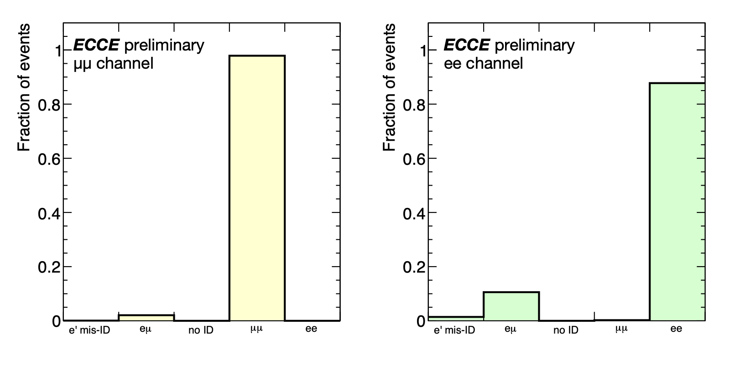
Particle identification efficiency/purity
Accepted events require two positive tags on decay products and a confirmation of electron candidate - otherwise event is rejected
97% PID efficiency for µµ and 85% for ee (gaps in calo acceptance): Electron/muon contamination in double-tag analysis found to be negligible.

Slide 4
Coherent process only (intermediate result)
p_{T}² is used as proxy for t
Correction is just simple integral of reconstructed counts over truth
Efficiency vs Q² is mostly constant but composed of many parts: e’ efficiency (track & cluster), charged decay products, PID cuts, kinematic constraints, etc.
Aggregate efficiency is 40% for ee, 60% for µµ. Expect 15% systematics or better, as many efficiencies should be measurable in data using tag & probe.
Tracking resolution sufficient for observation of “kinks” in the µµ channel - weaker for ee

Slide 5
Coherent signal & incoherent background
To estimate incoherent background, selections made on ZDC, Roman Pots, OMD and B0 detectors.
  Expect improvements with further optimization of detector design (e.g. B0 EMCal) and analysis methodology
Backgrounds modest up to second diffractive peak
  Cut more effective at larger t, but signal distribution drops rapidly

Slide 6
Incoherent signal
Events selected using “anti-veto” of the selections used for coherent x-sect.
Correction to convert reconstructed to final is a polynomial fit (for smoothing)
to truth/reco of yield vs. p_{T}². Uncertainties are identical to coherent case.
Flat distribution in t, so comparable performance for electrons and muons

Slide 7
Systematic uncertainties
General
  Luminosity: 1%
  Tracking efficiency: 2% (limited by tag & probe statistics)
  e’ PID (cluster matching): 2% (EEMC spatial variations, gaps in calo system)
  J/psi mass window: 2% for µµ, 5% for ee (variation on window size)
  J/psi PID – 3% in ee (gaps in calo system)
  Kinematic constraint to remove long tails from t=0 – 7% (variation of window)
Incoherent process tagging
  10% on total cross section (from larger inefficiency at t=0), 5% on t dependence
  Large O(50%) impact on cross sections at “high” t (~0.1 GeV²) where residual incoherent backgrounds are similar in magnitude to coherent signal

Slide 8
Unfolding signal distribution: first steps
First attempt at unfolding reconstructed ECCE t distribution
Response formed as a sum of Sartre 1.37 and BeAGLE 1.1 response matrices
  Sartre populates long reconstructed tail near true t=0, which strongly contaminates higher-t region
  BeAGLE has no dips and so provides a continuous t response over a wide range
Bayes prior reweighed to agree with simulated data
  Studying stability of result and sensitivity to details of input response and Bayes prior
ECCE is clearly able to observe structures related to the diffractive peaks, and the unfolding is identifying the correct positions of the minima, even if the depth will be difficult to measure.
  Have tested same procedure with featureless spectra and no dips are found after multiple iterations

Slide 9
Impact of removing t=0 tail (@ truth level)

