Slide 1
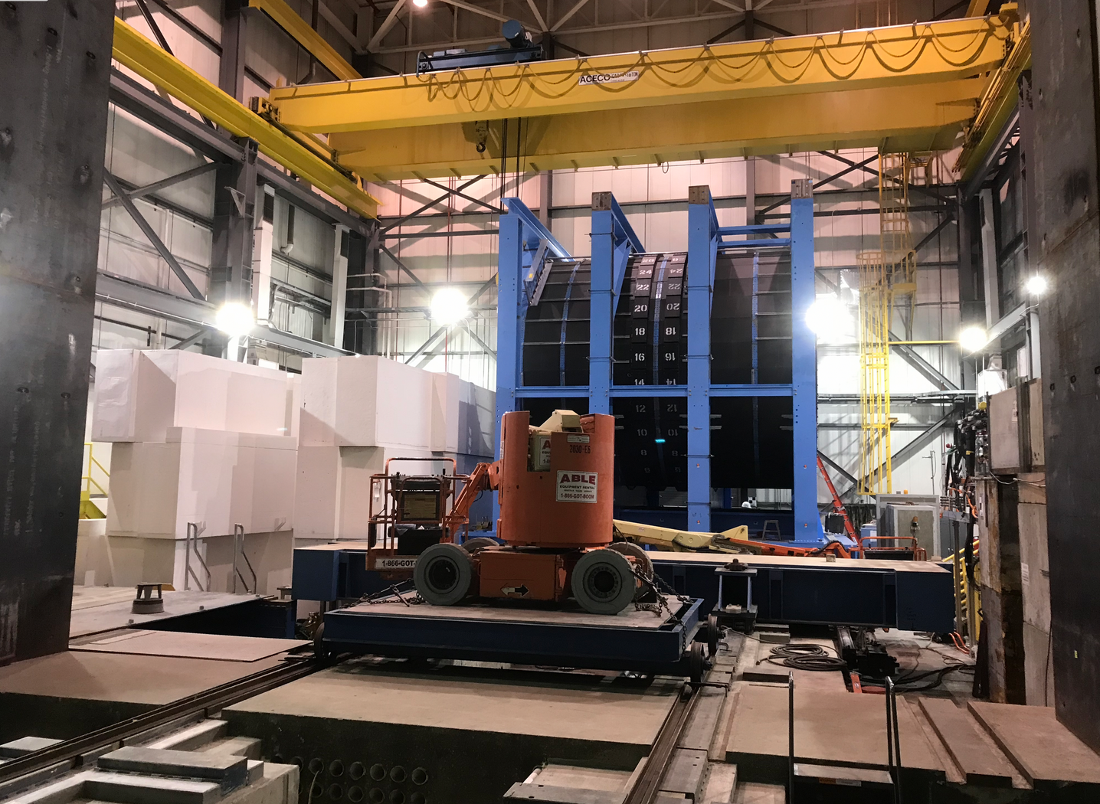
1008 Shield Wall Disassembled 4/20

Slide 2
sPHENIX Status
Update on the beam pipe
Status of TPC, INTT, MVTX, TPOT
EMCAL KPPs
Status of PEMP notables
Status of electronics components

Slide 3
STAR HFT Pipe will Work as a Replacement for the sPHENIX Pipe
BNL, MIT and LANL engineers met yesterday and agreed that the STAR HFT pipe could be used by sPHENIX, unmodified, with no impediment to MVTX installation
We have received permission from NPP ALD and STAR to use the HFT pipe (not currently in use by STAR)
Will extract the STAR pipe for the existing “CFC cone” structure at 1006 with help from STAR and CAD .
Store in existing protective crate.
Likely move to 905 so CAD Vacuum group can inspect, remove heating tape and perform any additional prep prior to installation in 1008 in December.
Vacuum group agrees to make interface conventional Al pipes to connect the STAR HFT pipe to the RHIC vacuum pipes in 1008.

Slide 4
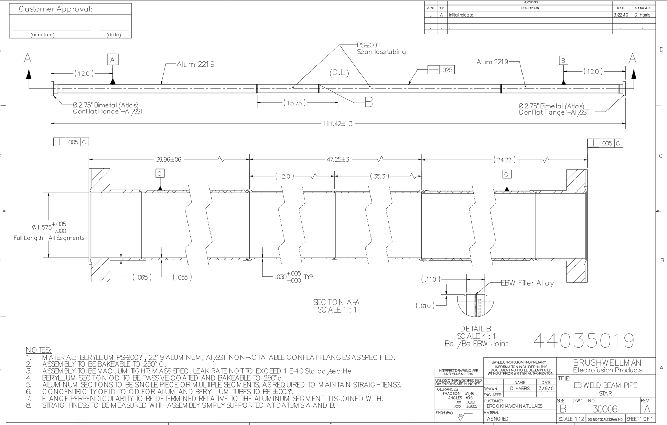
STAR HFT Pipe Installed in 1008
Differences between
STAR and PHENIX pipes:
Be section in the STAR pipe is 47.25” vs 31.5” for PHENIX
STAR pipe length 111” vs 101” for PHENIX
STAR Al pipe section asymmetrical vs symmetrical section in PHENIX pipe
80” from IP to South flange
31” from IP to North flange
1008 IP

Slide 5
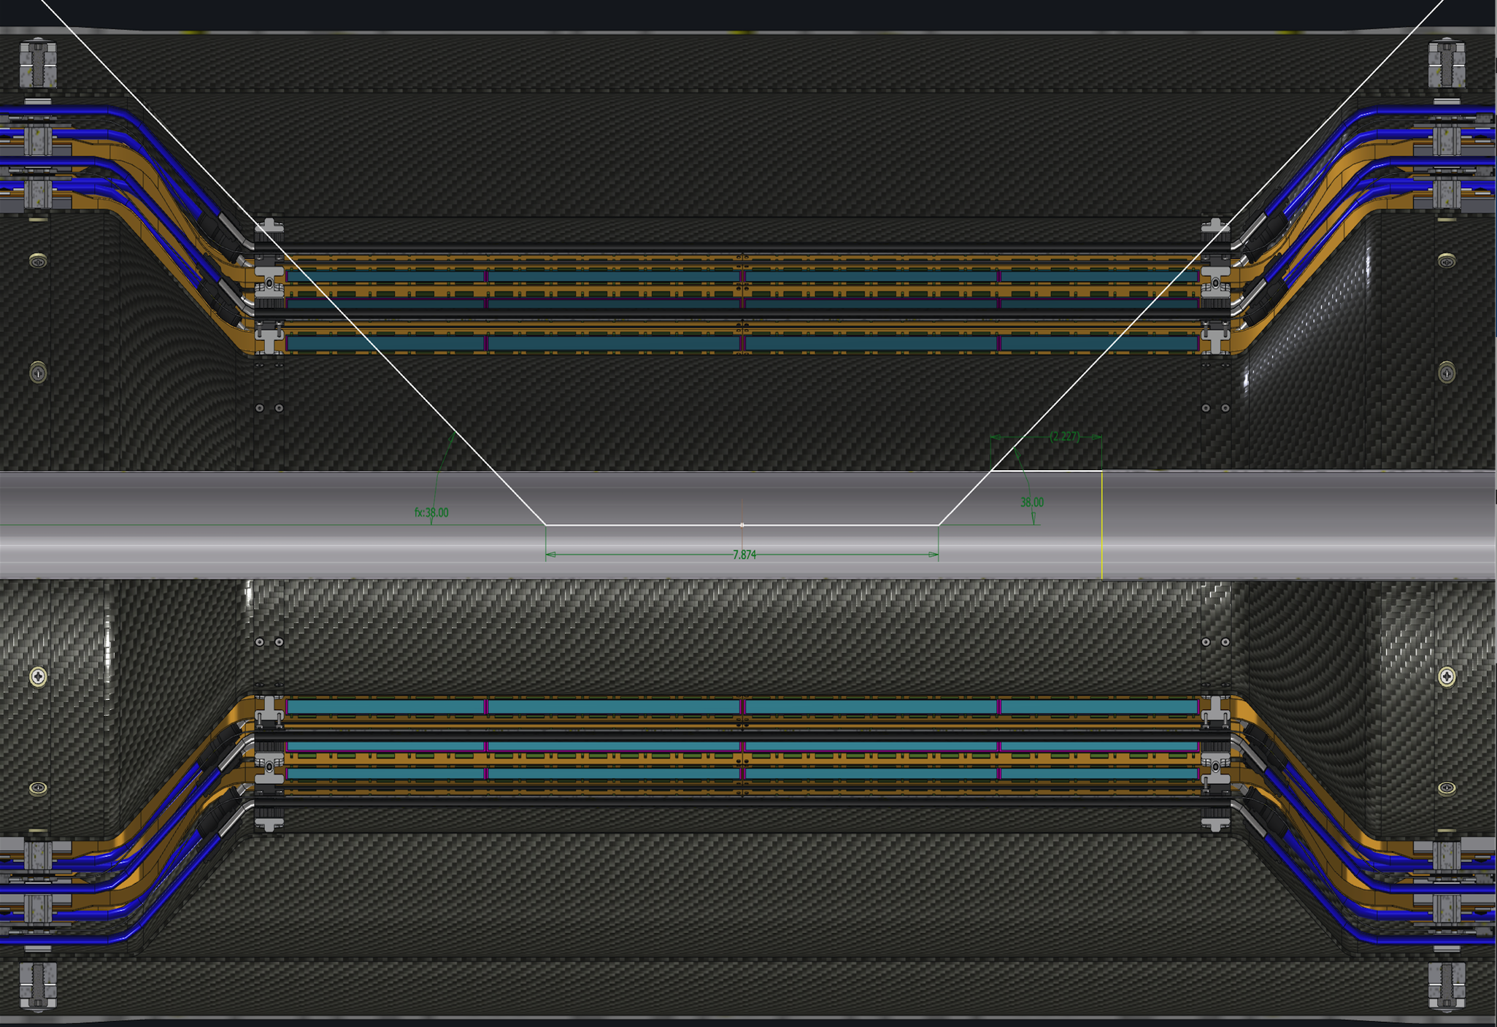
sPHENIX Beampipe Aperture
20 cm

Slide 6
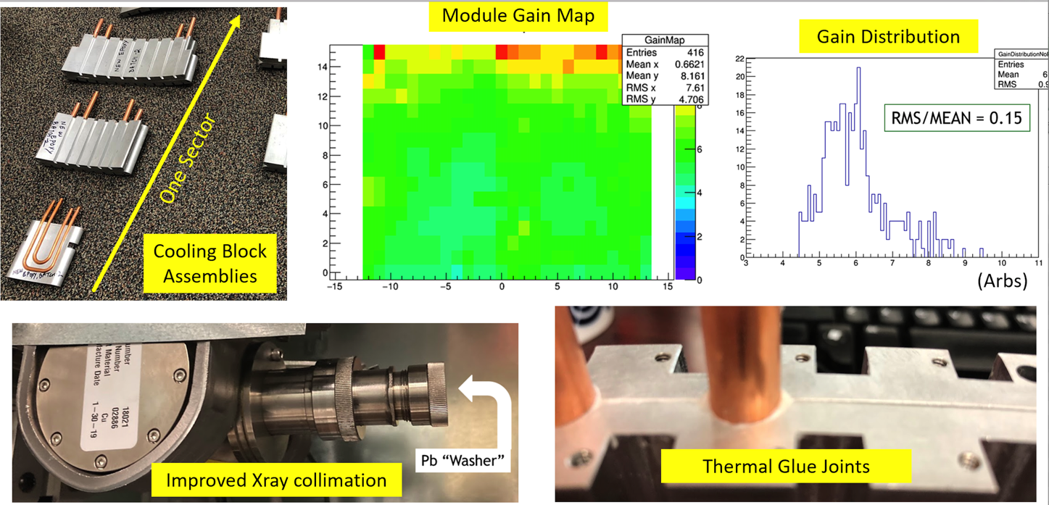
TPC Status
All 72 GEM modules assembled at SBU, HV and QA tested.
Major GEM fab contributions from WSU, Vanderbilt, Temple and WIS
GEM module calibration tests continuing at SBU for gain and IBF mapping with X-ray gun test bench.
Gain and Ion Back Flow measurements look good so far.
Aluminum deposition complete on central membrane petals, spares being prepared
Preparation being made for central membrane assembly
Laser motor test station for calibration system order has started.
Technical issue has developed with laser fiber splitter design. Unanticipated fiber damage relayed to the chosen wavelength of the laser. This will likely delay one of the two laser calibration system.
All TPC FELIX boards complete and tested. Firmware development underway.
All TPC Fee boards assembled and delivered to BNL by vendor. Board testing underway.
First article JACK (TPC controller) board being produced

Slide 7
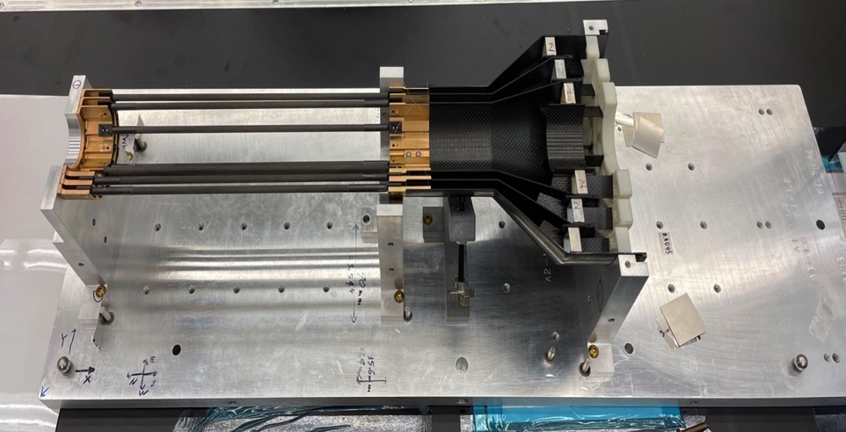
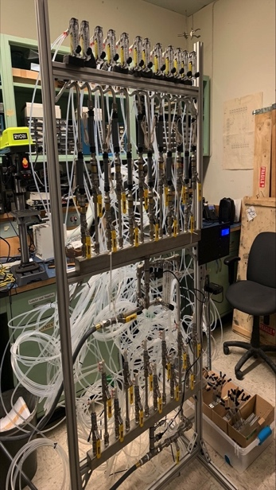
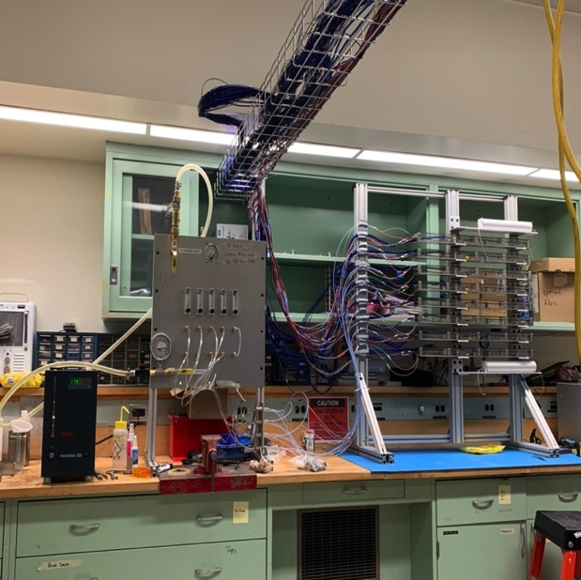
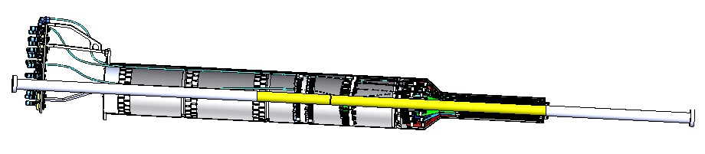
MVTX Status 04/20/2022
MVTX assembly at LBNL
Updated assembly procedure
Complete 2 half detector assembly by ~end of May
Complete power cable assembly by mid of May
Cooling system integration test by end of May
Stave cooling system test at MIT
Electronics rack cooling system test at LANL
Ship to BNL for commissioning in June 2022
Readout and control integration
8-stave telescope to test the full readout and control chain at LANL
Operation optimization in progress
Commissioning at BNL
Received all Readout Units and cables at BNL
2 racks ready for commissioning
Clean tent setup in progress at BNL
Ready ~ mid of May
Detector QC and commissioning in June 2022
Full insertion test at BNL late summer
Full detector pre-installation commissioning Aug – Dec. 2022
New MVTX installation schedule
Jan 17 – Feb. 13, 2023
MVTX assembly in progress at LBNL
8-stave full readout and
control chain test @LANL
Cooling system test @LANL
MVTX with the new STAR HFT beam pipe

Slide 8
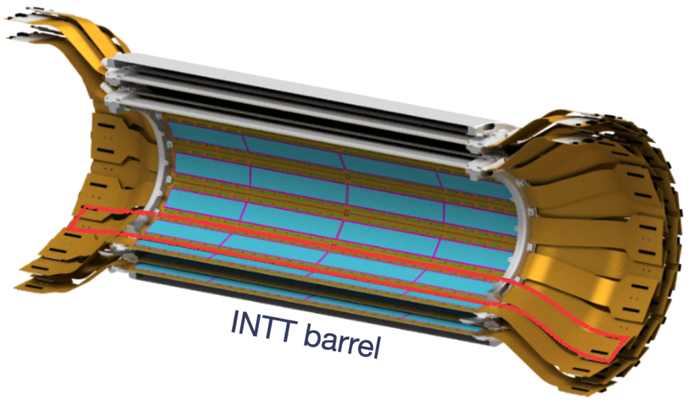
INTT Progress and Schedule
All Si sensors completed and tested
All HDIs complete and tested
All staves assembled and tested
Half barrel CFC parts in fab. Due at BNL in May
Bus extender production underway. Due to be complete in June
Conversion cable Jun-Aug production
Beam clock board Jul-Sep production
INTT installation and support mechanics fab to start at SBU in May
All ready for installation in sPHENIX in Jan

Slide 9
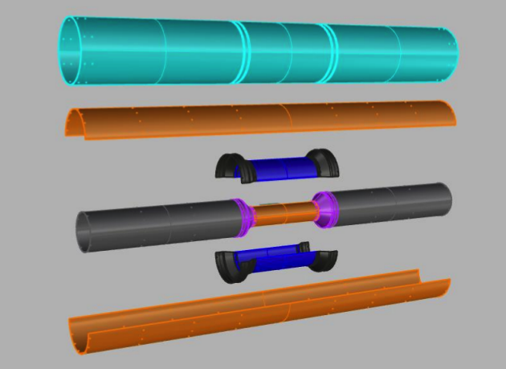
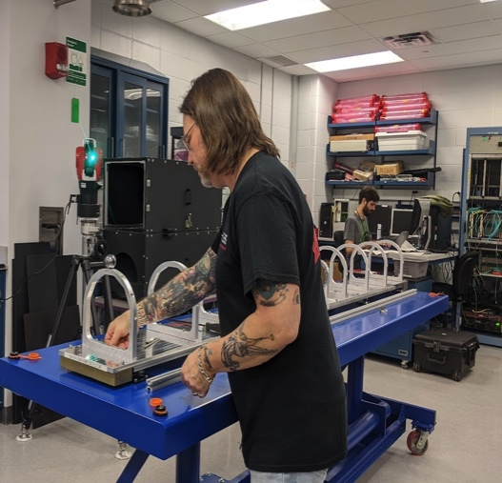
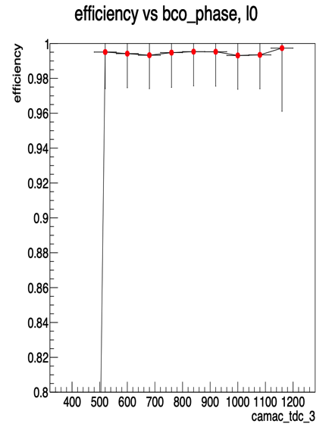
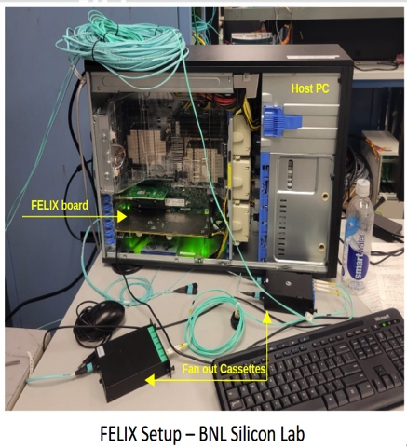
Status of the INTT - continued
Ladder mass production (84) at BNL achieved successfully → Class 1 (<= 0.5%) = 72 ladders (56 needed)
TPC/INTT installation review was successful
INTT LV/HV systems completed, tested and Installed in the IR
CFC barrels support structure under fabrication by WorkShape co. → First delivery (CFC Inner Parts) will be on May 9th, this will allow us to start full assembly of barrels and testing.
PO for Auxiliaries’ parts ($68k) of Barrels’ assembly was submitted and they are under production, first delivery was April 20th. All parts will be delivered in April.
Extender bus cables production (112 needed): first batch 20 delivered on March, second batch 40 delivered in April 15th, and third batch 70 by the end of May.
Coaxial conversion cable prototype under fabrication
INTT Review of Readout and Slow Control with Felix was successfully April 12th
→ Slow Control using Felix board successful
→ Felix readout data successful
Beam test at Tohuko Uni (Japan) using production ladders achieved successfully: Detection efficiency 99.6%
INTT Detector commissioning software calibration/maps/Ideal Geometry… making excellent progress

Slide 10
TPOT progress and schedule
Micromegas production at Saclay:
all parts ordered and received
production started
expect first modules shipped to BNL early May: ~3 weeks later than original schedule (04/19)
Mechanics (LANL/BNL/MIT):
Support structure design is completed. Checking interference with TPC
FEA analyses complete. Note is being reviewed internally
Detector cradle (assembly, internal survey, transportation) design complete
Insertion mechanics design is ongoing
FDR/PRR review anticipated for early May: ~1 month later than original schedule (04/04)
Electronics (BNL)
FEE and backend follows TPC schedule
Fibers ordered (in-time)
Transition board+flat cable (detector to FEE) ordered at SAMTEC expected mid-June
First test Detector+FEE completed. Encouraging results.
More tests foreseen with next TPOT module. Possible test beam at FNAL (June 13 to 27)
FEE cooling plates received. FEE cooling test at BNL in progress (in-time)
Other services (Saclay/BNL/MIT)
HV power supply and modules received. Need testing
All cables/tubes from detector to patch panel finalized, ready to order
Cables from patch panel to power supplies being finalized. Schedule aligned with TPC
FEE cooling lines being finalized
Gas system design is complete (Rob P.). Will use pre-mix Ar/iC4H10 90/20. No need for dedicated flammable gas detection
=> TPOT is about 1 month late with respect to original schedule (detectors and mechanics). Ready for insertion on the inside of the EMCAL by end of August (instead of 7/22). Efforts are being made to reduce this delay
Micromegas module at Saclay

Slide 11
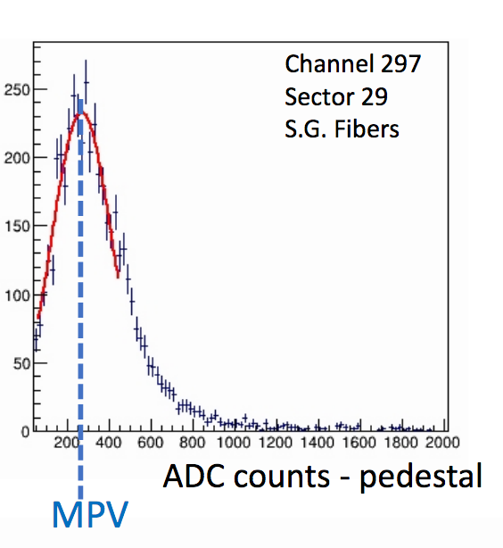
sPHENIX EMCal KPP’s
System | Demonstration or Measurement | Threshold KKP’s | Objective KPP’s
EM Calorimeter | Preinstall, Bench tests | ≥ 90% live channels based on LED, cosmics | ≥ 95% live channels based on LED, cosmics
EM Calorimeter | Preinstall, Bench tests | Each sector w/ an absolute energy precalibration of ≤ 35% RMS | Same
We’ve tested and burned in 56/64 EMCal sectors. So far the dead channel count is < 1%
We have large samples of cosmic ray ADC data recorded for each of the tested EMCal modules. Once all 64 sectors have the cosmic ray data-taking complete we will write up up the analysis to demonstrate that we have met the RMS criteria.
Example of CR data

Slide 12
sPHENIX PEMP Notable for 2022
Notable Outcome - BHSO/SC: Effectively plan, execute, and successfully deliver SC projects equal to or less than $50 million that have been delegated to the Laboratory Director by SC under DOE O 413.3B [Super Pioneering High Energy Nuclear Interaction (sPHENIX)]. Clearly demonstrate successful accomplishment of key milestones in FY 2022 (adjusted for schedule impacts created by the COVID-19 pandemic) in accordance with SC guidance. (Objective 7.2)
PEMP notable associated with the sPHENIX MIE L2 completion
IHCal mechanical sectors complete - Jan 1, 2022 ✔ Completed ahead of schedule
EMCal sectors complete - May 15, 2022 ✔ Completed ahead of schedule
DAQ/Trigger GL1/GTM production complete - June 1, 2022
Calorimeter electronics complete - July 1, 2022
All sPHENIX milestones related to the PEMP notable remain on schedule, though COVID impacts on the schedule are possible

Slide 13
sPHENIX Electronics
All EMCal and HCal on detector electronics complete.
All EMCal and HCal calorimeter digitizers being assembled now. Completed in 2nd half of June.
All TPC and MVTX FELIX boards complete. Firmware development underway.
TPC Fee fully assembled though PLLs yet to be installed due to late delivery. They can be fully tested without the PLL chip
MVTX has all RO Units
TPC JACK board needs pcb first article test before going to production. All parts in hand except pcb
DAQ/Trigger: GL1/GTM due in May. First article tested good.
DAQ/Trigger: LL1 boards awaiting one back ordered chip
DAQ/Trigger: DCMII boards awaiting one back ordered chip

Slide 14
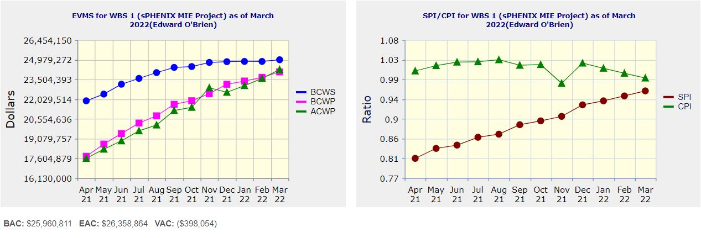
Performance Indices – sPHENIX MIE
Cumulative SPI | Cumulative CPI
0.96 | 0.99
Cumulative BCWS (Scheduled) | $24,853.936
Cumulative BCWP (Performed) | $23,664,352
Cumulative ACWP (Actual) | $23,580,763
DOE SPI or CPI Value Thresholds
0.90 to 1.15
0.85 to 0.89 or 1.16 to 1.25
<0.85 or >1.25

Slide 15
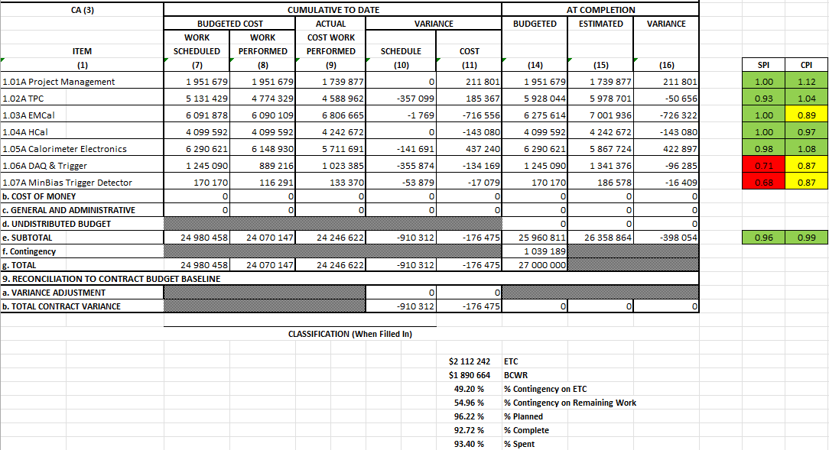
Cost Performance Report (CPR) – sPHENIX MIE
DOE SPI or CPI Value Thresholds
0.90 to 1.15
0.85 to 0.89 or 1.16 to 1.25
<0.85 or >1.25
*Highlights in table above takes variance $ into consideration, not just Indices

Slide 16
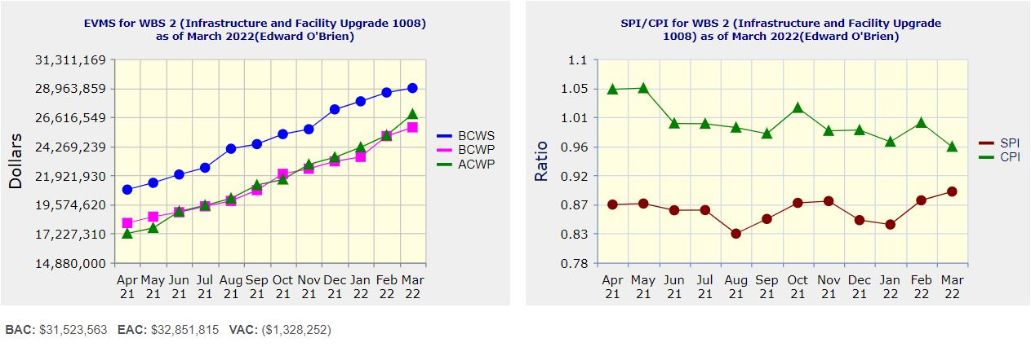
Performance Indices – 1008 Infra and Facility Upgrade
Cumulative SPI | Cumulative CPI
0.89 | 0.96
Cumulative BCWS (Scheduled) | $28,611,730
Cumulative BCWP (Performed) | $25,091,683
Cumulative ACWP (Actual) | $25,153,574
DOE SPI or CPI Value Thresholds
0.90 to 1.15
0.85 to 0.89 or 1.16 to 1.25
<0.85 or >1.25

Slide 17
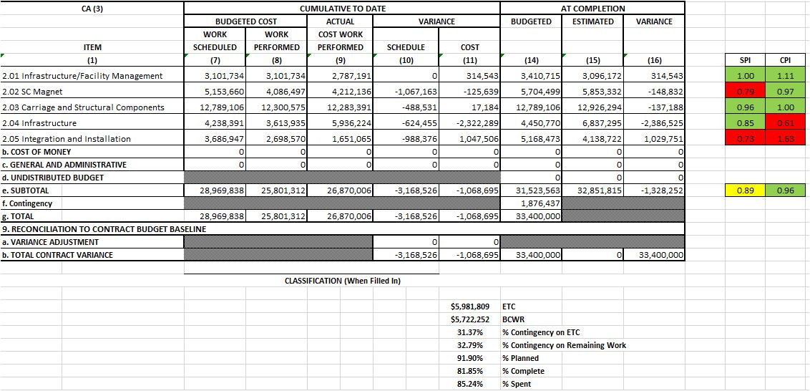
Cost Performance Report (CPR) – 1008 Infra and Facility Upgrade
DOE SPI or CPI Value Thresholds
0.90 to 1.15
0.85 to 0.89 or 1.16 to 1.25
<0.85 or >1.25
*Highlights in table above takes variance $ into consideration, not just Indices

Slide 18
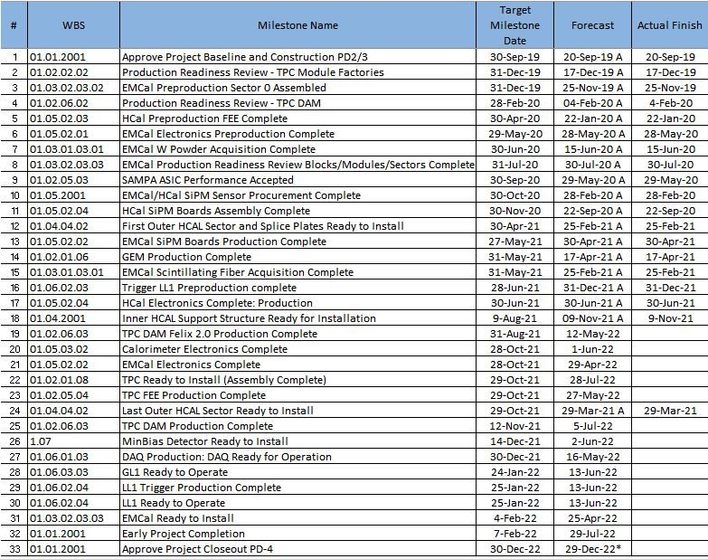
Milestones Status – sPHENIX MIE

Slide 19
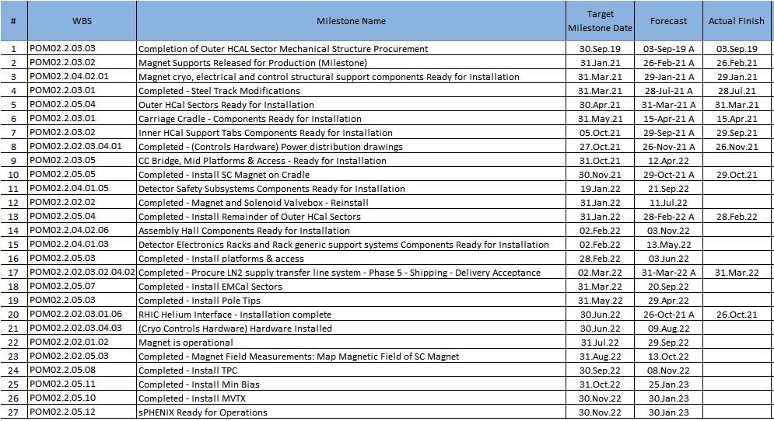
Milestones Status – 1008 Infra and Facility Upgrade

Slide 20
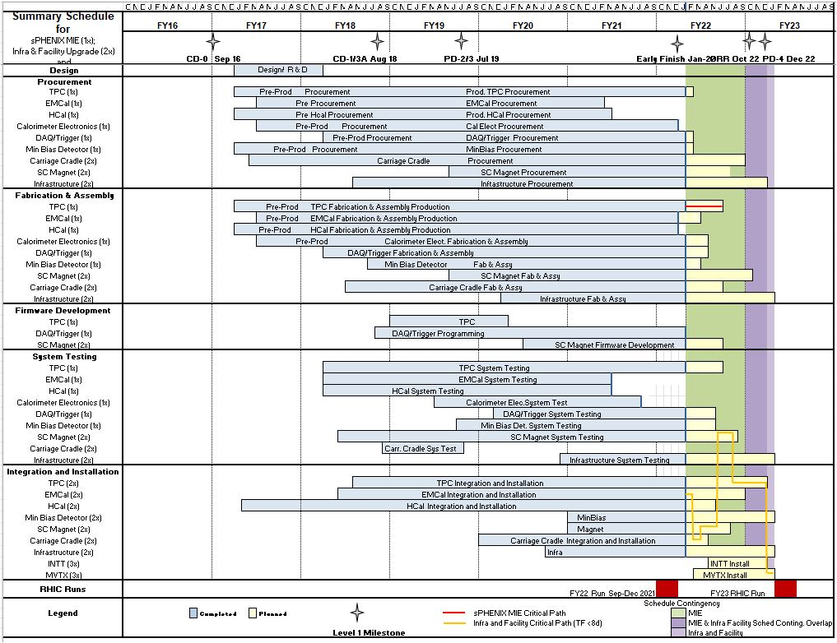
Summary Schedule – sPHENIX MIE and 1008 Infra and Facility Upgrade

Slide 21
Back - Up

Slide 22
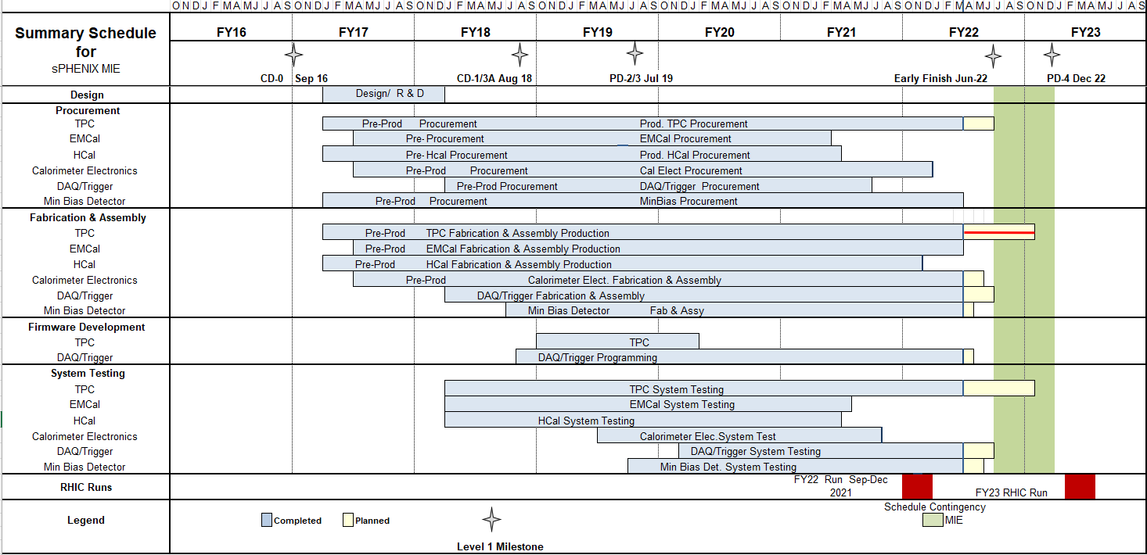
Summary Schedule – sPHENIX MIE

Slide 23
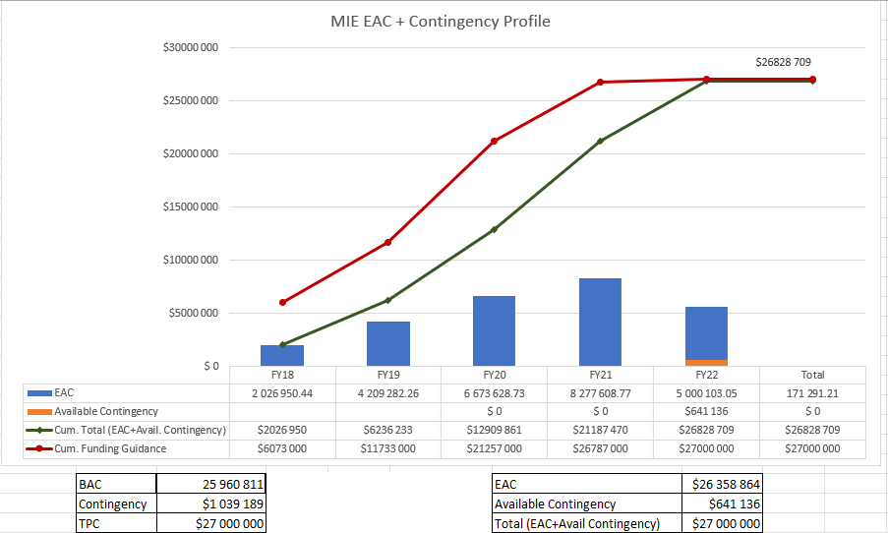
EAC and Contingency Profile – sPHENIX MIE

Slide 24
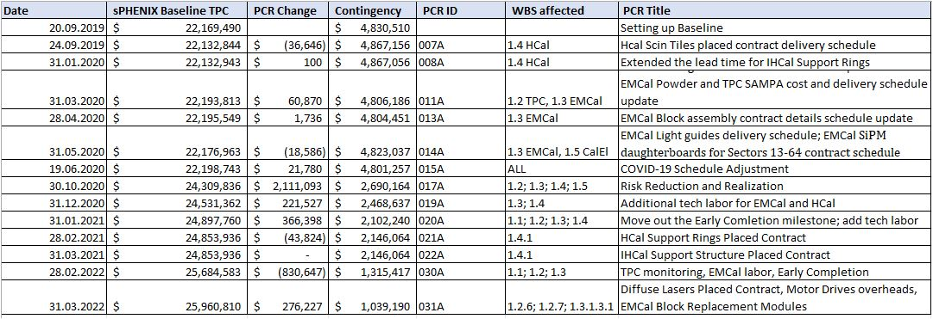
Baseline/Contingency Log and ETC adjustment Log - MIE
ETC Adjustments
Control Account | Aug’21 | Sep’21 | Oct’21 | Nov’21 | Dec’21 | Jan’22 | Feb’22 | Mar’22
1.02 | 326,377 | 556,377 | 716,238 | 725,089 | 722,064 | 703,567 | 244,065 | 228,272
1.03 |  |  |  | 34,439 | 18,420 | 17,328 | 67,559 | 9,776
1.05 | $22,833 | $22,833 | 219,343 | 414,468 | 250,807 | -6,101 | 87,313 | 11,509
1.06 | $79,352 | $79,352 | $26,259 | -62,490 | -63,278 | -63,278 | -45,001 | -45,001
1.07 | $25,705 | $25,705 | $16,041 | 16,575 | 8,731 | 8,731 | -7,013 | -1,748
Total | 454,267 | 684,267 | 977,880 | 1,128,081 | 936,744 | 660,247 | 346,923 | 202,798

Slide 25
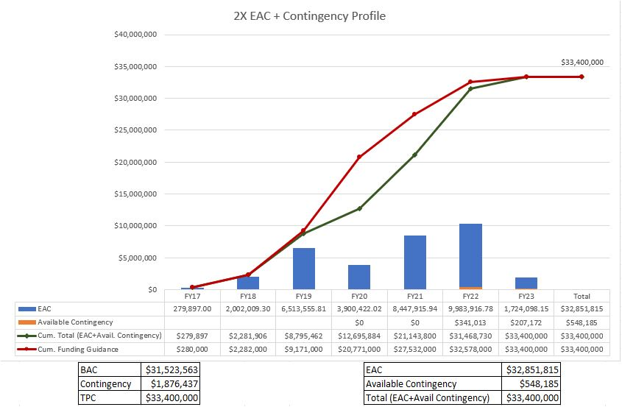
EAC and Contingency Profile – 1008 Infra and Facility Upgrade

Slide 26
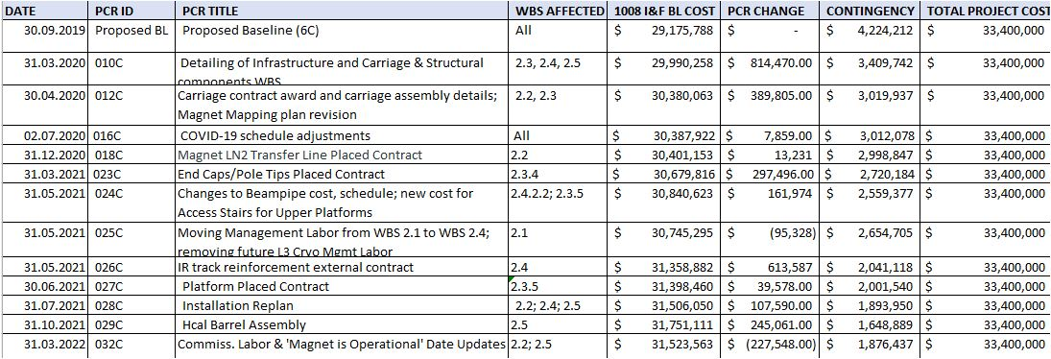
Baseline/Contingency Log and ETC adjustment Log – 2.X
ETC Adjustments
Control Account | Sep’21 | Oct’21 | Nov’21 | Dec’21 | Jan’22 | Feb’22 | Mar’22
2.2 | - | - | - | - | 20,551 | 14,635 | 8,407
2.3 | 90,775 | 70,349 | 125,472 | 102,957 | 117,533 | 102,161 | 138,461
2.4 | 70,160 | 350,388 | 152,069 | 69,283 | 23,810 | 296 | 52,663
2.5 | - | 73,413 | 63,117 | 161,496 | 208,816 | 136,000 | -
Total | 160,935 | 494,150 | 340,658 | 333,737 | 370,709 | 253,092 | 199,530

Slide 27
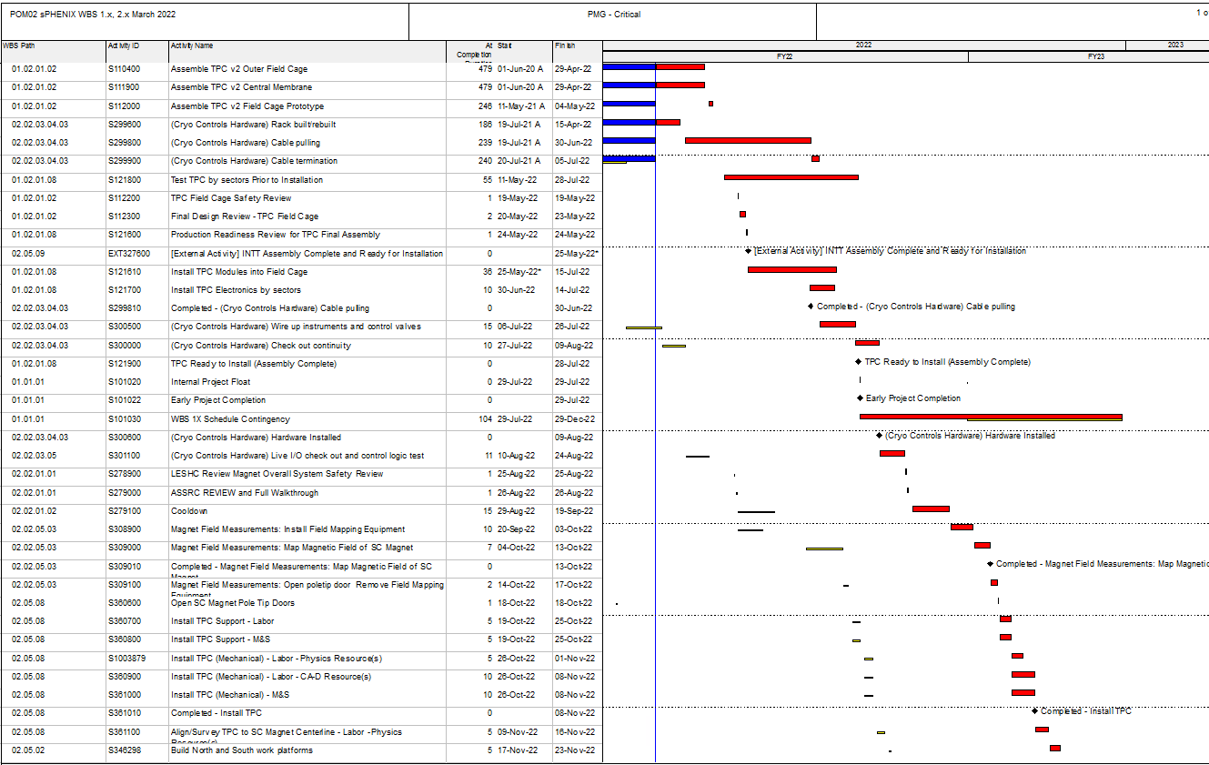
Critical Path (1x, 2x and 3x Combined)

Slide 28
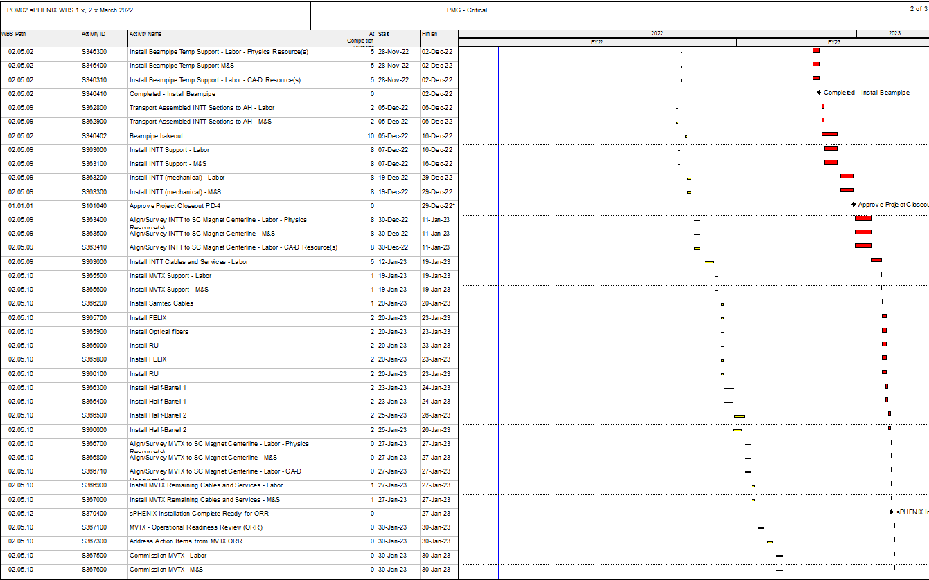
Critical Path (1x, 2x and 3x Combined)

Slide 29
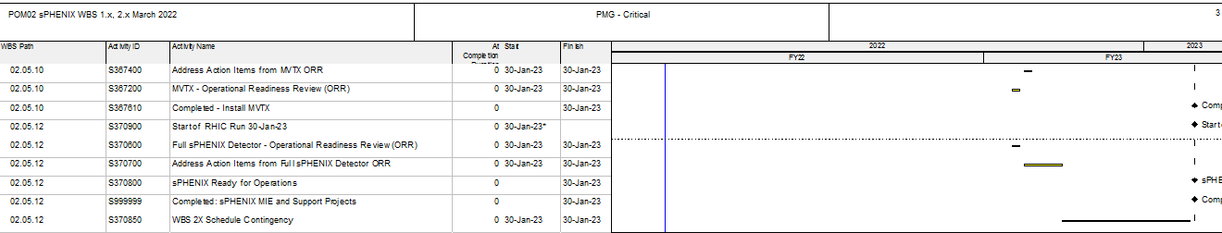
Critical Path (1x, 2x and 3x Combined)

