Slide 1
F&O Update
Tom Daniels, ALD Facilities and Operations
June 10, 2022

Slide 2
Agenda
Guest Services Update
F&O Projects
SUSC presentation
Q&A

Slide 3
F&O Projects

Slide 4
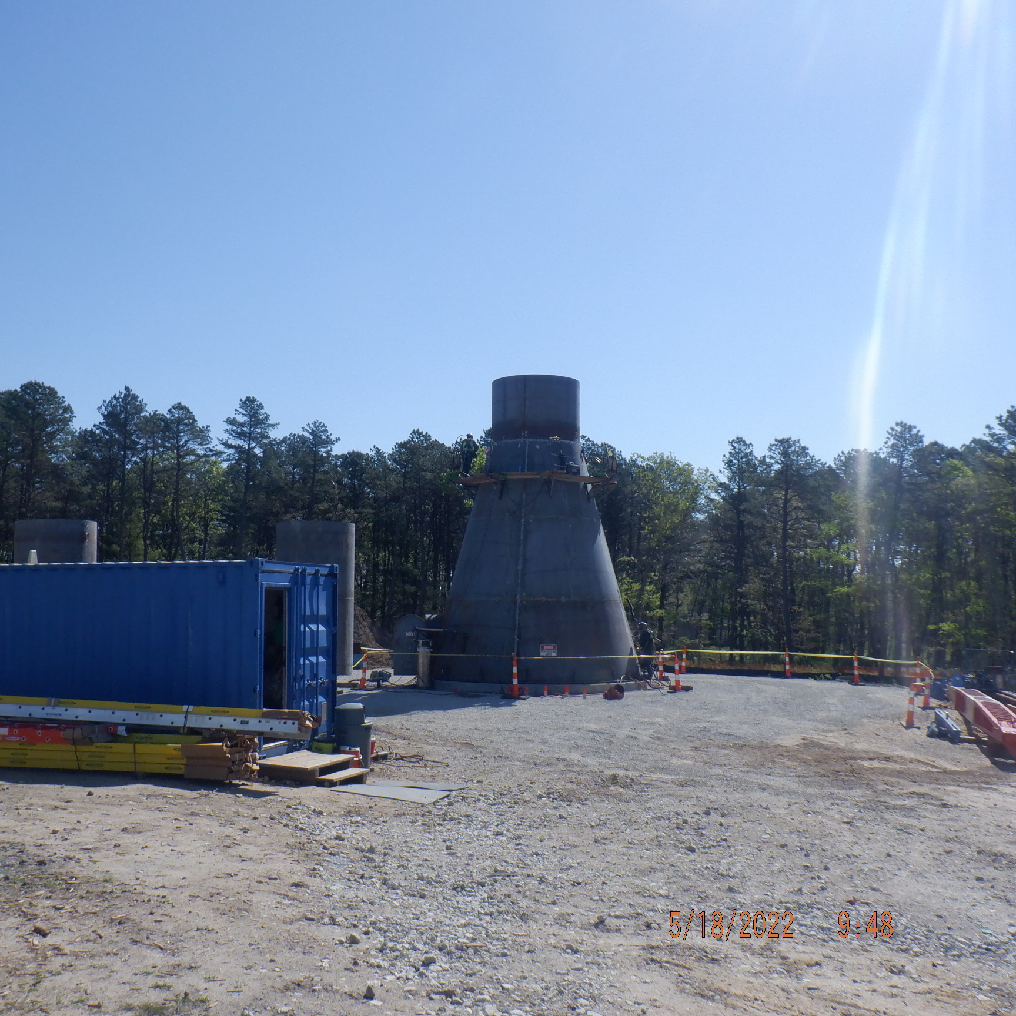
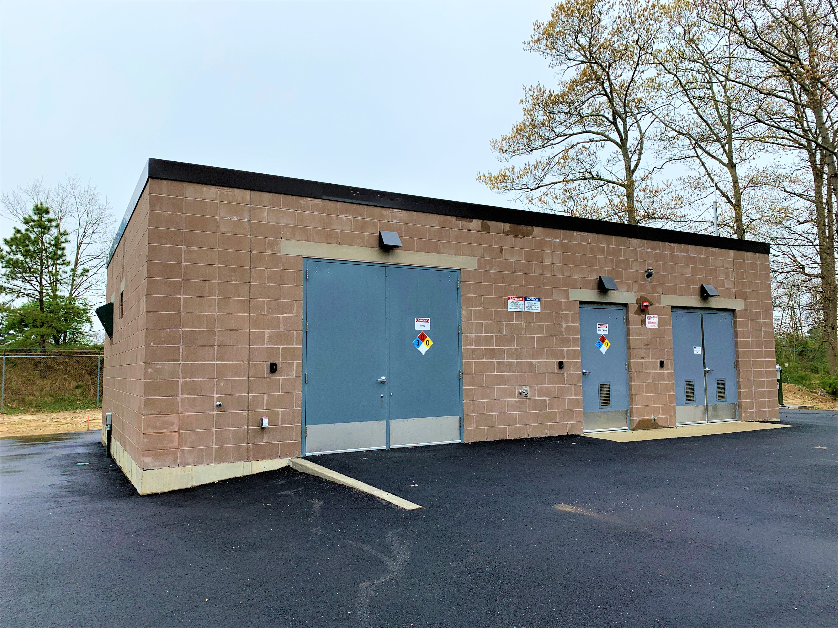
Improving the BNL Site
Since the start of the pandemic, we have completed approximately $45M in CURL Projects
Completed the NYS funded construction of LBMS and HEX
Completed the CFR Project
Commenced the SUSC Project
Commenced the CURP Project
Completed the HFBR stack removal
Demolished Building 650

Slide 5
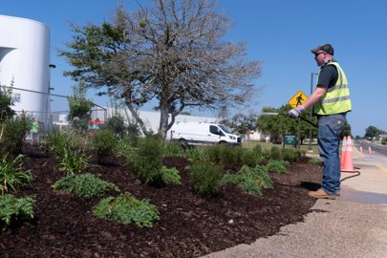
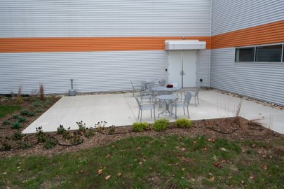
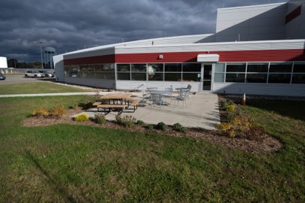
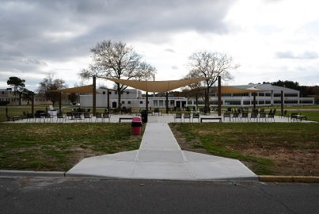
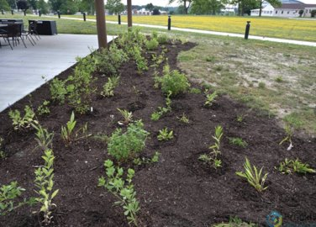
Outdoor Space and Landscaping
B725 Landscaping​
B745 Patio​
LOB Landscaping​
Brookhaven Square Park Access​
Brookhaven Square Park BERA Garden Club Garden​

Slide 6
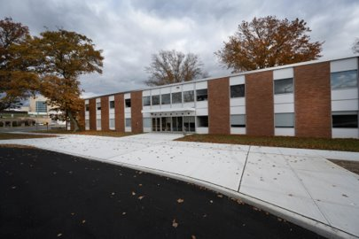
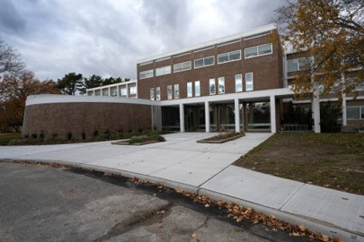
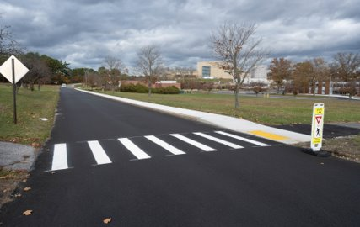
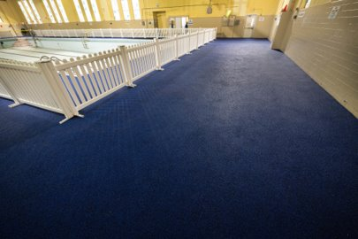
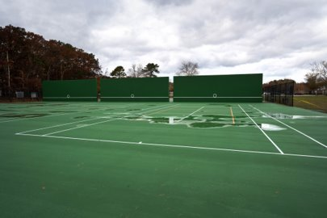
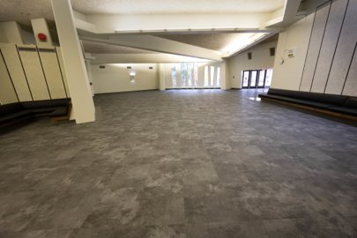
Upgrades
B510 Entrance​
B555 Entrance​
Center Street​
Pool Flooring​
Tennis Courts​
Berkner Dinning Area​

Slide 7
Science + User Support Center (SUSC)
Project Overview

Slide 8
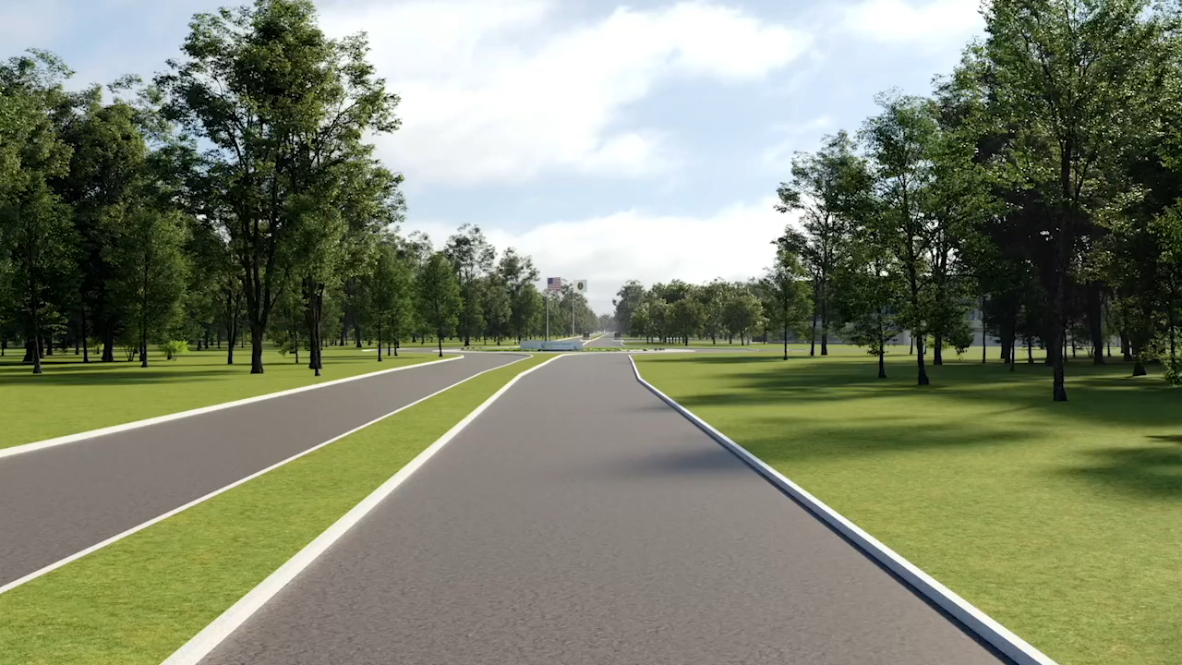

Slide 9
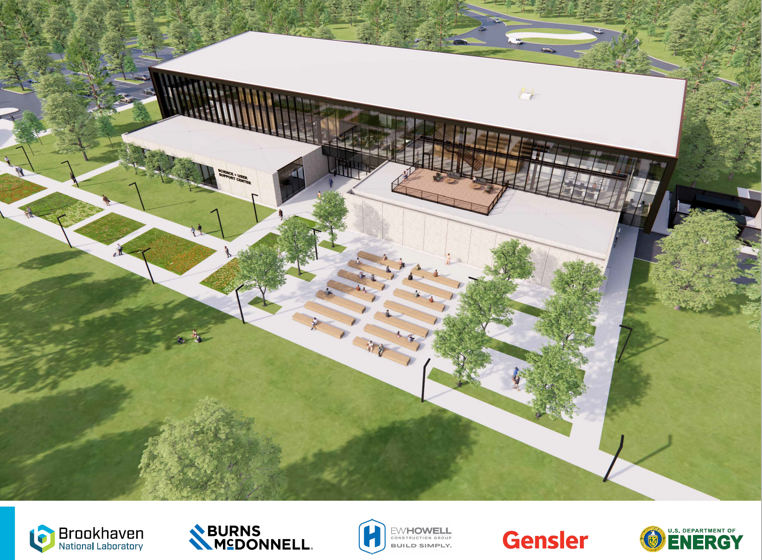
Project Cost: $86.2M
Construction Contract: $62M

Slide 10
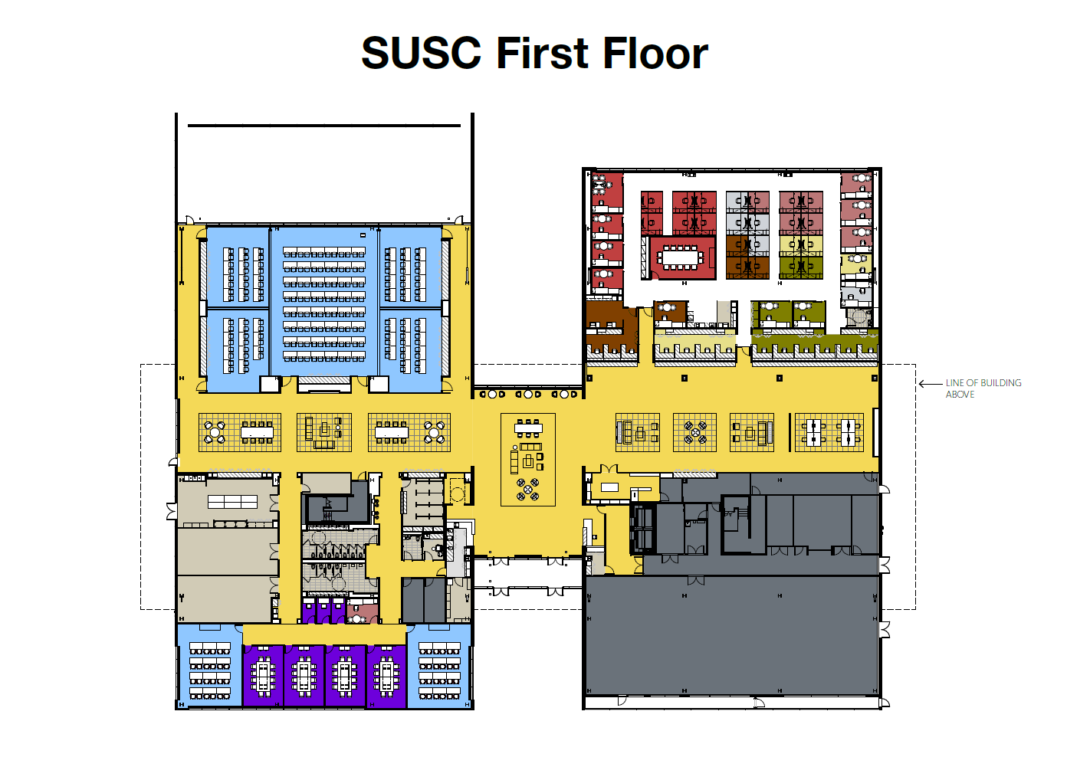

Slide 11
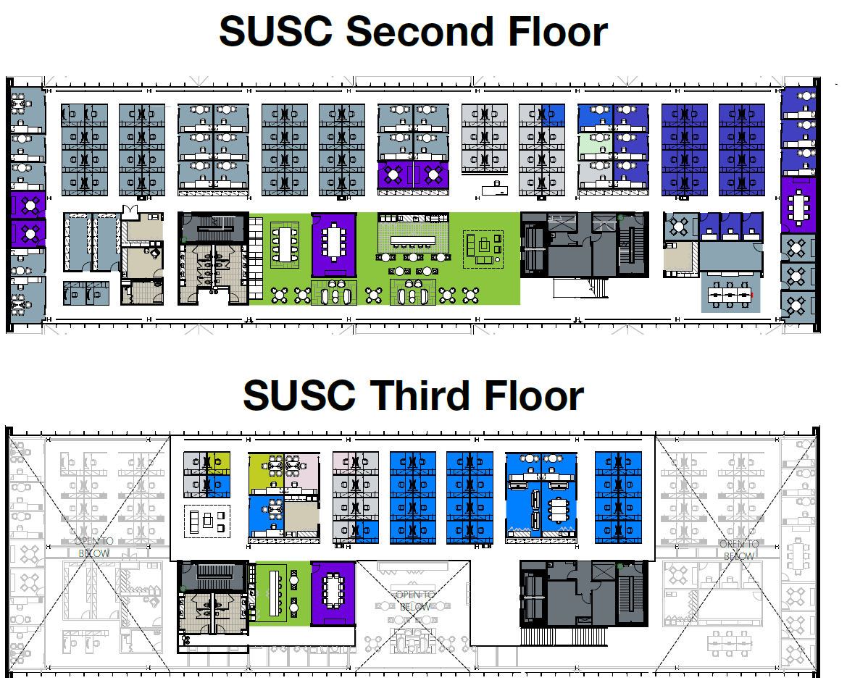

Slide 12
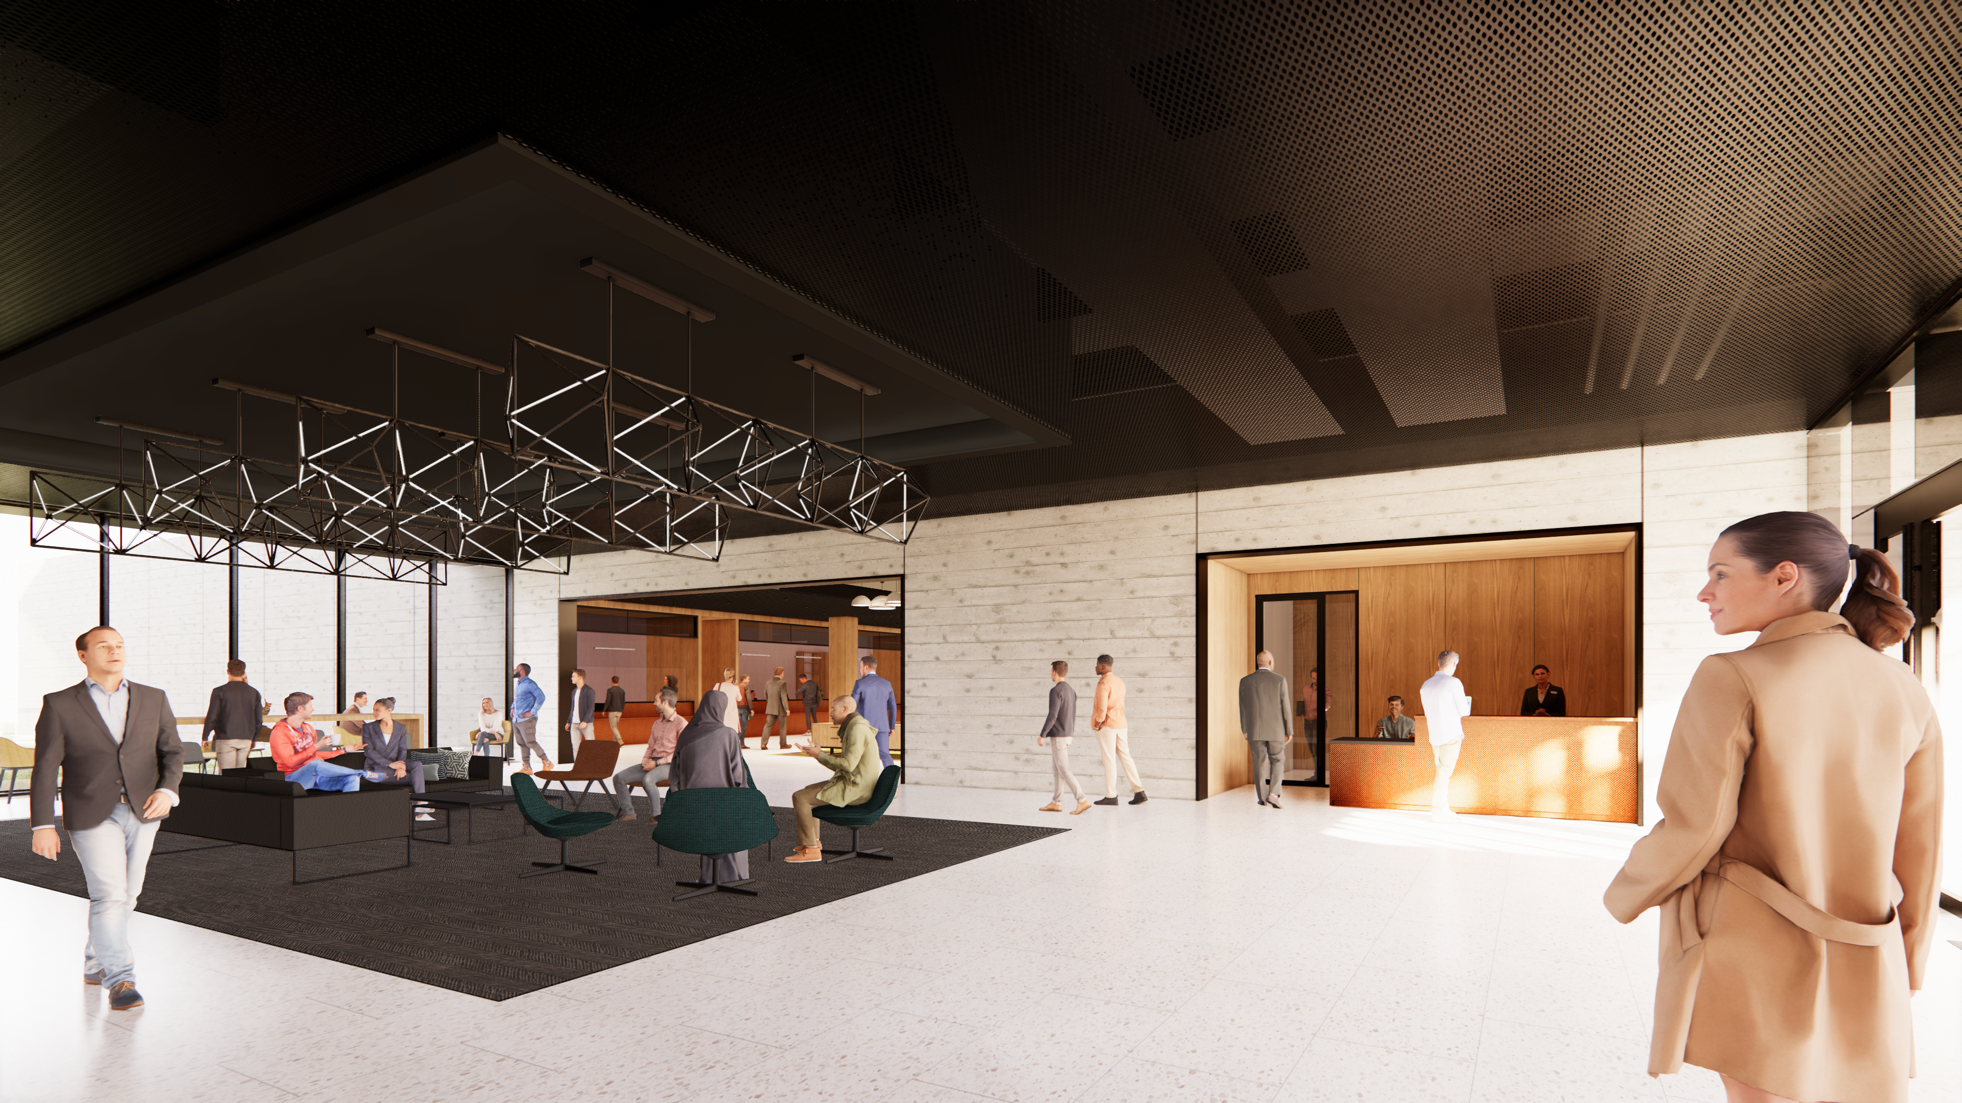
Main Lobby

Slide 13
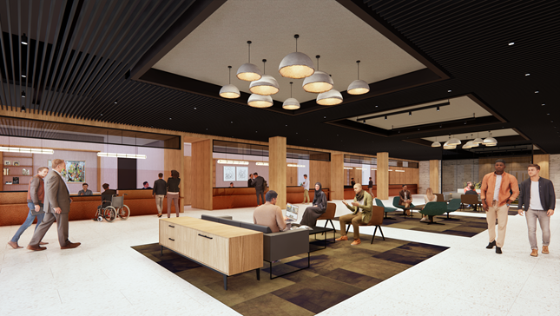
Badging, Housing and GUV Center

Slide 14
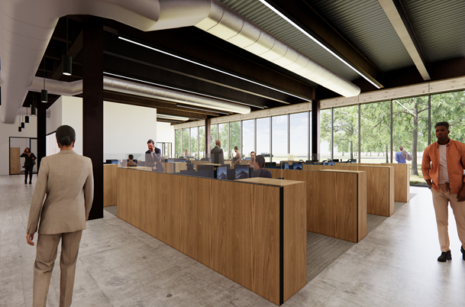
Badging, Housing and GUV Center

Slide 15
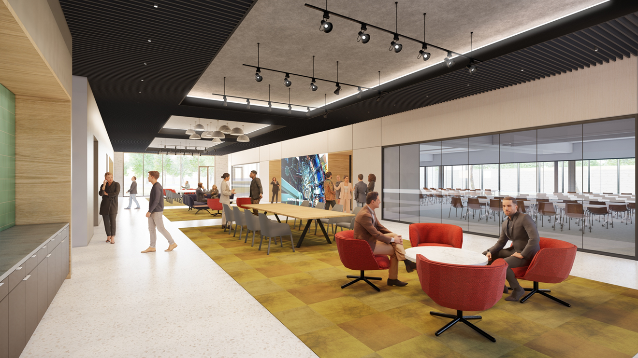
Conference Assembly Area

Slide 16
2nd Floor & Mezzanine

Slide 17
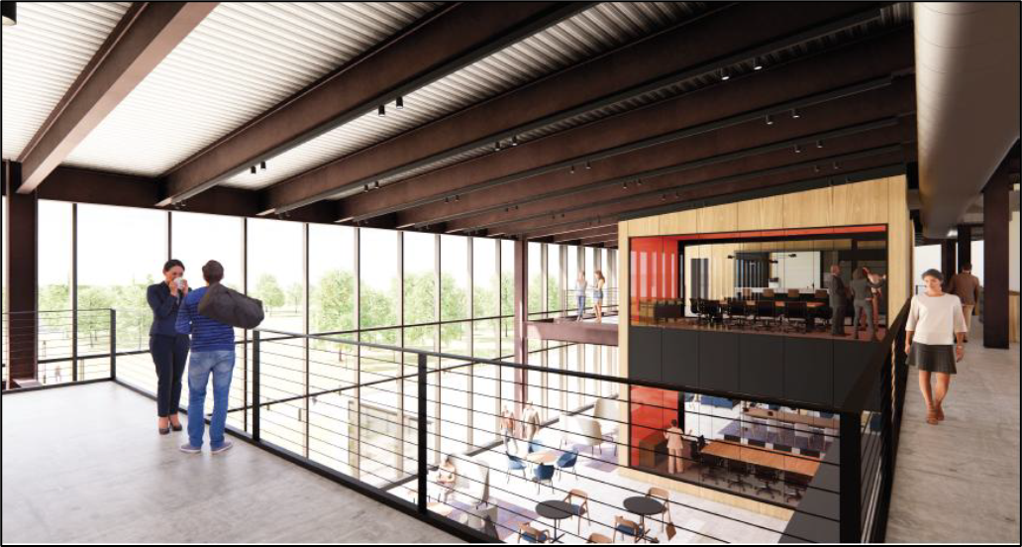
View From Mezzanine

Slide 18
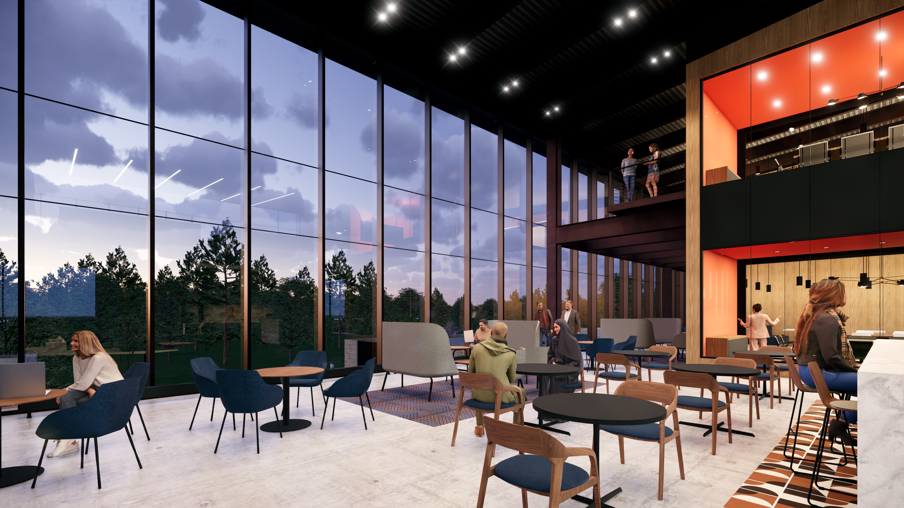
2nd Floor Work Cafe

Slide 19
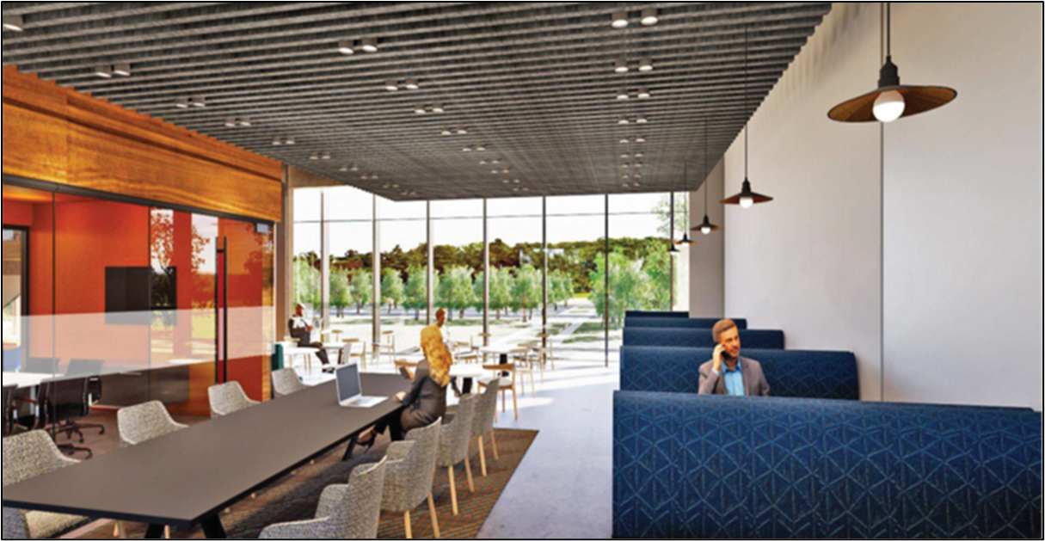
2nd Floor Work Cafe

Slide 20
Typical Open Workstation/Office Space

Slide 21

This Photo by Unknown Author is licensed under CC BY-SA-NC

