Slide 1
EIC Detector DAQ & Electronics
Detector 1 – DAQ Working Group
Conveners
Alexandre Camsonne (JLAB),
Chris Cuevas (JLAB)
Jeff Landgraf (BNL),
Jo Schambach (ORNL)

Slide 2
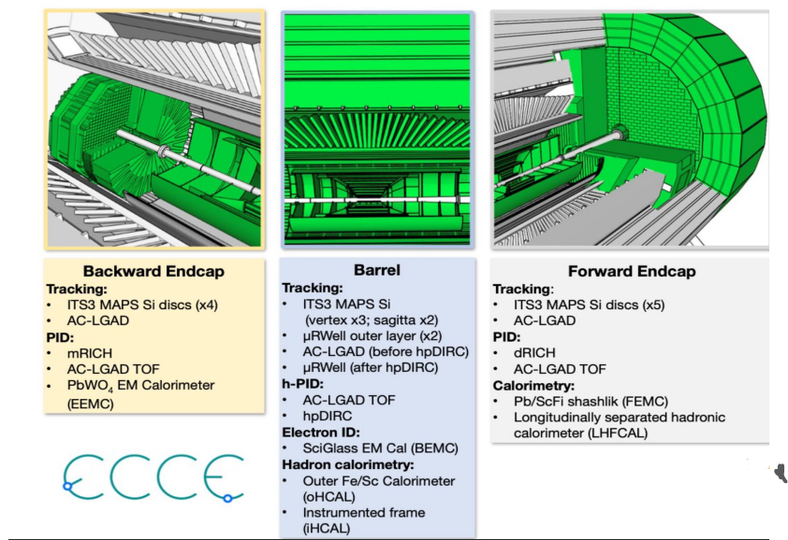
The Detector
Coming out of the DPAP processes, the ECCE detector was selected as a baseline but with the expectation of the need to recruit and to merge the collaborations
1.5 Tesla Magnet
Design is being further refined
~20 Detectors in central region
~10 Detectors in the far forward and far backward directions.
Several Detector Technologies
Silicon MAPS
MPGDs (uRWell)
AC-LGAD (TOF)
RICH (dRICH, mRICH, DIRC)
Calorimeters (SiPM readout)

Slide 3
Beam Crossing Rate: ~100MHz
Maximum Event Rates: ~500kHz

Slide 4
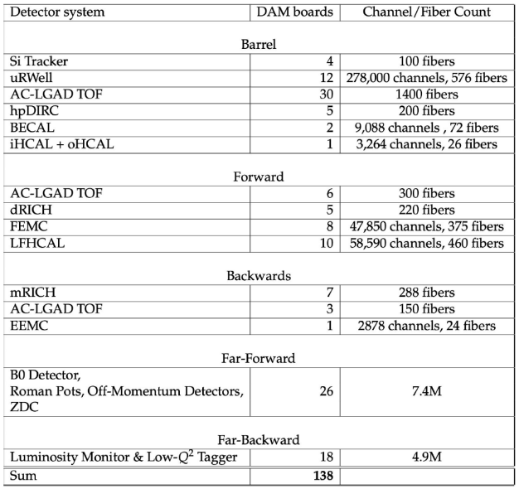
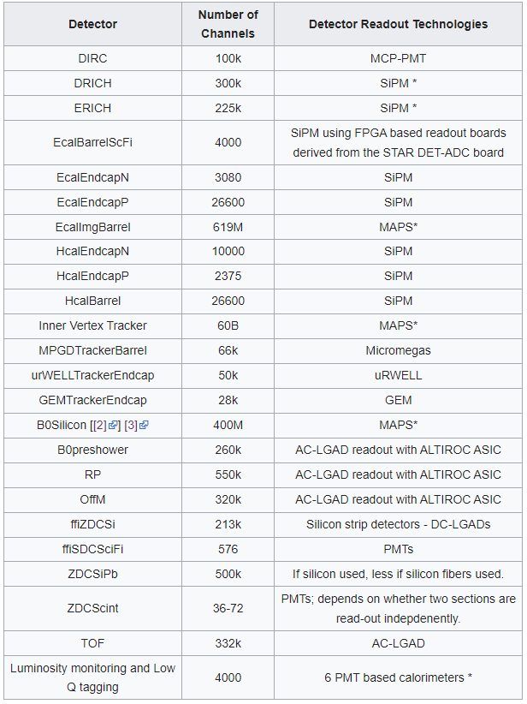
Scale of System
ECCE
ATHENA
Reconciliation is in progress But roughly:
4.5k Fiber,
2.5M channels + 57k MAPS sensors (60B MAPS channels)
120-140 Felix Boards
Huge number of channels but (relative to CERN) small total data throughput.
The number of fibers are set by detector and electronics topology and position, not data throughput.
Noise reduction is key! One hit/bunch crossing could require 5% of full data bandwidth!

Slide 5
Streaming DAQ Architecture
Wide acceptance in the community for a streaming DAQ scheme. This included the yellow report reference detector as well as the readout for all three proposals.
No External trigger
All collision data digitized but aggressively zero suppressed at FEE
Low / zero deadtime
Event selection can be based upon full data from all detectors (in real time, or later)
Collision data flow is independent and unidirectional-> no global latency requirements
Avoiding hardware trigger avoids complex custom hardware and firmware
The “Front End Processing”, programmable hardware between the FEEs and the DAQ computers, is deemphasized relative to the yellow report, but should not be precluded.
Data volume is reduced as much as possible at each stage

Slide 6
Summary of Proposed Data Reduction Techniques
Timing windows with respect to the collision time (FEE)
Zero Suppression (FEE)
Elimination of hits not part of tracks (AI/ML tracking in FEP, or any point later)
Elimination of hits not part of Cherenkov rings (AI/ML in FEP, DAM, or EBDC)
Feature Extraction (FEE, or any point later)
Cluster Finding (DAM, or any point later)
Software Trigger (DAM, or EBDC)
Lossless compression (EBDC or later)
We should also investigate features to keep the data clean in order to improve the above techniques
Automated thresholds (ex. pedestals)
Automated filters for common mode noise suppression
Dynamic control of calibrations in slow controls &/or FEEs
Dynamic monitoring / removal of aberrant channels
Automated recovery of single bit upsets

Slide 7
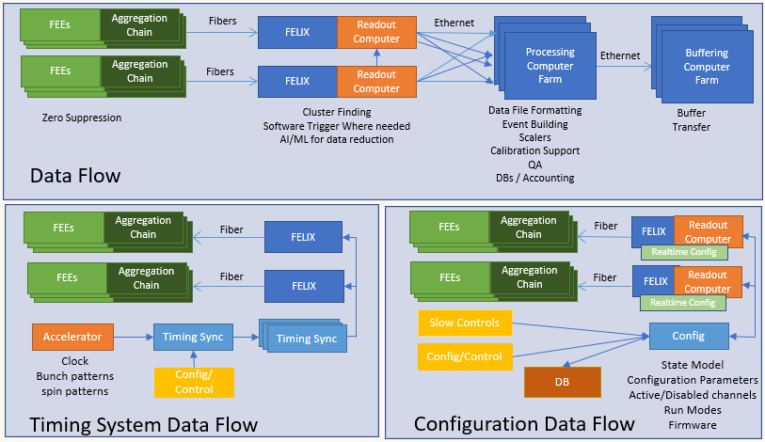
System Architecture
Despite conceptual simplicity, full data flow isn’t simple
Timing system is critical
Synchronize data from detectors (~10ns)
Time resolution (~10-20ps for some detectors)
Only source of real-time information shared by all detectors. (Calibration events, potential busy feedback, raw readout requirements, etc…)

Slide 8
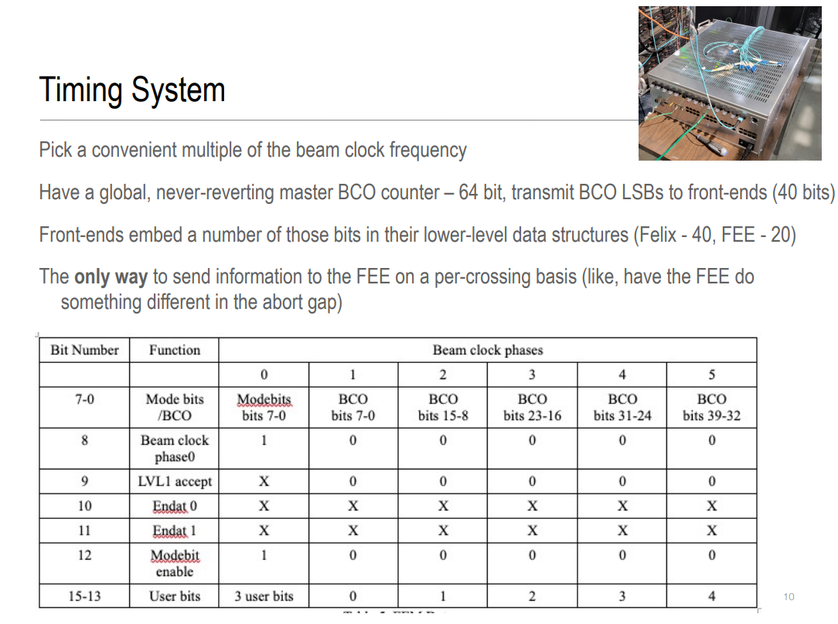
Two Parts of the Timing System:
The interface between the collider, the run control systems, and the DAM boards
Provides the clock to the DAM boards
Provides information to the FEE/DAM
Spin States
User Controls
Special Readouts
Abort Gap
Potentially triggers (in some form) for debugging or emergencies.
sPHENIX Timing System (Martin Purschke @ SWO X)

Slide 9
Two Parts of the Timing System:
The interface between the collider, the run control systems, and the DAM boards
Provides the clock to the DAM boards
Provides information to the FEE/DAM
Spin States
User Controls
Special Readouts
Abort Gap
Potentially triggers (in some form) for debugging or emergencies.
The timing electronics on the FEE boards providing the interface between the electrical components and the fiber.
Recovered clock good enough for most detectors
Some detectors (TOF) may need dedicated clock fiber
This interface on the FEE side is just one aspect of the electro-optical interface to DAQ. This will be part of the FEE’s, but the optical interface will be the same for each detector, while the electrical interface will be different for each. The DAQ group recognizes the need for collaboration-wide coordination. The form and content under discussion.
Why the electrical-optical interface is critical:
The interface and scheme is shared among all detectors
It needs to be reflected in the FEE requirements, so must be specified early
It needs to satisfy the special configuration, calibration, and running modes of every detector
It will be replicated in every FEE so cost is an issue
This interface will define the capabilities and limitations of the DAQ system and be next to impossible to change or replace.
Potentially thorny issues to consider
Radiation might be an issue in certain areas (synchrotron radiation)
Congestion is difficult to monitor and control using congested links
The use of CERN ASICS (or modified CERN ASICS) may force us to support 40MHz. This may include the timing system itself if lpGBT is used. Do we need to? How?
Options under discussion
lpGBT
Bare FPGA based system with commercial timing/fiber electronics
JLAB timing system (250MHz)
sPHENIX system
Multiple solutions for various detector technologies
Need detailed understanding of detector needs AND quantitative delimitation of options

Slide 10
Two Parts of the Timing System:
The interface between the collider, the run control systems, and the DAM boards
Provides the clock to the DAM boards
Provides information to the FEE/DAM
Spin States
User Controls
Special Readouts
Abort Gap
Potentially triggers (in some form) for debugging or emergencies.
The timing electronics on the FEE boards providing the interface between the electrical components and the fiber.
Recovered clock good enough for most detectors
Some detectors (TOF) may need dedicated clock fiber
The timing interface on the FEE side is just one aspect of the electro-optical interface to DAQ. This will be part of the FEE’s, but the optical interface will be the same for each detector, while the electrical interface may be different for each. The DAQ group recognizes the need for collaboration-wide coordination. The form and content under discussion.
Actions towards resolving
Potential topical meeting for the Streaming Workshop on the Electrical-optical interface
Coordination with project electronics/DAQ CAMs
DAQ working group attention
Define detector group contacts with expertise, to foster dialog with relevant groups.
Detector | Contact From DAQ | From Detector
Tracking (Silicon) | Jo Schambach | Jo Schambach
Tracking (MPGD) | (Iraqli Mandjavidze) | Kondo Gnanvo
PID (TOF) | Tonko Ljubicic | Tonko Ljubicic
PID (Cherenkov) | Alexandre | (Pietro Antonioli)
Calorimetry |  | Oskar Hartbrich
Far Forward | Jeff, Chris | (Alex Jentsch)
Far Backward | Jeff, Chris
Computing | Conveners | Sylvester
Simulation/QA | Conveners | Andreas
Global Integration | Conveners

Slide 11
System Architecture
Configuration is critical
All detectors need potentially complex configuration.
Need realtime control for providing features like periodic raw data for checking bias due to aggressive compression &/or AI/ML)
Need to adjust configuration in real time (pedestal drifts/hot channels/tracking failing electronics)

Slide 12
System Architecture
Slow controls integration may be important
AI/ML control of HV settings (May be uninteresting from the point of view of AI/ML research be useful for us. Think in terms of having theromostats for setting HV to control gains, timing windows, or phase shifts).
Automated power cycle/configuration recovery.

Slide 13
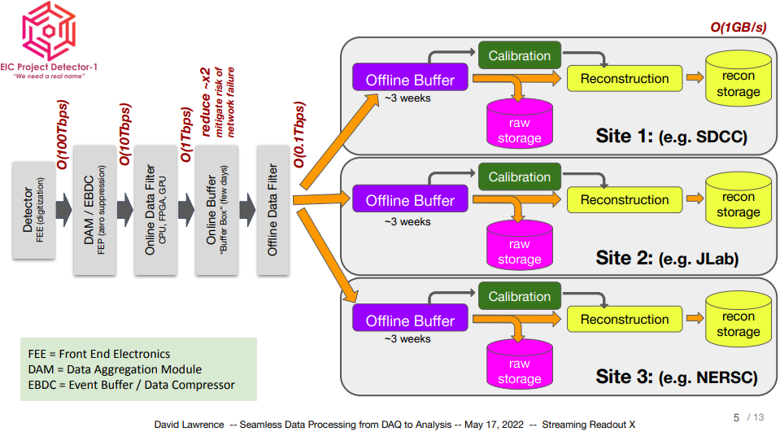
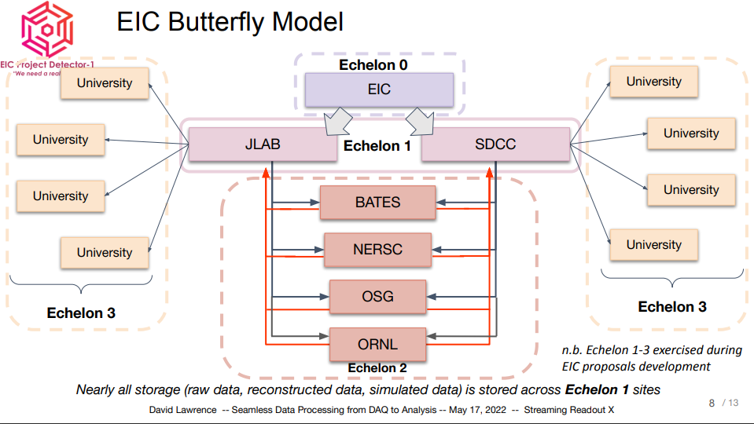
Computing Model Architecture
Streaming Readout is an opportunity to rethink DAQ as one component in the full computing chain, all optimized for production of physics data in real time (or “close” to real time)

Slide 14
Core responsibilities of DAQ to consider when discussing the blurring of DAQ/offline computing:
Scalers
Online QA
Monitoring detector performance including metrics such as uptime
Monitoring beam for collider feedback
Keeping track of events/event types to aid in tracking physics goals as well as goals for the collider and the operations group.
These involve at least an initial event selection ability within the seconds or minutes of data being taken.

Slide 15
Summary
Presented the plans for a streaming readout for the EIC Detector 1
Highlighted some of the current areas of attention
There is a lot of work yet to be done, so join us…

Slide 16
Backup…

Slide 17
EL2 : ASICs R&D
Provide a summary (e.g., in tabular format) of the specific R&D goals and development timescale for each individual ASIC, including each fallback option. For each ASIC, include estimate of when the decision needs to be taken whether to go with the baseline ASIC or the fallback option.
ASIC proposed | Institution(s) | R&D | Fall back option
ALCOR | INFN | Current version for low rate. Increase data throughput. Test streaming mode | (low risk)
ASTROPIX | ANL in collaboration with NASA | Customization for Imaging calorimeter, improved power and energy resolution | (low risk)
ALPIDE | EIC R&D silicon consortium in collaboration with CERN | 65 nm technology ITS3, lower material budget and lower | 180 nm ITS2
SALSA | CEA SACLAY in collaboration with University of Sao Paulo | Updated version of SAMPA for better performance and better support for streaming | SAMPA or VMM3
ALTIROC | CEA SACLAY/CNRS | Customization for EIC / AC LGAD Streaming | (low risk)
HDSOC64 | NALU | 64 channels version of HDSOC | HDSOC32
Advanced prototype for TDR - start production around 2026 and ASIC choice will be frozen at that date
All ASICs are based on existing design : development of new chip mostly for improved data links for better rate capability and streaming support making the R&D fairly low risk,
SALSA is a new iteration of SAMPA with higher channel density / higher sampling rate / lower power consumption
Other ASICs will be chosen in conjunction with project from available ASICs for better standardization
Detailed timeline in EL3

Slide 18
EL3 : ASICs timeline
Describe the development plan and timeline for the customization and prototyping of electronics specific to each sub-detector concept.
Detector type | ASIC proposed | R&D | Conceptual design | Preprototype | Full functional prototype | Integration with readout chain | Ready for production | Fall back
MCP PMT | HDSOC 64 channels |  |  |  | 2022 | 2023 |  | HDSOC32
SiPMT | ALCOR |  |  | 2022 | 2023-24 | 2025
Pixel detector Imaging calorimeter | ASTROPIX | 2015 | 2018/19 | March 2020 | 2021 | 2022 | 2023
MAPS | ALPIDE ITS3 |  | 2019 | 2021 | 2023 | 2024 | 2025 | ALPIDE ITS2
MPGD | SALSA | 2020 | 2021 | 2022 | 2025 |  |  | SAMPA or VMM3
AC-LGAD | ALTIROC |  |  | Early 2022

