Slide 1

Data-driven quark and gluon jet substructure
Jasmine Brewer
with Quinn Brodsky and Krishna Rajagopal [2110.13159]
Jesse Thaler and Andrew Patrick Turner [2008.08596]
Kylie Ying, Yi Chen, and Yen-Jie Lee [2204.00641]

Slide 2
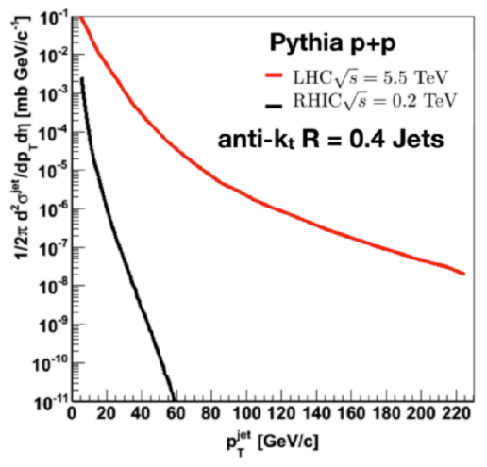
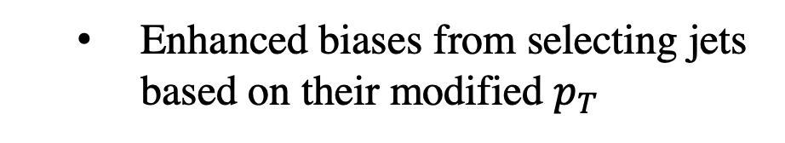
  Novel access to jet modification at RHIC
  Steeper jet spectra at RHIC
  LHC
  Enhanced biases from selecting jets based on their modified $p_{T}$
  RHIC
Notes:
There have been a multitude of nice measurements quantifying the differences between the properties of p-p and A-A jets through jet modification observables, for example the dijet asymmetry and jet shape modifications. The aim in this program is to use jet modification observables to make direct inferences about how the quark–gluon plasma interacts with partons traversing through it.

Slide 3
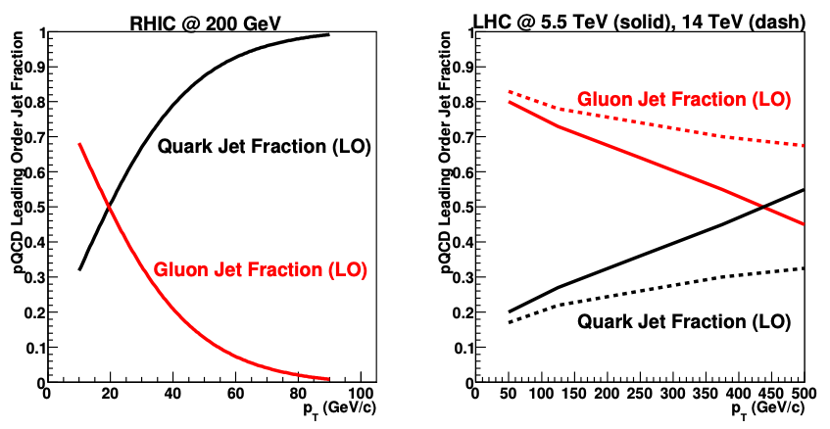
  Novel access to jet modification at RHIC
  Steeper jet spectra at RHIC
  LHC
  Enhanced biases from selecting jets based on their modified $p_{T}$
  RHIC
  RHIC
  LHC
  Different quark/gluon jet fractions
  Handle for disentangling quark/gluon jet modification
Notes:
There have been a multitude of nice measurements quantifying the differences between the properties of p-p and A-A jets through jet modification observables, for example the dijet asymmetry and jet shape modifications. The aim in this program is to use jet modification observables to make direct inferences about how the quark–gluon plasma interacts with partons traversing through it.

Slide 4
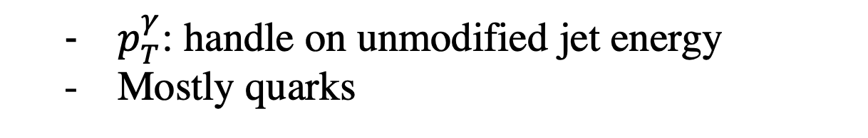

  Processes for light flavor jet quenching in sPHENIX
  No handle on unmodified jet energy
  Quarks and gluons
  $p_{T}^{γ}$: handle on unmodified jet energy
  Mostly quarks
$$γ$$
Notes:
There have been a multitude of nice measurements quantifying the differences between the properties of p-p and A-A jets through jet modification observables, for example the dijet asymmetry and jet shape modifications. The aim in this program is to use jet modification observables to make direct inferences about how the quark–gluon plasma interacts with partons traversing through it.

Slide 5
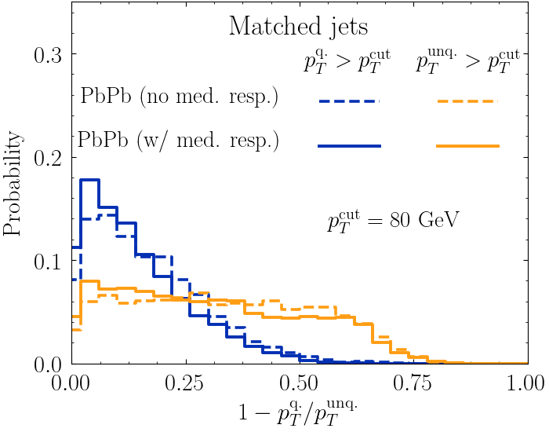


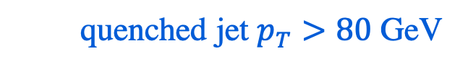


  $γ+jet$ events provide access to two different probes of quenching
  Select on $p_{T}^{jet}$
  quenched jet $p_{T}>80$ GeV
  unquenched jet $p_{T}>80$ GeV
$$γ$$
  Select on $p_{T}^{γ}$
  Fractional energy loss
  JB, Brodsky, Rajagopal [2110.13159]
Notes:
There have been a multitude of nice measurements quantifying the differences between the properties of p-p and A-A jets through jet modification observables, for example the dijet asymmetry and jet shape modifications. The aim in this program is to use jet modification observables to make direct inferences about how the quark-gluon plasma interacts with partons traversing through it.

Slide 6
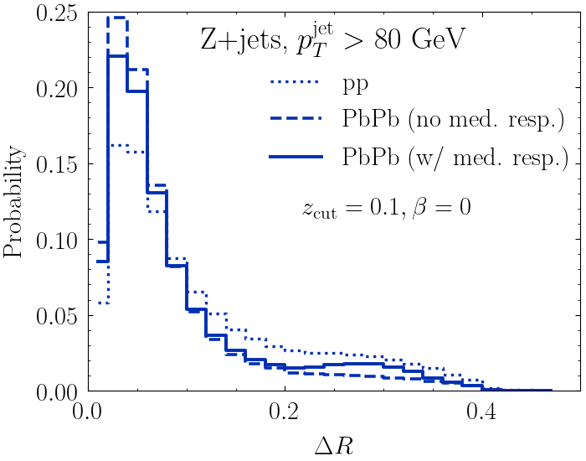
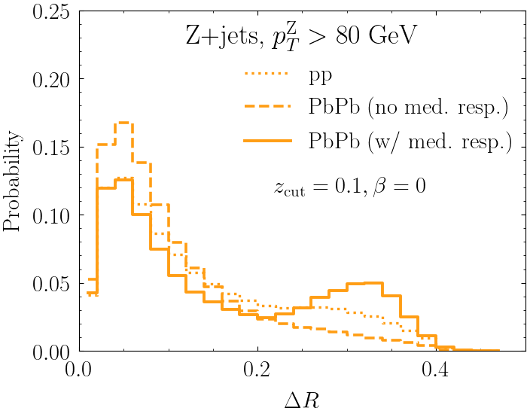
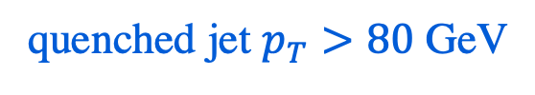

  Opportunity to disentangle effects of quenching on jet substructure
Smaller fractional energy loss
Larger fractional energy loss
Smaller fractional energy loss
Larger fractional energy loss
quenched jet $p_{T}>80$ GeV
boson $p_{T}>80$ GeV
  JB, Brodsky, Rajagopal [2110.13159]
Enhanced modification (especially from medium response) for jets that lose more energy
Notes:
Unfortunately, the interpretation of jet modification observables often depends crucially on which proton-proton jets are taken to be a comparable baseline for a given heavy-ion measurement. In di-jet and inclusive jet studies, the standard answer is to compare heavy-ion jets to a proton-proton baseline with the same reconstructed pT. For example, comparing the jet production spectra for p-p and HI at the same reconstructed pT (as illustrated by the blue arrows) gives rise to the famous jet RAA.

Slide 7
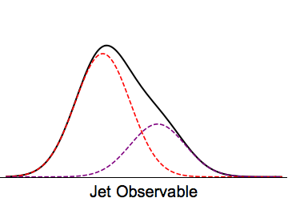
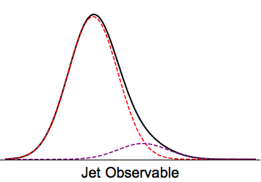
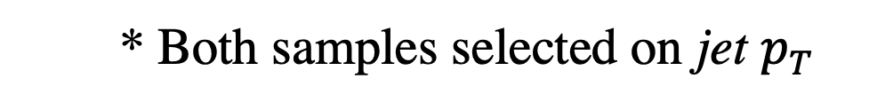

  Inclusive jet: quarks and gluons
  Boson+jet: mostly quarks
$$γ,Z$$
  q
  q
  g
  g
  * Both samples selected on jet $p_{T}$
Notes:
There have been a multitude of nice measurements quantifying the differences between the properties of p-p and A-A jets through jet modification observables, for example the dijet asymmetry and jet shape modifications. The aim in this program is to use jet modification observables to make direct inferences about how the quark–gluon plasma interacts with partons traversing through it.

Slide 8
  Goal: disentangle (sub)structure modification of quark and gluon jets
  “quark jet”
  “gluon jet”
  q
  g
  Sensitive to how the QGP resolves the color structure of a jet
Notes:
There have been a multitude of nice measurements quantifying the differences between the properties of p-p and A-A jets through jet modification observables, for example the dijet asymmetry and jet shape modifications. The aim in this program is to use jet modification observables to make direct inferences about how the quark–gluon plasma interacts with partons traversing through it.

Slide 9






  Disentangling mixture distributions into “quark” and “gluon”
$$p_{1}=f_{1}b_{1}+\left(1−f_{1}\right)b_{2}$$
$$b_{1}$$
$$b_{2}$$
$$p_{2}=\left(1−f_{2}\right)b_{1}+f_{2}b_{2}$$
$$b_{1}$$
$$b_{2}$$
  p–p: Metodiev and Thaler [1802.00008] Komiske, Metodiev, Thaler [1809.01140]
Notes:
There have been a multitude of nice measurements quantifying the differences between the properties of p-p and A-A jets through jet modification observables, for example the dijet asymmetry and jet shape modifications. The aim in this program is to use jet modification observables to make direct inferences about how the quark–gluon plasma interacts with partons traversing through it.

Slide 10
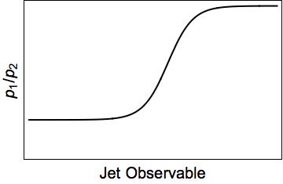
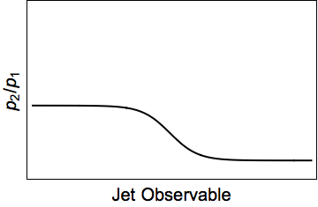

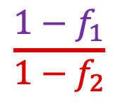
  Disentangling mixture distributions into “quark” and “gluon”
$$p_{1}=f_{1}b_{1}+\left(1−f_{1}\right)b_{2}$$
$$b_{1}$$
$$b_{2}$$
$$\frac{1−f_{1}}{1−f_{2}}$$
$$p_{2}=\left(1−f_{2}\right)b_{1}+f_{2}b_{2}$$
$$b_{1}$$
$$b_{2}$$
$$\frac{f_{2}}{f_{1}}$$
  p–p: Metodiev and Thaler [1802.00008] Komiske, Metodiev, Thaler [1809.01140]
Notes:
There have been a multitude of nice measurements quantifying the differences between the properties of p-p and A-A jets through jet modification observables, for example the dijet asymmetry and jet shape modifications. The aim in this program is to use jet modification observables to make direct inferences about how the quark–gluon plasma interacts with partons traversing through it.

Slide 11
  Disentangling mixture distributions into “quark” and “gluon”
$$p_{1}=f_{1}b_{1}+\left(1−f_{1}\right)b_{2}$$
$$b_{1}$$
$$b_{2}$$
$$\frac{1−f_{1}}{1−f_{2}}$$
$$p_{2}=\left(1−f_{2}\right)b_{1}+f_{2}b_{2}$$
$$b_{1}$$
$$b_{2}$$
$$\frac{f_{2}}{f_{1}}$$
  Solve for base distributions $b_{1}$,$b_{2}$ in terms of mixture distributions and fractions
  p–p: Metodiev and Thaler [1802.00008] Komiske, Metodiev, Thaler [1809.01140]
Notes:
There have been a multitude of nice measurements quantifying the differences between the properties of p-p and A-A jets through jet modification observables, for example the dijet asymmetry and jet shape modifications. The aim in this program is to use jet modification observables to make direct inferences about how the quark–gluon plasma interacts with partons traversing through it.

Slide 12




  Disentangling mixture distributions into “quark” and “gluon”
  example
  Requires…
  dijets
  $γ$+jet
  Independent mixtures of same base distributions
$$b_{1}$$
$$b_{1}$$
$$b_{2}$$
$$b_{2}$$
Notes:
There have been a multitude of nice measurements quantifying the differences between the properties of p-p and A-A jets through jet modification observables, for example the dijet asymmetry and jet shape modifications. The aim in this program is to use jet modification observables to make direct inferences about how the quark–gluon plasma interacts with partons traversing through it.

Slide 13
  Disentangling mixture distributions into “quark” and “gluon”
  example
  Requires…
  dijets
  $γ$+jet
  Independent mixtures of same base distributions
$$b_{1}$$
$$b_{1}$$
$$b_{2}$$
$$b_{2}$$
  samples are pure quark and pure gluon in some limits (“mutual irreducibility”)
  Above: base distributions are completely separated at $±∞$
  Satisfied by counting observables (e.g. constituent multiplicity distributions) in the high-energy limit
Frye et al [1704.06266]
Notes:
There have been a multitude of nice measurements quantifying the differences between the properties of p-p and A-A jets through jet modification observables, for example the dijet asymmetry and jet shape modifications. The aim in this program is to use jet modification observables to make direct inferences about how the quark–gluon plasma interacts with partons traversing through it.

Slide 14
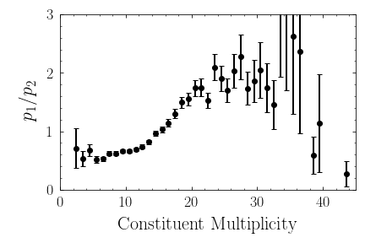
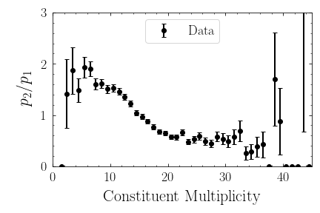





  Disentangling mixture distributions into “quark” and “gluon”
$$p_{2}$$
$$p_{1}$$
$$\frac{1−f_{1}}{1−f_{2}}$$
$$p_{1}=f_{1}b_{1}+\left(1−f_{1}\right)b_{2}$$
$$\frac{f_{2}}{f_{1}}$$
$$p_{2}=\left(1−f_{2}\right)b_{1}+f_{2}b_{2}$$
  Solve for base distributions $b_{1}$,$b_{2}$ in terms of mixture distributions and fractions
Notes:
There have been a multitude of nice measurements quantifying the differences between the properties of p-p and A-A jets through jet modification observables, for example the dijet asymmetry and jet shape modifications. The aim in this program is to use jet modification observables to make direct inferences about how the quark–gluon plasma interacts with partons traversing through it.

Slide 15
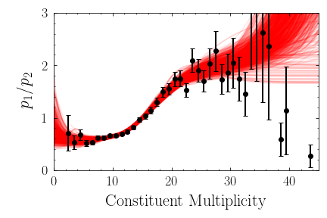
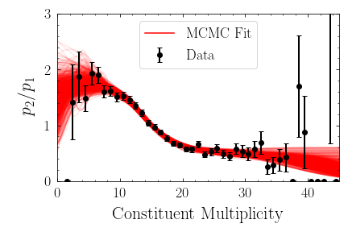
  Disentangling mixture distributions into “quark” and “gluon”
$$p_{2}$$
$$p_{1}$$
$$\frac{1−f_{1}}{1−f_{2}}$$
$$p_{1}=f_{1}b_{1}+\left(1−f_{1}\right)b_{2}$$
$$\frac{f_{2}}{f_{1}}$$
$$p_{2}=\left(1−f_{2}\right)b_{1}+f_{2}b_{2}$$
  Solve for base distributions $b_{1}$,$b_{2}$ in terms of mixture distributions and fractions
Notes:
There have been a multitude of nice measurements quantifying the differences between the properties of p-p and A-A jets through jet modification observables, for example the dijet asymmetry and jet shape modifications. The aim in this program is to use jet modification observables to make direct inferences about how the quark–gluon plasma interacts with partons traversing through it.

Slide 16
  Extracting quark/gluon contributions to constituent multiplicity
  proton–proton
Notes:
There have been a multitude of nice measurements quantifying the differences between the properties of p-p and A-A jets through jet modification observables, for example the dijet asymmetry and jet shape modifications. The aim in this program is to use jet modification observables to make direct inferences about how the quark–gluon plasma interacts with partons traversing through it.

Slide 17
  Extracting quark/gluon contributions to constituent multiplicity
  heavy-ion
Notes:
There have been a multitude of nice measurements quantifying the differences between the properties of p-p and A-A jets through jet modification observables, for example the dijet asymmetry and jet shape modifications. The aim in this program is to use jet modification observables to make direct inferences about how the quark–gluon plasma interacts with partons traversing through it.

Slide 18
  Extracting quark/gluon contributions to constituent multiplicity
  heavy-ion
  With fractions in pp and AA, can separate modification of q/g jets in any observable
Ying, Brewer, Chen, Lee [2204.00641]
Notes:
There have been a multitude of nice measurements quantifying the differences between the properties of p-p and A-A jets through jet modification observables, for example the dijet asymmetry and jet shape modifications. The aim in this program is to use jet modification observables to make direct inferences about how the quark–gluon plasma interacts with partons traversing through it.

Slide 19
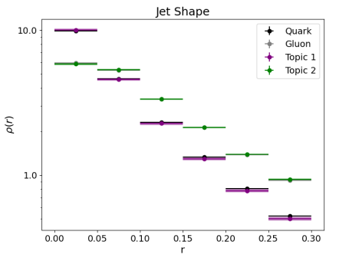
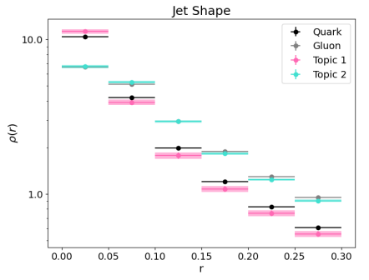
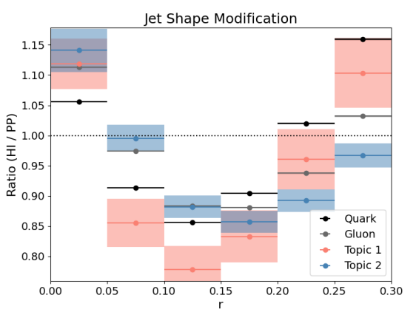
  Jet shape modification of quark and gluon jets
  proton-proton
  heavy-ion
  ratio
  Modified at smaller angles for quarks than gluons
Notes:
There have been a multitude of nice measurements quantifying the differences between the properties of p-p and A-A jets through jet modification observables, for example the dijet asymmetry and jet shape modifications. The aim in this program is to use jet modification observables to make direct inferences about how the quark–gluon plasma interacts with partons traversing through it.

Slide 20
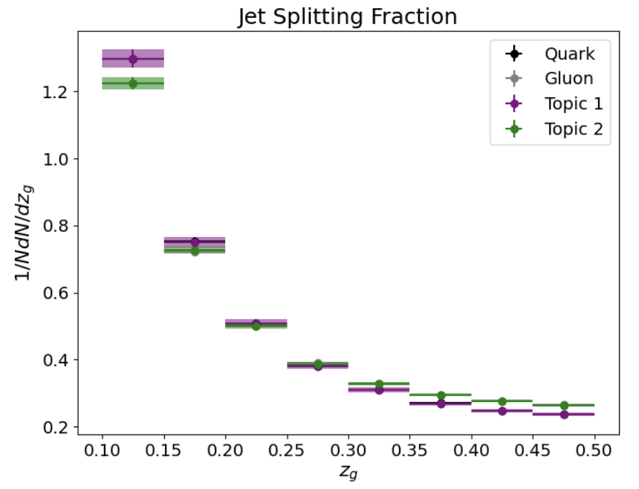
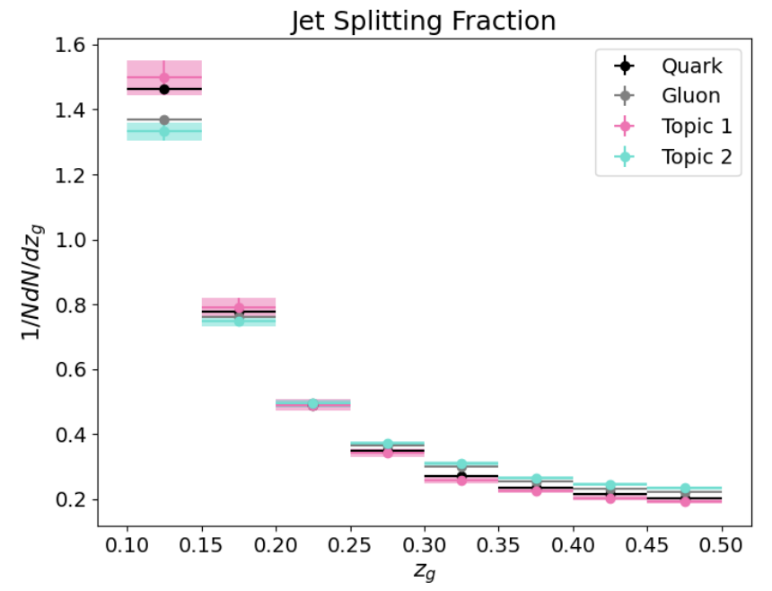
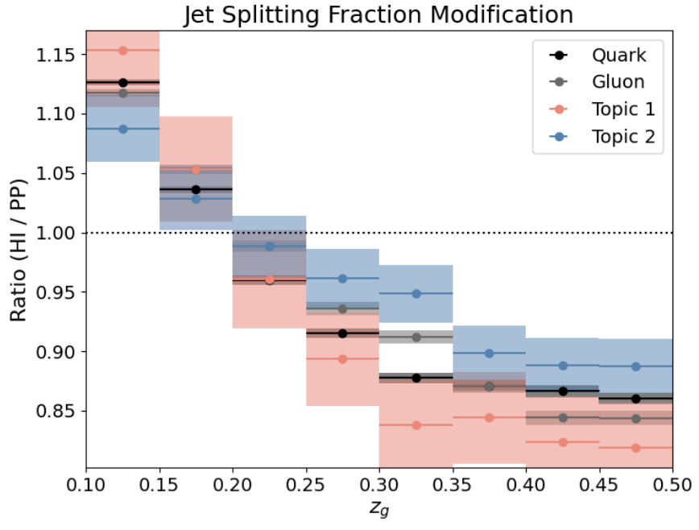
  Groomed momentum sharing of quark and gluon jets
  proton-proton
  heavy-ion
  ratio
  Larger modification for quarks than gluons
Notes:
There have been a multitude of nice measurements quantifying the differences between the properties of p-p and A-A jets through jet modification observables, for example the dijet asymmetry and jet shape modifications. The aim in this program is to use jet modification observables to make direct inferences about how the quark–gluon plasma interacts with partons traversing through it.

Slide 21



  Opportunities for jet quenching in sPHENIX
  quenched jet $p_{T}>80$ GeV
  Disentangling energy loss and substructure modification
  unquenched jet $p_{T}>80$ GeV
  Steeper spectra -> different from LHC
$$γ$$
  Fractional energy loss
Notes:
There have been a multitude of nice measurements quantifying the differences between the properties of p-p and A-A jets through jet modification observables, for example the dijet asymmetry and jet shape modifications. The aim in this program is to use jet modification observables to make direct inferences about how the quark–gluon plasma interacts with partons traversing through it.

Slide 22
  Opportunities for jet quenching in sPHENIX
  quenched jet $p_{T}>80$ GeV
  Disentangling energy loss and substructure modification
  unquenched jet $p_{T}>80$ GeV
  Steeper spectra -> different from LHC
$$γ$$
  Fractional energy loss
  Jet shape modification
  Quark and gluon jet modification
  Quarks
  Gluons
  More quark-enriched -> different from LHC
Notes:
There have been a multitude of nice measurements quantifying the differences between the properties of p-p and A-A jets through jet modification observables, for example the dijet asymmetry and jet shape modifications. The aim in this program is to use jet modification observables to make direct inferences about how the quark–gluon plasma interacts with partons traversing through it.

